Slide 1
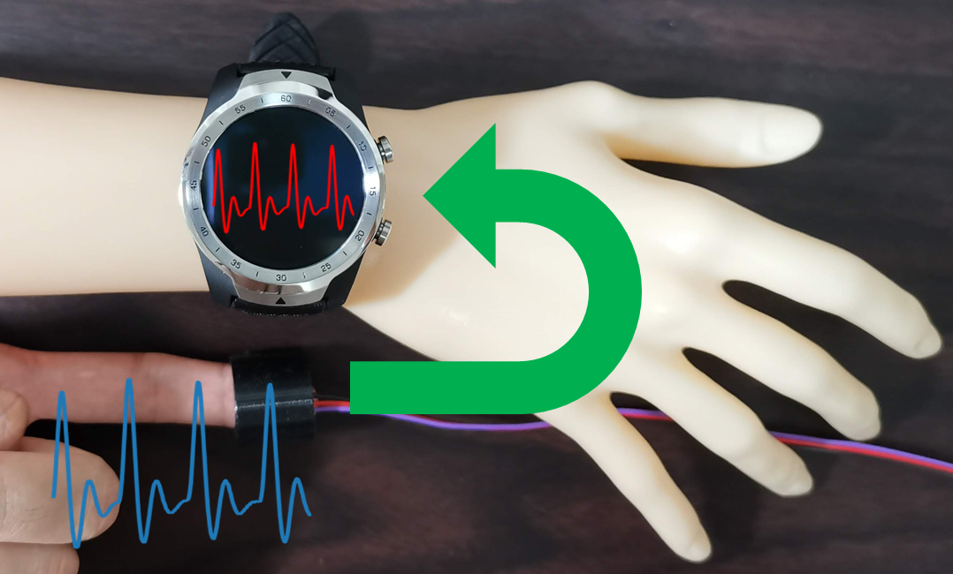
Disp2ppg Pulse Wave Generation to PPG Sensor using Display
Atsuhiro FUJII¹, Kazuya MURAO^{1, 3}, Naoji Matsuhisa^{2, 3}
¹Ritsumeikan University, Japan / ²Keio University, Japan /
³Japan Science and Technology Agency, PRESTO

