Slide 1
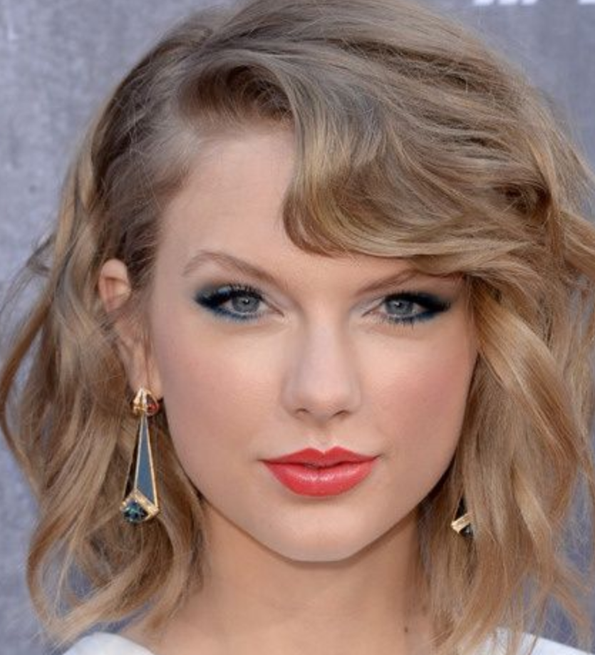
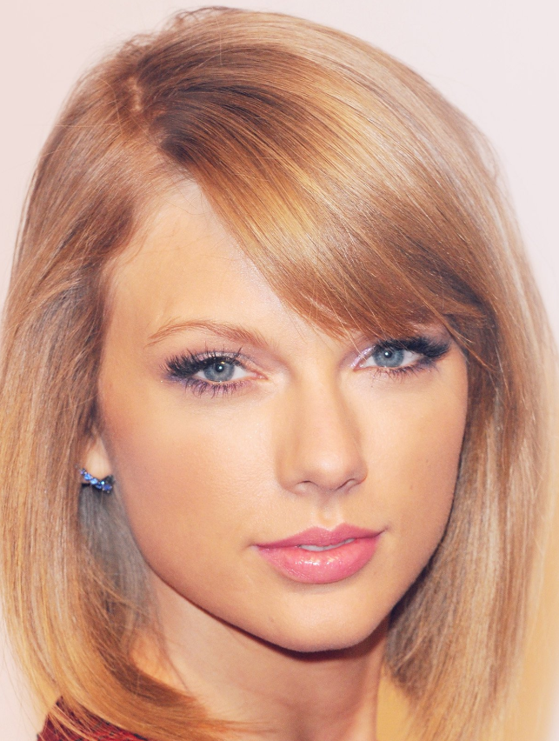
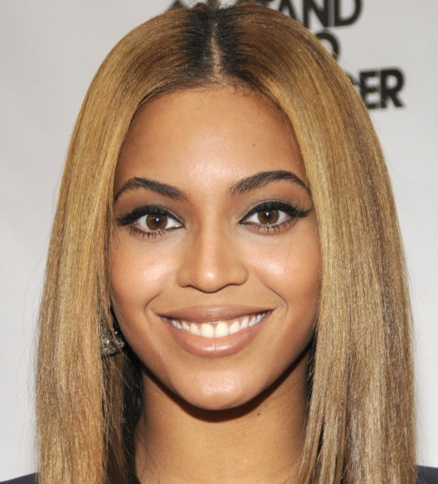
Encoding process
Comparing process
0.75
0
1.5
Docker
data.output_data
data
Match
No match
{
“faceEncodings”: [0.015, -0.001, …., 0.157],
“photoFilename” : “taylor_swift1.PNG”
}
surround.process(data)
Docker
distance(encoding1, encoding2)
0.61
{
“faceEncodings”: [-0.069, -0.051, …., 0.186],
“photoFilename” : “taylor_swift2.png”
}
surround.process(data)
distance(encoding1, encoding2)
1.40
{
“faceEncodings”: [-0.159, 0.045, …., -0.154],
“photoFilename” : “beyonce.png”
}
surround.process(data)

Slide 2
surround.process(data)
PhotoExtraction()
RotateImage()
DetectAndAlignFaces()
FaceTooBlurry()
{
“faceEncodings”: [0.015, -0.001, …., 0.157],
“photoFilename” : “taylor_swift1.PNG”
}
ExtractEncodingsResNet1()
LargestFace()
ImageTooDark()
DownsampleImage()

