Slide 1

Prediction of Heart Disease
Project Supervisor : Dr .praven
Name of the Student : Gajjala Amruth Reddy
Register Number : 39110307

Slide 2
Presentation Outline
Course Certificate
Introduction
Objectives
System Architecture / Ideation Map
Project Implementation
Application Snapshots
Result and discussions
Conclusion
References

Slide 3
Course Certificate

Slide 4
Introduction
According to the World Health Organization, every year 12 million deaths occur worldwide due to Heart Disease. Heart disease is one of the biggest causes of morbidity and mortality among the population of the world.
Thus preventing Heart diseases has become more than necessary. Good data-driven systems for predicting heart diseases can improve the entire research and prevention process, making sure that more people can live healthy lives. This is where Machine Learning comes into play. Machine Learning helps in predicting the Heart diseases, and the predictions made are quite accurate.
The objective of this study is to effectively predict if the patient suffers from heart disease. The health professional enters the input values from the patient's health report. The data is fed into model which predicts the probability of having heart disease

Slide 5
Objective
The objective of this study is to effectively predict if the patient suffers from heart disease. The health professional enters the input values from the patient's health report. The data is fed into model which predicts the probability of having heart disease

Slide 6
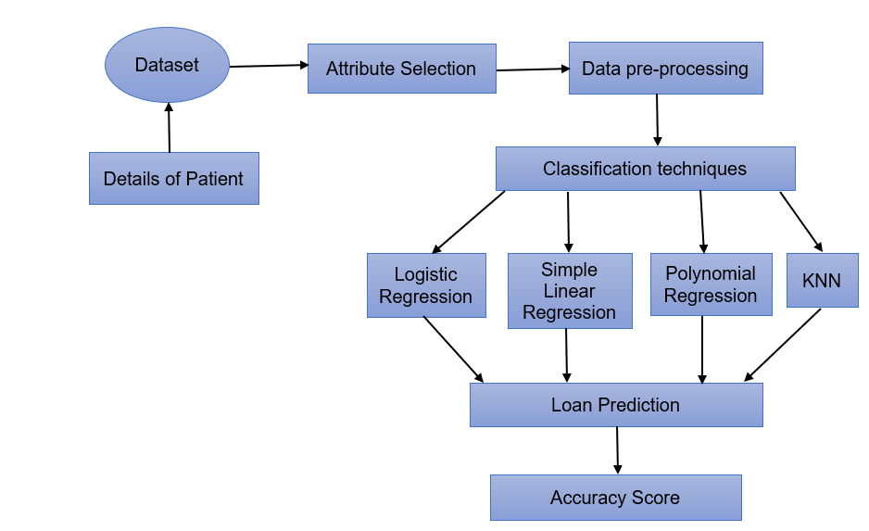
System Architecture / Ideation Map

Slide 7
Heart disease prediction
Heart is an important organ of the human body. It pumps blood to every part of our anatomy. If it fails to function correctly, then the brain and various other organs will stop working, and within few minutes, the person will die.
Change in lifestyle, work related stress and bad food habits contribute to the increase in the rate of several heart-related diseases. Heart diseases have emerged as one of the most prominent causes of death all around the world
Thus, feasible and accurate prediction of heart-related diseases is very important

Slide 8
Project Implementation
The working of the system starts with the collection of data and selecting the important attributes. Then the required data is preprocessed into the required format. The data is then divided into two parts training and testing data. The algorithms are applied and the model is trained using the training data. The accuracy of the system is obtained by testing the system using the testing data. This system is implemented using the following modules.
1.) Collection of Dataset
2.) Selection of attributes
3.) Data Pre-Processing
4.) Balancing of Data
5.) Disease Prediction

Slide 9
Collection of dataset
Initially, we collect a dataset for our heart disease prediction system. After the collection of the dataset, we split the dataset into training data and testing data. The training dataset is used for prediction model learning and testing data is used for evaluating the prediction model.
For this project, 70% of training data is used and 30% of data is used for testing. The dataset used for this project is Heart.csv The dataset consists of 304 Samples consisting of 14 attributes

Slide 10
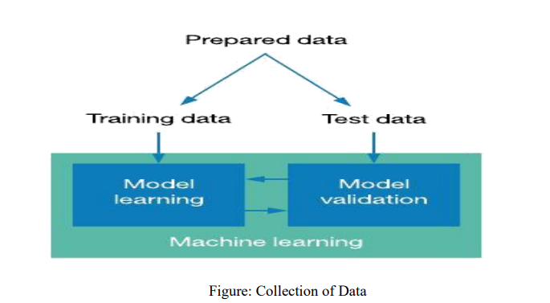
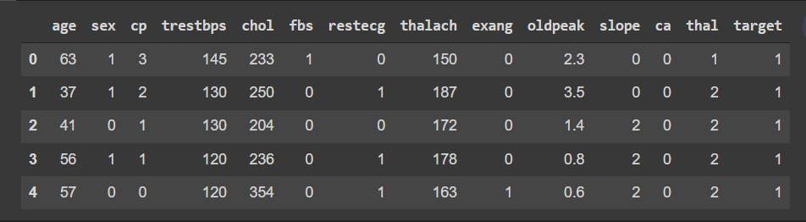

Slide 11
Selection of attributes
Attribute or Feature selection includes the selection of appropriate attributes for the prediction system. This is used to increase the efficiency of the system.
Various attributes of the patient like gender, chest pain type, fasting blood pressure, serum cholesterol, exang, etc are selected for the prediction. The Correlation matrix is used for attribute selection for this model

Slide 12
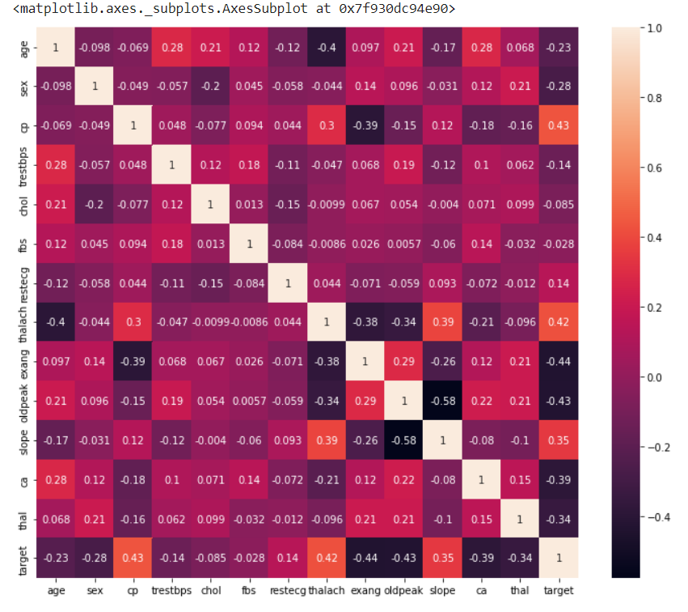

Slide 13
Pre-processing of Data
Data pre-processing is an important step for the creation of a machine learning model. Data pre-processing has the activities
Getting the dataset
Importing libraries
Importing datasets
Finding Missing Data
Encoding Categorical Data
Splitting dataset into training and test set
Feature scaling
Preprocessing of data is required for improving the accuracy of the model

Slide 14
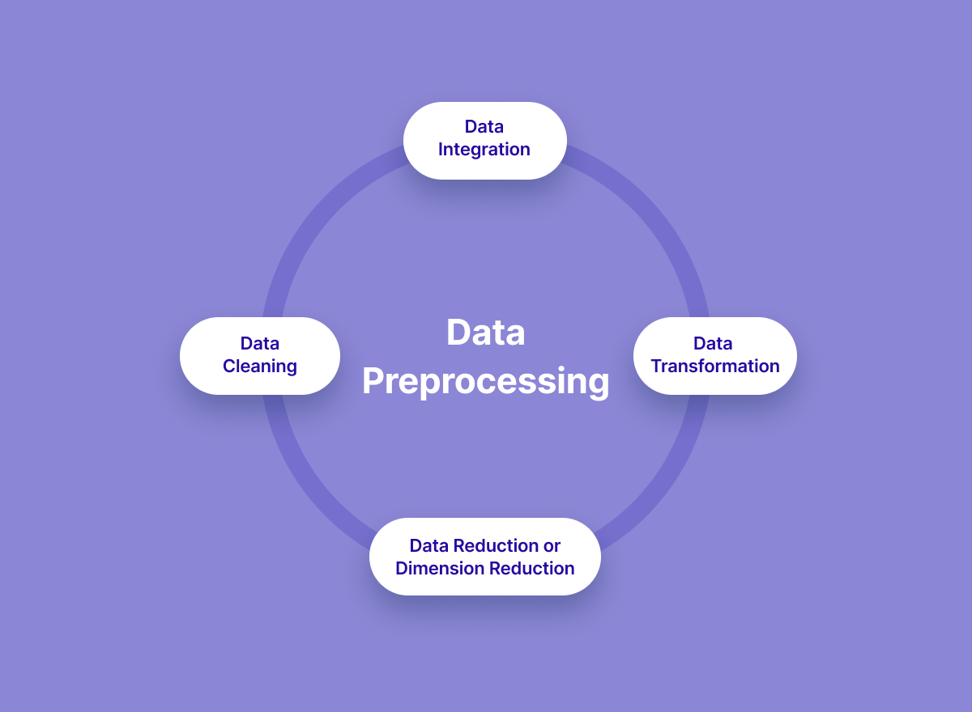

Slide 15
Balancing of Data
Imbalanced datasets can be balanced in two ways. They are Under Sampling and Over Sampling
(a) Under Sampling: In Under Sampling, dataset balance is done by the reduction of the size of the ample class. This process is considered when the amount of data is adequate.
(b) Over Sampling: In Over Sampling, dataset balance is done by increasing the size of the scarce samples. This process is considered when the amount of data is inadequate.

Slide 16
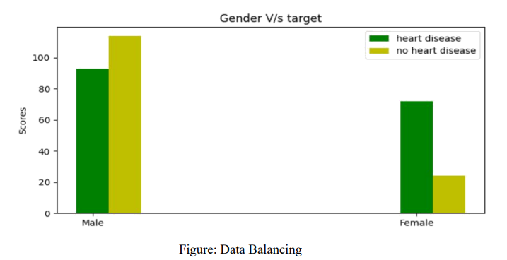

Slide 17
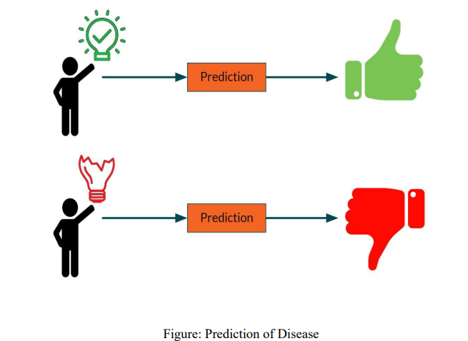
Prediction of Disease
Various machine learning algorithms like Simple linear Regression ,Polynomial Regression are used for classification. Comparative analysis is performed among algorithms and the algorithm that gives the highest accuracy is used for heart disease prediction.

Slide 18
Methodology
To predict the output using Simple Linear Regression and Polynomial Regression.
Jupyter notebook is used to code in python language and libraries used are sklearn ,pandas ,numpy ,matplotlib and machine learning algorithm used is decision tree regressor.
Using Simple Linear Regression ,Polynomial Regression, Logistic Regression, KNN we achieved to predict our output ,hence achieve our goal.
By visualizing the predicted data we get to know how best is our trained model.

Slide 19
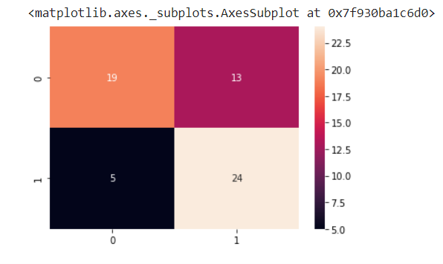

Performance Analysis

Slide 20
Result
This project aims to know whether the patient has heart disease or not .The records in the dataset are divided into the training set and test sets. After preprocessing the data.
The data classification technique namely Simple Linear Regression ,Polynomial Regression were applied. The project involved analysis of the heart disease patient dataset with proper data
The goal of our heart disease prediction project is to determine if a patient should be diagnosed with heart disease or not, which is a binary outcome, so: Positive result = 1, the patient will be diagnosed with heart disease a processing.

Slide 21
Output

Slide 23
Conclusion
Heart diseases are a major killer in India and throughout the world, application of promising technology like machine learning to the initial prediction of heart diseases will have a profound impact on society.
In this paper, the different machine learning algorithms used to measure the performance are Simple Linear Regression, Polynomial Regression, Logistic Regression, KNN applied on the dataset.
With the increasing number of deaths due to heart diseases, it has become mandatory to develop a system to predict heart diseases effectively and accurately.
The correct prediction of heart disease can prevent life threats, and incorrect prediction can prove to be fatal at the same time. In this paper different machine learning algorithms and deep learning are applied to compare the results and analysis of the UCI Machine Learning Heart Disease dataset.

Slide 24
References
[1] Soni J, Ansari U, Sharma D & Soni S (2011). Predictive data mining for medical diagnosis: an overview of heart disease prediction. International Journal of Computer Applications, 17(8), 43-8
[2] Ganna A, Magnusson P K, Pedersen N L, de Faire U, Reilly M, Ärnlöv J & Ingelsson E (2013). Multilocus genetic risk scores for coronary heart disease prediction. Arteriosclerosis, thrombosis, and vascular biology, 33(9), 2267-72.
[3] https://www.researchgate.net/publication/349470771_Using_Machine_Learning_for_Heart_Disease_Prediction

