Slide 1

Introduction to Python Programming
Foundation Course @H-BRS
By Behrouz Ghamkhar
Sep 2024

Slide 2
Contents
Introduction to Python
History of Python
Why Learn Python?
Getting Started
Basic Syntax
Data Types and Variables
Operators
Control Flow
Functions
Modules and Libraries
File Handling
Error Handling
Introduction to Classes and Objects
Inheritance
Encapsulation
Polymorphism
Applications of Python

Slide 3
Introduction to Python
Python is a high-level, interpreted programming language.
Emphasizes readability with its use of significant whitespace.
Supports multiple programming paradigms: procedural, object-oriented, and functional.

Slide 4
History of Python
Created by Guido van Rossum and released in 1991.
As a successor to the ABC programming language.
Named after the British comedy series "Monty Python’s Flying Circus."

Slide 5
Why Learn Python?
Versatile: Used in web development, data science, automation, and more.
Easy to Learn: Simple syntax, great for beginners.
Community Support: Large, active community with extensive resources.

Slide 6
Getting Started with Python
Installing Python: Download from python.org.
Python 3.x is recommended.
Writing Python code in:
Interactive Mode: Python Shell
Script Mode: Using a text editor or IDE like VS Code, PyCharm.

Slide 7

Basic Syntax (Part 1)
Python scripts typically end with .py.
Python uses indentation to define code blocks.
Example:

Slide 8

Basic Syntax (Part 2)
Comments start with #.
Example:

Slide 9
Data Types and Variables (Part 1)
Basic Data Types:
int: Integer (e.g., 5)
float: Floating point (e.g., 5.0)
str: String (e.g., "Hello")
bool: Boolean (e.g., True or False)

Slide 10
Data Types and Variables (Part 2)
Variables:
Variables are dynamically typed.
Example:
x = 10
y = "Hello"

Slide 11
Data Types and Variables (Part 3)
Lists, Tuples, and Dictionaries:
List: [1, 2, 3]
Tuple: (1, 2, 3)
Dictionary: {"key": "value"}

Slide 12
Operators (Part 1)
Arithmetic Operators:
Addition: +
Subtraction: -
Multiplication: *
Division: /

Slide 13
Operators (Part 2)
Comparison Operators:
Equal to: ==
Not equal to: !=
Greater than: >
Less than: <

Slide 14
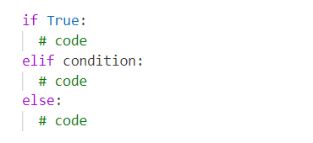
Control Flow - Conditional Statements
If-Else Statements:
Syntax:

Slide 15

Control Flow - Loops (Part 1)
For Loop:
Iterating over a sequence (e.g., list, string).
Example:

Slide 16

Control Flow - Loops (Part 2)
While Loop:
Continues as long as a condition is true.
Example:

Slide 17
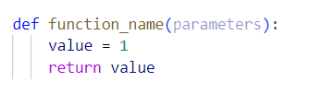
Functions (Part 1)
Defining Functions:
Example:

Slide 18
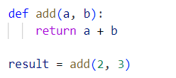
Functions (Part 2)
Calling Functions:
Example:

Slide 19
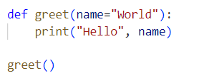
Functions (Part 3)
Default Arguments:
Example:
Output: Hello World

Slide 20

Modules and Libraries (Part 1)
Importing Modules:
Example:
Output: 4.0

Slide 21
Modules and Libraries (Part 2)
Common Libraries:
os: Interact with the operating system.
sys: System-specific parameters and functions.
datetime: Manipulate dates and times.
random: Generate random numbers.

Slide 22
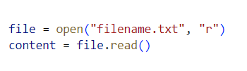
File Handling (Part 1)
Opening a File:
Example:

Slide 23
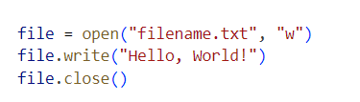
File Handling (Part 2)
Writing to a File:
Example:

Slide 24
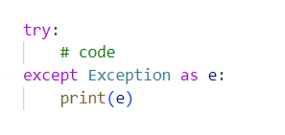
Error Handling (Part 1)
Try-Except Block:
Example:

Slide 25
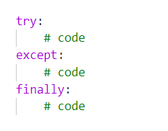
Error Handling (Part 2)
Finally Block:
Example:

Slide 26
Introduction to Classes and Objects
Python is an Object-Oriented Programming (OOP) language.
A class is a blueprint for creating objects.
An object is an instance of a class.

Slide 27
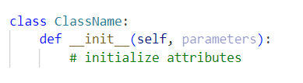
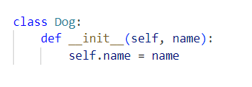
Defining a Class
Syntax:
Example:

Slide 28

Creating an Object
Once a class is defined, you can create an object:
Example:

Slide 29
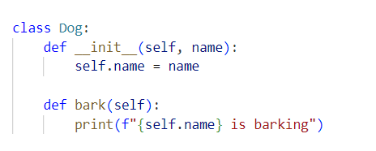
Methods in a Class
Methods are functions defined inside a class that operate on the object’s data.
Example:

Slide 30

Accessing Attributes and Methods
You can access an object’s attributes and methods using dot notation.
Example:

Slide 31
The Self Parameter
The `self` parameter refers to the current instance of the class.
It is used to access variables and methods within the class.

Slide 32
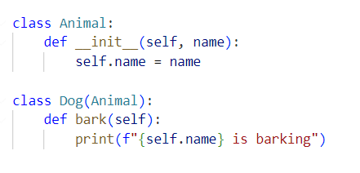
Inheritance (Part 1)
Inheritance allows a class to inherit properties and methods from another class.
Example:

Slide 33
Inheritance (Part 2)
The child class (Dog) inherits from the parent class (Animal).
You can override parent methods or extend functionality in the child class.

Slide 34
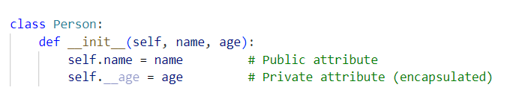
Encapsulation
Encapsulation refers to the bundling of data (attributes) and methods that operate on the data within a class.
It restricts direct access to some of the object’s components.
follow the convention by prefixing the name of the member by a single underscore “_”.

Slide 35
Polymorphism
Polymorphism allows different classes to be treated as instances of the same class through a common interface.
Example: Multiple classes can have a method with the same name but different implementations.

Slide 36
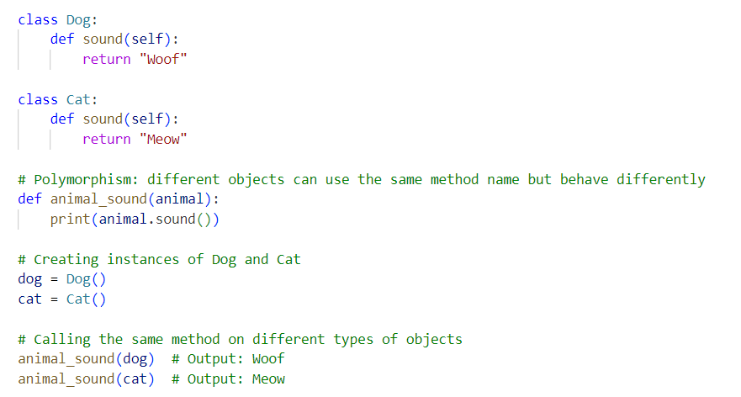
Polymorphism

Slide 37
Applications of Python
Web Development: Django, Flask
Data Science: Pandas, NumPy, Matplotlib
Automation: Selenium, PyAutoGUI
Machine Learning: Scikit-learn, TensorFlow
Game Development: Pygame
Networking: Scapy

Slide 38
Summary of Key Points
Python is versatile and beginner-friendly.
Covers basic syntax, data types, control flow, functions, and more.
Python’s applications span across many domains.

Slide 39
Thank you!

