Slide 1
Git
By Kiran Vasudev

Slide 2
Before we start...
Slack group
Visit to the Service Point

Slide 3
Introduction
Most widely used Version Control System(VCS).
Takes snapshots of the filesystem.
Only keeps track of files that have changed.
To install:
sudo apt-get install git
To check:
git --version
Install the GUI interface:
sudo apt-get install gitg
Notes:
Version control is a system that records changes to a file or set of files over time so that you can recall specific

Slide 4
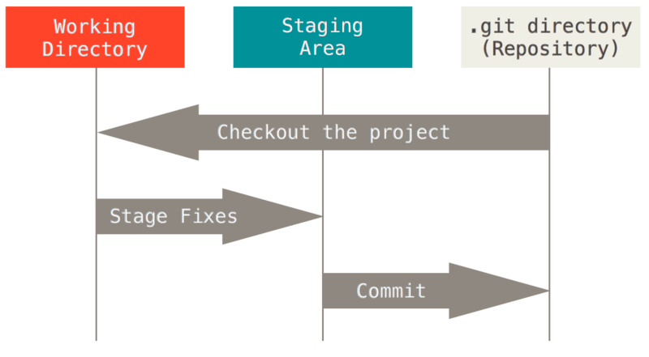
Introduction II
Three states:
  Working directory
  Stage
  Repository
Notes:
Version control is a system that records changes to a file or set of files over time so that you can recall specific

Slide 5
Important Commands
git config --global user.name "user-name"
git config --global user.email "email-id"
git init
git add f_name
git status
git commit -m "message here"
git log
git branch
git checkout b_name
Notes:
Version control is a system that records changes to a file or set of files over time so that you can recall specific

Slide 6
Important Commands II
git clone remote_location clone_name
git remote add remote_name remote_location
git remote -v
git fetch
git push remote_name branch_name
git pull
git tag tag_name
Notes:
Version control is a system that records changes to a file or set of files over time so that you can recall specific

Slide 7
Let's get our hands dirty !!
Notes:
Version control is a system that records changes to a file or set of files over time so that you can recall specific

