Slide 1
Guess the name!!!
WS-2024
Pallavi Aithal N
Salvin George

Slide 2



+
+

Slide 3
Sunesh Praveen

Slide 4
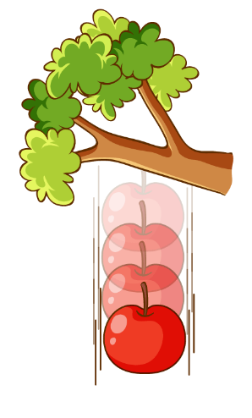


+
+
$$9.8m/s^{2}$$

Slide 5
Umang

Slide 6
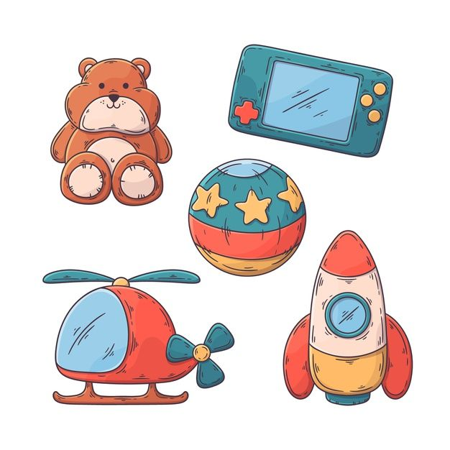

+

Slide 7
Oktay

Slide 8
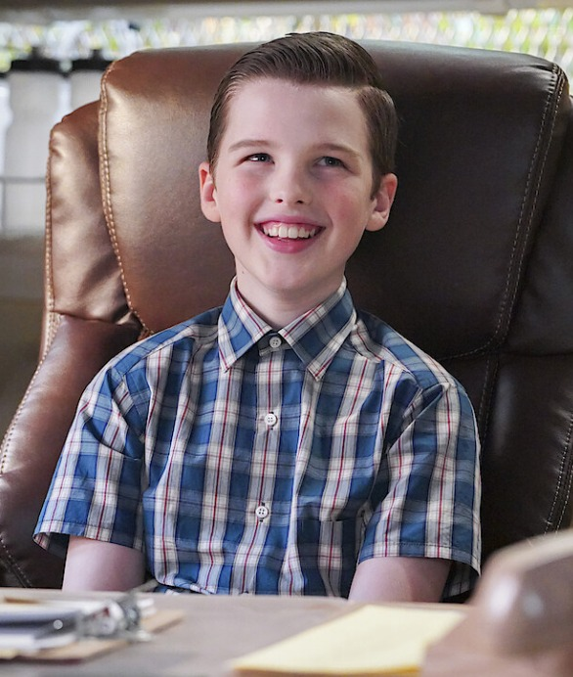


+
+

Slide 9
Mohammed Haroon Sanoj

Slide 10
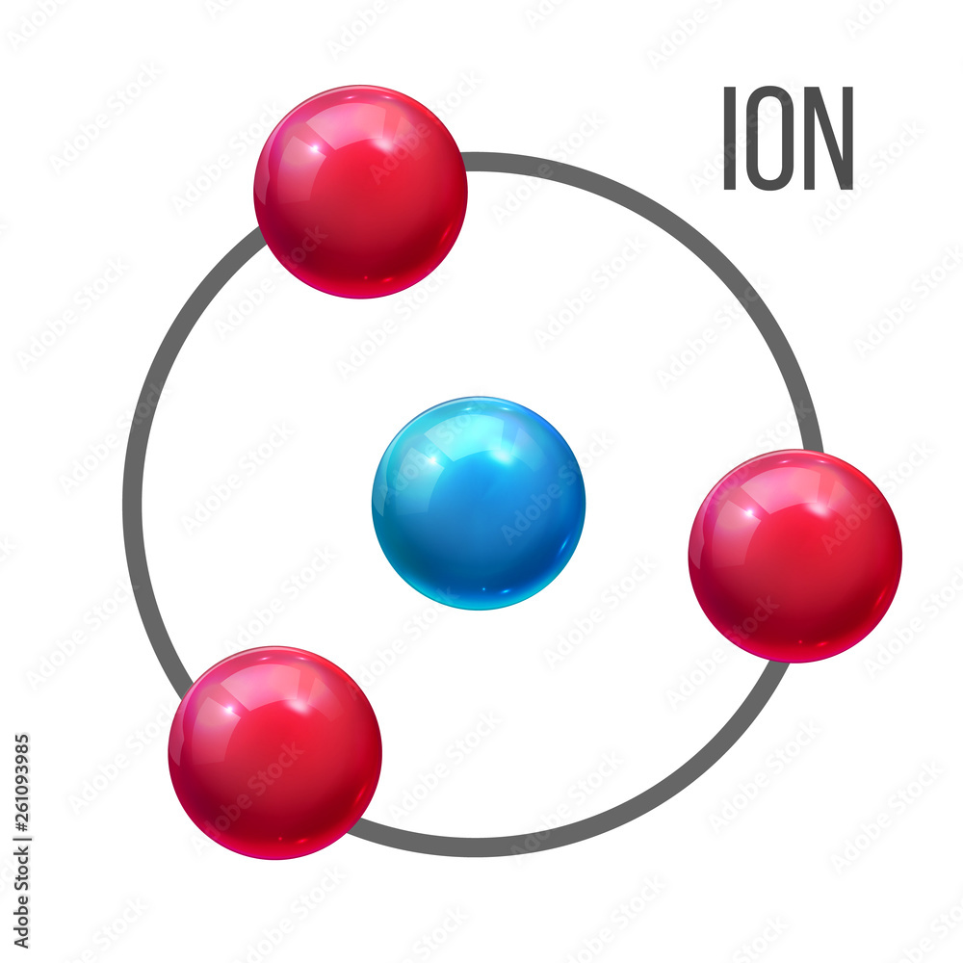

+

Slide 11
+

Slide 12
Fabian Huppertz

Slide 13
14 + 15 + 18 + 8 + 1 + 14

Slide 14
NORHAN

Slide 15


+

Slide 16
Chaeran Yoo

Slide 17
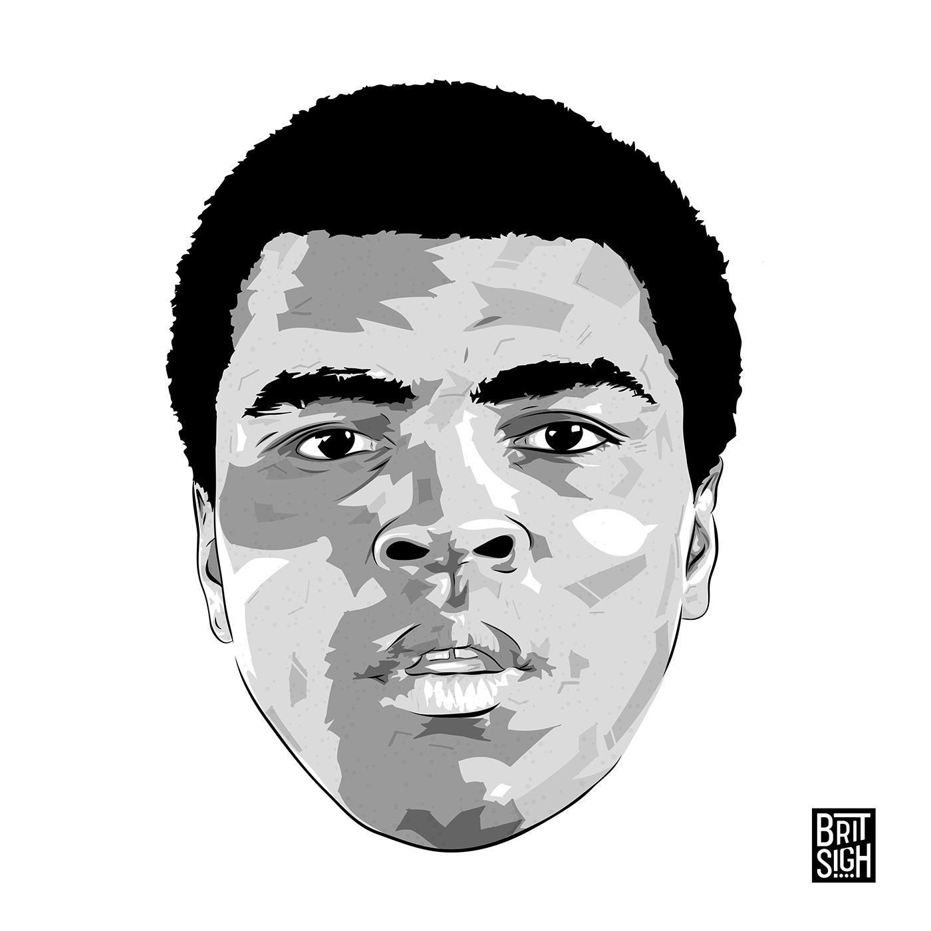
- Muhammad

Slide 18
Ali Ghafoor

Slide 19
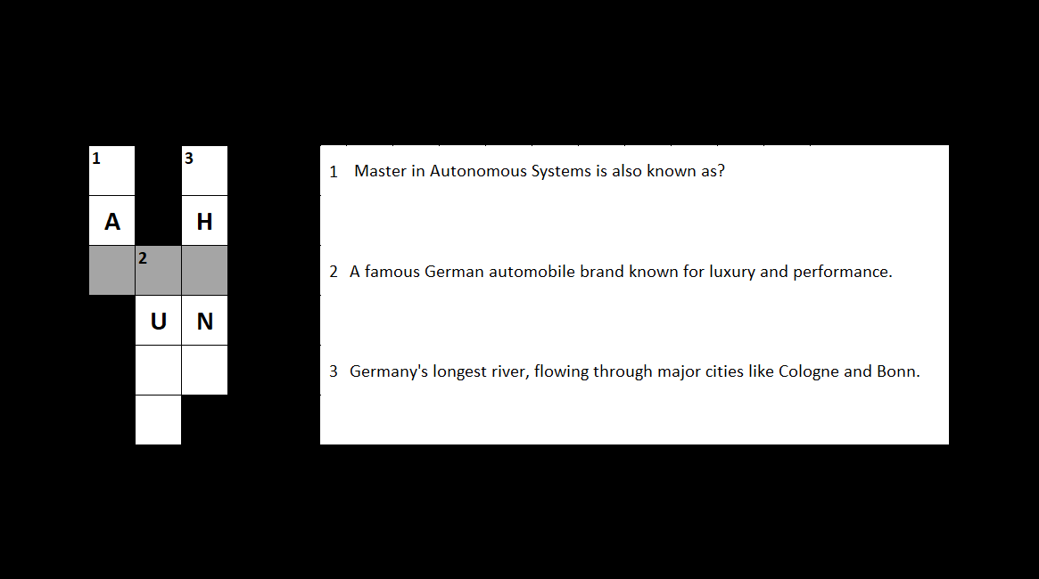

Slide 20
Sai Mukkundan

Slide 21


Slide 22
Fozilatunnesa Masuma

Slide 23


Slide 24
Ambuj

Slide 25


Slide 26
Linta Mariya

Slide 27


Slide 28
Aaron Cuthinho

Slide 29


Slide 30
Ahsan Kabir

