Slide 1
Version Control System(VCS)
Kiran Vasudev

Slide 2
What is it ?
A method to store data/files in a central location
A backup when things go wrong

Slide 3
Why should we use it ?
A complete long-term change history of every file.
Branching and merging
Ability to trace each change made
Allows multiple developers to work simultaneously

Slide 4
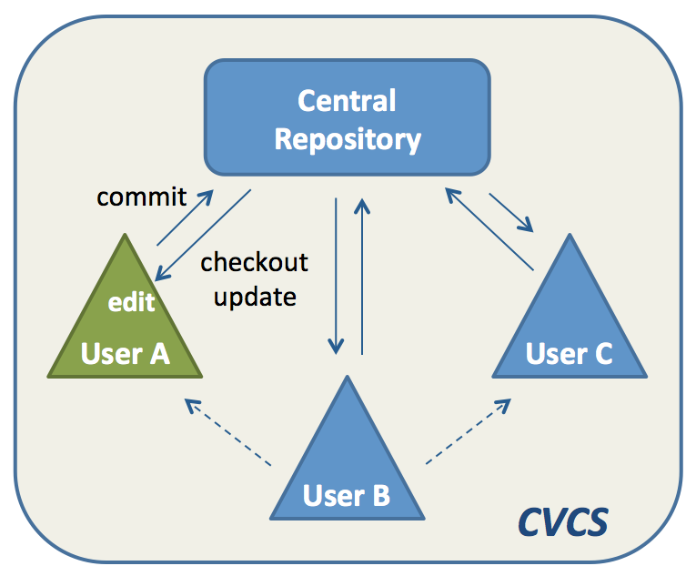
Central VCS
Centralized VCS keeps the history of changes on a central server.
Designed with the intent that there is only one true source
Sourceforge.net uses this type of versioning.
Fig.1 Central Version Control System [1]
Notes:
everyone requests the latest version of the work and pushes the latest changes to the central server. This means that everyone sharing the server also shares everyone’s work.

Slide 5
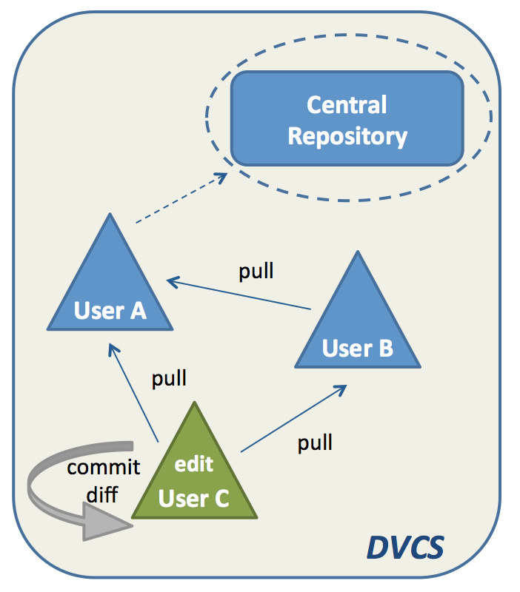
Distributed VCS
In distributed VCS, everyone has a local copy of the entire work’s history
Each repository is as good as the other
Prone to central server crash
Used mostly for programming projects
Mozilla Firefox uses this kind of versioning.
Fig.2 Distributed Version Control System [1]

Slide 6
References
[1] https://www.appfusions.com/display/StashSCMImporter/CVCS+vs.+DVCS+In+a+Nutshell

