Slide 1

Memristor
Amit Manchanda 14116013
Electronics & Communication
IIT Roorkee

Slide 2
Contents
History
Introduction
Memristor features
Course of Development
Structure and Working of TiO₂ memristor
Benefits and Future Applications
Conclusions
References

Slide 3
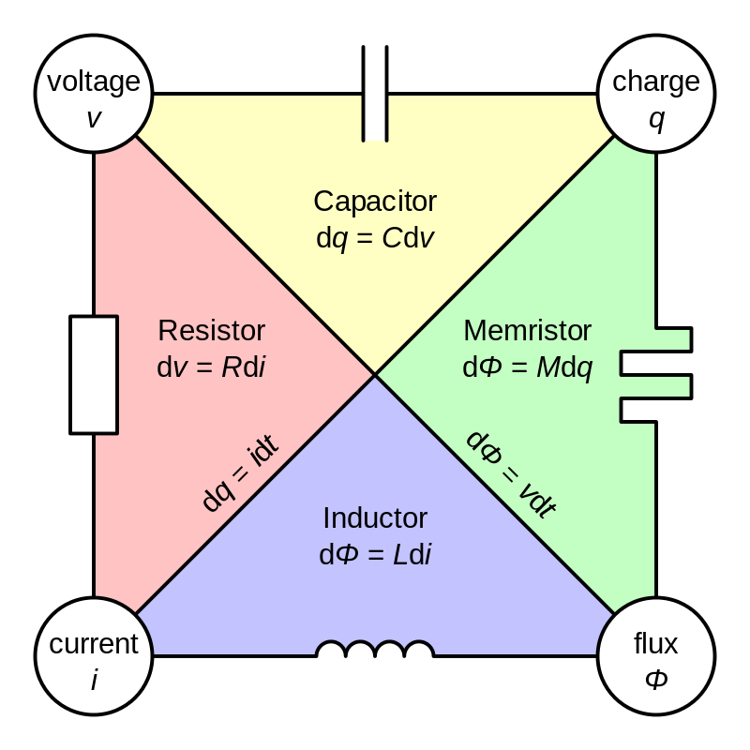
History
Four fundamental circuit variables.
Six possible combinations. Only five well known relationship.
Name coined in 1971 by circuit theorist Leon Chua.
Notes:
In his 1971 paper, Chua extrapolated a conceptual symmetry and theoretically conceptualised of memristor as another fundamental nonlinear circuit element
From the logical as well as axiomatic points of view, it is necessary for the sake of completeness to postulate the existence of a fourth basic two-terminal circuit element which is characterized by a flux-linkage - q curve.

Slide 4
Introduction
Stands for MEMory ResISTOR
Shows relation between magnetic flux and charge
Memristance depends upon the history of current that had previously flowed through the device.
Has a non-volatility property.
Notes:
A memristor is a hypothetical non linear 2 terminal electrical component relating electric charge and magnetic flux linkage.
As the device remembers its history it is so-called

Slide 5
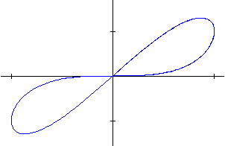
Introduction
I↑
V →
Notes:
Memristor resistance depends on the integral of the input applied to the terminals (rather than on the instantaneous value of the input as in a varistor).
Since the element "remembers" the amount of current that last passed through, it was tagged by Chua with the name "memristor"
Therefore A memristor is as any passive two-terminal circuit element that maintains a functional relationship between the time integral of current (called charge) and the time integral of voltage (often called flux, as it is related to magnetic flux).
The slope is defined as memristance

Slide 6
Memristor features
Resistance depends upon the magnitude, polarity and time application of voltage
Saves its state when turned off
Remembers how much charge has passed it
Notes:
A memristor could be compared to an imaginary pipe that carries water. When the water flows in one direction, the pipe’s diameter expands and allows the water to flow faster but when the water flows in the opposite direction, the pipe’s diameter contracts and slows down the water’s flow. If the water is shut off, the pipe’s diameter remains same till water is turned on.
The reason that the memristor is radically different from the other fundamental circuit elements is that, unlike them, it carries a memory of its past. When you turn off the voltage to the circuit, the memristor still remembers how much was applied before and for how long. That's an effect that can't be duplicated by any circuit combination of resistors, capacitors, and inductors, which is why the memristor qualifies as a fundamental circuit element.
We could replicate this but it would require alot of transistor and capacitor to replicate the job of one memristor

Slide 7
Course of Development
First predicted by Leon Chua in 1971 in paper “Memristor-The missing circuit element
First solid state version in 2008 by a research team of HP Labs stating “The missing memristor found”
Built from Titanium dioxide with cross bar structure
Notes:
Following this Leon Chua has argued that the memristor definition could be generalised to cover all forms of two-terminal nonvolatile memory devices based on resistance switching effects.

Slide 8
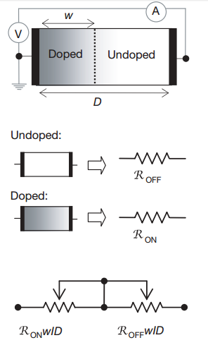
Construction of TiO₂ memristor
Consists of two layers, one slightly depleted with Oxygen atoms, other non-depleted layer.
Depleted layer has much lower resistance than the non-depleted layer
TiO_{2-x}
TiO₂
Notes:
titanium dioxide (TiO2 ) is a semiconductor, and in its pure state it is highly resistive.
In TiO 2 , the dopants don't stay stationary in a high electric field; they tend to drift in the direction of the current.
On the basis of this proposition, we consider a thin semiconductor film of thickness D sandwiched between two metal contacts, as shown in Fig. 2a. The total resistance of the device is determined by two variable resistors connected in series (Fig. 2a), where the resistances are given for the full length D of the device. Specifically, the semiconductor film has a region with a high concentration of dopants (in this example assumed to be positive ions) having low resistance RON, and the remainder has a low (essentially zero) dopant concentration and much higher resistance ROFF.

Slide 9
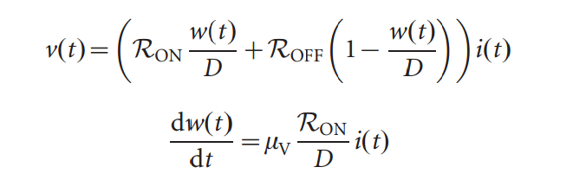

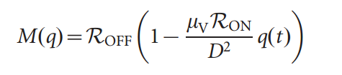
Working of TiO₂ memristor
w(t) - Thickness of doped layer
D - Total thickness
Notes:
The application of an external bias v(t) across the device will move the boundary between the two regions by causing the charged dopants to drift.
Dopant mobility is MyuV
Basic assumption that we have taken here is Ron<<Roff.

Slide 10
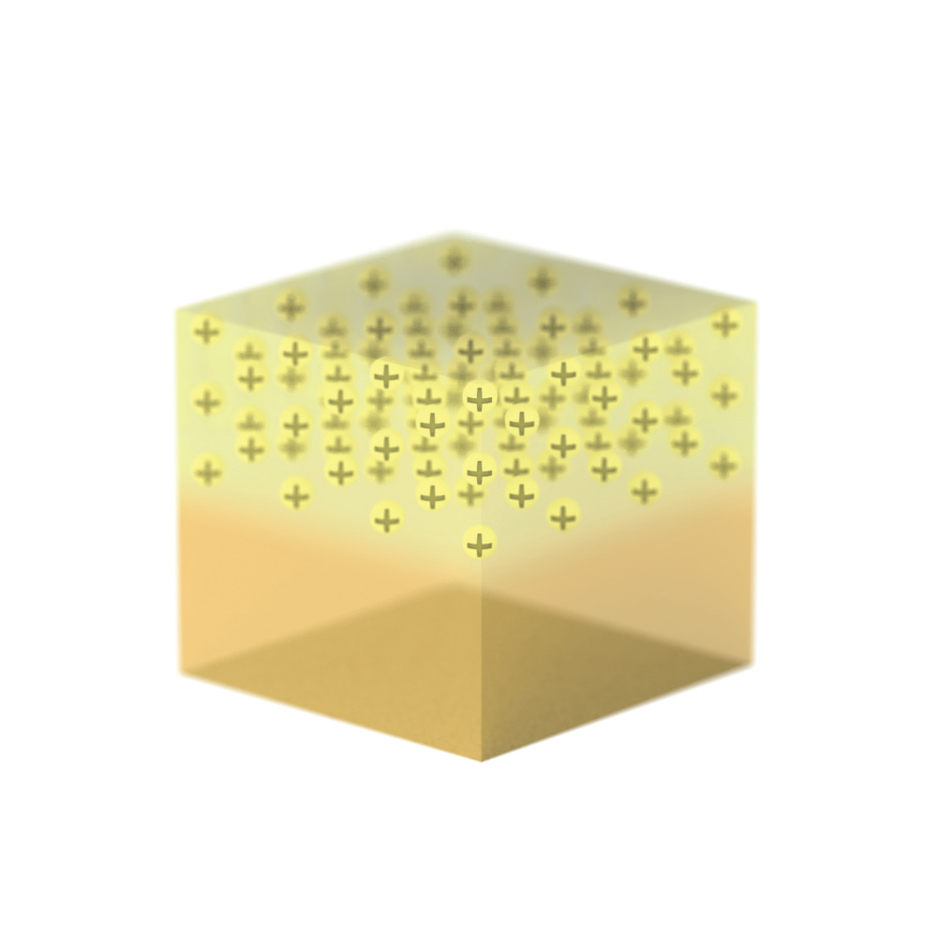
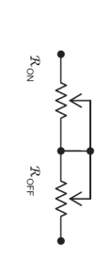
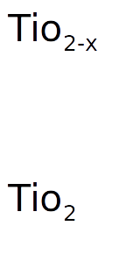
Working of TiO₂ memristor
Notes:
Putting a bias voltage across a thin film of TiO 2 semiconductor that has dopants only on one side causes them to move into the pure TiO 2 on the other side and thus lowers the resistance.
Running current in the other direction will then push the dopants back into place, increasing the TiO 2 's resistance.

Slide 11
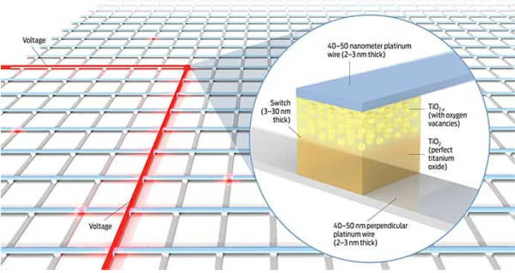
Memristor structure (Crossbar array)
Perpendicular wires crossing contains a switch connecting them.
To connect the wires the switch between the two wires must be closed.
Used as a storage system
Notes:
It contains a mesh of perpendicular wires which have a memristor structure between them which is used as switch.

Slide 12
Why Memristor ?
Conventional devices use only 0 and 1; Memristor use anything between 0 and 1
Do not consume power when idle.
Great data density. (100Gb in 1 square cm)
May replace transistors in ICs and has the potential to open door to a brand new type of electronics.

Slide 13
Future Applications
As a switch
Possible replacement for D-RAM
Booting free computers
Low power networks
Non-boolean computations
Can be used in neuromorphic circuits
Notes:
Computers using conventional D-RAM lack the ability to retain information once they are turned off. When power is restored to a D-RAM-based computer, a slow, energy-consuming "boot-up" process is necessary to retrieve data stored on a magnetic disk required to run the system.
In fact, he hopes to combine memristors with traditional circuit-design elements to produce a device that does computation in a non-Boolean fashion.

Slide 14

Big companies involved in research
Hewlett Packard
Samsung
AMD

Slide 15
Conclusion
No R,L,C circuit could duplicate the memristor
It will take a lot of transistors and capacitors to do the job of memristor
But Memristor will have to wait a few years ,like transistor which had to wait almost a decade after it’s invention for its popular applications.
Finally as Leon Chua mentioned
“It’s time to rewrite all the EE textbooks”

Slide 16
References
Chua, L. O. (1971), "Memristor—The Missing Circuit Element", IEEE Transactions on Circuit Theory, CT-18 (5): 507–519
D. B. Strukov, G. S. Snider, D. R. Stewart, R.S.Williams, “The missing memristor found,” Nature 453, 80–83(2008).
Chua, L. O. (2011), "Resistance switching memories are memristors", Applied Physics A, 102 (4): 765–783,
http://spectrum.ieee.org/semiconductors/design/the-mysterious-memristor
http://www.memristor.org/

Slide 17
Thank You

Slide 18
Any Questions?

