Slide 1
Building your first Chatbot
HYDPY Python Meetup, May 6, 2018
Samrudha Kelkar, DBS Bank
Ashhadul Islam, DBS Bank

Slide 2
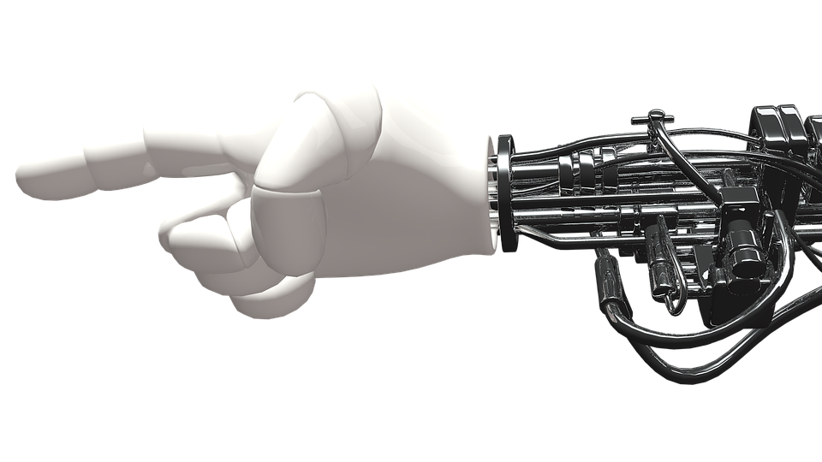
Agenda
Introduction to Chatbot and Natural Language Processing
Architecture of Chatbot
Intent and Entity extraction
Hands On building of a chatbot
Hosting your bot
Gartner says by 2020, 85% of the customer-brand interactions will be without humans

Slide 3

Bots in the world of humans
How comfortable are they?

Slide 4

NLP
NLP to extract entities
Filter relevant information
Intent classification
Understand the context

Slide 5
Entities
Metadata about the Intent
”Ok Google, set a reminder to go on a date on Saturday 6 PM at Starbucks
Ok, Google: Hot word
Set a reminder: Action
Saturday : Named entity Date
6 PM : Named entity Time
Starbucks: Named entity Location
Visualization For Spacy: https://explosion.ai/demos/displacy-ent

Slide 6
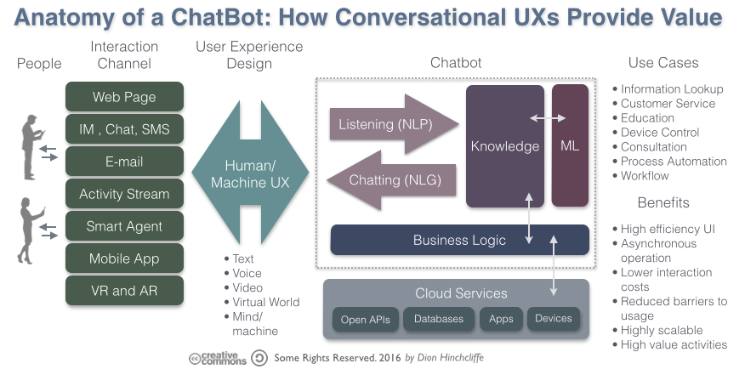
Architecture

Slide 7


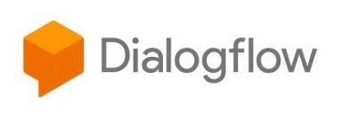

Bot Platforms
NLP as a service
Fast proto-typing
Training with ease
Host your bot

Slide 8


Custom bots
Motivation to build own chatbot
Data confidentiality
Behind the firewall
Price
More control over NLP Framework

Slide 9
Hands On Session
Building your first BOT
Follow along at
http://bit.ly/DBSPythonMeetup

Slide 10
Thank you

