Slide 1
Advanced Out-of-Distribution Detection Leveraging Vision Transformer with Adversarial Attack
JongHyeok Ahn, Leesang Youn
MS. Candidate
University of Seoul

Slide 2
Contents
Introduction
Related works
Method
Experiment

Slide 3
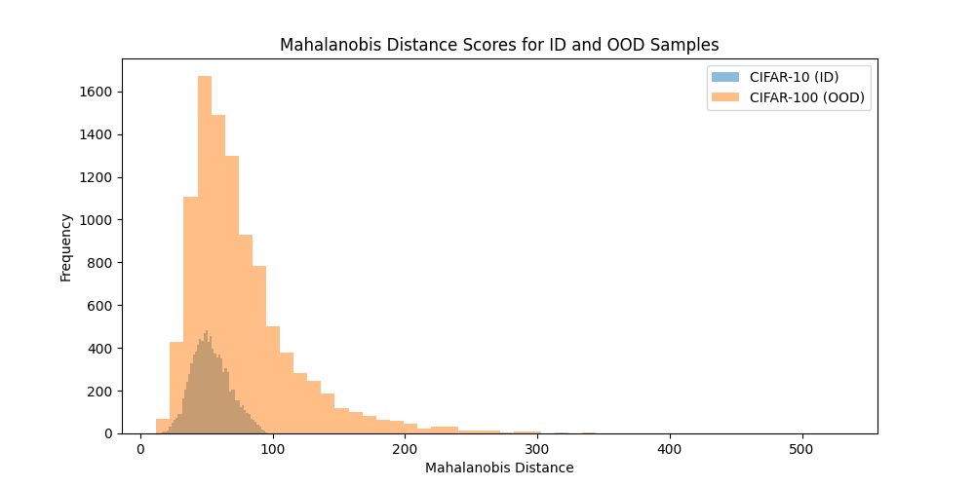
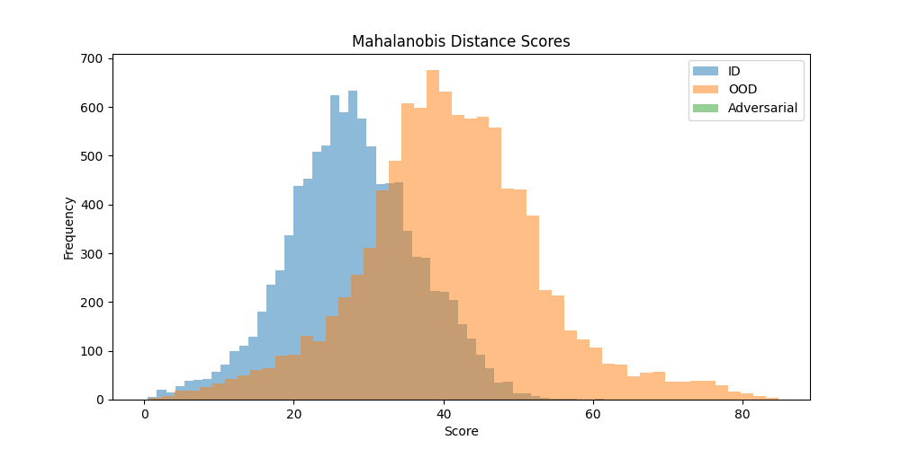
Limitation of prior Out-of-Distribution Detection
Introduction
Challenged of Near-OOD detection
Near-OOD data is much more similar to ID data to make it harder for existing methods
Distinguishing between CIFAR-10 and CIFAR-100 is challenging Near-OOD detection
To overcome these limitations, we proposed the Attention Masking method to improve model to more accurately distinguish between ID and OOD data

Slide 4
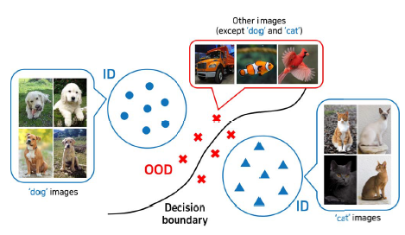
Objective of Attention Masking OOD detection
Introduction
Utilizing Vision Transformer(ViT) Models
Identifying and preprocessing important patches
This approach allows the model to focus more on significant parts of the image
Applying Mahalanobis distance calculation
Near Out-of-Distribution image classification
Got improved results on CIFAR-10(in) vs. CIFAR-100(out) and vice versa

Slide 5
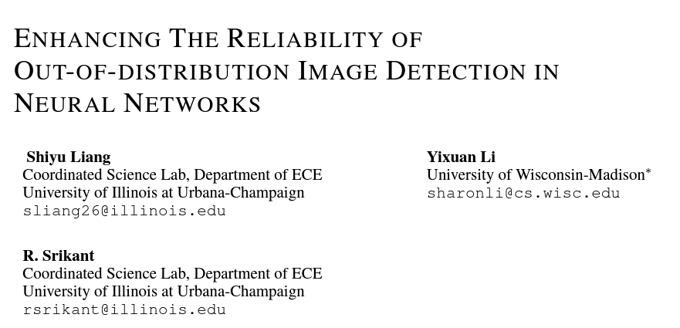

Slide 6
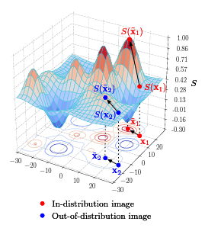
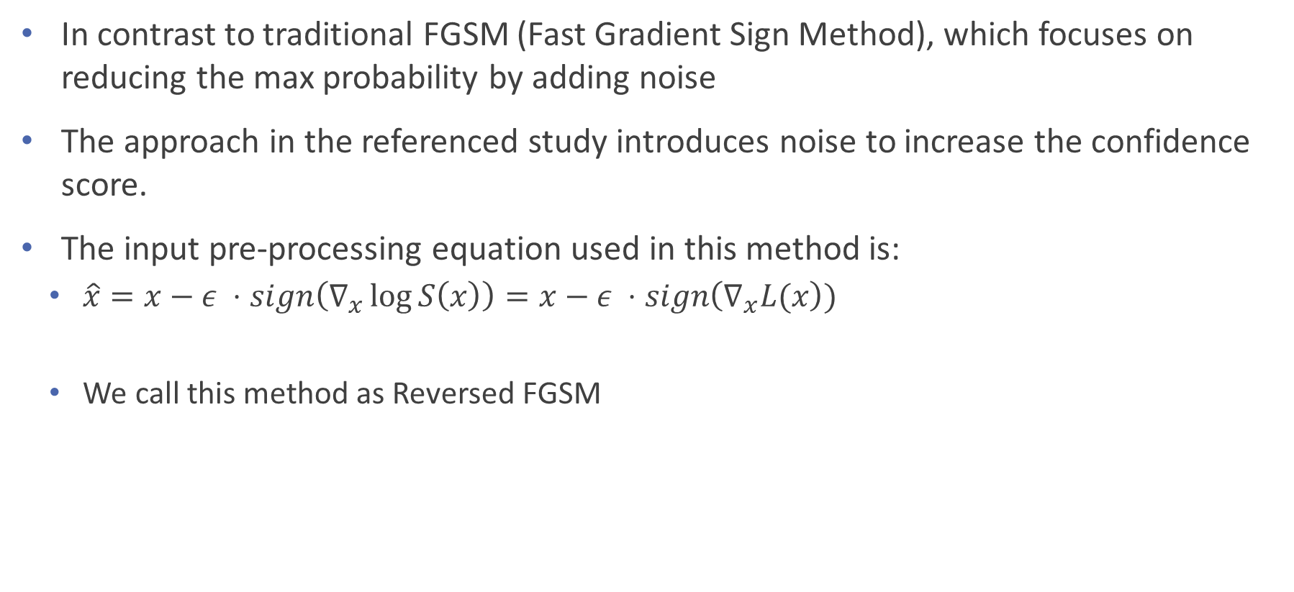
Input pre-processing(ODIN)
Related works
In contrast to traditional FGSM (Fast Gradient Sign Method), which focuses on reducing the max probability by adding noise
The approach in the referenced study introduces noise to increase the confidence score.
The input pre-processing equation used in this method is:
$\hat{x}=x−ε ⋅sign\left(∇_{x}\log{S\left(x\right)}\right)=x−ε ⋅sign\left(∇_{x}L(x\right))$
We call this method as Reversed FGSM

Slide 7
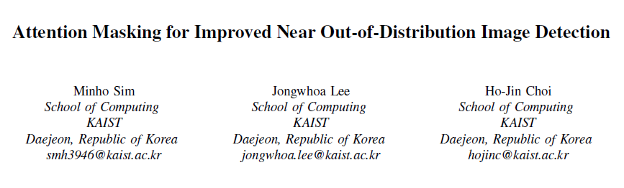

Slide 8
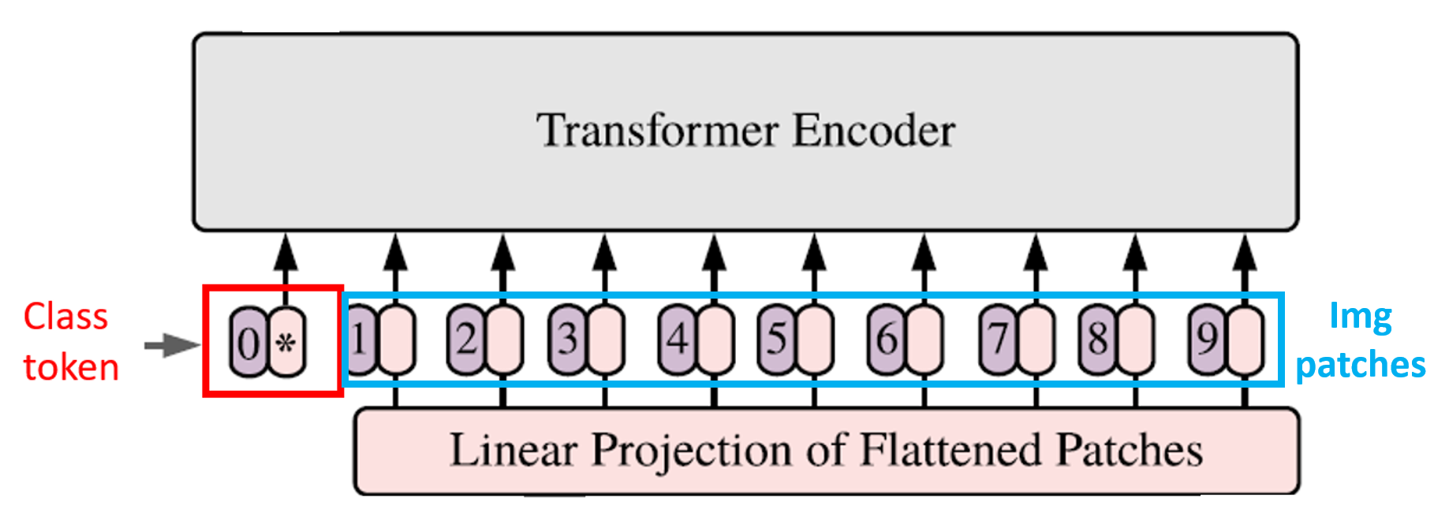
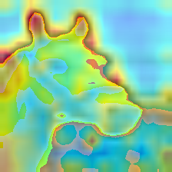
CLS Token for Attention Rollout Algorithm
Related works
Class Token(CLS Token)
CLS Token is a special token added to the input of the ViT model that learns the summary information of the entire image.
In each Transformer layer, the CLS token interacts with other patches through the attention mechanism, ultimately aggregating the important information of the entire image.
Attention Weights
Attention rollout heatmaps show how much the CLS token focuses on the image. This is what attention weights represent.
Attention heatmap
Notes:
버트 에서 쓰이는 class token so 이 토큰이 모델의 ‘분류;를 돕는다
image patch는 입력 이미지 전체의 부분들이기에, 모든 층을 다 거치고 난 후 이미지 전체의 일부인 자기 자신에 대한 정보를 더욱 뚜렷하게 갖게 됩니다. 함께 입력된 다른 값과 비교하였을 때 어떤 특징을 가지고 있는지를 표현하게 되는 거죠.
반면 cls token은 입력 이미지의 부분이 아닙니다. 랜덤하게 초기화된 학습 토큰입니다.
cls 토큰은 transformer 입력 이전에는 엄밀히 말하면 이미지에서 독립적입니다. 그러나 이미지 패치들과 함께 transformer 전체 층을 통과하게 됩니다. cls 토큰은 transformer 전체 층을 다 거치고 나면, 입력 전체를 결합한 의미를 갖게 됩니다.
즉 원래의 입력 이미지 전체에 대한 정보를 가장 잘 표상하는 토큰이 됩니다.이를 통해 모델은 입력 이미지에 대한 분류를 수행할 수 있습니다.
1)입력 이미지를 고정된 사이즈로 겹치지 않게 decompose
2) 이미지 패치를 flatten하여 linearly projection
3) 이미지 패치에 위치 정보를 더하여 embedding self-attention은 알아서 위치 정보를 찾아낼 수 없습니다. 위치 정보를 주지 않으면 그저 단순한 행렬곱셈, 내적연산일 뿐입니다.
CLS 토큰은 ViT 모델의 입력에 추가되는 특별한 토큰으로, 전체 이미지의 요약 정보를 학습합니다. 각 Transformer 층에서 CLS 토큰은 다른 패치들과 attention 메커니즘을 통해 상호작용하며, 최종적으로 이미지 전체의 중요한 정보를 집약합니다.
Attention 가중치: 각 층에서 attention 가중치는 패치들이 서로에게 얼마나 주의를 기울이는지를 나타냅니다. 특히, CLS 토큰이 각 패치에 얼마나 주의를 기울이는지를 알 수 있습니다. Attention Rollout Algorithm은 이러한 가중치를 활용하여 최종적으로 CLS 토큰이 각 패치에 얼마나 주의를 기울이는지를 계산합니다.

Slide 9
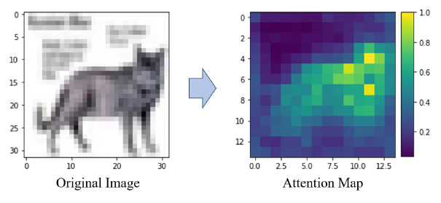
Visualization of Attention Mechanism
methods
Visualizing attention maps helps in understanding the model's decision-making process.
The attention mechanism allows the model to focus on the most relevant parts of the image.

Slide 10
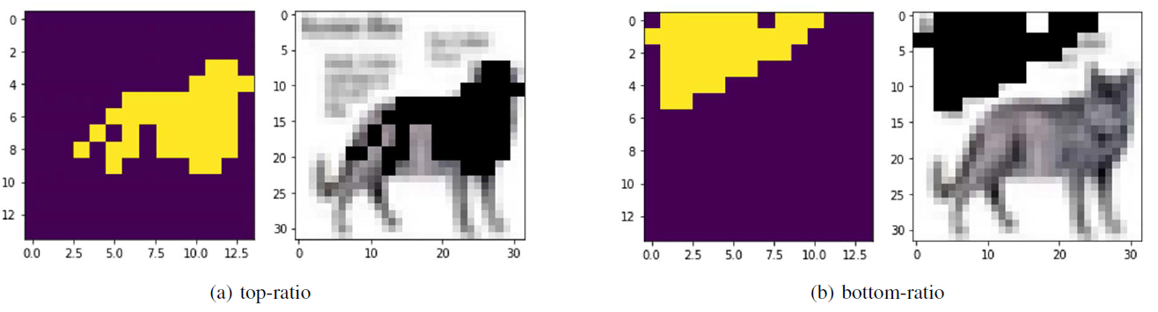
Masking strategy
Related works
In this paper the ratio was set to 20%
Masking Strategy | Patches to be Masked
Top-Ratio | Top N% of attention values
Bottom-Ratio | Bottom N% of attention values

Slide 11
How can we detect OODs?
The feature is extracted from the penultimate layer to capture high-level abstract representations of the input
Calculate the distance between the instance penultimate layer & mean penultimate vector of ID distribution.
Close distance: ID
Far distance: OOD
Which distance should we implement?

Slide 12
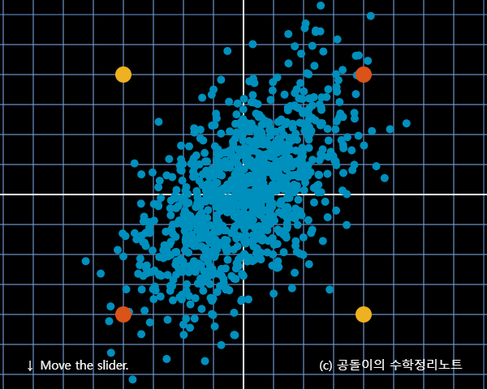
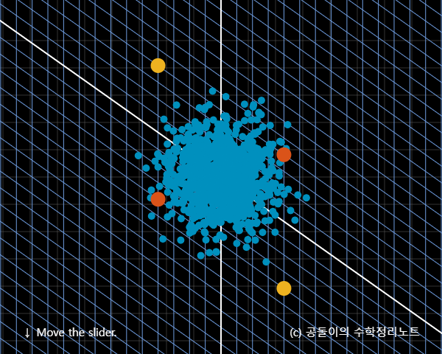
Mahalanobis distance based OOD detection
Mahalanobis distance is a measure of the distance between a point and a distribution.
It is used to identify how far a point is from the mean of a distribution, normalized by the covariance of the distribution.
In the context of OOD detection, it helps in distinguishing between ID and OOD samples based on their distance from the ID distribution.

Slide 13

Mahalanobis distance based OOD detection
$\hat{μ_{c}}=\frac{1}{N_{c}}\sum_{i;y_{i}∈c}{f(x_{i})} , c$ : class label
$\hat{∑}=\frac{1}{N}\sum_{c}{\sum_{i:y_{i}=c}{\left(f\left(x_{i}\right)−\hat{μ_{c}}\right){\left(f\left(x_{i}\right)−\hat{μ_{c}}\right)}^{T}}}$
$M\left(x\right)=\min_{c}{{\left(f\left(x_{i}\right)−\hat{μ_{c}}\right)}^{T}{\hat{\sum^{−1}{.}}\left(f\left(x_{i}\right)−\hat{μ_{c}}\right)}^{}}$
Attention Masking effectively helps in differentiating ID and OOD samples.
By focusing on the most relevant parts of the image, the model enhances its ability to distinguish between ID and OOD data
1.Assume a Gaussian distribution for each of the 10 labels(Cifar-10)
2. Calculate the Mahalanobis distance for each distribution
3. Select the nearest label

Slide 14
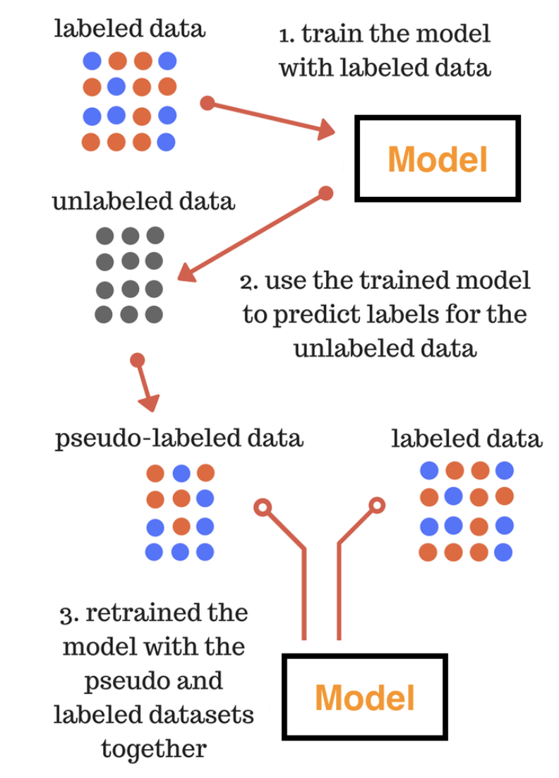
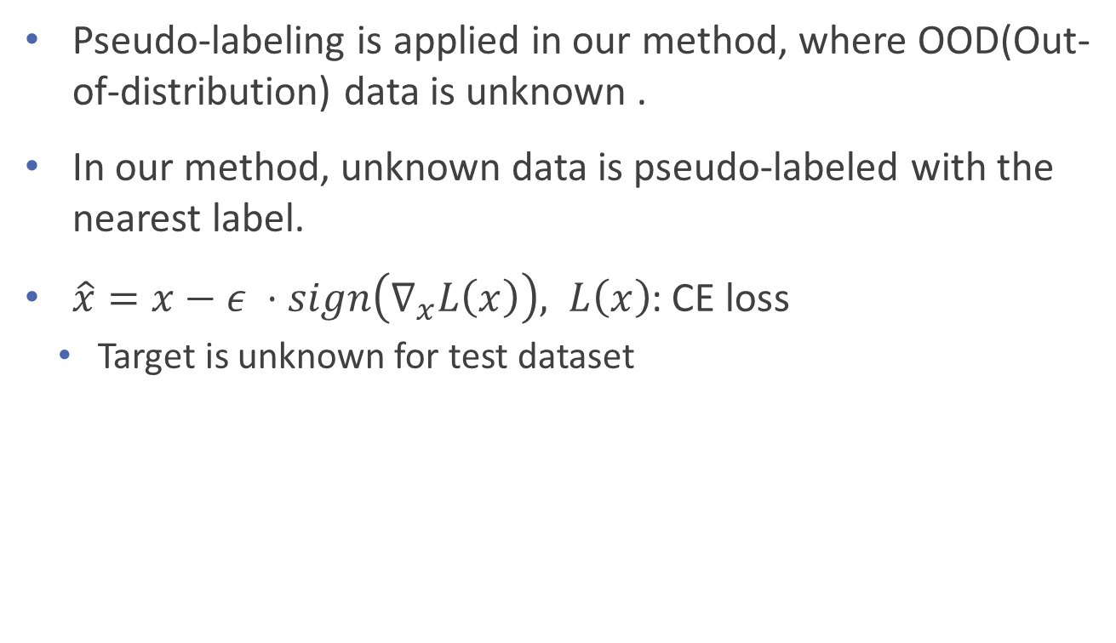
Pseudo Labeling for input pre-processing
methods
Pseudo-labeling is applied in our method, where OOD(Out-of-distribution) data is unknown .
In our method, unknown data is pseudo-labeled with the nearest label.
$\hat{x}=x−ε ⋅sign\left(∇_{x}L\left(x\right)\right), L\left(x\right)$: CE loss
Target is unknown for test dataset

Slide 15
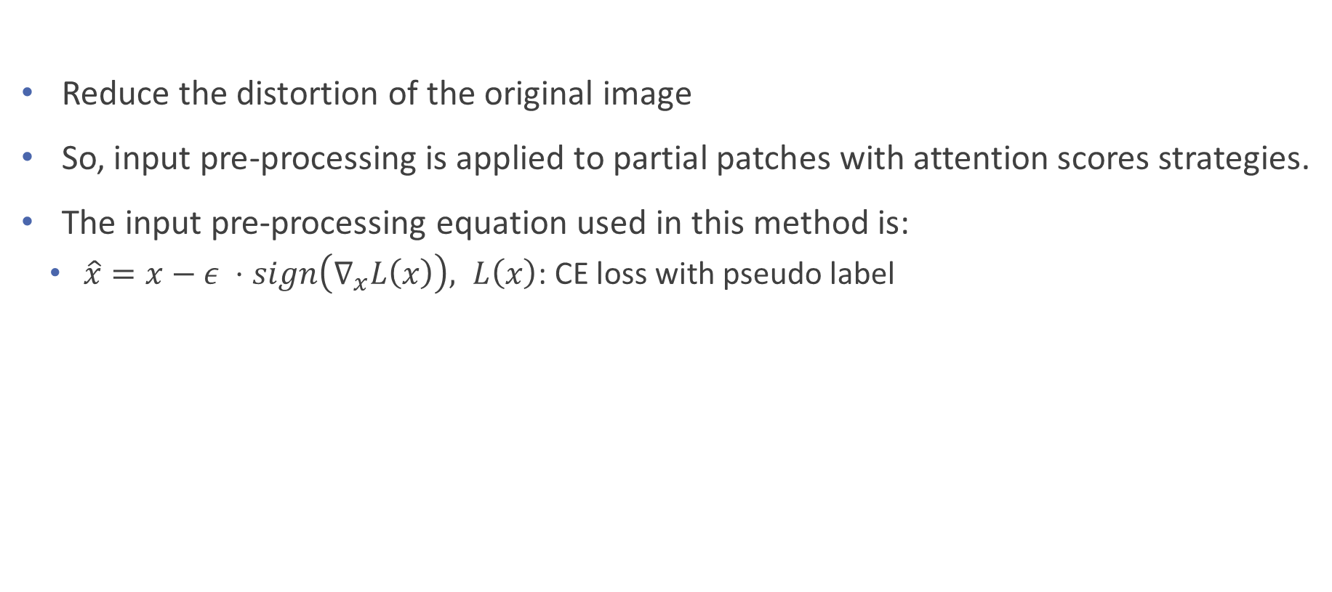
Input pre-processing
methods
Reduce the distortion of the original image
So, input pre-processing is applied to partial patches with attention scores strategies.
The input pre-processing equation used in this method is:
$\hat{x}=x−ε ⋅sign\left(∇_{x}L\left(x\right)\right), L\left(x\right)$: CE loss with pseudo label

Slide 16
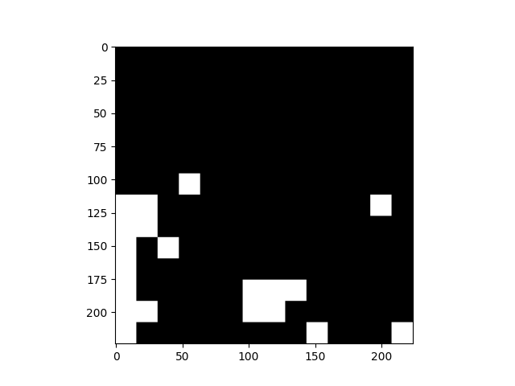
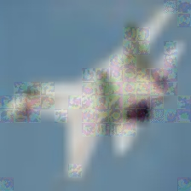
Pipeline of Attention Adversarial OOD
methods
1. The process begins with the input image. This is a raw image from the dataset
2. The input image is divided into smaller, non-overlapping patches. Each patch is processed individually by the Vision Transformer (ViT) model
3. The Vision Transformer model computes attention scores for each patch.
An attention map is generated, highlighting the areas of the image that the model focuses on the most.
4. Based on the attention scores, more important patches are identified and subtract adversarial noise.
This step enhances the model's focus on the significant parts of the image by removing or de-emphasizing the less relevant areas.
5. Generate perturbed image
Adversarial image by fgsm attack
Adversarial image * masking + original image * (1 – masking)

Slide 17
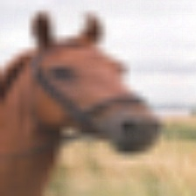
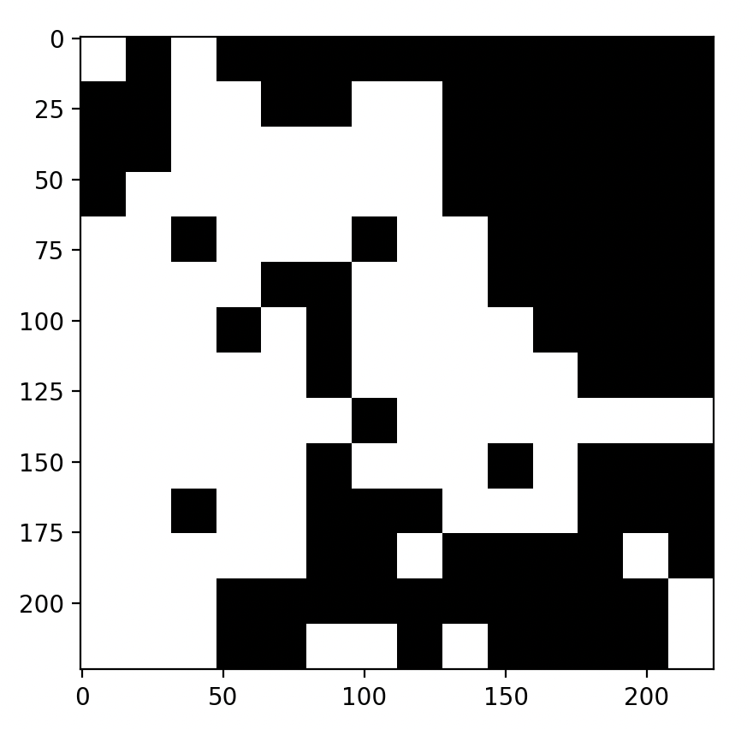
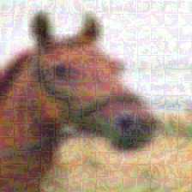
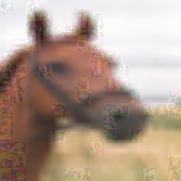
Pipeline of Attention Adversarial OOD
methods

Slide 18
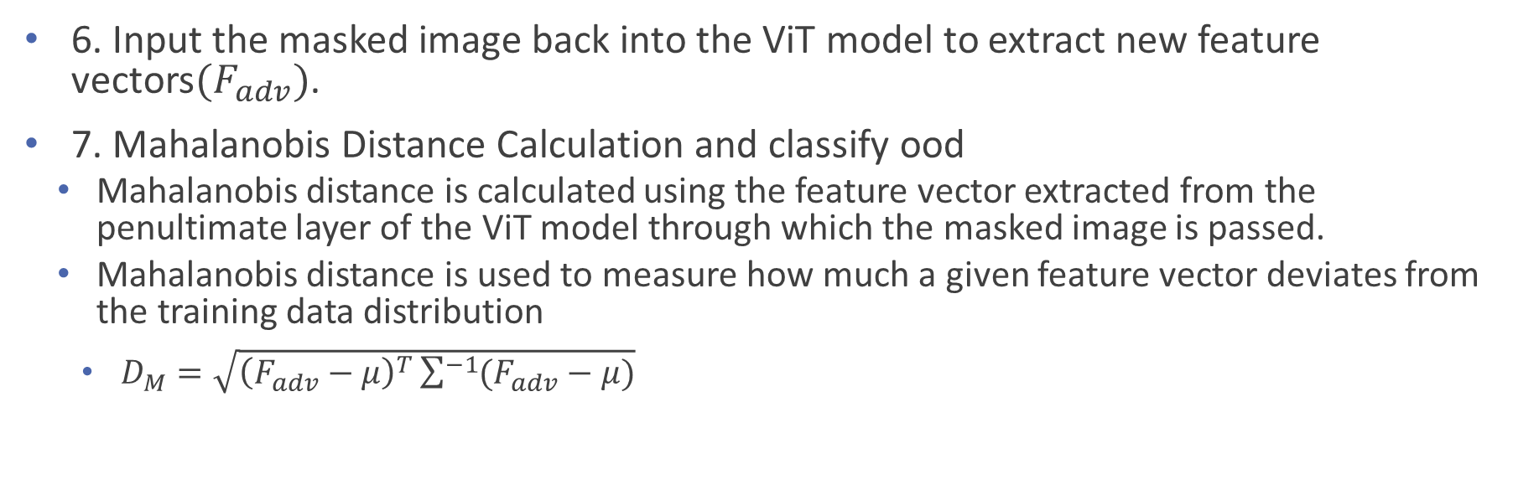
Pipeline of Attention Adversarial OOD
methods
6. Input the masked image back into the ViT model to extract new feature vectors$(F_{adv})$.
7. Mahalanobis Distance Calculation and classify ood
Mahalanobis distance is calculated using the feature vector extracted from the penultimate layer of the ViT model through which the masked image is passed.
Mahalanobis distance is used to measure how much a given feature vector deviates from the training data distribution
$D_{M}=\sqrt{{\left(F_{adv}−μ\right)}^{T}\sum^{−1}{(F_{adv}−μ)}}$

Slide 19
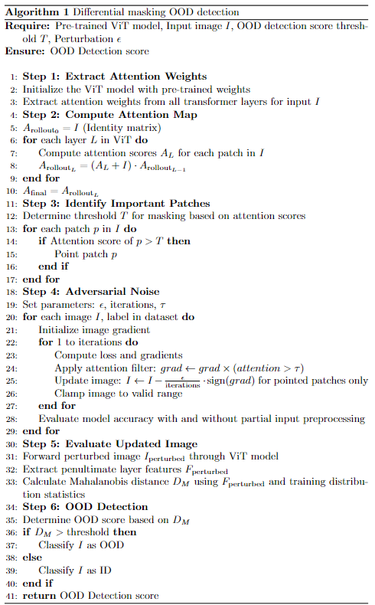
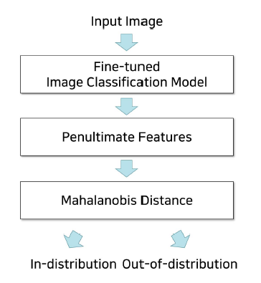
Pseudo code
methods
&

Slide 20
Experiment
experiment
Datasets: CIFAR-10(id), CIFAR-100(ood)
Models: CIFAR-10-finetuned ViT
Image Processing:
CIFAR images scaling 32x32 to 224x224
Metrics: AUROC, AUPR_ood
Experiment:
Near-OOD detection with fine-tuning
Baseline method:
Mahalanobis Distance

Slide 21
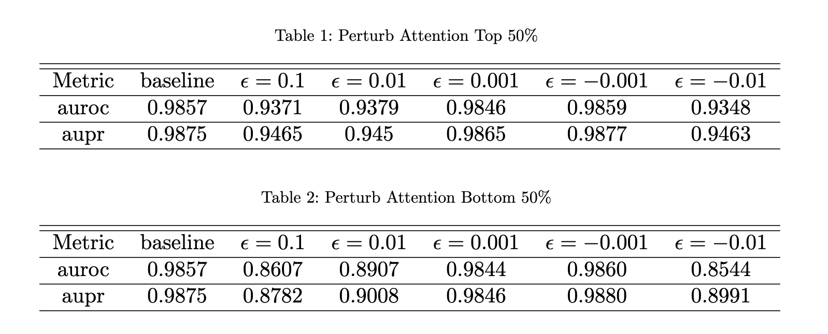
Result
experiment

Slide 22
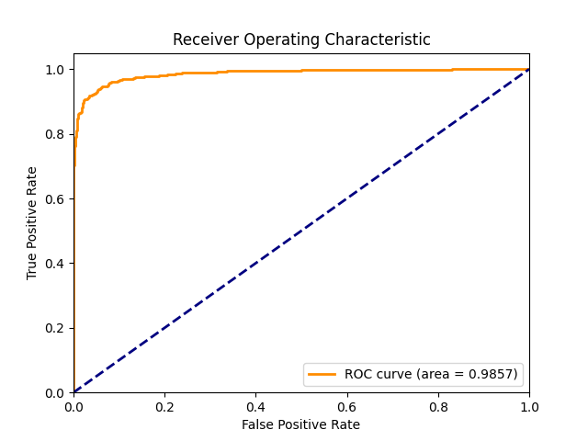
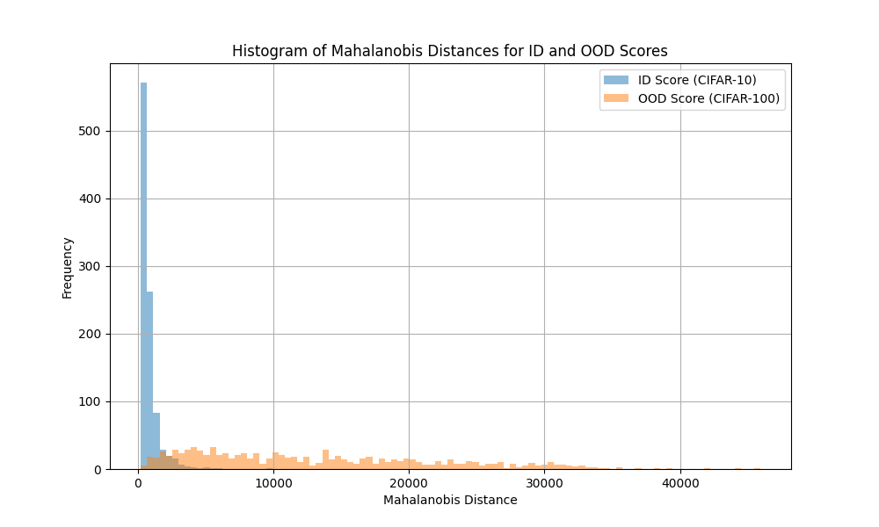
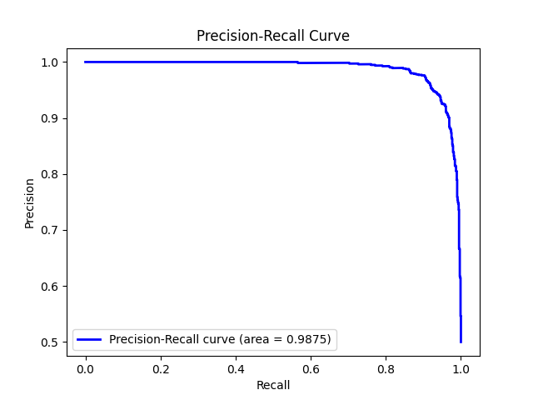
baseline
experiment

Slide 23
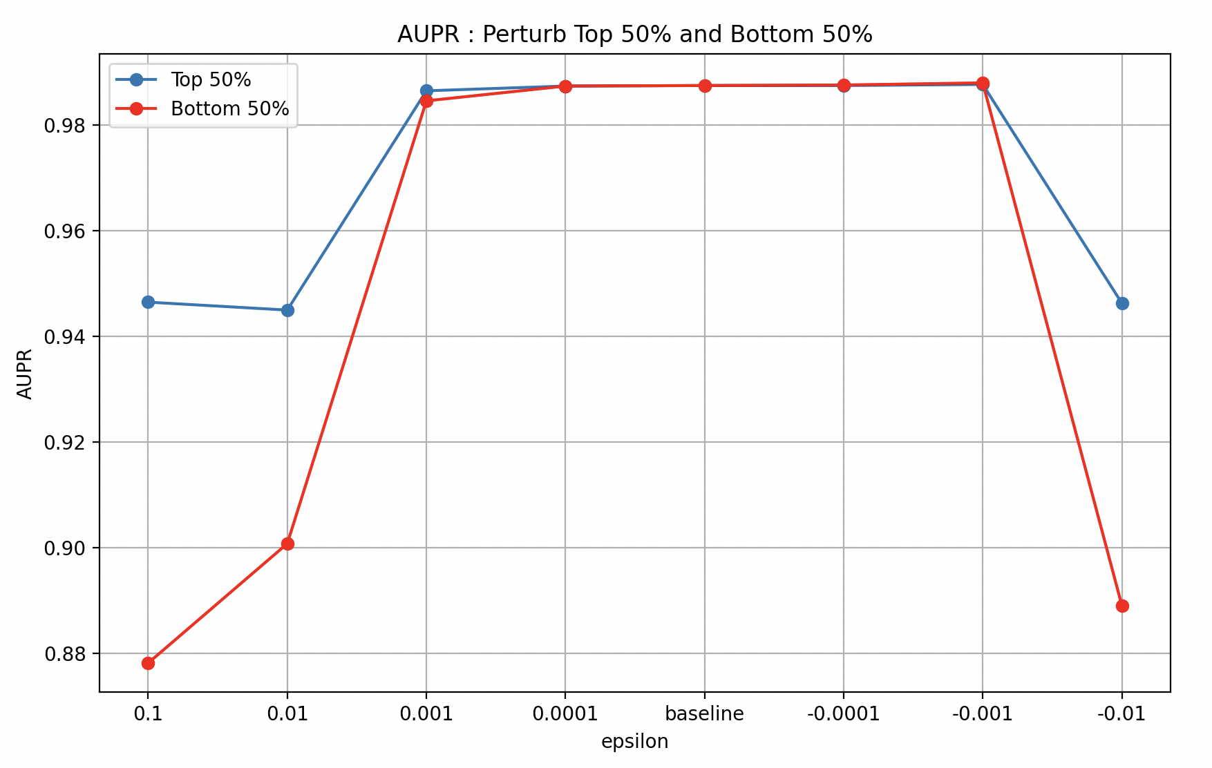
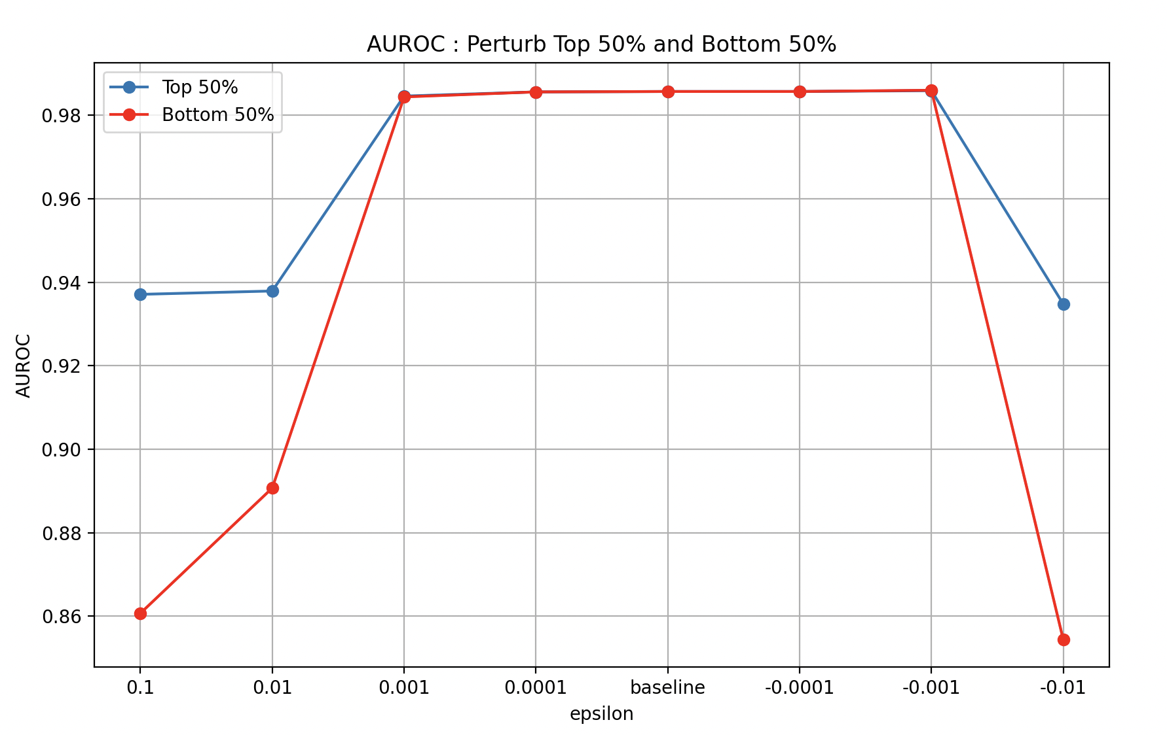
Result
experiment
Compare two strategy top 50% and bottom 50%

Slide 24
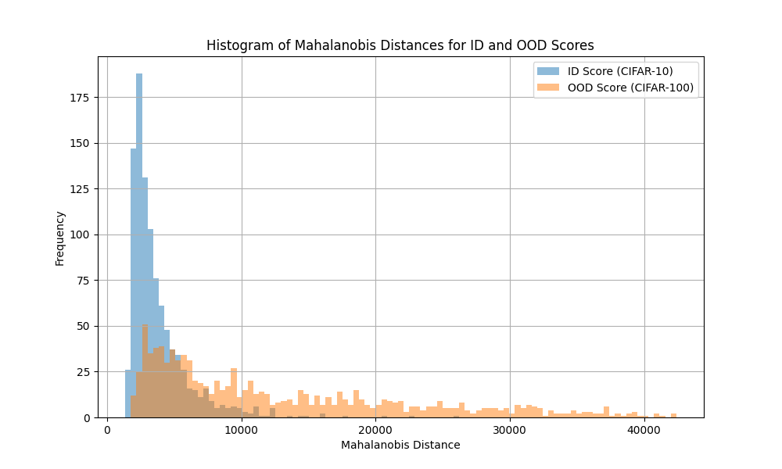

Result
Baseline
$ε$ = 0.1

Slide 25
Limitation
Limitation of method
Dataset is too easy, making it difficult to confirm whether detection is being performed accurately. So we should try using a different dataset.
The base performance of ViT is too high
Result may depend on fine-tuned ViT model

Slide 26
Appendix

Slide 27
CLS Token for Attention Rollout Algorithm
appendix
Calculation of Attention Rollout
Attention Rollout calculates the degree to which the CLS token attends to the patches at each layer.
To do this, it sequentially multiplies the attention weights of each layer to compute the final attention map.
Conclusion
The Attention Rollout Algorithm calculates how much the CLS token attends to each patch to generate the final attention map.
This final map visually expresses the importance of each patch in the model's final output.
In other words, it calculates and visualizes the importance of patches based on the attention given by the CLS token to each patch.
Notes:
Attention Rollout의 계산: Attention Rollout은 각 층에서 CLS 토큰이 패치들에 주의를 기울이는 정도를 계산합니다.
이를 위해 각 층의 attention 가중치를 순차적으로 곱하여 최종 attention 맵을 계산합니다.
결론 Attention Rollout Algorithm은 CLS 토큰이 각 패치에 얼마나 주의를 기울이는지를 계산하여 최종 attention 맵을 생성합니다.
이 최종 맵은 모델의 최종 출력에 대한 각 패치의 중요성을 시각적으로 표현합니다. 즉, CLS 토큰이 각 패치에 기울이는 주의를 기반으로 패치들의 중요성을 계산하여 시각화하는 것입니다.

Slide 28




Attention rollout algorithm
appendix
Proposed at “Quantifying Attention Flow in Transformers”
Visualizes and interprets how attention mechanisms in transformers contribute to model decisions.
Visualizes the effect of multi-head attention in a single graph.
Attention rollout Visualize multi-head Attention`s effect by one graph
layer1
layer2
Layer 1
Layer 2
Layer 3
layer3
Head 1
Head 2
Head 3
…
$A_{1 }$ = max
$A_{2}$ = max
$A_{N}$ = max
Normalize
$$Attention map$$
$$AttentionRollout_{1}=\left(A_{1}+I\right)AttentionRollout_{0}$$
$$AttentionRollout_{L}=\left(A_{L}+I\right)AttentionRollout_{L−1}$$
Notes:
K번째 head의 attention weights
AttentionRollout_0 =I(항등행렬) 이후 저 재귀적인 집계를 통해서 발생된다, 각 층의 attention 가중치 행렬 𝐴𝑙의 요소Aij​는 이전 층의 j번째 패치가 현재 층의 i번째 패치에 얼마나 주의를 기울이는지를 나타냅니다.

Slide 29
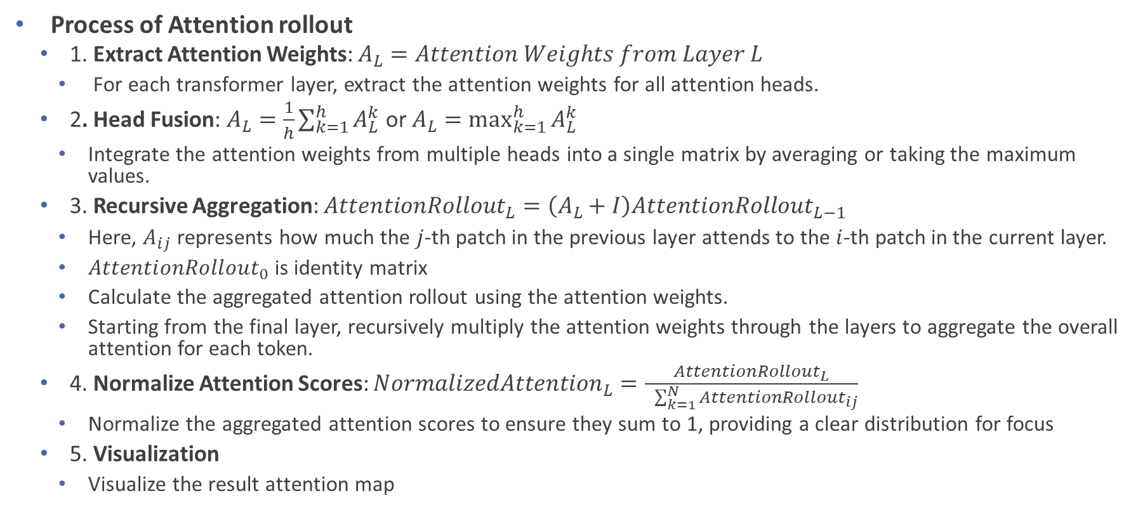
Attention rollout algorithm
appendix
Process of Attention rollout
1. Extract Attention Weights: $A_{L}=Attention Weights from Layer L$
For each transformer layer, extract the attention weights for all attention heads.
2. Head Fusion: $A_{L}=\frac{1}{h}\sum_{k=1}^{h}{A_{L}^{k}}$ or $A_{L}=\max_{k=1}^{h}{A_{L}^{k}}$
Integrate the attention weights from multiple heads into a single matrix by averaging or taking the maximum values.
3. Recursive Aggregation: $AttentionRollout_{L}=\left(A_{L}+I\right)AttentionRollout_{L−1}$
Here, $A_{ij}$ represents how much the $j$-th patch in the previous layer attends to the $i$-th patch in the current layer.
$AttentionRollout_{0}$ is identity matrix
Calculate the aggregated attention rollout using the attention weights.
Starting from the final layer, recursively multiply the attention weights through the layers to aggregate the overall attention for each token.
4. Normalize Attention Scores: $NormalizedAttention_{L}=\frac{AttentionRollout_{L}}{ \sum_{k=1}^{N}{AttentionRollout_{ij}}}$
Normalize the aggregated attention scores to ensure they sum to 1, providing a clear distribution for focus
5. Visualization
Visualize the result attention map
Notes:
K번째 head의 attention weights, L번째 layer
AttentionRollout_0 =I(항등행렬) 이후 저 재귀적인 집계를 통해서 발생된다, 각 층의 attention 가중치 행렬 𝐴𝑙의 요소Aij​는 이전 층의 j번째 패치가 현재 층의 i번째 패치에 얼마나 주의를 기울이는지를 나타냅니다.
재귀적으로 곱하기 때문에 sum to 1의 제약은 받지 않는다.
그리고 head fusion을 할 때 본 논문에서는 중요한 패치를 찾기 위해서 최댓값을 사용했다.
그리고 재귀적인 곱을 해준 뒤에 threshol값을 넘기거나 하는 masking strategy를 사용했다.

