Slide 1
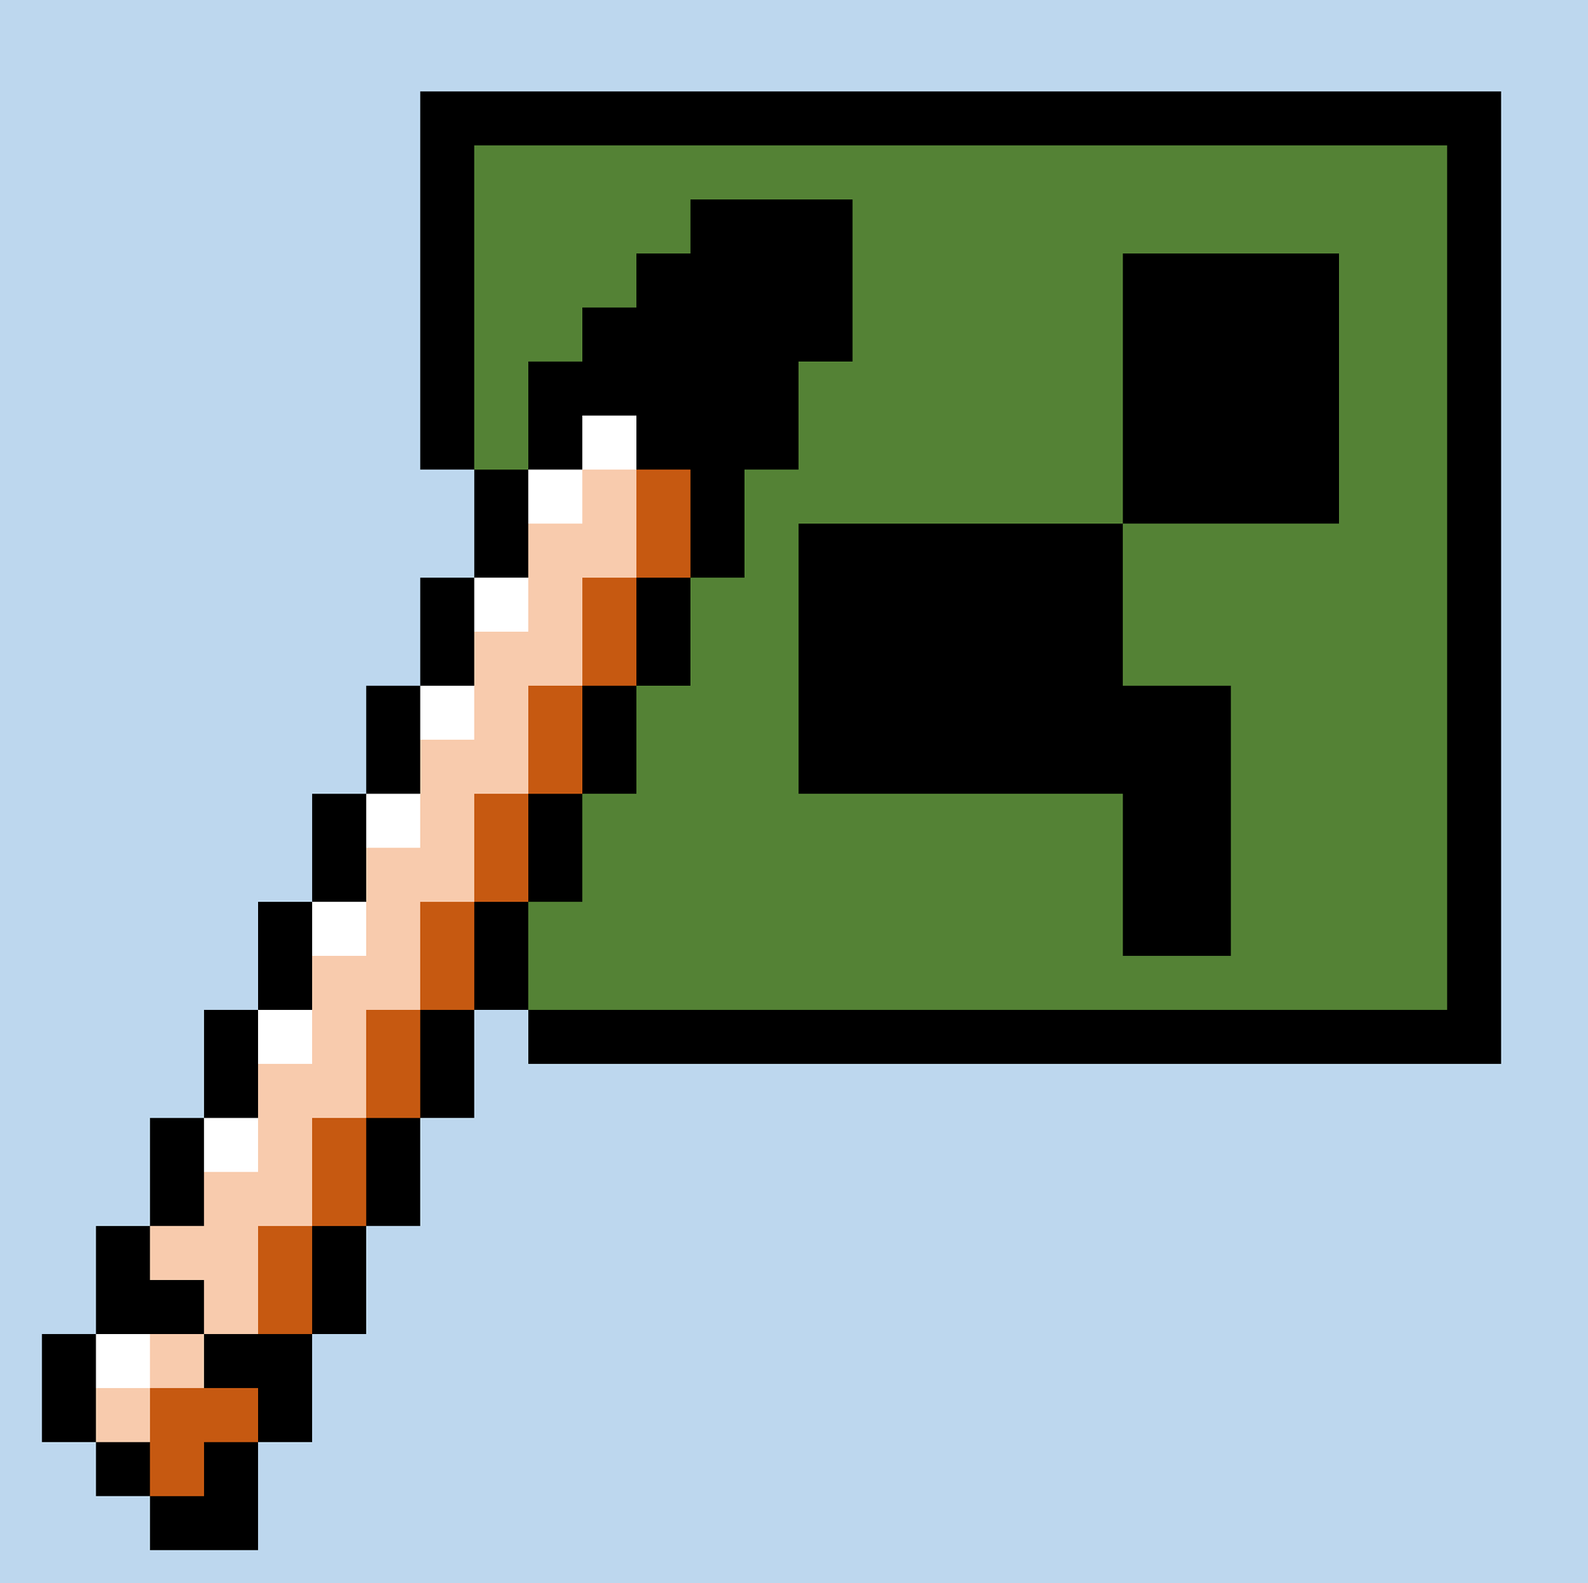
MC Pixel Art Navi
Alpha version
2021 Explorers of the Binary World

