Slide 1
Experiments of 802.15.4 Stack
Data Collection

Slide 2
Outline
Device & Software
Install
Tools
Practice
Data Collection
Advanced
Document Requirements
Grading Policies
Uploading to Ecourse

Slide 3
Device & Software
Device
FT-6251
Sensor Development Board x 1
Antenna x 1
A/C Adaptor x 1 ; AA Battery Holder x 1
UART-to-RS232 Serial Converter x 1
USB to RS-232 Cable x1

Slide 4
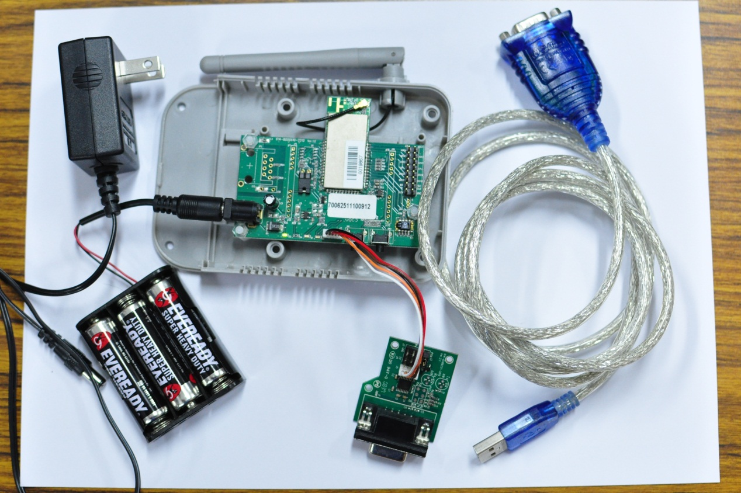
Device & Software
Device

Slide 5
Device & Software
Software
Windows XP or later (Please don’t use Windows 8)
RS232 to USB driver
Code::Blocks
Cygwin : Jennic Bash Shell
Jennic Flash Programmer
Putty

Slide 6


Preparation
Download hw1.rar
http://www.cs.ccu.edu.tw/~cih104m/2017_hw1.zip
Jennic Code::Blocks ：IDE install
Install JN-SW-4026-SDKwithIDE-1v4.8.msi
Finish
Install Patch
Install FT-6200-Patch-ba-1v0.exe
Install Path “where are your IDE”\jennic

Slide 7
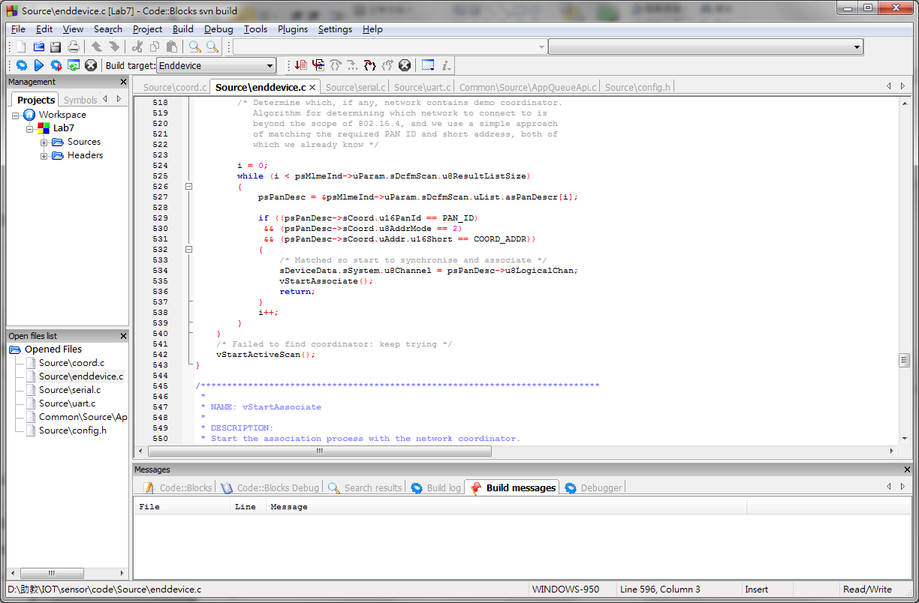
Tools
Jennic Code Block
Open Jennic Code Block
Open Lab7.cbp

Slide 8
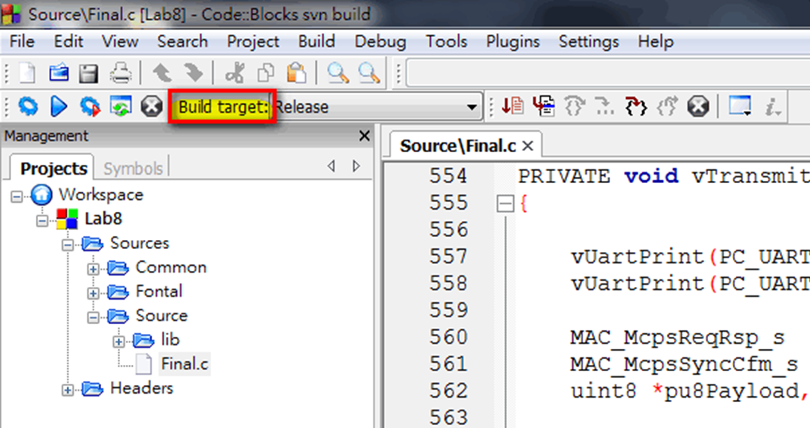
Tools
Compile Your Program
Choose build target

Slide 9
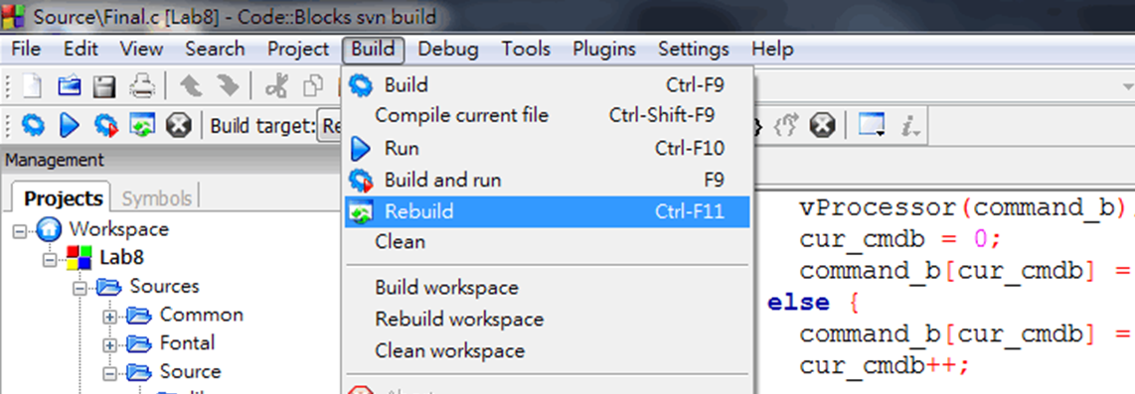
Tools
Compile Your Program
Press Build → Rebuild
View build log
Status 0: success

Slide 10
Tools
Jennic Flash Programmer
Burn our data to FT-6251
Need install USB to RS232 driver
Step1: open Jennic Flash Programmer
Step2: connect FT-6251to your computer
Step3: Press Browse, choose file which you compiled
Default path: ..\JN5121_Build\Release

Slide 11
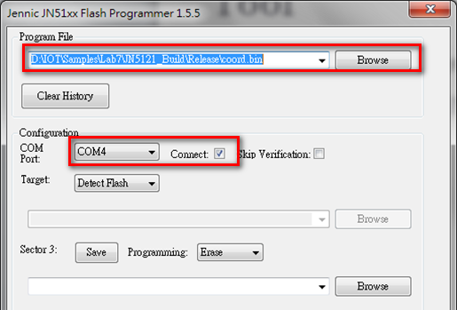
Tools
Jennic Flash Programmer

Slide 12
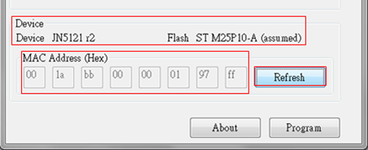
Tools
Jennic Flash Programmer
Step4: power off FT-6251
Step5: power on, FT-6251 come into Program mode
You will find , only one led is bright
Step6: Press Refresh

Slide 13
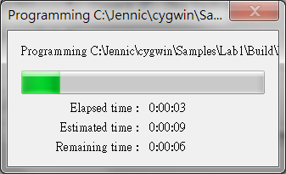
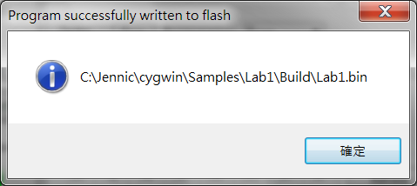
Tools
Jennic Flash Programmer
Step7: press program
Step8: finish
Step9: close flash program and restart FT-6251

Slide 14
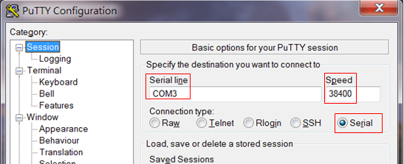
Tools
Output data
Download putty
Configure putty

Slide 15
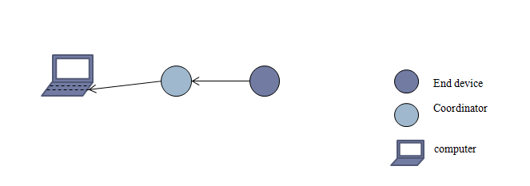
Practice
Data collection
End device senses data
End device transmits data to coordinator
Data: Short Address、Temperature、 Humidity 、LQI
Coordinator output information to computer

Slide 16
Practice
Lab 5 -- HeatTester.c
vTickTimerISR()
Observe case E_AHI_DEVICE_TICK_TIMER
Sense Temperature and Humidity
Lab 7 -- enddevice.c
vTickTimerISR()
sense Temperature and Humidity
Send packets to coordinator
vWUART_TxData()
Add Temperature and Humidity to packet
Array pu8Payload[] stores data

Slide 17
Practice
Lab 7 -- coord.c
vProcessIncomingData()
Store temperature and humidity
Array au8Sdu[] is array pu8Payload[]
vDrawUI()
vDrawUI output the data
Print temperature and humidity

Slide 18
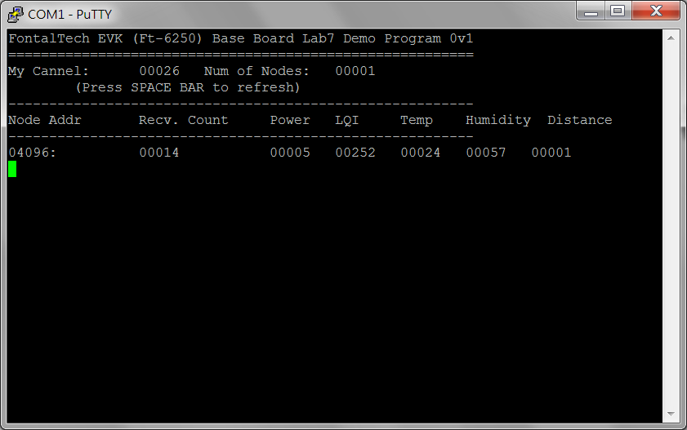
Practice
Use putty
Show the data information

Slide 19
Practice - Advanced
Use LQI(Link Quality Indicator) to calculate the distance between end device and coordinator.
Observe the relationship between LQI and distance
LQI is a metric of the current quality of
Write a program to receive serial port data.
GUI
Presenting data with any patterns except words in your GUI.
Allow all of the programing language.

Slide 20
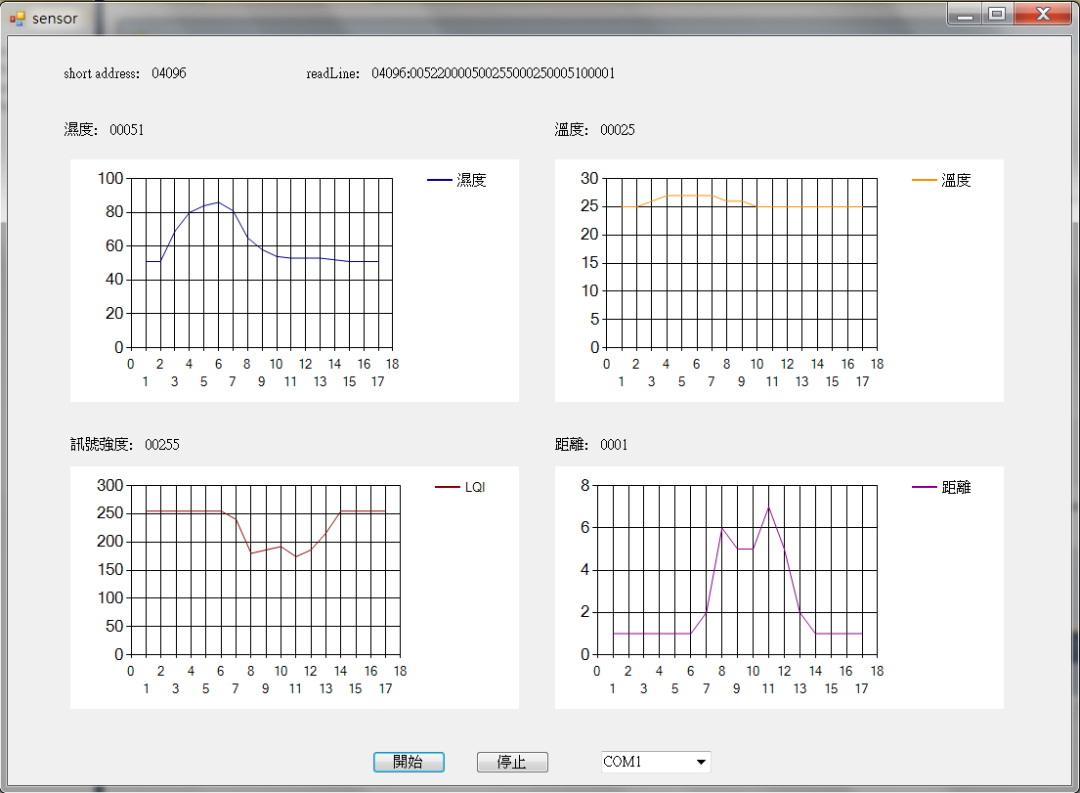
Practice - Advanced
GUI Example

Slide 21
Document Requirements
Your document have to include content below:
Cover (group ID, student ID, name)
An experimental platform and environment
The relationship between LQI and distance
Code and Explanation
Final Result

Slide 22
Grading Policies
Demo
地點:創新大樓lab308
4/25 (二) 10:00-12:00
4/26 (三) 10:00-12:00
Grading
Data Collection 60%
Advanced 20%
Report 20%
BUG：-3 point/ BUG
Delayed：-3 point/ Day

Slide 23
Uploading to Ecourse
Deadline: 2017/04/26
上傳到Ecourse http://ecourse.elearning.ccu.edu.tw/
格式：“組別_hw1.pdf”
同時繳交一份紙本報告給助教

Slide 24
Question
TA: 趙柏凱
Email: a65843@gmail.com

