Slide 1
Experiments of Zigbee
Short Address Assignment

Slide 2
Outline
Device & Software
Preparation
Operation Tool
Practice
Short Address Assignment
Data collection
Advance
Grading Policies
Document Requirements
Deadline

Slide 3
Device & Software
Device
FT-6251 H.P. ZigBee Sensor Development Board X3
Sensor Development Board X 1
Antenna X 1
A/C Adaptor X 1 ; AA Battery Holder X 1
UART-to-RS232 Serial Converter X 1
USB to RS-232 Cable X1

Slide 4
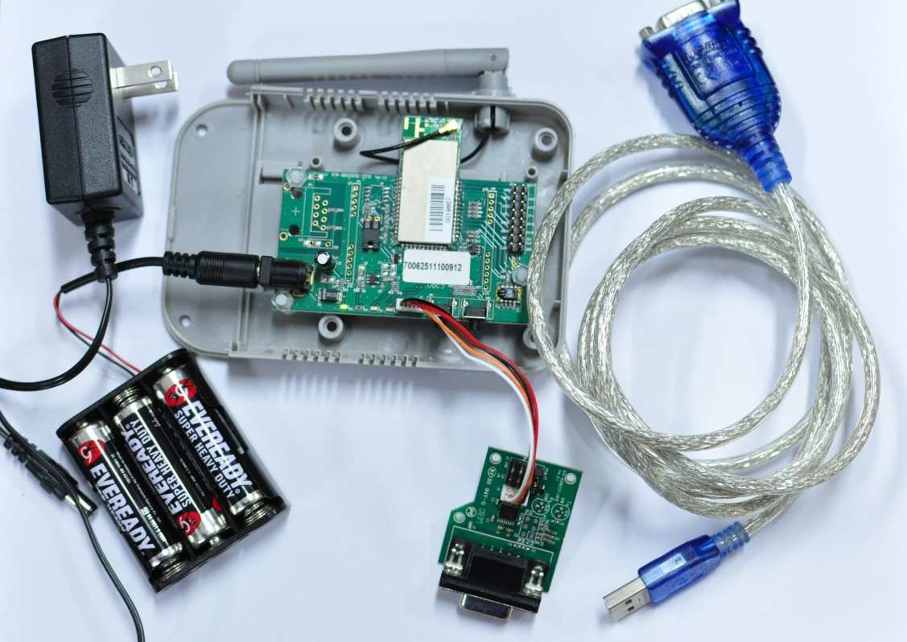
Device & Software
Device

Slide 5
Device & Software
Software
Windows XP or later
RS232 to USB driver
Code::Blocks
Cygwin : Jennic Bash Shell
Jennic Flash Programmer
Putty

Slide 6
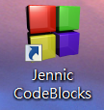

Preparation
Download Experiments_of_Zigbee.RAR
http://www.cs.ccu.edu.tw/~cih104m/2017_hw2.zip
Jennic Code::Blocks ：IDE install
Install JN-SW-4026-SDKwithIDE-1v4.8.msi
Finish
Install Patch
Install FT-6200-Patch-ba-1v0.exe
Install Path “where are your IDE”\jennic

Slide 7
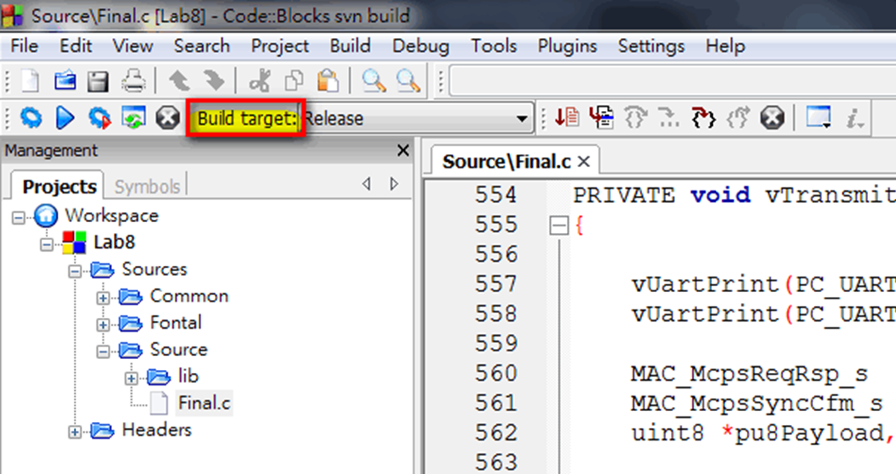
Operation Tool
Compile Your Program
Choose build target

Slide 8
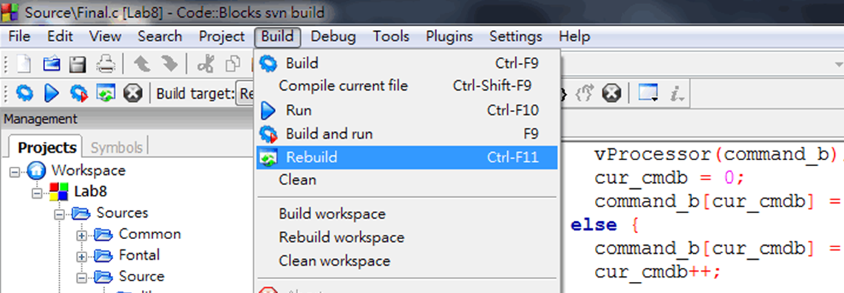
Operation Tool
Compile Your Program
Press Build → Rebuild
View build log
Status 0: success

Slide 9
Operation Tool
Jennic Flash Programmer
Burn our data to FT-7251
Need install USB to RS232 driver
Step1: open Jennic Flash Programmer
Step2: connect FT-7251to your computer
Step3: Press Browse, choose file which you compiled
Default path: ..\JN5121_Build\Release

Slide 10
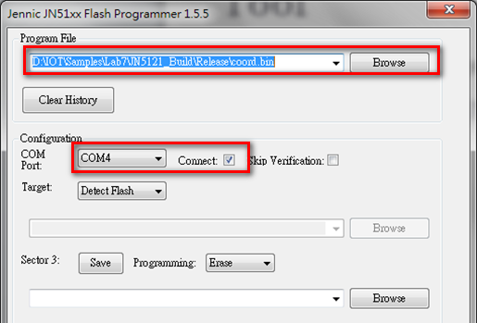
Operation Tool
Jennic Flash Programmer

Slide 11
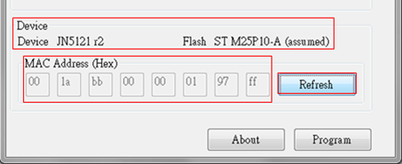
Operation Tool
Jennic Flash Programmer
Step4: power off FT-7251
Step5: power on, FT-7251 come into Program mode
You will find , only one led is bright
Step6: Press Refresh
Notes:
如果MAC address全ff 表機器有問題

Slide 12
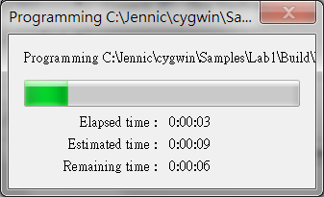
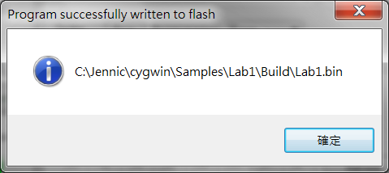
Operation Tool
Jennic Flash Programmer
Step7: press program
Step8: finish
Step9: close flash program and restart FT-7251

Slide 13
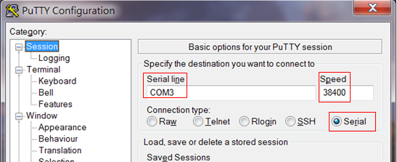
Operation Tool
Output data
Download putty
Configure putty

Slide 14
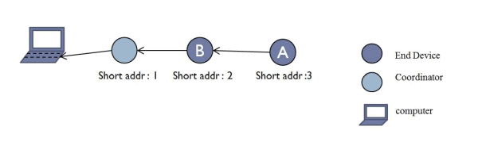
Practice
Goal
End device transmits data to coordinator
Data: Short Address、Temperature、 Humidity 、LQI (between itself and its father node)
Coordinator output information to computer

Slide 15
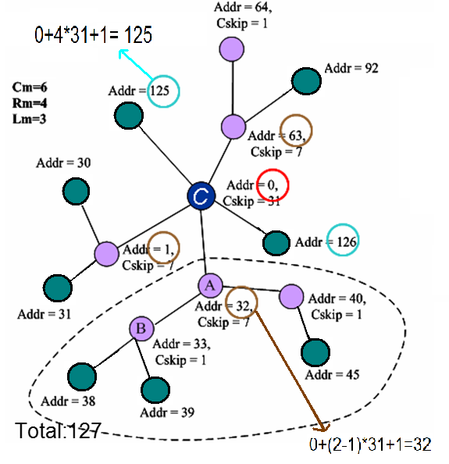
Practice
Short Address Assignment Algorithm
the nth child router is assigned to address
Aparent + (n-1) × Cskip(d) + 1
nth child end device is assigned to address
Aparent + Rm × Cskip(d) + n

Slide 16
Practice
Lab 8 – Final.h
#define MAX_CHILD
Define max child number
Set to 1
#define CSKIP_ADDR
Define cskip value
Set to 1

Slide 17
Practice
Lab 8 -- Final.c
vHandleNodeAssociation()
Change sNodeData.sChildData[u16EndDeviceIndex].u16ShortAdr
sMlmeReqRsp.uParam.sRspAssociate.u16AssocShortAddr
Child short address
Set by zigbee address Assignment
vTickTimerHandler()
Coordinator do not transmit packet
Transmit packet to it’s parent
Use zigbee address Assignment

Slide 18
Practice
Basic Requirements
Transfer the data (node A → node B → Coordinator)
Each nodes Show the receive data information.
Data ： Data Generated Node 、 Temperature、 Humidity 、LQI (between itself and its father node)、Relay Node

Slide 19
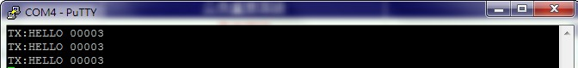
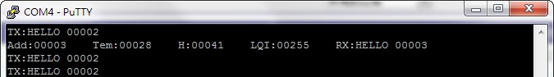
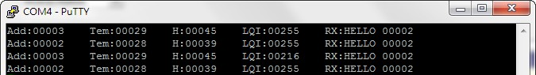
Practice
A
B
Coordinator

Slide 20
Practice
Advance Requirements
Write a program to receive serial port data
GUI(Presenting data with any patterns except words in your GUI.)
If any data change large, report an alarm

Slide 21
Document Requirements
Your document have to include content below
Cover (group ID, student ID, name)
An experimental platform and environment
Code and Explanation about what and how you do
Final Result
PDF format
DON'T COPY AND PASTE ALL THE CODE
Compress the PDF and your source code as 組別_HW2.zip
Notes:
上傳至

Slide 22
Grading Policies
Demo
地點:創新大樓lab308
5/9 (二) 10:00-12:00
5/10(三) 10:00-12:00
Grading
Basic 65%
Advance 15%
Report 20%
BUG：-3 point/ BUG
Delayed：-3 point/ Day

Slide 23
Uploading to Ecourse
Deadline: 2017/05/10
上傳到Ecourse http://ecourse.elearning.ccu.edu.tw/
格式：“組別_hw2.pdf”
同時繳交一份紙本報告給助教

Slide 24
Question
TA: 趙柏凱
Email: a65843@gmail.com

