Slide 1


BMW of Fort Walton Beach
Responder Tool
Step-by-step user guide
15 steps, from opening the tool to confirming a review has been handled.

Slide 2
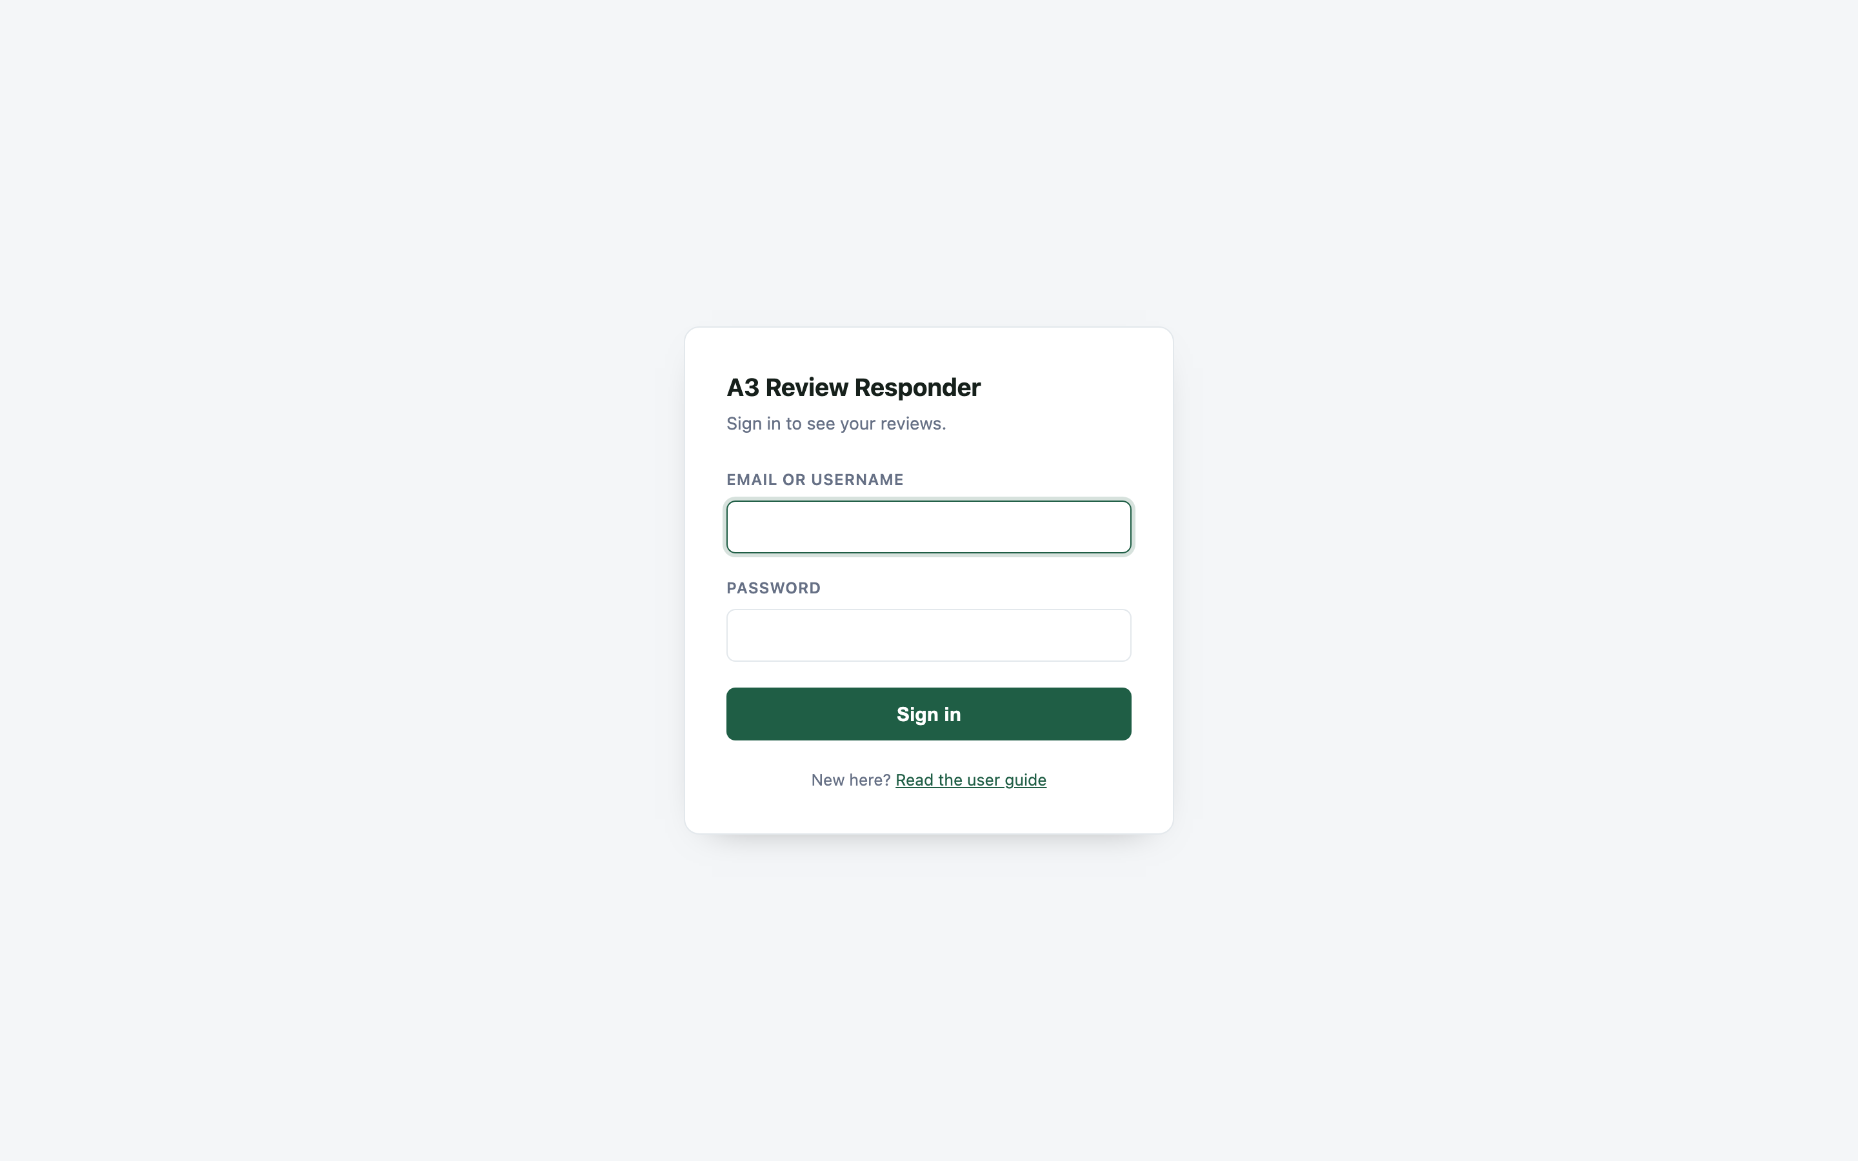
Step 1
Open the Responder Tool
Open the BMW of Fort Walton Beach Responder Tool using the provided system link and wait for the dashboard to load completely.
1 of 15
BMW of Fort Walton Beach Responder Tool
Notes:
Screenshot taken from the live system on 2026-09-28 (01-login.png).

Slide 3
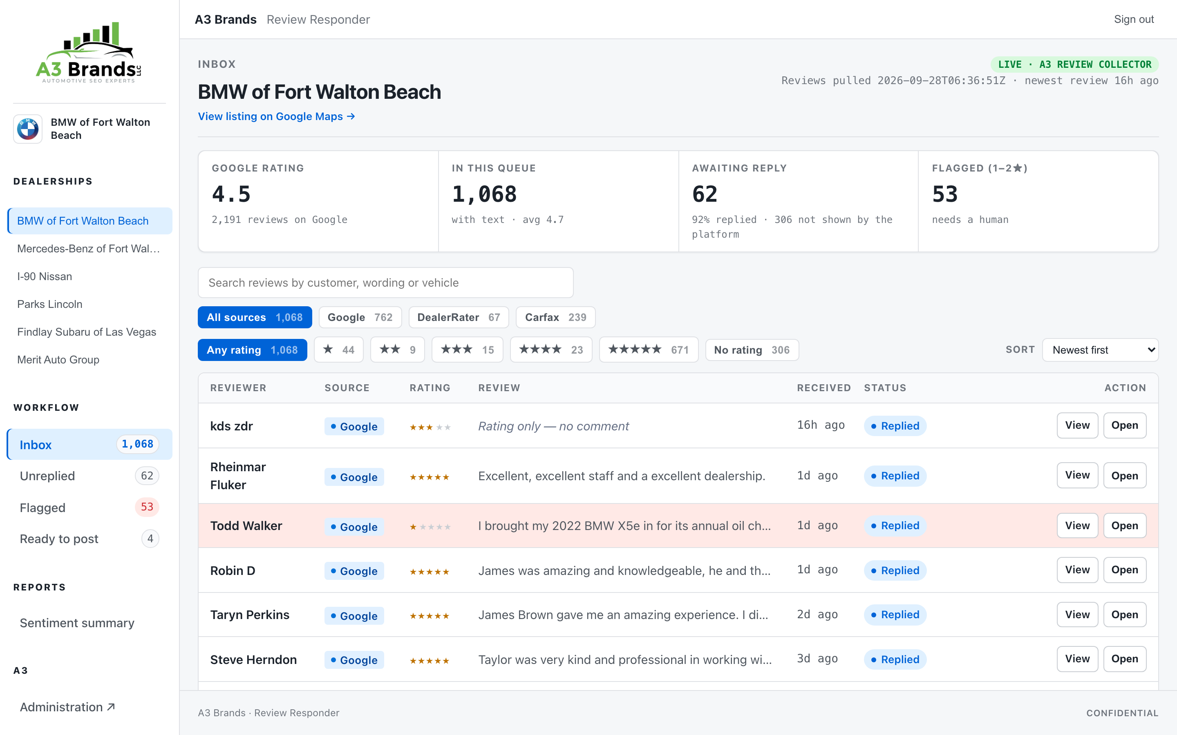
Step 2
Access the Dashboard
Once the system is open, enter the required login information and proceed to the main dashboard.
2 of 15
BMW of Fort Walton Beach Responder Tool
Notes:
Screenshot taken from the live system on 2026-09-28 (02-dashboard.png).

Slide 4
Step 3
Select BMW of Fort Walton Beach
From the dashboard, select BMW of Fort Walton Beach to make sure you are viewing and managing reviews for the correct dealership.
3 of 15
BMW of Fort Walton Beach Responder Tool
Notes:
Screenshot taken from the live system on 2026-09-28 (03-dealer-selected.png).

Slide 5
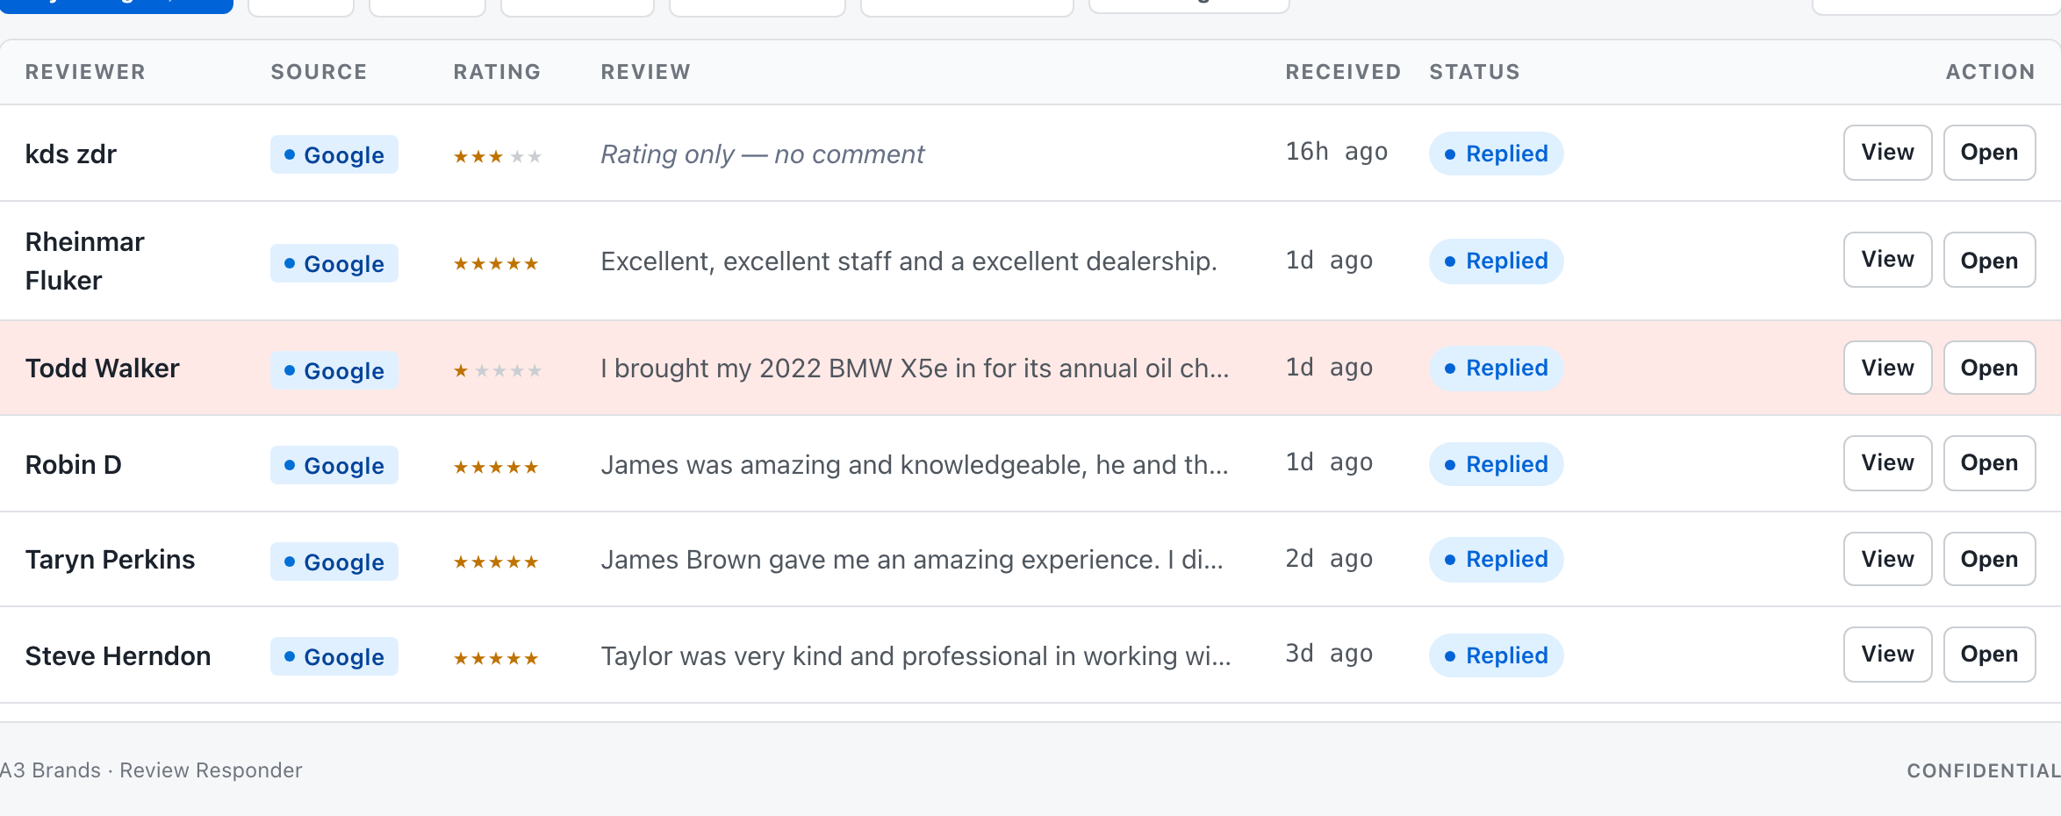
Step 4
Review New Customer Reviews
After selecting the dealership, review the available customer reviews and start with the newest review that requires attention.
4 of 15
BMW of Fort Walton Beach Responder Tool
Notes:
Screenshot taken from the live system on 2026-09-28 (04-review-list.png).

Slide 6
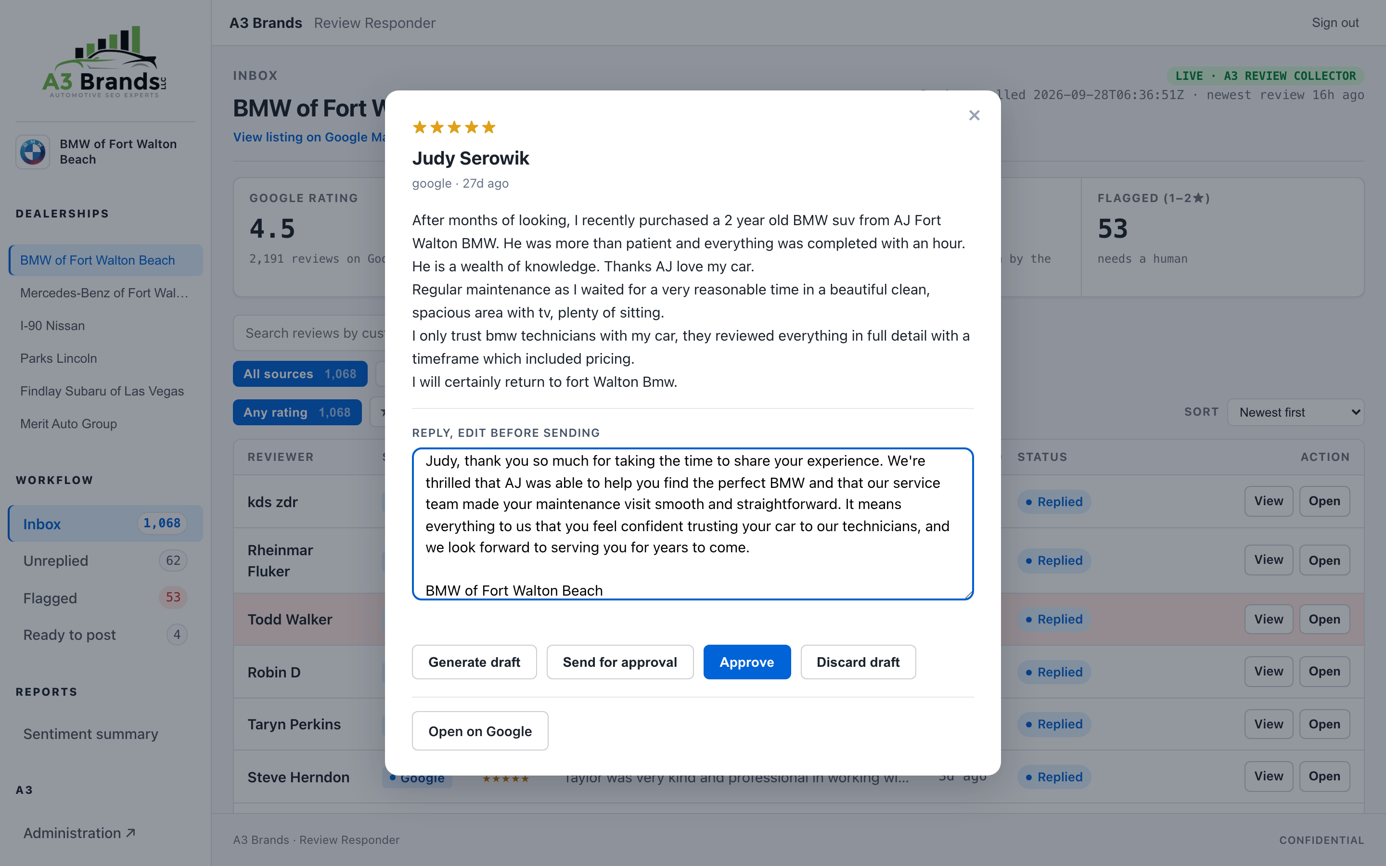
Step 5
Open a Customer Review
Click the customer review to view the reviewer's name, star rating, review date, and complete review message.
5 of 15
BMW of Fort Walton Beach Responder Tool
Notes:
Screenshot taken from the live system on 2026-09-28 (05-review-open.png).

Slide 7
Step 6
Review the Generated Response
Read the response generated by the system and compare it with the customer's original review to make sure the response is accurate, relevant, and professional.
6 of 15
BMW of Fort Walton Beach Responder Tool
Notes:
Screenshot taken from the live system on 2026-09-28 (06-generated-response.png).

Slide 8
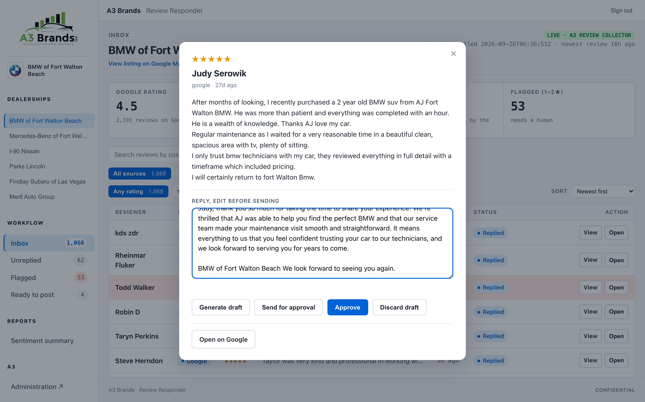
Step 7
Edit the Response if Necessary
If the generated response requires any corrections, edit the response so that it properly addresses the customer's feedback while maintaining a professional dealership tone.
7 of 15
BMW of Fort Walton Beach Responder Tool
Notes:
Screenshot taken from the live system on 2026-09-28 (07-editing.png).

Slide 9
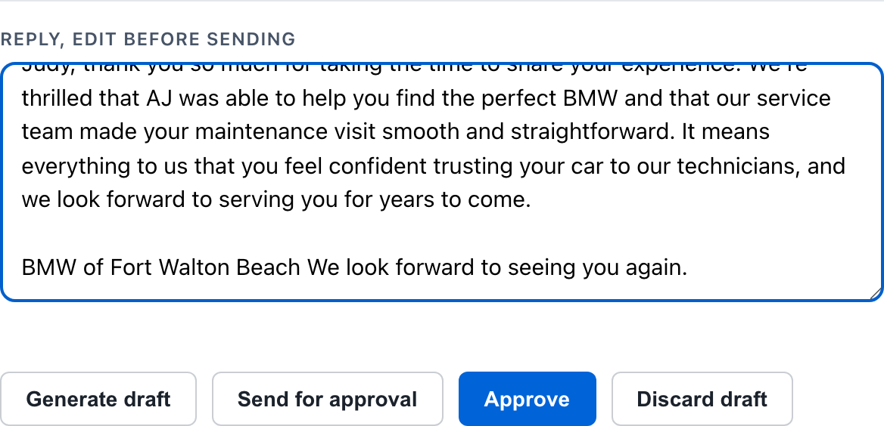
Step 8
Approve the Response
Once the response has been reviewed and is ready, click Approve to confirm that the response is ready for the next stage of the review workflow.
8 of 15
BMW of Fort Walton Beach Responder Tool
Notes:
Screenshot taken from the live system on 2026-09-28 (08-approve-button.png).

Slide 10
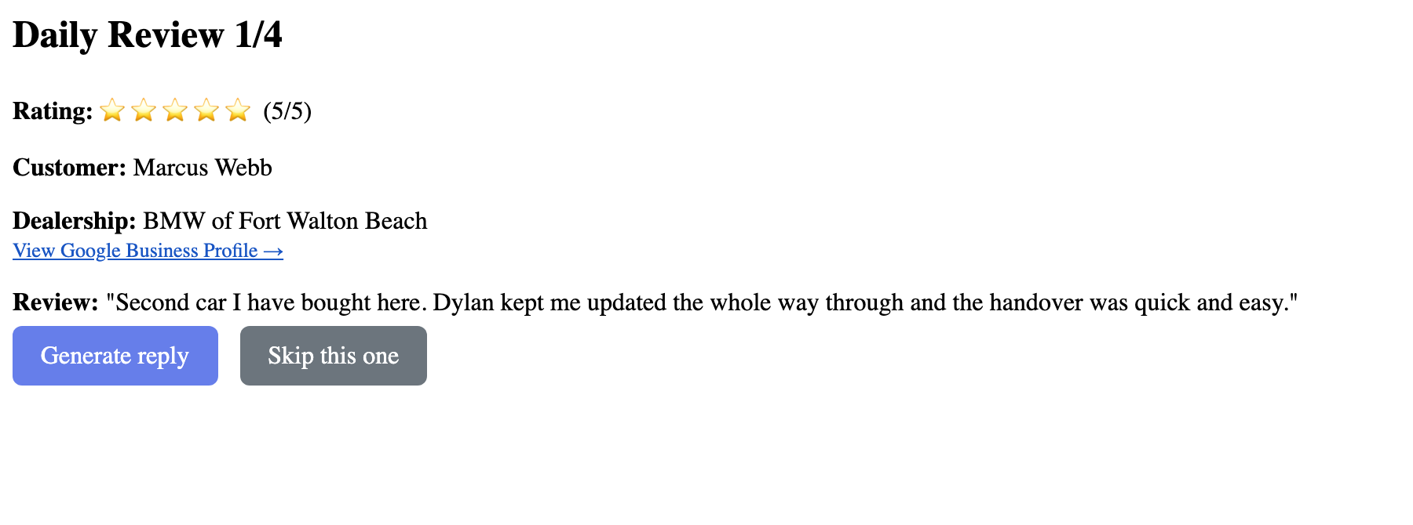
Step 9
Skip a Review if Needed
If a review requires additional checking or should not be processed yet, select Skip so it can be handled later.
9 of 15
BMW of Fort Walton Beach Responder Tool
Notes:
Screenshot taken from the live system on 2026-09-28 (09-skip-option.png).

Slide 11
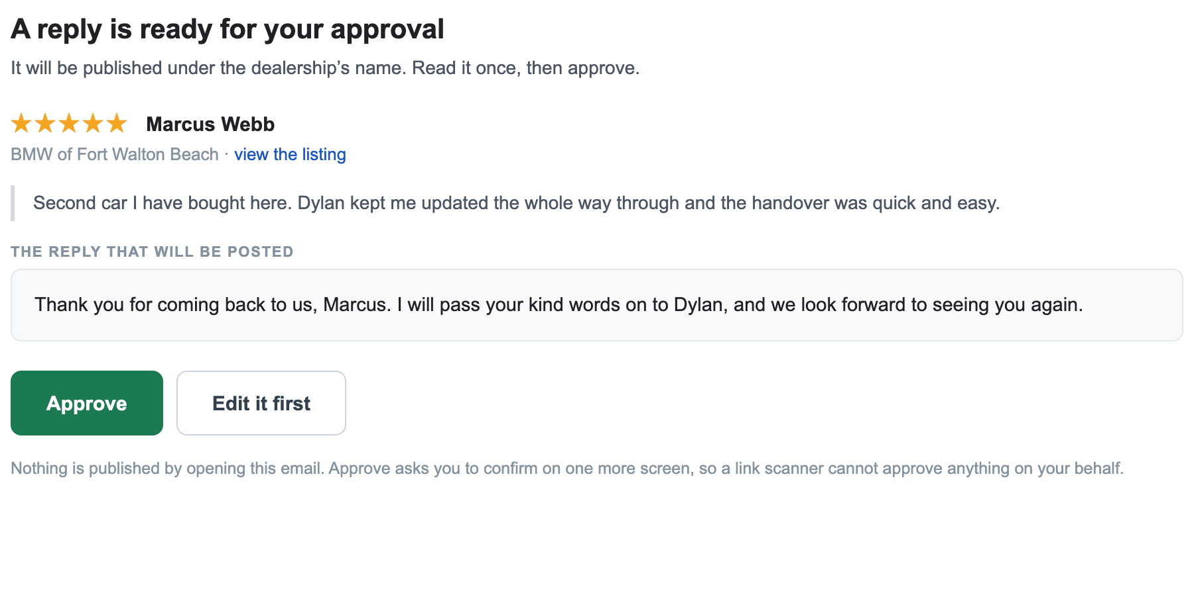
Step 10
Check the Email Notification
When a new review is detected, the designated email account will receive a notification containing the relevant review and responder information.
10 of 15
BMW of Fort Walton Beach Responder Tool
Notes:
Screenshot taken from the live system on 2026-09-28 (10-email-notification.png).

Slide 12
Step 11
Open the Review Email
Open the notification email and review the customer information, star rating, original review, and generated response provided in the notification.
11 of 15
BMW of Fort Walton Beach Responder Tool
Notes:
Screenshot taken from the live system on 2026-09-28 (11-email-opened.png).

Slide 13
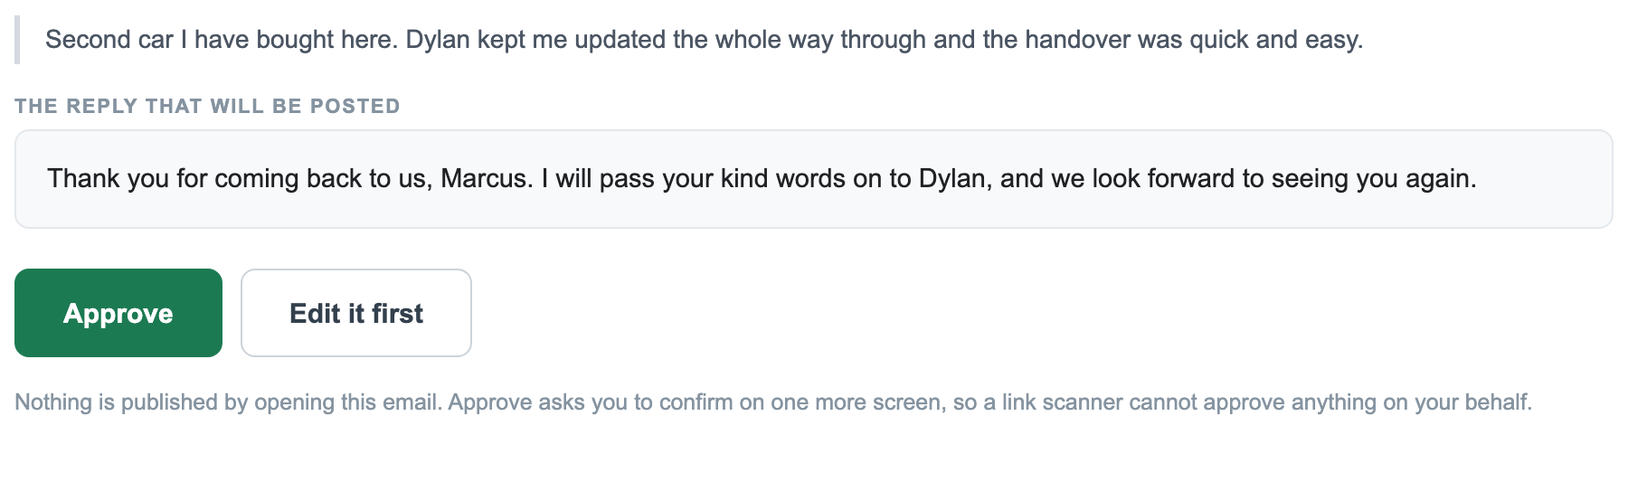
Step 12
Use the Email Action
Follow the action or button provided in the email to access the responder workflow and continue reviewing the customer response.
12 of 15
BMW of Fort Walton Beach Responder Tool
Notes:
Screenshot taken from the live system on 2026-09-28 (12-email-action.png).

Slide 14
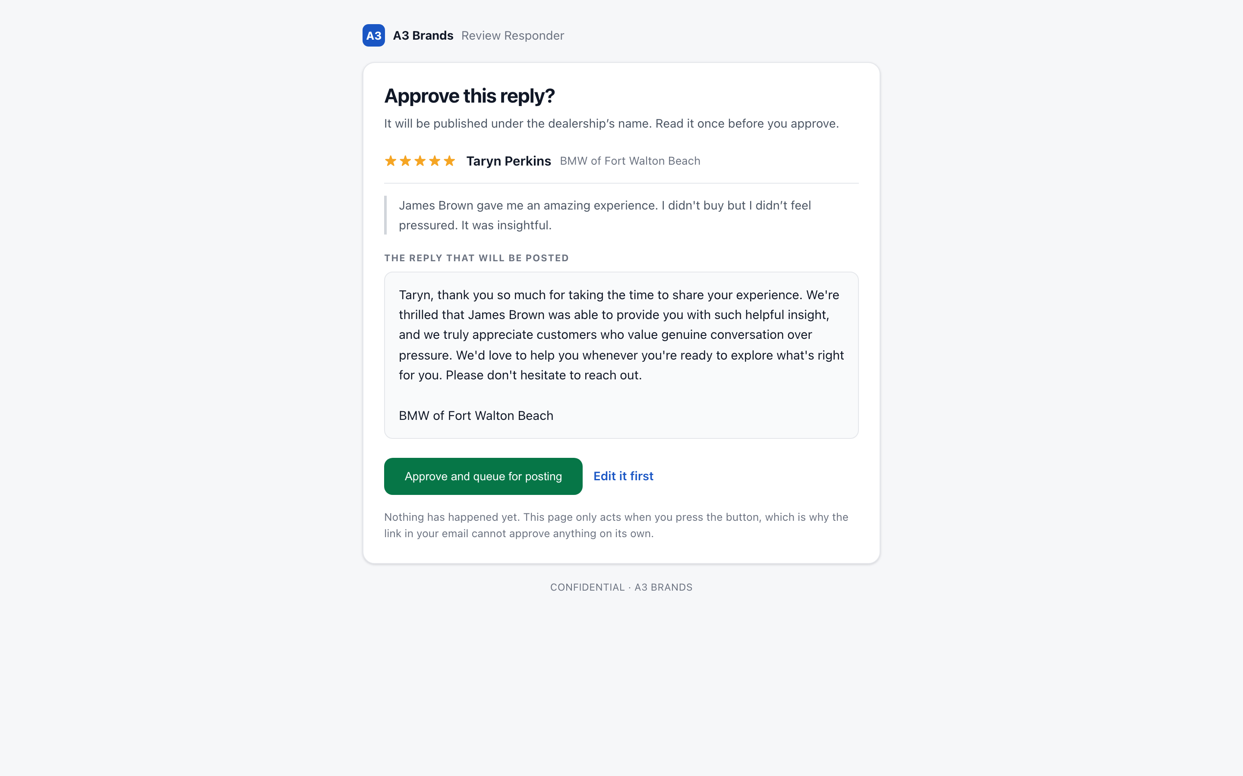
Step 13
Review the Response Again
After opening the responder workflow from the email, verify that the response accurately reflects the customer's feedback before taking any final action.
13 of 15
BMW of Fort Walton Beach Responder Tool
Notes:
Screenshot taken from the live system on 2026-09-28 (13-response-review.png).

Slide 15
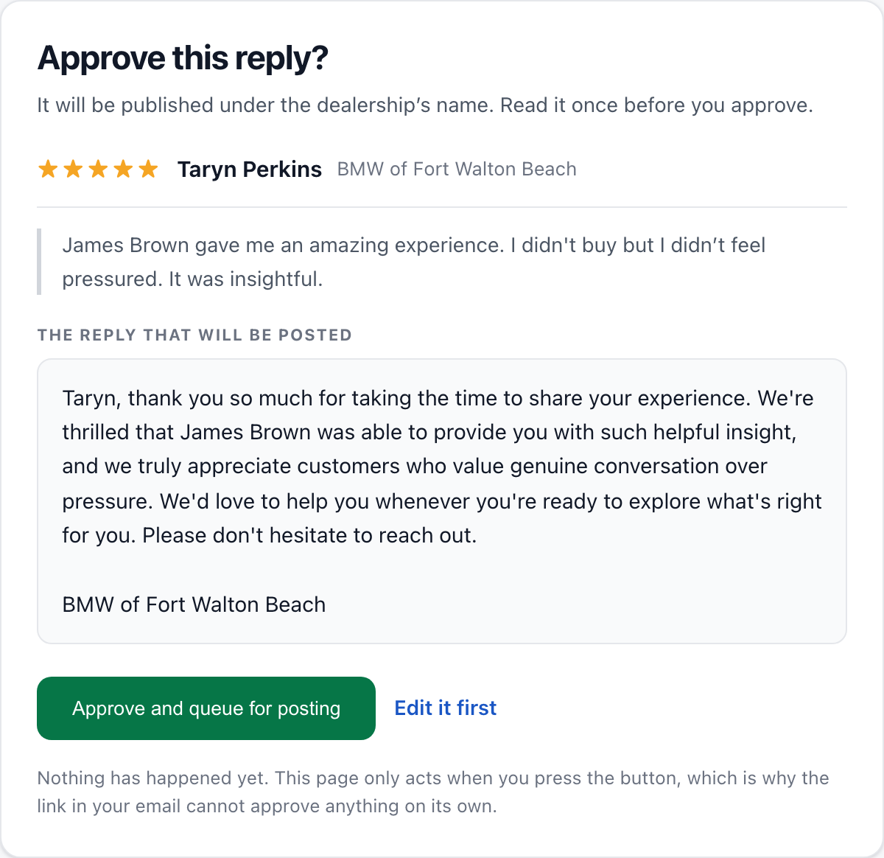
Step 14
Approve or Skip
If the response is correct, select Approve, or select Skip if the review needs additional attention before it can be processed.
14 of 15
BMW of Fort Walton Beach Responder Tool
Notes:
Screenshot taken from the live system on 2026-09-28 (14-approve-or-skip.png).

Slide 16
Step 15
Confirm the Review Was Processed
Return to the dashboard and verify that the review has been updated to the appropriate status after the action has been completed.
15 of 15
BMW of Fort Walton Beach Responder Tool
Notes:
Screenshot taken from the live system on 2026-09-28 (15-confirm-status.png).

Slide 17
Complete workflow
1
New Google review
2
Review collected
3
Response generated
4
Email notification
5
Open email
6
Review response
7
Edit if needed
8
Approve or skip
9
Confirm status
Important
Always review the customer's original feedback and the generated response before approving it, and make sure the final response is accurate, professional, and appropriate for BMW of Fort Walton Beach.

