Slide 1
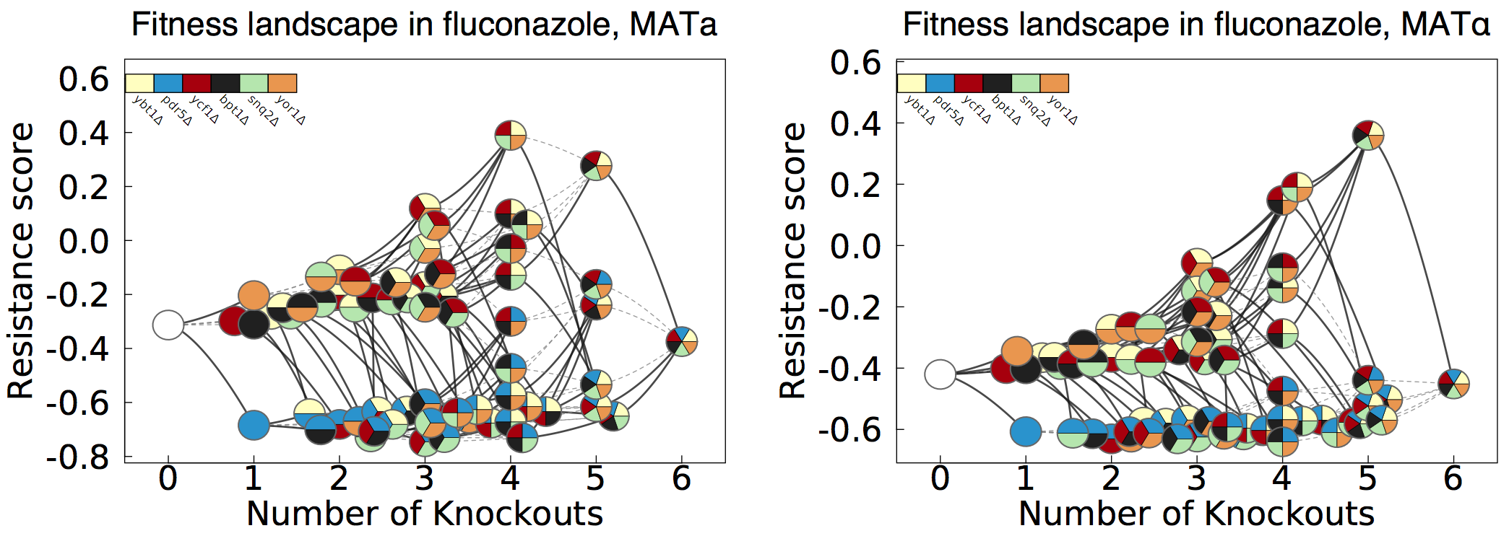
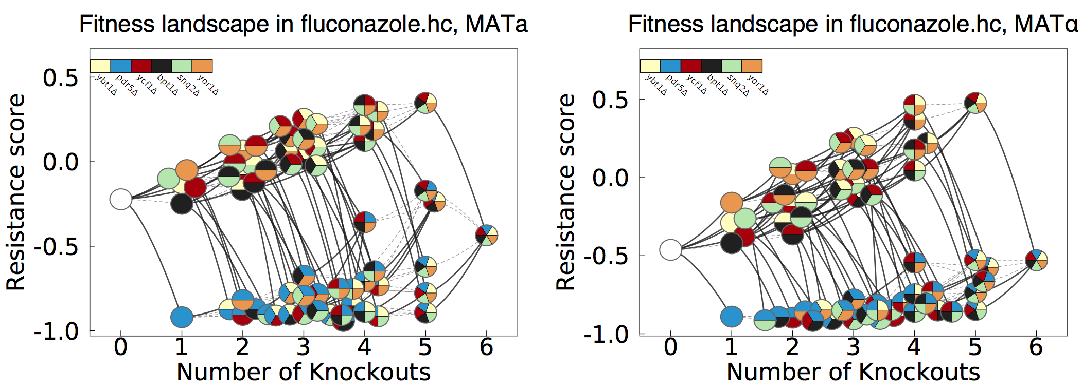
Comparing Nov. 2014 vs May 2017 (high complexity) results for fluconazole
Nov 2014
May 2017
-Roles for SNQ2, YBT1, YCF1, YOR1 preserved, but different overall dynamics
-Competition pressure may be different as strains are more consistently kept in log phase
-Potential new role for BPT1 as well

Slide 2
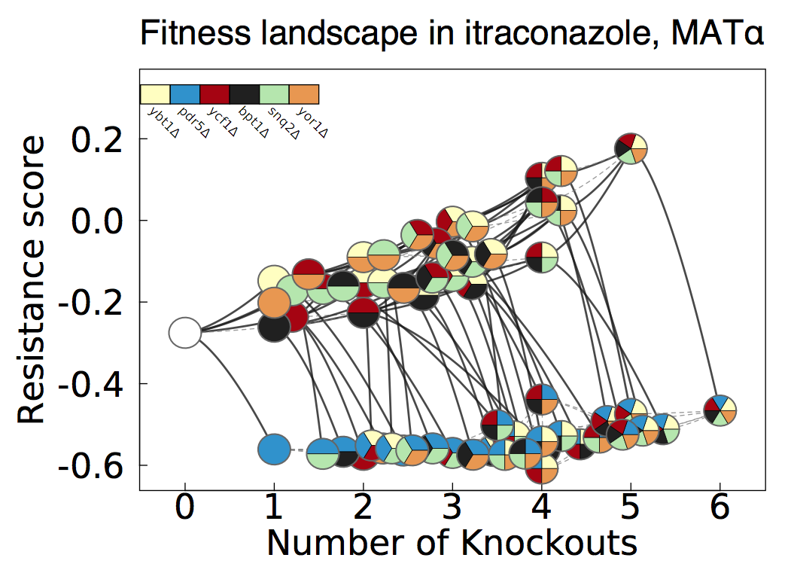
May 2017 results mimic Nov 2014 results for Itraconazole
Nov 2014,
itraconazole
May 2017
-For drugs of similar mode-of-action, batch may affect results

Slide 3
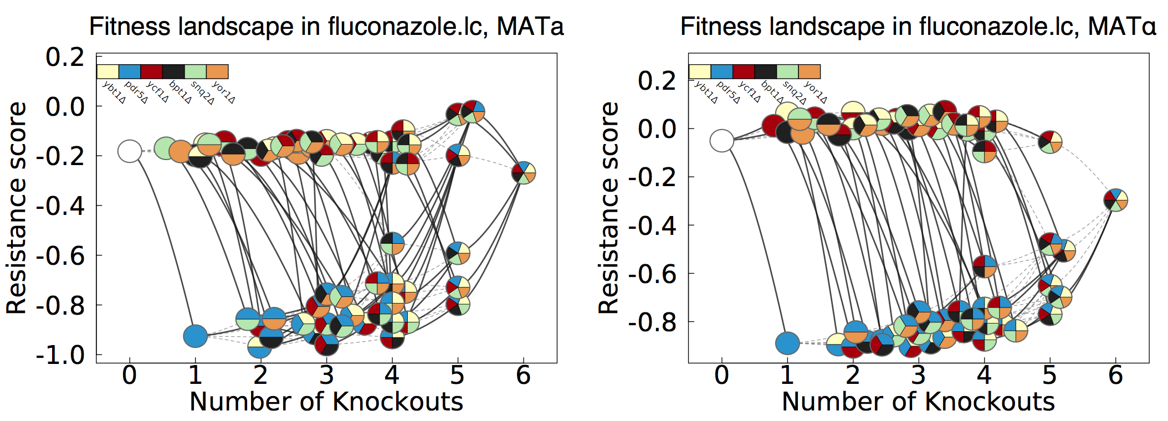
Decreasing pool complexity greatly affects the results
May 2017,
low
complexity
-At 200 cells per genotype, the compensatory activation phenomenon is not observed

Slide 4
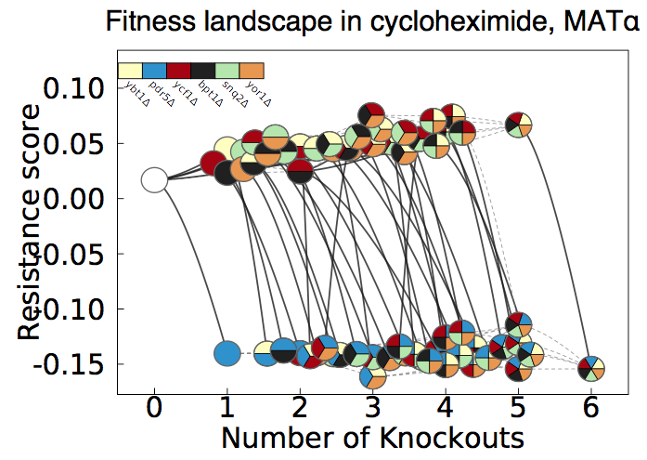
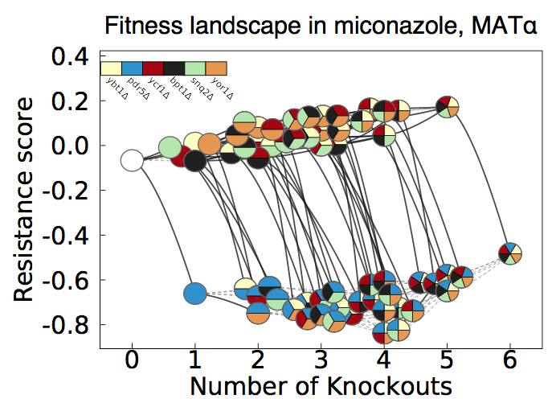
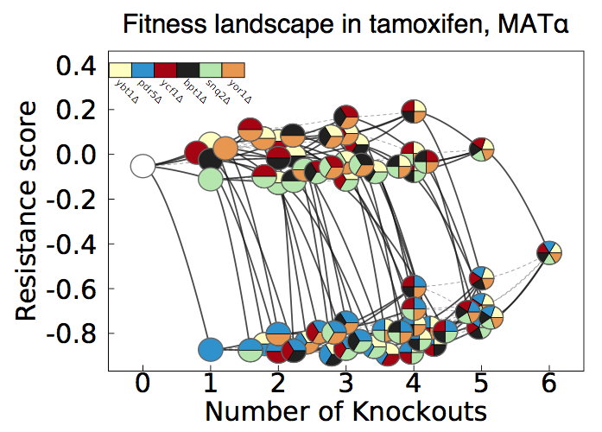
In previous data, this lack of compensatory activation was seen for several Pdr5 substrates
-Re-doing PDR5 substrates as well as R6G will determine if compensatory activation is compound-specific

