Slide 1
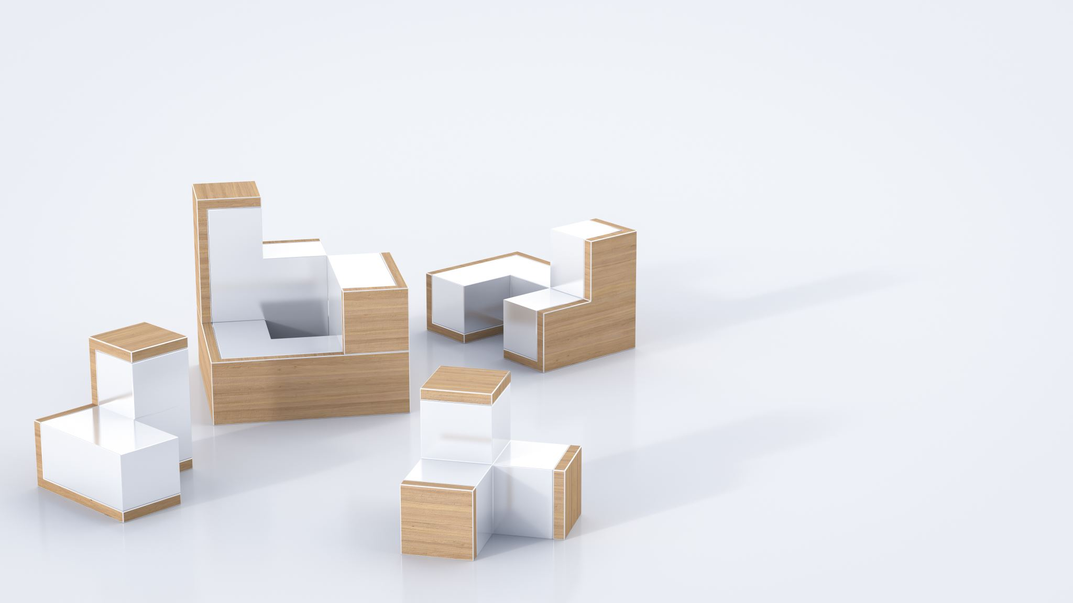
Templates for 3D Object Pose Estimation Revisited:
Generalization to New Objects and Robustness to Occlusions

Slide 2
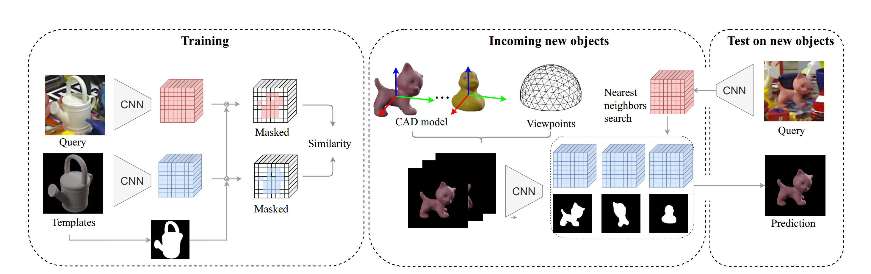
Complete Proposed Process
Poses are extracted by matching an image to a large dataset of templates allowing masking of tested images
Resulting template matches are then scored for similarity to the initial image allowing for more precise pose estimation
Proposal aims to have a model which can be trained fast yet still work with occlusions and on objects with very different geometry

Slide 3
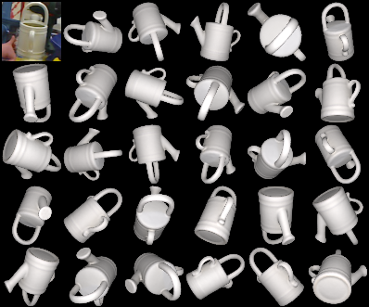
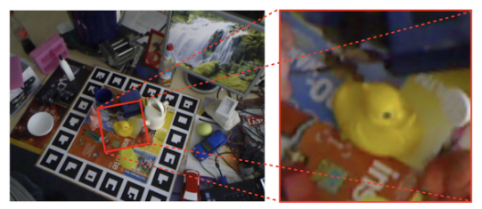
The Problem of 6D pose
Goal is to find the pose of a specific object just based on the RGB image and corresponding CAD model
Images are taken from a much larger cluttered image, and the CAD model is used to create a set of templates with known poses
Templates are extracted following the guidelines provided by the respective dataset, and images are cropped to a uniform size

Slide 4
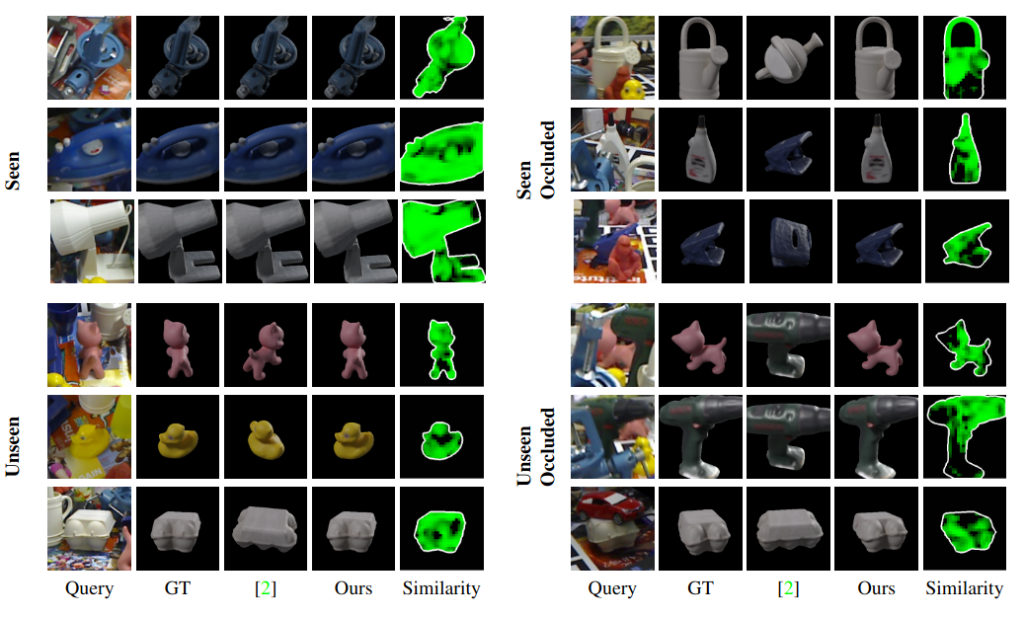
Improvements and Goal
Train a model to recognize local features instead of global features unlike predecessors
This change will allow the model to work even on unseen images and corresponding templates
The resulting model will also be more robust to occlusions and cluttered background

Slide 5
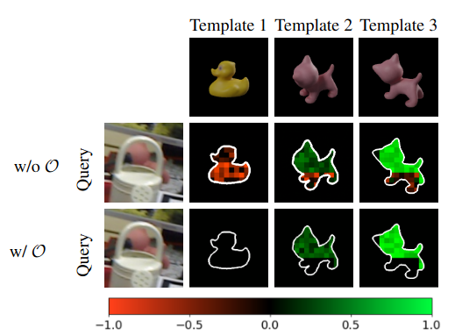
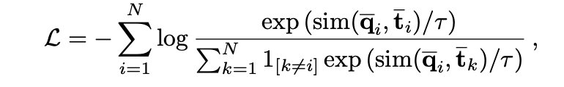

Method (Loss Function and Similarity)
InfoNCE loss function takes into account positive and negative pairs, and adds a temperature parameter (0.1)
Similarity function is modified from cosine similarity to include a template mask and occlusion mask
Template mask is used to remove the background and occlusion mask is used to get rid of large areas where the image is dissimilar

Slide 6

Experimental - Setup
LINEMOD (LM) & Occlusion-LINEMOD (O-LM):
3 Splits for generalization testing:
Split #1: Unseen = Ape, Benchvise, Camera, Can
Split #2: Unseen = Cat, Driller, Duck, Eggbox
Split #3: Unseen = Glue, Holepuncher, Iron, Lamp, Phone
Templates: 301 per object
Metric: Acc15 (correct object + pose error < 15°)
T-LESS:
Training: Objects 1-18
Testing: All 30 objects (including unseen 19-30)
Templates: 92,232 (dense) or 21,672 (coarse) per object
Metric: Recall at VSD < 0.3

Slide 7
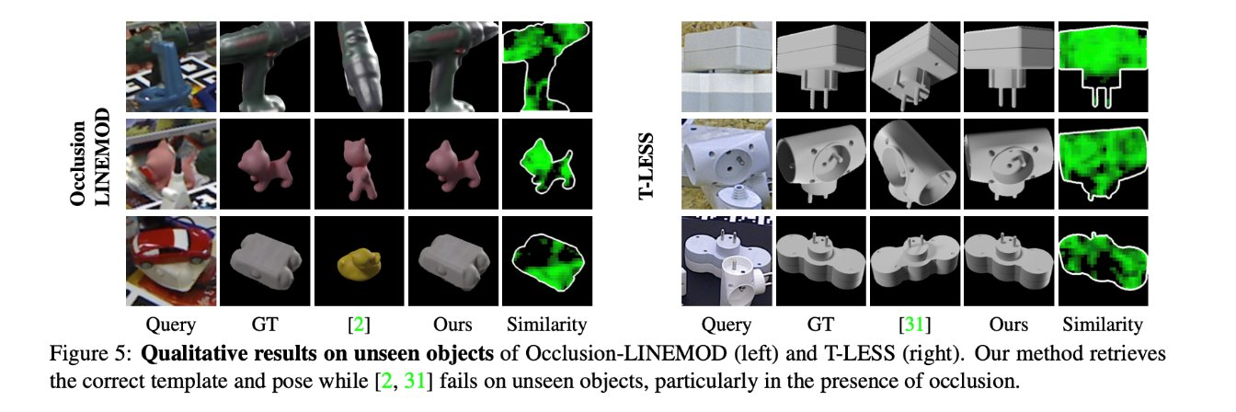
Qualitative Results

Slide 8
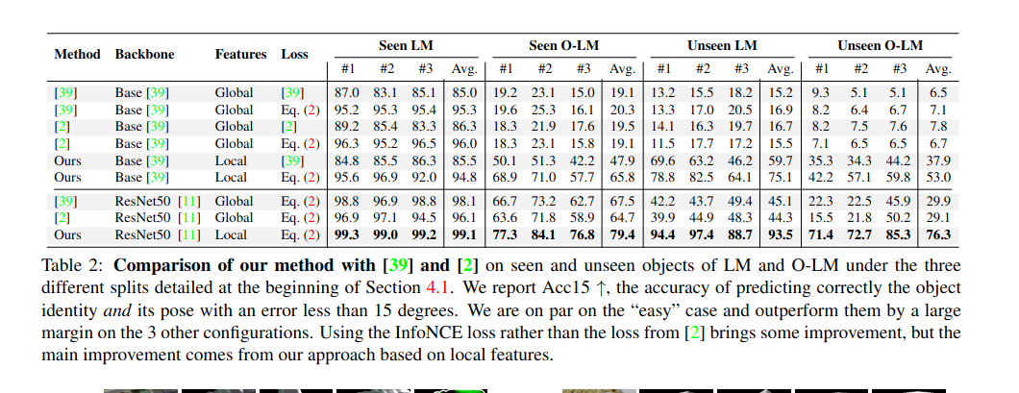
Quantitative Results

Slide 9
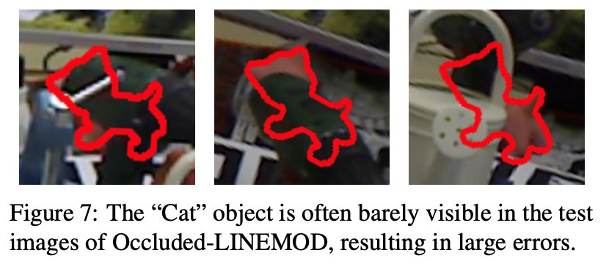
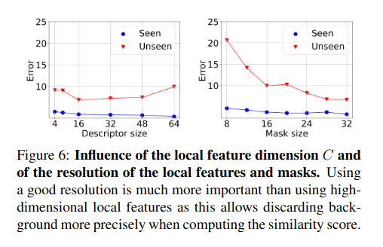
Limitations/Possible Improvements
Extremely heavy occlusions remain challenging as seen above
Above outline is not an output of the paper

Slide 10
Demo

