Slide 1
Sprint 1 presentation
Cookyourself
wennad yulunt yunpengx --Team 205

Slide 2
Agenda
Background
Our goals
Sprint 1 Tasks & Roles
Sprint 1 Demo & Problems
Next Sprint’s goal
Q & A

Slide 3
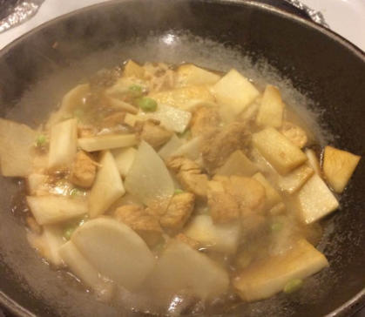
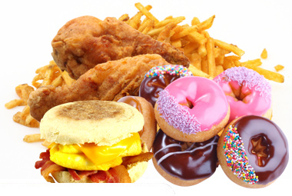
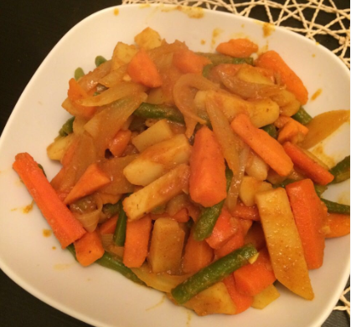
Background
Where does the idea come from?
OR
Notes:
The project idea “meal exchange” comes from our study experience in CMU.
Many students would like to prepare several days’ or even a week’s food from one-time cook since they want to save more time for their study. But as time goes by, meals would not be that good as before.
If these students can exchange their prepared meals with other students, they can all eat different, fresh, delicious food every day!
Meal exchange, an idea to share, try different food and make new friends, comes into our minds.

Slide 4
Goals of our website
All you need about cooking!
Learning..
Recipe and instructions in text or video
Sharing..
Recipe, experiences, opinions
Recommendation..
Weekly cooking plan or “lucky” search
Even exchanging and shopping!

Slide 5
Sprint 1 Goals
Complete all static page templates
Home, dish, shopping list, user cooking history,
recommendation…
UI compatibility in cellphone, tablet and PC
Study related APIs usage
Google map, YouTube Videos, Beautiful Soup (web
content crawler)
Notes:
Good user experience on different platforms

Slide 6
Tasks & Roles
10/27 | 10/28 | 10/29 | 10/30 | 10/31 | 11/01 | 11/02 | 11/03 | 11/04 | 11/05 | 11/06 | 11/07
Task1: Base.html & CSS & Main page - Yunpeng
Task2: Scrapy/beautiful soup/youtube API - Yulun
Task3: HTML Geolocation & Google map API - Wenna
Task4: Profile & Comments - Yunpeng
Task5: Recommendation page & Shopping list - Yulun
Task6: Dish page & Google map - Wenna
Task7: Integration & Presentation preparation - All
Sprint 1 Backlog

Slide 7
Sprint 1 Demo
http://54.203.8.161/

Slide 8
Sprint 1 Problems & Difficulties
Choose to finish dish sharing page later, together with implementation.
Google Map display and getting location need more secure protocol like https.
Not completely realize UI compatibility: Phone version need to be improved.

Slide 9
Next Sprint --Goals
Improve phone version websites and pages’ consistency.
Implement all server-side features using Django.
Implement client-side interaction using React.js.
Most important: get real data, parse and display.

Slide 10
Sprint 2--Tasks
Task | Costs
crawler to gather price information of ingredient | 24 mhors
parser to extract units of ingredient and complete unit conversion | 24 mhors
revise responsiveness of web on mobile phone and consistency among pages | 24 mhors
study React.js | 8 mhours
Django navigation and database interaction | 8 mhours
AWS S3 Database setting | 8 mhours
image preprocessing with js | 16 mhours
FB login api Oauth | 8 mhours
Integration and Presentation preparation | 8 mhours

Slide 11

Comments & Questions

