Slide 1
Genre Classification and Sentiment Analysis of Game Reviews
Asad Kothawala
B00825551

Slide 2
Introduction
The video game industry is one of the fastest growing industries in the world.
Lots of games are reviewed and advertised online. This makes lots of data available.
Goal is to perform Sentiment Analysis and Multi-Label Classification on Steam Review Data.

Slide 3
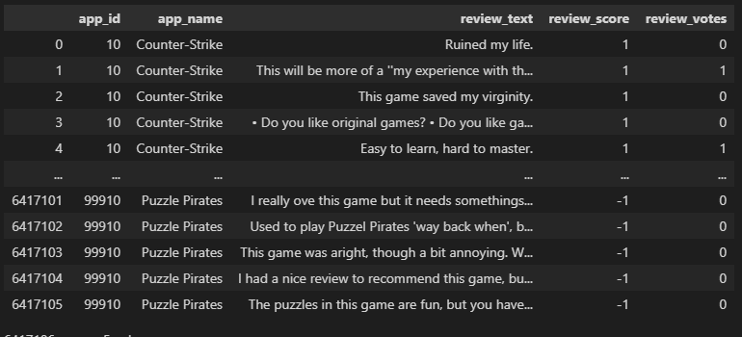
Datasets
Steam Python API no longer working
The first dataset contains over 6.4 million reviews however it has only 5 columns (including whether others found a review helpful).
Supplementary dataset containing Steam games and genre information was used to label the reviews.

Slide 4
Data Preparation
Merged review dataset and games list to create a labelled dataset.
Removed null fields.
For sentiment analysis I took the top ten games of the genres I am interested in.
For Multilabel Classification I took random sample from the more helpful reviews.

Slide 5
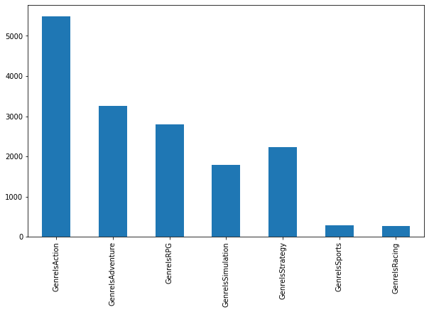
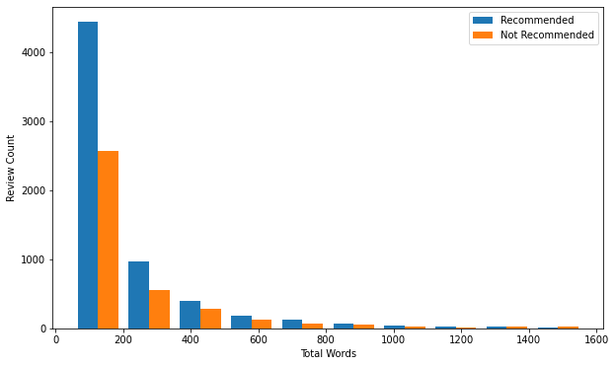
Data Exploration

Slide 6
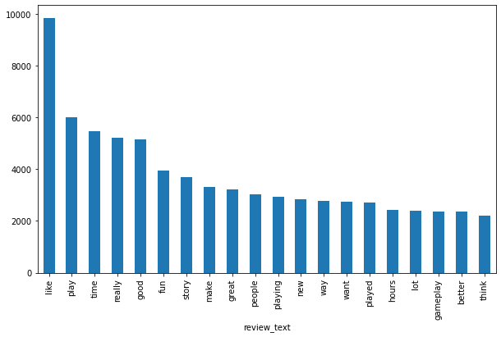
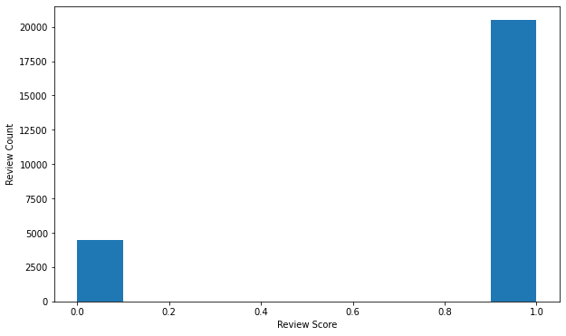
Data Exploration

Slide 7
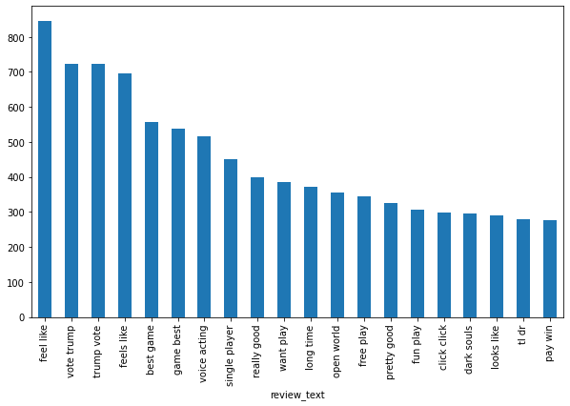
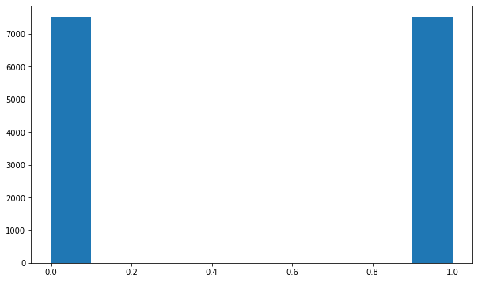
Data Exploration

Slide 8
Proposed Techniques
LSTM
SVM
Word Embeddings
GloVe
Word2Vec
TF-IDF

Slide 9
Evaluation Metrics
Accuracy
Hamming Loss
Precision, Recall, F1-score

Slide 10
Part A: Multi-Label Genre Classification

Slide 11
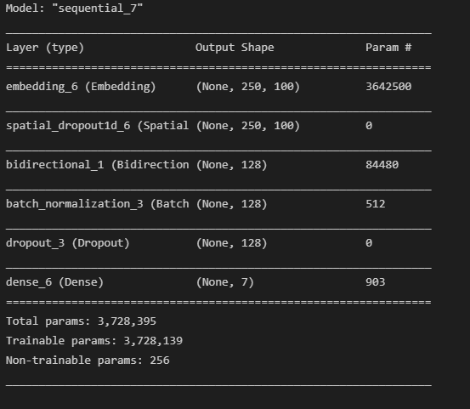
Bidirectional LSTM (Base)
Applied preprocessing pipeline and sequenced data for LSTM.
Bidirectional
SpatialDropout1D Layer

Slide 12
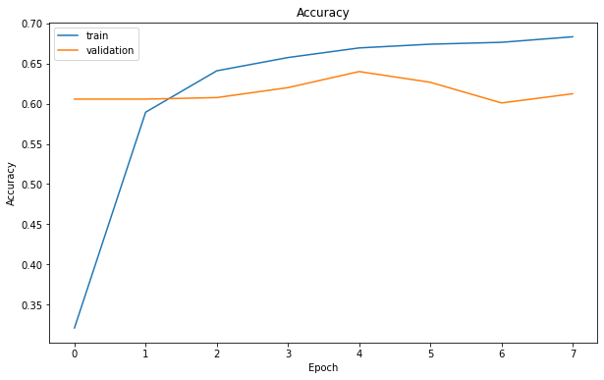
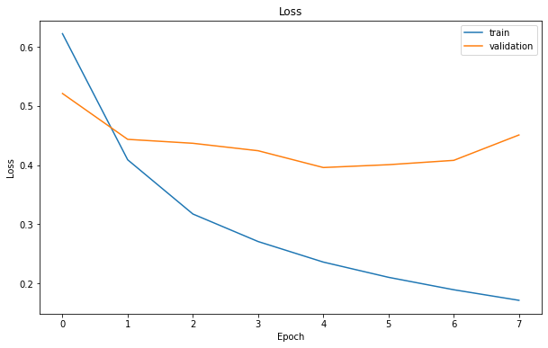
Bidirectional LSTM (Base)

Slide 13
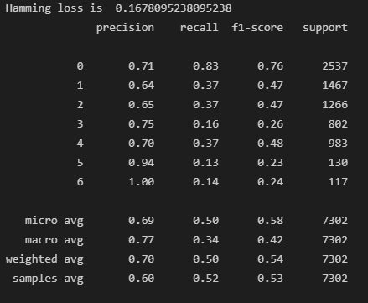
Bidirectional LSTM (Base)

Slide 14
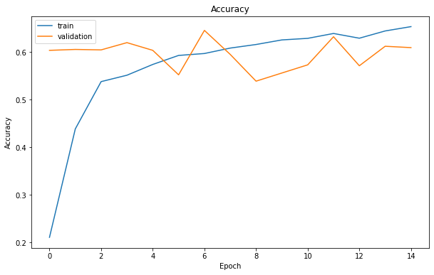
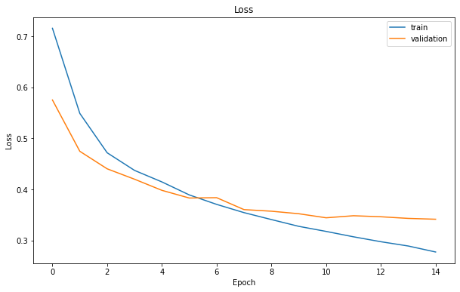
Bidirectional LSTM (GloVe)

Slide 15
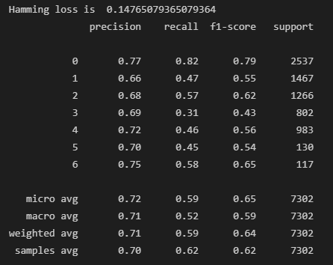
Bidirectional LSTM (GloVe)

Slide 16
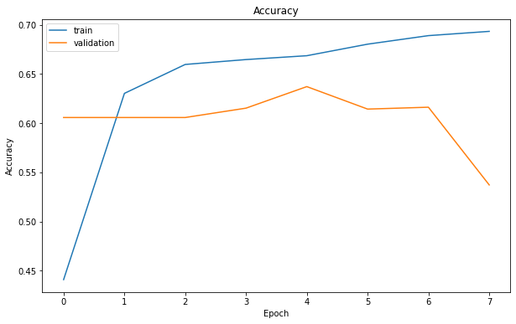
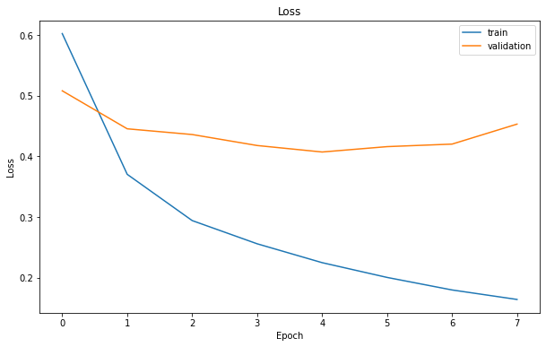
Bidirectional LSTM (Word2Vec)

Slide 17
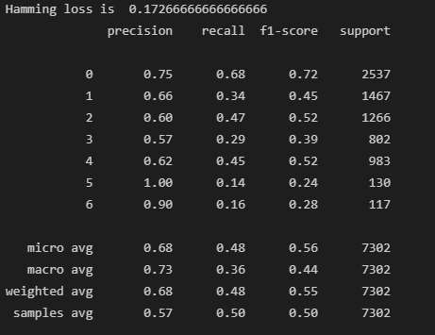
Bidirectional LSTM (Word2Vec)

Slide 18
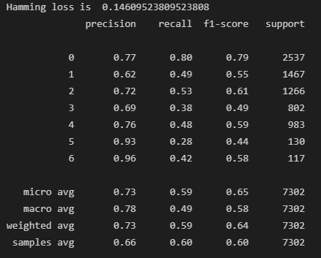
Support Vector Machine (TF-IDF)
LinearSVC
OneVsRestClassifier

Slide 19
Part B: Sentiment Analysis

Slide 20
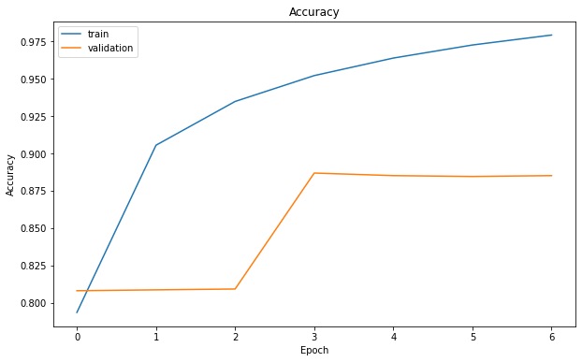
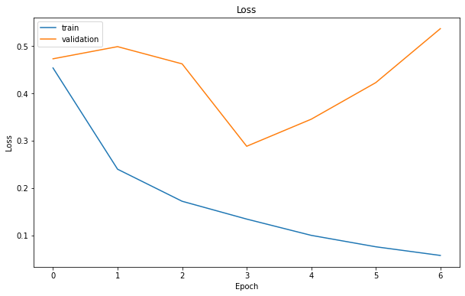
Bidirectional LSTM (Base)

Slide 21
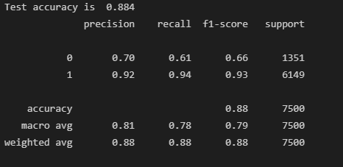
Bidirectional LSTM (Base)

Slide 22
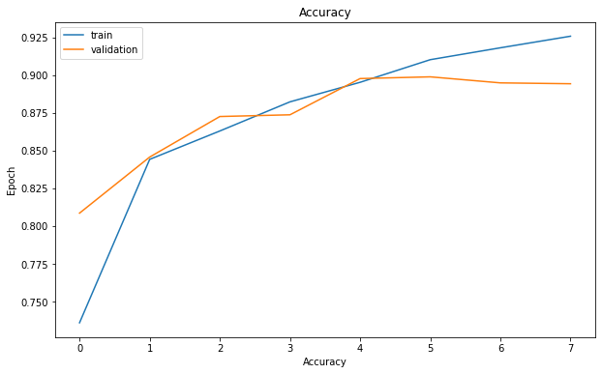
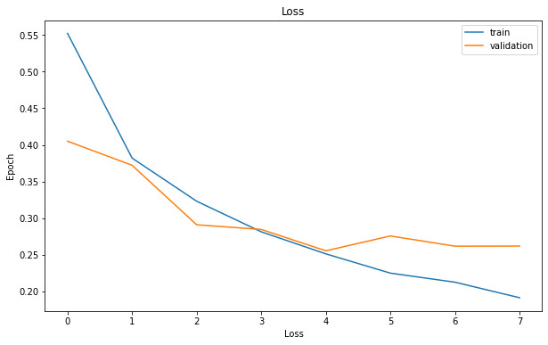
Bidirectional LSTM (GloVe)

Slide 23
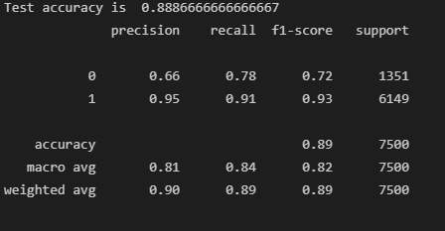
Bidirectional LSTM (GloVe)

Slide 24
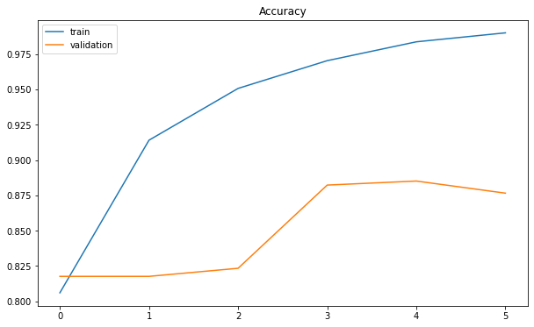
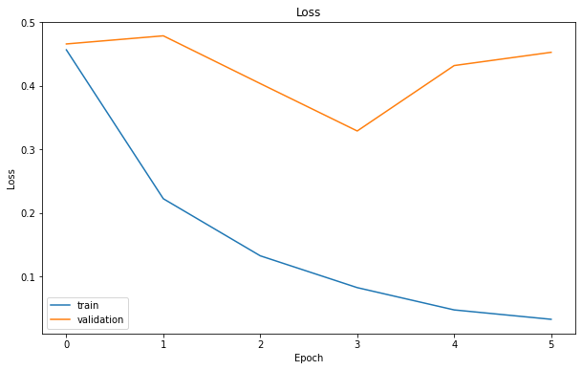
Bidirectional LSTM (Word2Vec)

Slide 25
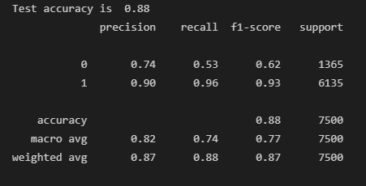
Bidirectional LSTM (Word2Vec)

Slide 26
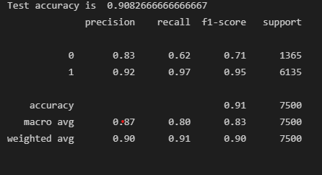
Support Vector Machine (TF-IDF)

Slide 27
Conclusion
Although limited in scope, Multilabel model shows similar performance to similar work. This is, however, not very good.
On the other hand, all variants performed sentiment classification of reviews quite well.

Slide 28

Thank you!

