Slide 1

201X
BUSINESS PLAN
公司网络项目
The user can demonstrate on a projector or computer, or print the presentation and make it into a film to be used in a wider field. Using PowerPoint

Slide 2
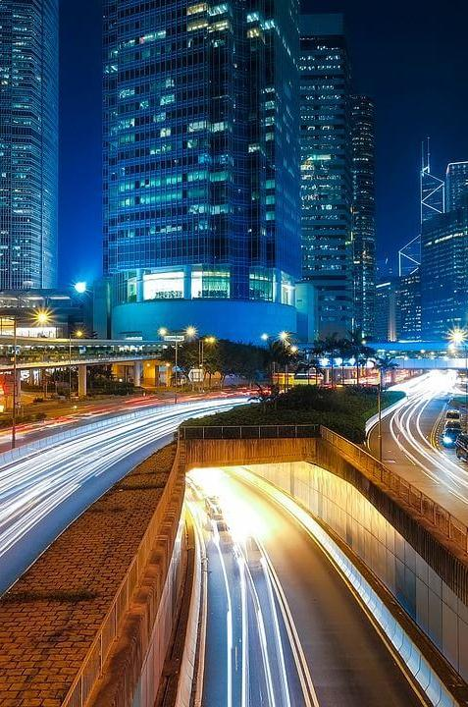
CONTENT
1
项目需求
2
人员分工
3
配置概况
4
缺点与不足

Slide 3
PART 01
项目需求
The user can demonstrate on a projector or computer, or print the presentation and make it into a film to be used in a wider field.

Slide 4





项目需求
The user can demonstrate on a projector or computer
通过网络运行商接入Internet
实现所有办公人员访问Internet网络，除了财务部。财务部不允许与其他部门互访
内部网络使用私有IP地址
所有网络设备可进行远程管理
公司总部与分支结构可通过Internet安全的通信
企业管理类：OA
交流沟通类：门户网站，EMAIL
视频音频类：视频会议

Slide 5
PART 02
人员分工
The user can demonstrate on a projector or computer, or print the presentation and make it into a film to be used in a wider field.

Slide 6




任务集合
The user can demonstrate on a projector or computer
虚拟项目配置
实体机项目配置
实施文档
PPT制作
The user can demonstrate on a projector or computer, or print the presentation and make it into a film to be used in a wider field. Using PowerPoint,
The user can demonstrate on a projector or computer, or print the presentation and make it into a film to be used in a wider field. Using PowerPoint,
The user can demonstrate on a projector or computer, or print the presentation and make it into a film to be used in a wider field. Using PowerPoint,
The user can demonstrate on a projector or computer, or print the presentation and make it into a film to be used in a wider field. Using PowerPoint,

Slide 7
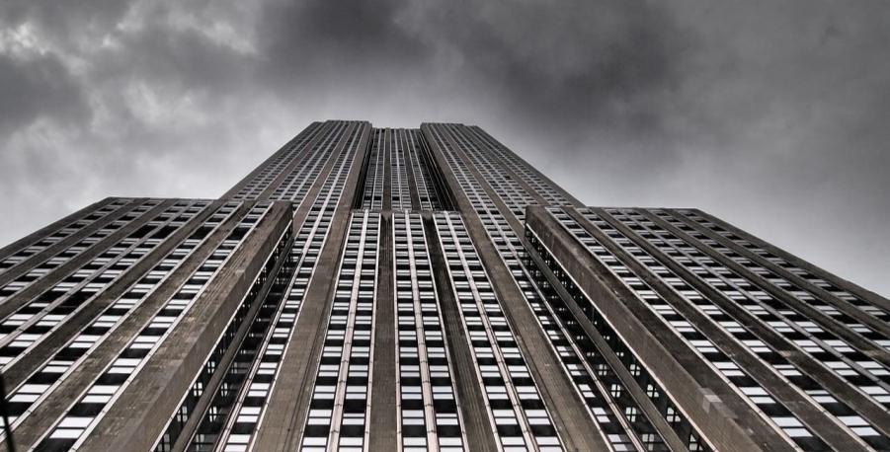
人员分工
The user can demonstrate on a projector or computer
汇报人：陈天宇（组长）
虚拟项目配置：
陈天宇、蔡少平、许嘉威、曾佳炜
实体机项目配置：
陈天宇、蔡少平、许嘉威
实施文档及测试文档：
郑晓栋、杨佳梁、陈天宇、蔡少平、许嘉威、曾佳炜
PPT制作：
许嘉威

Slide 8
PART 03
配置概况
The user can demonstrate on a projector or computer, or print the presentation and make it into a film to be used in a wider field.

Slide 9
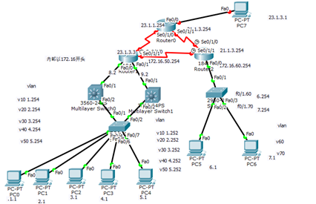
实施拓扑图
The user can demonstrate on a projector or computer
The user can demonstrate on a projector or computer, or print the presentation and make it into a film to be used in a wider field. Using PowerPoint, The user can demonstrate on a projector or computer, or print the presentation and make it into a film to be used in a wider field. Using PowerPoint, The user can demonstrate on a projector or computer, or print the presentation and make it into a film to be used in a wider field. Using PowerPoint,

Slide 10
实现步骤
1.网络拓扑结构的建立
构建拓扑图的三层结构
① 核心层② 汇聚层③ 接入层
2.IP地址规划
3.VLAN划分及VTP管理
4.生成树协议及热备份配置
5. 内部路由器之间使用RIP协议与PPP协议相连，内部路由器通过NAT转换的方式把内部IP转换成外部IP与外网连接
6.配置访问财务部控制列表
The user can demonstrate on a projector or computer

Slide 11

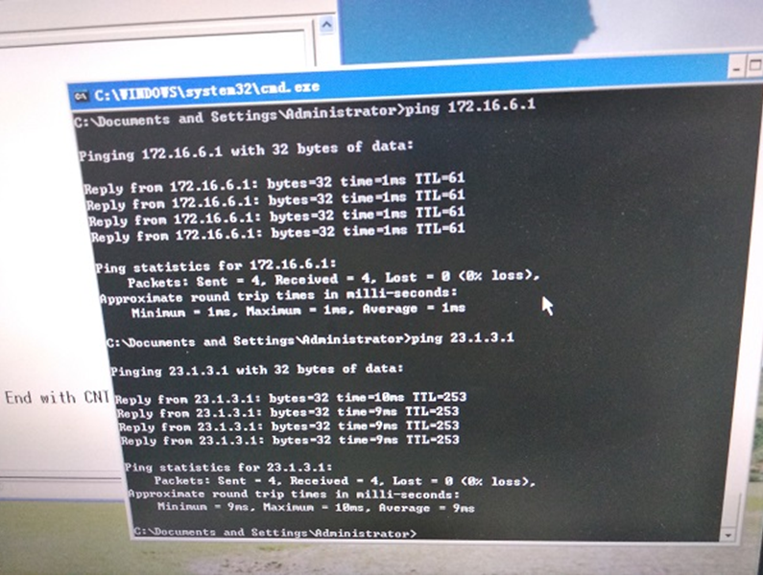
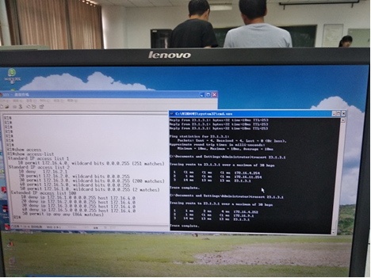
最终测试结果
The user can demonstrate on a projector or computer
通过对设备连通性、Nat转换功能、VLAN跟踪、业务部权限测试结果，基本实现了相关需求

Slide 12
PART 04
缺点与不足
The user can demonstrate on a projector or computer, or print the presentation and make it into a film to be used in a wider field.

Slide 13
缺点与不足
The user can demonstrate on a projector or computer
项目准备
技术水平
时间紧张
任务分配不均衡
The user can demonstrate on a projector or computer, or print the presentation and make it into
The user can demonstrate on a projector or computer, or print the presentation and make it into
The user can demonstrate on a projector or computer, or print the presentation and make it into
The user can demonstrate on a projector or computer, or print the presentation and make it into
The user can demonstrate on a projector or computer, or print the presentation and make it into a film to be used in a wider field. Using PowerPoint, The user can demonstrate on a projector or computer, or print the presentation and make it into a film to be used in a wider field. Using PowerPoint, The user can demonstrate on a projector or computer, or print the presentation and make it into a film to be used in a wider field. Using PowerPoint,
PPT模板下载：www.1ppt.com/moban/ 行业PPT模板：www.1ppt.com/hangye/
节日PPT模板：www.1ppt.com/jieri/ PPT素材下载：www.1ppt.com/sucai/
PPT背景图片：www.1ppt.com/beijing/ PPT图表下载：www.1ppt.com/tubiao/
优秀PPT下载：www.1ppt.com/xiazai/ PPT教程： www.1ppt.com/powerpoint/
Word教程： www.1ppt.com/word/ Excel教程：www.1ppt.com/excel/
资料下载：www.1ppt.com/ziliao/ PPT课件下载：www.1ppt.com/kejian/
范文下载：www.1ppt.com/fanwen/ 试卷下载：www.1ppt.com/shiti/
教案下载：www.1ppt.com/jiaoan/
字体下载：www.1ppt.com/ziti/

Slide 14
项目准备
在项目开始之前，没有提前预习好相关内容。特别是没有提前对模拟式上进行相关的项目配置，导致项目开始的第一天整天都在模拟器上进行
技术水平
本小组在网络方向总体平均水平不够，导致相关配置过程中错误过多，效率低下
时间紧张
本次实训与校数学建模比赛冲突，组内有多人参与比赛，导致两方面都需要顾及，无法专心和投入全部时间在实训之上
任务分配不均衡
任务分配不合理，导致有的组员工作量过大，有的组员任务过少

Slide 15
无论
感谢
老师的指导
组外同学的帮助
组内同学的共同努力
2018
THANKS

