Slide 1
The “assessment for all” Initiative (a4a)
Ernesto Jardim*
Colin Millar
Iago Mosqueira
Chato Osio
Finlay Scott
JRC
Unit of Maritime Affairs
Fishreg
* ernesto.jardim@jrc.ec.europa.eu

Slide 2
Long term vision
a4a Init
To have a group of standard methods that can be applied rapidly to a large number of stocks, without requiring a strong statistical technical background, but making use of the technical knowledge on the fisheries, stocks and ecosystem characteristics.

Slide 3
Why
a4a Init
Increasing demand for marine fish abundance and exploitation estimates.
Large investments being made in collecting information.
Increasing will to rely on scientific advice for fisheries management.

Slide 4
Setting the scene in Europe
a4a Init
Biological parameters (growth & reproduction) are being collected for 300+ stocks in waters where European fleets operate.
The DCF reports make it difficult to evaluate the number of species being sampled, but it should be hundreds.
DCF & Advice budget 2007-2013 is ~360m€^{(*)}
(*) SEC(2011) 1417 final (**) 2008/949/EC, Annex, Chapter I, 1.b

Slide 5

e.g. PT sampled species (lenghts)
a4a Init

Slide 6
Setting the scene worldwide
a4a Init
US law requires all federal fisheries to come up with annual catch limits, including appropriate buffers to account for scientific and management uncertainties.

Slide 7
However ...
a4a Init
Beddington et.al (2007) show that intermediate data stocks that are not being assessed make up for 30% in the USA, 78% in New Zealand, 48% in Australia, 61% in the North-East Atlantic.

Slide 8
So what ? (Miles dixit)
a4a Init
What if ~2020 EU fisheries scientists are asked to assess hundreds of stocks, and justify ~1bn€ spent in data collection ?

Slide 9

a4a Init

Slide 10
Solution !?
a4a Init
Standardize and enter automatic mode !!

Slide 11
Solution !?
a4a Init
Estimate what you know,
MSE^{(*)} what you don't !!
(*) Management Strategies Evaluation

Slide 12
Solution !?
a4a Init
Move focus from numerical magic into more interesting subjects, like ecossystem, population or fleet dynamics.

Slide 13
a4a initiative
a4a Init
develop an assessment method targeting stocks that have a reduced knowledge base on biology and moderate time series on exploitation and abundance;
trigger the discussion about the problem of massive stock assessment.
capacity building

Slide 14
a4a methods' workflow
a4a Init
DATA
ASSESSMENT
FORECAST

Slide 15
How ?
a4a Init
Define a moderate data stock (entry level)
Develop a stock assessment framework
Develop a forecasting algorithm based on MSE
Carry out training courses for marine scientists

Slide 16
a4a Init
(1) The “moderate data stock”
Exploitation
    Nominal effort
    Volume (L, D)
    Length frequencies
Biology
    Information based knife edge mat ogive
    Indications for growth model
    Length – weight relationship
Index of abundance

Slide 17
a4a Init
(2) The stock assessment framework
Non-Linear catch-at-age model implemented in R/FLR^{(*)}/ADMB that can be applied rapidly to a wide range of situations with low parametrization requirements
(*) http://flr-project.org

Slide 18
a4a Init
As simple as a linear regression !?
fmodel = separable()
qmodel = trawl(techcreep=0.03)
rmodel = beverton(a=s(NAO))
(*) http://flr-project.org

Slide 19
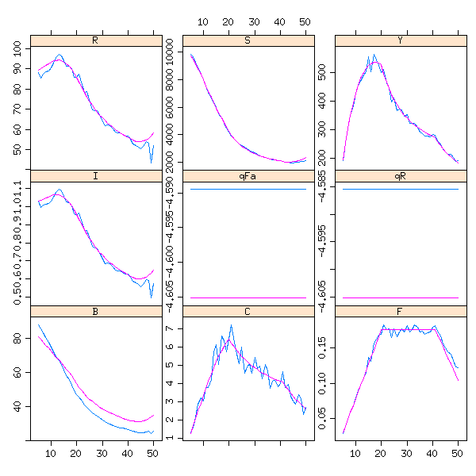
a4a Init
Testing, 1,2 …
WKLIFE stocks
Fishbase stocks^{(*)}
(*) http://fishnet-dev.jrc.it/web/guest/a4a

Slide 20
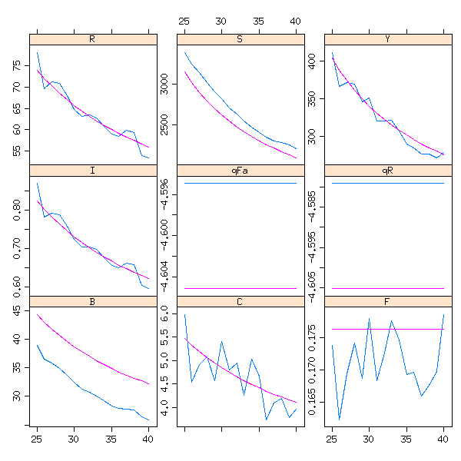
a4a Init
Testing, 1,2 ...

Slide 21
a4a Init
(3) Forecasting (MSE & Co.)
MSE is seen as a sophisticated forecasting algorithm that takes into account structural uncertainty about stock dynamics (growth, recruitment, maturity) and on exploitation by commercial fleets (selectivity), embedding the framework of decision making.

Slide 22
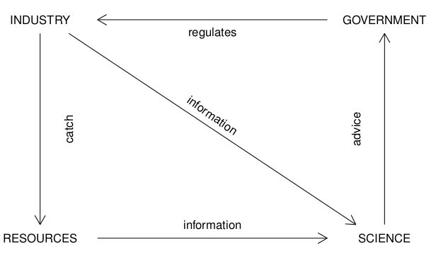
a4a Init
Fisheries Management Cycle

Slide 23
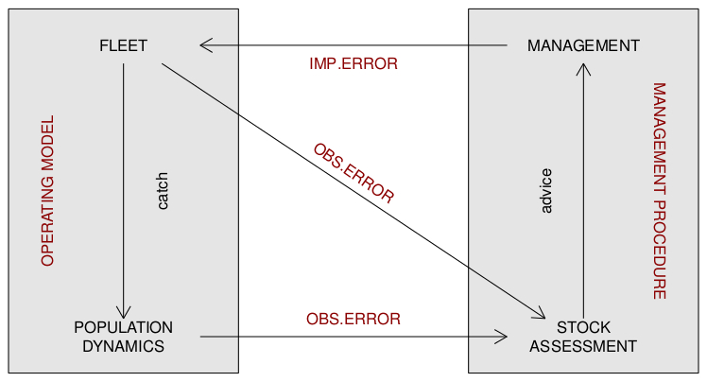
a4a Init
Management Strategies Evaluation (MSE)

Slide 24
a4a Init
Components of a standard MSE
Operating model
natural mortality, growth, S/R, exploitation pattern
Management procedure
indicator to inform HCR, HCR shape
Observation error model
error in catch, error in the abundance index
Implementation error model
error in effective F, overcatch

Slide 25
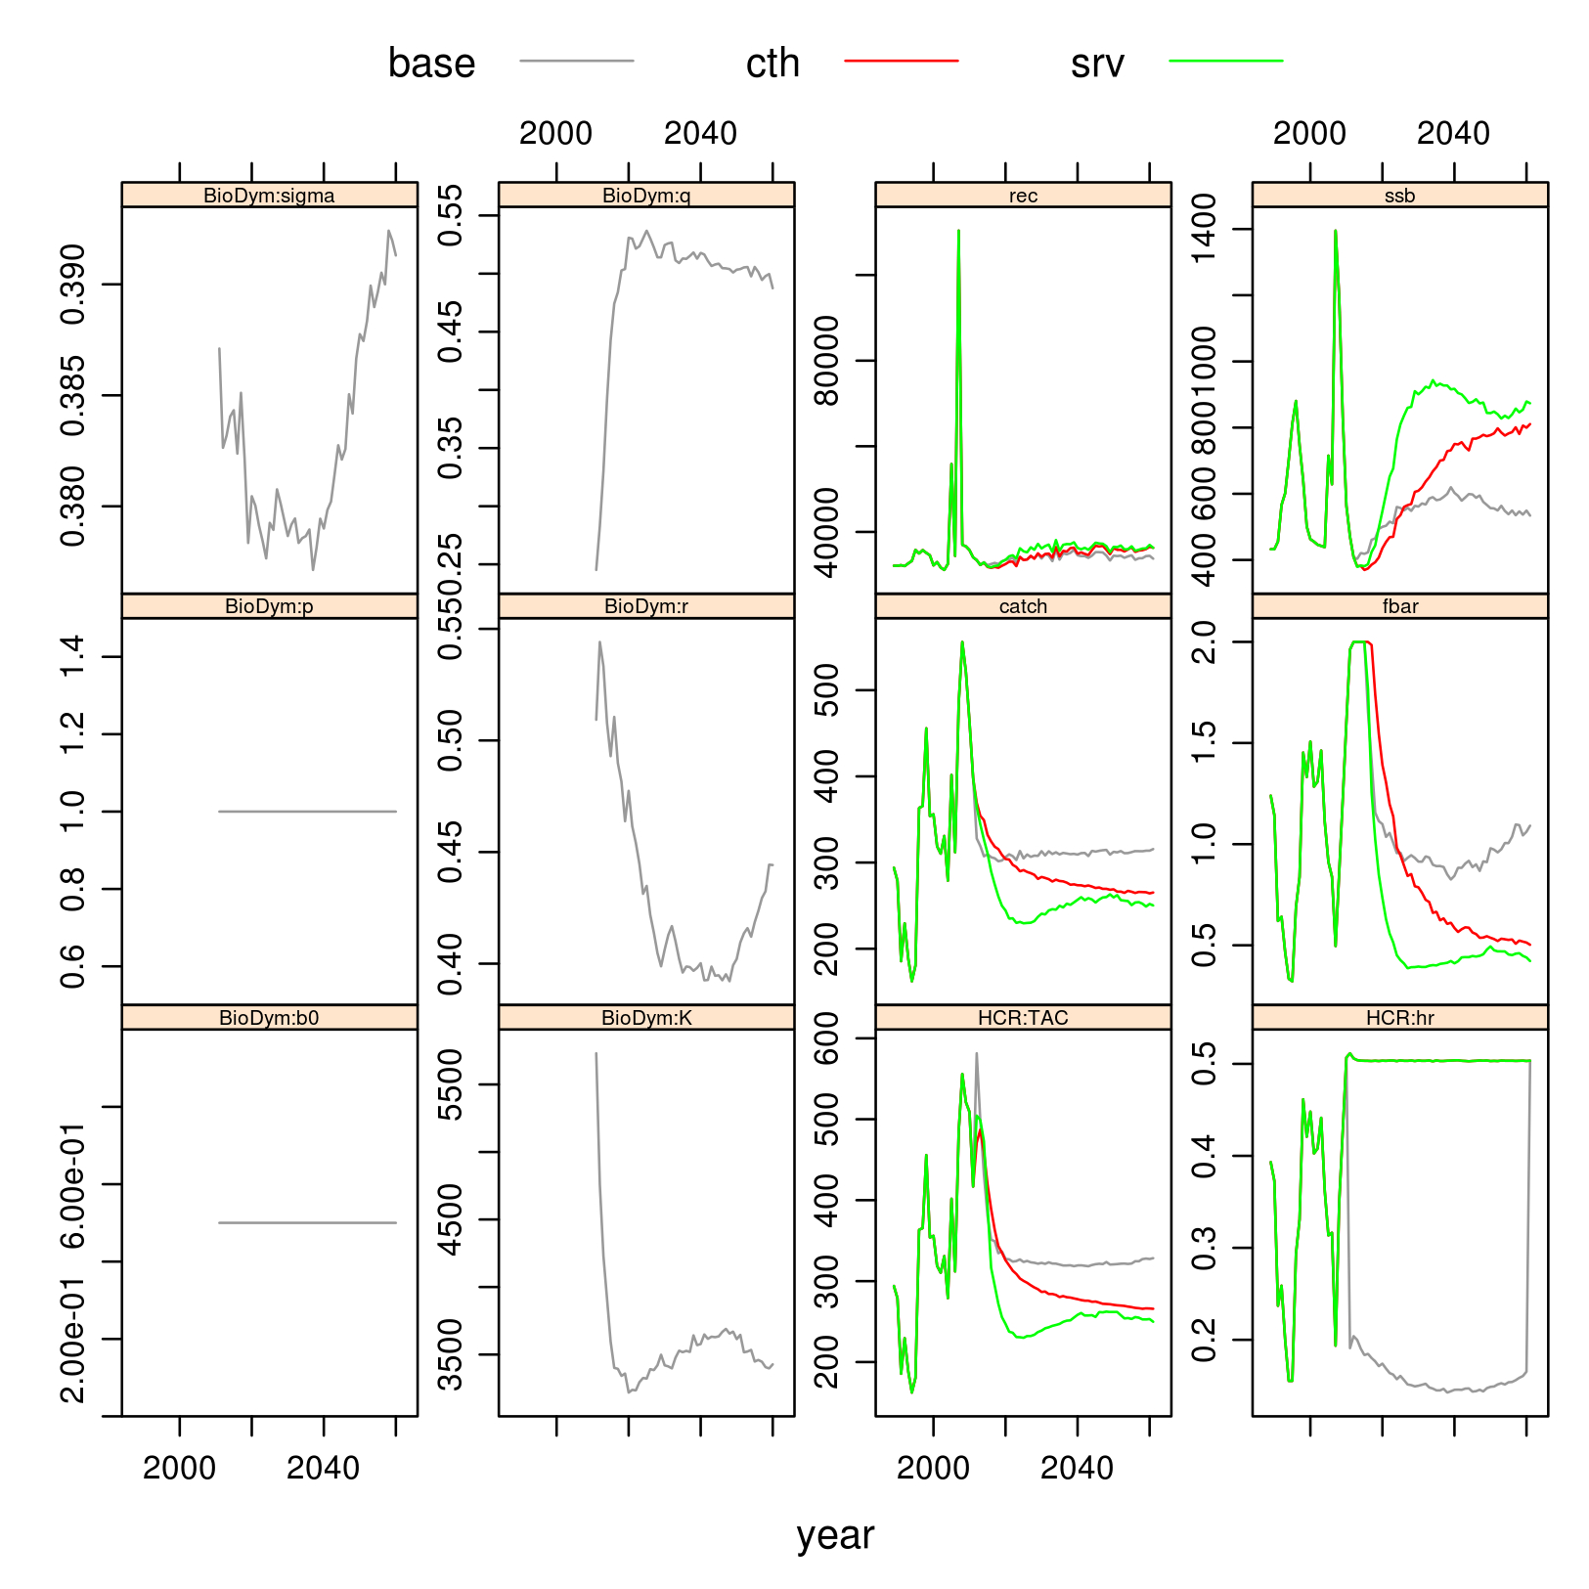
a4a Init
MSE example
(loosely based on S.aurita in Northwest Africa)

Slide 26
a4a Init
(4) Intuitive
Methods should be implemented in a way that it doesn't require a highly specialized statistician to use them.
Parametrization must have a biological meaning:
trawl(catchability="linear")
s(age, 4) + factor(year) + year
Courses and dissemination/demonstration actions

Slide 27
a4a methods' workflow
a4a Init
DATA
ASSESSMENT
FORECAST
UNCERTAINTY
GROWTH
MODEL
IMPLEMENTATION
NATURAL MORTALITY
PARAMETERS
DECISION MAKING
SCENARIOS

Slide 28
Wrapping up
a4a Init
a4a aims to provide standard methods for stock assessment and forecasting that can be applied rapidly to a large number (all ?) stocks in a sea basin.

Slide 29
Thank you for your attention !
(https://fishreg.jrc.ec.europa.eu/web/a4a)
a4a Init

