Slide 1
The “assessment for all” Initiative (a4a)
Ernesto Jardim*
Colin Millar
Iago Mosqueira
Chato Osio
Finlay Scott
JRC
Unit of Maritime Affairs
Fishreg
* ernesto.jardim@jrc.ec.europa.eu

Slide 2
a4a Init
Long term vision
To have a group of standard methods that can be applied rapidly to a large number of stocks, without requiring a strong statistical technical background, but making use of the technical knowledge on the fisheries, stocks and ecosystem characteristics.

Slide 3
a4a Init
Why
Increasing demand for marine fish abundance and exploitation estimates.
Large investments being made in collecting information.
Increasing will to rely on scientific advice for fisheries management.

Slide 4
a4a Init
Setting the scene in Europe
Biological parameters (growth & reproduction) are being collected for 300+ stocks in waters where European fleets operate.
The DCF reports make it difficult to evaluate the number of species being sampled, but it should be hundreds.
DCF & Advice budget 2007-2013 is ~360m€^{(*)}
(*) SEC(2011) 1417 final (**) 2008/949/EC, Annex, Chapter I, 1.b

Slide 5

a4a Init
e.g. PT sampled species (lenghts)

Slide 6
a4a Init
Setting the scene worldwide
US law requires all federal fisheries to come up with annual catch limits, including appropriate buffers to account for scientific and management uncertainties.

Slide 7
a4a Init
So what ? (Miles dixit)
What if ~2020 EU fisheries scientists are asked to assess hundreds of stocks, and justify ~1bn€ spent in data collection ?

Slide 8

a4a Init

Slide 9
a4a Init
Solution !?
Standardize and enter automatic mode !!

Slide 10
a4a Init
Solution !?
Estimate what you know,
MSE^{(*)} what you don't !!
(*) Management Strategies Evaluation

Slide 11
a4a Init
Solution !?
Move focus from numerical magic into more interesting subjects, like ecossystem, population or fleet dynamics.

Slide 12
a4a Init
a4a initiative
develop an assessment method targeting stocks that have a reduced knowledge base on biology and moderate time series on exploitation and abundance;
trigger the discussion about the problem of massive stock assessment.
capacity building

Slide 13
a4a Init
How ?
Define a moderate data stock (entry level)
Develop a stock assessment framework
Develop a forecasting algorithm based on MSE
Carry out training courses for marine scientists

Slide 14
a4a Init
(1) The “moderate data stock”
Exploitation
    Nominal effort
    Volume (L, D)
    Length frequencies
Biology
    Information based knife edge mat ogive
    Indications for growth model
    Length – weight relationship
Index of abundance

Slide 15
a4a Init
(2) The stock assessment model framework
Non-Linear catch-at-age model implemented in R/FLR^{(*)}/ADMB that can be applied rapidly to a wide range of situations with low parametrization requirements
(*) http://flr-project.org

Slide 16
a4a Init
As simple as a linear regression !?
fmodel = separable()
qmodel = trawl(techcreep=0.03)
rmodel = beverton(a=s(NAO))
(*) http://flr-project.org

Slide 17
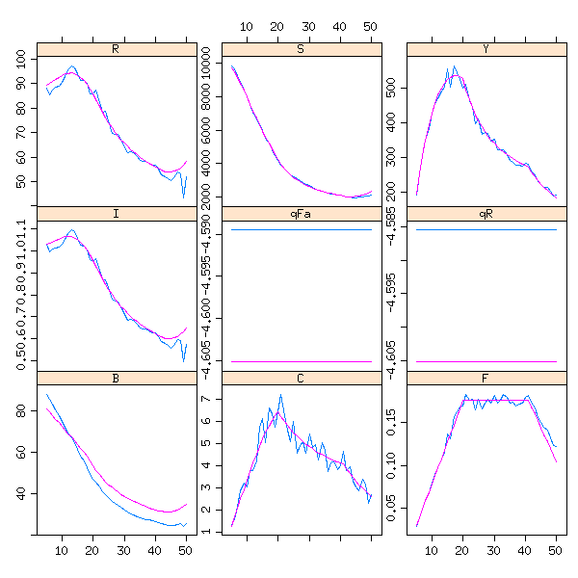
a4a Init
Testing, 1,2 …
WKLIFE stocks
Fishbase stocks^{(*)}
(*) http://fishnet-dev.jrc.it/web/guest/a4a

Slide 18
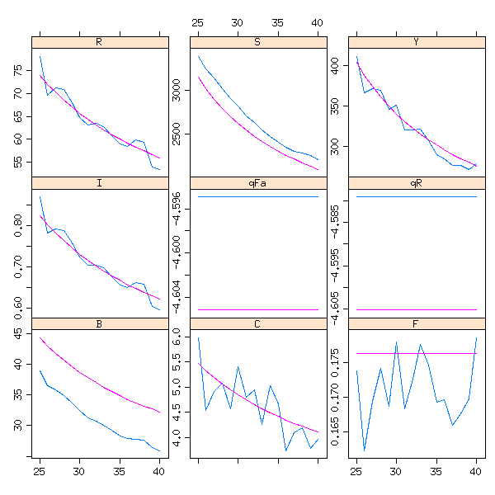
a4a Init
Testing, 1,2 ...

Slide 19
a4a Init
(3) Forecasting (MSE & Co.)
MSE is seen as a sophisticated forecasting algorithm that takes into account structural uncertainty about stock dynamics (growth, recruitment, maturity) and on exploitation by commercial fleets (selectivity), embedding the framework of decision making.

Slide 20
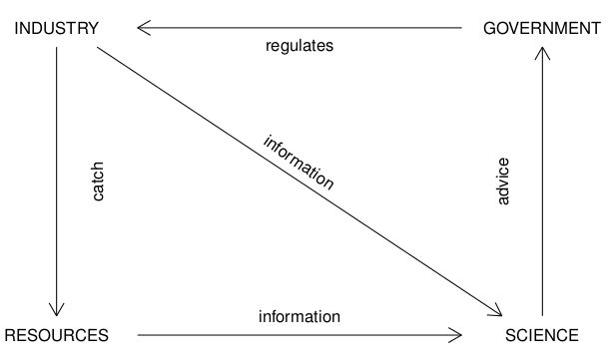
a4a Init
Fisheries Management Cycle

Slide 21
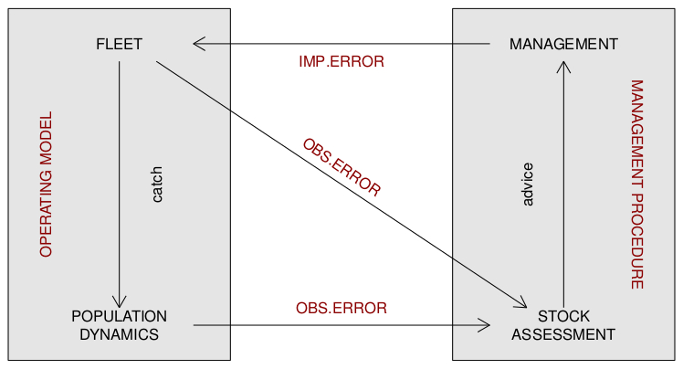
a4a Init
Management Strategies Evaluation (MSE)

Slide 22
a4a Init
The standard MSE
OM uncertainty in growth, S/R and selectivity
3 HCR based on:
catch, surveys, assessments
3 assessment models
biodyn , simple and complex SCA
OE for catch and index
IE in F or catch

Slide 23
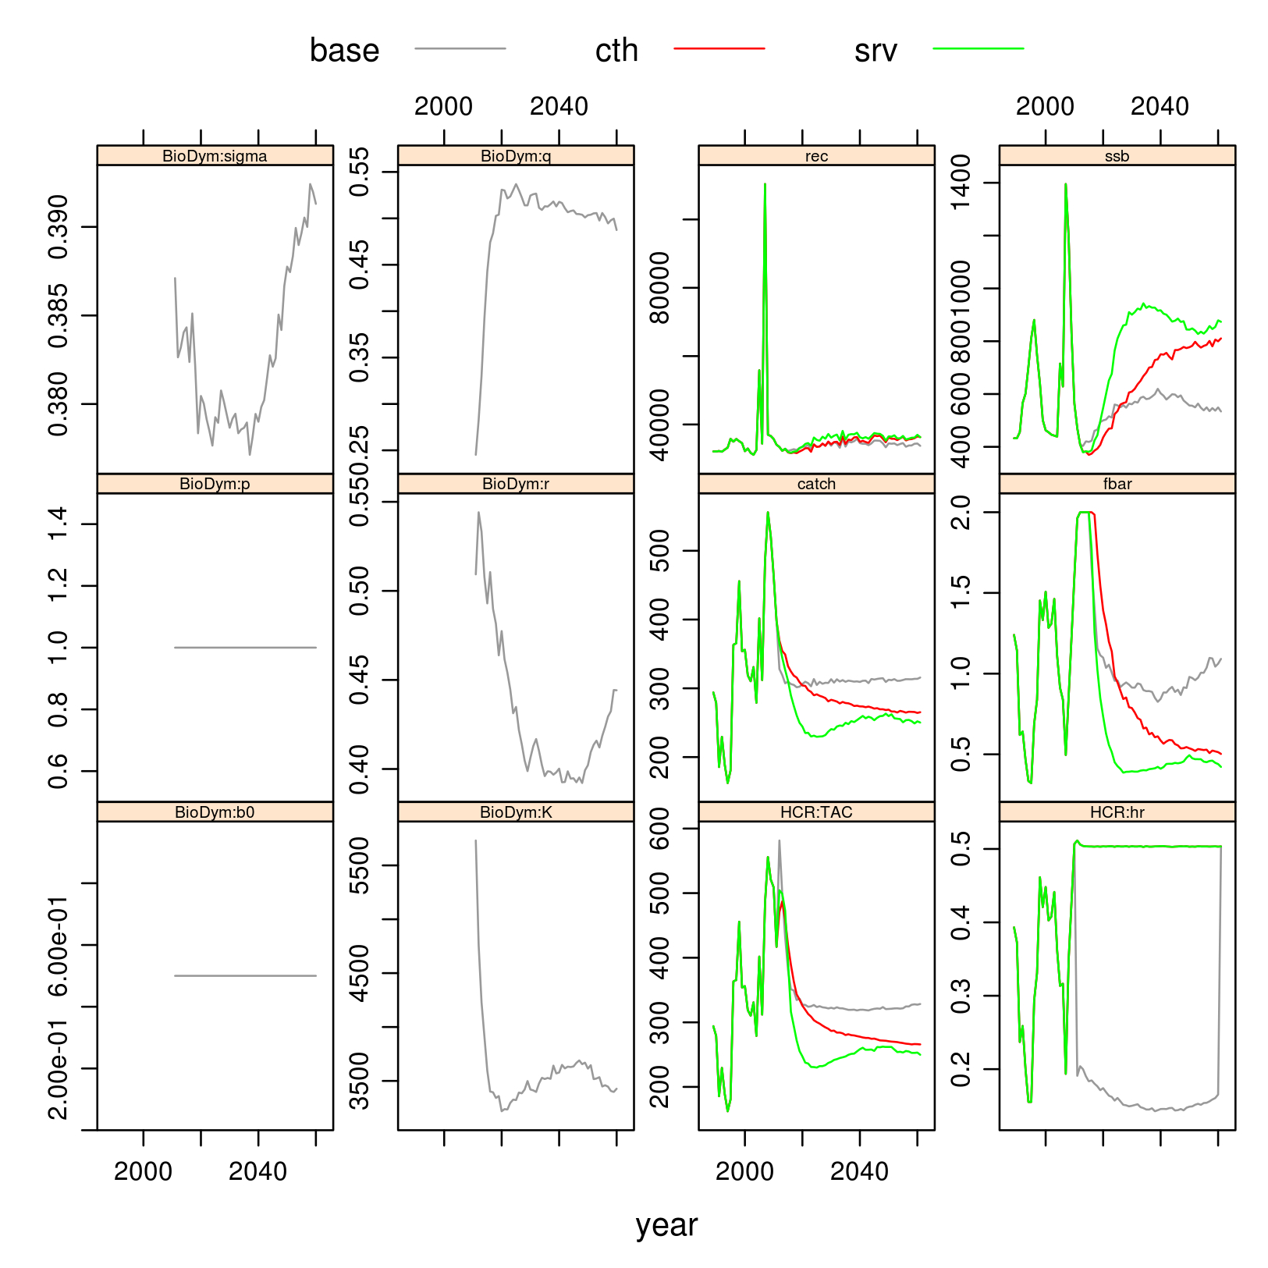
a4a Init
MSE example
(loosely based on S.aurita in Northwest Africa)

Slide 24
a4a Init
(4) Intuitive
Methods should be implemented in a way that it doesn't require a highly specialized statistician to use them.
Parametrization must have a biological meaning:
trawl(catchability="linear")
s(age, 4) + factor(year) + year
Courses and dissemination/demonstration actions

Slide 25
a4a Init
a4a methods' workflow
DATA
ASSESSMENT
FORECAST
METHODS

Slide 26
a4a Init
a4a methods' workflow
DATA
ASSESSMENT
FORECAST
UNCERTAINTY
GROWTH
MODEL
IMPLEMENTATION
NATURAL MORTALITY
PARAMETERS
DECISION MAKING
SCENARIOS

Slide 27
a4a Init
Wrapping up
a4a aims to provide standard methods for stock assessment and forecasting that can be applied rapidly to a large number (all ?) stocks in a sea basin.

Slide 28
a4a Init
Thank you for your attention !
(https://fishreg.jrc.ec.europa.eu/web/a4a)

