Slide 1
STRATEGIC VISION 2026
xTalent
A next-generation Human Capital Management solution built on the Self-Evolving Platform (SEP) — designed to continuously learn, adapt, and evolve alongside your organization in the age of AI Agents.
Strategic Vision 2026 xTalent The Self-Evolving HCM Platform A next-generation Human Capital Management solution built on the Self-Evolving Platform (SEP) — designed to continuously learn, adapt, and evolve alongside your organization in the age of AI Agents.

Slide 2
Agenda
1 Market Context — The Era of Cognitive Autonomy
2 The Problem — Why Traditional HCM Falls Short
3 Our Vision — xTalent on the Self-Evolving Platform
4 Architecture — The Four-Layer Model
5 Capabilities — Use Cases on SEP
6 Roadmap — Three Phases to Evolution
7 ROI & Governance — Value & Trust

Slide 3
MARKET CONTEXT
The Era of Cognitive Autonomy
AI has shifted from experimental pilots to production-grade autonomous systems delivering measurable P&L impact.
40%
Enterprise apps with agentic capabilities
$3-5T
Global Agentic Commerce revenue
3.5×
ROI per $1 invested in Agentic AI
15%
Daily decisions made autonomously by AI

Slide 4
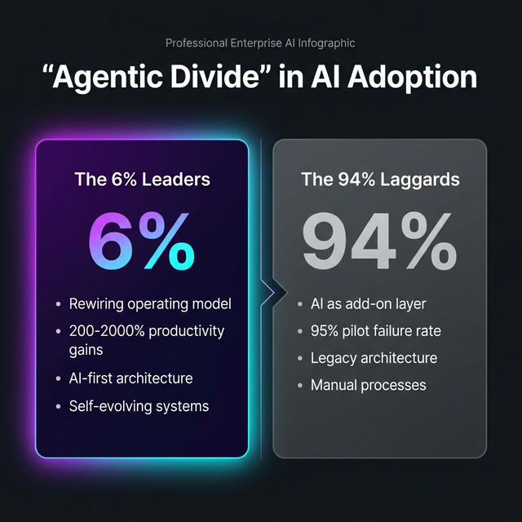
MARKET CONTEXT
The Agentic Divide
A stark gap is emerging between organizations that rewire around AI vs. those treating it as an add-on.

Slide 5
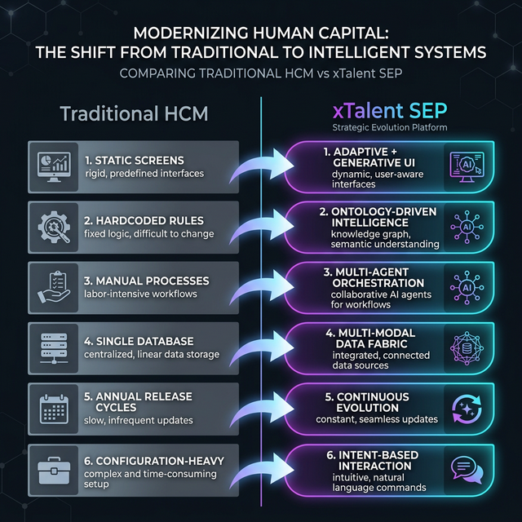
THE PROBLEM
Traditional HCM is Fundamentally Broken

Slide 6
OUR VISION
xTalent on the Self-Evolving Platform
Software that understands, learns, and evolves — transforming HCM from a static tool to a living system.
Self-Understanding
AI Agents comprehend HR processes like a domain expert through Ontology-Driven Knowledge
Self-Adapting
Interfaces generate in real-time based on user intent — from fixed screens to AI-created views
Self-Orchestrating
Multi-agent workflows coordinate across HR functions — onboarding, payroll, compliance
Self-Managing Data
Multi-modal data architecture grows organically — from ACID databases to AI-native vector stores

Slide 7
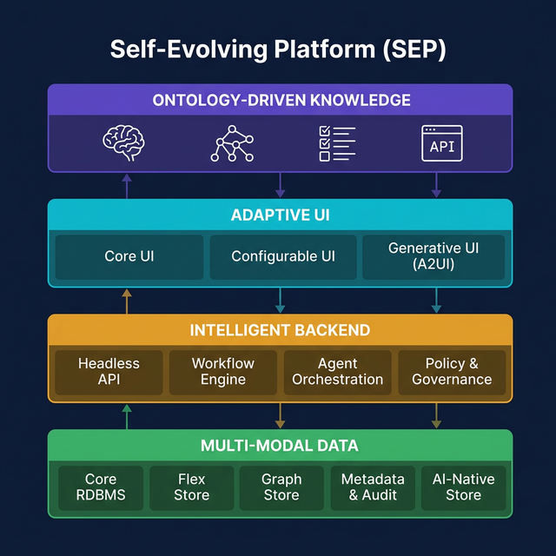
ARCHITECTURE
The Four-Layer Model

Slide 8
LAYER 1
Ontology-Driven Knowledge Layer
Domain Ontology
Formal HR entity models in LinkML/OWL
Semantic Layer
Business terms → technical data mapping
Knowledge Graph
Employee → Position → Dept relationships
Rules Engine
Encoded labor law & policy guardrails
Cognitive API
"SME-as-a-Service" for any Agent

Slide 9
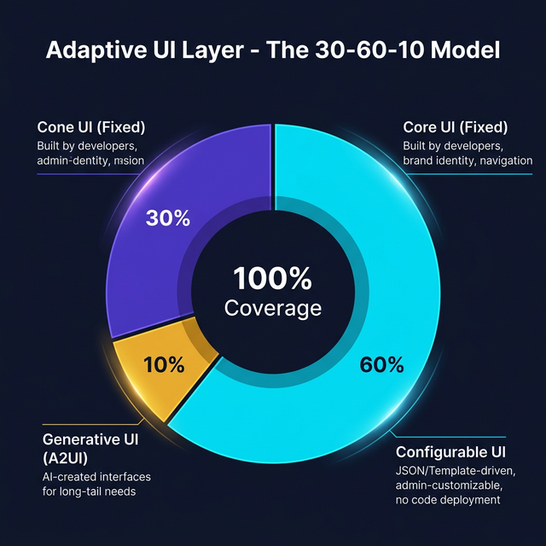
LAYER 2
Adaptive UI Layer — The 30-60-10 Model

Slide 10
LAYER 3
Intelligent Backend Layer
Headless API
REST/GraphQL stateless CRUD — serves all clients
Workflow Engine
Visual workflow designer for HR processes — zero-code customization
Agent Orchestration
Multi-agent teams: Recruit, Comply, Payroll, Analytics
Policy & Governance
Agent RBAC, audit logs, kill switches, HITL gates
⚡ Workflow Engine Impact: Customer requests "3-level approval for leave > 5 days" → Traditional: 2-week release. xTalent: Configure & deploy instantly.

Slide 11
LAYER 4
Multi-Modal Data Layer
Core RDBMS
PostgreSQL — ACID, strict schema, audit trail
Flex Store
SurrealDB — schemaless custom fields, dynamic forms
Graph Store
Neo4j — org charts, skill maps, GraphRAG
Metadata & Audit
Catalog + lineage — AI decision traceability
AI-Native Store
Vector DB — embeddings, semantic search, RAG

Slide 12
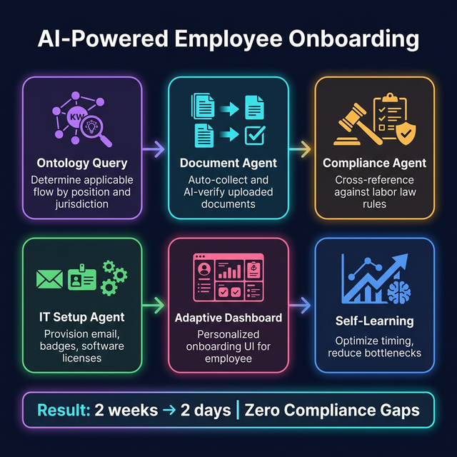
USE CASE
Self-Evolving Employee Onboarding

Slide 13
MORE USE CASES
AI-Driven HR Operations
AI Performance Review
Continuous data collection from attendance, projects, peer feedback → Performance Agent synthesizes insights → Manager sees Generative UI dashboard → Business Rules ensure fairness From annual subjective reviews → continuous data-driven assessment
Adaptive Payroll Compliance
Tax rules encoded in Ontology → Regulation changes update ontology only → Payroll Agent runs + verifies in parallel → Full audit trail in Metadata layer Zero code changes when regulations update — ontology-only updates
Intent-Based HR Analytics
Employee: "How many vacation days do I have?" → Manager: "Show attrition risk" → CHRO: "Headcount cost by region YoY" Same flow: Intent → Ontology → Generative UI → Governance check

Slide 14
ROADMAP
Three Phases to Evolution
Phase 1: Foundation
Months 1-6 Core HR Domain Ontology (LinkML) Knowledge Graph — org structure Headless REST/GraphQL APIs Core UI — design system RDBMS + Flex Store + Metadata
Phase 2: Intelligence
Months 7-12 Workflow Engine — visual designer Agent Team: Onboard, Comply, Payroll Configurable UI (JSON-driven) Full Knowledge Graph + GraphRAG Vector DB — semantic search
Phase 3: Evolution
Months 13-18 Generative UI — A2UI integration Multi-Agent cross-functional teams MAPE-K self-optimization loops Predictive HR Analytics Auto-evolving rules & workflows

Slide 15
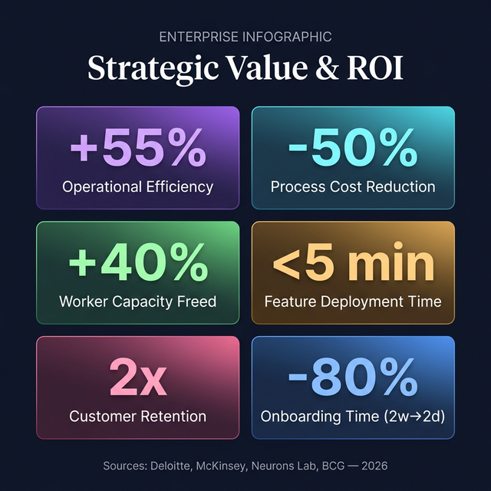
VALUE
ROI & Strategic Impact

Slide 16
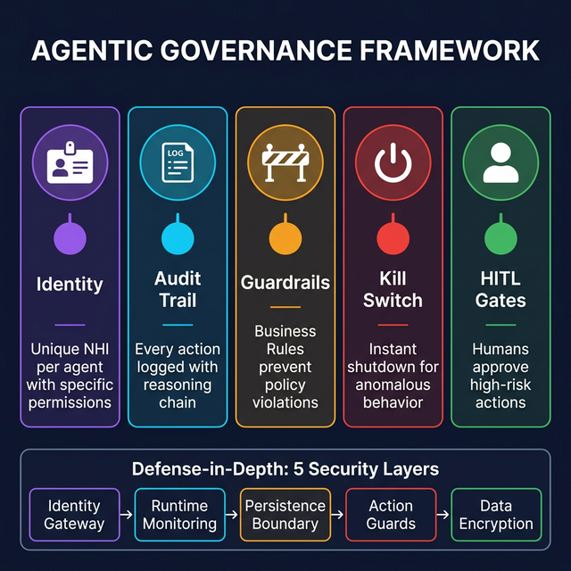
TRUST
Governance & Security Framework

Slide 17
xTalent is not just the future of HCM. It is the future of enterprise software.
xTalent is not just the future of HCM. It is the future of enterprise software.
From static software to living systems. From configuration to conversation. From siloed data to unified knowledge. From manual compliance to automatic governance.
Ontology-First
Intent-Over-Configuration
Evolution-by-Design

