Slide 1

STRATEGIC VISION 2026
xTalent
The Self-Evolving HCM Platform
A next-generation Human Capital Management solution built on the Self-Evolving Platform (SEP) — designed to continuously learn, adapt, and evolve alongside your organization in the age of AI Agents.

Slide 2
Agenda
1
Market Context — The Era of Cognitive Autonomy
2
The Problem — Why Traditional HCM Falls Short
3
Our Vision — xTalent on the Self-Evolving Platform
4
Architecture — The Four-Layer Model
5
Capabilities — Use Cases on SEP
6
Roadmap — Three Phases to Evolution
7
ROI & Governance — Value & Trust

Slide 3
MARKET CONTEXT
The Era of Cognitive Autonomy
AI has shifted from experimental pilots to production-grade autonomous systems delivering measurable P&L impact.
40%
$3-5T
3.5x
15%
Enterprise apps with agentic capabilities
Global Agentic Commerce revenue
ROI per $1 invested in Agentic AI
Daily decisions made autonomously by AI
Sources: Gartner, McKinsey, Deloitte, Neurons Lab — 2026

Slide 4
MARKET CONTEXT
The Era of Cognitive Autonomy
AI has shifted from experimental pilots to production-grade autonomous systems delivering measurable P&L impact.
40%
$3-5T
3.5x
15%
Enterprise apps with agentic capabilities
Global Agentic Commerce revenue
ROI per $1 invested in Agentic AI
Daily decisions made autonomously by AI
Sources: Gartner, McKinsey, Deloitte, Neurons Lab — 2026

Slide 5
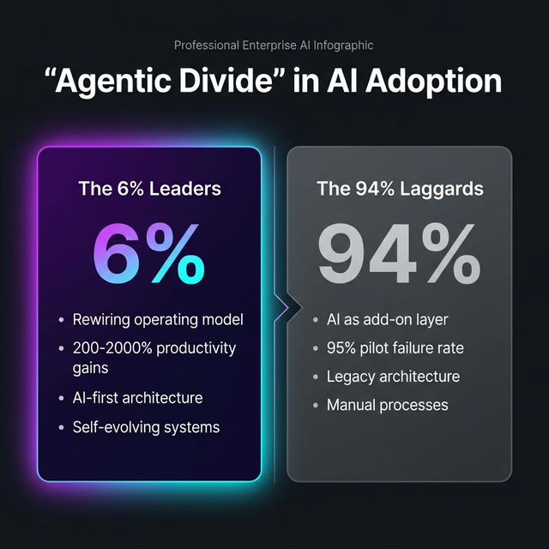
MARKET CONTEXT
The Agentic Divide
A stark gap is emerging between organizations that rewire around AI vs. those treating it as an add-on.

Slide 6
OUR VISION
xTalent on the Self-Evolving Platform
Software that understands, learns, and evolves — transforming HCM from a static tool to a living system.
Self-Understanding
Self-Adapting
Self-Orchestrating
AI Agents comprehend HR processes like a domain expert through Ontology-Driven Knowledge
Interfaces generate in real-time based on user intent — from fixed screens to AI-created views
Multi-agent workflows coordinate across HR functions — onboarding, payroll, compliance
Self-Managing Data
Multi-modal data architecture grows organically — from ACID databases to AI-native vector stores

Slide 7
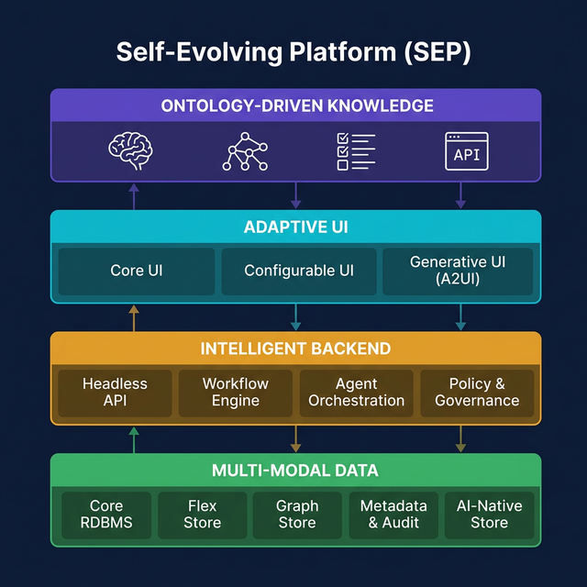
ARCHITECTURE
The Four-Layer Model

Slide 8
LAYER 1
Ontology-Driven Knowledge Layer
The "semantic brain" — enabling AI Agents to understand HR domain as deeply as a subject matter expert.
Domain Ontology
Semantic Layer
Knowledge Graph
Rules Engine
Cognitive API
Formal HR entity models in LinkML/OWL
Business terms to technical data mapping
Employee, Position, Dept relationships
Encoded labor law and policy guardrails
SME-as-a-Service for any Agent
Without this layer, AI is surface-level automation. With it, AI becomes a domain-aware decision partner.

Slide 9
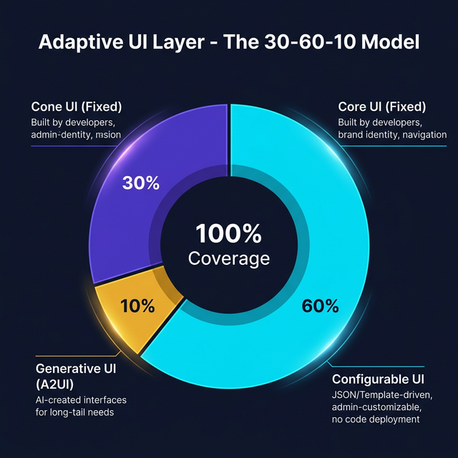
LAYER 2
Adaptive UI Layer — The 30-60-10 Model
The right interface, to the right user, at the right time — balancing consistency with flexibility.
Core UI (Fixed) — 30%
Navigation, design system, brand identity. Built by developers.
Configurable UI — 60%
JSON/Template-driven views. Admins customize without code.
Generative UI (A2UI) — 10%
AI Agents create interfaces on-demand for long-tail needs.
Powered by: A2UI (Google) + AG-UI (Event Protocol) + MCP (Data Access)

Slide 10
LAYER 3
Intelligent Backend Layer
From APIs to agent teams — processing business logic through traditional and AI-powered orchestration.
Headless API
Workflow Engine
Agent Orchestration
Policy & Governance
REST/GraphQL stateless CRUD
Visual workflow designer, zero-code
Multi-agent teams: Recruit, Comply, Payroll
Agent RBAC, audit, kill switches, HITL
Workflow Engine Impact: Customer requests "3-level approval for leave > 5 days" — Traditional: 2-week release. xTalent: Configure and deploy instantly.

Slide 11
LAYER 4
Multi-Modal Data Layer
The right storage paradigm for every type of data — from strict transactional records to AI-native stores.
Core RDBMS
Flex Store
Graph Store
Metadata & Audit
AI-Native Store
PostgreSQL — ACID, strict schema
SurrealDB — schemaless custom fields
Neo4j — org charts, skill maps
Catalog + lineage — AI traceability
Vector DB — embeddings, RAG
Metadata and Audit is mandatory for HR compliance — labor law, data privacy, GDPR/PDPA, AI transparency.

Slide 12
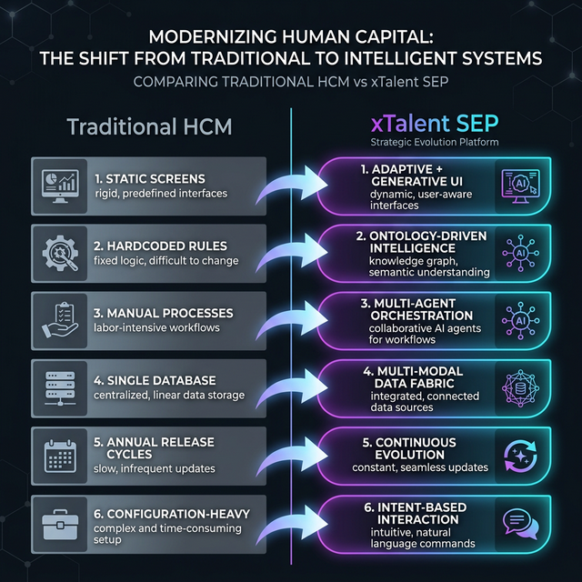
THE PROBLEM
Traditional HCM is Fundamentally Broken

Slide 13
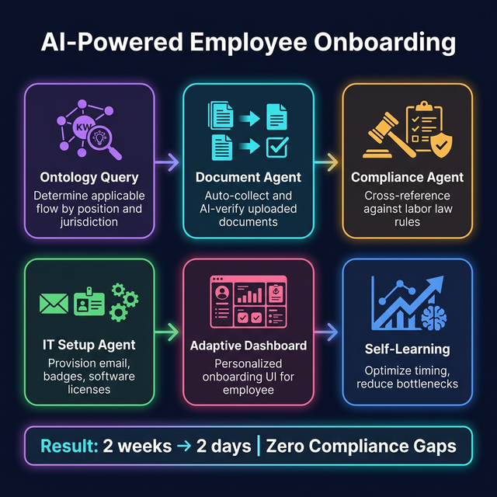
USE CASE
Self-Evolving Employee Onboarding
6 AI-powered steps orchestrated across all 4 layers of the Self-Evolving Platform

Slide 14
MORE USE CASES
AI-Driven HR Operations
AI Performance Review
Adaptive Payroll Compliance
Continuous data collection from attendance, projects, peer feedback. Performance Agent synthesizes insights. Manager sees Generative UI dashboard. Business Rules ensure fairness.
Tax rules encoded in Ontology. Regulation changes update ontology only. Payroll Agent runs and verifies in parallel. Full audit trail in Metadata layer.
Zero code changes when regulations update — ontology-only updates
From annual subjective reviews to continuous data-driven assessment
Intent-Based HR Analytics
Employee: "How many vacation days do I have?" Manager: "Show attrition risk" CHRO: "Headcount cost by region YoY"

Slide 15
ROADMAP
Three Phases to Evolution
Phase 1: Foundation
Phase 2: Intelligence
Phase 3: Evolution
Months 1-6
Months 7-12
Months 13-18
Core HR Domain Ontology (LinkML)
Workflow Engine — visual designer
Generative UI — A2UI integration
Knowledge Graph — org structure
Agent Team: Onboard, Comply, Payroll
Multi-Agent cross-functional teams
Headless REST/GraphQL APIs
Configurable UI (JSON-driven)
MAPE-K self-optimization loops
Core UI — design system
Full Knowledge Graph + GraphRAG
Predictive HR Analytics
RDBMS + Flex Store + Metadata
Vector DB — semantic search
Auto-evolving rules and workflows

Slide 16
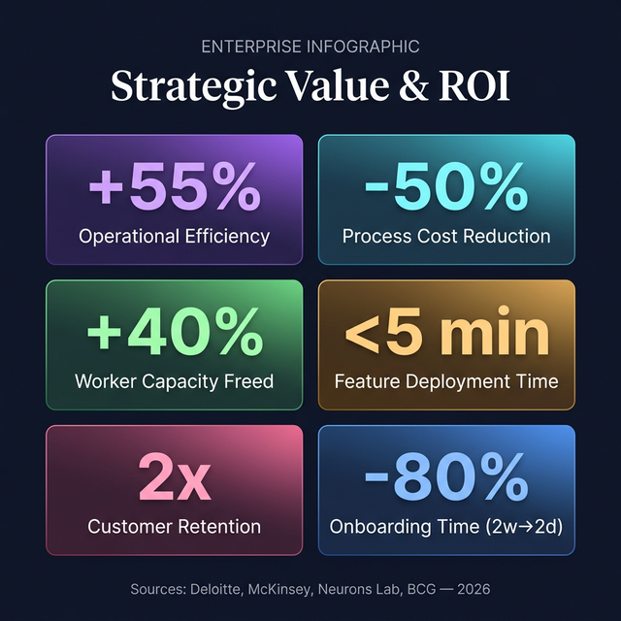
VALUE
ROI & Strategic Impact

Slide 17
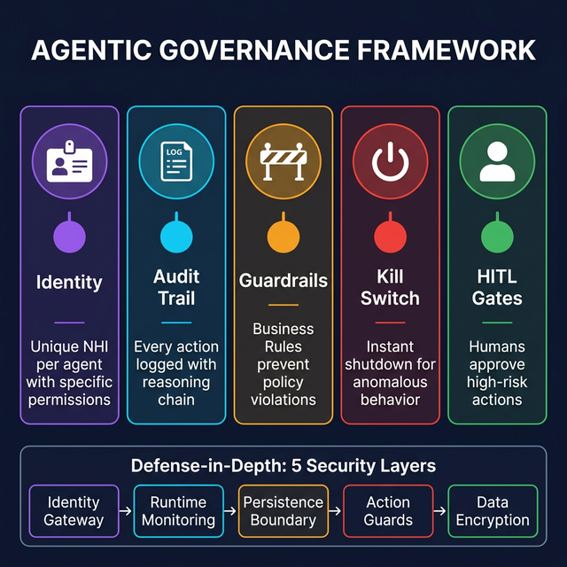
TRUST
Governance & Security Framework
Every AI Agent operates under strict governance — with 5 pillars and 5 layers of defense-in-depth security.

Slide 18

xTalent is not just the future of HCM.
It is the future of enterprise software.
From static software to living systems. From configuration to conversation. From siloed data to unified knowledge. From manual compliance to automatic governance.
Ontology-First
Intent-Over-Configuration
Evolution-by-Design

