Slide 1
Short Term Power Burn Model
GAS Analytics

Slide 2
Rationale:

Slide 3
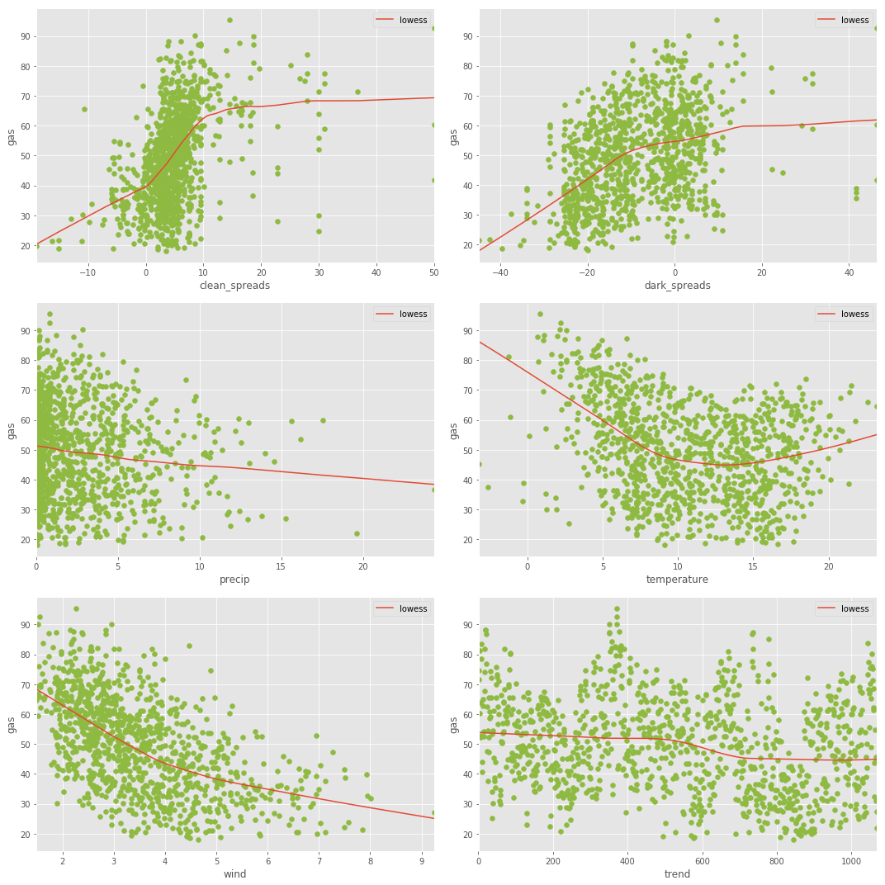
Covariates:
Dependent:
gas demand
clean spreads
dark spreads
temperature
wind
precipitation
monday_thursday flag
Fourier series
Data:
3 years daily sampling

Slide 4
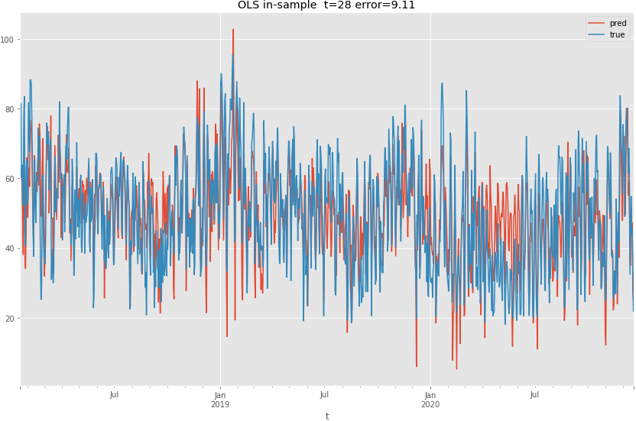
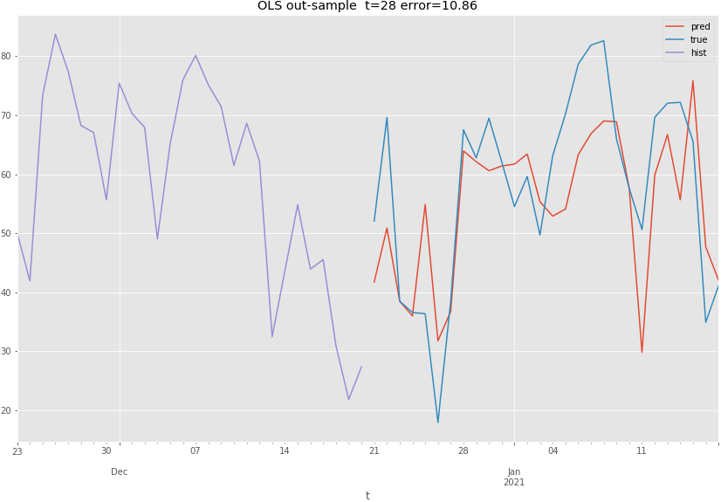
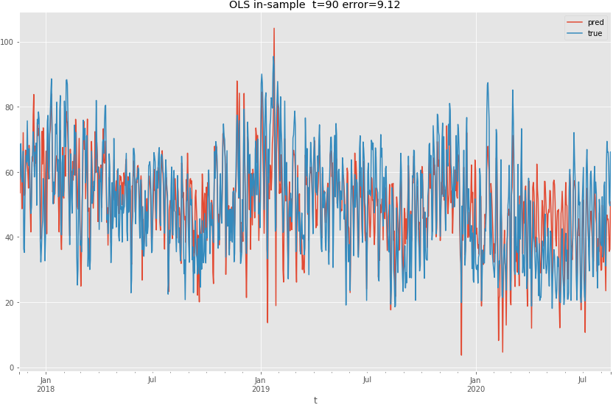
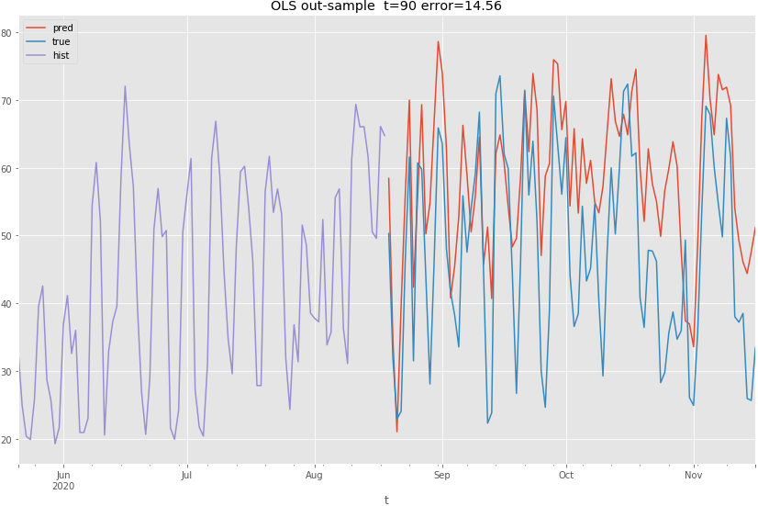
Calibrator (exog): Linear Regression
CV= 9.43 (2.08)
CV= 10.57 (1.79)

Slide 5
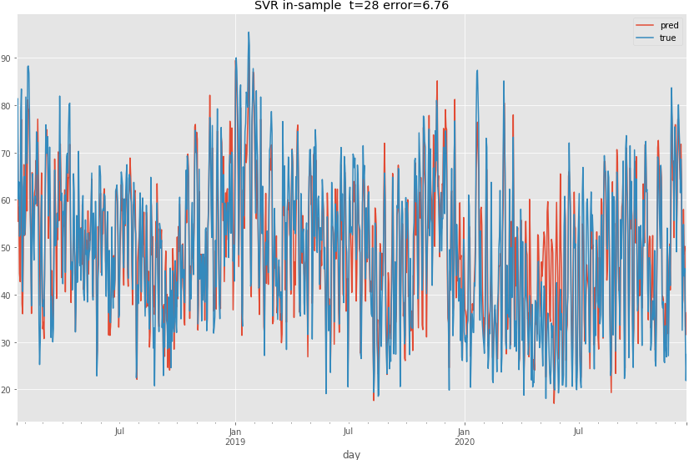
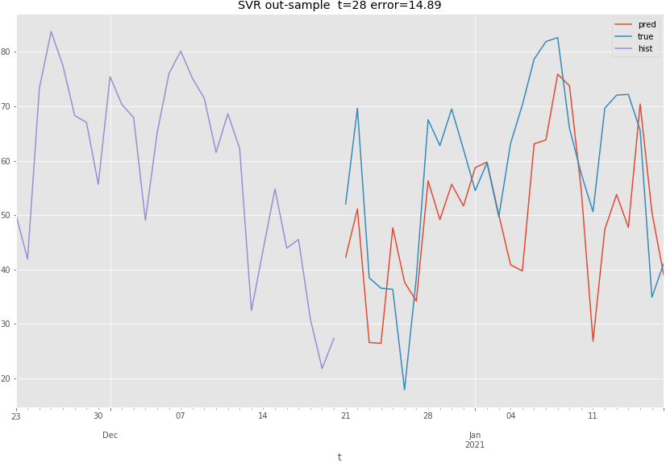
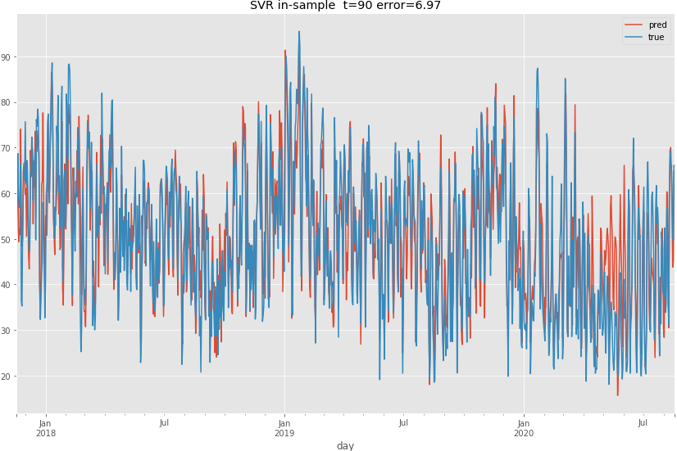
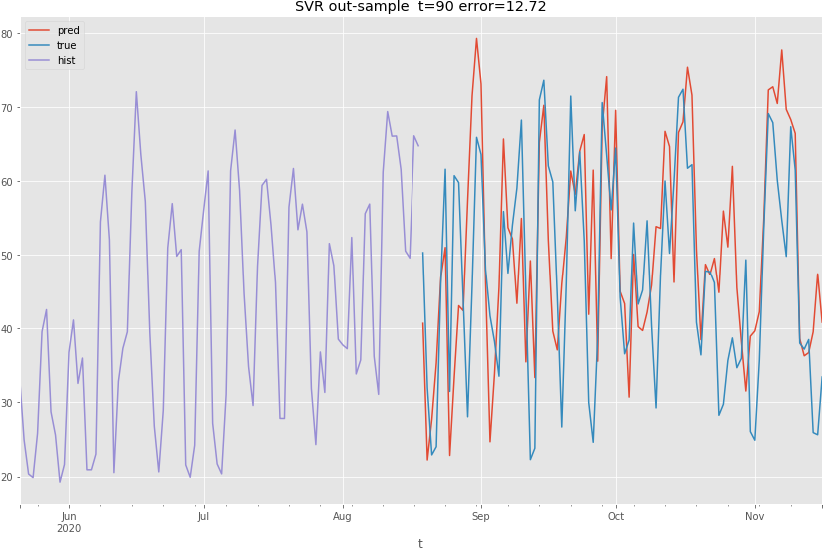
Calibrator (exog): Support Vector (kernel) Regression

Slide 6
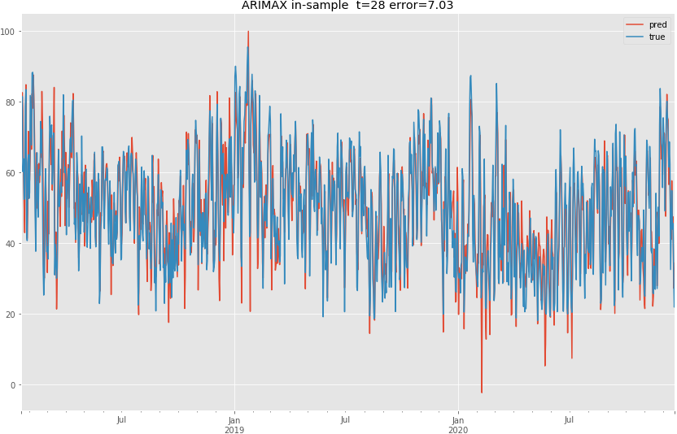
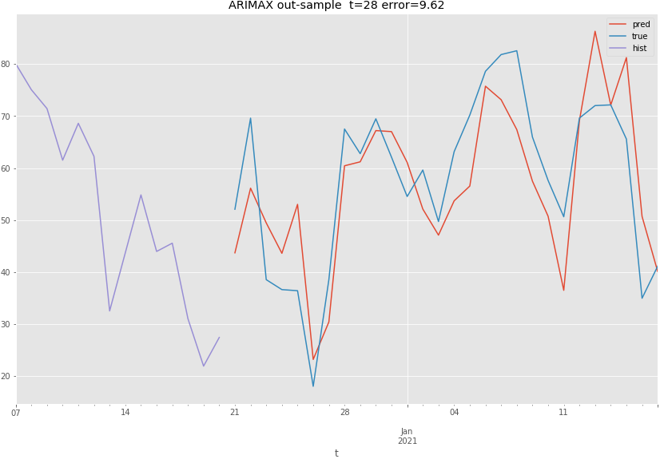
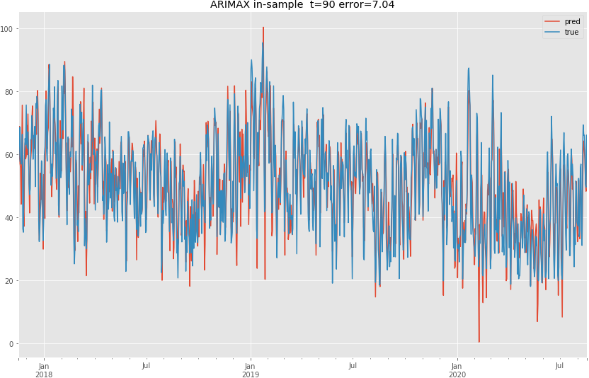
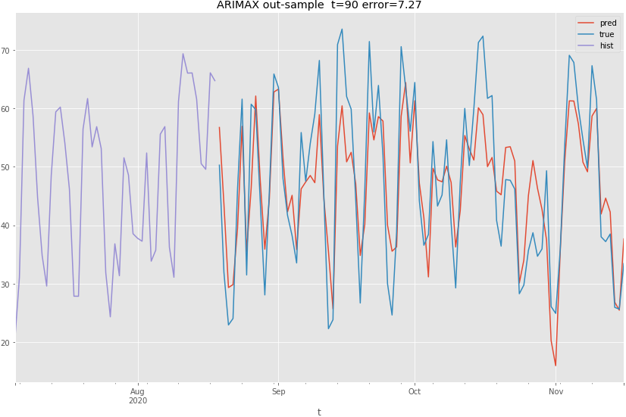
Calibrator (exog): SARIMAX
CV= 8.44 (1.71)
CV= 10.37 (2.41)

Slide 7
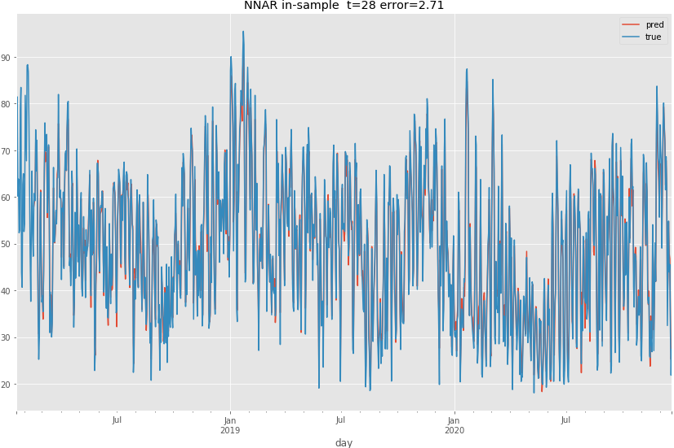
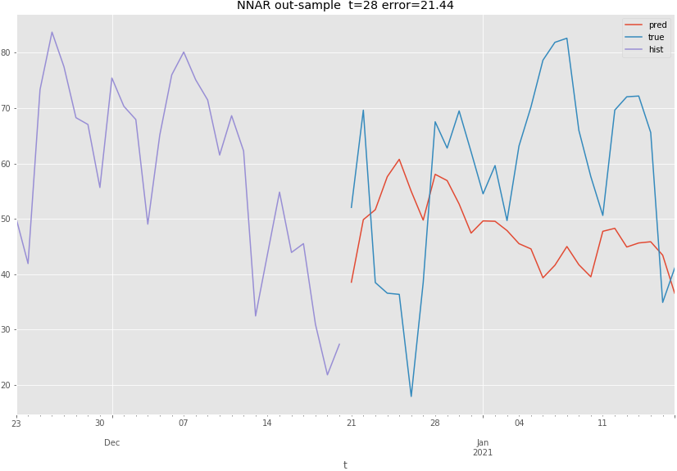
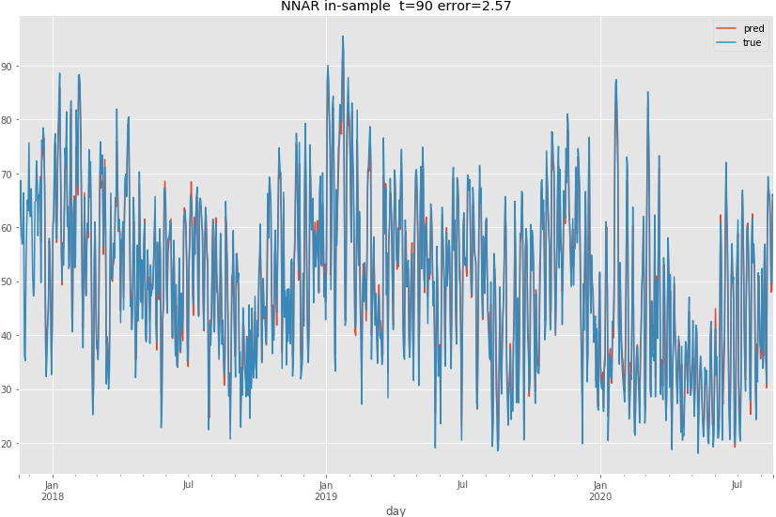
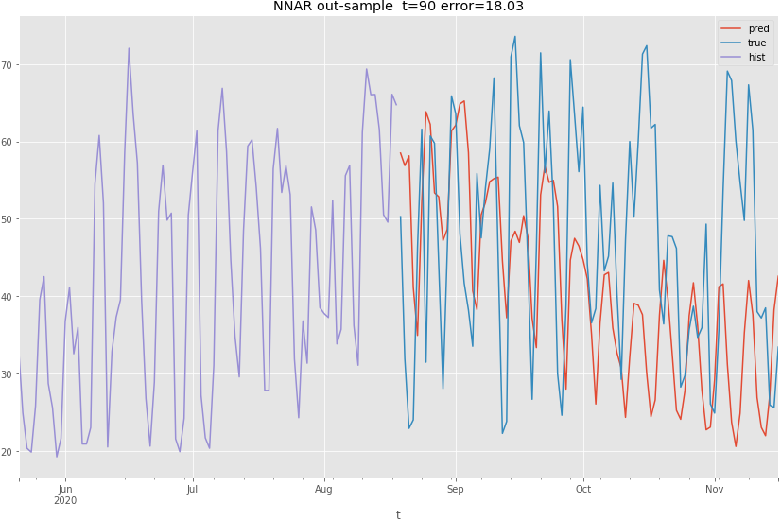
Calibrator (endog): Neural Network Autoregression

Slide 8
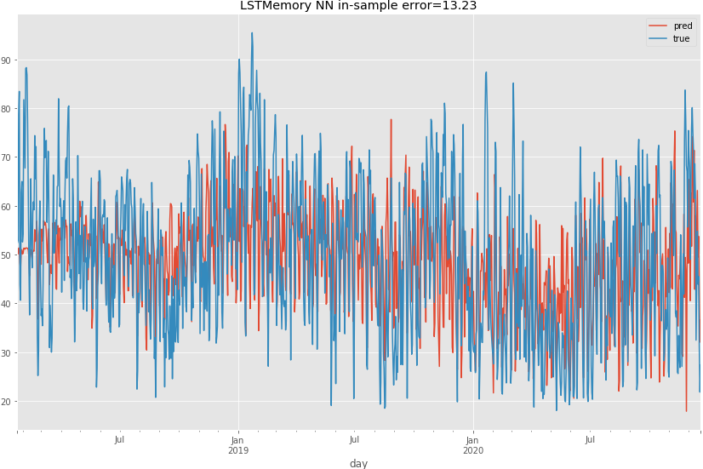
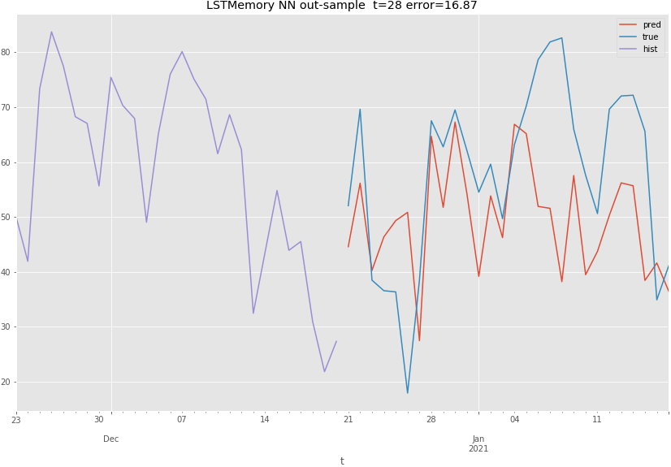
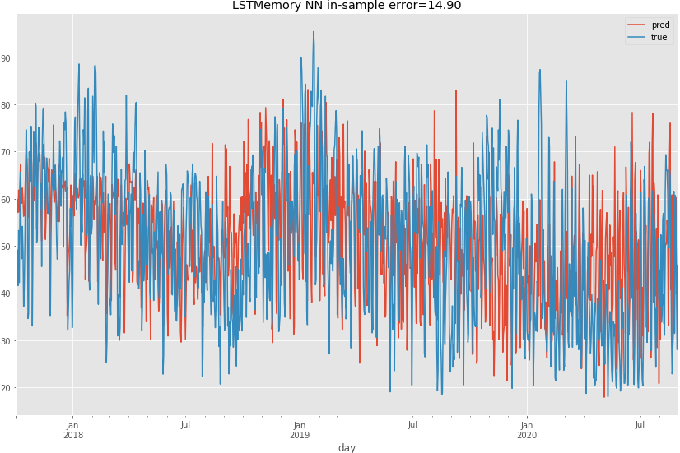
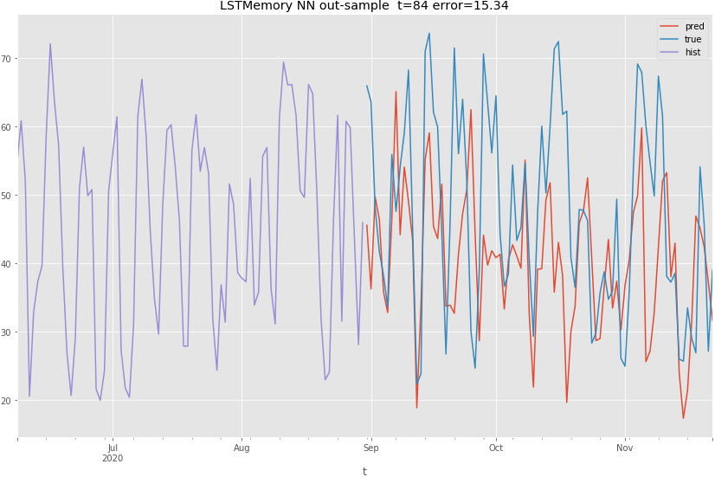
Calibrator (endog): Neural Network Long Short Term Memory

Slide 9
Appendix A:
Model | Parameters | Description
EXOGENEOUS RELATIONSHIP:
Linear Regression | const, trend, clean_spreads, precipitation, temperature, wind, S1-7, C1-7, S2-7, C2-7, S3-7, C3-7, mo_th_yes | Modelling in levels Exog variables: grid search with BIC criterion 3 terms of Fourier series at weekly frequency
SARIMAX | SARIMAX(1, 0, 1)x(1, 0, 1, 7) const, dark_spreads, precipitation, temperature, wind, | Modelling in levels Specification: grid search with BIC criterion Exog variables: grid search with BIC criterion
Support Vector Regression | type="eps-regression" kernel='radial’ cost= 8 gamma= 0.0625 epsilon= 0.3 | Dependent variable and features scaling: standardization Specification: grid search with 10-fold CV
ENDOGENEOUS RELATIONSHIP:
Neural Network Autoregression | Model: NNAR(29,1,15)[7] Average of 20 networks, each of which is a 29-15-1 network with 466 weights options were - linear output units | Dependent variable scaling: standardization
Long Short Term Memory Neural Network

Slide 10
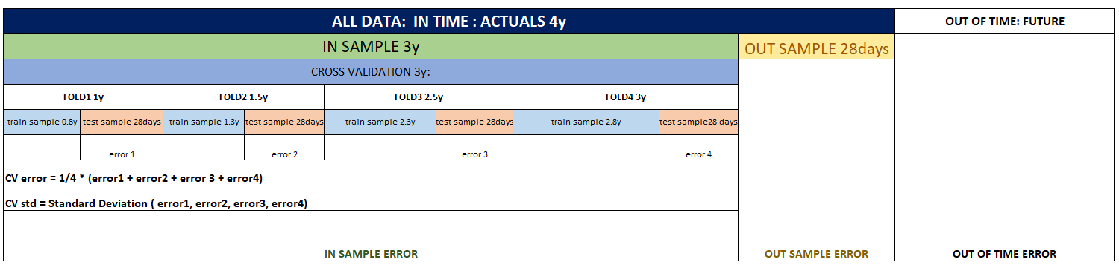
Appendix B:
error = Root Mean Square Error

Slide 11
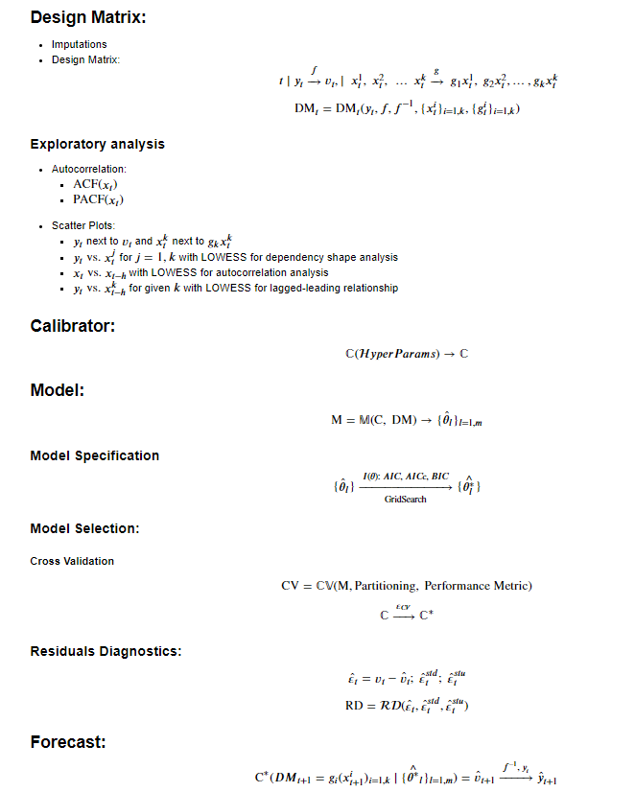
Appendix C: Modelling Framework

