Slide 1
希望不要被組
Group 11: 411410020 楊國梅 411410078 李承弘 411422076 游筑安
408235018 陳金諄 408235021 陳恆睿

Slide 2
Database : online personal store
The store own by one person Seller has its default account and password.
People can sign up or login by its own account and password
Seller can Add(by keyboard or txt) and delete product Check the order
Buyer can buy some product with change it order first check his order_list

Slide 3
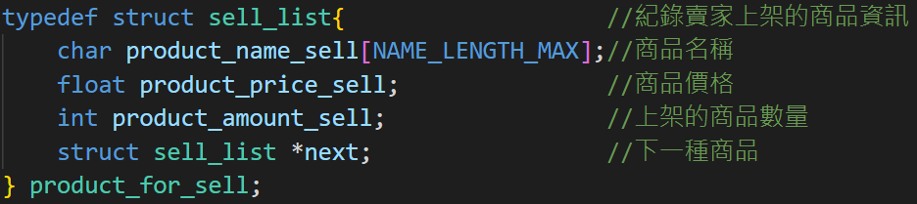
Basic Part data structure
at least three basic data types (e.g., int, float, char) product price =>float product’s quantity=>int product name=>char combined
at least one data with the string type account or password
at least one kind of data created using structure, union, or enumerations struct
at least a linked list to store some data different product in same seller’s store

Slide 4
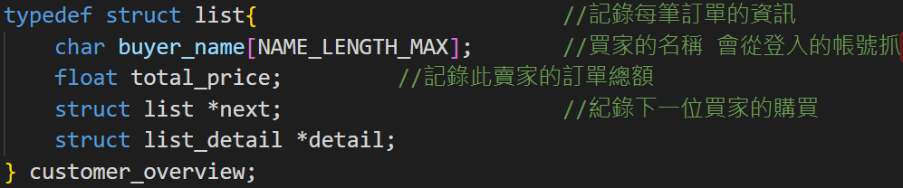
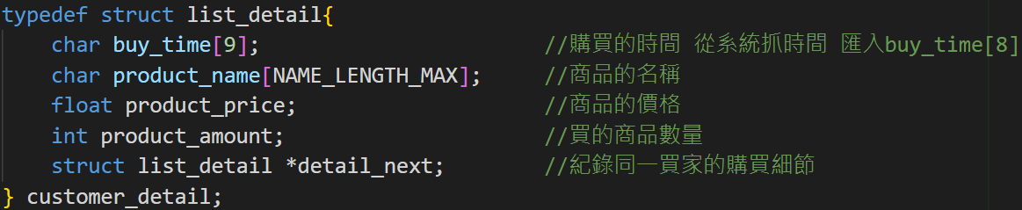
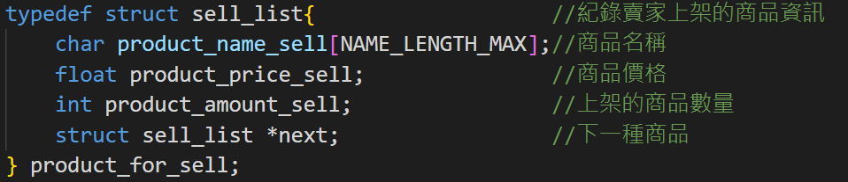
ruler
pen
Jane
tape
Han
L
i
s
t
pen
Larry
List_detail
pen
ruler
tape
beef
sell_list

Slide 5
Basic Part Operations
Add function : seller_add_stdin() seller_add_fileIO() seller add product by stdin or file
Delete function : DEL_product() seller delete product
Traverse function : list_product() list all product
Search function : cheak_account_is_exist() prevent from regist by same account again
Sort function : Sort_amount_HighToLow() sort the product by its information
File I/O function : seller_add_fileIO() read product information from file user offered

Slide 6

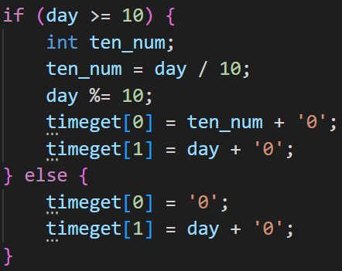
8 digits ex:now 2023/07/01 15:21:23 => 01152123
1
0
15>=10
15/10=1
15%10=5
1<10
=0
1%10=1
5
1

Slide 7

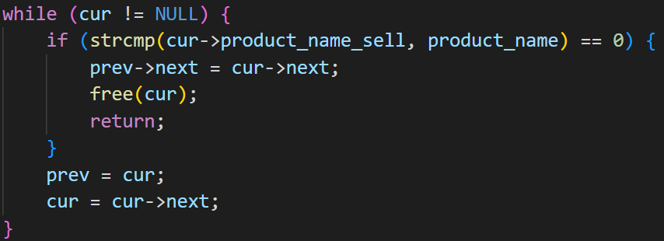
Need to find tape
2
pen
ruler
tape
1
beef
3
Free(cur)
prev
cur

Slide 8



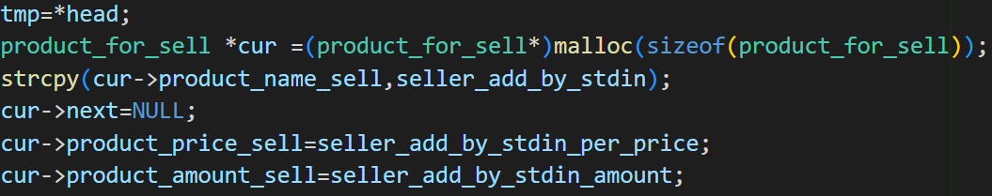
Add eraser
pen
ruler
tape
beef
new
eraser
If both name and price same,add number,only same name=>warning message

Slide 9

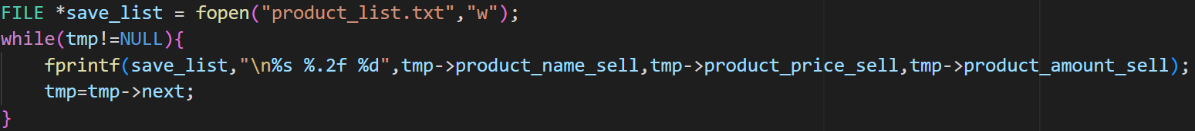
eraser
pen
ruler
tape
beef
. . . . .
txt
1

Slide 10



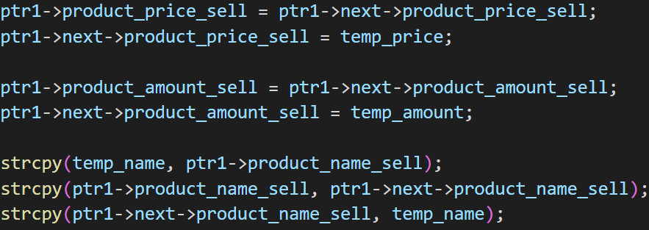
If(beef.price>tape.price) then swap
Tape price:10.00 quantity:2000
Beef price:100.00 quantity:200
1
2
3
Temp price:
Temp amount:
Temp name:

Slide 11

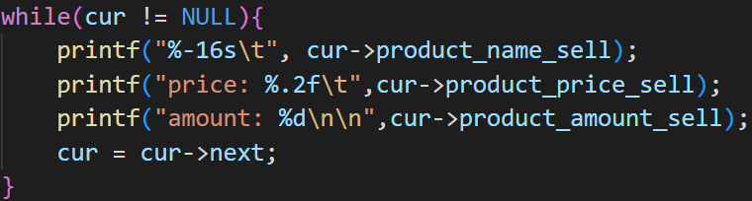
Beef price:100.00 quantity:200
Beef price: 100.00 amount: 200
Tape price: 10.00 amount: 2000
Tape price:10.00 quantity:2000

Slide 12

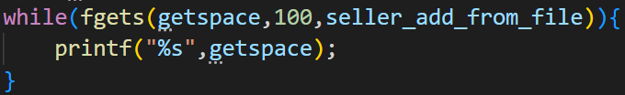
txt
Seller enter “order” get:
Jane
->Beef 100
->Tape 300
Total price : 13000.00
Han
->Beef 10
->Tape 30
Total price : 1300.00
Larry
->Beef 1
->Tape 3
Total price : 130.00
Jane
->Beef 100
->Tape 300
Total price : 13000.00
Han
->Beef 10
->Tape 30
Total price : 1300.00
Larry
->Beef 1
->Tape 3
Total price : 130.00

Slide 13

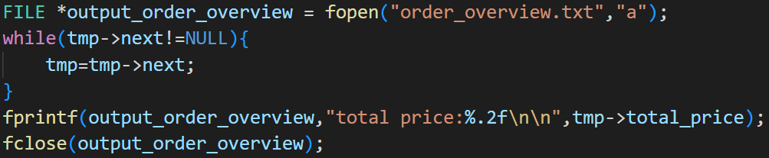
Update when buyer bought something
Jane
->Beef 100
->Tape 300
Total price : 13000.00
Han
->Beef 10
->Tape 30
Total price : 1300.00
Larry
->Beef 1
->Tape 3
Total price : 130.00
Also represent that the buyer‘s purchase has been completed

Slide 14
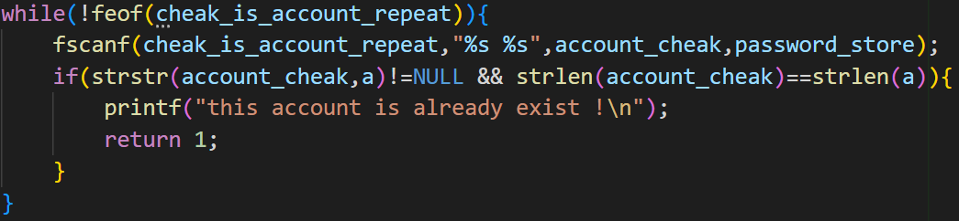
txt
New sign up
Jane 13245
Jane 13245
Han 12345
Larry 1657498

Slide 15
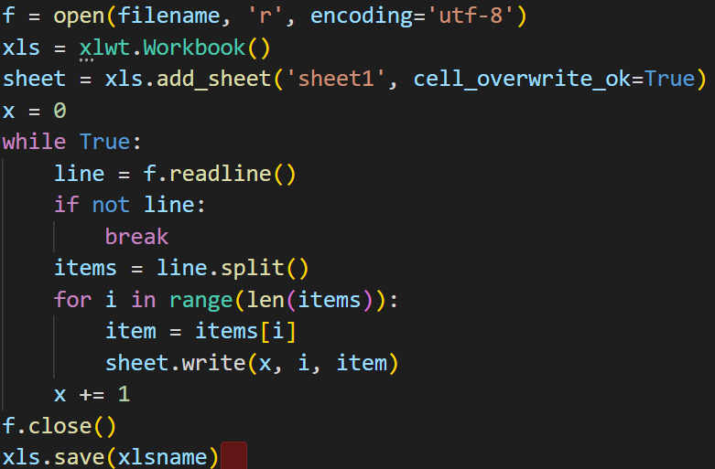
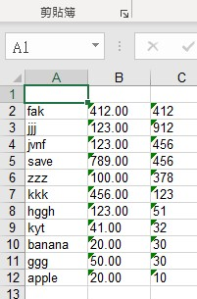
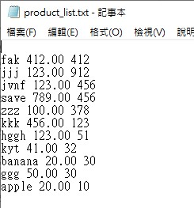
Advanced Part
Txt2excel:exe made by .py convert txt to excel,easier to read or use excel function it offered

Slide 16
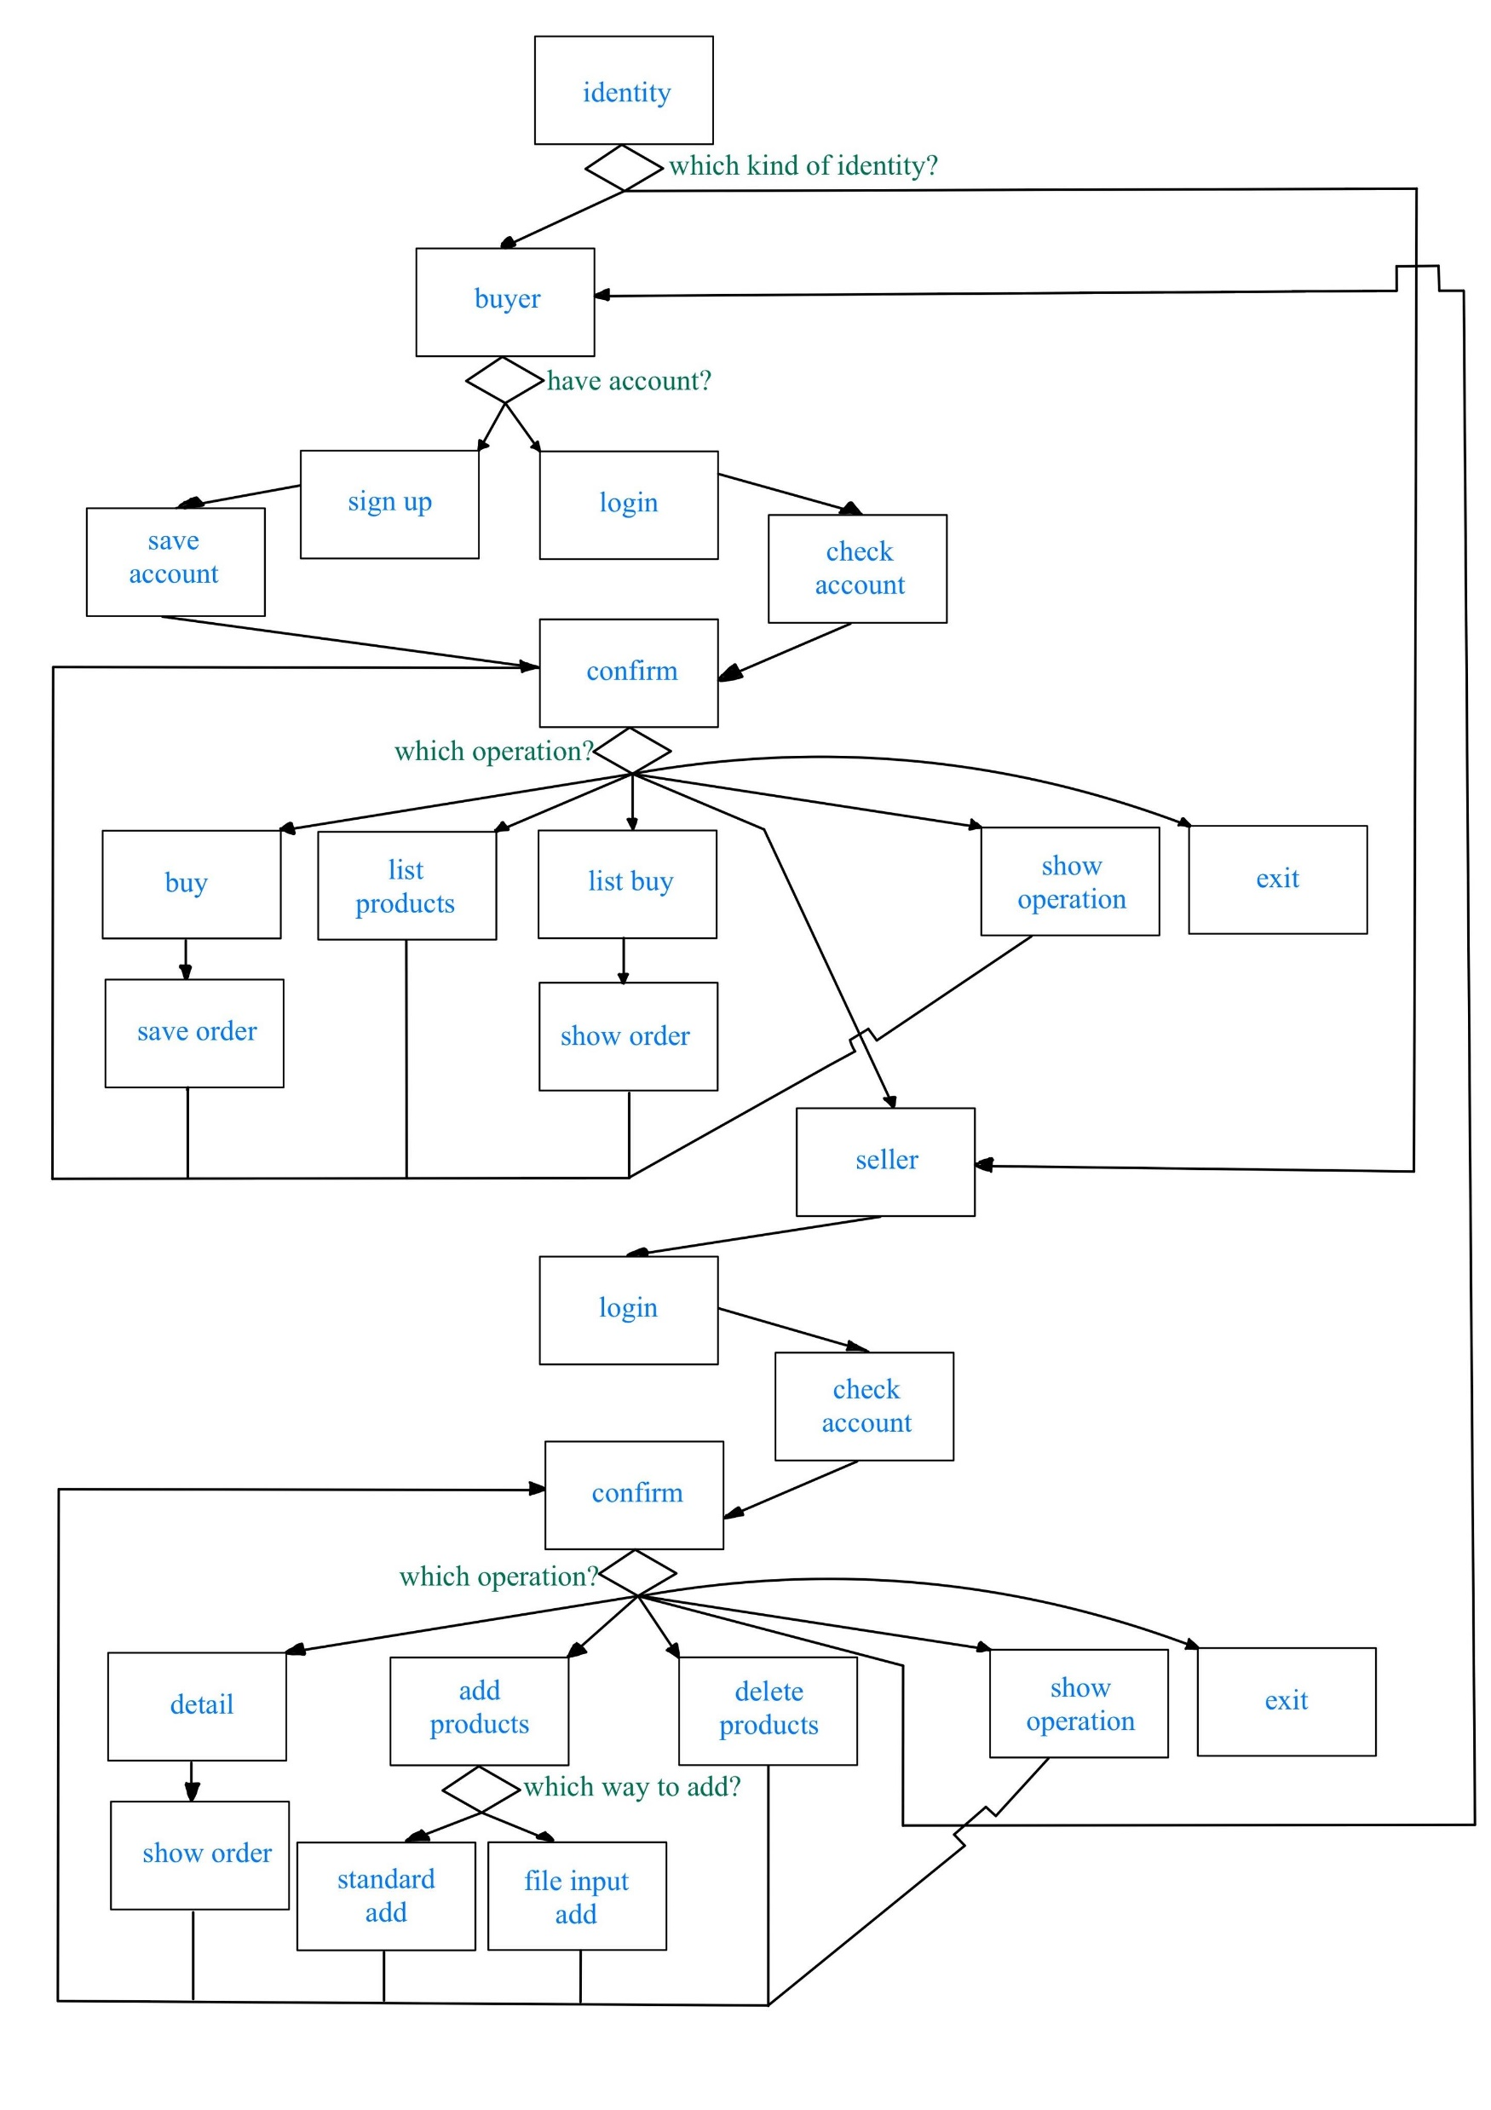
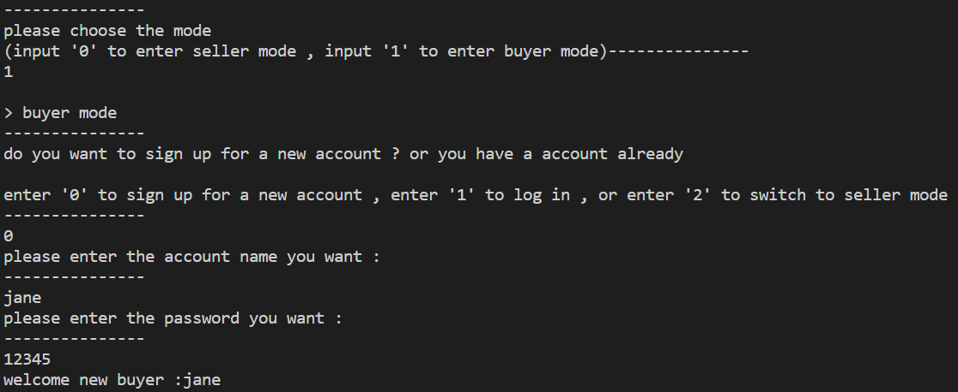
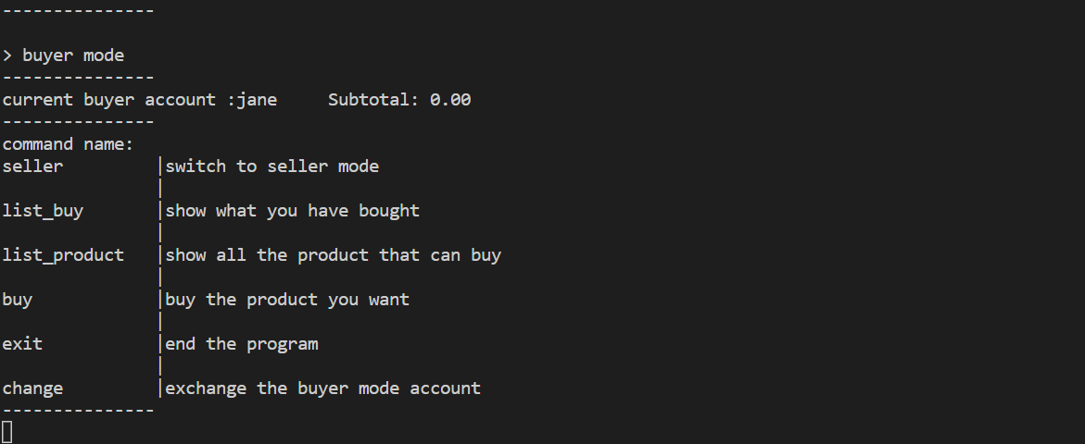
buyer

Slide 17
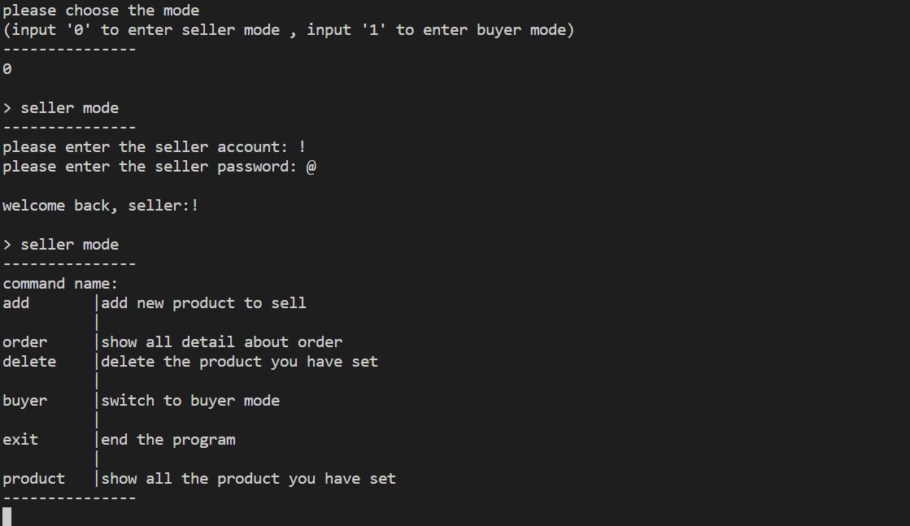
seller

Slide 18
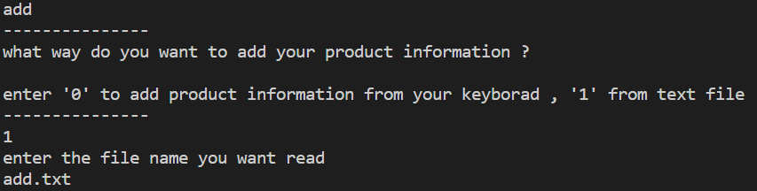
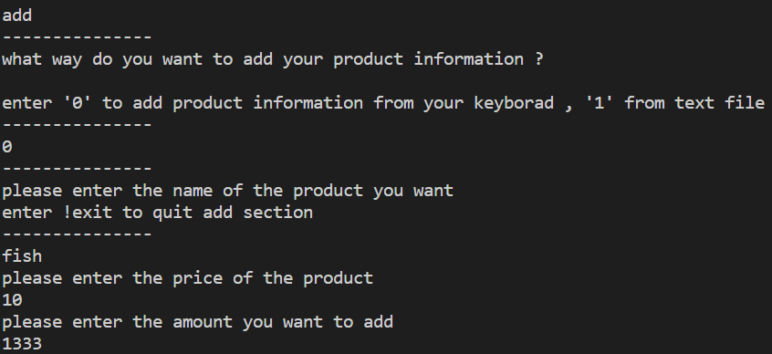
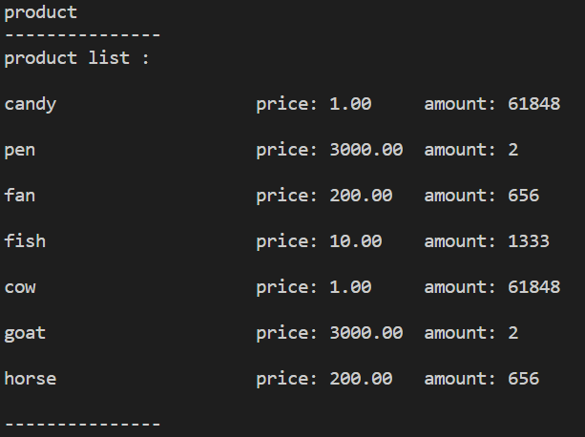
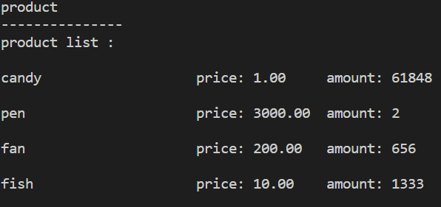
add

Slide 19
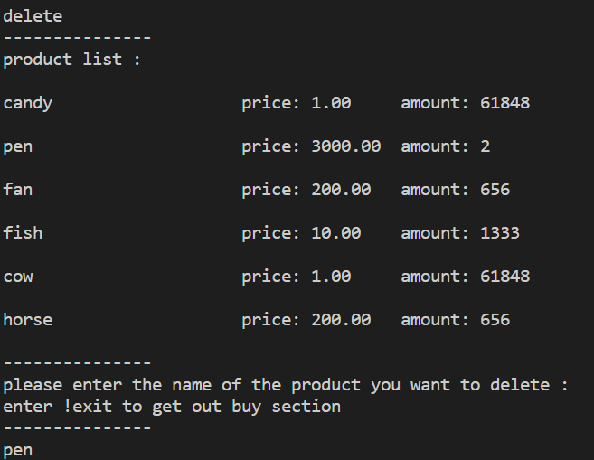
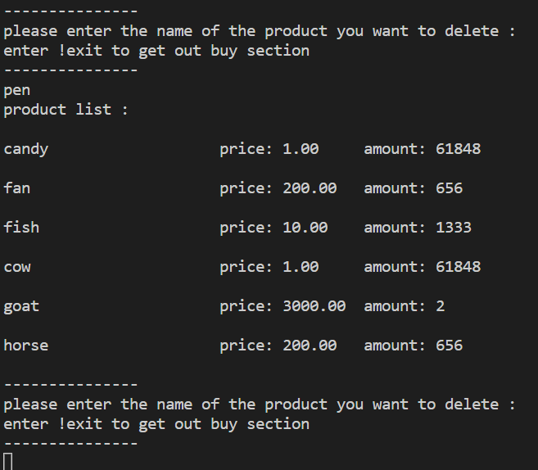
delete

Slide 20
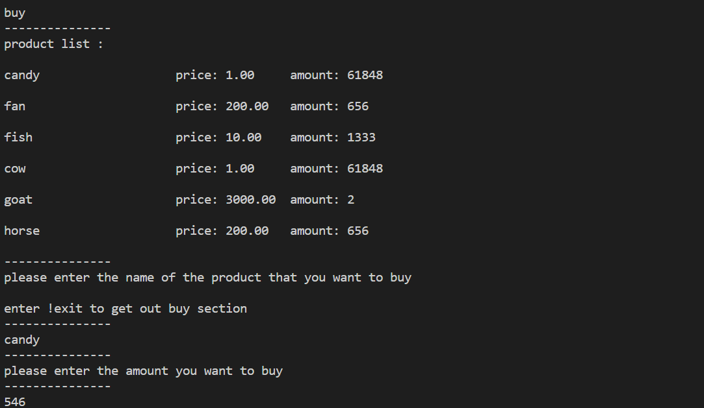

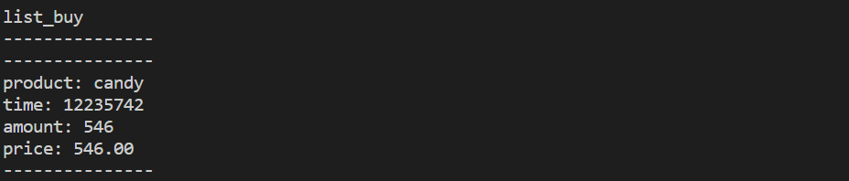
buy

Slide 21
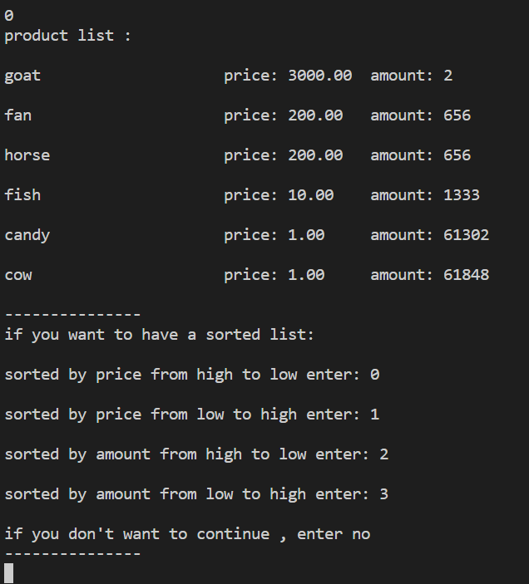
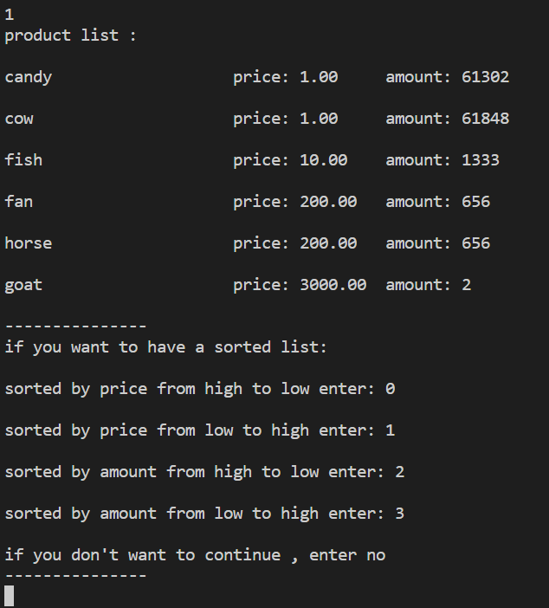
sort

Slide 22
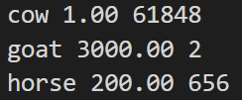

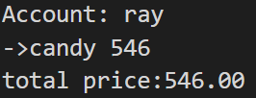
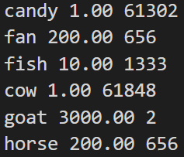
file
add.txt
buyer_account_list.txt
order_overview.txt
product_list.txt

