Slide 1
Large Scale Machine Learning
by
{Shiva Teja Reddy, Sachin Bhat, Umang Jain}

Slide 2
Topics
Introduction
Unsupervised & Supervised Machine Learning
Machine Learning Basics
Perceptrons
SVM
K nearest neighbour algorithm

Slide 3
Introduction
Machine Learning is a way of summarizing data, Learning about it and discovering something about the data that will be seen in future.
Eg: Classification of data

Slide 4
Unsupervised Machine Learning
Discussed in clustering in yesterdays presentation
The term “unsupervised” refers to the fact
that the input data does not tell the
clustering algorithm what the clusters
should be.

Slide 5
Supervised Learning
The available data includes information about the correct way to classify at least some of the data. The already classified data is called the training set.

Slide 6
Machine Learning Model/Basics

Slide 7
Training Sets and Training Examples
The data to which a machine-learning algorithm is applied is called a training set.
A training set consists of a set of pairs
(x, y),called training examples

Slide 8
What are x & y?
x is a vector of values, often called a feature vector. Each value, or feature,can be categorical (values are taken from a set of discrete values, such as {red, blue, green}) or numerical (values are integers or real numbers)
y is the label, the classification value for x.

Slide 9
The objective ?
The objective of the ML process is to discover a function y = f (x) that
best predicts the value of y associated with each value of x.

Slide 10
Possible values of y
y is a real number. In this case, the ML problem is called regression.
y is a boolean value true-or-false, more commonly written as +1 and −1,respectively. In this class the problem is binary classification.

Slide 11
3. y is a member of some finite set.The members of this set can be thought of as “classes,” and each member represents one class. The problem is Multiclass classification.

Slide 12
Some Illustrative Examples

Slide 13
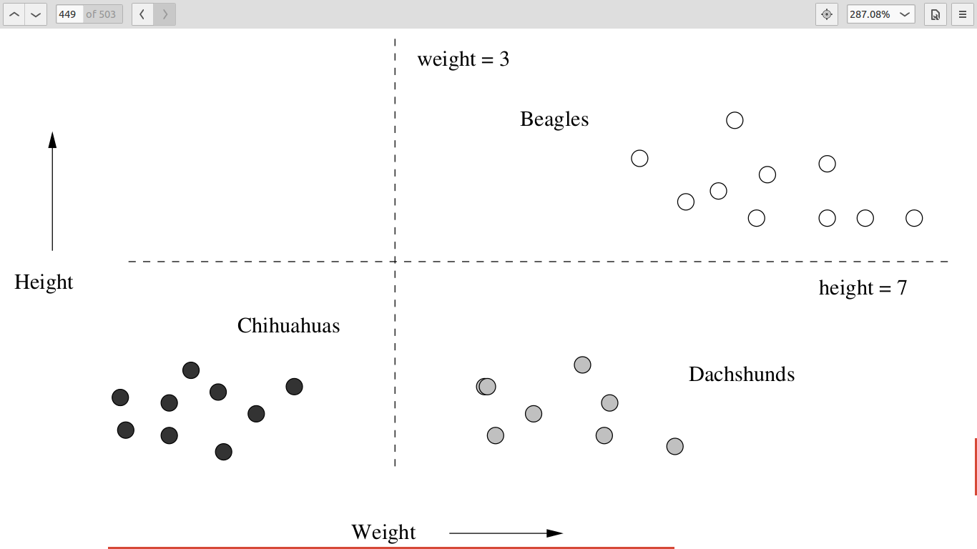
Some Illustrative Examples

Slide 14
This is plot of height and weight of dogs in three classes : Beagles, Chihuahuas, and Dachs-
hunds.
We can think of this data as a training set. Each pair (x, y) in the training set consists of a feature vector x of the form [height, weight]. The associated label y is the variety of the dog.
For eg : ([5 inches, 2 pounds], Chihuahua)

Slide 15
What about the decision function?
An appropriate way to implement the decision function f(x) would be to imagine two lines, as shown in the figure.
The Horizontal line represents a height of 7 inches and separates Beagles from Chihuahuas and Dachshunds.
The Vertical line represents a weight of 3 pounds and separates Chihuahuas from Beagles and Dachshunds.

Slide 16
As you can see,
Here, we are performing supervised learning with the data augmented by classifications for the training data

Slide 17
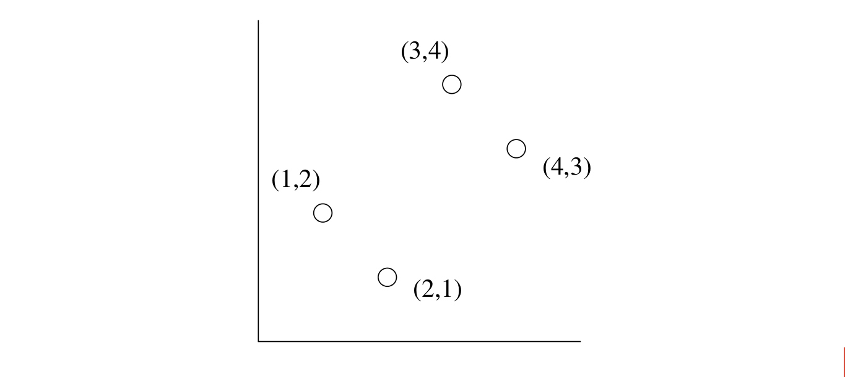
One more example ...

Slide 18
One dimensional feature vector
There are four points in the graph.
Here the vectors can be thought of as one dimensional.
i.e The point (1, 2) can be thought of as a pair ([1], 2), where [1] is the one-dimensional feature
vector x, and 2 is the associated label y.

Slide 19
The learning function?
Let us suppose we want to “learn” the linear function
f (x) = ax + b
that best represents the points of the training set.

Slide 20

The obvious !
The best f(x) is that with the least RMSE of the value of f(x) with the given value of y.

Slide 21
Expand the summation and differentiate it w.r.t a and b and we get
60a + 20b − 56 = 0
20a + 8b − 20 = 0
Solving this gives us
f(x) = ⅗ a + 1

Slide 22
Approaches to Machine Learning
1. Decision Trees
2. Perceptrons
3. Neural Networks
4. Instance based Learning
5. SVMs(Support Vector Machines)

Slide 23
Machine Learning Architecture
1. Training and Testing
2. Batch Learning
3. On-Line Learning
4. Feature Selection
5. Creating the Training Set

Slide 24
Training and Testing
Till now we have had a Data set that we used to train the Model.
A bit of the Data - Set is kept back as the Test set , to cross check the accuracy of the model once it has been generated

Slide 25
Overfitting of Data
Performance of a Model is not measured by its correctness when applied on the training set but when applied on Unseen Data.

Slide 26
How do we know that overfitting isn’t happening ?
If the error rate on the test data is not much worse than the error rate of the model on the
training data itself, then we expect there is little, if any, overfitting, and the model can be used

Slide 27
Batch Learning
The entire training set is available at the beginning of the process, and it is all used in whatever way the algorithm requires to produce a model once and for all.

Slide 28
On-Line Learning
The training set arrives in a stream and, like any stream, cannot be revisited after it is processed.
We maintain a model at all times

Slide 29
Batch vs On Line Learning
1. Deal with very large training sets, because it does not access more than one training example at a time.
2. Adapt to changes in the population of training examples as time goes on.

Slide 30
Feature Selection
The input we give to the model while training it is called the Feature.
Eg: Spam Mail Classification

Slide 31
Creating the Training Set
1. Creating labels for the unclassified data
2. Crowd-sourcing techniques can and have been used to label data.
Eg: Open Directory (DMOZ) has millions of pages labeled by topic. Useful for classification of Web Pages

Slide 32
Perceptrons

Slide 33
A Perceptron is a linear binary classifier.
Input:
Input Vector: x = [x 1 , x 2 , . . . , x d ]
Weight Vector w = [w 1 , w 2 , . . . , w d ]
Output:
-1 or +1

Slide 34
Hows the output decided?
Every perceptron has a threshold value , θ
+1 if w.x > θ,
-1 if w.x < θ.
-1 if w.x = θ.

Slide 35
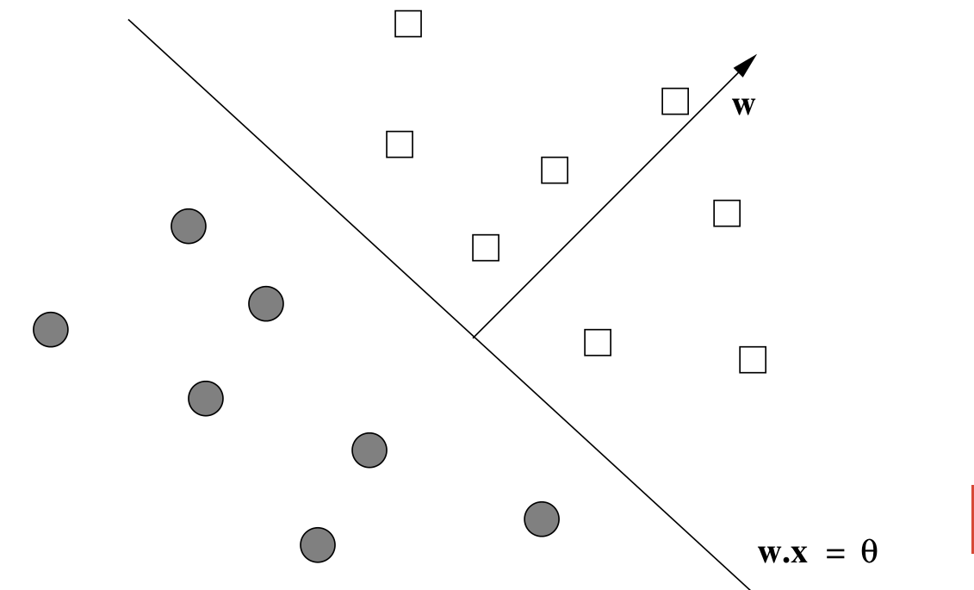

Slide 36
Visualising the bigger picture
The weight vector defines a Hyperplane
Points on the positive side are classified as +1
Points on the negative side are classified as -1
Data should be Linearly Separable.
Notes:
Explain the cases when more than one hyperplanes exist and when none of them exist

Slide 37
Training a Perceptron
Need to find a weight vector w and threshold θ such that all the feature vectors with y = +1 are on the positive side of the hyperplane and all those with y = −1 are on the negative side.
No guarantee that any hyperplane separates all the positive and negative examples in the training set

Slide 38
Steps in training the Perceptron
Assume the threshold is 0
Initialize the weight vector to all 0’s.
Pick up a learning parameter η, a small positive real number
If η is too small, convergence is slow
if η is too big, convergence is slow

Slide 39
for every t(x,y) in training examples
y ′ = w.x.
If y ′ and y have the same sign:
do nothing.
else if y ′ and y have different signs or y′=0:
replace w by w + ηyx.
Notes:
w + ηyx : That is, adjust w slightly in the direction of x.
moving w in the direction of x moves the hyperplane that is
perpendicular to w in such a direction that it makes it more likely that x will
be on the correct side of the hyperplane, although it does not guarantee that
to be the case.

Slide 40
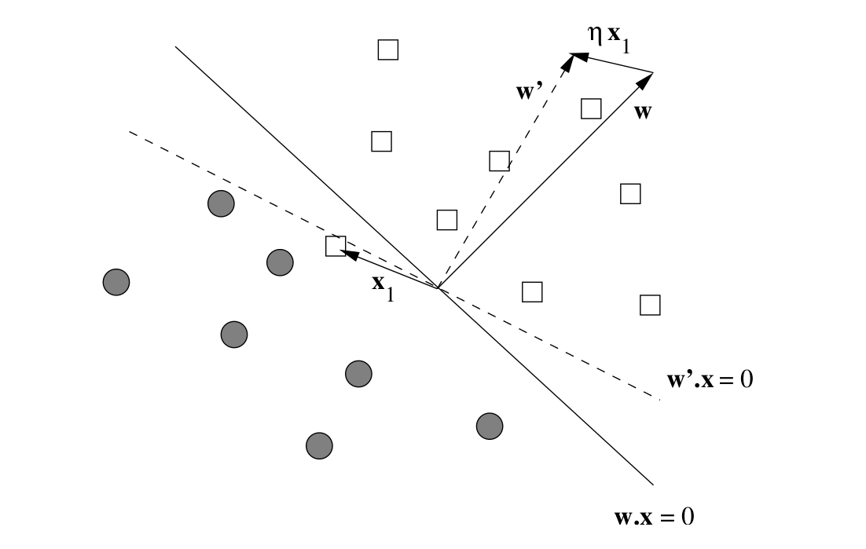

Slide 41
Example
Lets train a perceptron to classify spam Emails
The Training set :
Pairs (x, y) where x is a vector of 0’s and 1’s,
with each component x i corresponding to
the presence (x i = 1) or absence (x i = 0)

Slide 42
The value of y :
+1 if the email is known to be spam
−1 if it is known not to be spam.
Lets just assume that the training set has only 6 words and the learning rate is η = ½.

Slide 43
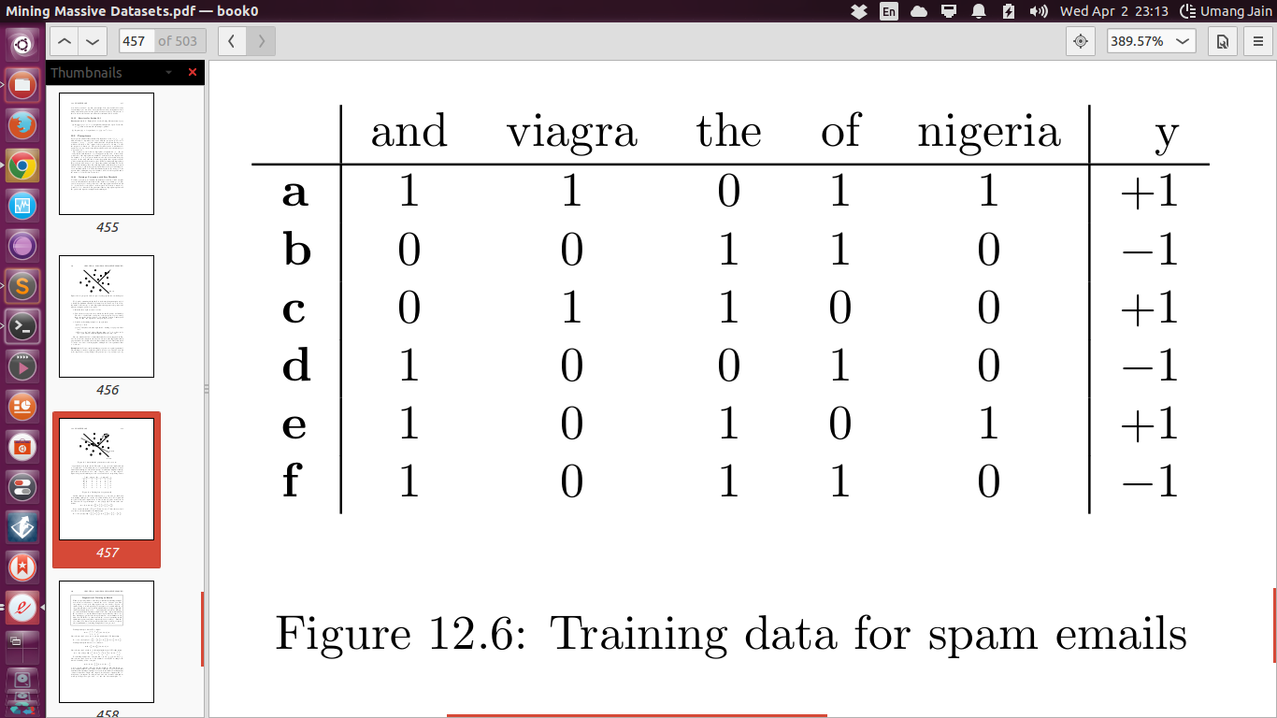

Slide 44
Step 1:
Initialize w = [0, 0, 0, 0, 0]
Step 2:
Compute w.a = 0
Step 3:
Since 0 is not positive so update w
w := w + (1/2)(+1)a.

Slide 45
w = [0, 0, 0, 0, 0] + [ 1/2,1/2,1/2,0,1/2,1/2]
= [ 1/2,1/2,1/2,0,1/2,1/2]
Step 4:
Repeat step 1 with the updated value of w

Slide 46
Convergence of Perceptrons
Till now , we just magically seemed to have a linearly separable data
Well in case the data isn’t linearly separable, The algorithm gets into a infinite loop !

Slide 47
Cases when the Algorithm fails
1. Linearly inseparable data
2. Very large data set (training might just never end! )
3. Even if test set is linearly separable, the actual unseen data set might turn out to be linearly inseparable

Slide 48
Ensuring convergence of Hyperplane
1. Terminate after a certain number of steps
2. Terminate when the number of misclassified training points stops changing.
3. Withhold a test set from the training data, and after each round, run the perceptron on the test data. Terminate the algorithm when the number of errors on the test set stops changing.

Slide 49
What about lowering the learning rate?
Keep reducing the learning constant according to the number of rounds
Initialize
η = η₀
and lower it according to
η = η₀ /(1 + ct)
where c is some small constant.

Slide 50
The Winnow Algorithm
Till now while updating the Weight vector , The update weight vector was obtained by adding an increment value to the previous Weight vector.
Winnow algorithm replaces addition with Multiplication

Slide 51
Whenever we wrongly classify the data , we update the weight vector on those elements which also exist in the training data either by multiplying it by a large number or by a small number depending on which side of the hyperplane the point lies on.

Slide 52
If w.x > θ and y = +1, or w.x < θ and y = −1:
no change to w
else if w.x ≤ θ and y = +1:
if x_{i} = 1:
then set w_{i} := 2w_{i}
else if w.x ≥ θ and y = −1:
if x_{i} = 1:
then set w_{i} := w_{i}/2.

Slide 53
Problems with Perceptrons
1. Biggest problem is that sometimes
the data is inherently not separable by a hyperplane
2. Overfitting
3. More than one hyperplanes possible, Choosing the optimal hyperplane

Slide 54
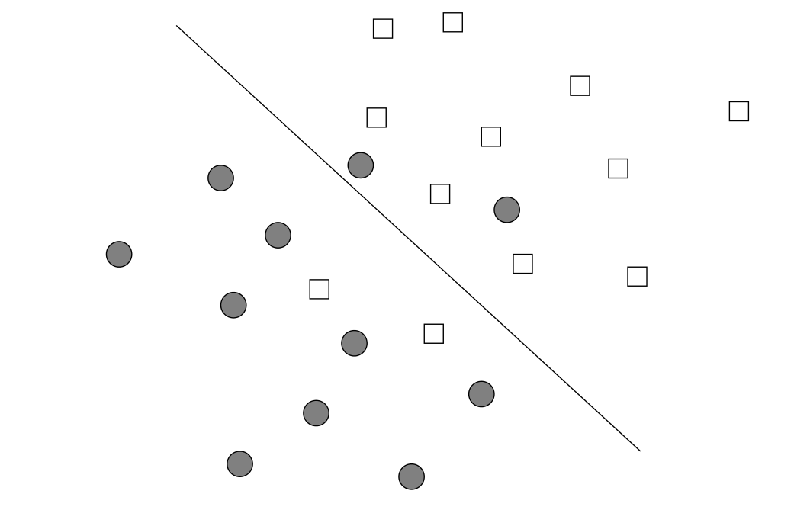
No hyperplane !

Slide 55
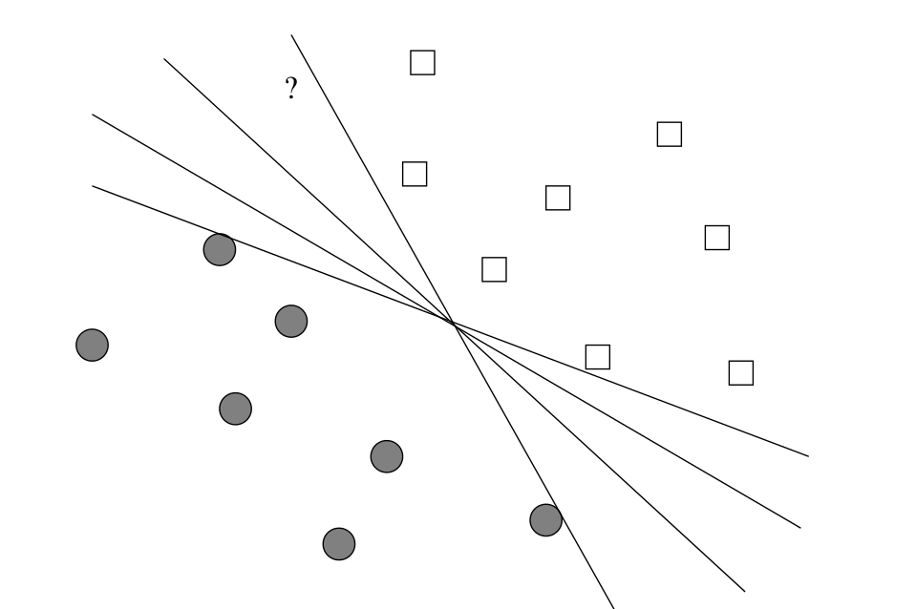
Too many HyperPlanes !

Slide 56
Parallel Implementation of Perceptrons using MapReduce

Slide 57
Why parallelize ?
The vectors tend to be really high dimensional

Slide 58
Map Function:
Input : Chunk of training examples
[{[x_{0,} x_{1,} x_{2,}...........x_{d}],y},
{[x_{0,} x_{1,} x_{2,}...........x_{d}],y},
:
{[x_{0,} x_{1,} x_{2,}...........x_{d}],y}]
and Initial Weight vector W
[w_{0,} w_{1,} w_{2,}...........w_{d}]

Slide 59
Output of Mapper:
Key: Index of the feature
Value: Increment to applied to the corresponding
weight value in the weight vector
{1, ηyx₁} , {2, ηyx₂}, {3, ηyx₃} ,..., {d, ηyx_{d}}
where d is dimension of the feature vector,
i.e. the number of features

Slide 60
What exactly is happening in map?
Each mapper knows the current w
It computes w.x for each feature vector and compares that dot product with the label y which is +1 or −1, associated with x.
If the signs disagree, then for each nonzero component x i of x the key-value pair(i, ηyx i ) is produced

Slide 61
Reduce Function:
Input : {Key, Value} pairs
{1, ηyx₁} , {2, ηyx₂}, {3, ηyx₃} ,..., {d, ηyx_{d}}
{1, ηyx₁} , {2, ηyx₂}, {3, ηyx₃} ,..., {d, ηyx_{d}}
:
{1, ηyx₁} , {2, ηyx₂}, {3, ηyx₃} ,..., {d, ηyx_{d}}
One set of {Key, Value} would be generated for each training example
Output : New weight vector

Slide 62
What exactly is happening in reduce ?
For each key i, the Reduce task that handles
key i adds all the associated increments and
then adds that sum to the ith component
of w.

Slide 63
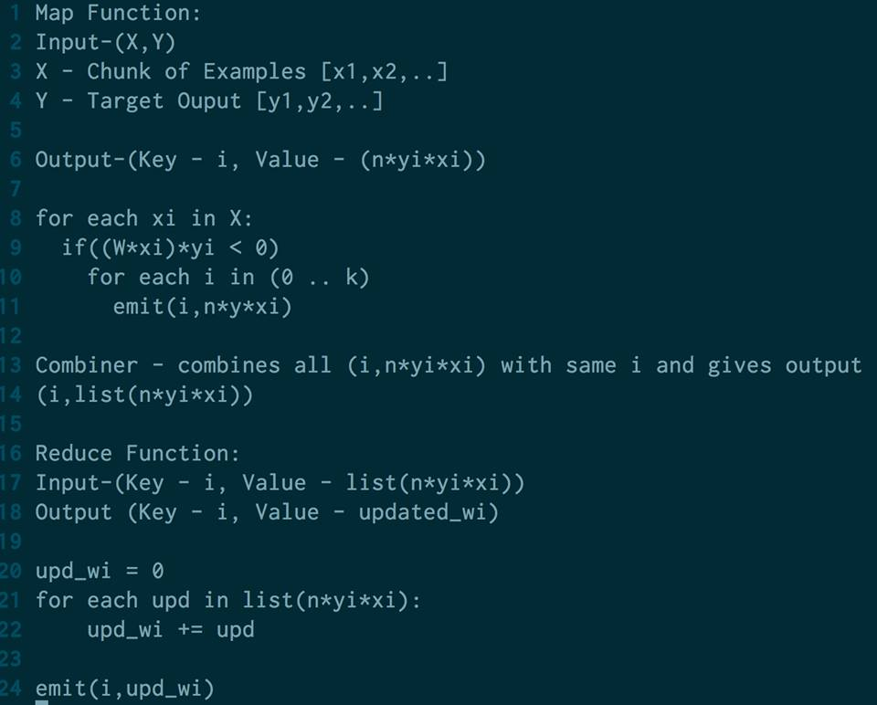
Pseudocode:

Slide 64
Looping the Map Reduce Jobs
One MR job might not be enough to train the perceptron
So, We can loop over a different training set because the effect on w will be different as w is different after each iteration.

Slide 65
Support Vector Machines

Slide 66
SVMs
Improvement on the perceptrons
Can separate non-linear data
Selects a hyperplane that maximizes the margin - the distance between the hyperplane and the closest points of the training set.

Slide 67
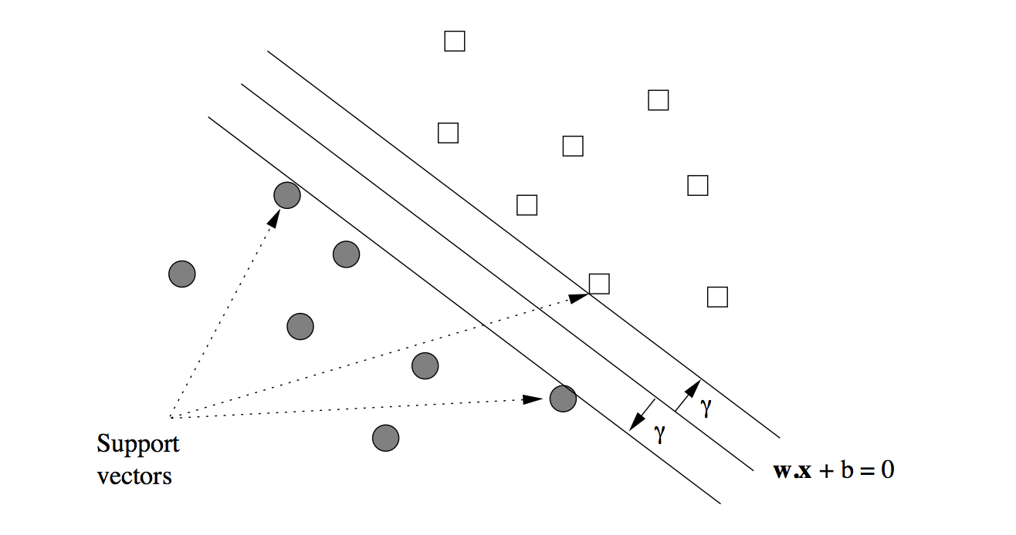
SVMs Contd...

Slide 68
Goal of SVM
Given a training set (x₁, y₁), (x₂, y₂),...,(x_{n}, y_{n})
Maximize γ (by varying w and b) subject to the constraint that for all i = 1,2,...,n
y_{i}(w.x_{i} + b) > γ

Slide 69
Problems With Previous Formulation
We have y_{i}(w.x_{i} + b) > γ
Multiplying 2 on both sides gives
y_{i}((2w).x_{i} + 2b) > 2γ
Which implies choosing 2w and 2b can get us better γ

Slide 70
Normalization The Hyperplane
Solution for the previous problem - Normalize the weight vector w i.e, the unit of measure perpendicular to the separating hyperplane is the unit vector w/||w||.

Slide 71
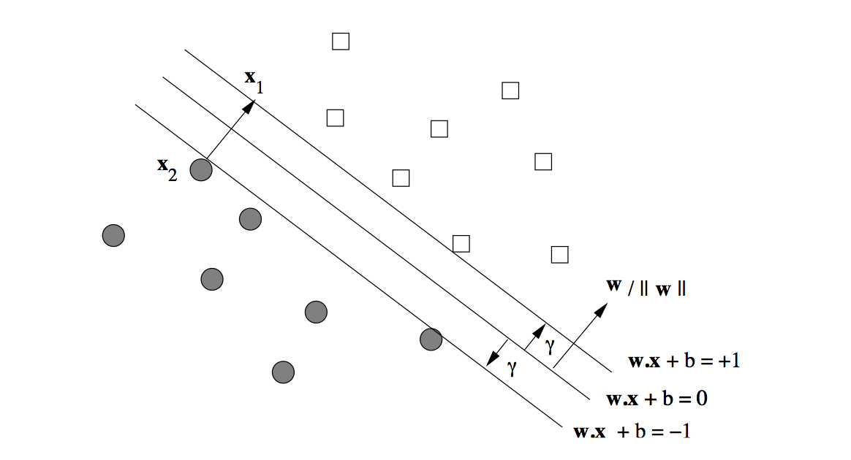

Slide 72
Consider x₁ and x₂ in the previous diagram.
x₁ = x₂ + 2γ * w/||w||
Solving this gives
γ*(w.w)/||w|| = 1
=> γ = 1/||w||

Slide 73
What was that?
In a special case we proved that, to maximize γ we have to minimize ||w|| i.e γ is inversely proportional to ||w||
Can be generalized easily.

Slide 74
Finding The Hyperplane
Minimize ||w|| (by varying w and b) subject to the constraint that for all i = 1,2,...n,
y_{i}(w.x_{i} + b) > 1
We’ll see how to solve this

Slide 75
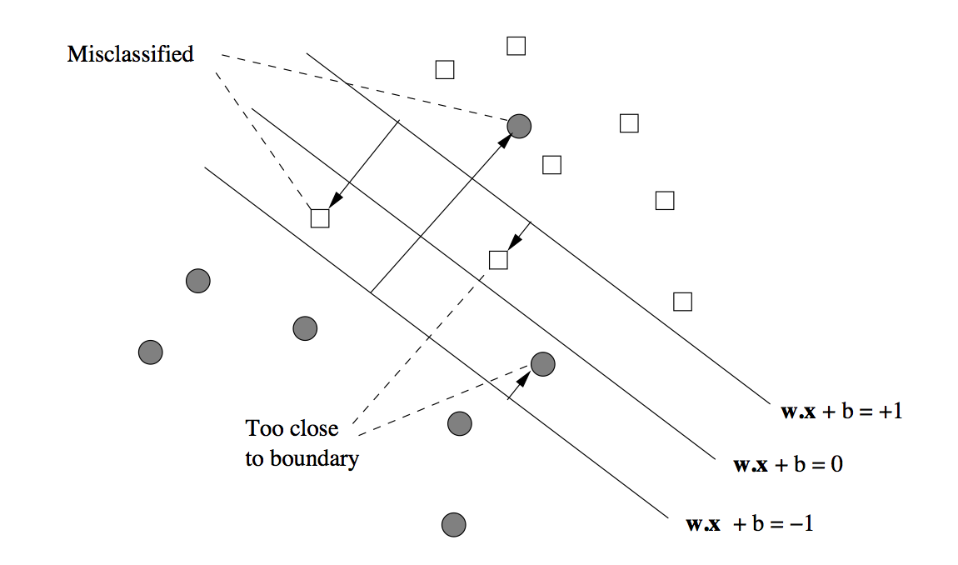
Finding Optimal Approximate Separators
It is okay to misclassify a few points

Slide 76
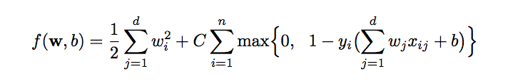
Approximate Separators Contd..
Define a new function that calculates the cost of misclassification
Our goal is to minimize the function

Slide 77
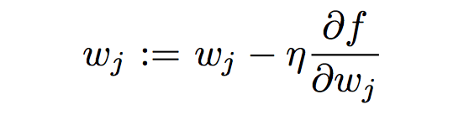
SVM Solutions By Gradient Descent
Similar to perceptrons, iteratively calculate each component of weight vector using the following equation

Slide 78
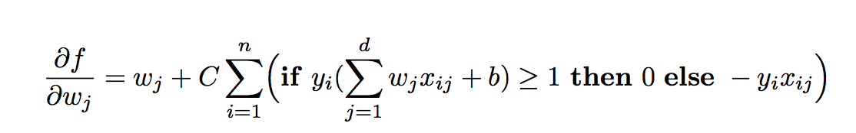
Gradient Descent Contd..

Slide 79
Finding Hyperplane
Algorithm using Gradient Descent
Pick values for the parameter C and η
Initialize the values w, including the (d+1)st component b.

Slide 80
Finding Hyperplane Contd..
Then, repeatedly:
Compute the partial derivatives of f(w, b) with respect to the w_{j}’s
Adjust the values of w by subtracting η∂f/∂w_{j}

Slide 81
MapReduce for SVM
Map Function:
Input-(W,X,Y)
W - Weight matrix [w1,w2,..]
X - Chunk of Examples [x1,x2,..]
Y - Target Ouput [y1,y2,..]
Output-(Key - i, Value - (upd_wi))
while (termination criteria not reached):
Compute the partial derivatives of f(w) with respect to the wj’s.
for each j in (1 .. W.length)
wj -= η*∂f/∂w_{j}
for each i in (1 .. W.length):
emit(i,upd_wi)

Slide 82
MapReduce for SVM contd..
Combiner - combines all (i,upd_wi) with same i and gives output
(i,list(upd_wi))
Reduce Function:
Input-(Key - i, Value - list(upd_wi))
Output (Key - i, Value - final_wi)
sum_upd_wi = 0
for each upd in list(n*yi*xi):
sum_upd_wi += upd_wi
fin_upd_wi = sum_upd_wi / (list(upd_wi)).length /* Taking the average */
emit(i,fin_upd_wi)

Slide 83
k Nearest Neighbors
Based on the paper:
Chi Zhang, Feifei Li, and Jeffrey Jestes. 2012. Efficient parallel kNN joins for large data in MapReduce. In Proceedings of the 15th International Conference on Extending Database Technology (EDBT '12)

Slide 84
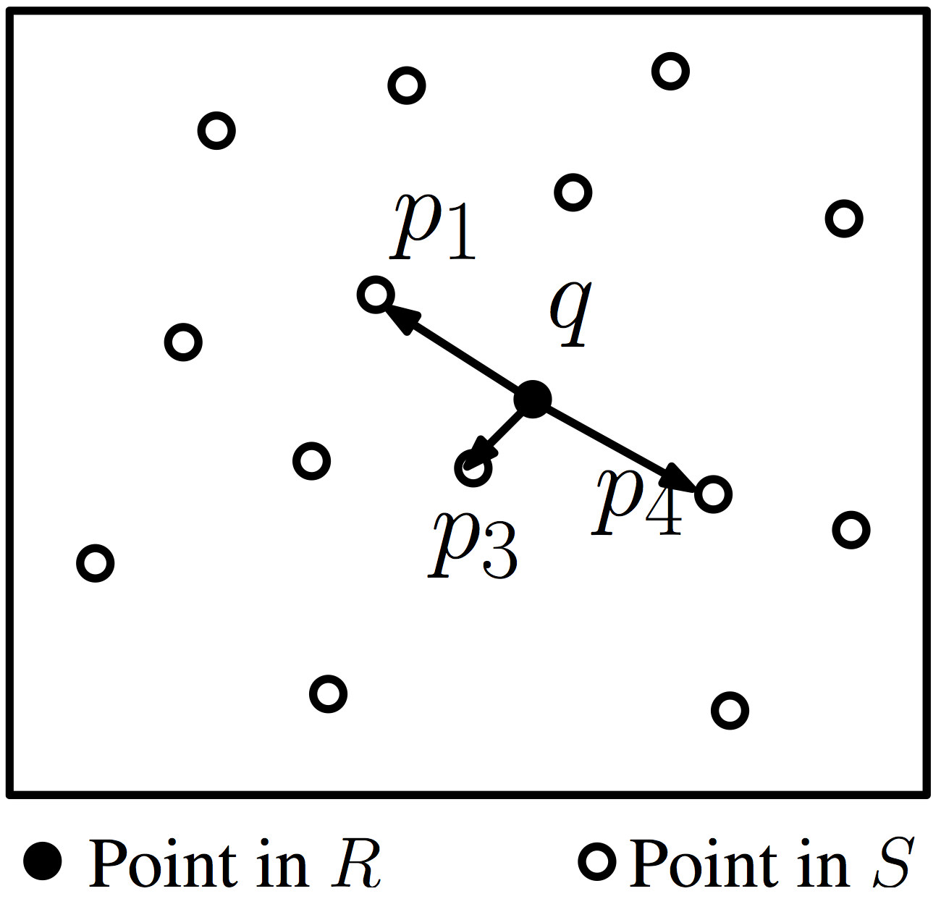
k nearest neighbor join (kNN join)
Given two data sets R and S, for every point q in R, kNN join returns k nearest points of q from S
3-NN join for q
(q, p1)
(q, p3)
(q, p4)

Slide 85
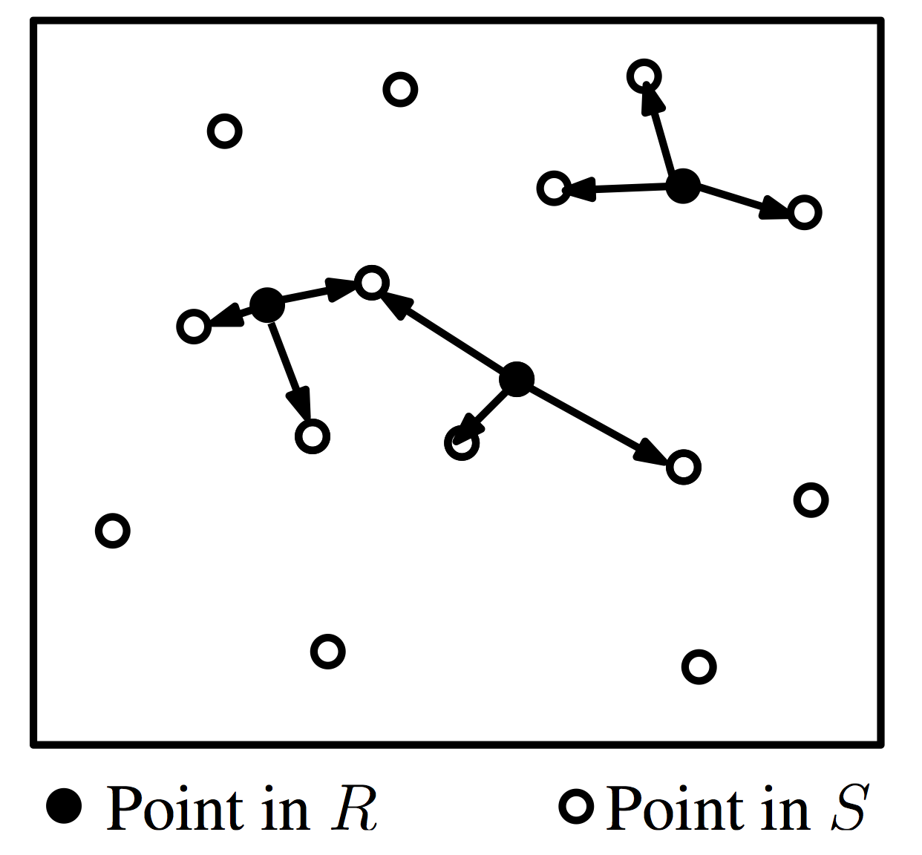
kNN in S for all points in R
3NN join for R

Slide 86
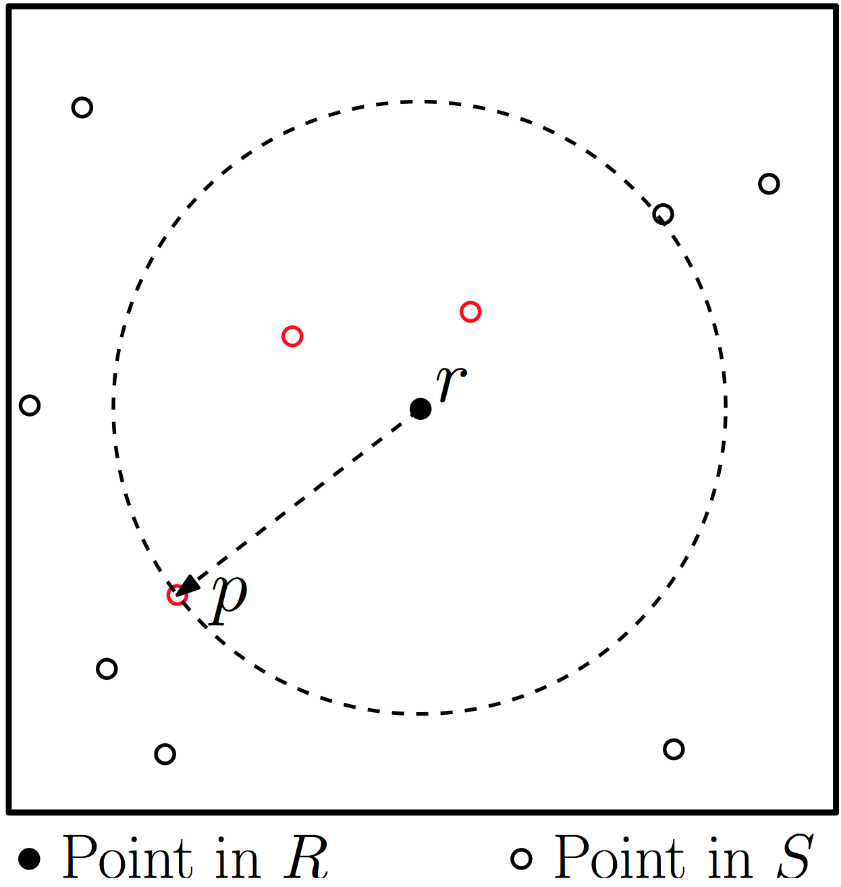
Exact kNN Join
knnJ(R,S) = {(r, knn(r, S))| for all r ∈ R}

Slide 87
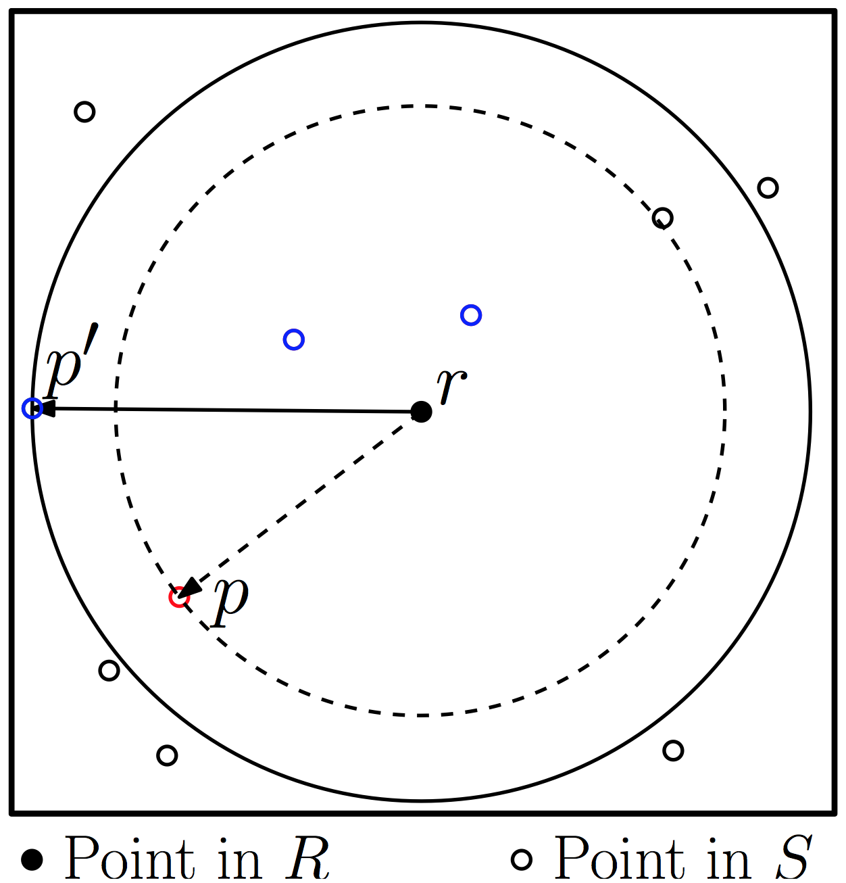
Approximate kNN Join
aknn(r,S) = approximate kNN of r from S
aknnJ(R,S) = {(r,aknn(r,S))| for all r ∈ R}

Slide 88
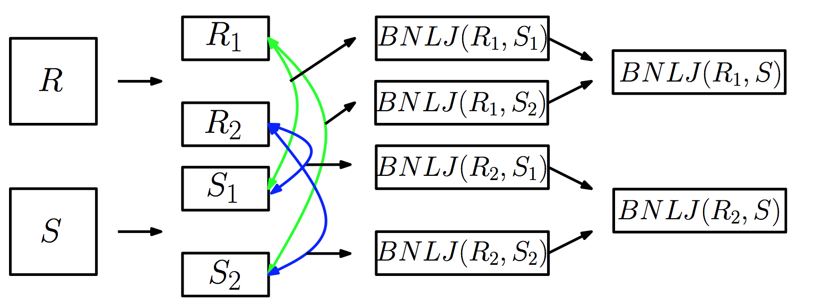
Exact kNN join: Block Nested Loop Join
Block nested loop join (BNLJ) based method
1. Partition R and S, each into n equal-sized disjoint blocks.
2. Perform (BNLJ) for each possible R_{i} ,S_{j} pairs of blocks
3. Get global kNN results from n local kNN results for every record in R

Slide 89
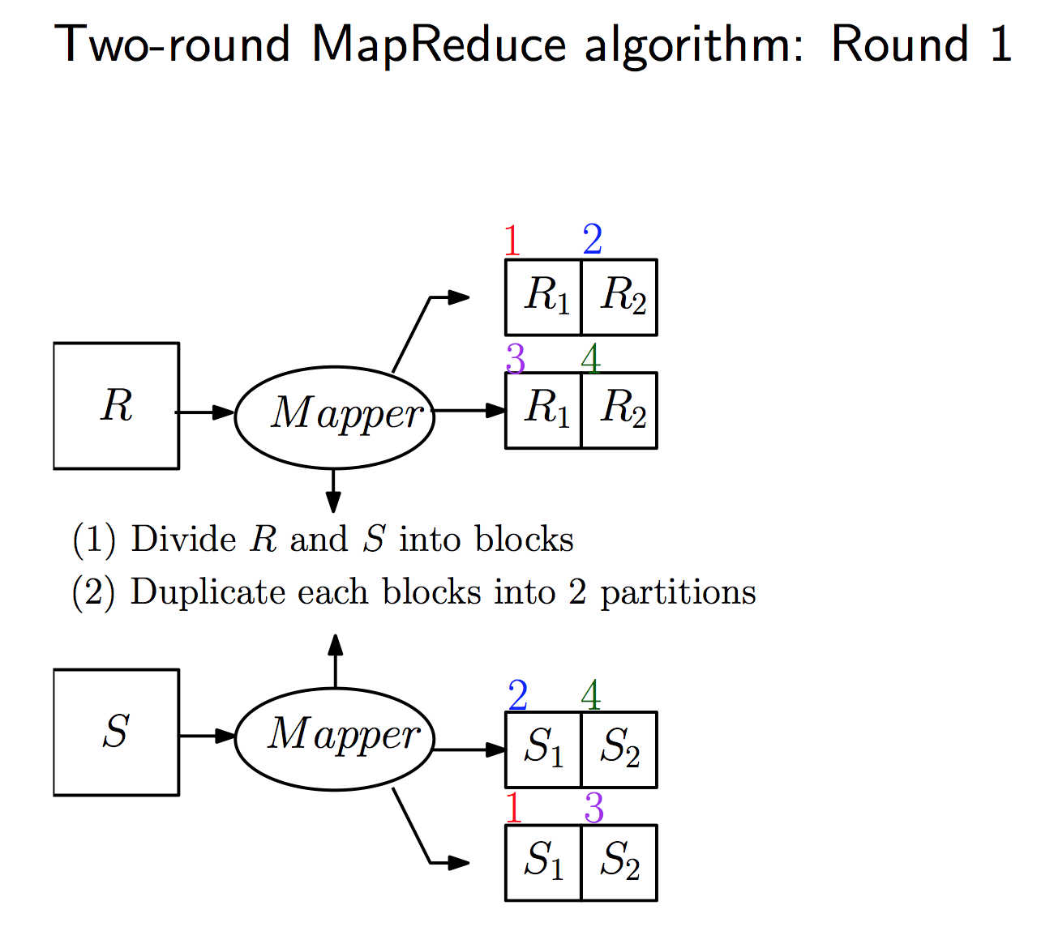

Slide 90
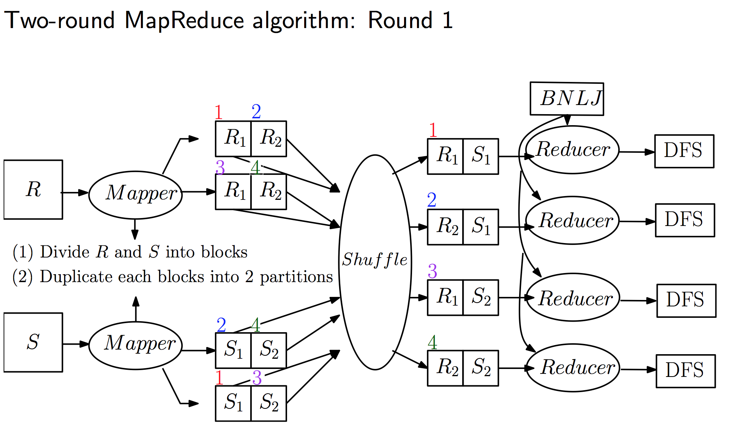

Slide 91
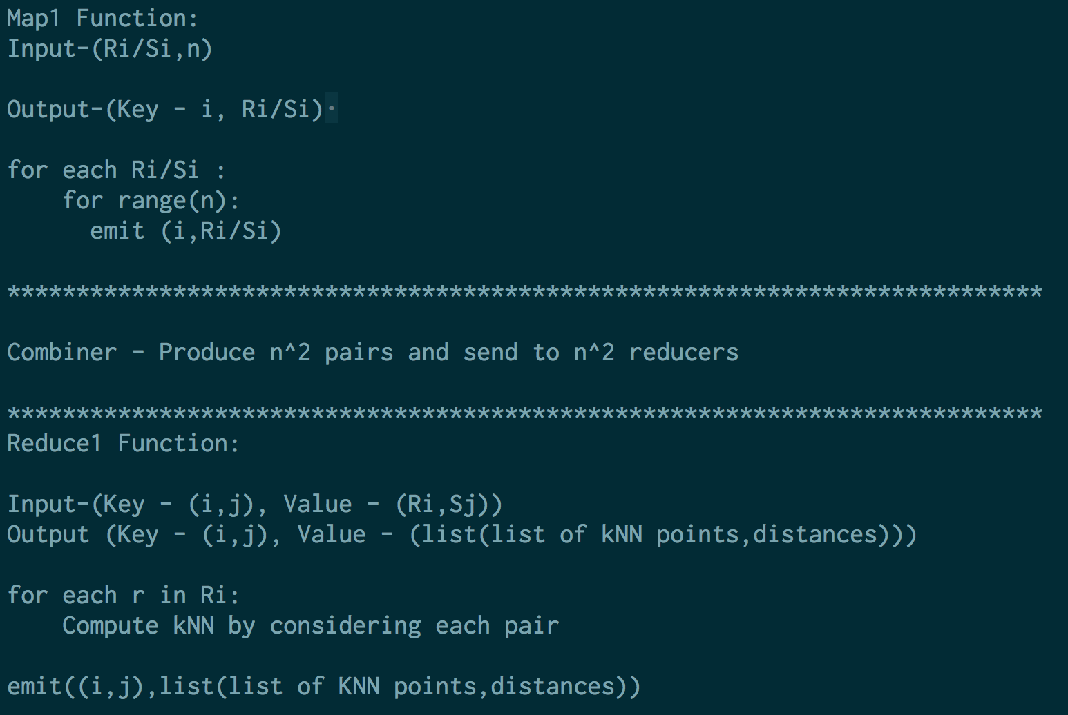

Slide 92
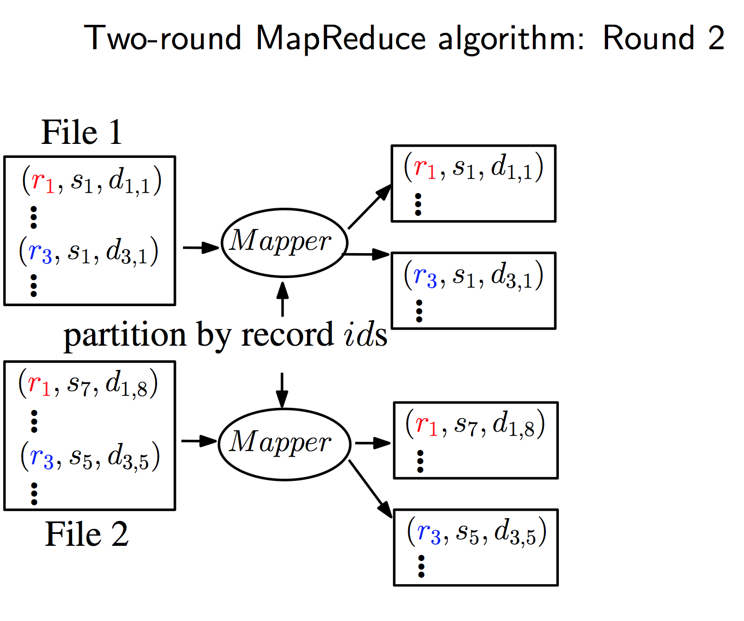

Slide 93
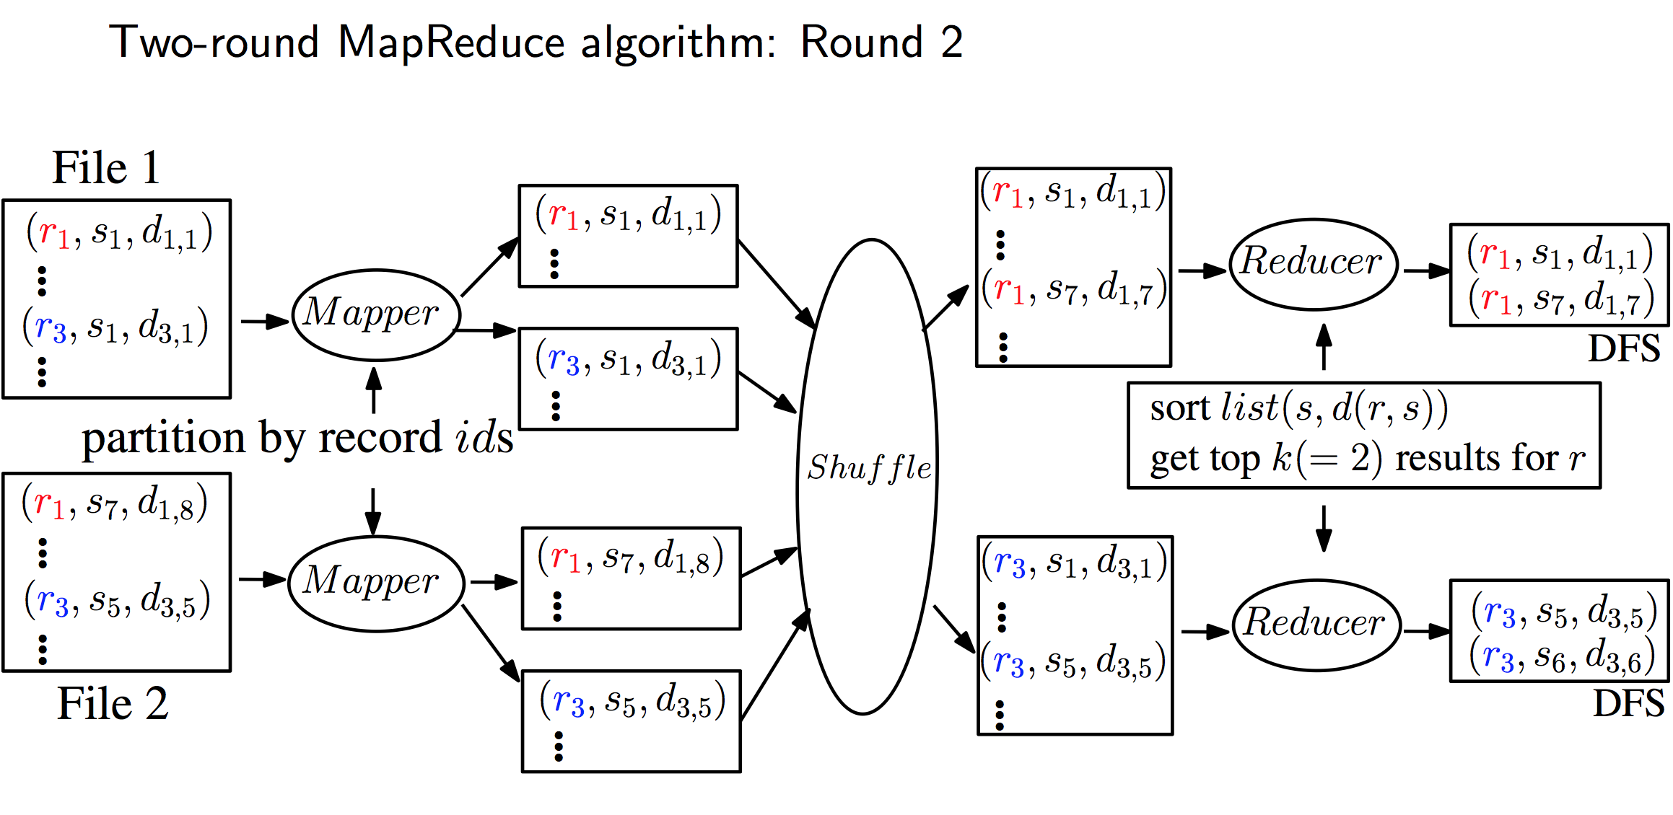

Slide 94
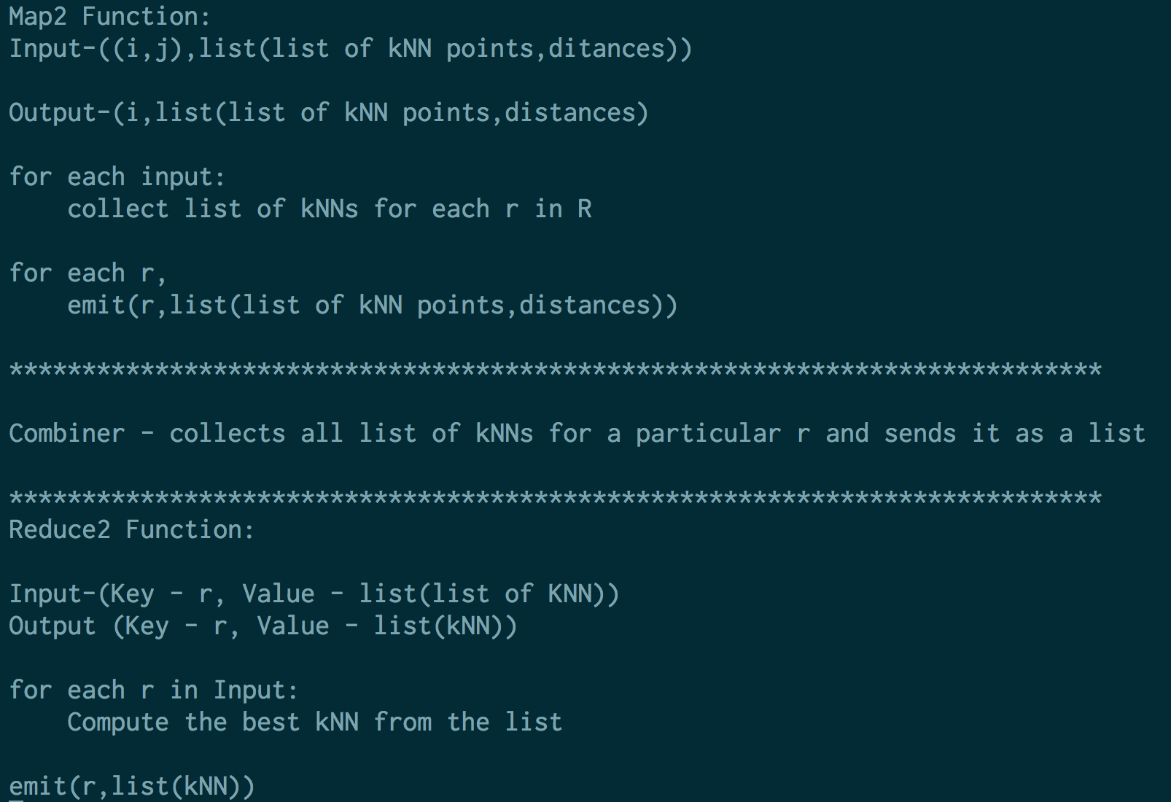

Slide 95
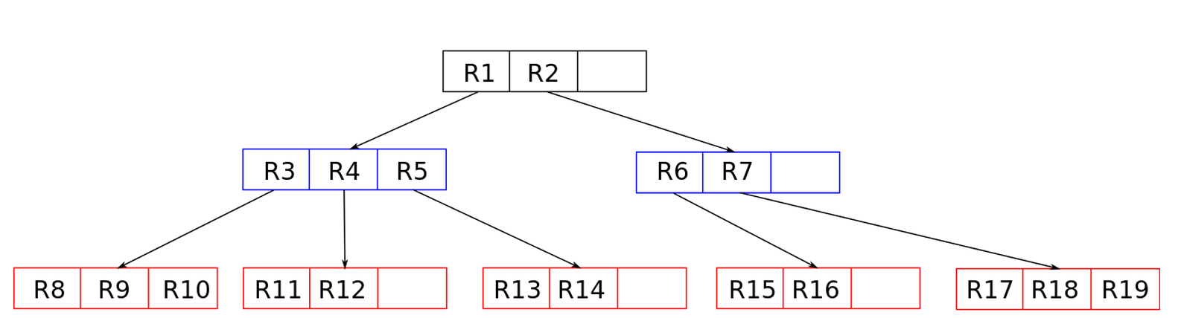
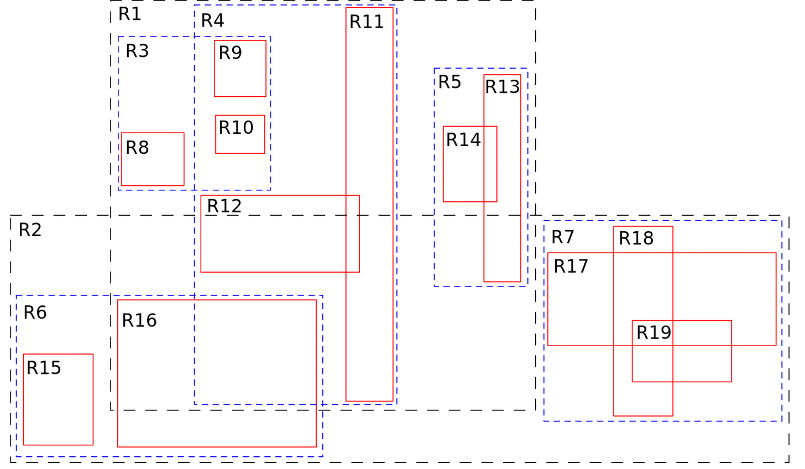
R-Tree to improve performance
R-trees are tree data structures used for spatial access methods
They are balanced trees.

Slide 96
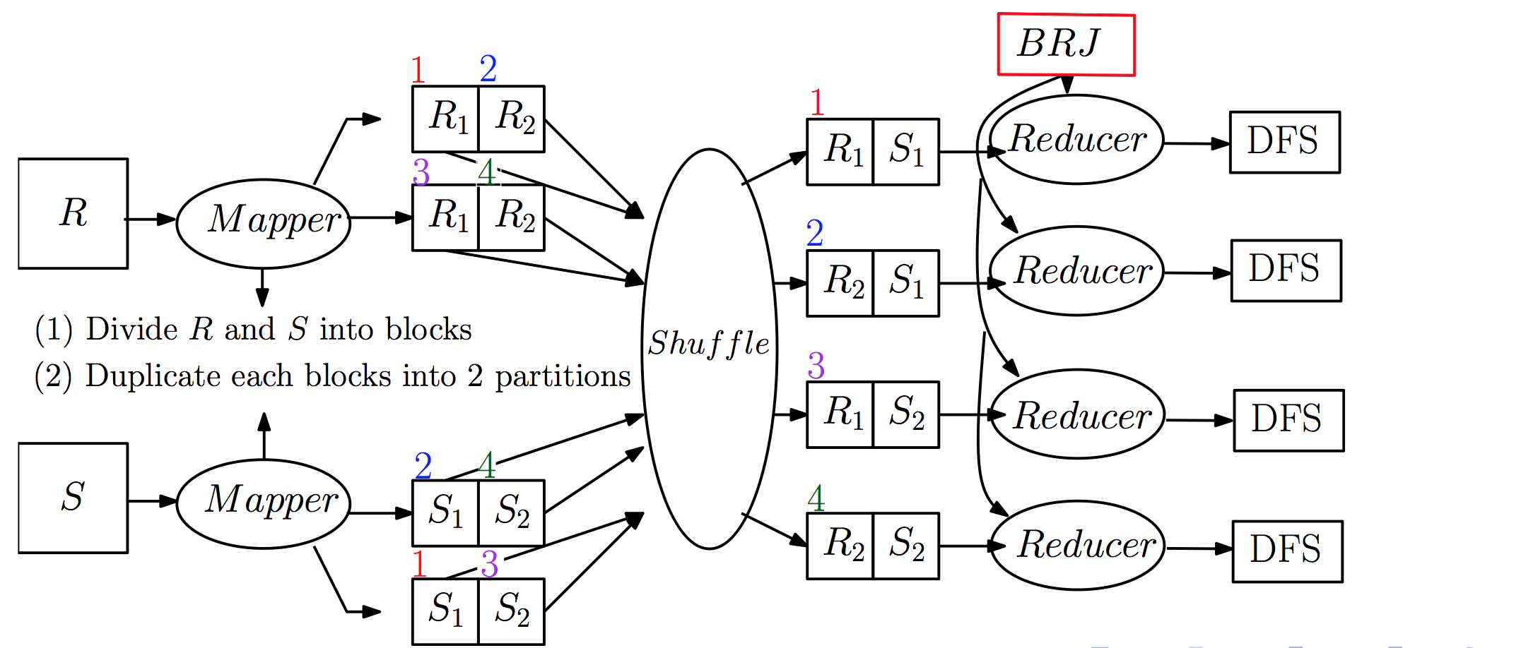
Build R-tree index for a block of S in a bucket to speed up kNN computations.
Similar to BNLJ algorithm, only need to replace BNLJ with block R-tree join (BRJ) in the first round.

Slide 97
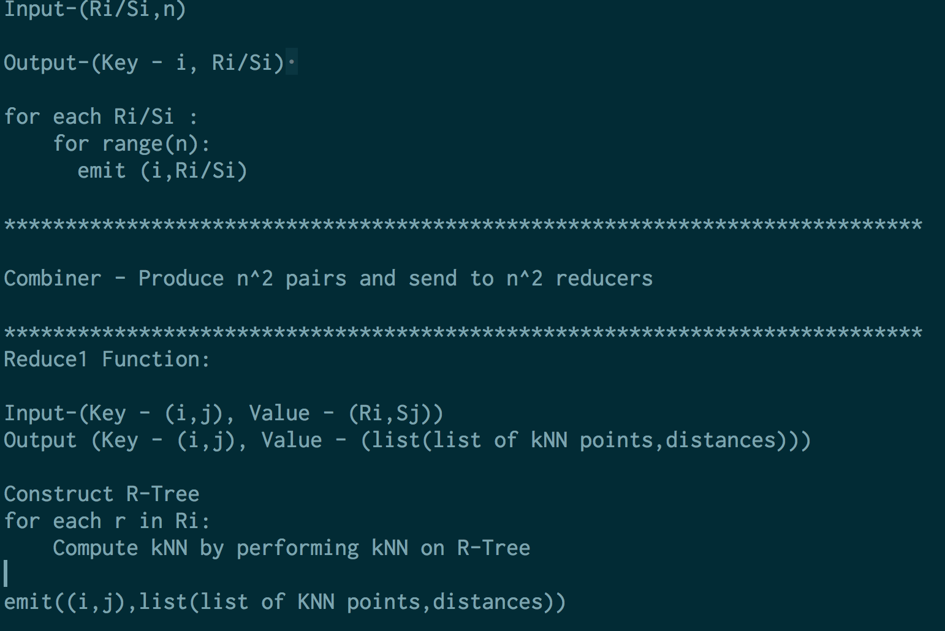

Slide 98
Approximate kNN Join
Problem with exact kNN join solution
Too much communication and computation (n² buckets required)
We need to find a solution requiring O(n) buckets
Approximate solutions
Space-filling curve based methods (dubbed zkNN)

Slide 99
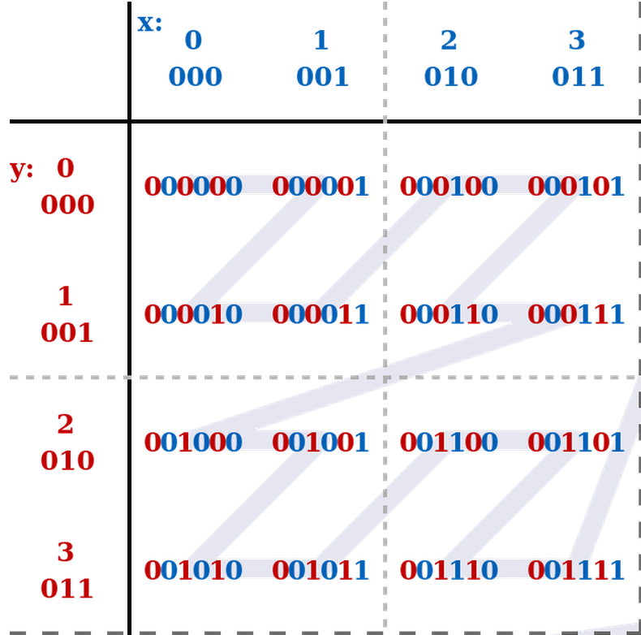
The idea of zkNN - maintaining spatial locality
Transform d-Dimensional points to 1-D values using Z-value
Map d-dimensional kNN join query to to 1-D range queries
Z-value order:
(0,0) -> 0
(1,0) -> 1
(0,1) -> 2
(1,1) -> 3
(2,0) -> 4
(3,0) -> 5
(2,1) -> 6
(3,1) -> 7
(0,2) -> 8
.
.
.

Slide 100
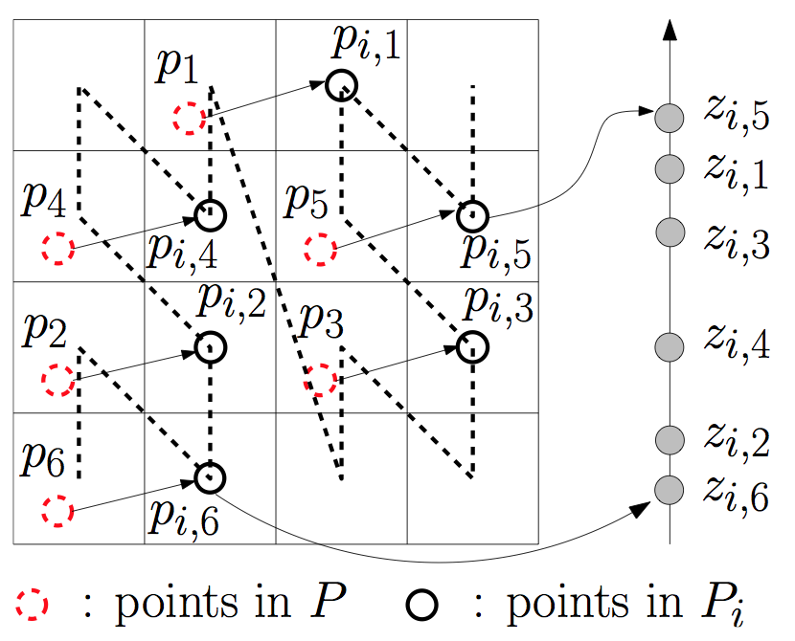
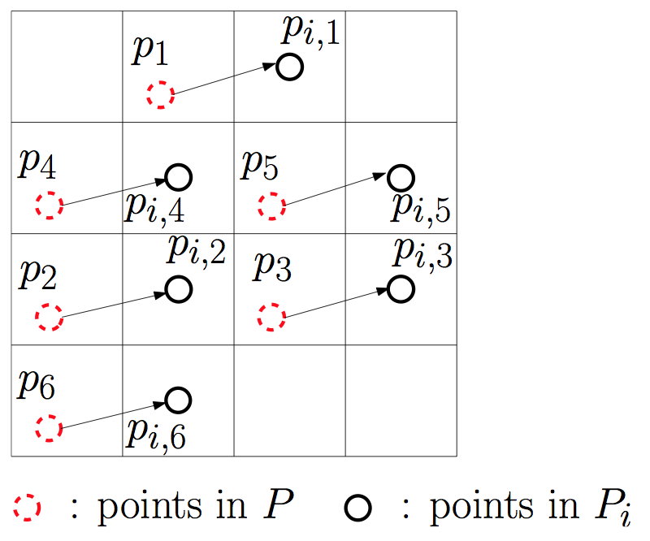
Random shift copies

Slide 101
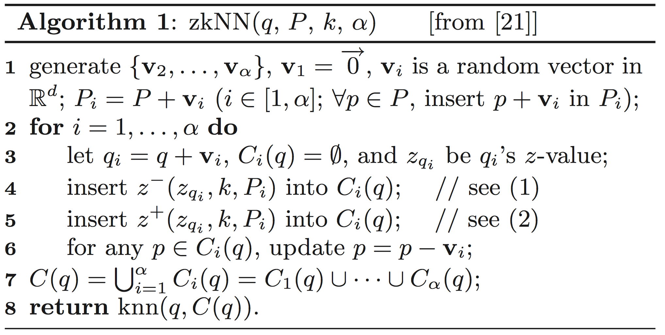
The algorithm is as follows:

Slide 102
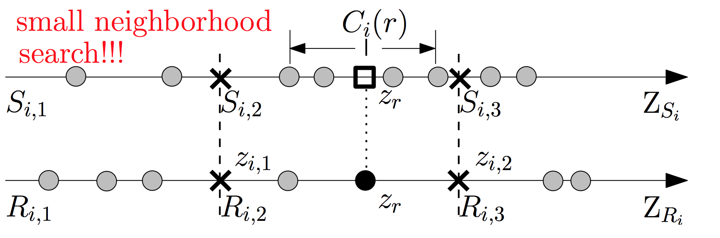
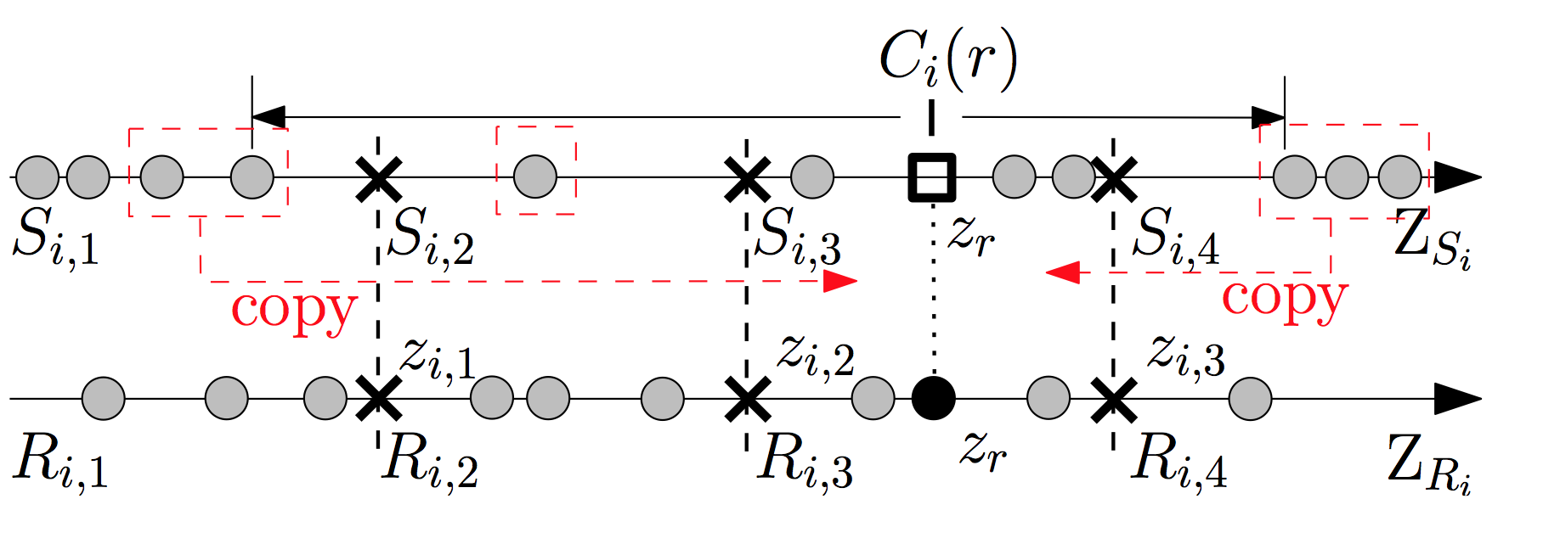
Partitioning R and S

Slide 103
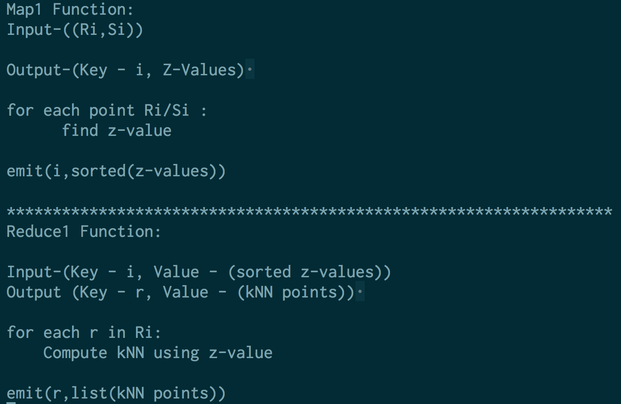
Implementation using MapReduce

Slide 104
} Thank You {
:wq

