Slide 1
Large Scale ML
by
{Sachin Bhat, Shivateja Reddy, Umang Jain}
Notes:
<number>

Slide 2
Quick Recap
Machine Learning is a way of summarizing data, Learning about it and discovering something about the data that will be seen in future.
“Unsupervised ML” refers to the ML when the input data does not tell the clustering algorithm what the clusters should be.
"Supervised ML" refers to when the available data includes information about the correct way to classify at least some of the data. The already classified data is called the training set.
Notes:
<number>

Slide 3
Format of Input Data& Objective of the ML Process
The training set consists of a set of pairs (x, y),called training examples.
x is a vector of values, often called a feature vector.
y is the label, the classification value for x.
The objective of the ML process is to discover a function y = f (x) that best predicts the value of y associated with each value of x.
Notes:
<number>

Slide 4
What we were supposed to do
Map Reduce Code for Perceptron
Map Reduce Code for SVM
Map Reduce Code for KNN-Joins
Notes:
<number>

Slide 5
What we did
Exactly what we were supposed to do
Notes:
<number>

Slide 6
Perceptron
A Perceptron is a linear binary classifier.
Data should be Linearly Separable.
Need to find a weight vector w and threshold θ such that all the feature vectors with y = +1 are on the positive side of the hyperplane and all those with y = −1 are on the negative side.
Learning Rate = 0.1
Test for convergence : Difference between weights is negligible
Notes:
<number>

Slide 7
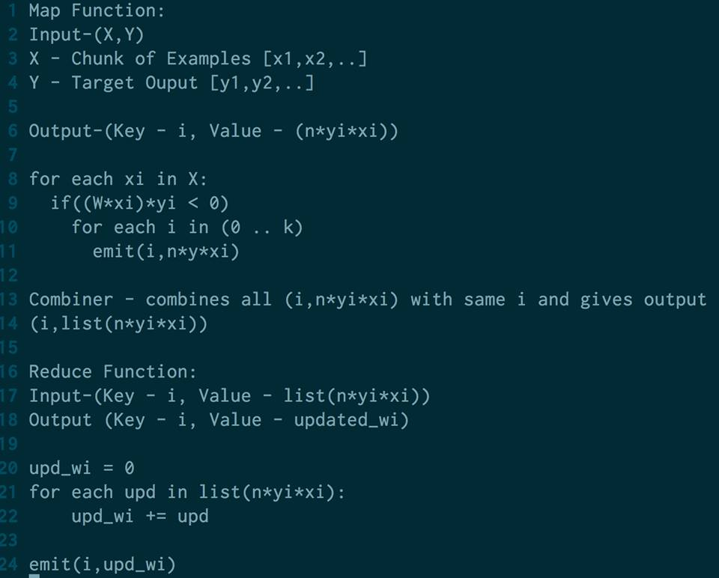
Notes:
<number>

Slide 8
SVM
Can separate non-linear data
Selects a hyperplane that maximizes the margin - the distance between the hyperplane and the closest points of the training set.
Given a training set (x1, y1), (x2, y2),...,(xn, yn) , maximize γ (by varying w and b) subject to the constraint that for all i = 1,2,...,n
yi(w.xi + b) > γ
Notes:
<number>

Slide 9
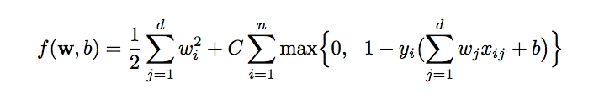
Goal is to minimize this:
Notes:
<number>

Slide 10
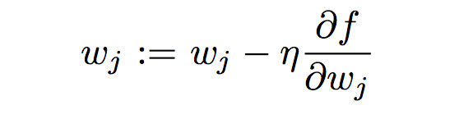
Similar to perceptrons, iteratively calculate each component of weight vector using the following equation
Notes:
<number>

Slide 11
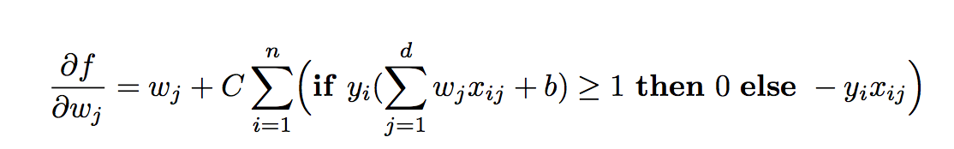
Calculating the change
Notes:
<number>

Slide 12
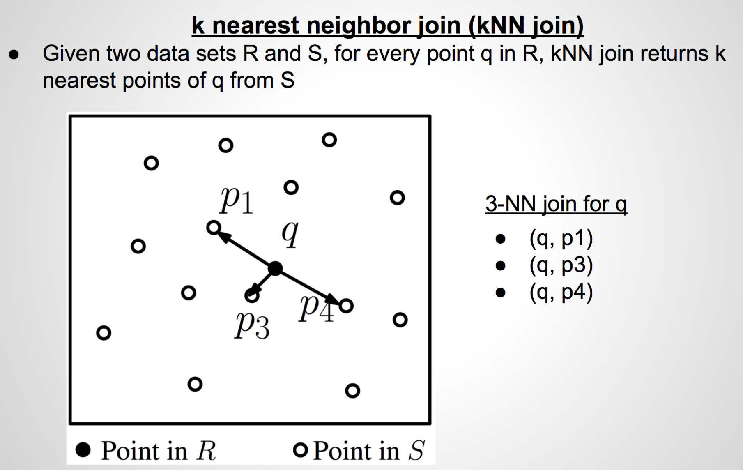
kNN Join

Slide 13
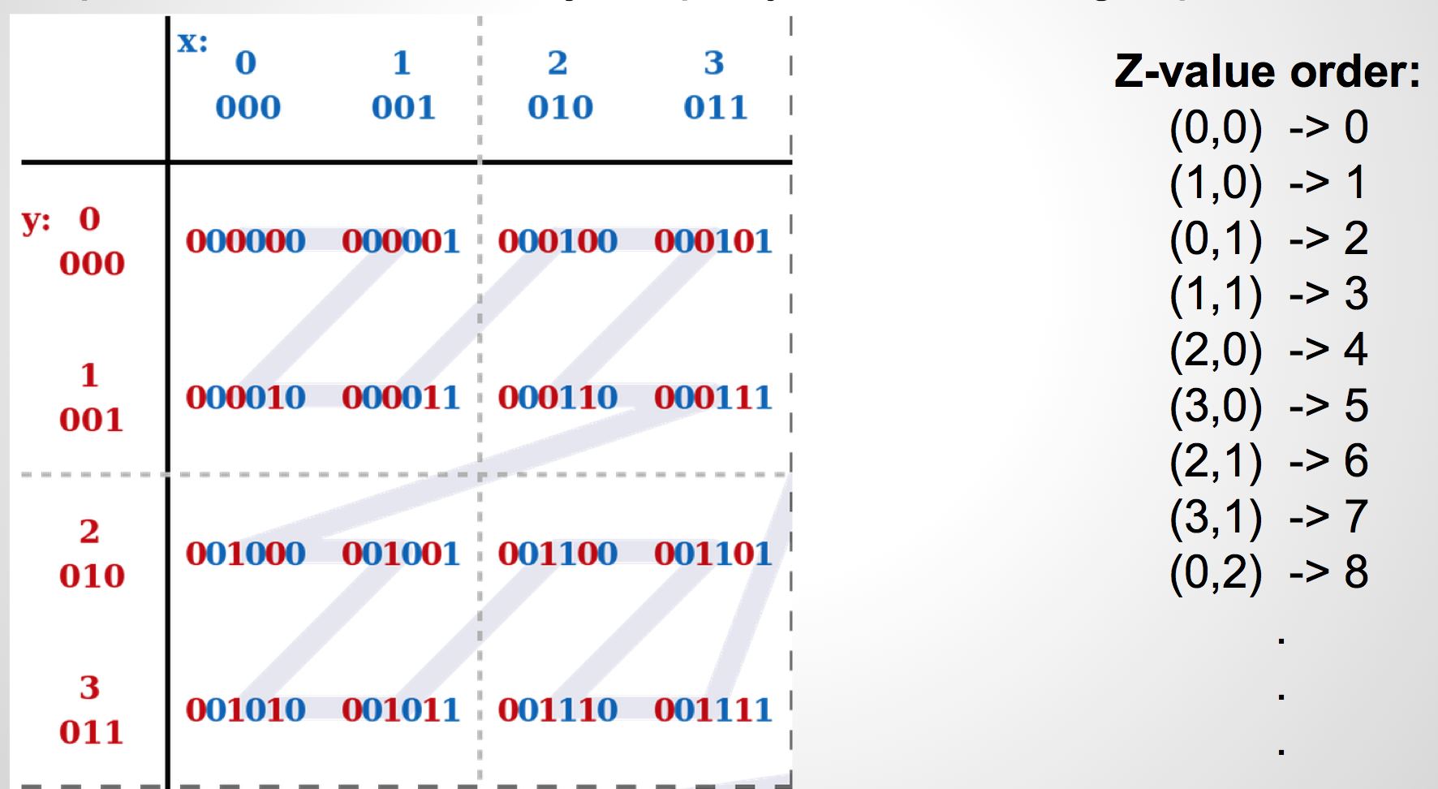
Z value calculation

Slide 14
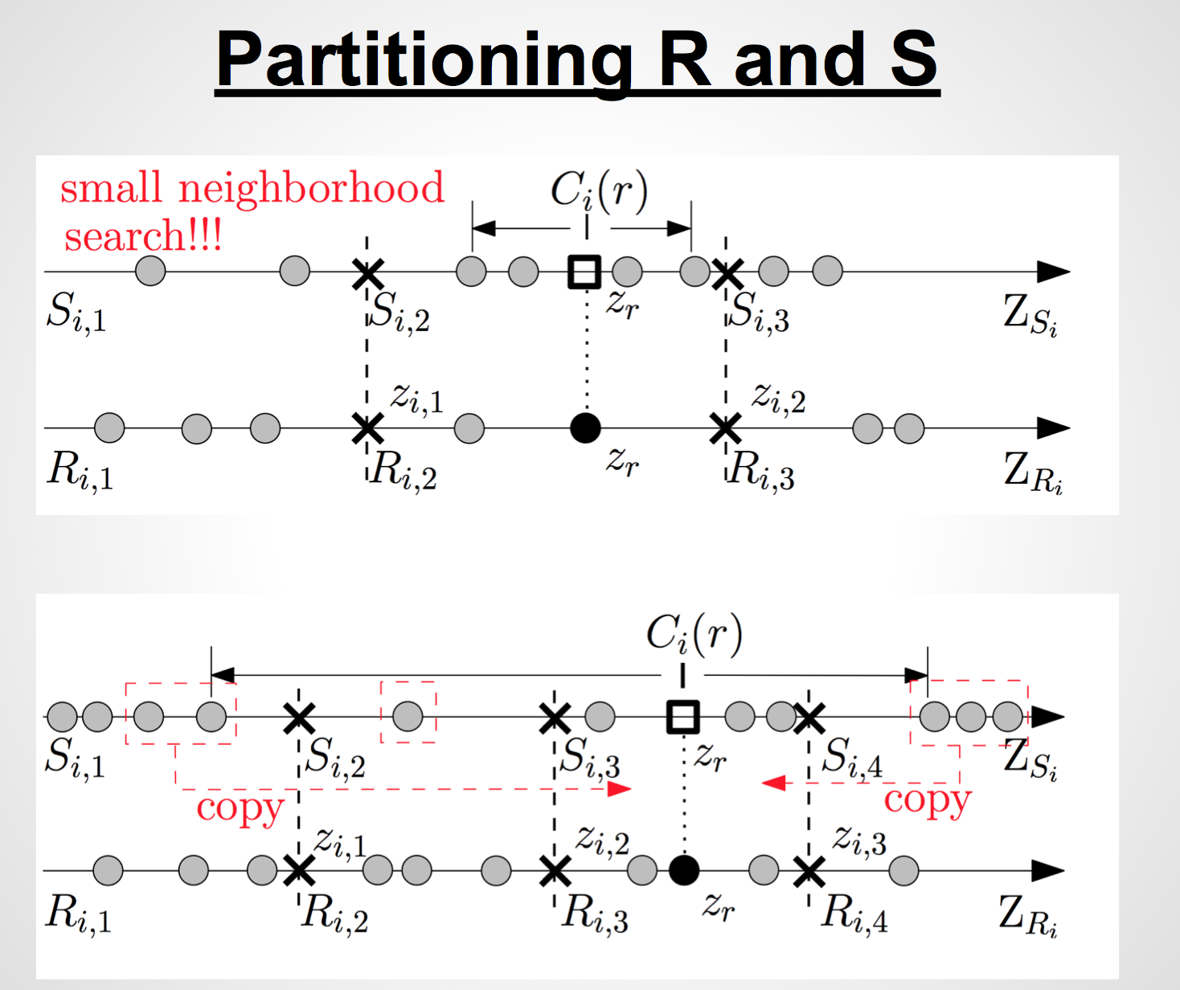

Slide 15
Thank You :wq

