Slide 1
DIABETES Classificatin
Ahmed Ashraf Moahmmed
Abdallah Ashraf Elsaadany
Aya Fouda
Youssef Amr

Slide 2
Outlines
Problem definition
Dataset
Methods
Preparations & preprocessing
Results
Models
Conclusion

Slide 3
Problem definition
Predicting the incidence of diabetes
The main feature affecting the incidence of diabetes
T
0

Slide 4
The used dataset
768 records
01
Pregnancies
Glucose
02
03
04
BMI
Insulin
05
06
07
08
Blood Pressure
Skin Thickness
Diabetes Pedigree Function
Age
T
0

Slide 5
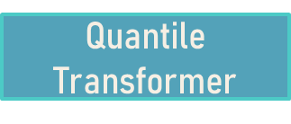




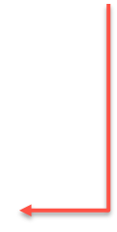
Methods
Box Plot/ QQ Plot
Heatmap
decision tree
Logistic Regression
K-nearest neighbors(k-NN)
Ensemble Classifier
Final Evaluation

Slide 6
Preparation and Preprocessing
Split the data into train and test (75%, 25%)
Remove duplicates records
Replace the Nans values
Remove outliers using boxplot
Remove less important features
T
1

Slide 7
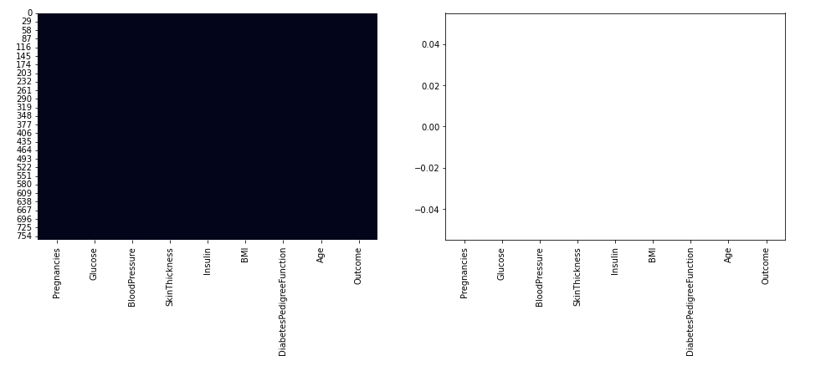
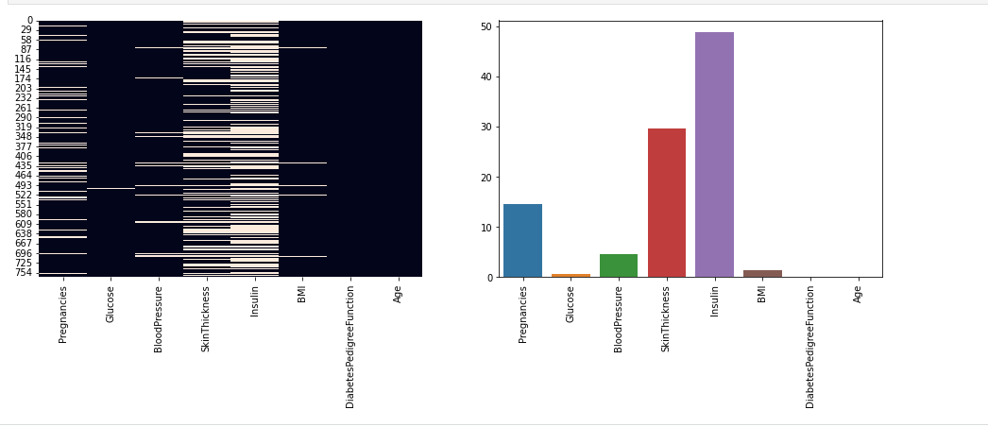
Check null value
Before After

Slide 8
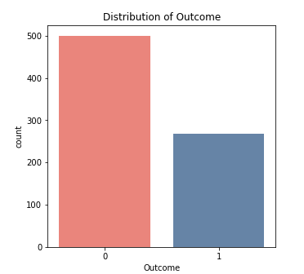
The dataset is unbalanced
Due to this, predictions will be biased towards
Non-Diabetes cases. So, we must balance this class

Slide 9
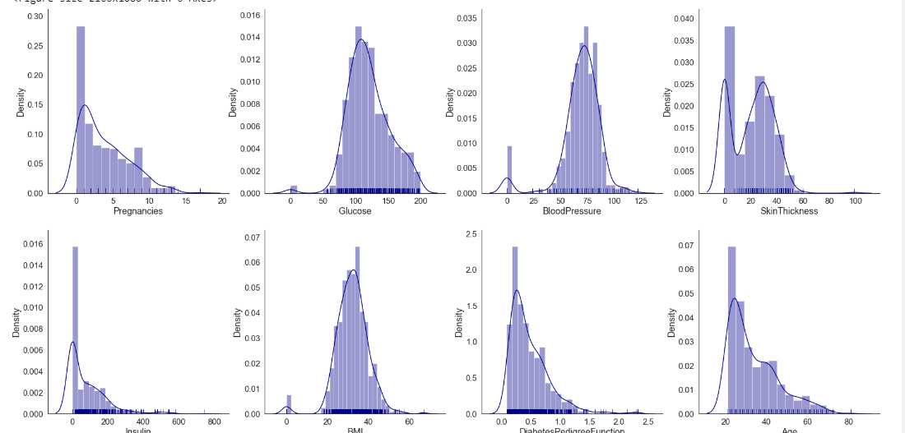
Exploratory data analysis

Slide 10
Exploratory data analysis
Pregnancies, Insulin, DiabetesPedigreeFunction, Skin Thickness and Age have positively or rightly skewed data distribution.
Data distributions of Glucose, BloodPressure & BMI are near a normal distribution.
There is few outliers and also distribution is normal , So we decided to fill zeroes with mean value or median or mode depend on features.
Mean [Glucose – BMI – Skin Thickness ]
Median [BloodPressure – Insulin]

Slide 11
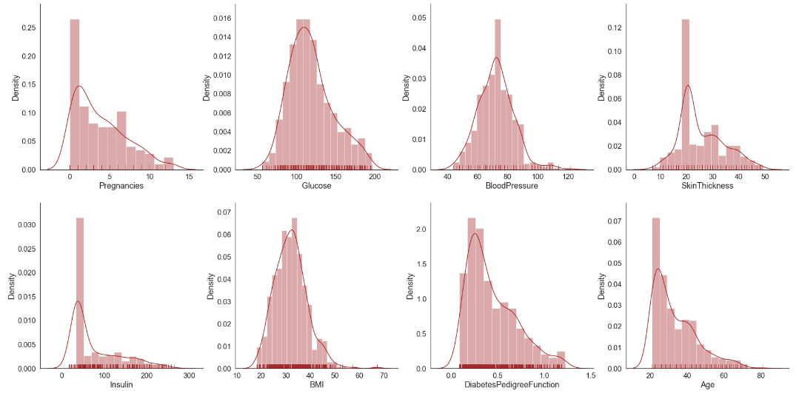
Exploratory data analysis

Slide 12
Results
T
1

Slide 13
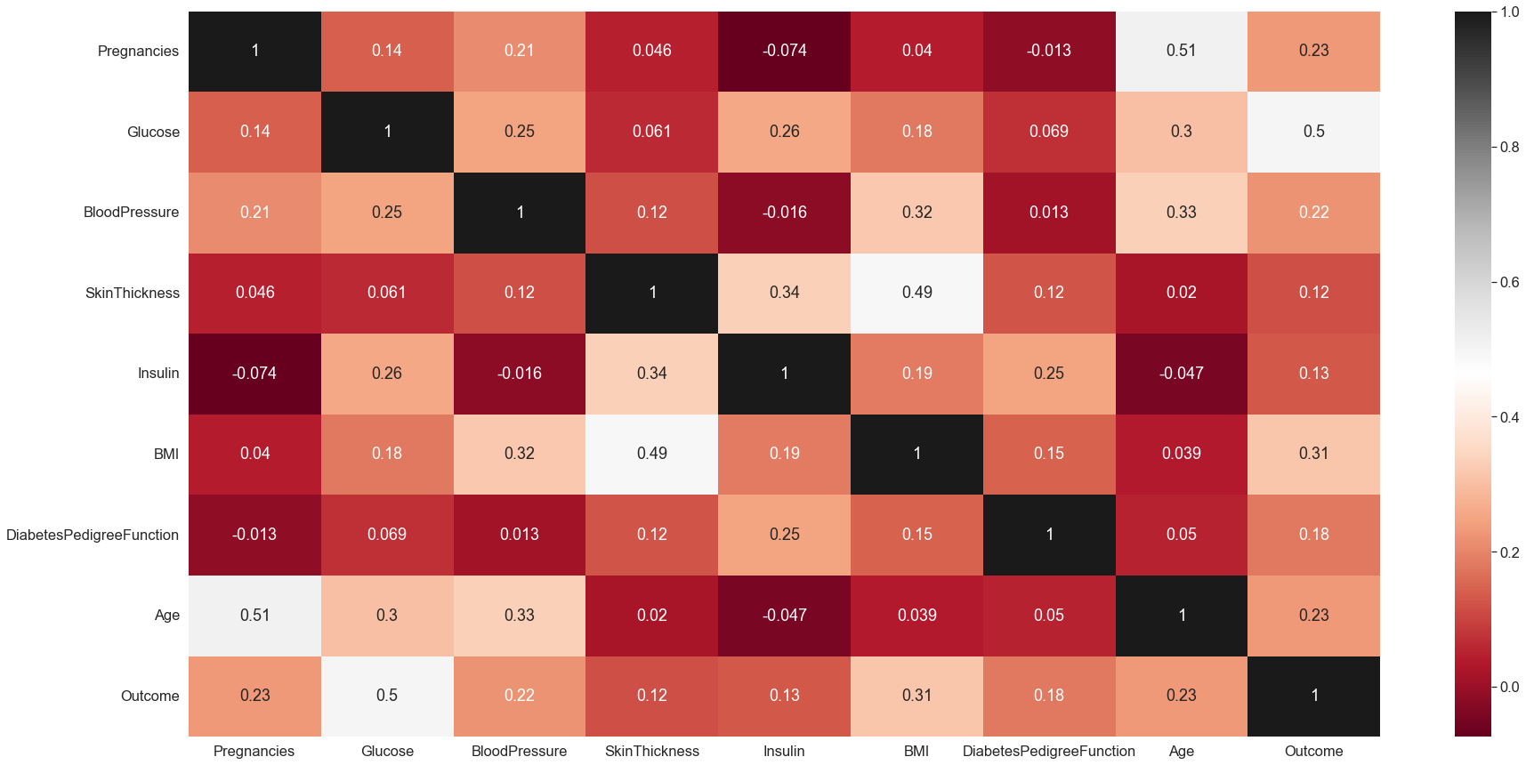
Correlation
Outcome Glucose
Pregnancies Age.
SkinThickness BMI.

Slide 14
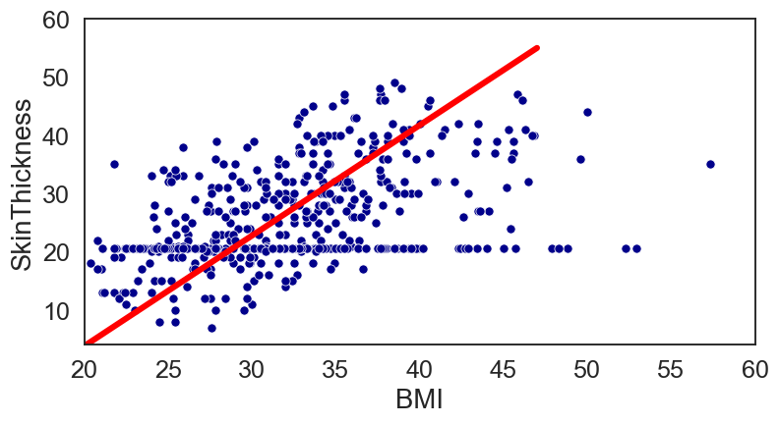
Correlation
As: BMI and SkinThickness are highly correlated

Slide 15
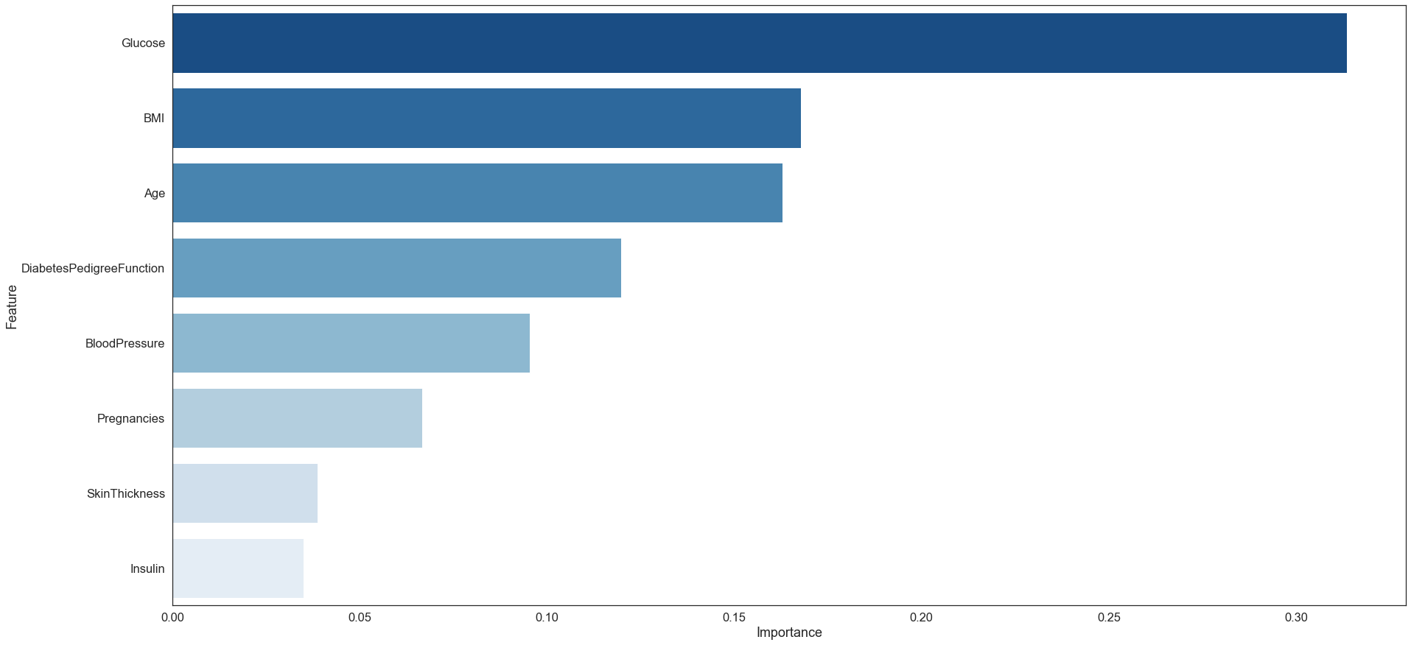
Feature selection
After applying the decision tree we have found that the less important features are the SkinThickness and the insulin

Slide 16
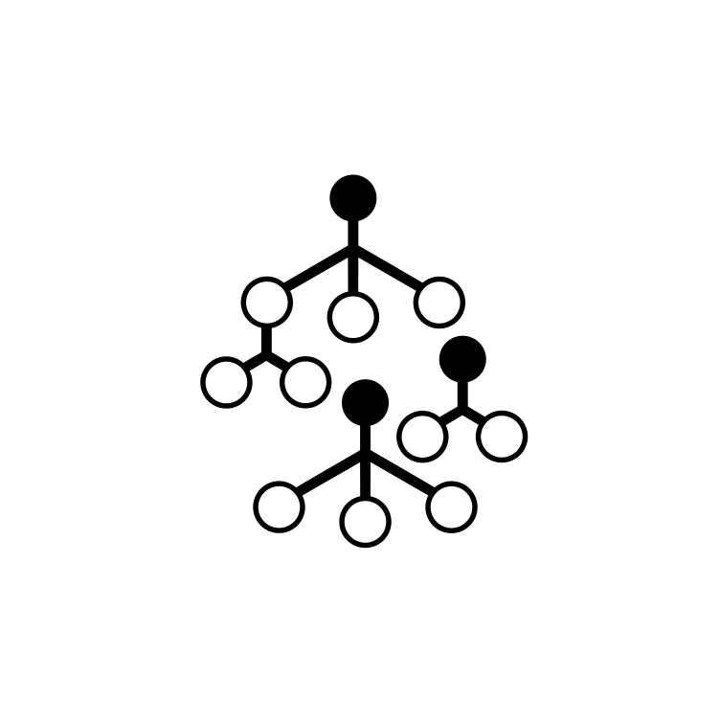

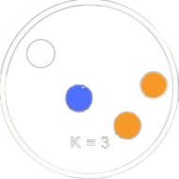
Our models
ADABoost
Logistic Regression
Random forest
KNN
algorithm that combines multiple "weak" classifiers to create a single "strong" classifier.
Efficient statistical method of modeling bionomial out come (0 - 1)
Like logistic regression but
more suitable for larger datasets
uses proximity to make classifications or predictions about the grouping of an individual data point
T
4

Slide 17
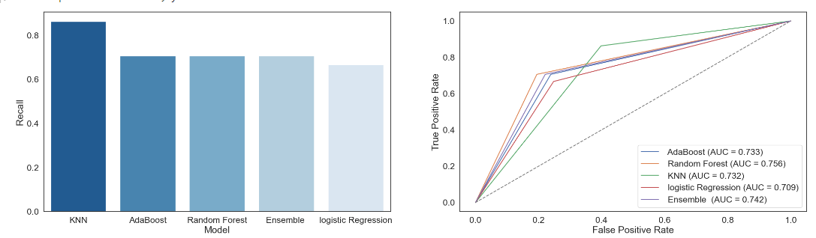
Final evaluation

Slide 18
Conclusion
we have dropped the Insulin and the Skin Thickness from our date.
We noticed that the Glucose has a big impact on the outcome
K-NN accuracy is 75%

