Slide 1
Telecom Customer Churn Prediction and Segmentation
Prepared by: Anas Elfeky , Ola Adel , Mohammed Ahmed

Slide 2
Introduction
Objective:
Churn prediction: Predict if a customer will churn based on their profile.
Clustering: Segment customers into meaningful clusters to identify target groups.
Data Overview:
Number of rows and columns: 7043 rows, 21 columns.
Data source: Telecom customer churn dataset.
Key features: gender, SeniorCitizen, tenure, PhoneService, InternetService, OnlineSecurity, StreamingTV, MontlyCharges, Churn, etc.

Slide 3
Data Preparation
Data Cleaning:
Missing value
There are 11 missing values in “TotalCharges” feature that were filled by median because the distribution was right-skewed.
Removing Duplicates
No duplicates found
Feature scaling
Applied Log Transformation to normalize the right-skewed features—”TotalCharges” and “tenure_per_contract”—and also scaling them to become easier in process.
Data Type Conversion
Convert “TotalCharges” feature to numerical data type.
Outlier Detection and Treatment
There were 840 outliers of total 7043 elements in “tenure_per_contract” feature.
Treatment was done by applying Log Transformation.

Slide 4
Data Preparation
Feature Engineering:
Feature Creating:
“tenure_per_contract”: Average tenure per contract period
“uses_streaming_services”: Shows whether a customer subscribes to any streaming service.
“num_additional_services”: Counts how many additional services a customer is using.
“PhoneServiceCombined”: Represents the status of a customer’s phone service.
Feature Selection
All features were selected.
Features like “SeniorCitizen”, “gender”, “Partner”, and “dependent” shows churn rates based on Customer Demographics.
Some Features used to create new features to helps us to identify churn rates.
Other features were important to improve the accuracy of the model.

Slide 5
Data Preparation
Feature Engineering:
Encoding for Classification
Categorical features that contain two classes like “gender” were handled using map method to reduce the additional columns produced by OneHotEncoder.
Categorical features that contain more than two classes were handled using OneHotEncoder because the classes had no ordinal order.
Encoding for Clustering
Categorical features were handled using map method to reduce the additional columns produced by OneHotEncoder.
Dimensionality Reduction
PCA was used to reduce the data into two features.
PCA applied before clustering algorithm to reduce the number of features and remove correlated features.

Slide 6
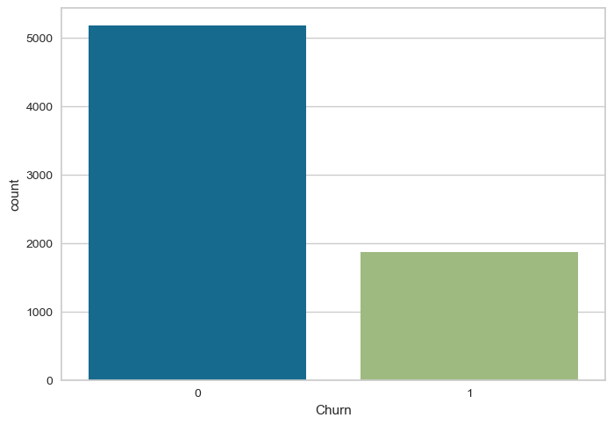
Exploratory Data Analysis (EDA):
Visualization:
Distribution of churn vs. non-churn.

Slide 7
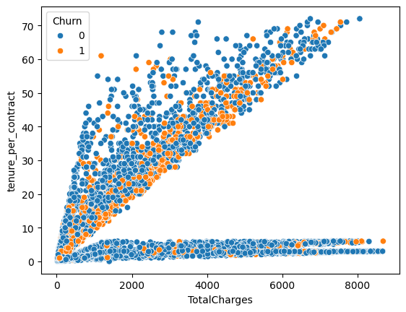
Exploratory Data Analysis (EDA)
Visualization:
“tenure_per_contract” vs. “TotalCharges”
Insights:
Customer with month-to-month contracts have a higher churn rate.
Customer with higher monthly charges also show higher churn tendencies.
Customers with low tenure_per_contract were highly to churn.

Slide 8
Modeling Approach
Algorithm Used:
Churn Classification: Logistic Regression, Random Forest, and KNN.
Clustering: K-Means and Hierarchical Clustering.
Model Pipeline:
Input → Preprocessing → Model Selection → Training → Prediction.

Slide 9
Modeling Approach
Challenges:
Class Imbalance in Churn Data:
The churn dataset likely had more non-churned customers than churned one, leading to class imbalance, which can affect model performance.
Feature Scaling for Distance-Based Algorithm (KNN):
Features needed scaling to ensure proper performance of KNN, which rely on distance calculations.
Solutions:
Addressed Class Imbalance:
Used SMOTE to balance the dataset and improve mode accuracy.
Feature Engineering:
Created meaningful new features(e.g., tenure_per_contract, num_additional_services) to enhance model performance and mitigate any bias in the data.

Slide 10
Model Performance: Churn Prediction
Metrics Used: Accuracy, Precision, Recall, F1 score.
Results:
Random Forest achieved the highest accuracy at 85%.with an F1 score of 84%.
Model Comparison Table:
 | Logistic Regression | Random Forest | KNN
Accuracy | 80% | 85% | 81%
Precision | 79% | 83% | 78%
Recall | 83% | 89% | 88%
F1 score | 81% | 86% | 83%

Slide 11
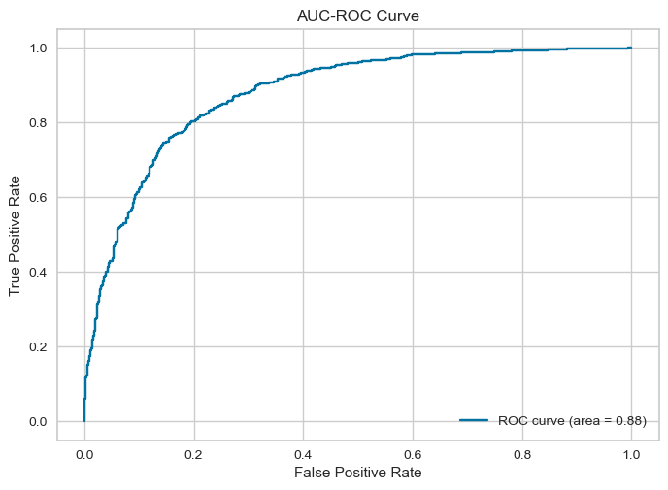
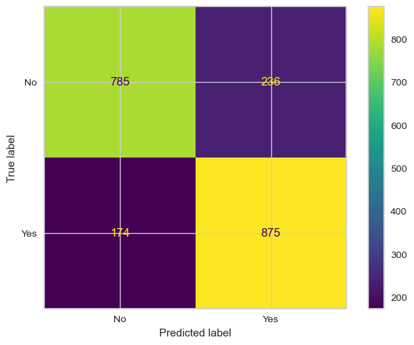
Model Performance: Churn Prediction
Visualizations:
Logistic Regression

Slide 12
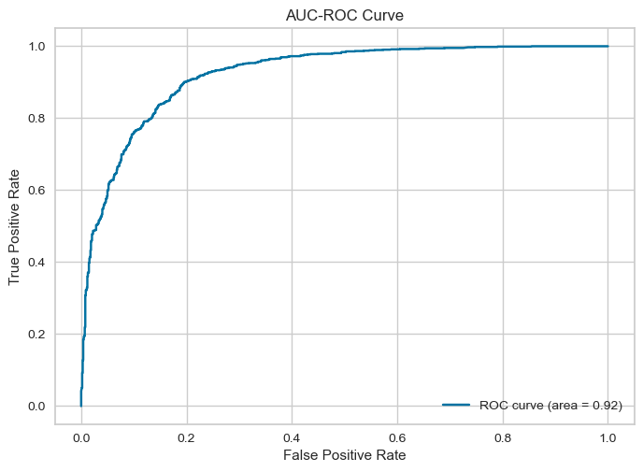

Model Performance: Churn Prediction
Visualizations:
Random Forest

Slide 13
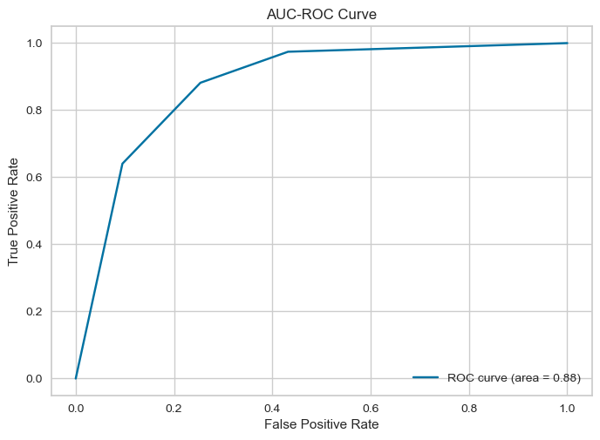
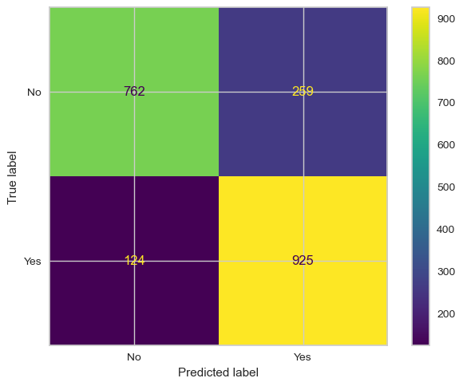
Model Performance: Churn Prediction
Visualizations:
Kneightbors

Slide 14
Model Performance: Clustering
Algorithms Used
K-Means, Hierarchical Clustering.
Number of Clusters
Determined using the Elbow Method and Silhouette Score
Elbow Method: The optimal number of clusters was determined to be 3.
Silhouette Score: The average silhouette score for the clustering was approximately 0.64, indicating a reasonable separation between the clusters.
Results:
Customers segmented into three groups:
High spenders ( cluster 2 ) with long tenure and multiple service.
Mid-tier (cluster 1 ) users with moderate spending and tenure.
Budget-conscious (cluster 0 ) users with low spending and limited service.

Slide 15
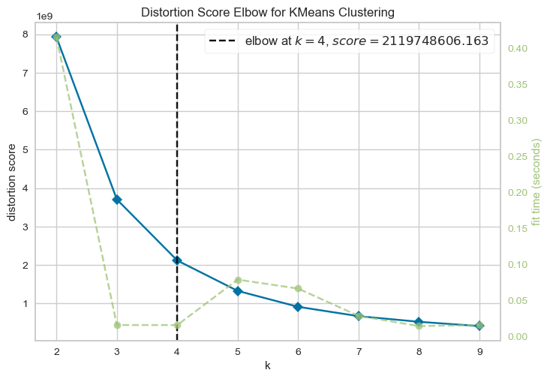
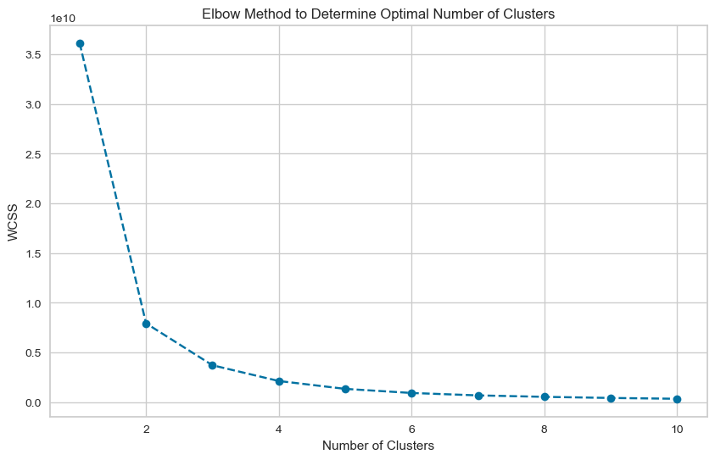
Model Performance: Clustering
Visualization
Elbow Method
standard method

Slide 16
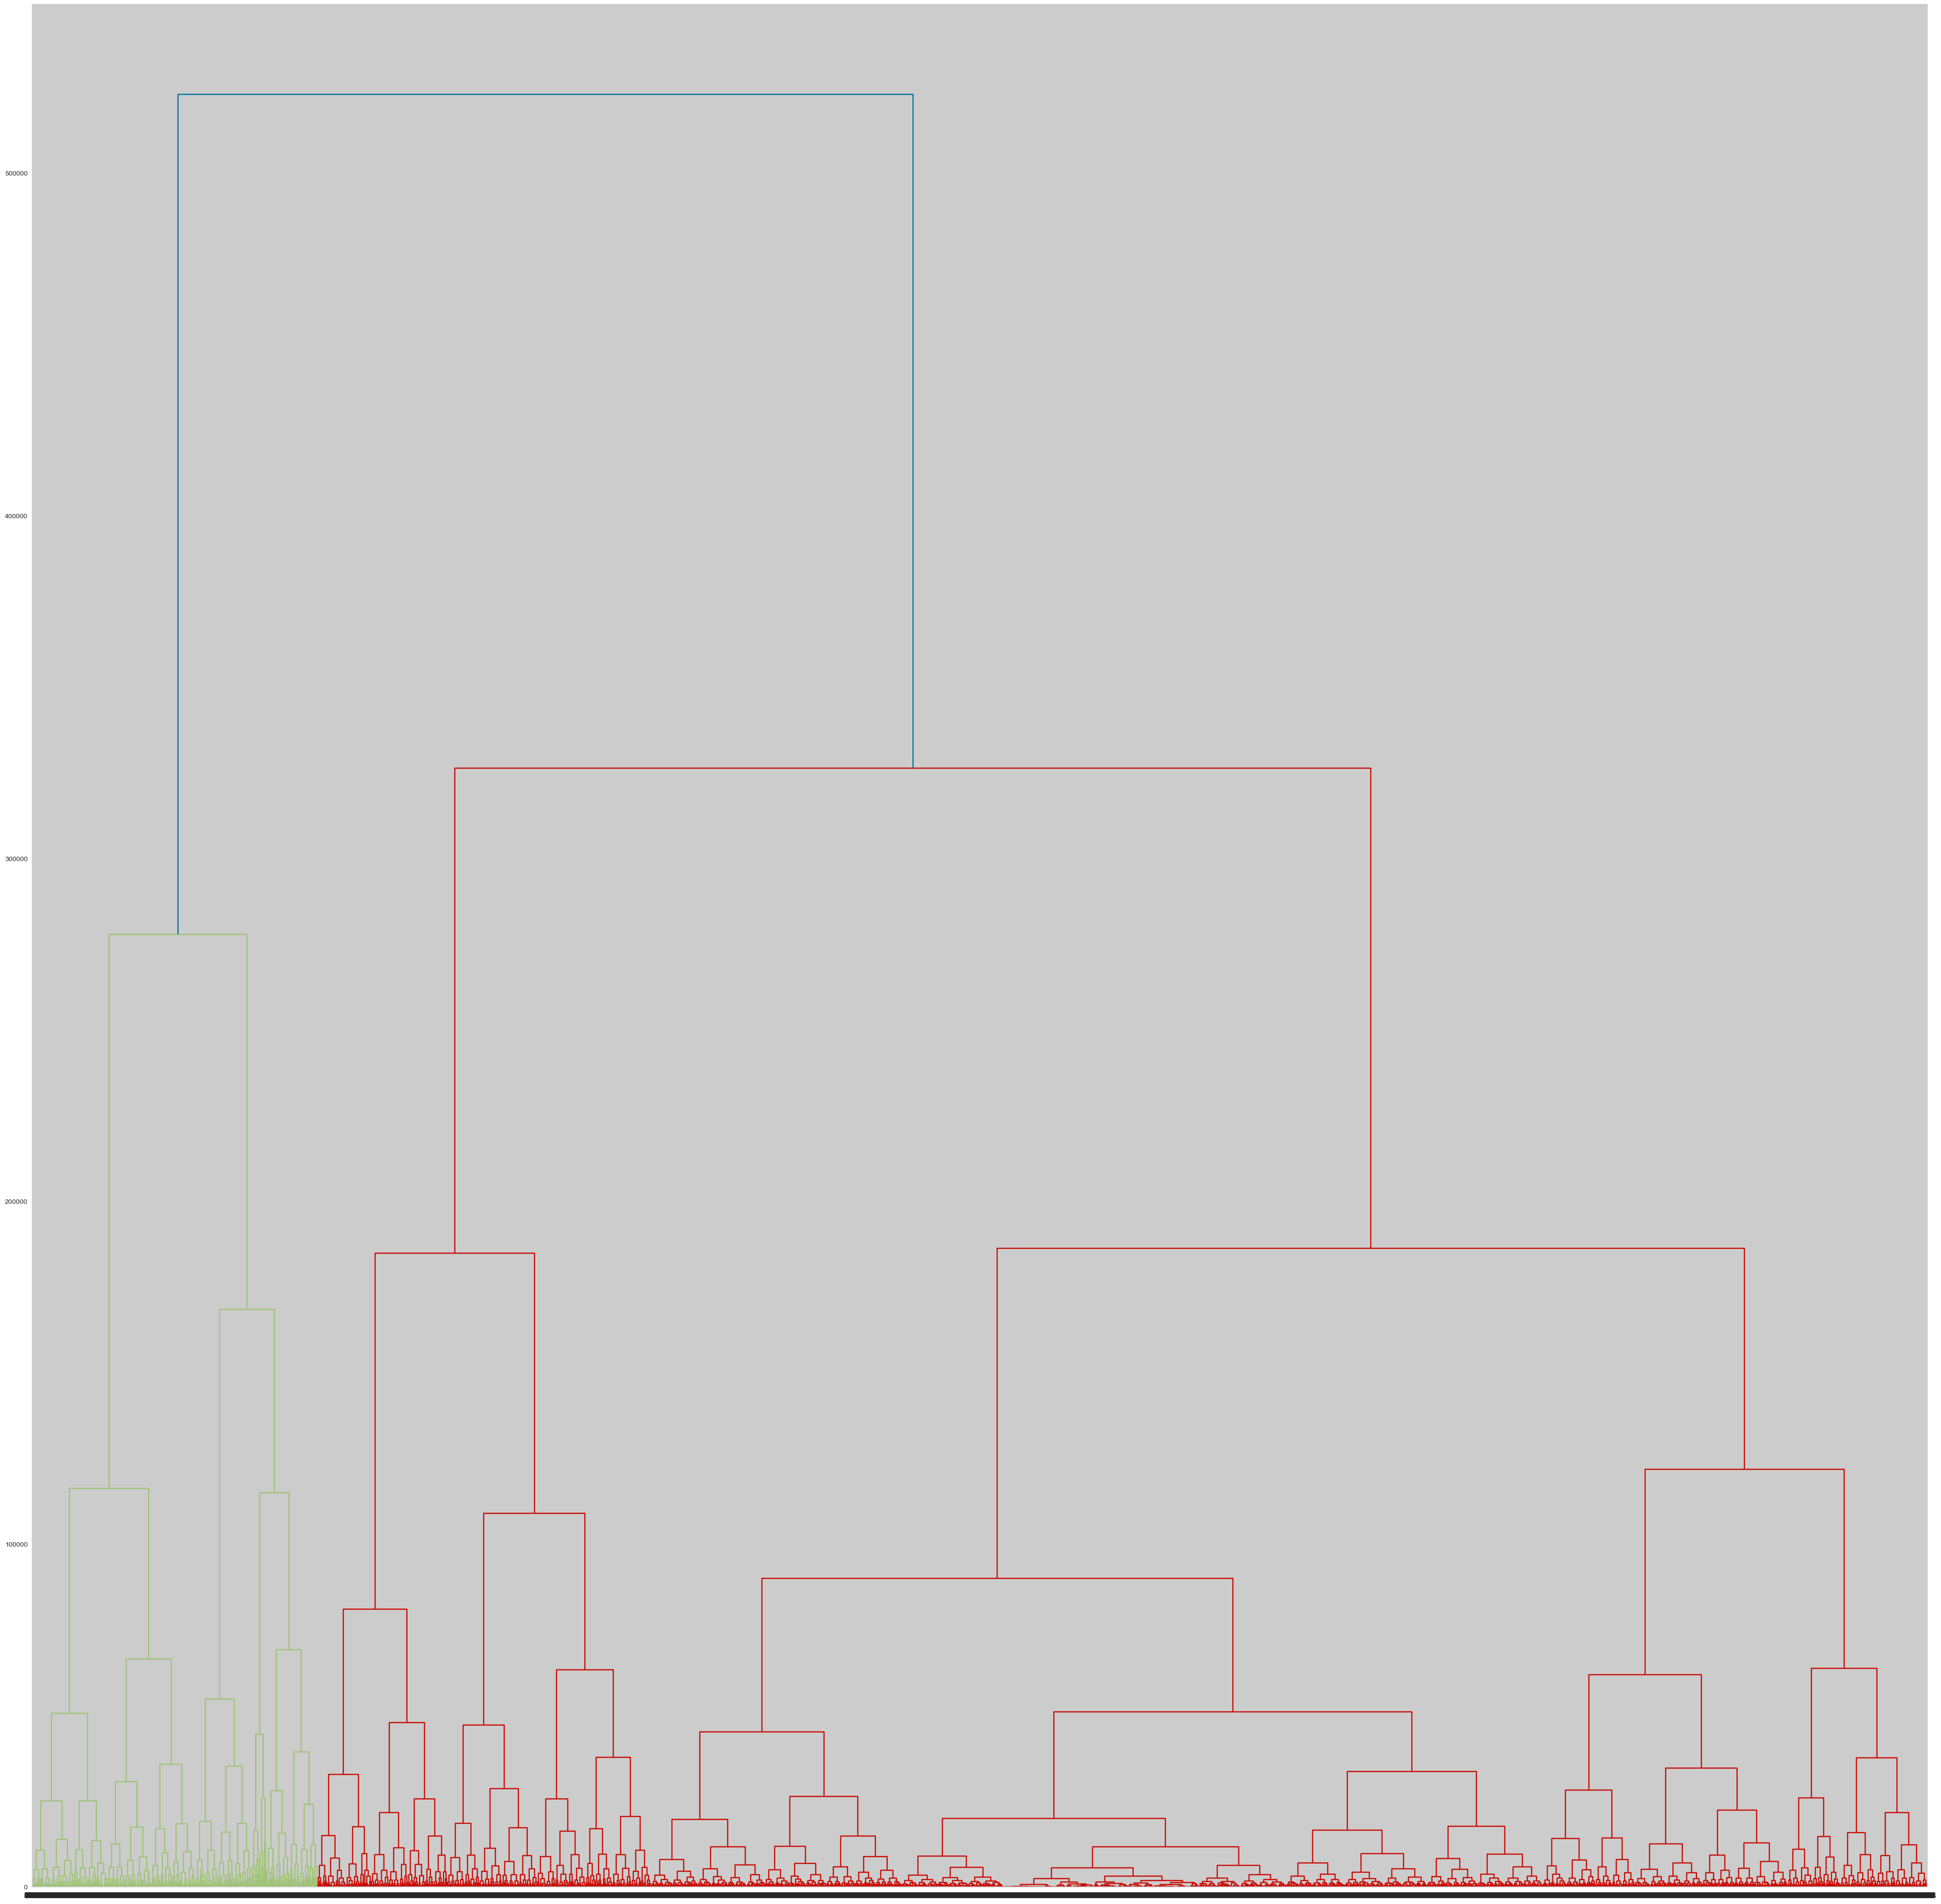
Model Performance: Clustering
Visualization
hierarchical clustering dendrogram

Slide 17
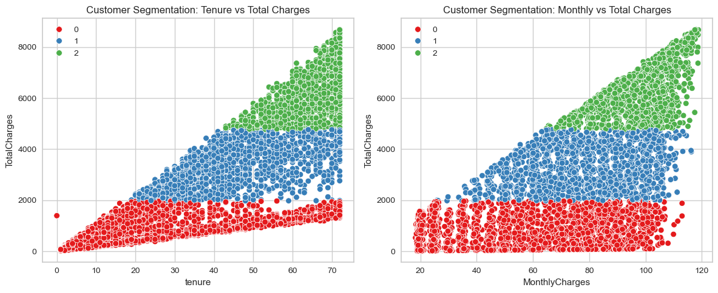
Model Performance: Clustering
Visualization
K-Means Clusters Visualization

Slide 18
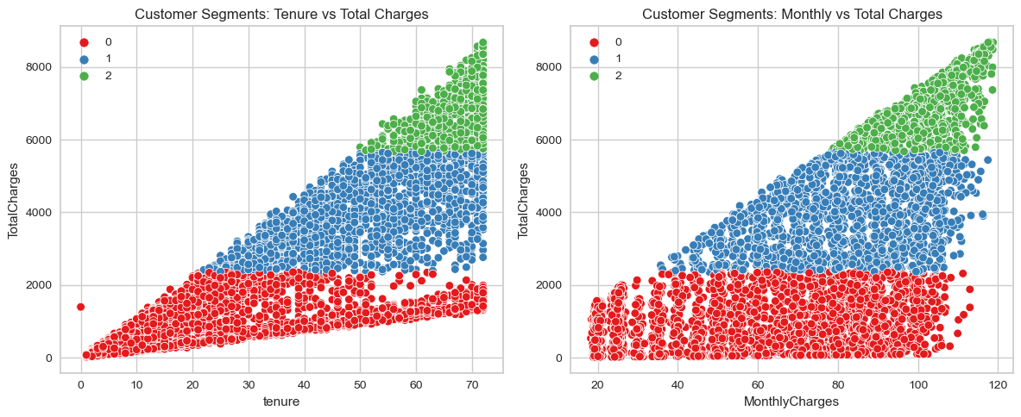
Model Performance: Clustering
Visualization
Hierarchical Clusters Visualization

Slide 19
Hyperparameters Tuning
Process: Used RandomizedSearchCV for hyperparameter tuning
Results:
Random Forest: with 81 trees, max depth of 15, and “log loss” criterion provided the best results.
KNN: Tuned n_neighbors parameters, choosing k = 3 as the optimal value.

Slide 20
User-Friendly Interface for Data Input and Prediction
Overview:
We developed GUI where users can input customer details and receive real-time predictions.
The GUI allows users to input values for each customer profile attribute (e.g., gender, contract type, tenure, etc.) and select the algorithm they wish to use for clustering
Data Entry Form:
The GUI includes text fields for numerical features and dropdown menus for categorical features to ensure that data is valid and accurate
Algorithm Selection:
The GUI includes dropdown menus for algorithm selection. Users can choose from models like K-Means, and Hierarchical Clustering based on their preference.

Slide 21
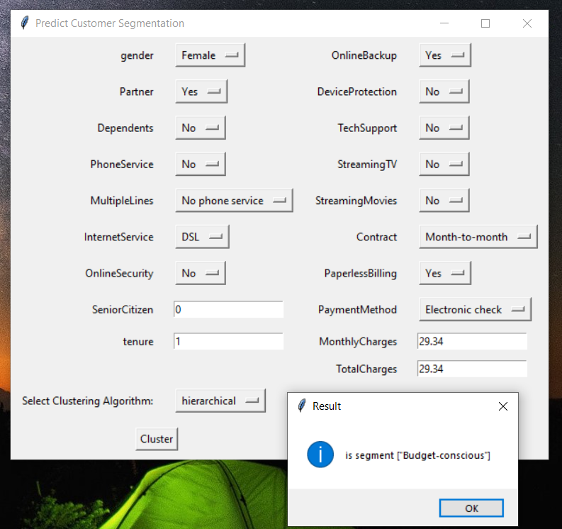
User-Friendly Interface for Data Input and Prediction
Benefits:
This user-friendly interface allows non-technical users to interact with complex machine learning models without needing coding knowledge

Slide 22
Key Insights and Recommendations
Churn Prediction Insights
Short tenure, month-to-month contracts, and fewer additional services are likely to higher churn.
Recommendation: Offer Incentives for Long-Term Contracts
To reduce churn, introduce special discounts or bundle deals to incentivize month-to-month contract customers to switch to longer-term contracts.
Clustering Insights
Cluster analysis reveals that customers with long tenure and high monthly charges are less likely to churn, potentially indicating valuable, loyal customers.
Recommendation: Focus on Retaining High-Value Customers (Cluster 2)
High-value customers (high tenure, multiple service) are loyal and spend more. Implement loyalty programs (e.g., VIP services, exclusive offers, or discounts) to keep them engaged and prevent them from switching to competitors.

Slide 23
Conclusion
Summary
Best model: Random Forest with 85% accuracy for churn prediction. Clustering identified three customer segments.
Clustering identified three distinct customer segments, with high spenders as the most loyal group.
Next Steps
Future work could focus on incorporating customer feedback data for further refining retention strategies.

