Slide 1
Final Project
P76074436 陳俊佑

Slide 2
Outline
Architecture
Original
OM2M
Design
Demo
Github Link

Slide 3
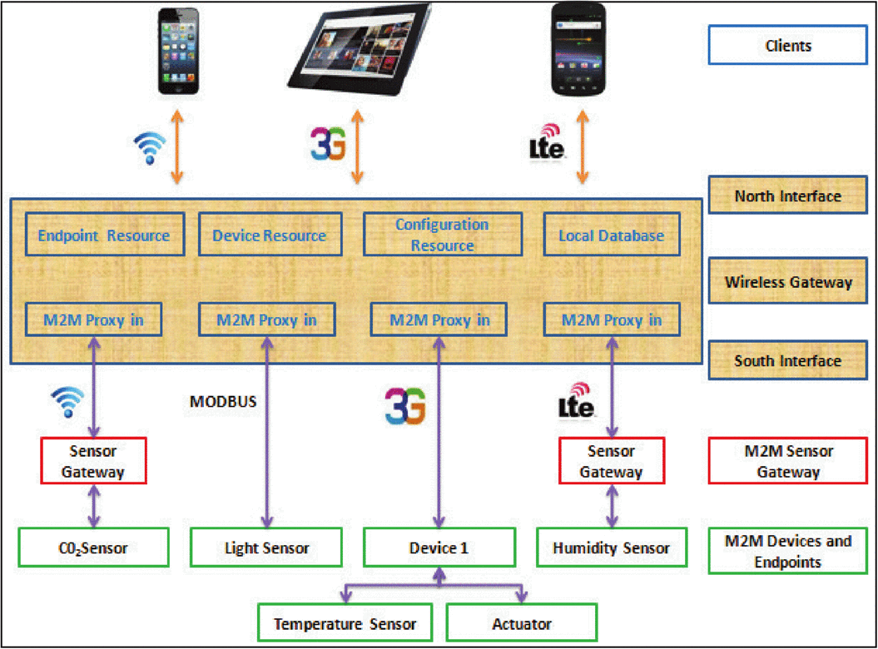
Original Architecture

Slide 4
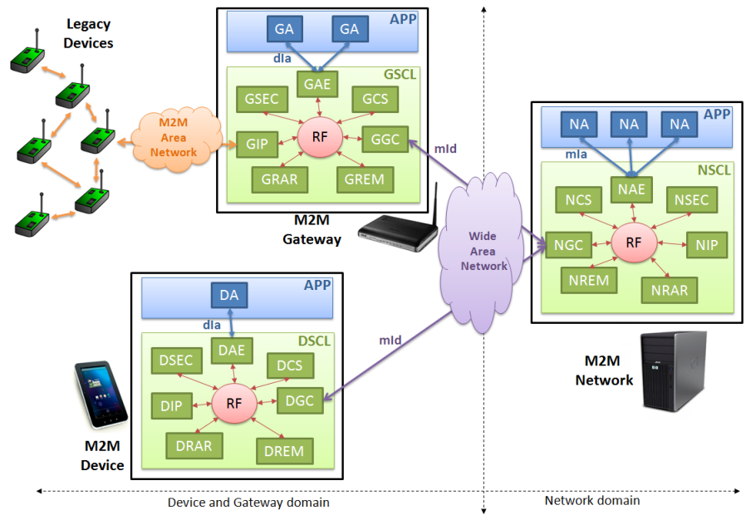
OM2M Architecture
[1] The Eclipse Foundation, “OM2M,” Project OM2M.[Online]. Available: https://www.eclipse.org/proposals/technology.om2m/

Slide 5
Design Architecture
Any smart phone with UI Android App.
Users
HTTP Restful API
OS: Ubuntu 18.04
IP: 140.116.245.252
Network SCL
Network Application
Gateway SCL
OM2M
Gateway Application
IoT Device
Temperature
IoT Device
Fan
IoT Devices

Slide 6
Demo Architecture
Any smart phone with UI Android App.
Users
HTTP Restful API
OS: Ubuntu 18.04
IP: 140.116.245.252
Network Application
OM2M
Gateway Application
Gateway SCL
IoT Devices
IoT Device
Temperature
IoT Device
Fan

Slide 7
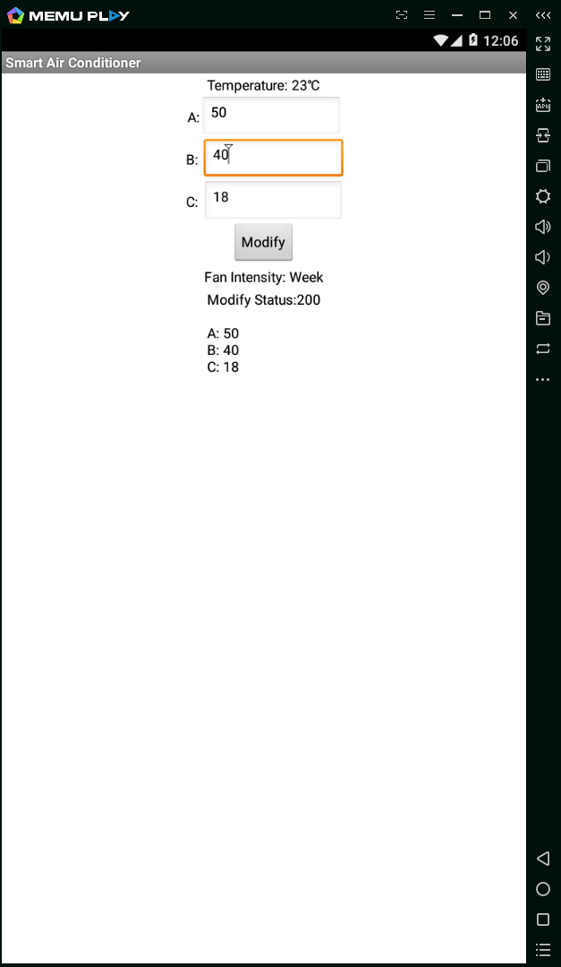
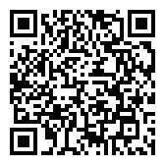
Demo Architecture
Smart Phone:
File: FinalProject.apk, FinalProject.aia
Goal: design user interface to control devices
Implementation: AppInventor2
App QR code
Notes:
https://drive.google.com/open?id=13P1XIuHH-MA1W1MQHmBQZbEDSqxfh80D

Slide 8
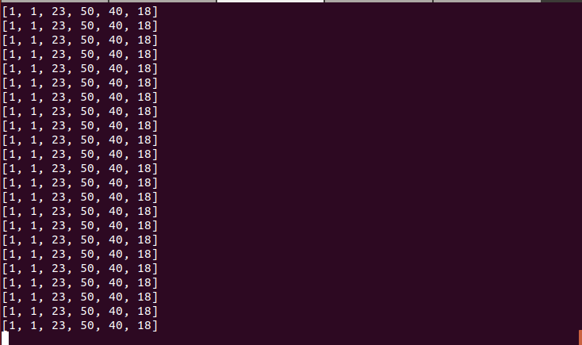
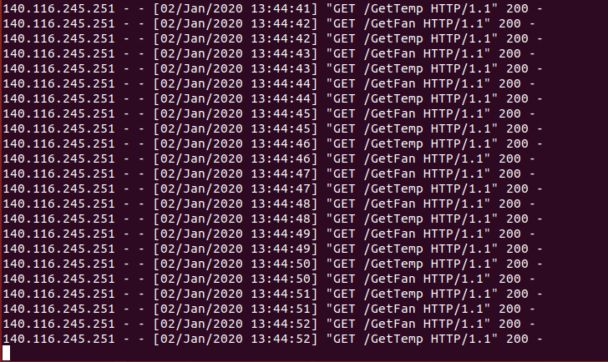
Demo Architecture
Network Application (NA):
File: NA.py, NAautoUpdate.py
Goal: subscription in OM2M and data transmission to mobile
Implementation: Python3
Lib: Requests (HTTP Restful API)
Lib: Flask (HTTP Server)

Slide 9
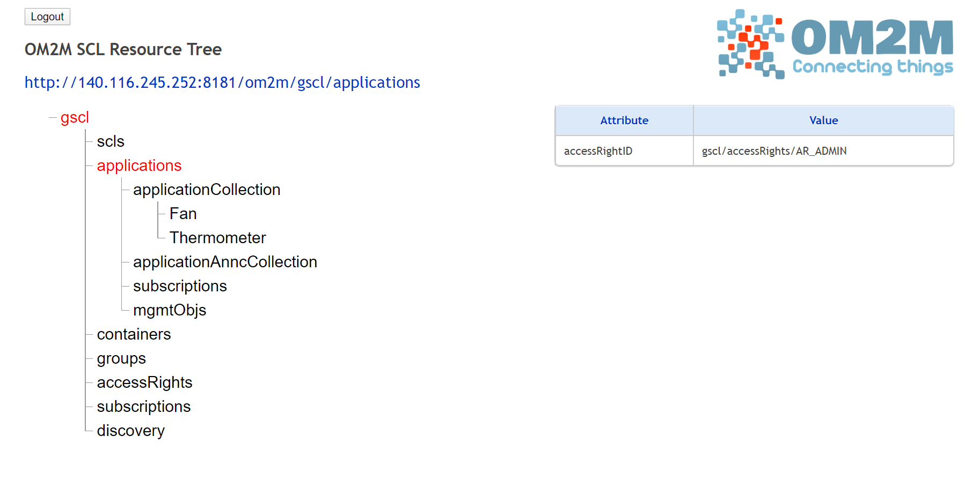
Demo Architecture
Gateway Service Capability Layer (GSCL):
Goal: data collector
Implementation: The Eclipse OM2M GSCL

Slide 10
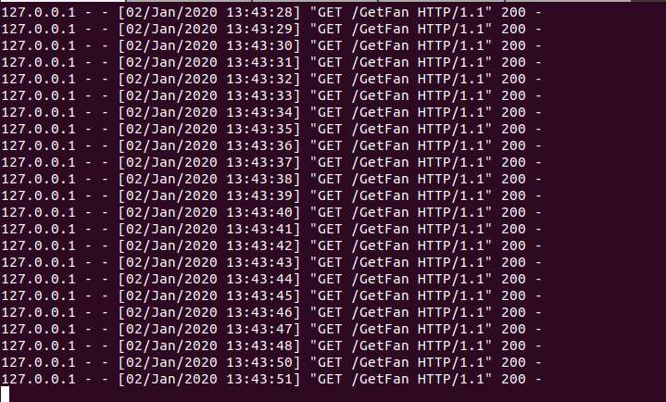
Demo Architecture
Gateway Application (GA):
File: GA.py
Goal: subscription in OM2M and data transmission to mobile
Implementation: Python3
Lib: Requests (HTTP Restful API)
Lib: Flask (HTTP Server)

Slide 11
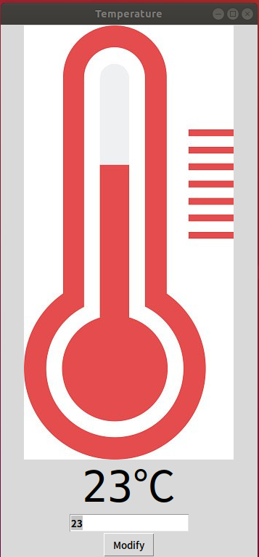
Demo Architecture
Device Temperature:
Goal: transfer temperature data to Internet
Implementation: Python3
Lib: Requests (HTTP Restful API)
Lib: Tkinter (GUI)

Slide 12
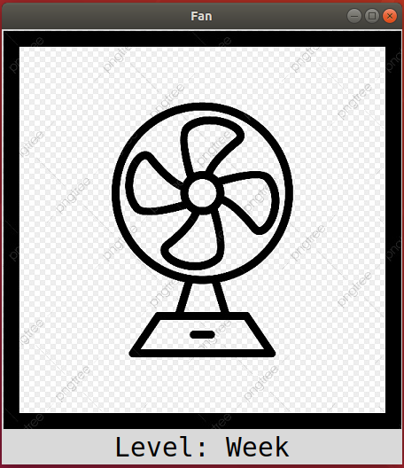
Demo Architecture
Device Fan:
Goal: transfer fan status and receive instruction from Internet
Implementation: Python3
Lib: Requests (HTTP Restful API)
Lib: Tkinter (GUI)
Control Level:
Strong: temp > A
Mid: A >= temp > B
Week: B >= temp > C
Off: temp <= C

Slide 13
Github Link
https://github.com/a60504a60504/om2m_LAB

