Slide 1
New Vulnerability Score Prediction
Machine Learning

Slide 2
Introduction
Predict CVSS score for new CVEs
Predictor (X): CVE Summary text
Target (y): CVSS Score
Data Source: Kaggle (NVD Data)
Total Number of records: 89,660
Published between: Jan, 1999 and Nov, 2019
Data Elements Used: cvss, and summary

Slide 3
Model Training: Pre-processing
Multi Variate Linear Regression
Number of Training Records: 62,761
Number of Test Records: 26, 899
Method used for Feature Selection: sklearn SelectKBest f_regression
(Linear model for testing the individual effect of each of many regressors. This is a scoring function to be used in a feature selection procedure)
Number of features used: [all (82934), 500, 400, 300, 200, 100]

Slide 4
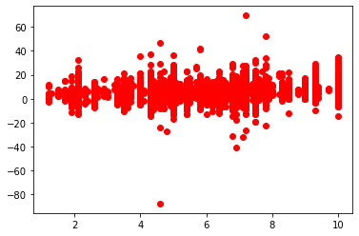
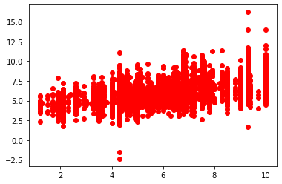
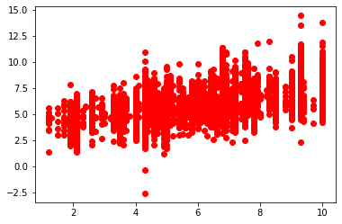

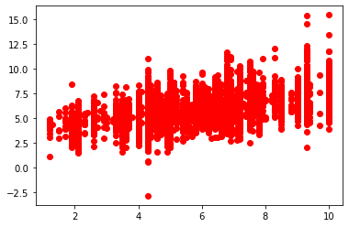
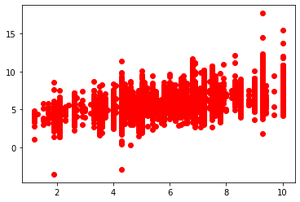
Model Training
All Features
X-axis: actual, y-axis: prediction
100 Features
X-axis: actual, y-axis: prediction
200 Features
X-axis: actual, y-axis: prediction
300 Features
X-axis: actual, y-axis: prediction
400 Features
X-axis: actual, y-axis: prediction
500 Features
X-axis: actual, y-axis: prediction
# of Features | RMSE^{1 ▼} | R-Squared²
300 | 1.3285 | 0.5387
500 | 1.3309 | 0.5371
400 | 1.3403 | 0.5305
200 | 1.3474 | 0.5255
100 | 1.3659 | 0.5124
all | 3.3321 | -1.9018
²Coefficient Determination (R-squared): The coefficient of determination effectively compares the variance in the data to the variance in the residual. The residual is the difference between the predicted and observed value and its variance is the sum of squares of this difference. The closer to 1 is better.
¹Root Mean Squared Error (RMSE): The mean squared error tells you how close a regression line is to a set of points. The lower is better.

Slide 5
Model Evaluation: Prediction Comparisons
21 New CVEs
(Last 20 Scored Vulnerability IDs & Summaries on 11/18/2020)

Slide 6
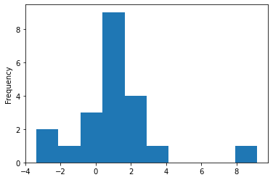
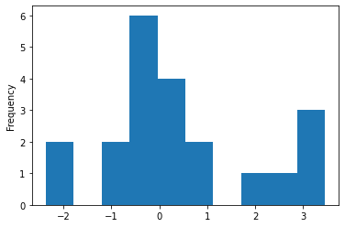
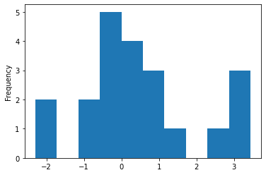

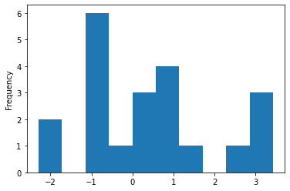
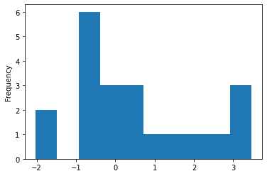
Model Evaluation: Prediction Comparisons (CVSS V2.0)
diff = prediction - actual
All Features
X-axis: diff, y-axis: frequency
100 Features
X-axis: diff, y-axis: frequency
200 Features
X-axis: diff, y-axis: frequency
300 Features
X-axis: diff, y-axis: frequency
400 Features
X-axis: diff, y-axis: frequency
500 Features
X-axis: diff, y-axis: frequency

Slide 7
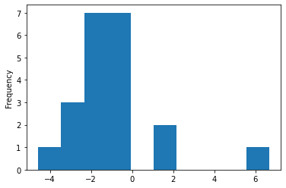
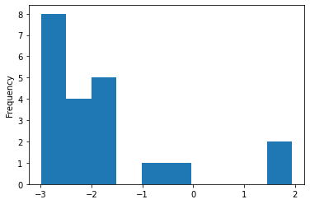
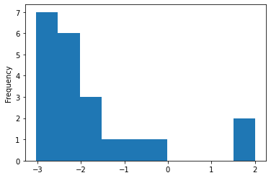
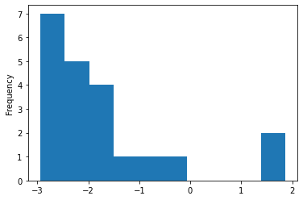
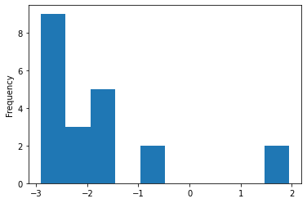
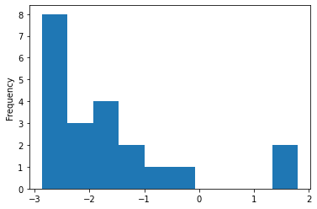
Model Evaluation: Prediction Comparisons (CVSS V3.0)
diff = prediction - actual
All Features
X-axis: diff, y-axis: frequency
100 Features
X-axis: diff, y-axis: frequency
200 Features
X-axis: diff, y-axis: frequency
300 Features
X-axis: diff, y-axis: frequency
400 Features
X-axis: diff, y-axis: frequency
500 Features
X-axis: diff, y-axis: frequency

Slide 8
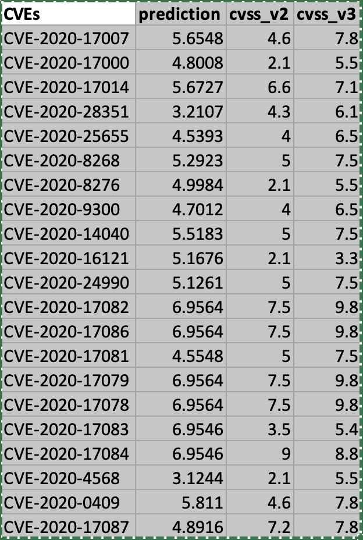
Model Predictions

Slide 9
Conclusion

Slide 10
Future Work

Slide 11
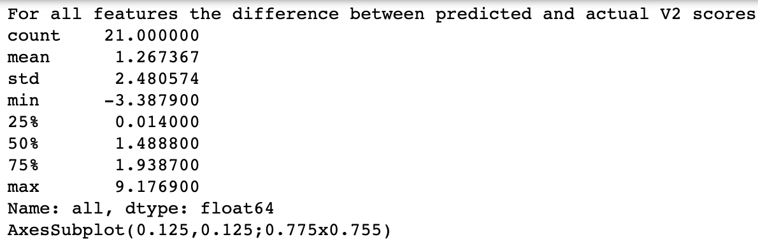
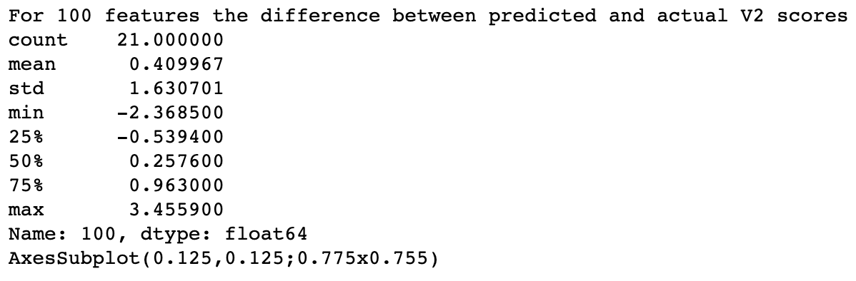
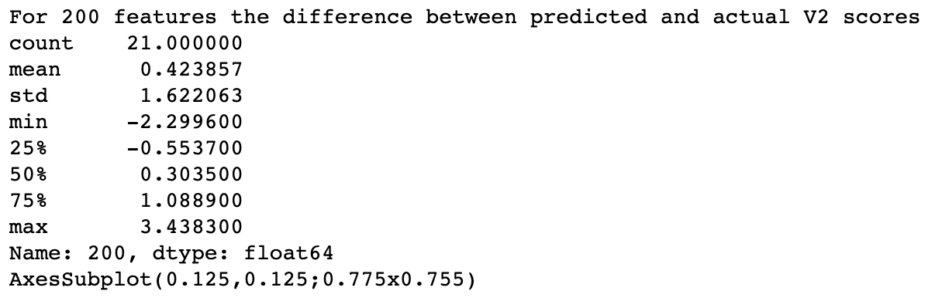
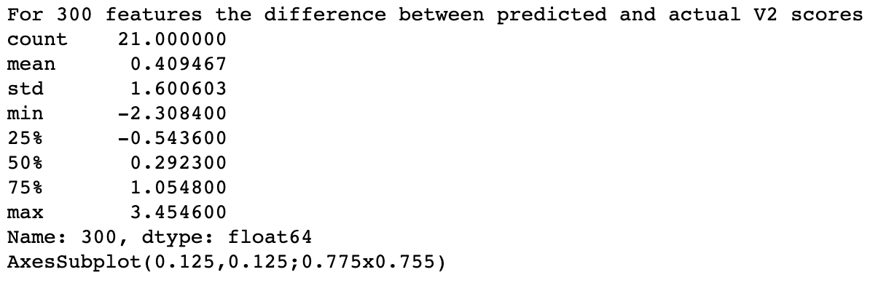
Model Evaluation: Prediction Comparisons (CVSS V2.0)

Slide 12
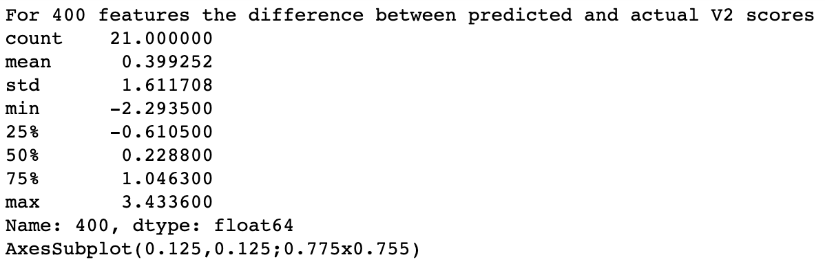
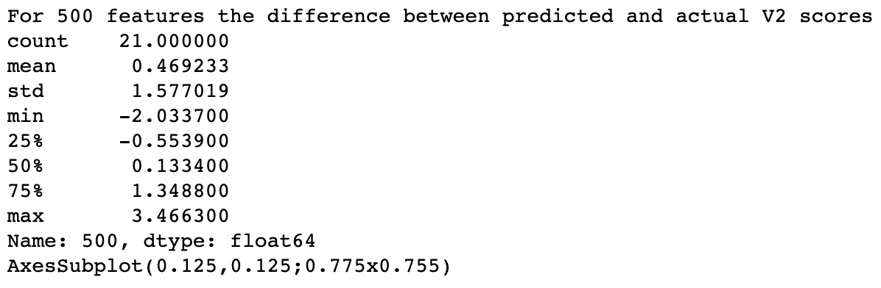
Model Evaluation: Prediction Comparisons (CVSS V2.0)

Slide 13
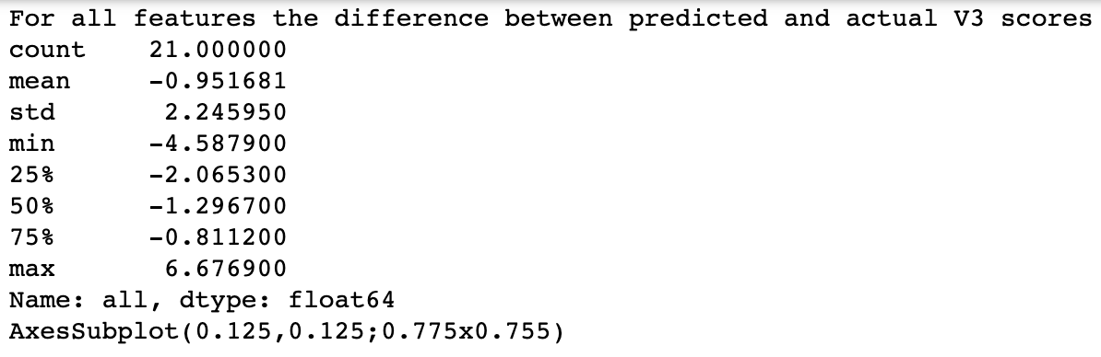
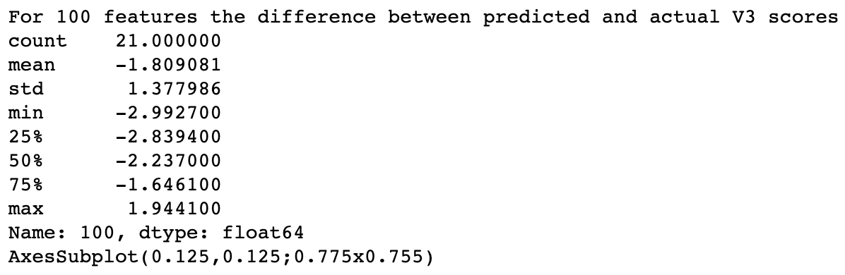
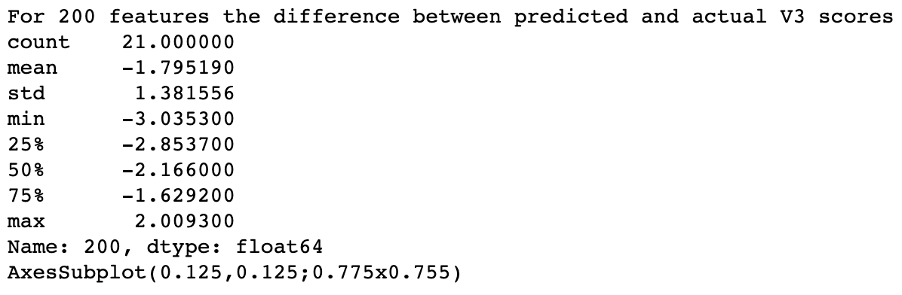

Model Evaluation: Prediction Comparisons (CVSS V3.0)

Slide 14
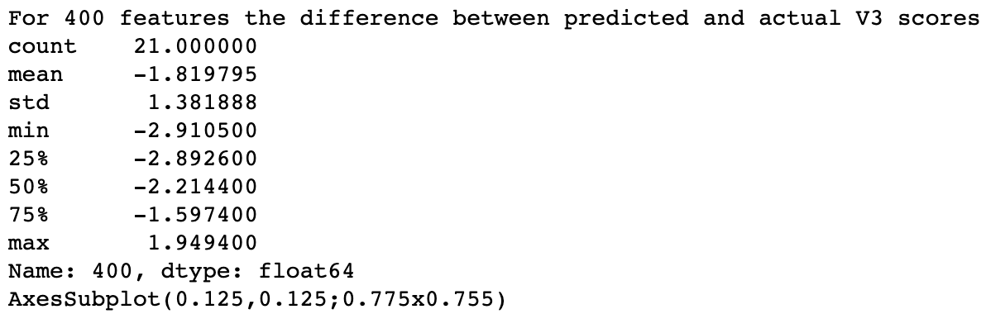
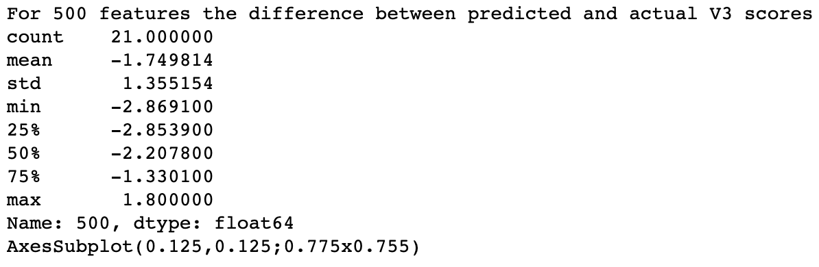
Model Evaluation: Prediction Comparisons (CVSS V3.0)

