Slide 1
Uncertainty-aware Medical Image Diagnosis
L
K
J
I
H
(Classification || Segmentation)
G
F
BY :
Ahmed Mohmed Mahrous Ahmed Hany Abd-El Kader
Ahmad Ayman Mansour Sameh Salah Mohamed
Mohamed Mosbeh El-Said Abd-El Khalik Harby
E
D
C
B
Under Supervision of :
A
DR/Amr Mohamed Abd-El latif

Slide 2

L
Breast cancer is the second leading cause of cancer deaths among U.S. women
K
J
I
H
Invasive ductal carcinoma (IDC) is - with ~ 80 % of cases - one of the most common types of breast cancer
G
F
E
D
C
Our goal:
Given a patient and a patch of a tissue slice predict whether it contains IDC or not & locate where it is .
B
A

Slide 3

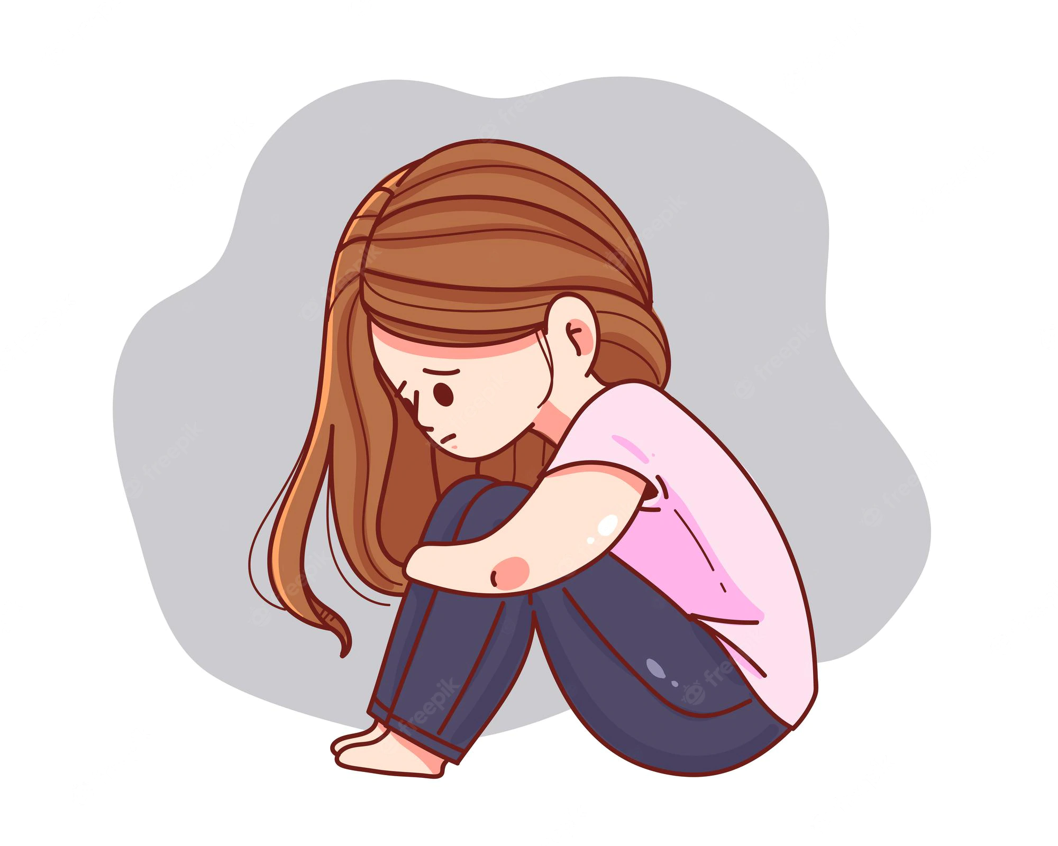
What problem we are here to solve :
L
K
J
I
H
She HAS or NOT !
G
F
E
D
C
Where it is ?
B
A

Slide 4




HAS || NOT
Data
L
(Classification)
K
J
1
- The Images are grouped into 279
I
H
0
- Each patient folder has two sub-folders that groups together images with the same class (0 | 1)
279
G
F
So It’s a lot of data to work with
E
Make it easier :
D
C
- Create a new directory to store all available images
B
A
- Create a list with all the patient ID numbers :
(Each patient ID folder has 2 sub (0 &1) )

Slide 5
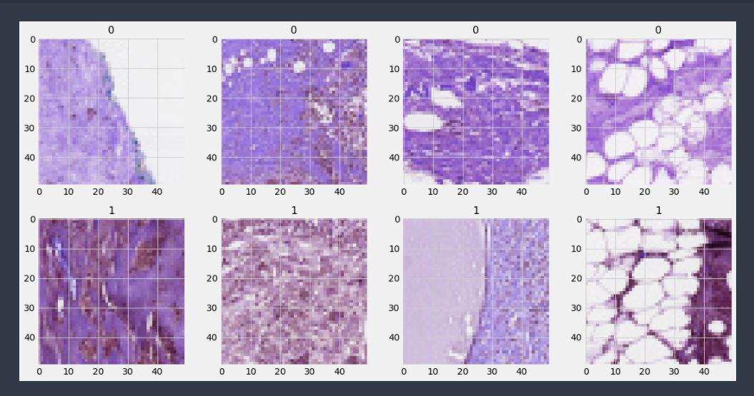
HAS || NOT
Data
(Classification)
L
K
J
What the data look like !
I
H
G
F
E
Count polt of each class (1,0)
D
200,000
150,000
100,000
50,000
0
Pie polt of each class (1,0)
C
Target
B
A
0
1

Slide 6

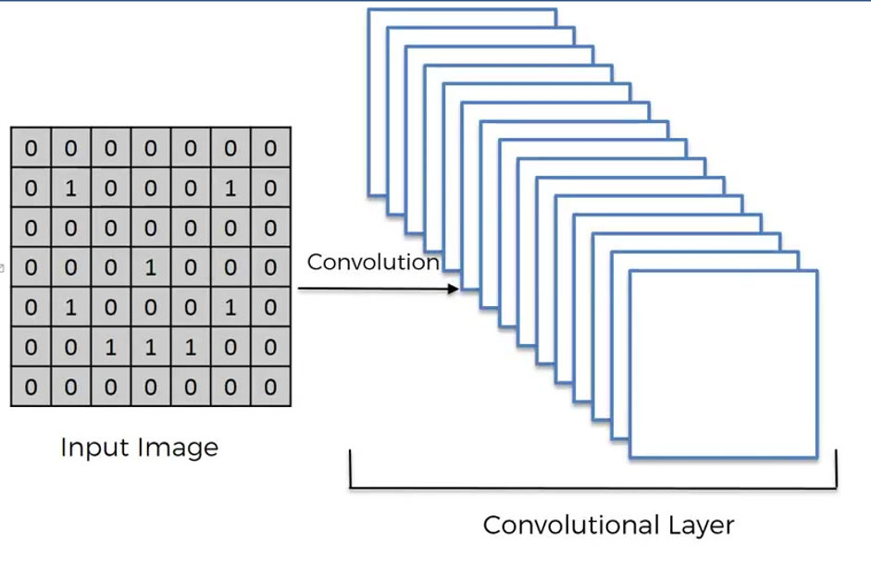
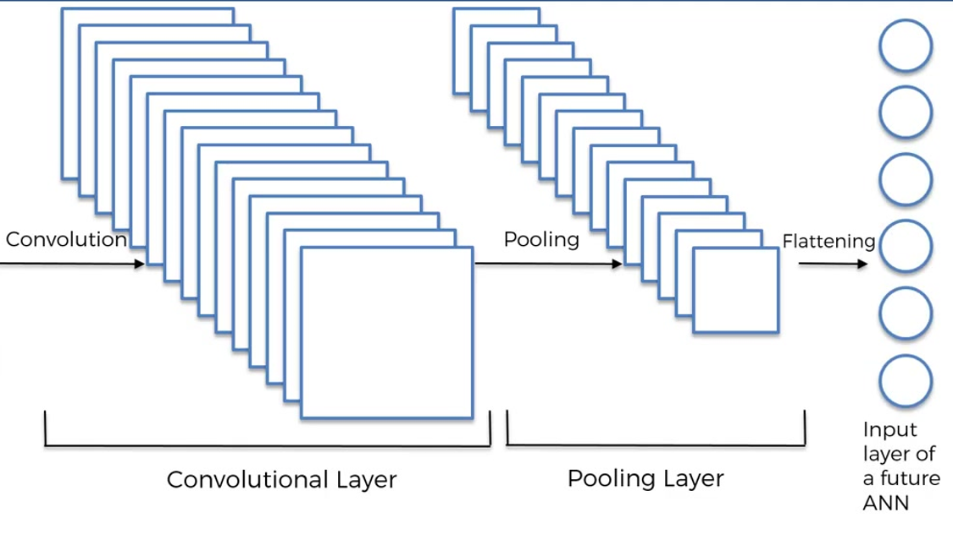
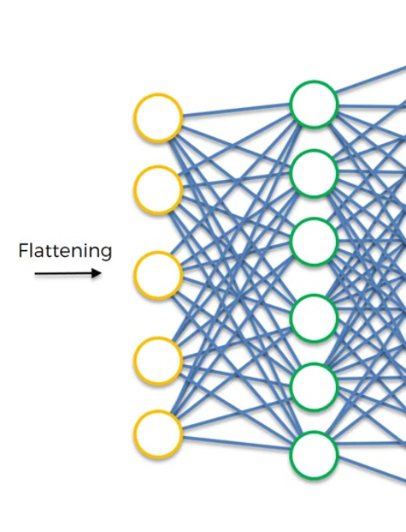
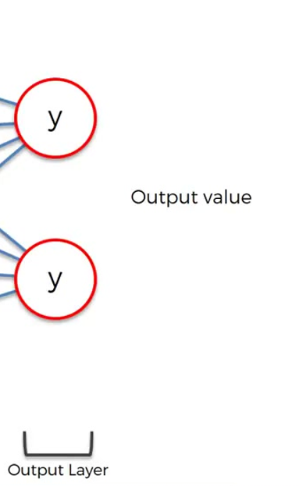
Classification Model
L
K
J
I
H
G
F
E
D
C
B
A

Slide 7
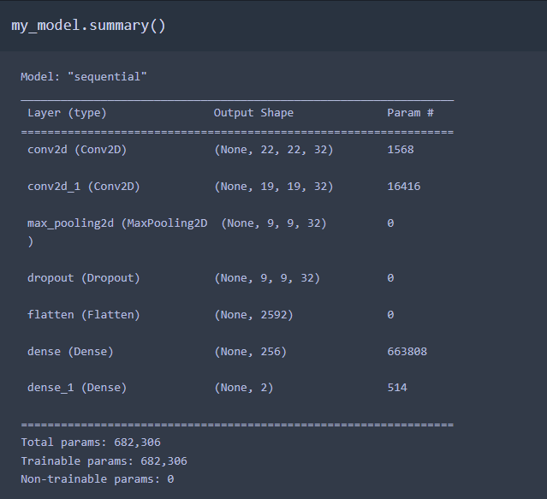
Classification Model
L
K
Model Summary
J
I
H
G
F
E
D
C
B
A

Slide 8
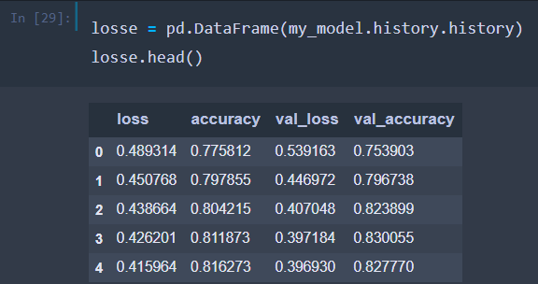
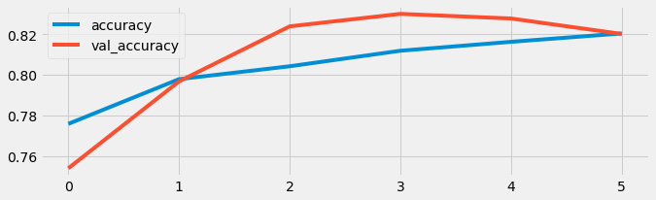
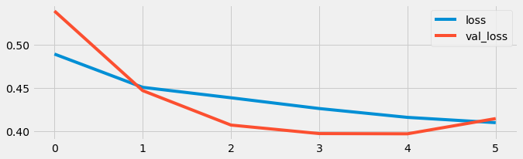
Classification Model
L
K
J
Test
I
H
G
F
E
D
C
B
A

Slide 9
Classification Model
L
K
J
Model Evalutation :
I
Val Loss = 0.4146
H
Val accuracy = 0.8202
G
F
E
D
(The model took 12.34 hours to train Run on CPU )
C
B
A

Slide 10

L
Where it is ?
(Segmentation)
K
J
This is our next step : To be more specific in the diagnosis
I
H
G
F
Data
2017 ISIC skin lesion segmentation challenge
E
D
Training , Validation , testing (2000 , 150 , 600 )
all the images were resized to 256×256
C
B
A

Slide 11
Segmentation Model
L
K
We build a Dense U-Net that consist of :
J
I
H
- 5 dense blocks
G
- Bottle neck of our U-Net consist of 2 Dense
F
- Up sampling Path of 5 Dense block
E
D
(All the convolution layers with the kernel size 3*3 and the same padding, 2 dense layers of 1024 units ,The final activation function is sigmoid function that translate the output values between 0 and 1. )
C
B
A

Slide 12
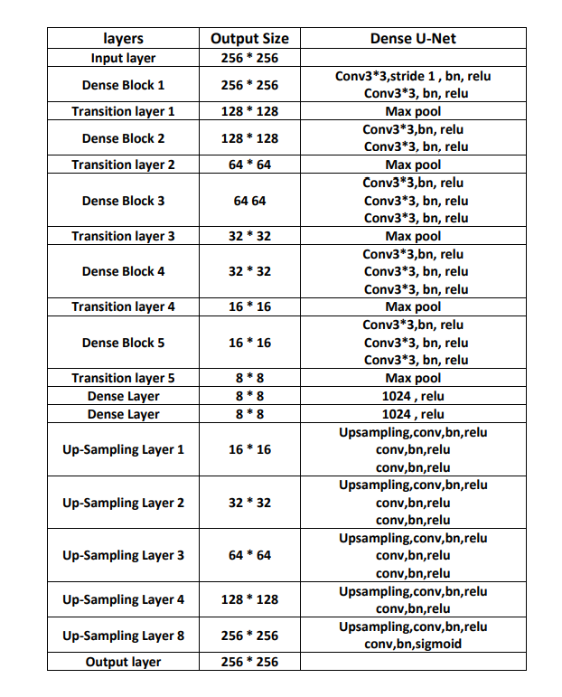
Segmentation Model
L
K
J
I
H
G
F
E
D
C
B
A

Slide 13
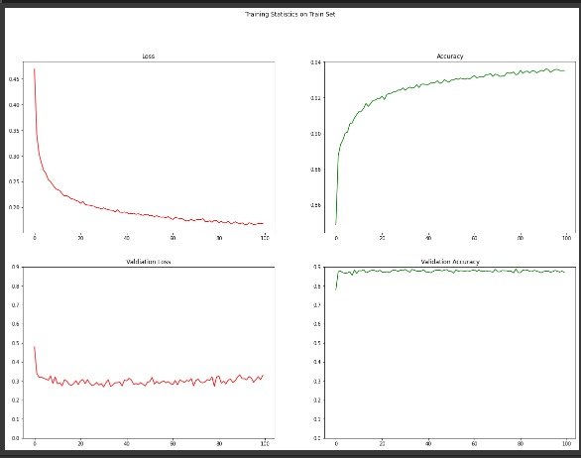
Segmentation Model
L
K
J
Result Analysis
I
Training Accuracy= 93.5
H
G
Val Accuracy = 87.01
F
E
D
C
B
A

Slide 14

L
The Execution of what we have achieved :
K
J
I
H
we decide to make mobile app to show how we can benefit from the model
G
F
E
Good Care APP
We Built a Flutter APP To reach and serve as many mothers as possible .
D
C
B
A

Slide 15




What we built !
L
K
J
I
H
G
F
E
D
C
B
Flutter App
A

Slide 16

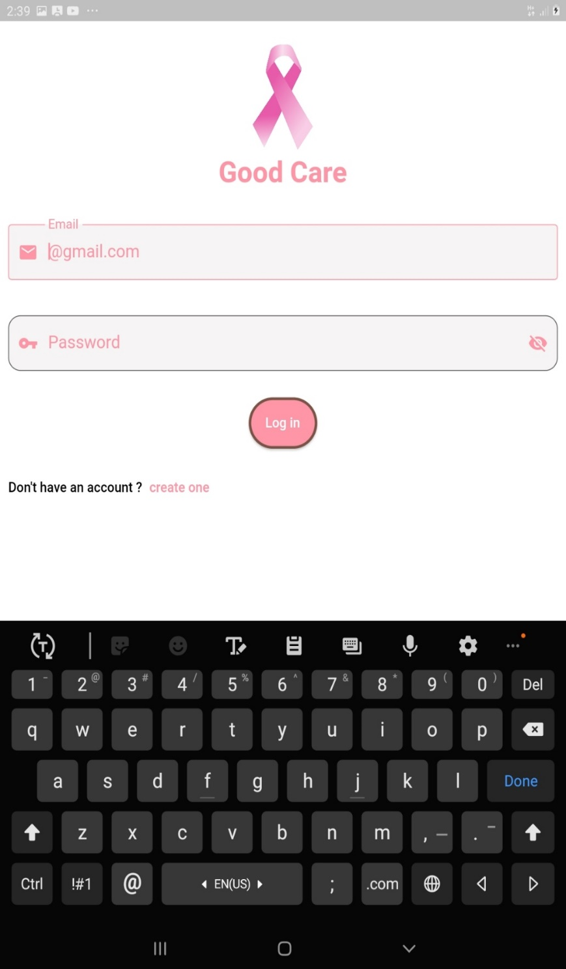
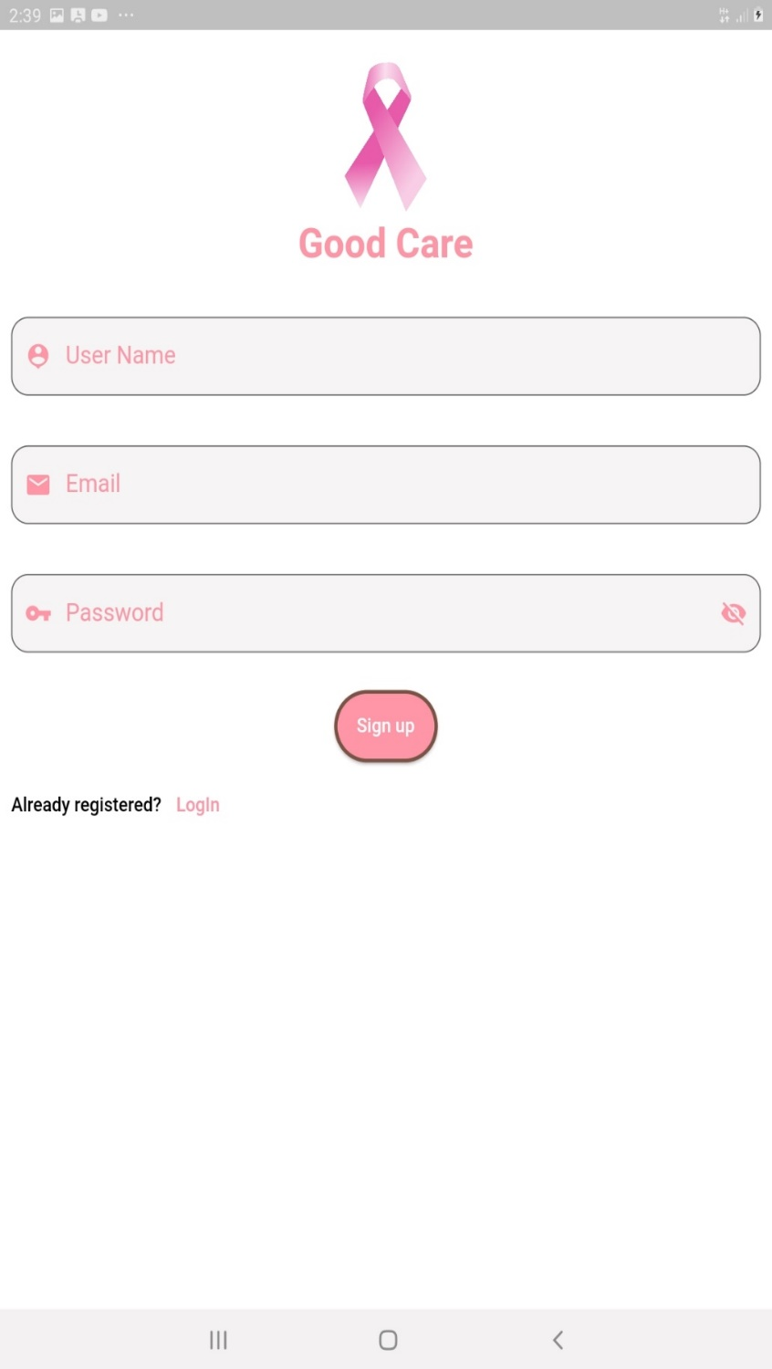
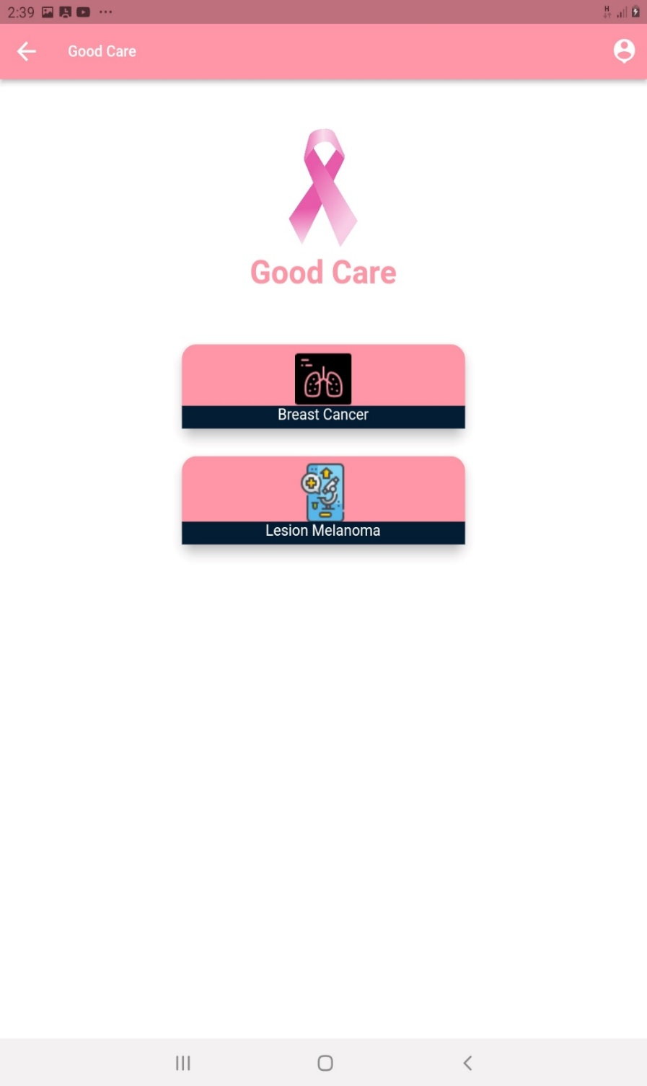
Front - End
L
K
J
I
H
G
F
E
D
C
B
A

Slide 17
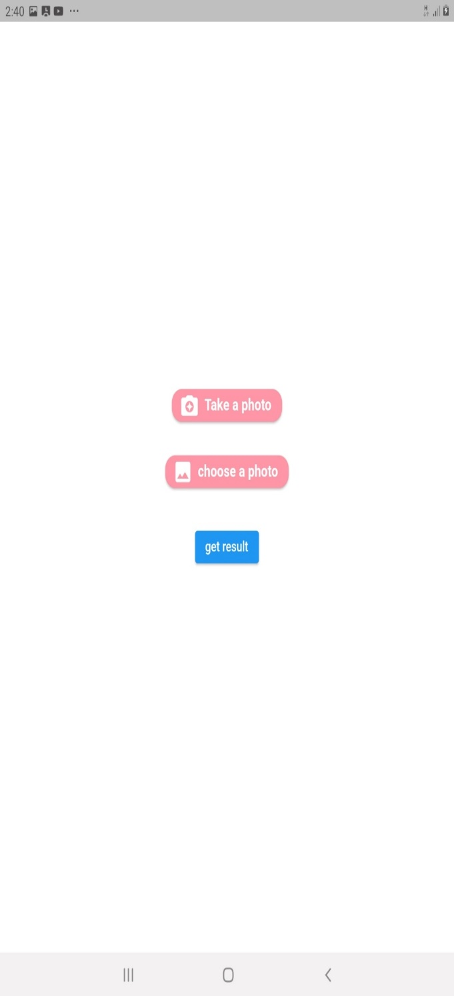
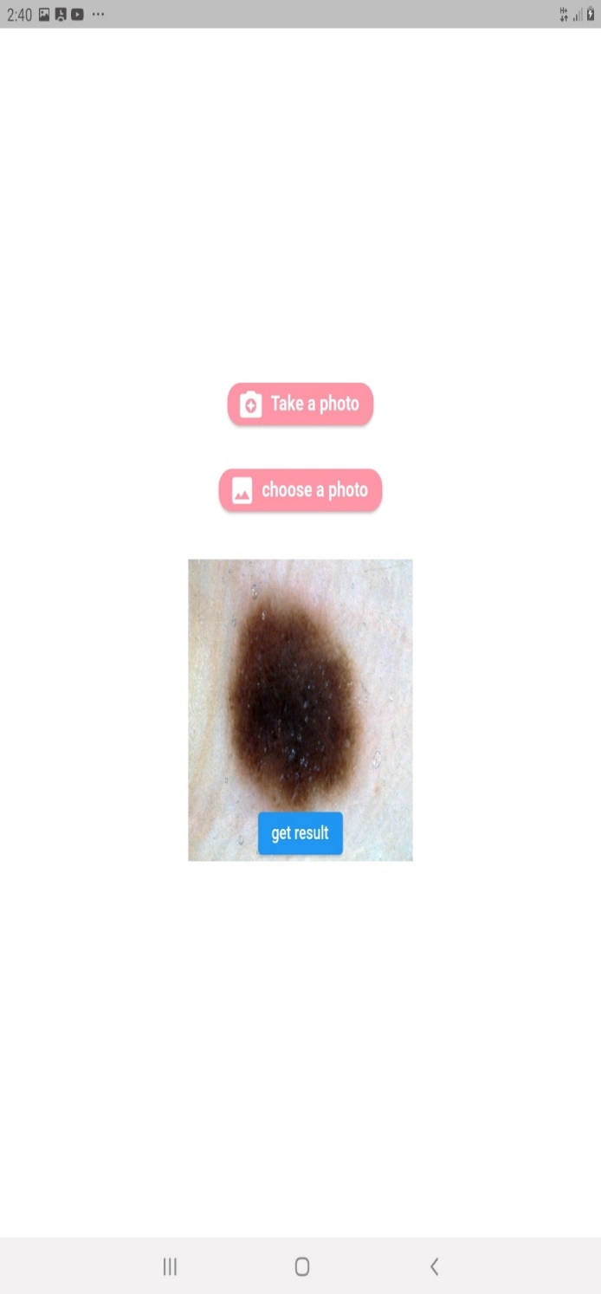
Front - End
L
K
J
I
H
G
F
E
D
C
B
A

Slide 18










Technologies – tools Used
L
K
J
I
H
G
F
E
D
C
B
A

Slide 19
Our Future Work
L
We already had created Model to check while the tumor is malicious or not using effecient-Net p4
K
J
I
Data
H
We use the same data we Use for the Segmentation state
G
F
Model
E
- We use EfficientNetB3 and added one layer
D
C
Training Accuracy= 98 %
B
A
Val Accuracy = 82 %

Slide 20
L
K
Thanks for Listening with great patience
J
I
H
G
F
Good Care APP
Under supervision of
Dr/ Amr Mohamed Abd-El latif
E
D
C
B
A

