Slide 1

Pug JS

Slide 2

Introduction and What is Pugjs
What’s Pugjs ?
What’s Jade ?
Why I Use Template Engine ?

Slide 3
Installation
Ensure that you have Node.js installed on your system. (Check using the 'node -v‘ command)
Install Pug globally by running the command: 'npm install -g pug'
Create and initialize a Node.js project.
Install Pug as a Dependency: 'npm install pug'
Create .pug file and write code.
Compile Pug to HTML: 'pug <template-file> -o <output-directory>

Slide 4
Watching Pug.JS Files
Watching Pug.js files refers to a process where the Pug.js compiler automatically monitors for changes in your Pug files and recompiles them into HTML whenever a modification is detected.
[ pug -w <template-file>.pug -o <output-directory> ]
Also you can use the '-p' or '--pretty' to get a clean code. [ pug -w <template-file>.pug -o <output-directory> --pretty ]

Slide 5
Features
Clean Code
Dynamic Content
Include
Iteration
Switch
If Condition
Inheritance: Extends

Slide 6
Syntax of PugJs
Indentation-based syntax. PugJS uses indentation to define the structure of code, eliminating the need for closing tags.
Shorthand syntax PugJS offers a shorthand syntax for commonly used HTML elements, resulting in more concise and easier to read code.

Slide 7
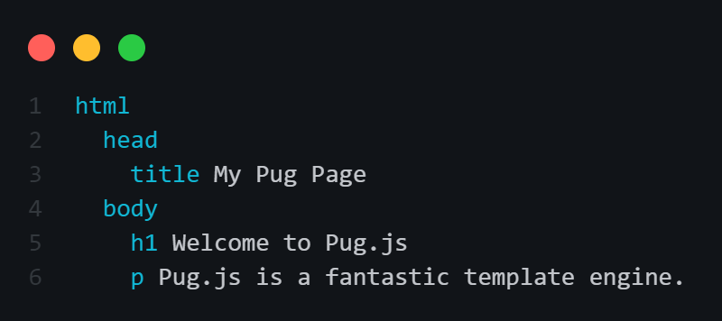
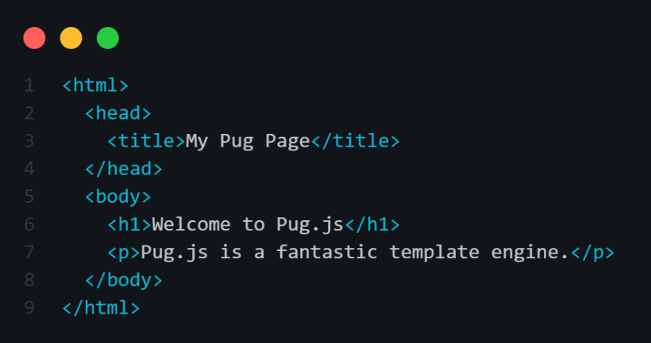
Example

Slide 8
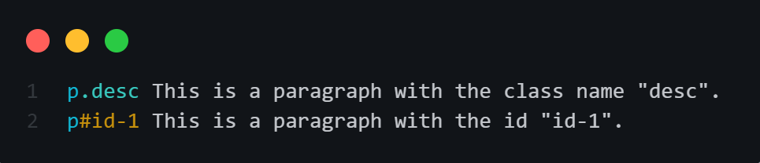
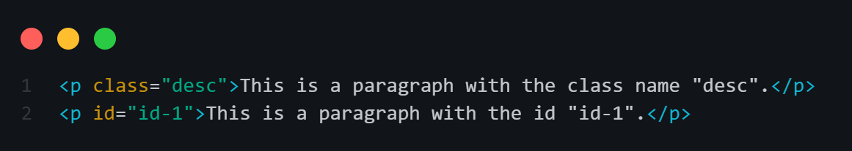
Attributes in Pug.js
You can add a single attribute, such as id or class, by using '#‘ or '.' respectively after the element name.
The compiled code:

Slide 9
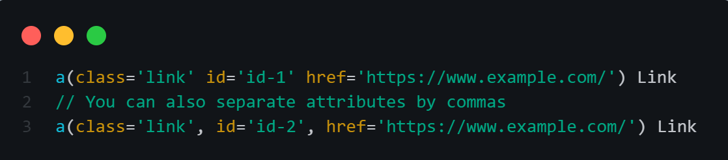
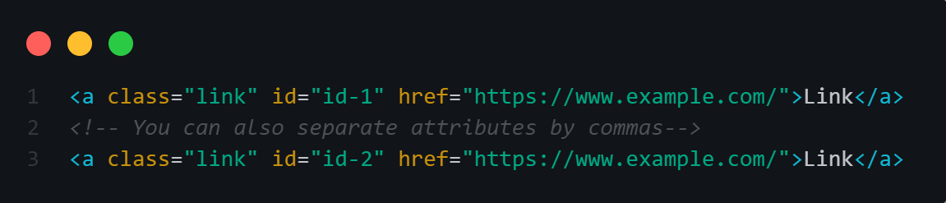
Attributes in Pug.js
In certain cases, you may want to add multiple attributes to an element. You can achieve this by using parentheses '( )' and separating the attributes with commas or spaces.
The compiled code:

Slide 10
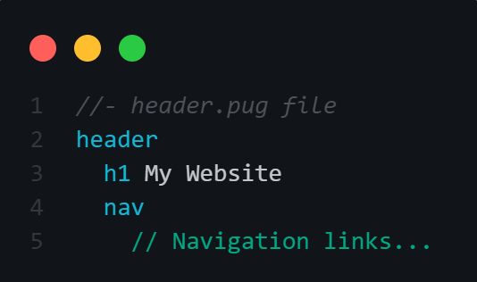
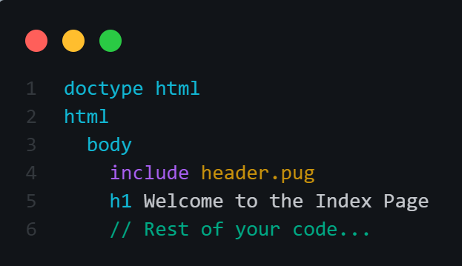
Include
in Pug.js, you can use the 'include' keyword to include the content from a separate file.

Slide 11
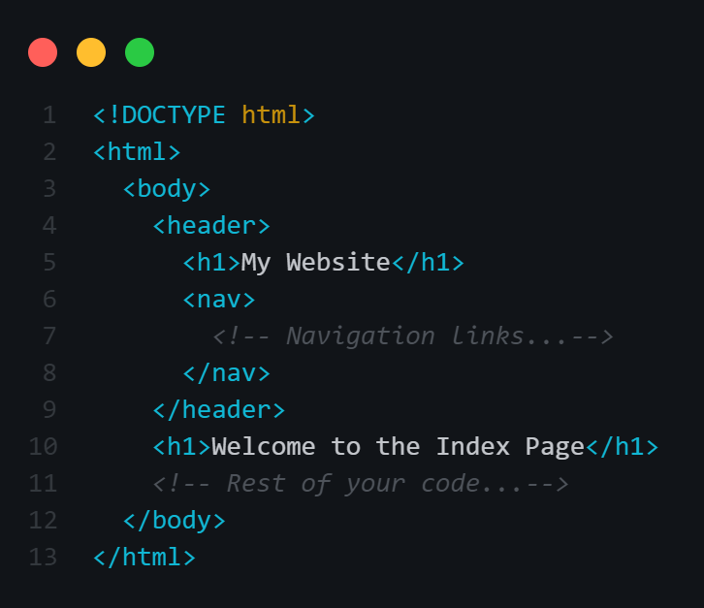
Include
The compiled code of index.pug:

Slide 12
Code
Pug allows you to write inline JavaScript code in your templates.
There are three types of code:
Unbuffered Code.
Buffered Code.
Unescaped Buffered Code.

Slide 13
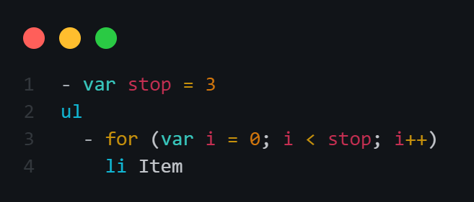
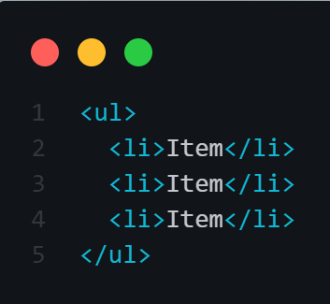
Unbuffered Code
UnBuffered code starts with a hyphen '-'.
It does not directly add anything to the output.
UnBuffered code is typically used for tasks like loops or declaring variables using keywords such as var, let, or const. The result of unBuffered code does not directly affect the generated output.
The compiled code of index.pug:

Slide 14
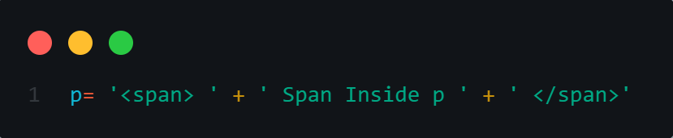
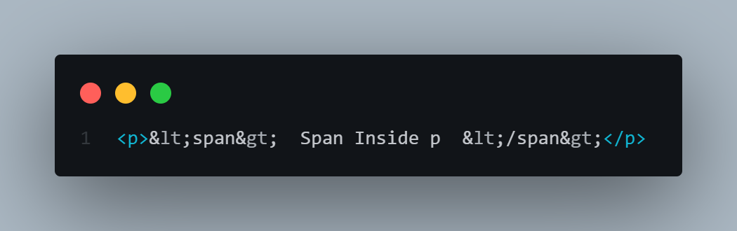
Buffered Code
Buffered code starts with ‘=‘.
It evaluates the JS expression and output the result.

Slide 15
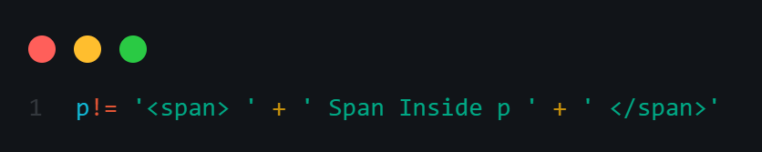
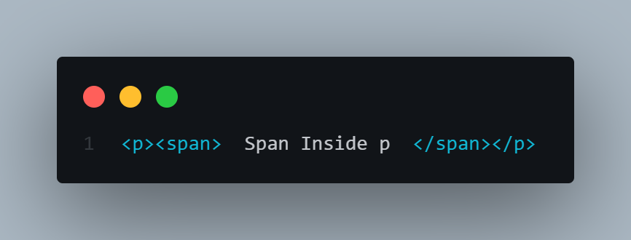
UnEscaped Buffered Code
UnEscaped buffered code starts with an exclamation mark and equal sign '!='. It evaluates the JavaScript expression and outputs the result without performing any HTML escaping. This is useful when you want to include specific elements or raw HTML content.

Slide 16
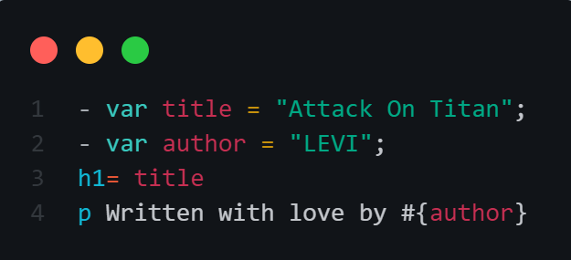
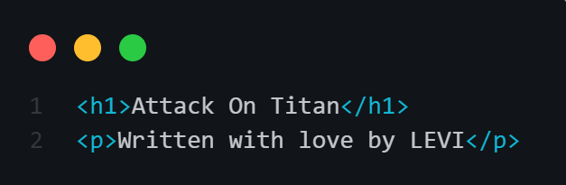
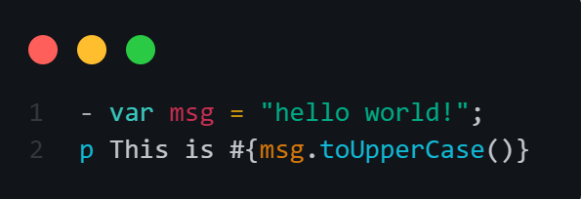
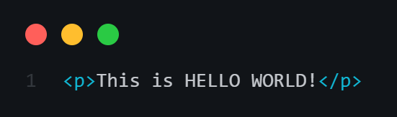
Interpolation
In PugJS, interpolation is a way to dynamically insert JavaScript expressions and variables into the HTML output. It is denoted by #{...} syntax and allows for dynamic content generation based on the values of variables or expressions.

Slide 17
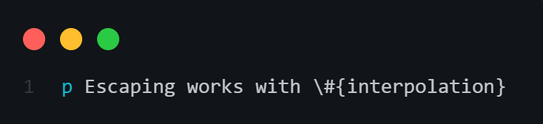
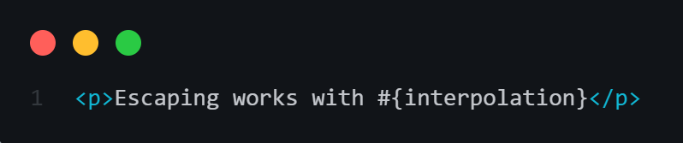
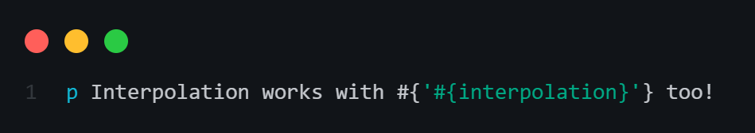
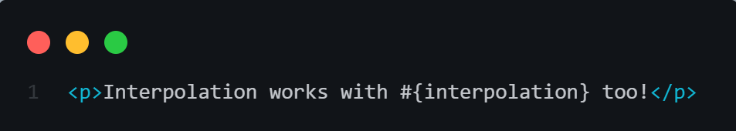
Interpolation
If you need to include a verbatim #{, you can either escape it, or use interpolation.

Slide 18
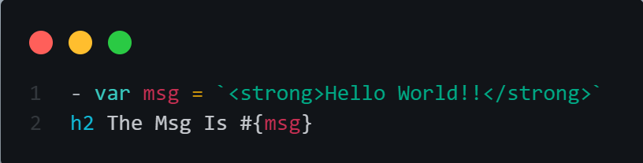
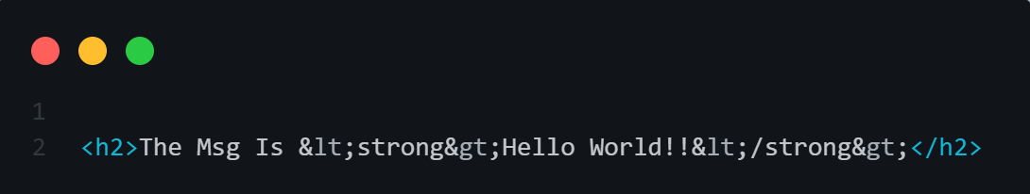
Interpolation
However, if you add markup inside the interpolation, it will be escaped.

Slide 19
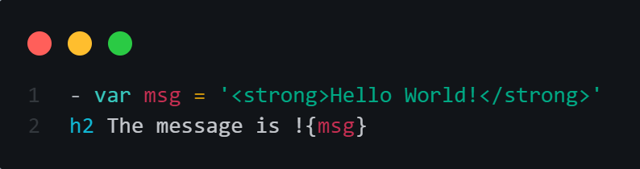
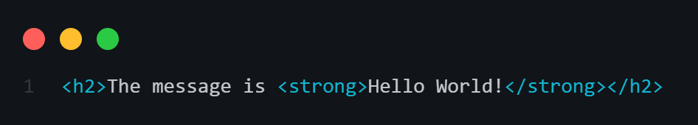
Unescaped Interpolation
Unescaped interpolation, denoted by '!{...}', allows HTML characters to be interpreted as markup in the resulting string.

Slide 20
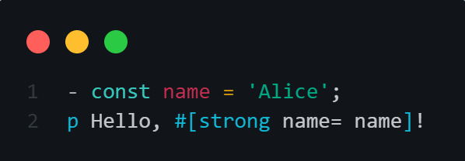
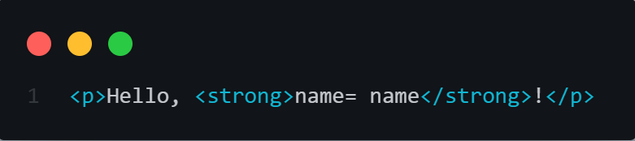
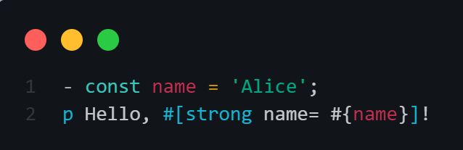
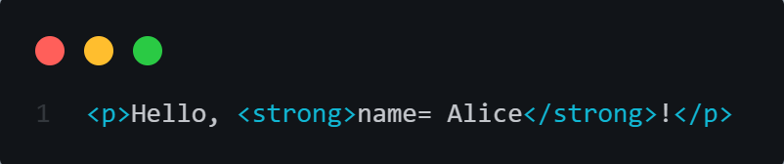
Tag Interpolation
Tag interpolation is a way to dynamically insert values into a pre-defined template using placeholders.
In PugJS, the syntax involves using #[tag=value] to interpolate values into HTML tags.

Slide 21
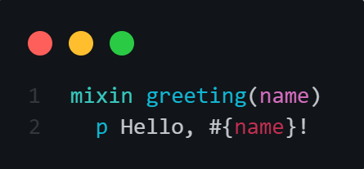
Mixins
Mixins are a powerful feature in Pug.JS that allow you to create reusable blocks of code, which can be called and included in other templates. They provide a convenient way to avoid code duplication and promote code reuse.
To define a mixin in Pug.JS, you can use the 'mixin' keyword, followed by the mixin name and any arguments it may accept.

Slide 22
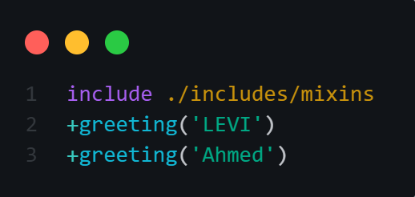
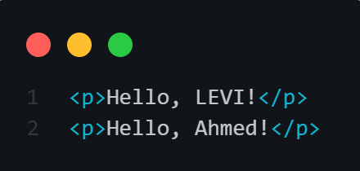
Mixins
To use the defined mixin, you can include and call it by its name followed by parentheses, passing in the required arguments. Here's an example of using the greeting mixin:
The compiled code of index.pug

Slide 23
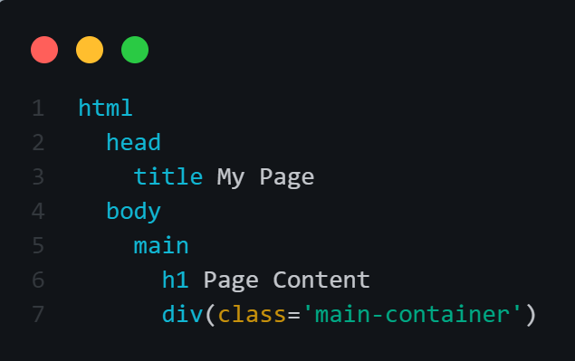
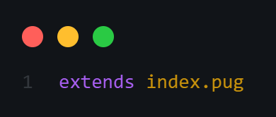
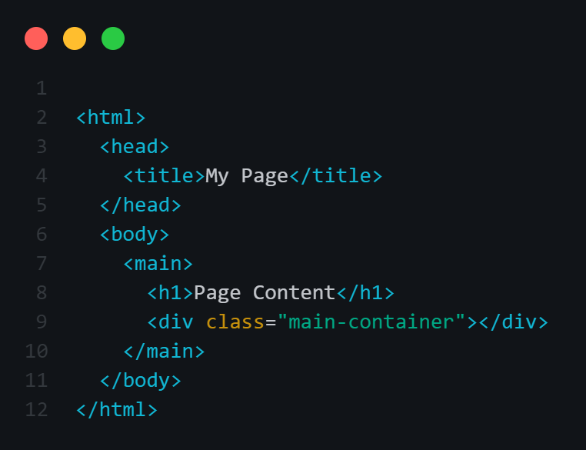
Inheritance: Extends
In PugJS, the extends keyword allows templates to inherit from a base template.
In index.pug file:
In demo.pug file:
The compiled code of demo.pug file:

Slide 24
Inheritance: Extends
In PugJS, the extends keyword allows templates to inherit from a base template.
In index.pug file:
In demo.pug file:
The compiled code of demo.pug file:

Slide 25
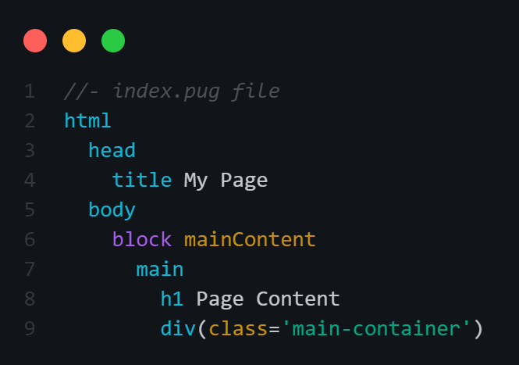
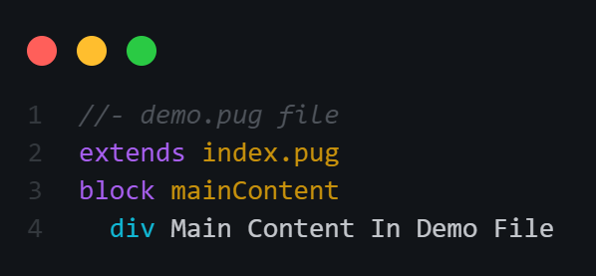
Inheritance: Extends
In the example above, you simply copy all the content, but often you need to override a block in the parent.
You can do this using the block keyword. Use the block keyword with the name of the block declared in the parent file and then write the new value.

Slide 26
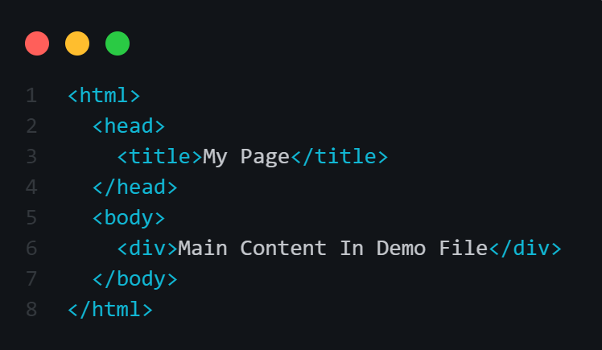
Inheritance: Extends
The compiled code of demo.pug file:

Slide 27
Thanks for your attention
Ahmed Alawneh

