Slide 1
Chapter 1
Database Systems

Slide 2
Learning Objectives
After completing this chapter, you will be able to:
Define the difference between data and information
Describe what a database is, various types, and why they are valuable assets for decision making
Explain the importance of database design
See how modern databases evolved from file systems
Understand flaws in file system data management
Outline the main components of the database system
Describe the main functions of a database management system (DBMS)

Slide 3
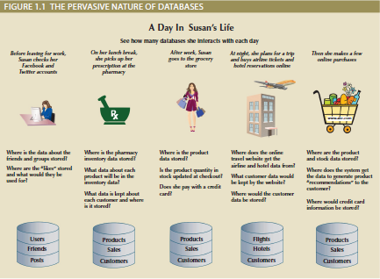
Why Databases?
Characteristics of data in today’s world
Ubiquitous (i.e., abundant, global, and everywhere)
Pervasive (i.e., unescapable, prevalent, and persistent)
Databases make data persistent and shareable in a secure way
Specialized structures that allow computer-based systems to store, manage, and retrieve data very quickly

Slide 4
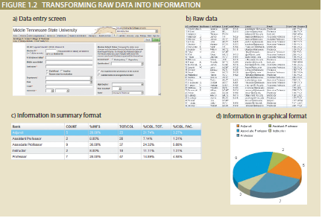
Data versus Information
Data consists of raw facts
Not yet processed to reveal meaning to the end user
Building blocks of information
Information results from processing raw data to reveal meaning
Requires context
Bedrock of knowledge
Should be accurate, relevant, and timely

Slide 5
Introducing the Database
Shared, integrated computer structure that stores data
End-user data: raw facts of interest to end user
Metadata: data about data, through which the end-user data is integrated and managed
Describes data characteristics and relationships
Database management system (DBMS)
Collection of programs
Manages the database structure
Controls access to data stored in the database

Slide 6
Role and Advantages of the DBMS (1 of 2)
Database management system (DBMS): intermediary between the user and the database
Enables data to be shared
Presents the end user with an integrated view of data
Provides more efficient and effective data management
Improves sharing, security, integration, access, decision-making, productivity, etc.

Slide 7
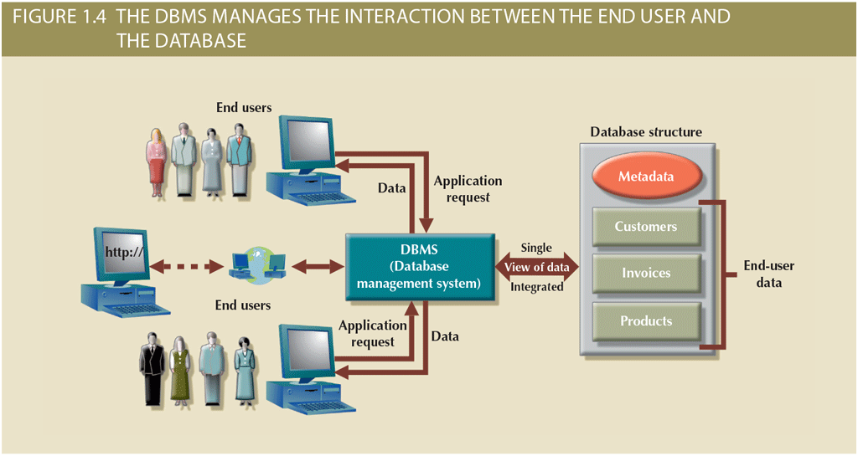
Role and Advantages of the DBMS (2 of 2)

Slide 8
Evolution of File System Data Processing (2 of 3)
Table 1.2 | Basic File Terminology
TERM | DEFINITION
Data | Raw facts, such as a telephone number, a birth date, a customer name, and a year-to-date (YTD) sales value. Data has little meaning unless it has been organized in some logical manner.
Field | A character or group of characters (alphabetic or numeric) that has a specific meaning. A field is used to define and store data.
Record | A logically connected set of one or more fields that describes a person, place, or thing. For example, the fields that constitute a record for a customer might consist of the customer’s name, address, phone number, date of birth, credit limit, and unpaid balance.
File | A collection of related records. For example, a file might contain data about the students currently enrolled at Gigantic University.

Slide 9
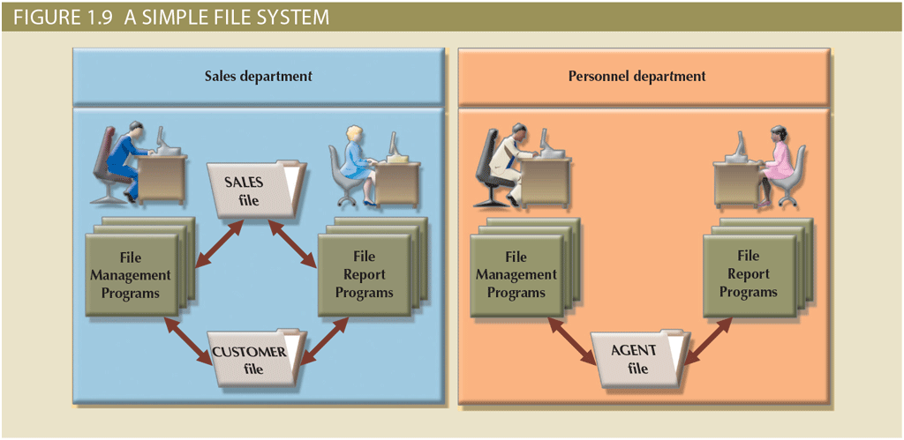
Evolution of File System Data Processing (3 of 3)

Slide 10
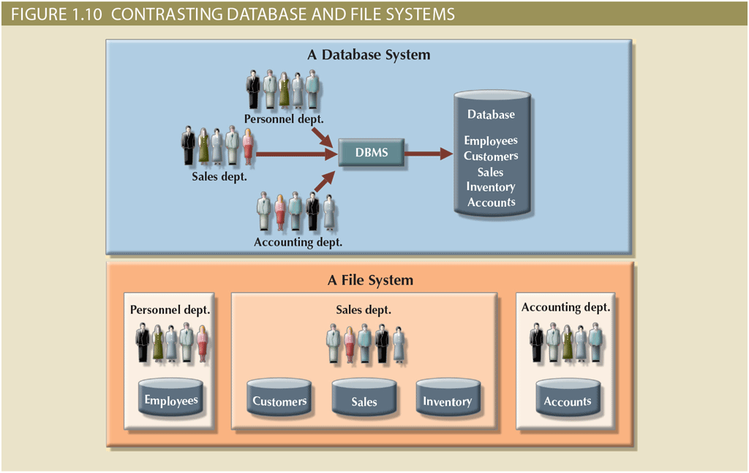
Database Systems (2 of 2)

Slide 11
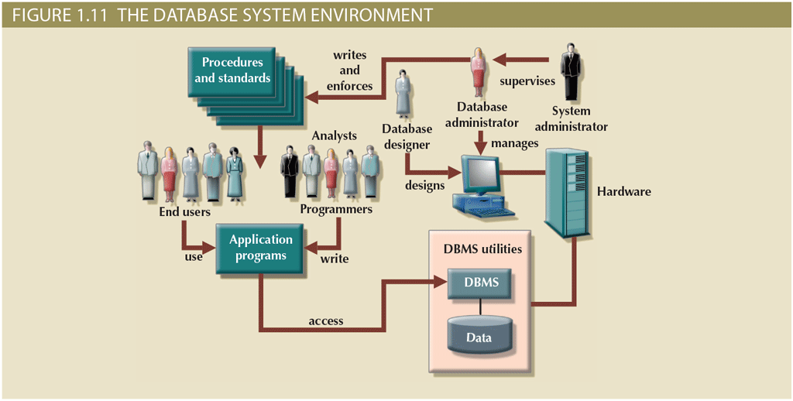
The Database System Environment (2 of 2)

Slide 12
DBMS Functions (1 of 3)
Data dictionary management
Data dictionary: stores definitions of data elements and their relationships
Data storage management
Performance tuning ensures efficient performance
Data transformation and presentation
Data is formatted to conform to logical expectations
Security management
Enforces user security and data privacy

Slide 13
DBMS Functions (2 of 3)
Multiuser access control
Sophisticated algorithms ensure that multiple users can access the database concurrently without compromising its integrity
Backup and recovery management
Enables recovery of the database after a failure
Data integrity management
Minimizes redundancy and maximizes consistency

Slide 14
DBMS Functions (3 of 3)
Database access languages and application programming interfaces
Query language: lets the user specify what must be done without having to specify how
Structured Query Language (SQL): de facto query language and data access standard supported by the majority of DBMS vendors
Database communication interfaces
Accept end-user requests via multiple, different network environments

Slide 15
Preparing for Your Database Professional Career
TABLE 1.3 | DATABASE CAREER OPPORTUNITIES
JOB TITLE | DESCRIPTION | SAMPLE SKILLS REQUIRED
Database Developer | Create and maintain database-based applications | Programming, database fundamentals, SQL
Database Designer | Design and maintain databases | Systems design, database design, SQL
Database Administrator | Manage and maintain DBMS and databases | Database fundamentals, SQL, vendor courses
Database Analyst | Develop databases for decision support reporting | QL, query optimization, data warehouses
Database Architect | Design and implementation of database environments (conceptual, logical, and physical) | DBMS fundamentals, data modeling, SQL, hardware knowledge, etc.
Database Consultant | Help companies leverage database technologies to improve business processes and achieve specific goals | Database fundamentals, data modeling, database design, SQL, DBMS, hardware, vendor-specific technologies, etc.
Database Security Officer | Implement security policies for data administration | DBMS fundamentals, database administration, SQL, data security technologies, etc.
Cloud Computing Data Architect | Design and implement the infrastructure for next-generation cloud database systems | Internet technologies, cloud storage technologies, data security, performance tuning, large databases, etc.
Data Scientist | Analyze large amounts of varied data to generate insights, relationships, and predictable behaviors | Data analysis, statistics, advanced mathematics, SQL, programming, data mining, machine learning, data visualization

Slide 16
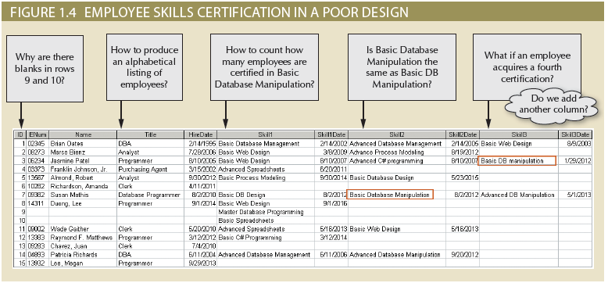
Why Database Design is Important

Slide 17
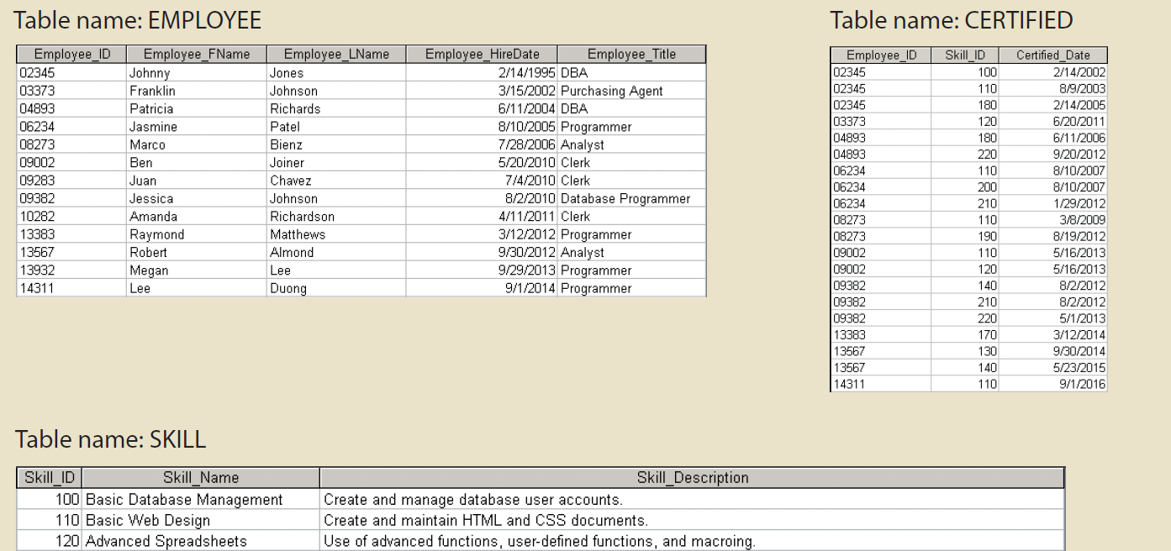
Why Database Design is Important

Slide 18
Summary
Data consists of raw facts and is usually stored in a database
Database design defines the database structure
Can be classified according to the number of users, location, as well as data usage and structure
Databases evolved from manual and computerized file systems
There are some limitations of file system data management
DBMSs were developed to address the file system’s inherent weaknesses

