Slide 1
Database Principles
“Database Principles: Fundamentals of Design, Implementation, and Management”, C. Coronel, S. Morris, P.Rob
Database Models
4-<number>

Slide 2
Views & Abstraction
Designers, programmers, and end users see data in different ways
Different views of same data lead to designs that do not reflect organization’s operation
Data modeling reduces complexities of database design
Various degrees of data abstraction help reconcile varying views of same data
4-<number>

Slide 3
Data Modeling and Data Models
Data models
  Relatively simple representations of complex real-world data structures
    Often graphical
Model: an abstraction of a real-world object or event
  Useful in understanding complexities of the real-world environment
Data modeling is iterative and progressive
4-<number>

Slide 4
The Importance of Data Models
Facilitate interaction among the designer, the applications programmer, and the end user
End users have different views and needs for data
Data model organizes data for various users
Data model is an abstraction
  Cannot draw required data out of the data model
4-<number>

Slide 5
Data Model Basic Building Blocks
Entity: anything about which data are to be collected and stored
Attribute: a characteristic of an entity
Relationship: describes an association among entities
  One-to-many (1:M) relationship
  Many-to-many (M:N or M:M) relationship
  One-to-one (1:1) relationship
Constraint: a restriction placed on the data
4-<number>

Slide 6
Business Rules
Descriptions of policies, procedures, or principles within a specific organization
  Apply to any organization that stores and uses data to generate information
Description of operations to create/enforce actions within an organization’s environment
  Must be in writing and kept up to date
  Must be easy to understand and widely disseminated
Describe characteristics of data as viewed by the company
4-<number>

Slide 7
Discovering Business Rules
Sources of business rules:
  Company managers
  Policy makers
  Department managers
  Written documentation
    Procedures
    Standards
    Operations manuals
  Direct interviews with end users
4-<number>

Slide 8
Translating Business Rules into Data Model Components
Nouns translate into entities
Verbs translate into relationships among entities
Relationships are bidirectional
Two questions to identify the relationship type:
  How many instances of B are related to one instance of A?
  How many instances of A are related to one instance of B?
4-<number>

Slide 9
Naming Conventions
Naming occurs during translation of business rules to data model components
Names should make the object unique and distinguishable from other objects
Names should also be descriptive of objects in the environment and be familiar to users
Proper naming:
  Facilitates communication between parties
  Promotes self-documentation
4-<number>

Slide 10
The Relational Model
Developed by E.F. Codd (IBM) in 1970
Table (relations)
  Matrix consisting of row/column intersections
  Each row in a relation is called a tuple
Model was conceptually simple at expense of computer overhead
Let the user/designer operate in a human logical environment
4-<number>

Slide 11
The Relational Model
Relational data management system (RDBMS)
  Performs same functions provided by hierarchical model
  Hides complexity from the user
Relational diagram
  Representation of entities, attributes, and relationships
Relational table stores collection of related entities
4-<number>

Slide 12
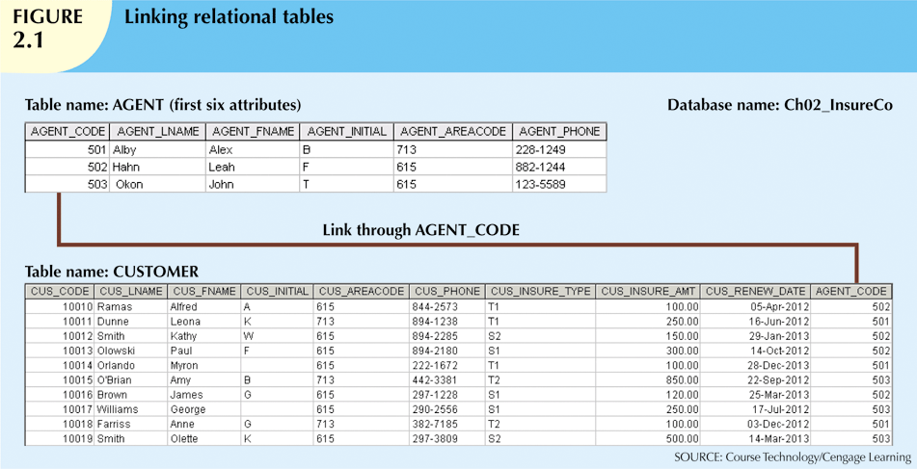

Slide 13
The Relational Model
SQL-based relational database application involves three parts:
  End-user interface
    Allows end user to interact with the data
  Set of tables stored in the database
    Each table is independent from another
    Rows in different tables are related based on common values in common attributes
  SQL “engine”
    Executes all queries
4-<number>

Slide 14
The Entity Relationship Model
Widely accepted standard for data modeling
Introduced by Chen in 1976
Graphical representation of entities and their relationships in a database structure
Entity relationship diagram (ERD)
  Uses graphic representations to model database components
  Entity is mapped to a relational table
4-<number>

Slide 15
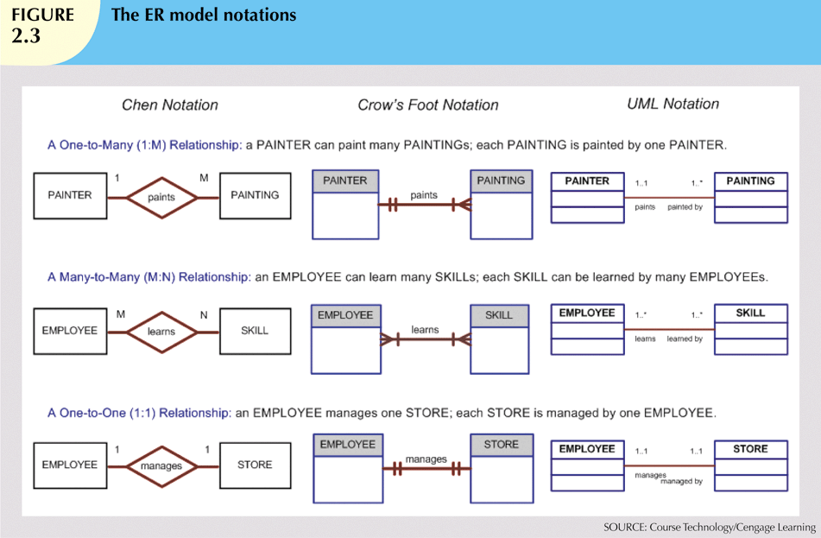

Slide 16
The Entity Relationship Model
Entity instance (or occurrence) is row in table
Entity set is collection of like entities
Connectivity labels types of relationships
Relationships are expressed using Chen notation
  Relationships are represented by a diamond
  Relationship name is written inside the diamond
Crow’s Foot notation used as design standard in this book
4-<number>

Slide 17
The Entity Relationship Model
Advantages
  Exceptional conceptual simplicity
  Visual representation
  Effective communication tool
  Integrated with the relational data model
Disadvantages
  Limited constraint representation
  Limited relationship representation
  No data manipulation language
  Loss of information content
4-<number>

Slide 18
Degrees of Data Abstraction
Database designer starts with abstracted view, then adds details
ANSI Standards Planning and Requirements Committee (SPARC)
  Defined a framework for data modeling based on degrees of data abstraction (1970s):
    External
    Conceptual
    Internal
5-<number>

Slide 19
The External Model
End users’ view of the data environment
ER diagrams represent external views
External schema: specific representation of an external view
  Entities
  Relationships
  Processes
  Constraints
5-<number>

Slide 20
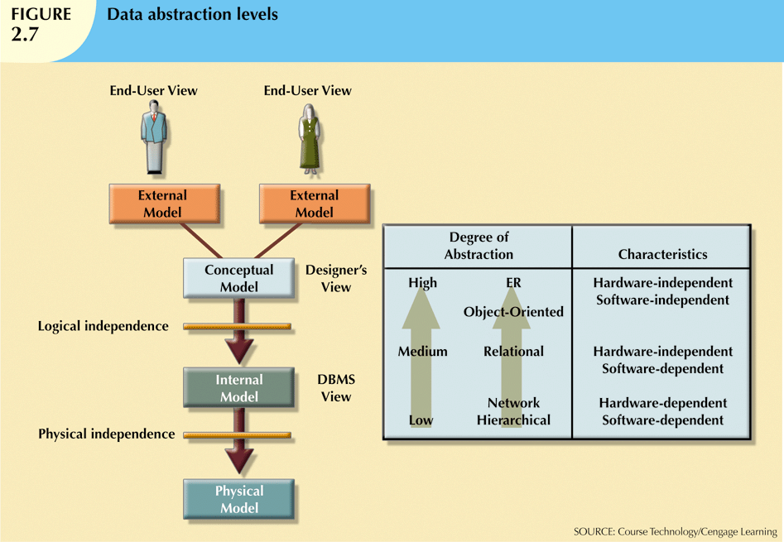
5-<number>

Slide 21
The External Model
Easy to identify specific data required to support each business unit’s operations
Facilitates designer’s job by providing feedback about the model’s adequacy
Ensures security constraints in database design
Simplifies application program development
5-<number>

Slide 22
The Conceptual Model
Represents global view of the entire database
All external views integrated into single global view: conceptual schema
ER model most widely used
ERD graphically represents the conceptual schema
5-<number>

Slide 23
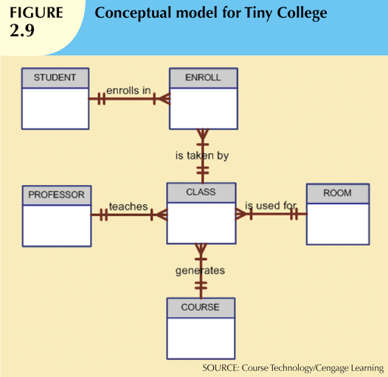

Slide 24
The Conceptual Model
Provides a relatively easily understood macro level view of data environment
Independent of both software and hardware
  Does not depend on the DBMS software used to implement the model
  Does not depend on the hardware used in the implementation of the model
  Changes in hardware or software do not affect database design at the conceptual level
5-<number>

Slide 25
The Internal Model
Representation of the database as “seen” by the DBMS
  Maps the conceptual model to the DBMS
Internal schema depicts a specific representation of an internal model
Depends on specific database software
  Change in DBMS software requires internal model be changed
Logical independence: change internal model without affecting conceptual model
5-<number>

Slide 26
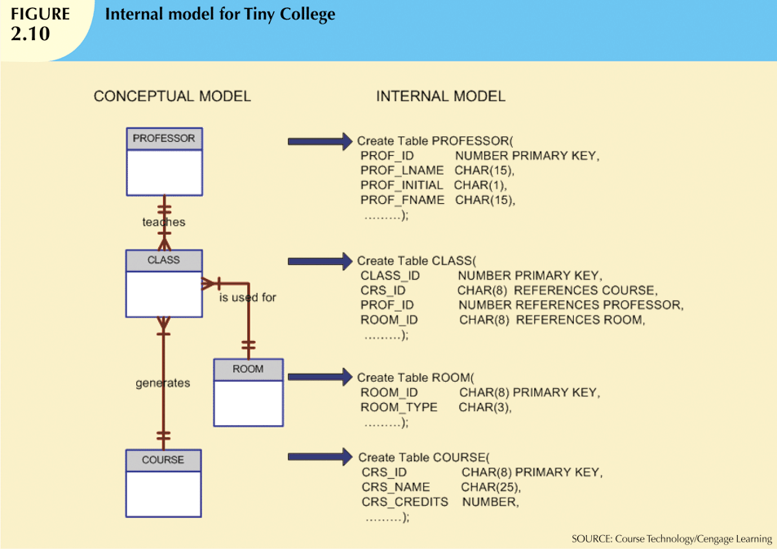

Slide 27
The Physical Model
Operates at lowest level of abstraction
  Describes the way data are saved on storage media such as disks or tapes
Requires the definition of physical storage and data access methods
Relational model aimed at logical level
  Does not require physical-level details
Physical independence: changes in physical model do not affect internal model
5-<number>

Slide 28
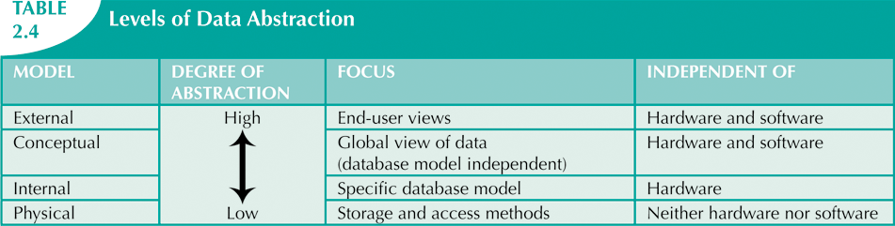

Slide 29
Summary
Object-oriented data model: object is basic modeling structure
Relational model adopted object-oriented extensions: extended relational data model (ERDM)
OO data models depicted using UML
Data-modeling requirements are a function of different data views and abstraction levels
  Three abstraction levels: external, conceptual, and internal
5-<number>

