Slide 1

Database Systems: Design, Implementation, and Management Tenth Edition
Chapter 11
Database Performance Tuning and Query Optimization

Slide 2
Objectives
In this chapter, you will learn:
Basic database performance-tuning concepts
How a DBMS processes SQL queries
About the importance of indexes in query processing

Slide 3
Objectives (cont’d.)
About the types of decisions the query optimizer has to make
Some common practices used to write efficient SQL code
How to formulate queries and tune the DBMS for optimal performance

Slide 4
Database Performance-Tuning Concepts
Goal of database performance is to execute queries as fast as possible
Database performance tuning
Set of activities and procedures designed to reduce response time of database system
All factors must operate at optimum level with minimal bottlenecks
Good database performance starts with good database design

Slide 5
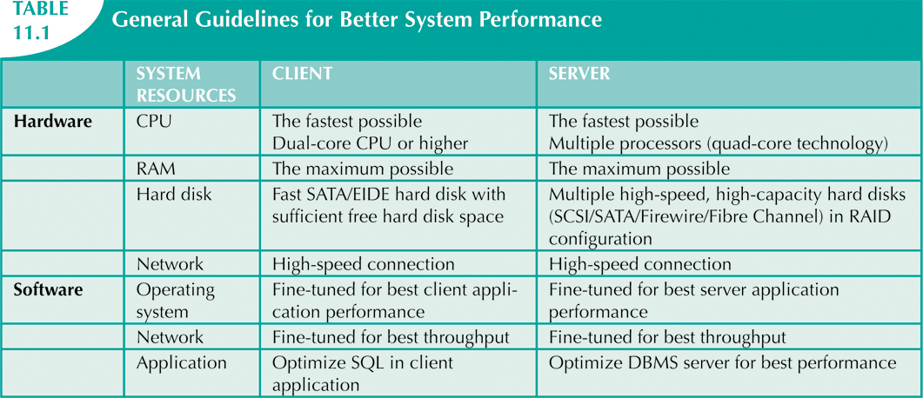

Slide 6
Performance Tuning: Client and Server
Client side
Generate SQL query that returns correct answer in least amount of time
Using minimum amount of resources at server
SQL performance tuning
Server side
DBMS environment configured to respond to clients’ requests as fast as possible
Optimum use of existing resources
DBMS performance tuning

Slide 7
DBMS Architecture
All data in database are stored in data files
Data files
Automatically expand in predefined increments known as extends
Grouped in file groups or table spaces
Table space or file group
Logical grouping of several data files that store data with similar characteristics

Slide 8
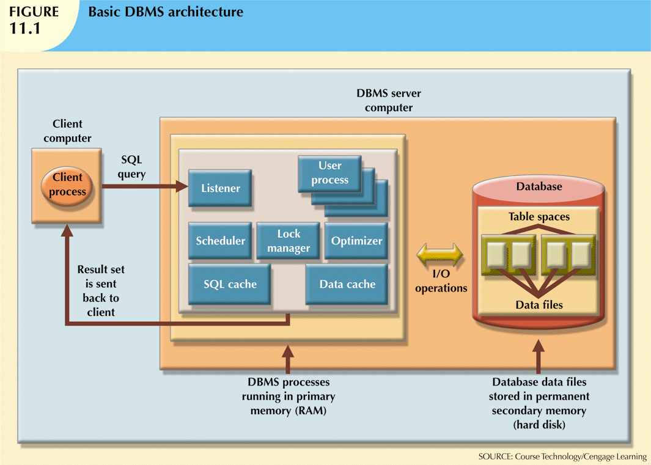

Slide 9
DBMS Architecture (cont’d.)
Data cache or buffer cache: shared, reserved memory area
Stores most recently accessed data blocks in RAM
SQL cache or procedure cache: stores most recently executed SQL statements
Also PL/SQL procedures, including triggers and functions
DBMS retrieves data from permanent storage and places it in RAM

Slide 10
DBMS Architecture (cont’d.)
Input/output request: low-level data access operation to/from computer devices
Data cache is faster than data in data files
DBMS does not wait for hard disk to retrieve data
Majority of performance-tuning activities focus on minimizing I/O operations
Typical DBMS processes:
Listener, user, scheduler, lock manager, optimizer

Slide 11
Database Query Optimization Modes
Automatic query optimization
DBMS finds the most cost-effective access path without user intervention
Manual query optimization
Requires that the optimization be selected and scheduled by the end user or programmer
Static query optimization
Takes place at compilation time
Dynamic query optimization
Takes place at execution time

Slide 12
Database Query Optimization Modes (cont’d.)
Statistically based query optimization algorithm
Uses statistical information about the database
Dynamic statistical generation mode
Manual statistical generation mode
Rule-based query optimization algorithm
Based on a set of user-defined rules to determine the best query access strategy

Slide 13
Database Statistics
Measurements about database objects and available resources:
Tables
Indexes
Number of processors used
Processor speed
Temporary space available

Slide 14
Database Statistics (cont’d.)
Make critical decisions about improving query processing efficiency
Can be gathered manually by DBA or automatically by DBMS

Slide 15
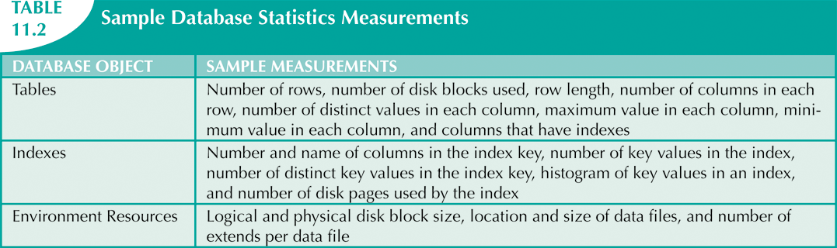

Slide 16
Query Processing
DBMS processes queries in three phases
Parsing
DBMS parses the query and chooses the most efficient access/execution plan
Execution
DBMS executes the query using chosen execution plan
Fetching
DBMS fetches the data and sends the result back to the client

Slide 17
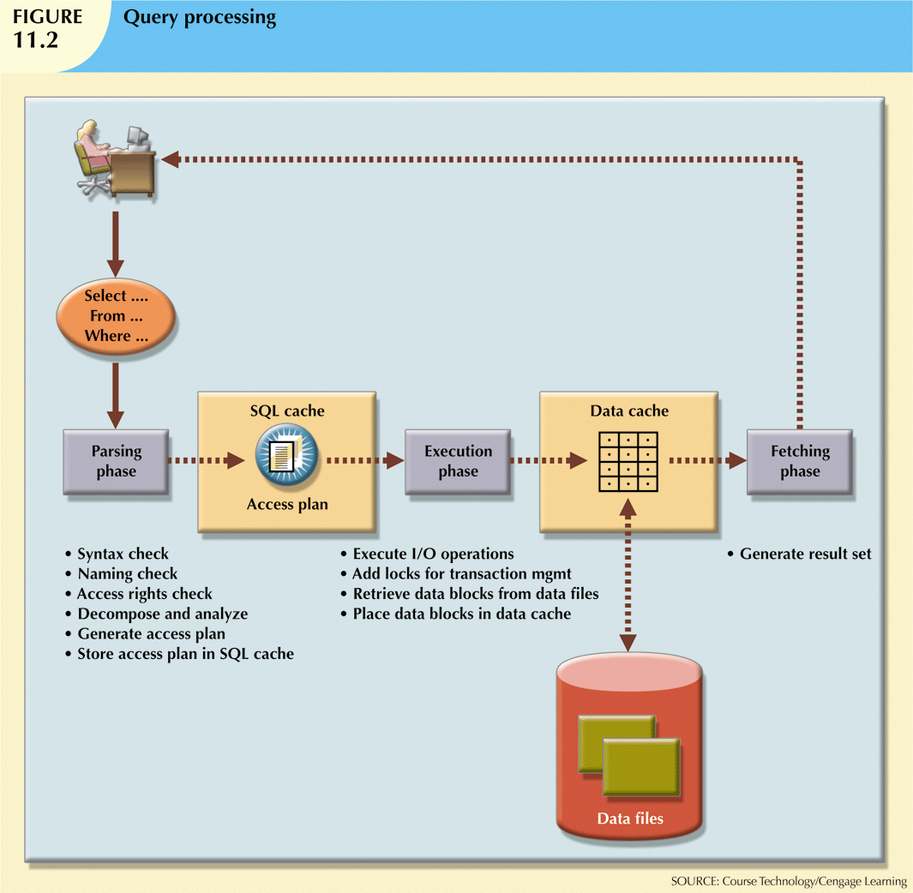

Slide 18
SQL Parsing Phase
Break down query into smaller units
Transform original SQL query into slightly different version of original SQL code
Fully equivalent
Optimized query results are always the same as original query
More efficient
Optimized query will almost always execute faster than original query

Slide 19
SQL Parsing Phase (cont’d.)
Query optimizer analyzes SQL query and finds most efficient way to access data
Validated for syntax compliance
Validated against data dictionary
Tables and column names are correct
User has proper access rights
Analyzed and decomposed into components
Optimized
Prepared for execution

Slide 20
SQL Parsing Phase (cont’d.)
Access plans are DBMS-specific
Translate client’s SQL query into a series of complex I/O operations
Required to read the data from the physical data files and generate result set
DBMS checks if access plan already exists for query in SQL cache
DBMS reuses the access plan to save time
If not, optimizer evaluates various plans
Chosen plan placed in SQL cache

Slide 21
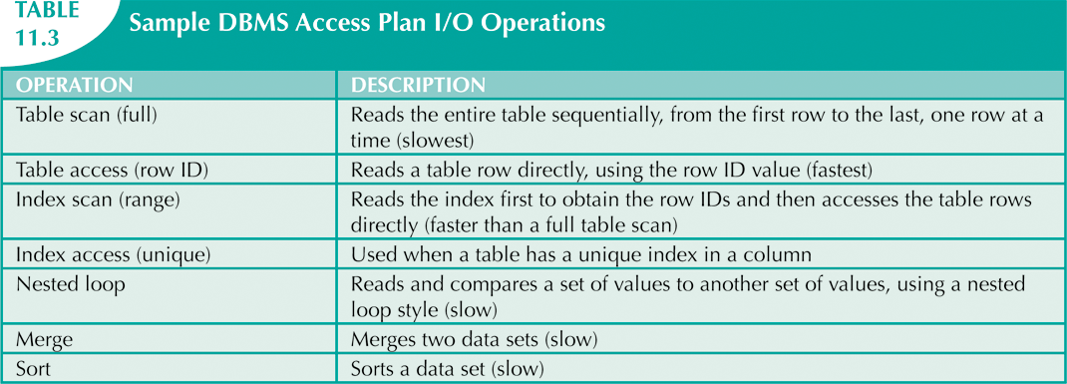

Slide 22
SQL Execution Phase SQL Fetching Phase
All I/O operations indicated in access plan are executed
Locks acquired
Data retrieved and placed in data cache
Transaction management commands processed
Rows of resulting query result set are returned to client
DBMS may use temporary table space to store temporary data

Slide 23
Query Processing Bottlenecks
Delay introduced in the processing of an I/O operation that slows the system
CPU
RAM
Hard disk
Network
Application code

Slide 24
Indexes and Query Optimization
Indexes
Crucial in speeding up data access
Facilitate searching, sorting, and using aggregate functions as well as join operations
Ordered set of values that contains index key and pointers
More efficient to use index to access table than to scan all rows in table sequentially

Slide 25
Indexes and Query Optimization (cont’d.)
Data sparsity: number of different values a column could possibly have
Indexes implemented using:
Hash indexes
B-tree indexes
Bitmap indexes
DBMSs determine best type of index to use

Slide 26
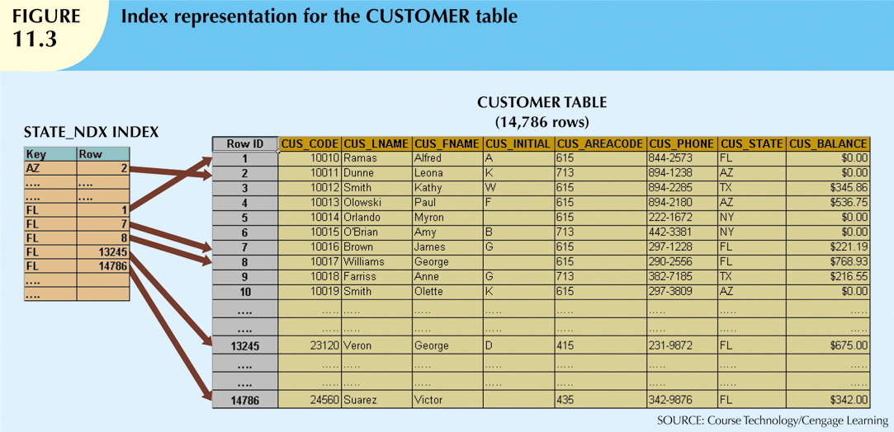

Slide 27
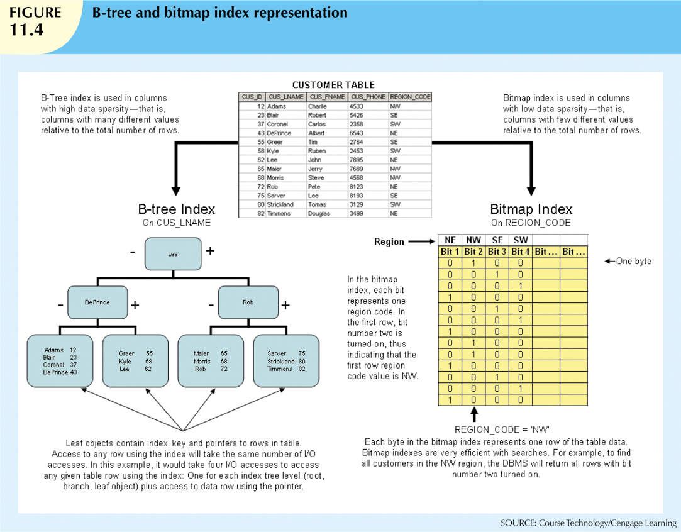

Slide 28
Optimizer Choices
Rule-based optimizer
Preset rules and points
Rules assign a fixed cost to each operation
Cost-based optimizer
Algorithms based on statistics about objects being accessed
Adds up processing cost, I/O costs, resource costs to derive total cost

Slide 29
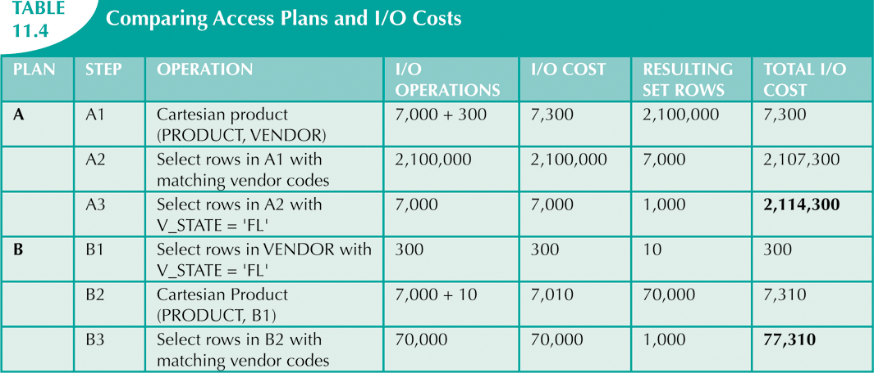

Slide 30
Using Hints to Affect Optimizer Choices
Optimizer might not choose best plan
Makes decisions based on existing statistics
Statistics may be old
Might choose less-efficient decisions
Optimizer hints: special instructions for the optimizer embedded in the SQL command text

Slide 31
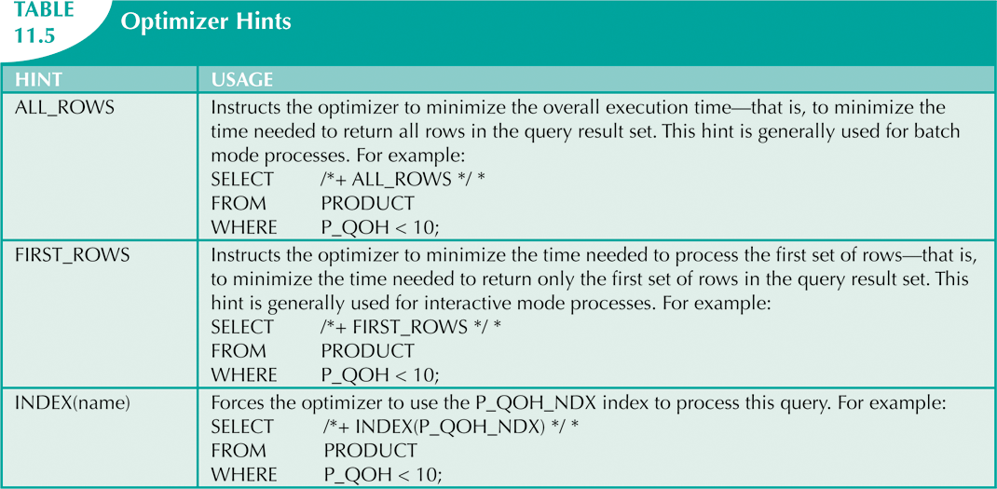

Slide 32
SQL Performance Tuning
Evaluated from client perspective
Most current relational DBMSs perform automatic query optimization at the server end
Most SQL performance optimization techniques are DBMS-specific
Rarely portable
Majority of performance problems are related to poorly written SQL code
Carefully written query usually outperforms a poorly written query

Slide 33
Index Selectivity
Indexes are used when:
Indexed column appears by itself in search criteria of WHERE or HAVING clause
Indexed column appears by itself in GROUP BY or ORDER BY clause
MAX or MIN function is applied to indexed column
Data sparsity on indexed column is high
Measure of how likely an index will be used

Slide 34
Index Selectivity (cont’d.)
General guidelines for indexes:
Create indexes for each attribute in WHERE, HAVING, ORDER BY, or GROUP BY clause
Do not use in small tables or tables with low sparsity
Declare primary and foreign keys so optimizer can use indexes in join operations
Declare indexes in join columns other than PK/FK

Slide 35
Conditional Expressions
Normally expressed within WHERE or HAVING clauses of SQL statement
Restricts output of query to only rows matching conditional criteria

Slide 36
Conditional Expressions (cont’d.)
Common practices for efficient SQL:
Use simple columns or literals in conditionals
Numeric field comparisons are faster
Equality comparisons are faster than inequality
Transform conditional expressions to use literals
Write equality conditions first
AND: use condition most likely to be false first
OR: use condition most likely to be true first
Avoid NOT

Slide 37
Query Formulation
Identify what columns and computations are required
Identify source tables
Determine how to join tables
Determine what selection criteria is needed
Determine in what order to display output

Slide 38
DBMS Performance Tuning
Includes managing DBMS processes in primary memory and structures in physical storage
DBMS performance tuning at server end focuses on setting parameters used for the:
Data cache
SQL cache
Sort cache
Optimizer mode

Slide 39
DBMS Performance Tuning (cont’d.)
Some general recommendations for creation of databases:
Use RAID (Redundant Array of Independent Disks) to provide balance between performance and fault tolerance
Minimize disk contention
Put high-usage tables in their own table spaces
Assign separate data files in separate storage volumes for indexes, system, and high-usage tables

Slide 40
DBMS Performance Tuning (cont’d.)
Take advantage of table storage organizations in database
Partition tables based on usage
Use denormalized tables where appropriate
Store computed and aggregate attributes in tables

Slide 41
Query Optimization Example
Example illustrates how query optimizer works
Based on QOVENDOR and QOPRODUCT tables
Uses Oracle SQL*Plus

Slide 42
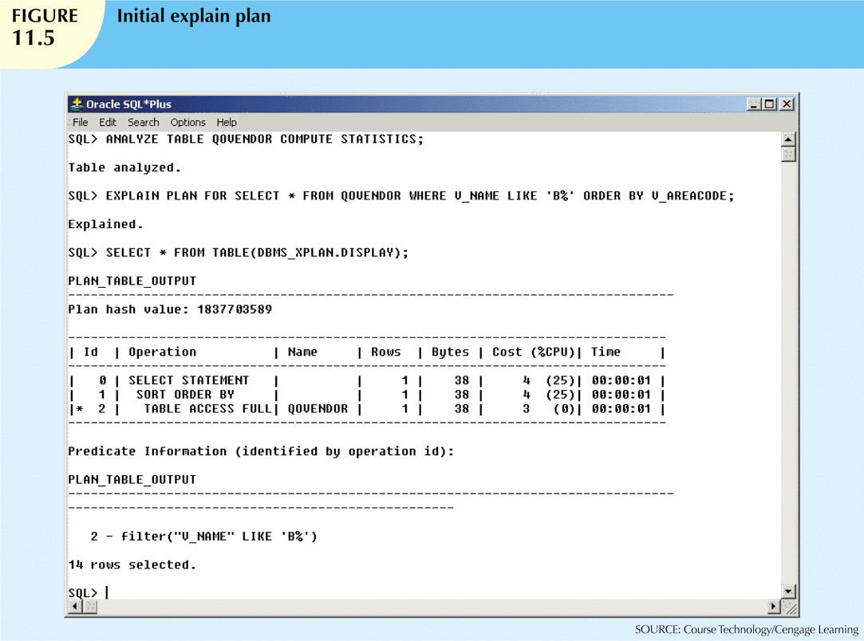

Slide 43
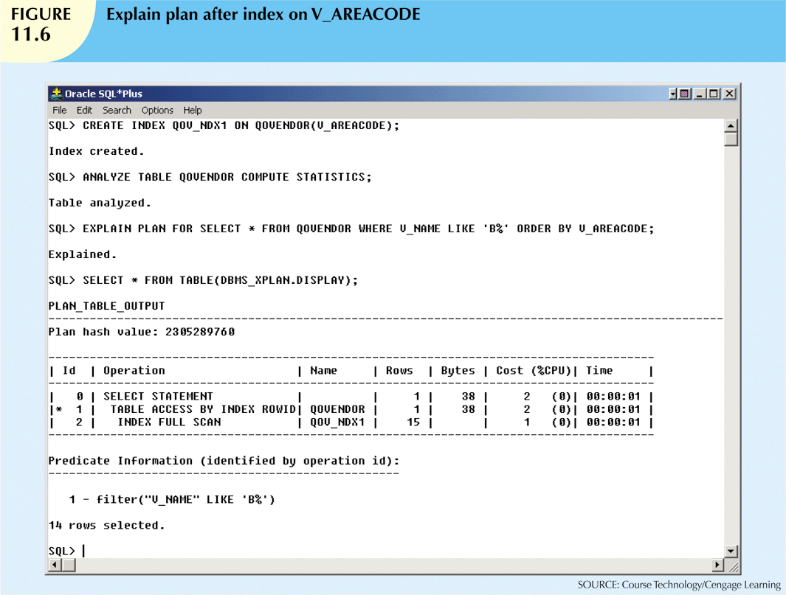

Slide 44
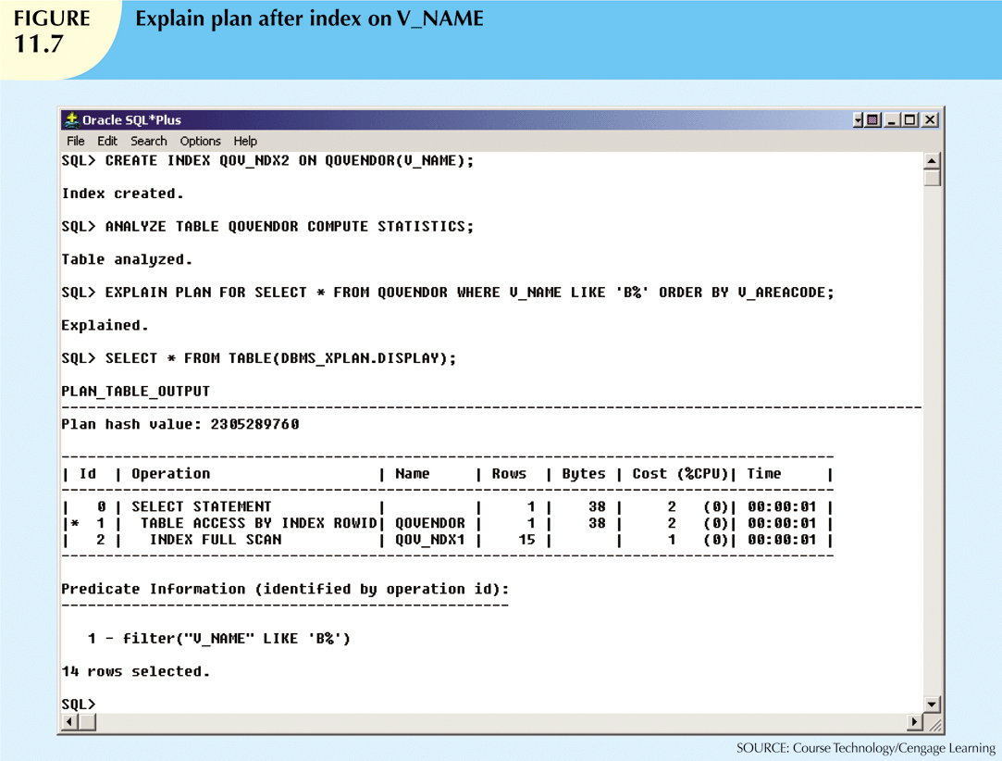

Slide 45
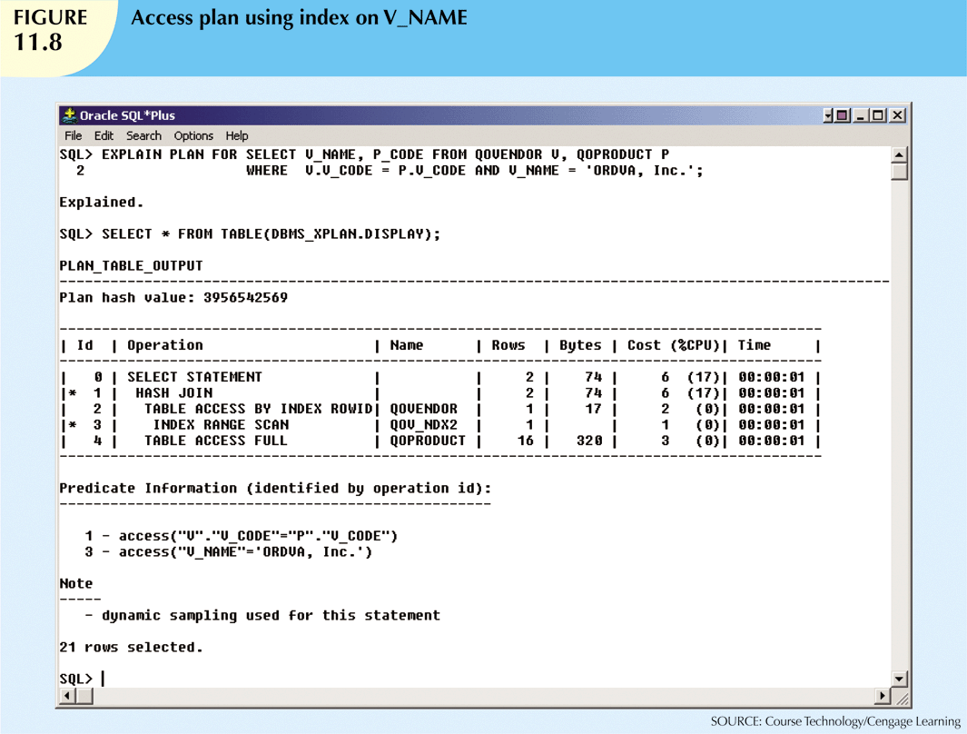

Slide 46
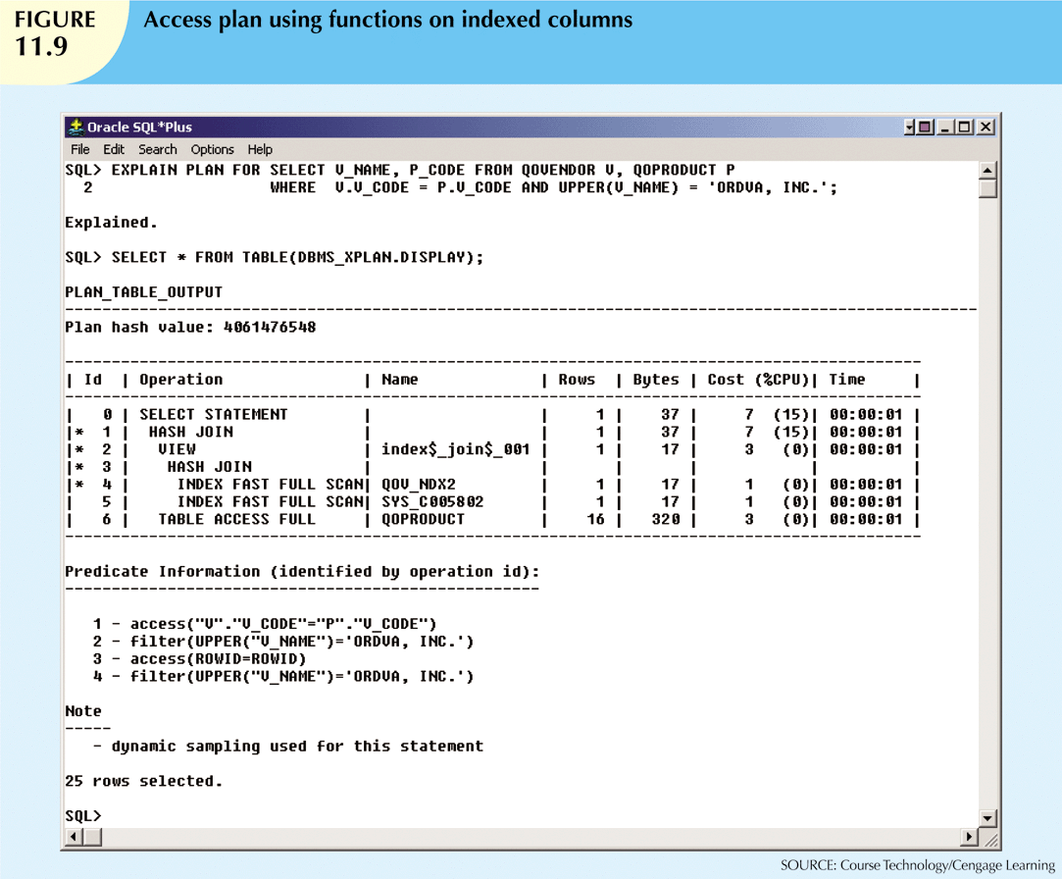

Slide 47
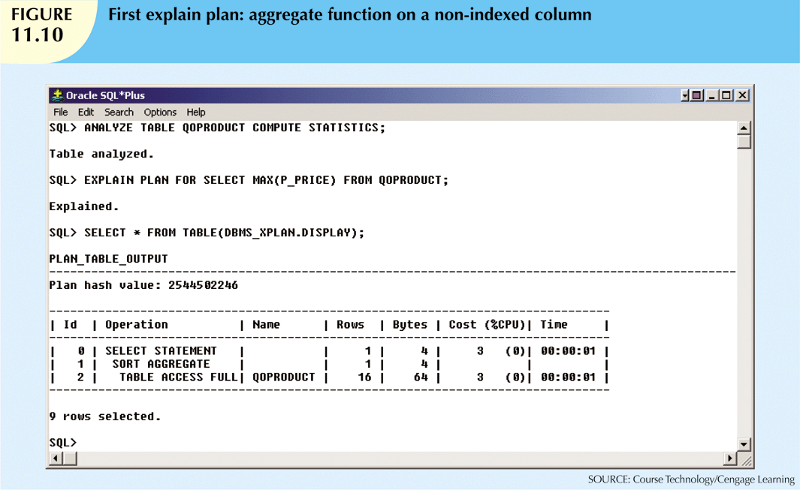

Slide 48
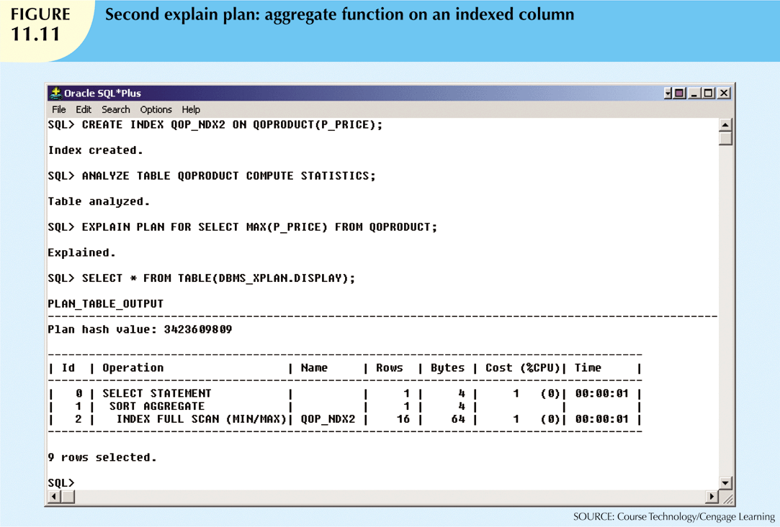

Slide 49
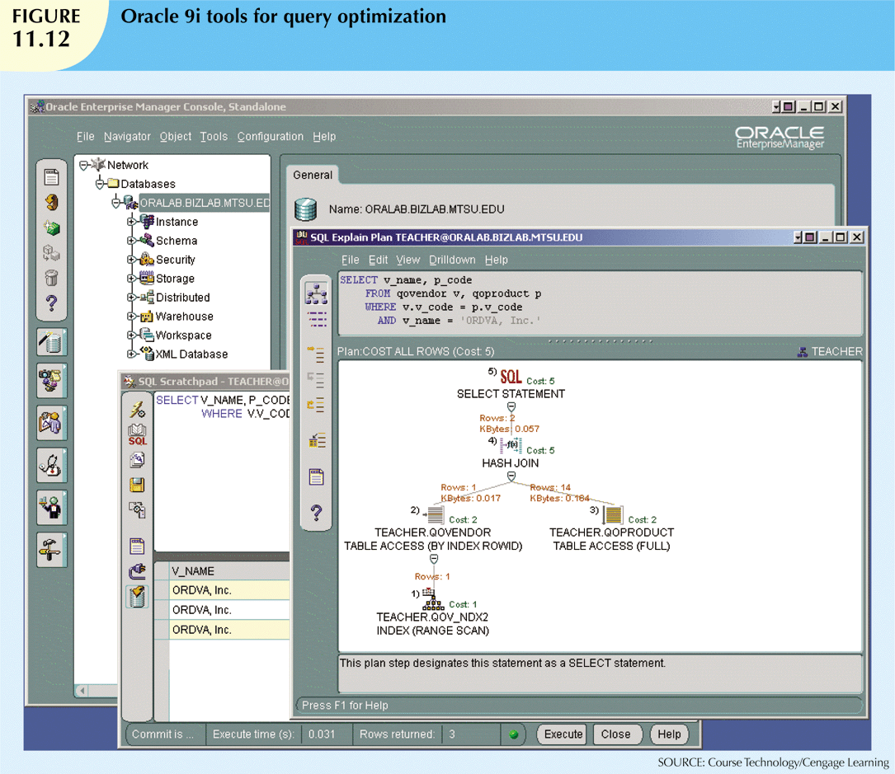

Slide 50
Summary
Database performance tuning
Refers to activities to ensure query is processed in minimum amount of time
SQL performance tuning
Refers to activities on client side to generate SQL code
Returns correct answer in least amount of time
Uses minimum amount of resources at server end
DBMS architecture is represented by processes and structures used to manage a database

Slide 51
Summary (cont’d.)
Database statistics refers to measurements gathered by the DBMS
Describe snapshot of database objects’ characteristics
DBMS processes queries in three phases: parsing, execution, and fetching
Indexes are crucial in process that speeds up data access

Slide 52
Summary (cont’d.)
During query optimization, DBMS chooses:
Indexes to use, how to perform join operations, table to use first, etc.
Hints change optimizer mode for current SQL statement
SQL performance tuning deals with writing queries that make good use of statistics
Query formulation deals with translating business questions into specific SQL code

