Slide 1
Introduction to OOAD

Slide 2
Teaching Points:
Why OO Analysis and Design?
Three tools for coping with complexity
Abstract Data Types and Modularization
Information Hiding

Slide 3
Teaching Points
The " Kind-of' Hierarchy
What is an object?
What is a class?

Slide 4
Software Characteristics
1. Software is developed or engineered, it is not manufactured in the classical sense.
Software is not manufactured. Humans are the main resource in software development. Human creativity will always play a main role in developing software products.
Different use and role of people. Humans are the raw material in the software supply chain.

Slide 5
Software Characteristics
2. Software doesn't wear out
Failure rate for hardware follows a classic predicted curve. The life time of software can not be easily predicted in the same manner as the hardware. The market, competition, and new products are factors that may affect on software life duration.
Software is not subject to environmental maladies or problems (i.e. water, wind, etc.) that cause wear out.

Slide 6
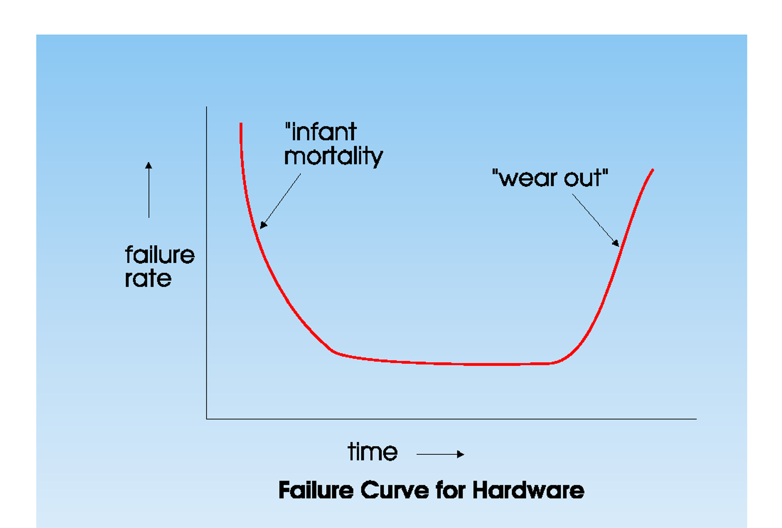

Slide 7
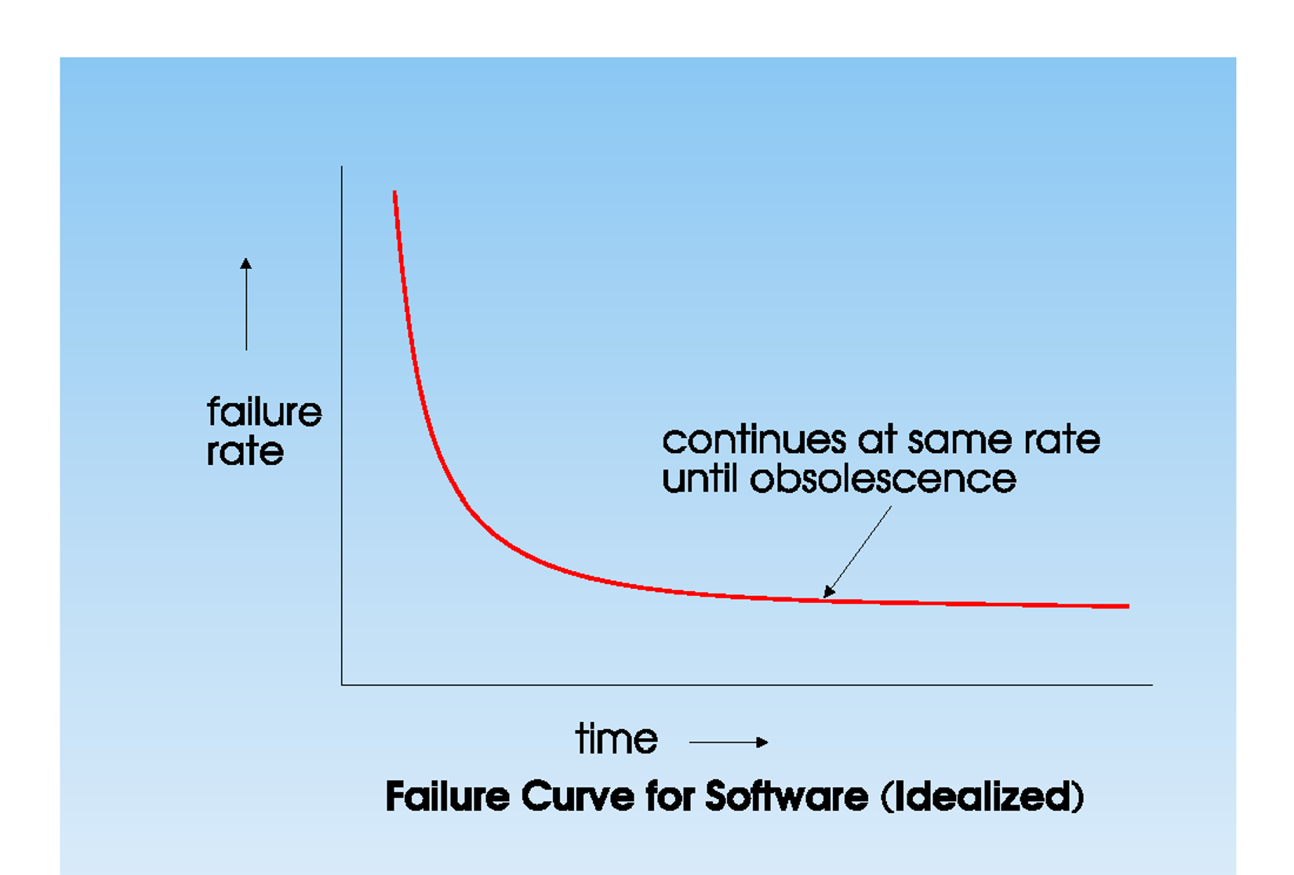

Slide 8
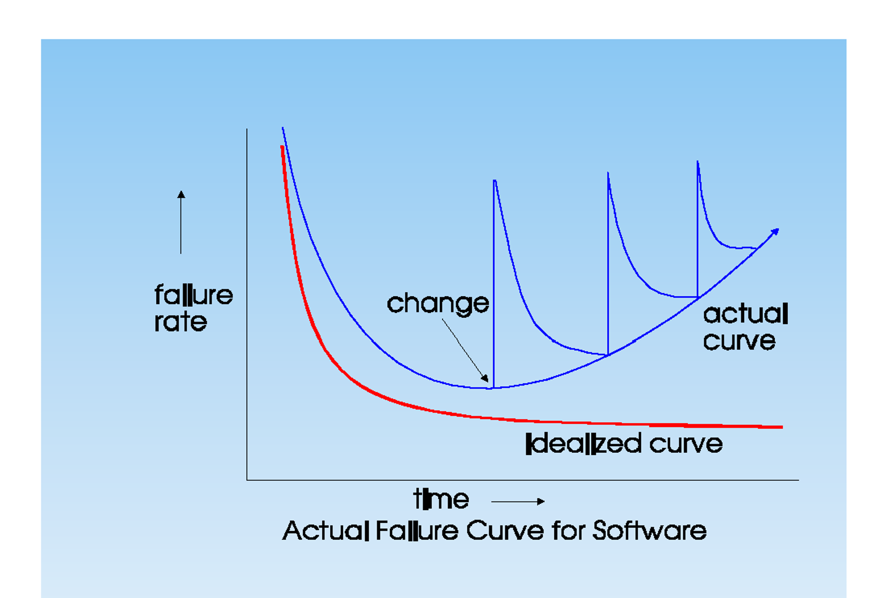

Slide 9
Software Characteristics
3. Unlike manufacturing, where a car, a toy, a cell | phone can be designed once and replicated in millions, most software products are custom-built, rather than being assembled from existing components. Each copy may have distinguished features from others.
Presently few applications with catalogues of software components (Such as Windows, Office, etc.) .
Software usually comes off-the-shelf only as a complete unit. We cant assemble SW as hardware (plug & play).
No standard building codes. Always personality counts.

Slide 10
Complexity in Software
The complexity of the problem domain
Large number of competing, even contradictory requirements.
Users and developers have problems in mutual understanding, and common interpretation.
Requirements change (often as a result of software development).
Managing complexity is about dealing, not getting rid of, complexity.

Slide 11
Managing Complexity in Software
Difficulty in managing the Development Process
large problems lead to large development teams. Teams maybe located in different cities, or countries.
more developers means complex communication. More time will be spent on communication overhead, dealing with human communication problems or conflicts, management and technical barriers, etc.

Slide 12
Dealing with Complexity
Three Tools:
Decomposition
Hierarchy
Abstraction

Slide 13
1- Decomposition
Def: Breaks the problem into understandable components (Divide and Concur)
Allows elements of an organization to work on small chunks of the system.
This is particularly important when teams are located in different cities or countries.

Slide 14
Decomposition
Can limit flexibility by producing well defined (possibly reusable) building blocks.
Opens the possibility for separation of issues or concerns; allowing isolation of the state space (Know only what you need to know). A car driver does not need to know all details about the car in order to drive it. They need to know functions that are relevant to driving the car only.
Coupling vs. Cohesion

Slide 15
Coupling Vs Cohesion
We want different modules to be loosely coupled to be independent from each other, so that a change in one module will not cause massive changes in many others (i.e. low coupling).
On the other hand, we want each module inside functions to be highly related to each other (i.e. high cohesion).

Slide 16
2- Hierarchy
In universities and theaters, they made chairs of different levels so that all can see the screen without interfering with each other.
Hierarchy allows understanding of relationships between small numbers of components.
Different kinds of hierarchies allow insight into different aspects of the complex system.
This organization schemes is directly related to decomposition and abstraction.
We decompose the system into different abstraction levels that form a hierarchy.

Slide 17
Hierarchy
A kind o f hierarchy (Inh.)
A cat is an animal
A part of hierarchy (Part-whole/Com./Agg)
The wing is part of the airp lane

Slide 18
3- Abstraction
Probably the most important of the three tools or Concepts.
The overlooking of unimportant or irrelevant details. If we are studying the geography of Jordan, in one map we focus on cities and population and ignore other details, in another view we focus on features, terrain, etc. If we take them all together, it will be then hard to understand any.
Concentration upon the essential features of an idea.

Slide 19
Object-Based and Object-Oriented Programming Languages
Smalltalk, Object Pascal, C++.
Abstract data types.
Strong typing (in some languages). This means that language stresses the strict conformance with syntax.
Little global data. Global variables exists in structures programming languages and are undesired in OO languages.

Slide 20
Object-Based and Object-Oriented Programming Languages
abstraction: abstract data types, int, decimal, object, where developers can use and extends them.
Design paradigms: define types, provide operations for types, exploit commonalities (for reusability which is a good OO design property).
OO has inheritance while OB does not.

Slide 21
The Object-Oriented Paradigm
No longer a tree of process invocations
Now a network of cooperating objects that call and use each other.
The OOparadigm stresses on reusability. Why do I need to write a piece of code twice ? Even if they are somewhat different, bring the common and then extend it.

Slide 22
What is an Object?
An object has:
State ( properties, va lues). Muhammad is a current student. He has ID of 23456, major of CIS, etc.
Behavior ( modifiers , iterators, selectors, constructors , destructors ). He can enroll in classes, drop classes, etc.
Identity (Something that he can be distinguished with from others).

Slide 23
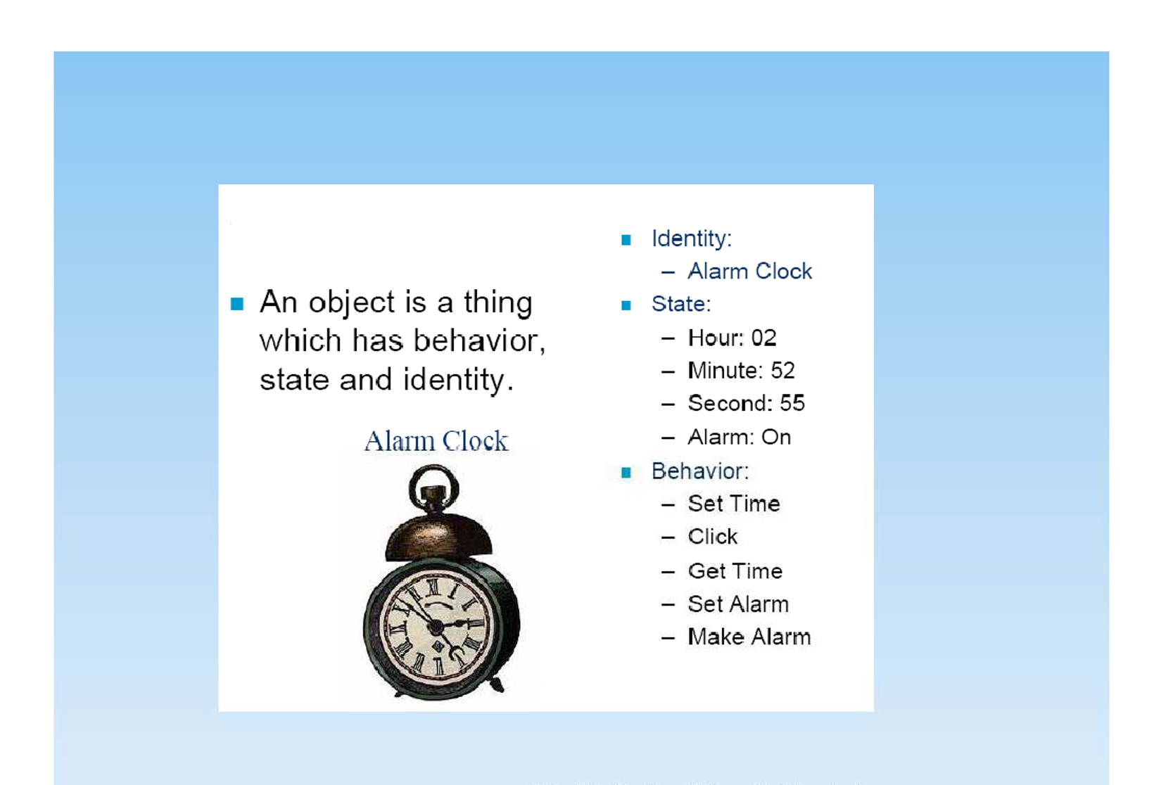

Slide 24
Object Identity
An object is normally referred to by a name.
The name of the object is not the same thing as the object, because the same object may have several different names
An object may have an anonymous or unidentified name.

Slide 25
Object State
The state of an object is all the data which it encapsulates.
An object normally has a number of attributes (variables or data members) each of which has a value.
Attributes of an object do not change during the life-time of an object, but values may do.

Slide 26
Objects are instances of classes and will hold specific values for those attributes and will participate in specific occurrences of the associations with other objects.
set of attribute values and instances of associations with other objects is referred to as the state of an object.
If the value of an attribute of the object changes or an association with another object is made or broken, then the state of the object may change.
Not all changes to attribute values or associations result in a change of state.

Slide 27
Object Behavior
The way an object acts or reacts, in terms of its state changes and message passing.
An object understands a fixed set of messages.
The way in which it reacts to a message may depend on the current values of its attributes, which may change as part of the reaction to receiving messages.

Slide 28
What is a class?
An abstraction or the essence of an object [Student, teacher, employee].
Here we don't mean a specific individual but a type.
represents a set of objects that share a common structure and a common behavior ( interface).
A kind-of-things.
A single object is simply an instance of a class.

Slide 29
Object classes are templates or data types (ADTs) for objects.
They may be used to create objects.
A class includes declarations of all attributes (variables) and services (methods) associated with an object of that class.
Object classes may inherit attributes and services from other object classes.

Slide 30
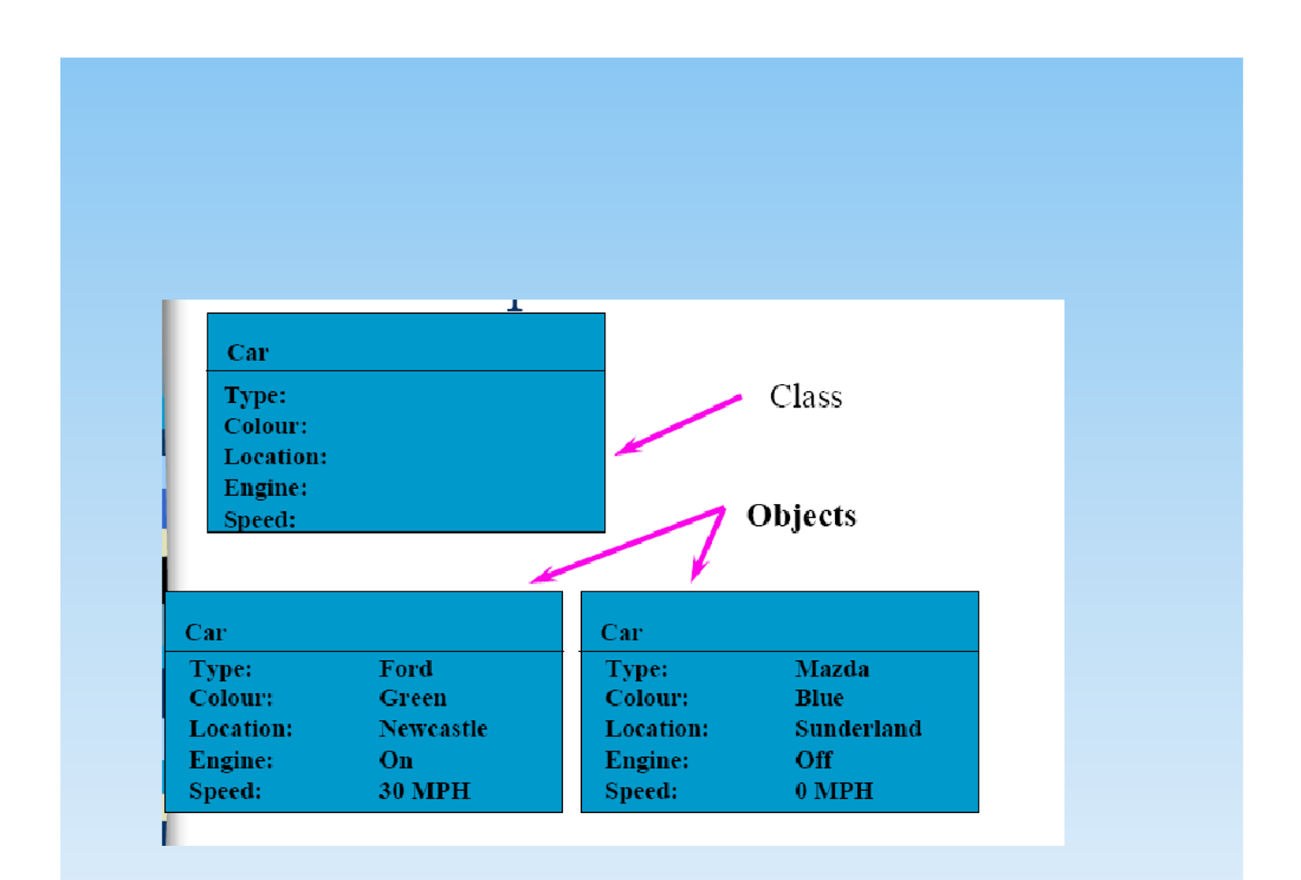

Slide 31
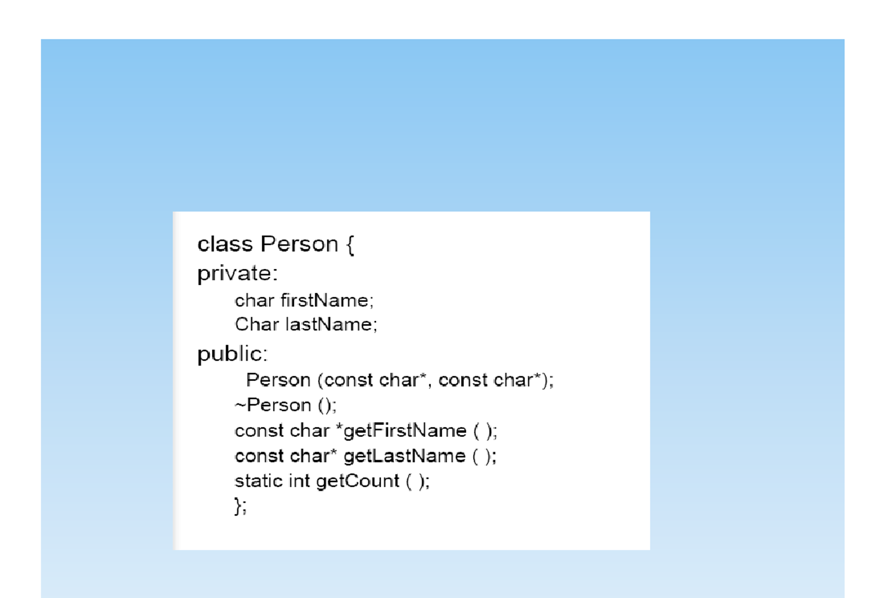

Slide 32
Objects' Communication
Objects communicate by passing messages.
The object's public interface defines which messages it will accept regardless of where they come from.
Two types of interfaces:
Public (for messages from all parts),
Private (for internal messages and privileged parts)

Slide 33
method: A specific piece of code which implements the operation.
Object Signature: The method name and list of required arguments are what is needed to interact with an object.
The signature and return type for each method (plus public data) are the object's interface.

Slide 34
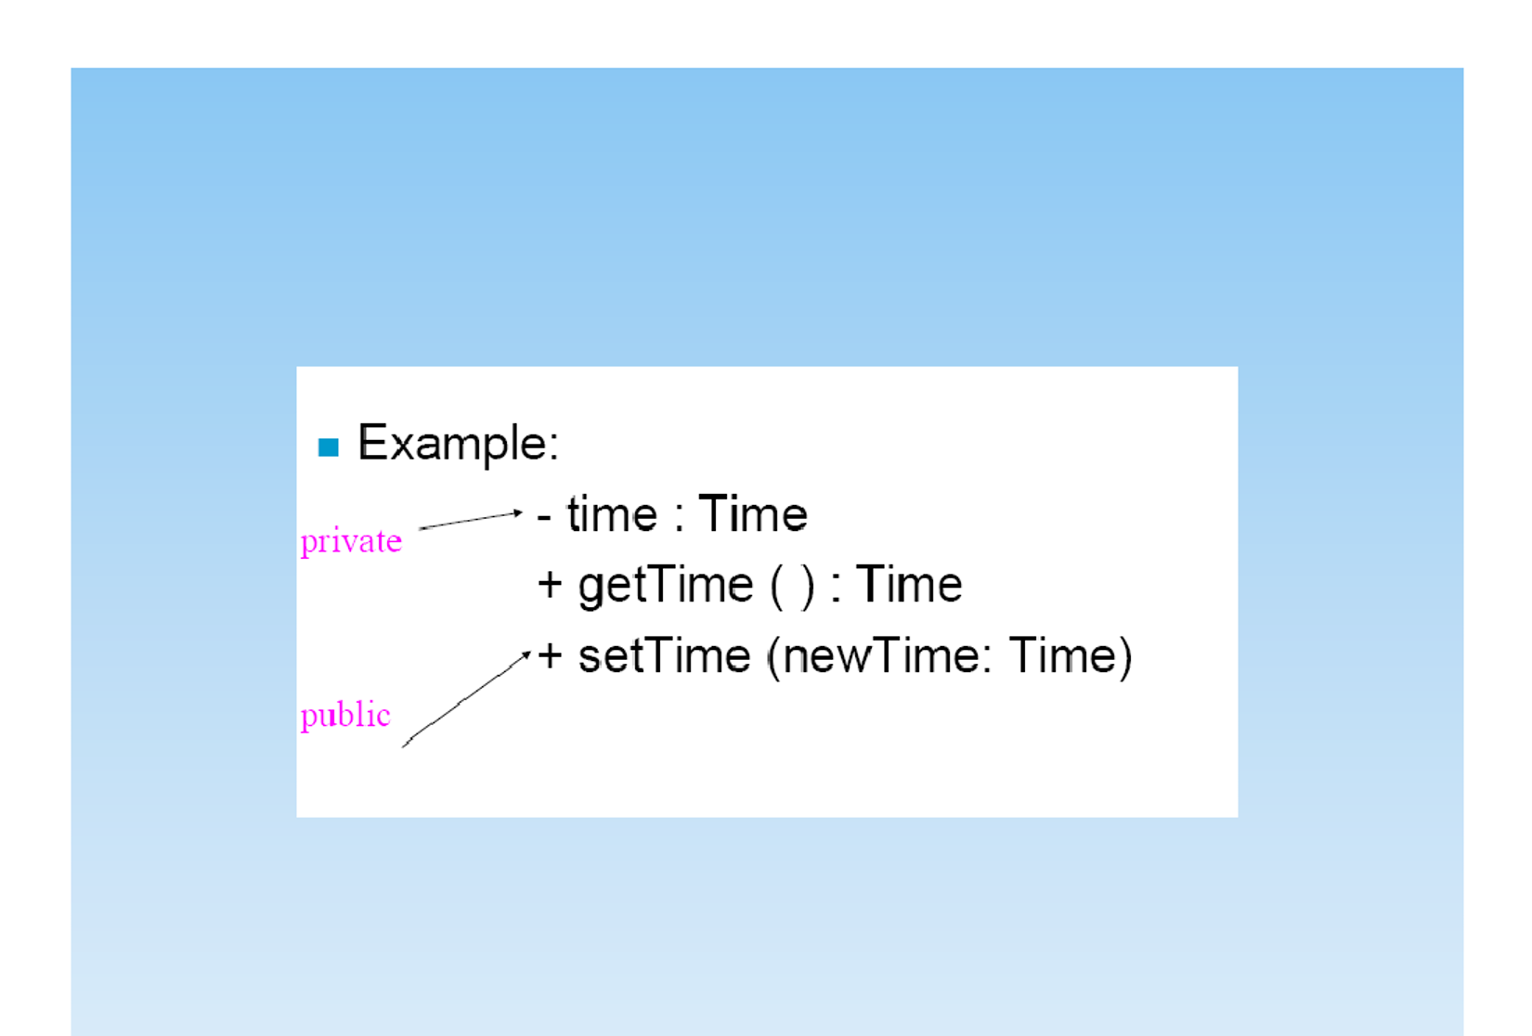

Slide 35
Messages
A message is a request made by one object to another to perform some operation. (Service, Method, Behavior, or Function).
Sending a message is equivalent to calling a message.
Messages can be external or internal.
An object can always send to itself any message which it can understand.
The message sent to an object must correspond to a method of an object.

Slide 36
Elements of a complete message:
Object reference (the name or identity of the object).
The name of the service (method) requested by the calling object (name of the message).
Copies of the information required to execute the service and the name of a holder for the result of the service(arguments).

Slide 37
