Slide 1

Car Rental Management System
Course: Database Programming (DPR400210) Student Name: Ahmed Student ID: 31517_2025 Submitted to: Mr. Eric Maniraguha UNILAK

Slide 2
Introduction
• The car rental industry in Rwanda is expanding rapidly due to tourism and business logistics.
• Local businesses require integrated database tools to manage fleet operations efficiently.
• This project introduces a secured system to automate and protect rental records.

Slide 3
Problem Statement
• Manual Tracking: Paperwork dependency causes vehicle double-booking and clerical mistakes.
• Inaccurate Calculations: Manual handling of daily rates and return timelines leads to billing errors.
• Security Vulnerabilities: Risk of unauthorized data updates outside of standard business hours.

Slide 4
Project Objectives
• Data Integration: Design a 3NF normalized structure to eliminate data redundancy.
• Financial Automation: Build programmatic functions to calculate exact rental costs automatically.
• Security Hardening: Restrict modifications outside allowed times and track user actions.

Slide 5
System Workflow (BPMN)
• Step 1: Front-desk agent verifies customer records and driving license validity.
• Step 2: System dynamically checks the current vehicle availability status.
• Step 3: The rental contract is generated, total cost computed, and vehicle status becomes 'Rented'.

Slide 6
Database Schema (3NF)
​Customers: Stores customer IDs, names, contact numbers, and unique driving license information.
​Cars: Manages fleet data, plate numbers, model years, and real-time rental availability status.
​Bookings: The central relational table linking customers to cars, tracking rental dates and calculated financial totals.
​Holidays & Audit Logs: Auxiliary tables used for enforcing system security rules and logging all database actions.

Slide 7
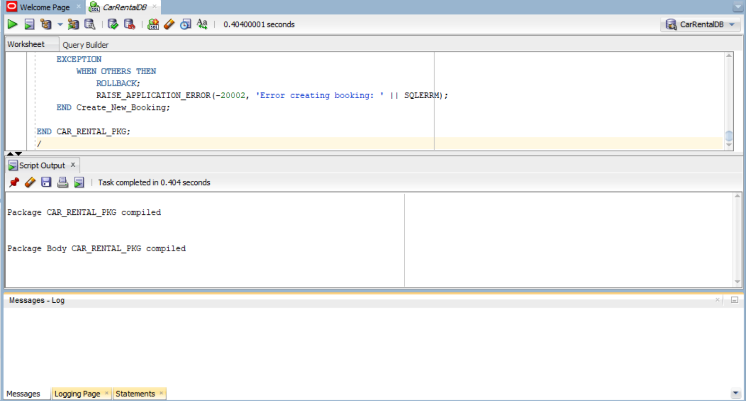
Core Database Logic (CAR_RENTAL_PKG)
• Encapsulation: Groups the operational logic inside a centralized Oracle PL/SQL Package.
• Function Calculate Total Cost Dynamically computes rental amounts by multiplying days by daily rate.
• Procedure Create New Booking Validates car availability, updates records, and handles transaction controls.

Slide 8
Advanced Security & Trigger Controls
• Trigger (TRG_RESTRICT_MAINTENANCE): Enforces strict database-level security rules.
• Operational Control: Automatically blocks modifications (INSERT, UPDATE, DELETE) on fleet tables during core business hours and national holidays.
• Integrity Protection: Safeguards live vehicle records from unauthorized administrative changes during active shifts.

Slide 9
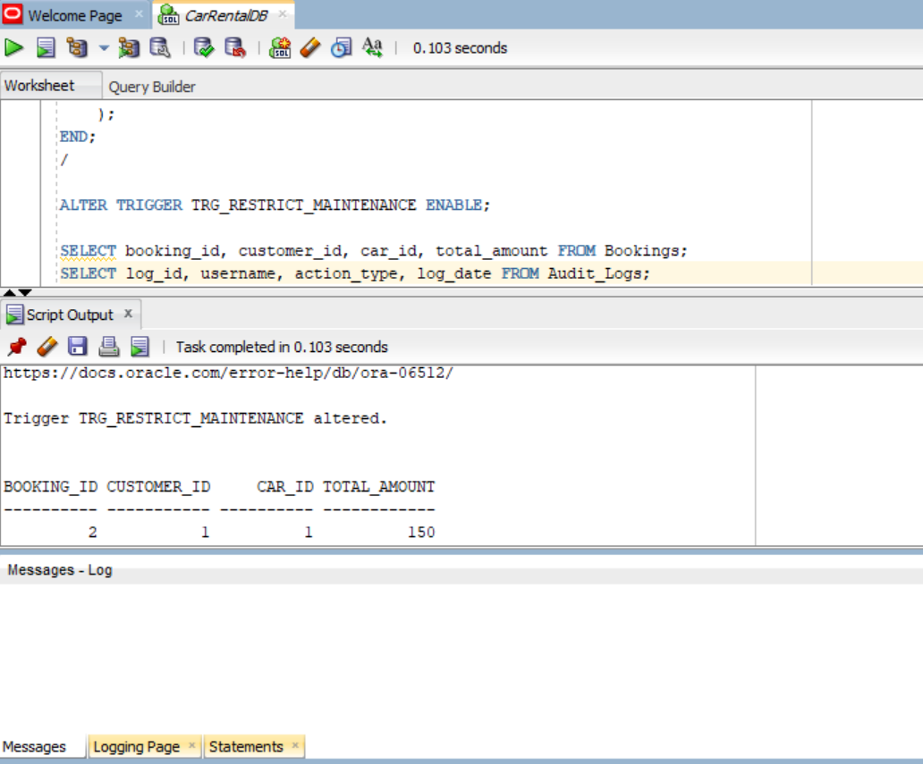
System Auditing & Execution Results
• Trigger (TRG_AUDIT_BOOKINGS): Automatically logs all transactional events in real-time.
• Traceability: Records the active DB user, execution type (INSERT/UPDATE), and a precise timestamp into the Audit Logs table.
• Dynamic Pricing: Successfully calculated the exact bill of $150.00 for a 3-day rental transaction.

Slide 10
Conclusion
• Delivered a secure, high-performance database schema using Oracle SQL Developer.
• Successfully replaced manual workflows with automated financial processing and strict structural logging.
• Project artifacts, including source code and documentation, are fully tracked and maintained.

