Slide 1
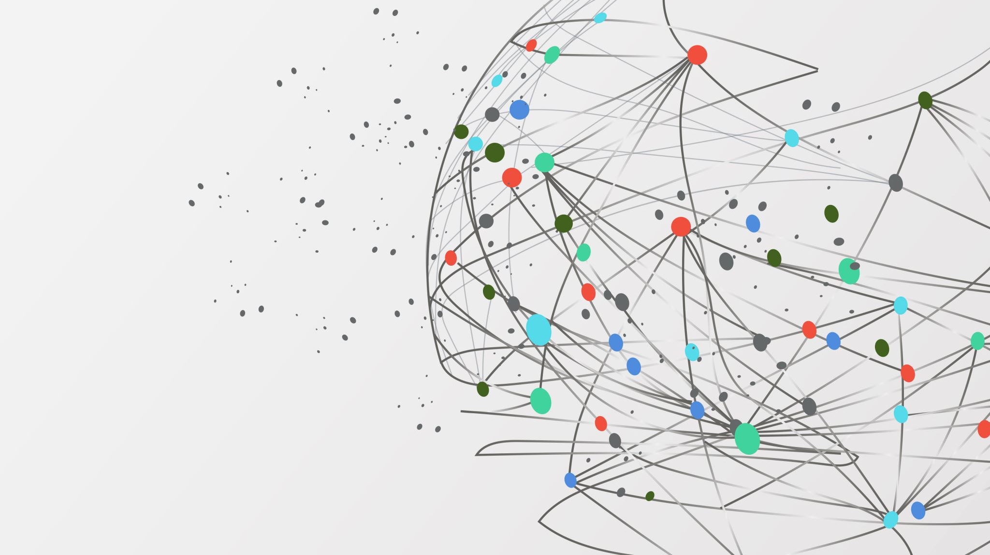
E-Learning Platform prof.dr/Ibrahim el-awady
Project Team Members:-
Ahmed Mazhar Mahmoud El-sayed
Ahmed Osama fathi
Ahmed Osama Ragab
Ahmed Assem Radwan

Slide 2
Moore’s vision
FOR: Students, professionals, and lifelong learners seeking accessible and high-quality education.
WHO: Need a flexible, personalized, and engaging way to acquire new skills and knowledge.
The: Learning Hub is a centralized online education platform
THAT: Offers a diverse range of courses, collaborative tools, and progress tracking to make learning effective and enjoyable.
UNLIKE: Traditional e-learning platforms with static content or limited engagement options.
OURPRODUCT: Provide AI-driven personalization , real-time collaboration and a resource-rich ecosystem , ensuring a tailored and dynamic learning experience.

Slide 3
Project Vision
Definition of E-Learning Platforms:-
E-learning platforms are digital environments that enable learners to access educational content online. These platforms offer resources like videos, articles, quizzes, and interactive forums for learning.
Types of E-Learning Platforms
Open Platforms: Platforms like Coursera and edX that offer courses from universities.
Institutional Platforms: Platforms like Moodle and Blackboard used by educational institutions for academic courses.
Professional Learning Platforms: Platforms like LinkedIn Learning that focus on career skills and professional development

Slide 4
Project vision
Advantages of E-Learning Platforms:-
Flexibility: Learners can access materials anytime, anywhere.
Interaction and Collaboration: Tools for discussions, forums, and quizzes promote engagement between teachers and students.
Customization: Learning experiences can be tailored to individual student needs

Slide 5
Project vision
Challenges and Future Trends
Challenges: Limited personal interaction, reliance on technology, and the need for self-motivation.
Future Trends: The use of Artificial Intelligence (AI) for personalized learning, blended learning combining traditional and online methods, and Virtual Reality (VR) and Augmented Reality (AR) for immersive learning experiences

Slide 6
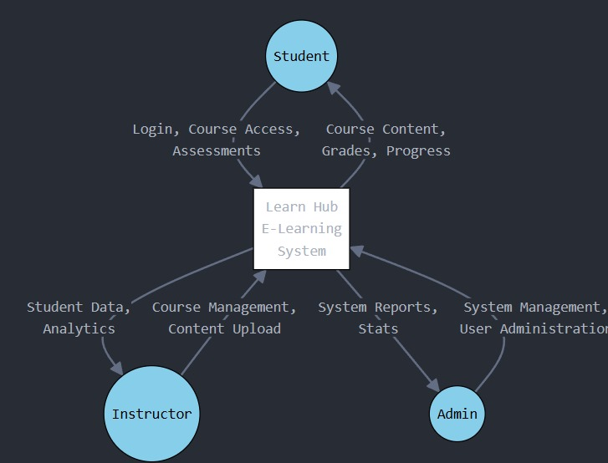
DFD level 0

Slide 7
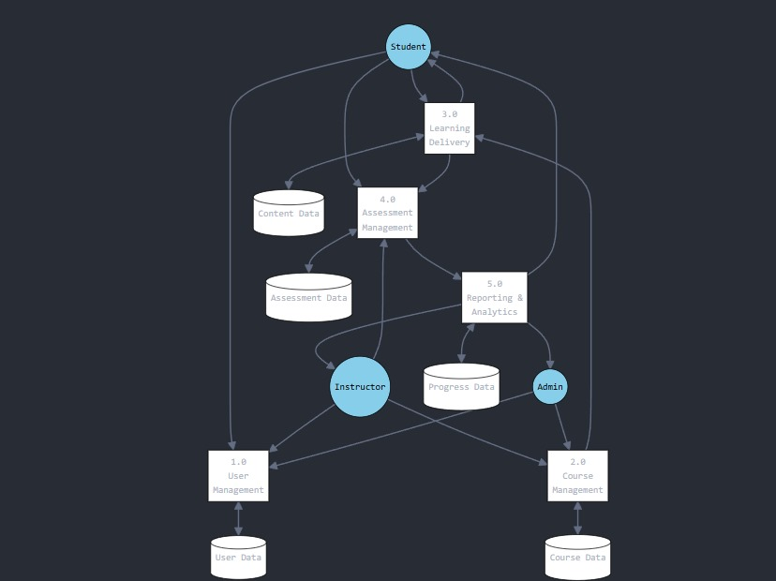
Dfd level 1

Slide 8
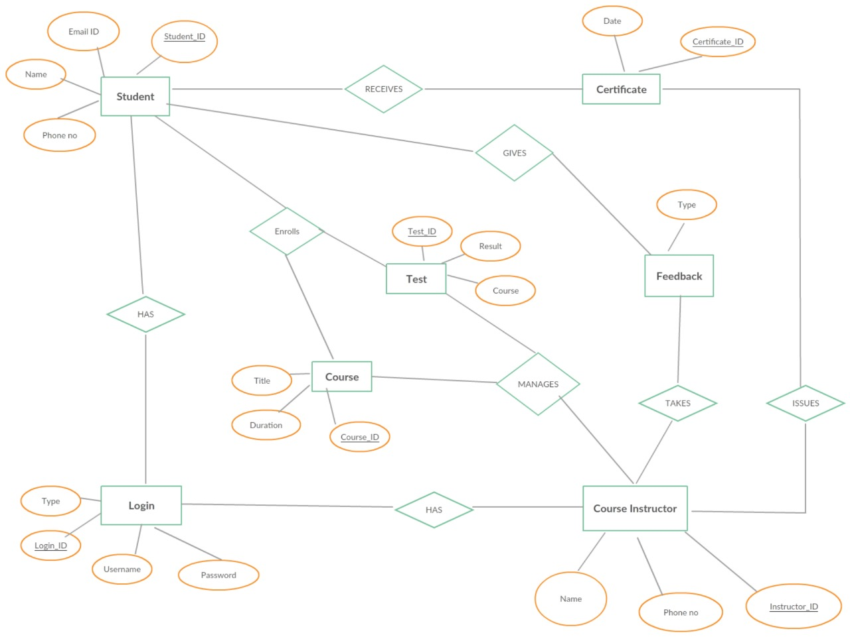
erd

Slide 9
Gantt chart
Phase | Task | Duration | Start Date | End Date
1. Planning | Define Project Goals | 1 week | Month 1, Week 1 | Month 1, Week 1
 | Requirement Gathering | 2 weeks | Month 1, Week 1 | Month 1, Week 2
 | Feasibility Analysis | 1 week | Month 1, Week 3 | Month 1, Week 3
 | Approval & Kickoff | 1 week | Month 1, Week 4 | Month 1, Week 4
2. Design | Platform Architecture | 2 weeks | Month 2, Week 1 | Month 2, Week 2
 | UI/UX Design | 3 weeks | Month 2, Week 1 | Month 2, Week 3
 | Prototyping & Review | 1 week | Month 2, Week 4 | Month 2, Week 4
3. Development | Frontend Development | 4 weeks | Month 3, Week 1 | Month 3, Week 4
 | Backend Development | 6 weeks | Month 3, Week 1 | Month 4, Week 2
 | Database Development | 4 weeks | Month 3, Week 1 | Month 3, Week 4
 | Integration of Components | 2 weeks | Month 4, Week 3 | Month 4, Week 4
4. Testing | Unit Testing | 2 weeks | Month 5, Week 1 | Month 5, Week 2
 | System Testing | 2 weeks | Month 5, Week 3 | Month 5, Week 4
 | User Acceptance Testing (UAT) | 1 week | Month 6, Week 1 | Month 6, Week 1
5. Deployment | Deployment Preparation | 1 week | Month 6, Week 2 | Month 6, Week 2
 | Deployment to Live Environment | 1 week | Month 6, Week 3 | Month 6, Week 3
 | Final Review & Handover | 1 week | Month 6, Week 4 | Month 6, Week 4

Slide 10
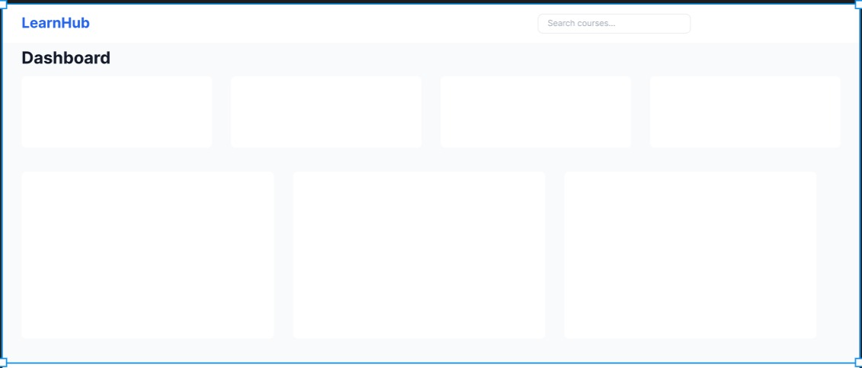
figma

Slide 11
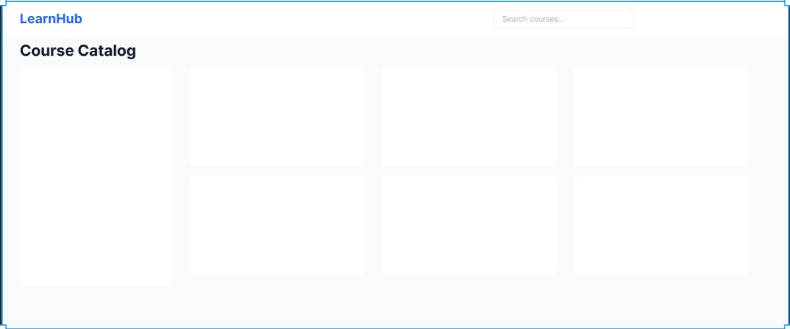
figma

Slide 12
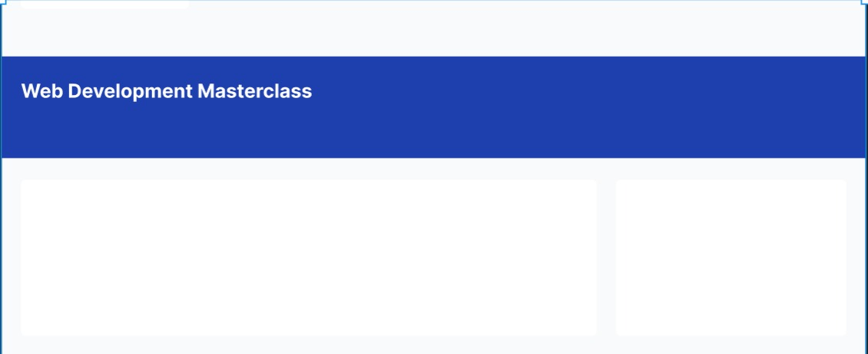
figma

Slide 13
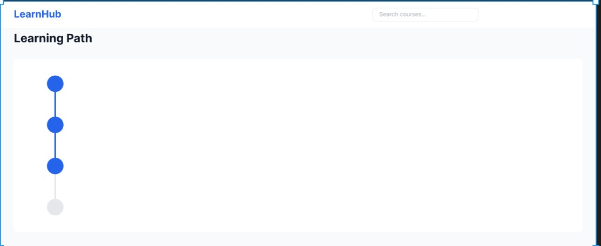
figma

Slide 14
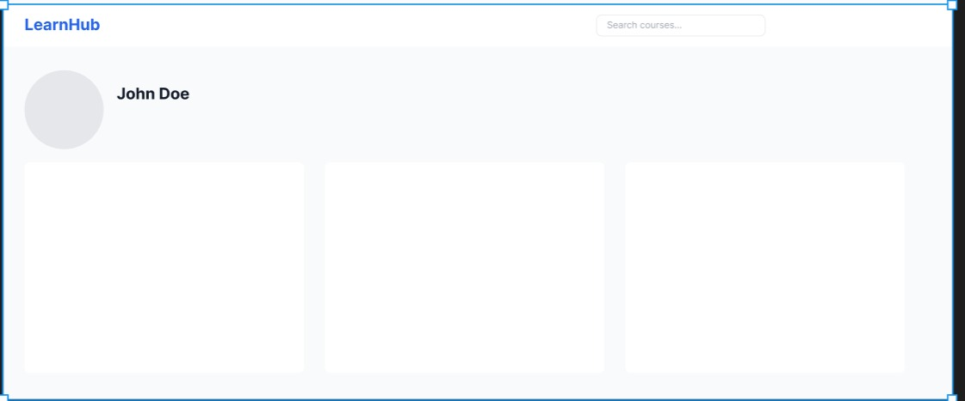
figma

Slide 15
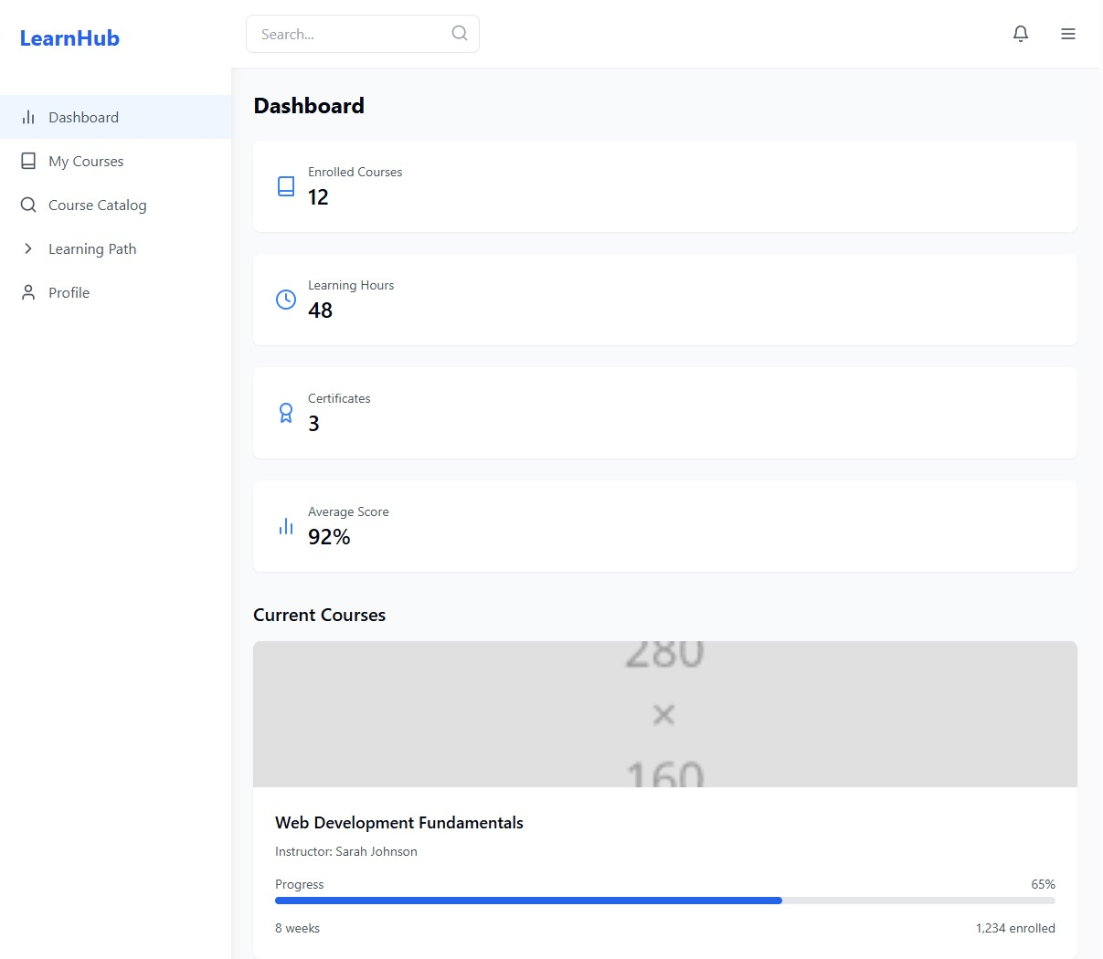
User-interface

Slide 16
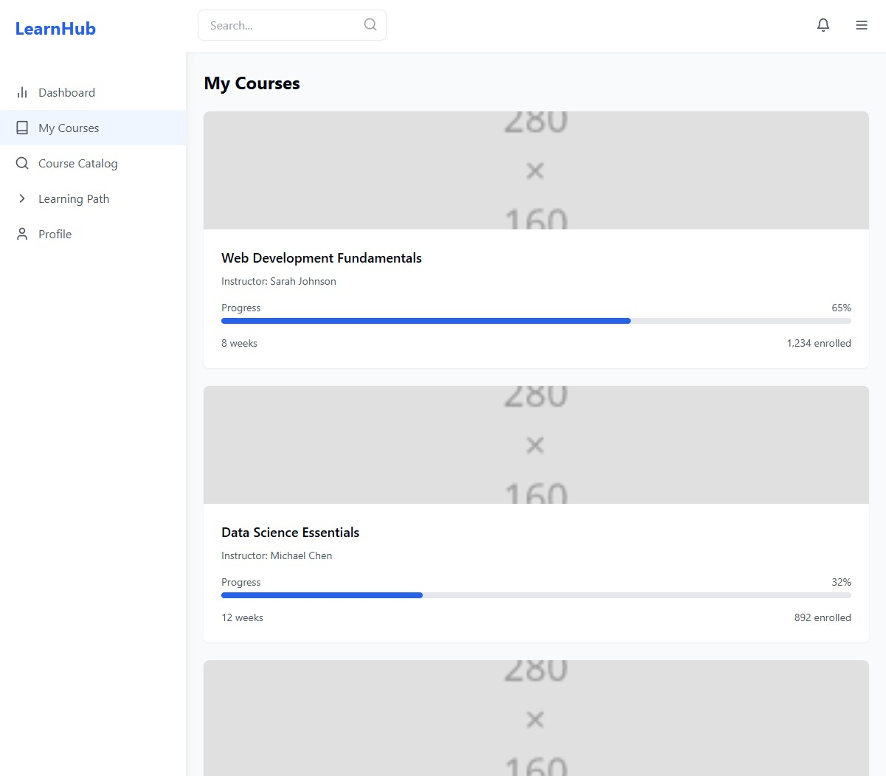
User-interface

Slide 17
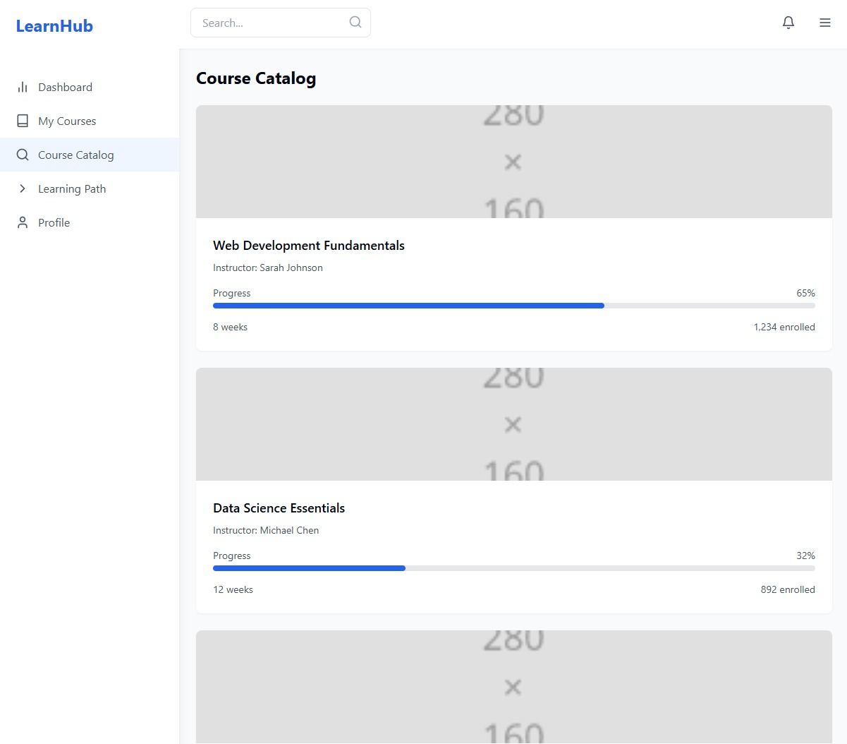
User-interface

Slide 18
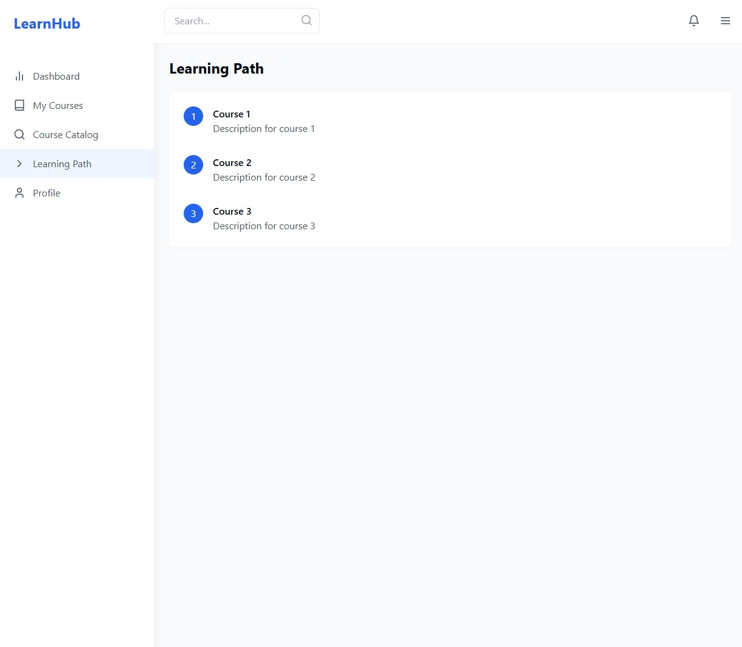
User-interface

Slide 19
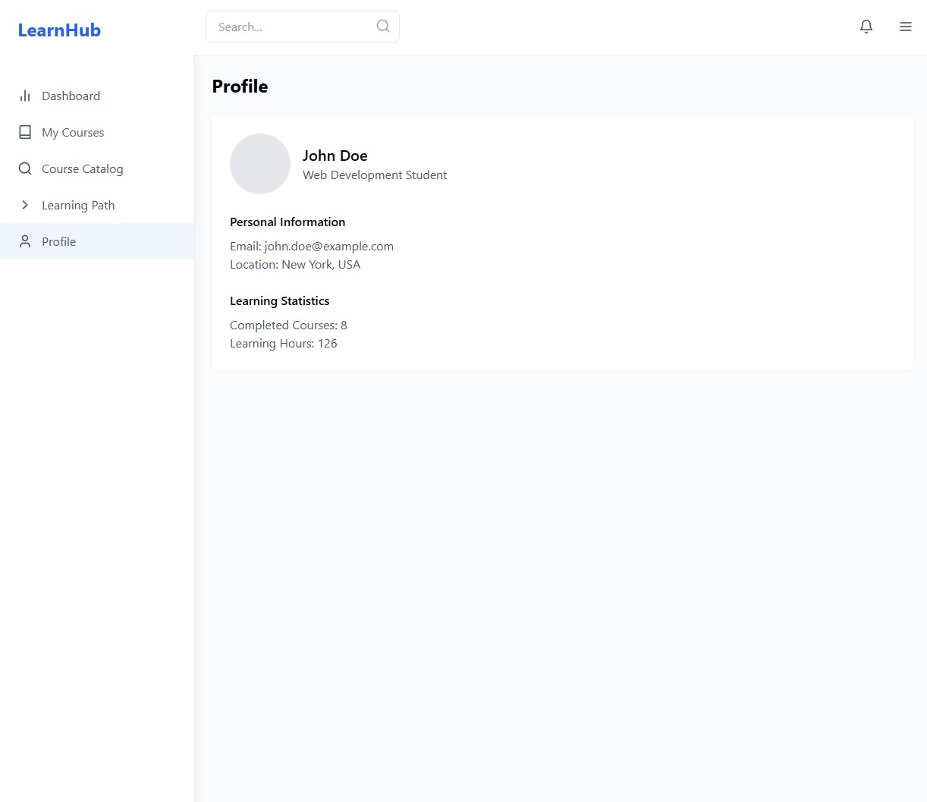
User-interface

Slide 20
That’s it thanks!

