Slide 1
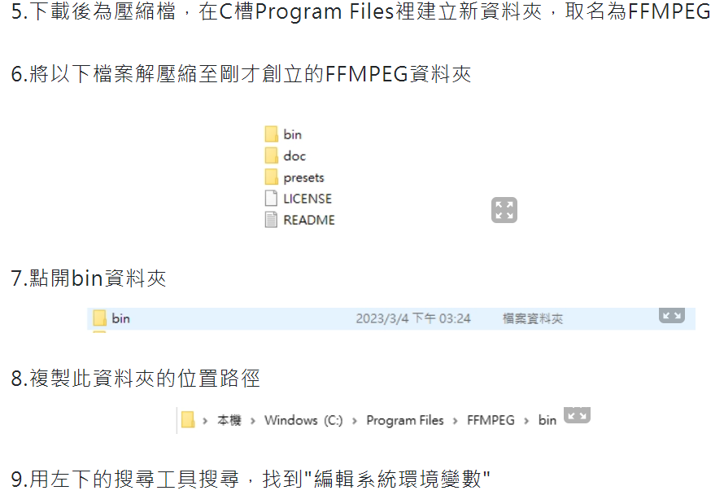
Env
Python: 3.8 (virtual env)
OS: win11
GPU: GTX1660ti
CUDA: 12.1 (https://developer.nvidia.com/cuda-12-1-0-download-archive?target_os=Windows&target_arch=x86_64&target_version=11&target_type=exe_local)
Cudnn: v8.9.7 (https://developer.nvidia.com/rdp/cudnn-archive)
Pytorch: v2.2.1 (pip3 install torch torchvision torchaudio --index-url https://download.pytorch.org/whl/cu121)
FFMPEG (https://www.gyan.dev/ffmpeg/builds/)

Slide 2
Voicecho Work Flow
User pre-defined
Prompt Personality
Training
Provided Voices
Question
LLM
Chatbot
Response
SV2TTS
Text Transform Voice
User
Real time communicate

Slide 3
LLM
RAG
口語化字句資料庫
User pre-defined
Prompt Personality
LLM
Chatbot
LLM framework
LangChain-Chatbot
LLM model
ChatGLM3
https://github.com/HqWu-HITCS/Awesome-Chinese-LLM
https://github.com/THUDM/ChatGLM3
https://github.com/chatchat-space/Langchain-Chatchat

Slide 4
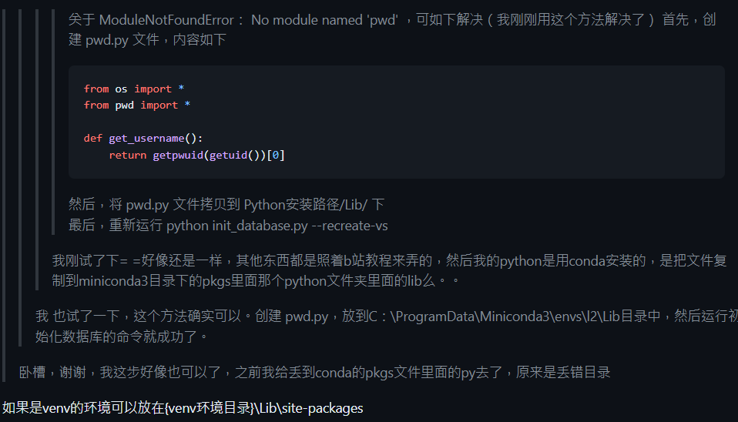
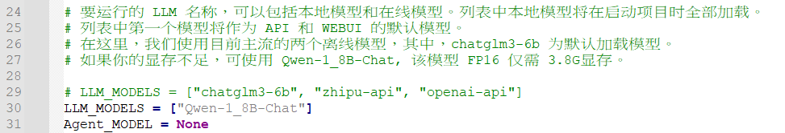
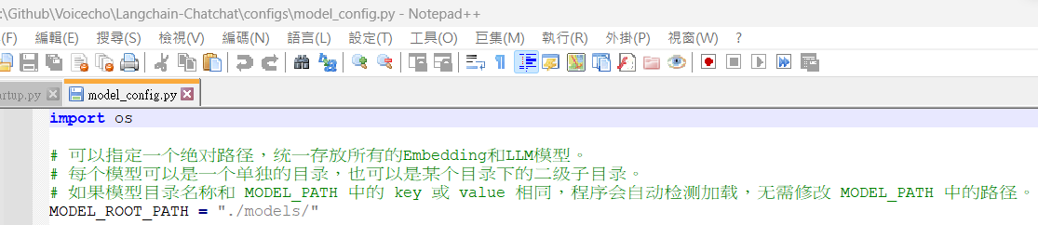
Debug: LangChain-Chatbot
Model_name設為對應檔名
將211的”Yi-34B-Chat註解”，會有bug
修改config為模型對應路徑

Slide 5
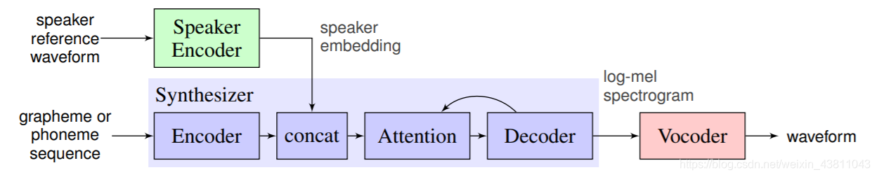
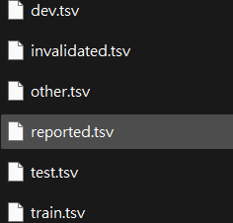
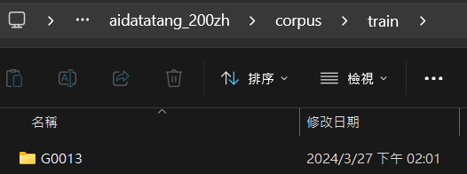
SV2TTS
Training
Provided Voices
SV2TTS
Text Transform voice
目前網路上開源pre-train model多為北京口音，若需要著重台灣口音需要重新訓練
使用預先訓練好的model + 台灣開放資料庫進行訓練(Common Voice Corpus 17.0)
訓練過程照github上進行，下列為資料前處理步驟
依照不同資料格式(aidatatang_200zh or magicdata)把台灣資料進行處理
以aidatatang_200zh與Common Voice Corpus 17.0為例，需將mp3資料轉檔成wav放進aidatatang_200zh /corpus/train/G0013的資料夾
同時把tsv檔只選[“path”, “sentence”]兩個欄位並存成txt檔放進D:\Github\Voicecho\data\aidatatang_200zh\transcript中
模型主要實現方法分為三個區塊Encoder、Synthesizer、Vocoder
Encoder: 用來將目標語音轉成向量供後續使用
Synthesizer: 將輸入的文字轉成mel-spectrogram
Vocoder: 將mel-spectrogram生成語音
註: mel-spectrogram就是將目標語音與輸入文字進行類頻譜分析，使其可以讓輸入文字對應到目標語音的音調
https://github.com/ChadCSong/Realtime-Voice-Clone-Chinese/tree/main
https://aclanthology.org/2022.rocling-1.6.pdf
https://commonvoice.mozilla.org/en/datasets
https://zhuanlan.zhihu.com/p/112627134
https://github.com/babysor/MockingBird

Slide 6
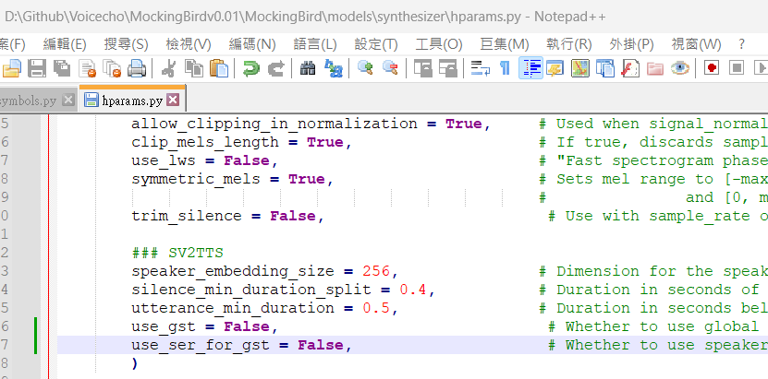
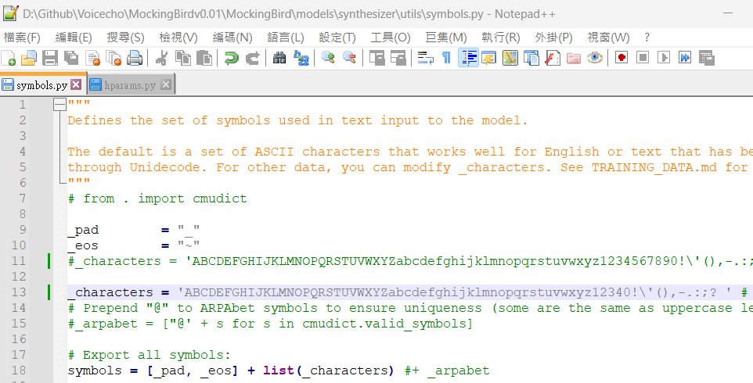
Debug: Realtime-Voice-Clone-Chinese修改項目
Python 套件:
Numpy 1.23.1
Libraso: 0.9.2

Slide 7
Reference
https://blog.csdn.net/weixin_43811043/article/details/102600940

