Slide 1
大型生产企业库存管理系统
THESIS DEFENSE
指导老师：叶建栲
答辩人：岑烁伟

Slide 2
00
技术栈
后端
JAVA+SpringBoot+SpringSecurity+MyBatis
前端
JavaScript+LayUI+Echars+Thymeleaf
数据库
MySQL
通过MyBatis连接数据库，将数据库结果封装到Java对象中，再操作对象将需要的结果封装成LayUI需求的格式返回给前端，在前端可以通过Thymeleaf对后台传递的数据再进行操作，例如动态显示用户名或传递数据给Echarts。

Slide 3
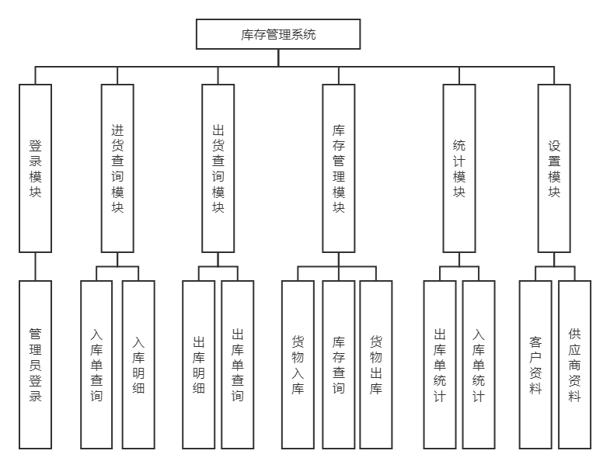
功能FUNCTION

Slide 4
01
登录
SpringSecurity
http.formLogin() :处理登录操作
http.logout():处理注销操作
http.rememberMe():保存用户cookie于自动创建的数据库persistent_logins中

Slide 5
02
进货查询/出货查询
按条件模糊查询货物（单号、货物属性）
货物属性：出入库单号、货物编码、货物名称、出入库日期、供应商或客户资料
删除一项或多项的进/出货物订单记录
导出订单

Slide 6
03
库存管理
按照货物编码或货物名称模糊查询库存
货物入库并生成入库订单
货物出库并生成出库订单
删除一项或多项的进/出库存记录
导出库存记录

Slide 7
04
统计
统计近四年的入库货物（图表）
统计近四年的出库货物（图表）
统计库存货物（图表）
统计总订单数

Slide 8
05
资料设置
供应商资料管理
客户资料管理

Slide 9
06
用户设置
添加用户
删除用户
设置用户权限
禁用或启用用户

Slide 10
恳请各位老师批评指正
TAHNK YOU FOR WATCHING
指导老师：叶建栲
答辩人：岑烁伟

Slide 11
进货查询/出货查询
Option 01
We have many PowerPoint templates that has been specifically designed.
Option 03
We have many PowerPoint templates that has been specifically designed.
Option 02
We have many PowerPoint templates that has been specifically designed.
Option 04
We have many PowerPoint templates that has been specifically designed.
We have many PowerPoint templates that has been specifically designed to help anyone that is stepping into the world of PowerPoint for the very first time. We have many PowerPoint templates that has been specifically designed to help anyone that is stepping into the world of PowerPoint for the very first time.
We have many PowerPoint templates that has been specifically designed to help anyone that is stepping into the world of PowerPoint for the very first time. We have many PowerPoint templates that has been specifically designed to help anyone that is stepping into the world of PowerPoint for the very first time.

Slide 12
此处添加标题文本
01
03
Option 03
We have many PowerPoint templates that has been specifically designed to help anyone that is stepping into the world of PowerPoint for the very first time.
Option 04
We have many PowerPoint templates that has been specifically designed to help anyone that is stepping into the world of PowerPoint for the very first time.
02
04
Option 01
We have many PowerPoint templates that has been specifically designed to help anyone that is stepping into the world of PowerPoint for the very first time.
We have many PowerPoint templates that has been specifically designed to help anyone that is stepping into the world of PowerPoint for the very first time.
Option 02

Slide 13
此处添加标题文本
TOPIC HEADER HERE
We have many PowerPoint templates that has been specifically designed.
TOPIC HEADER HERE
We have many PowerPoint templates that has been specifically designed.
TOPIC HEADER HERE
We have many PowerPoint templates that has been specifically designed.
TOPIC HEADER HERE
We have many PowerPoint templates that has been specifically designed.
TOPIC HEADER HERE
We have many PowerPoint templates that has been specifically designed.

Slide 14
此处添加标题文本
Strengths
We have many PowerPoint templates that has been specifically designed.
S
W
Weakness
We have many PowerPoint templates that has been specifically designed.
O
T
Opportunities
We have many PowerPoint templates that has been specifically designed.
Threats
We have many PowerPoint templates that has been specifically designed.

Slide 15
此处添加标题文本
We have many PowerPoint templates that has been specifically designed to help anyone that is stepping into the world of PowerPoint for the very first time.
We have many PowerPoint templates that has been specifically designed to help anyone that is stepping into the world of PowerPoint for the very first time.
We have many PowerPoint templates that has been specifically designed to help anyone that is stepping into the world of PowerPoint for the very first time.
We have many PowerPoint templates that has been specifically designed to help anyone that is stepping into the world of PowerPoint for the very first time.

Slide 16
02
研究思路与方法
研究思路
研究方法
研究方案可行性说明

Slide 17
此处添加标题文本
02
Option here
03
Option here
TOPIC HEADER HERE
We have many PowerPoint templates that has been specifically designed to help anyone that is stepping into the world of PowerPoint for the very first time.
01
Option here
TOPIC HEADER HERE
We have many PowerPoint templates that has been specifically designed to help anyone that is stepping into the world of PowerPoint for the very first time.
04
Option here
TOPIC HEADER HERE
We have many PowerPoint templates that has been specifically designed to help anyone that is stepping into the world of PowerPoint for the very first time.
TOPIC HEADER HERE
We have many PowerPoint templates that has been specifically designed to help anyone that is stepping into the world of PowerPoint for the very first time.

Slide 18
此处添加标题文本
20%
TOPIC HEADER HERE
We have many PowerPoint templates that has been specifically designed to help anyone that is stepping into the world of PowerPoint for the very first time.
TOPIC HEADER HERE
We have many PowerPoint templates that has been specifically designed to help anyone that is stepping into the world of PowerPoint for the very first time.
15%
TOPIC HEADER HERE
We have many PowerPoint templates that has been specifically designed.
25%
TOPIC HEADER HERE
We have many PowerPoint templates that has been specifically designed to help anyone that is stepping into the world of PowerPoint for the very first time.
TOPIC HEADER HERE
We have many PowerPoint templates that has been specifically designed to help anyone that is stepping into the world of PowerPoint for the very first time.
40%

Slide 19
此处添加标题文本
TOPIC HEADER HERE
We have many PowerPoint templates that has been specifically designed to help anyone that is stepping into the world of PowerPoint for the very first time.
TOPIC HEADER HERE
We have many PowerPoint templates that has been specifically designed to help anyone that is stepping into the world of PowerPoint for the very first time.
TOPIC HEADER HERE
TOPIC HEADER HERE
We have many PowerPoint templates that has been specifically designed to help anyone that is stepping into the world of PowerPoint for the very first time.
TOPIC HEADER HERE
We have many PowerPoint templates that has been specifically designed to help anyone that is stepping into the world of PowerPoint for the very first time.
We have many PowerPoint templates that has been specifically designed.
TOPIC HEADER HERE
We have many PowerPoint templates that has been specifically designed to help anyone that is stepping into the world of PowerPoint for the very first time.
TOPIC HEADER HERE
We have many PowerPoint templates that has been specifically designed to help anyone that is stepping into the world of PowerPoint for the very first time.

Slide 20
此处添加标题文本
1
2
3
4
$1,234,000
$1,234,000
$1,234,000
$1,234,000
TOPIC HEADER HERE
We have many PowerPoint templates that has been specifically designed to help anyone that is stepping into the world of PowerPoint for the very first time.
TOPIC HEADER HERE
We have many PowerPoint templates that has been specifically designed to help anyone that is stepping into the world of PowerPoint for the very first time.
TOPIC HEADER HERE
We have many PowerPoint templates that has been specifically designed to help anyone that is stepping into the world of PowerPoint for the very first time.
TOPIC HEADER HERE
We have many PowerPoint templates that has been specifically designed to help anyone that is stepping into the world of PowerPoint for the very first time.

Slide 21
此处添加标题文本
TOPIC HEADER HERE
We have many PowerPoint templates that has been specifically designed.
TOPIC HEADER HERE
We have many PowerPoint templates that has been specifically designed.
TOPIC HEADER HERE
We have many PowerPoint templates that has been specifically designed.
TOPIC HEADER HERE
We have many PowerPoint templates that has been specifically designed.
TOPIC HEADER HERE
We have many PowerPoint templates that has been specifically designed.
TOPIC HEADER HERE
We have many PowerPoint templates that has been specifically designed.

Slide 22
03
关键技术与实践难点
关键技术
实践难点
市场调研分析
案例对比分析

Slide 23
此处添加标题文本
01
02
03
04
TOPIC HEADER HERE
We have many PowerPoint templates that has been specifically designed.
TOPIC HEADER HERE
We have many PowerPoint templates that has been specifically designed.
TOPIC HEADER HERE
We have many PowerPoint templates that has been specifically designed.
TOPIC HEADER HERE
We have many PowerPoint templates that has been specifically designed.

Slide 24


此处添加标题文本
TOPIC HEADER HERE
We have many PowerPoint templates that has been specifically designed to help anyone that is stepping into the world of PowerPoint for the very first time. We have many PowerPoint templates that has been specifically designed.

Slide 25

此处添加标题文本
TOPIC HEADER HERE
We have many PowerPoint templates that has been specifically designed to help anyone that is stepping into the world of PowerPoint for the very first time.
We have many PowerPoint templates that has been specifically designed to help anyone that is stepping into the world of PowerPoint for the very first time.
We have many PowerPoint templates that has been specifically designed to help anyone that is stepping into the world of PowerPoint for the very first time.
We have many PowerPoint templates that has been specifically designed to help anyone that is stepping into the world of PowerPoint for the very first time.
We have many PowerPoint templates that has been specifically designed.

Slide 26
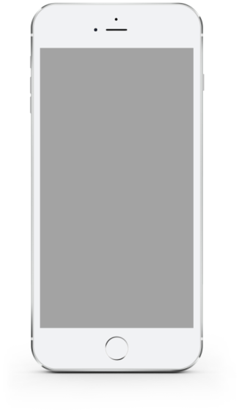
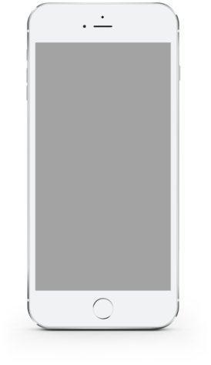


此处添加标题文本
TOPIC HEADER HERE
We have many PowerPoint templates that has been specifically designed to help anyone that is stepping into the world of PowerPoint for the very first time.

Slide 27
此处添加标题文本
We have many PowerPoint templates that has been specifically designed to help anyone that is stepping into the world of PowerPoint for the very first time.
We have many PowerPoint templates that has been specifically designed to help anyone that is stepping into the world of PowerPoint for the very first time.
We have many PowerPoint templates that has been specifically designed to help anyone that is stepping into the world of PowerPoint for the very first time.
We have many PowerPoint templates that has been specifically designed to help anyone that is stepping into the world of PowerPoint for the very first time.
We have many PowerPoint templates that has been specifically designed to help anyone that is stepping into the world of PowerPoint for the very first time.
We have many PowerPoint templates that has been specifically designed to help anyone that is stepping into the world of PowerPoint for the very first time.
We have many PowerPoint templates that has been specifically designed to help anyone that is stepping into the world of PowerPoint for the very first time.
We have many PowerPoint templates that has been specifically designed to help anyone that is stepping into the world of PowerPoint for the very first time.

Slide 28
04
研究成果与应用
研究目标
成果形式
应用前景

Slide 29

此处添加标题文本
We have many PowerPoint templates that has been specifically designed to help anyone that is stepping into the world of PowerPoint for the very first time.We have many PowerPoint templates that has been specifically designed to help anyone that is stepping into the world of PowerPoint for the very first time.
We have many PowerPoint templates that has been specifically designed to help anyone that is stepping into the world of PowerPoint for the very first time.We have many PowerPoint templates that has been specifically designed to help anyone that is stepping into the world of PowerPoint for the very first time.

Slide 30
此处添加标题文本
TOPIC HEADER HERE
We have many PowerPoint templates that has been specifically designed.
TOPIC HEADER HERE
We have many PowerPoint templates that has been specifically designed.
TOPIC HEADER HERE
We have many PowerPoint templates that has been specifically designed.
STEP 01
STEP 02
STEP 03
STEP 04
STEP 05
STEP 06
TOPIC HEADER HERE
We have many PowerPoint templates that has been specifically designed.
TOPIC HEADER HERE
We have many PowerPoint templates that has been specifically designed.
TOPIC HEADER HERE
We have many PowerPoint templates that has been specifically designed.

Slide 31





此处添加标题文本
TOPIC HEADER HERE
We have many PowerPoint templates that has been specifically designed.
TOPIC HEADER HERE
We have many PowerPoint templates that has been specifically designed.
TOPIC HEADER HERE
We have many PowerPoint templates that has been specifically designed.
TOPIC HEADER HERE
We have many PowerPoint templates that has been specifically designed.
TOPIC HEADER HERE
We have many PowerPoint templates that has been specifically designed.

Slide 32

此处添加标题文本
TOPIC HEADER HERE
We have many PowerPoint templates that has been specifically designed to help anyone that is stepping into the world of PowerPoint for the very first time.
We have many PowerPoint templates that has been specifically designed to help anyone that is stepping into the world of PowerPoint for the very first time.
We have many PowerPoint templates that has been specifically designed to help anyone that is stepping into the world of PowerPoint for the very first time.
We have many PowerPoint templates that has been specifically designed to help anyone that is stepping into the world of PowerPoint for the very first time.
We have many PowerPoint templates that has been specifically designed to help anyone that is stepping into the world of PowerPoint for the very first time.
We have many PowerPoint templates that has been specifically designed to help anyone that is stepping into the world of PowerPoint for the very first time.
We have many PowerPoint templates that has been specifically designed.
We have many PowerPoint templates that has been specifically designed.

Slide 33
此处添加标题文本
We have many PowerPoint templates that has been specifically designed to help anyone that is stepping into the world of PowerPoint for the very first time. We have many PowerPoint templates that has been specifically designed to help anyone that is stepping into the world of PowerPoint for the very first time.
Option 01
Option 02
OPTION 01
We have many PowerPoint templates that has been specifically designed.
OPTION 02
We have many PowerPoint templates that has been specifically designed.
KEY WORDS
OPTION 03
We have many PowerPoint templates that has been specifically designed.
OPTION 04
We have many PowerPoint templates that has been specifically designed.
Option 03
Option 04

Slide 34
05
相关建议与论文总结
问题评估
相关对策
研究总结
成绩与思考

Slide 35
此处添加标题文本
01
TOPIC HEADER HERE
We have many PowerPoint templates that has been specifically designed to help anyone that is stepping into the world of PowerPoint for the very first time.
02
TOPIC HEADER HERE
We have many PowerPoint templates that has been specifically designed to help anyone that is stepping into the world of PowerPoint for the very first time.
03
TOPIC HEADER HERE
We have many PowerPoint templates that has been specifically designed to help anyone that is stepping into the world of PowerPoint for the very first time.
04
TOPIC HEADER HERE
We have many PowerPoint templates that has been specifically designed to help anyone that is stepping into the world of PowerPoint for the very first time.

Slide 36
此处添加标题文本
TOPIC HEADER HERE
We have many PowerPoint templates that has been specifically designed to help anyone that is stepping into the world of PowerPoint for the very first time.
Option here
TOPIC HEADER HERE
We have many PowerPoint templates that has been specifically designed to help anyone that is stepping into the world of PowerPoint for the very first time.
02
01
Option here
Option here
03
04
TOPIC HEADER HERE
We have many PowerPoint templates that has been specifically designed to help anyone that is stepping into the world of PowerPoint for the very first time.
Option here
TOPIC HEADER HERE
We have many PowerPoint templates that has been specifically designed to help anyone that is stepping into the world of PowerPoint for the very first time.

Slide 37
此处添加标题文本
01
We have many PowerPoint templates that has been specifically designed to help anyone that is stepping into the world of PowerPoint for the very first time.
02
We have many PowerPoint templates that has been specifically designed to help anyone that is stepping into the world of PowerPoint for the very first time.
03
We have many PowerPoint templates that has been specifically designed to help anyone that is stepping into the world of PowerPoint for the very first time.
04
We have many PowerPoint templates that has been specifically designed to help anyone that is stepping into the world of PowerPoint for the very first time.
05
We have many PowerPoint templates that has been specifically designed to help anyone that is stepping into the world of PowerPoint for the very first time.
06
We have many PowerPoint templates that has been specifically designed to help anyone that is stepping into the world of PowerPoint for the very first time.

Slide 38
此处添加标题文本
TOPIC HEADER HERE
We have many PowerPoint templates that has been specifically designed to help anyone that is stepping into the world of PowerPoint for the very first time.
TOPIC HEADER HERE
We have many PowerPoint templates that has been specifically designed to help anyone that is stepping into the world of PowerPoint for the very first time.
TOPIC HEADER HERE
We have many PowerPoint templates that has been specifically designed to help anyone that is stepping into the world of PowerPoint for the very first time.
TOPIC HEADER HERE
We have many PowerPoint templates that has been specifically designed to help anyone that is stepping into the world of PowerPoint for the very first time.

Slide 39
此处添加标题文本
TOPIC HEADER ONE
We have many PowerPoint templates that has been specifically designed.
TOPIC HEADER TWO
We have many PowerPoint templates that has been specifically designed.
TOPIC HEADER HERE
We have many PowerPoint templates that has been specifically designed.
TOPIC HEADER THREE
We have many PowerPoint templates that has been specifically designed.
TOPIC HEADER FOUR
We have many PowerPoint templates that has been specifically designed.

