Slide 1
Hadoop Ecosystem in Twitter Data in Relation to Apple Inc. Topic
Yu-Chun,Chou

Slide 2
Outline
Data collection
preprocessing
Analysis1—text cloud
Analysis2—user’s location
Analysis3—products popularity
conclusion

Slide 3
Outline
Data collection
preprocessing
Analysis1—text cloud
Analysis2—user’s location
Analysis3—products popularity
conclusion

Slide 4
Data collection
Twitter API
Restful API
https://api.twitter.com/1.1/search/tweets.json
JSON format
{ "created_at": "Thu Apr 06 15:24:15 +0000 2017", "id_str": "850006245121695744",….}
Search API for history data
Stream API for nearly real time data-low latency
Can use API mode (OAuth) and user mode
Will have time rate limit

Slide 5
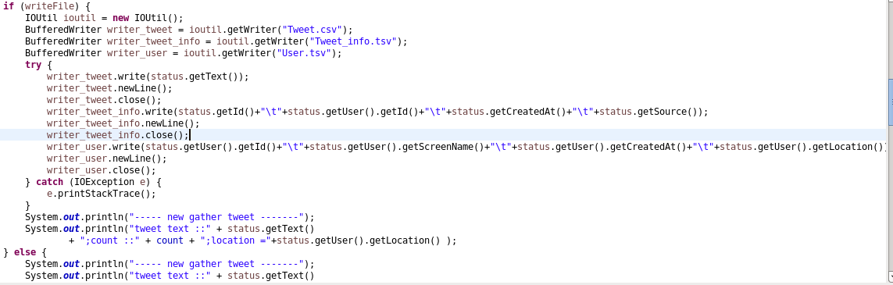
Data collection and preprocessing
Twitter4j
Java library for twitter API
Use multi thread and call back function to implement asynchronous mechanism

Slide 6
Twitter collection in big data
In data mining course
Using ‘spurs’ as keyword and collect 12000 data in 8 hours
Using ‘Spurs , nba , Kawhi’ as keyword and collect 13000 data in 1.5hours
We assume maybe we can collect data very easily by using different keyword
In big data course
Using ‘Apple’ as keyword
On average, every hour we can collect 10000 data
If we need 2 million data, it will require 200 hours
35 hours
File_name | number
Tweet.csv | 688018
Tweet_info.tsv | 688018
User.tsv | 688270

Slide 7
Input data format
Tweet_info.tsv
Attribute name | Data type
Tweet_id | string
User_id | string
Create_at | date
source | string
User.tsv
Attribute name | Data type
User_id | string
Screen_name | string
Create_at | date
location | string
Tweet.tsv
Attribute name | Data type
Tweet content | string

Slide 8
Some learning
Using big data technology to store and analyze social media, the data generating rate change tremendously.
Design other mechanisms to enhance the efficiency of data collection
Use Batch framework
Use multi Twitter account
Collect history data and nearly real-time data
Design other mechanisms to reduce the I/O cost
Store in Hadoop directly---Make use of the advantage of Hadoop storing data locally
Store in Hbase or Cassandra

Slide 9
Outline
Data collection
preprocessing
Analysis1—text cloud
Analysis2—user’s location
Analysis3—products popularity
conclusion

Slide 10
Preprocessing-jobs and folders
objective | description | Job | Input folder | Output folder
Ananlysis_1 | Word cloud for 100 frequent word | wordCount | /input-tweet | /output-1/temp
 |  | Top100 | /output-1/temp | /output-1/final
Ananlysis_2 | Get the sum information of user location, relation to tweet | TweetJoinUser | /input-tweet-info /input-user | /output-2/temp
 |  | GroupByLocation | /output-2/temp | /output-2/final
Ananlysis_3 | Get the tweet has product keywords (eg. iPhone,iPad,etc.) | GrepJob | /input-tweet | /output-3

Slide 11
Some learning
Folder : as the jobs become more and more , file system planning will be important
Input folder name , location
Output folder name , location
Naming convention
Job : we must consider about the flexibility and dependency
Follow the MapReducer design pattern
Use Job chain to integrate different jobs
Test
Unit test : MRUnit is useful, for beginner, Object data type and Text data type will be easier
Integration test : use 500 data is enough
Configuration management
java : Maven
Clousera : shell

Slide 12
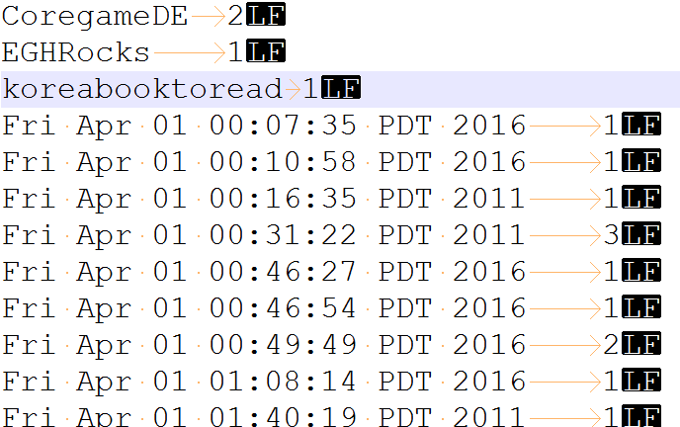
Some learning
MapReduce is very useful in Clean data
Non-structure data sometimes very difficult to analyze
We can design preprocessing job
Example : create_date of tweet
What’s that?????

Slide 13
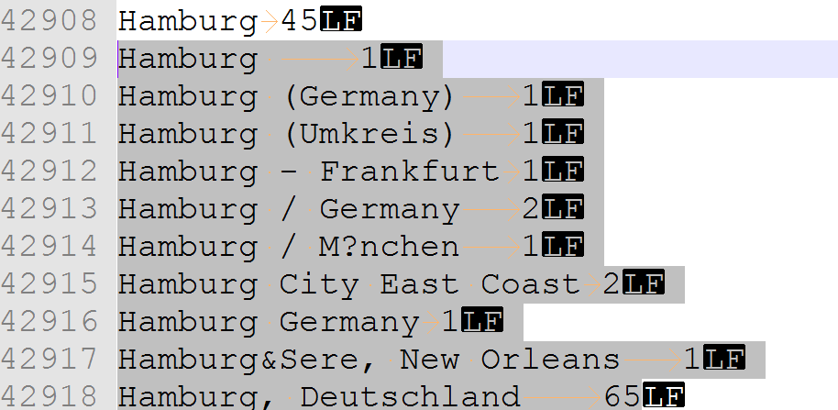
Some learning
Input file type for mapReducer must be careful
Our assignment used .tsv, but it’s clean data
Xml or hbase will be better than .tsv or .csv , because lots of attributes will use them to separate
For example :
normal data ,but use tab and comma
Washington, D.C. USA
Washington, D.C. USA
Washington, D.C. USA
Washington, D.C., Petworth resident
Washington, D.C., via Karachi
Washington, D.C./London
Washington, DC
Washington, DC
Normal data
-909 | 2
-909 | 2
-860 | 4
-860 | 5
-858 | 6
-818 | 6
-818 | 6
-818 | 6
Strange data ,may be latitude ,there is a tab

Slide 14
Outline
Data collection
preprocessing
Analysis1—text cloud
Analysis2—user’s location
Analysis3—products popularity
conclusion

Slide 15
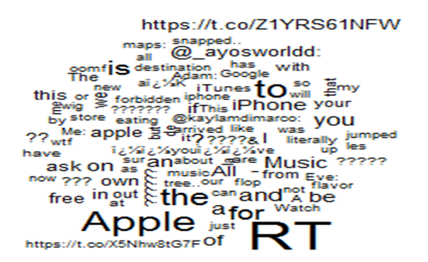
Text cloud
Use pattern
Word count pattern
Top K pattern
result

Slide 16
Some learning
Stop word list removal ,
Grep pattern to ‘filter’ and ‘remove’ the stop words (the ,off ,and , too)
Useful, but still lots garbage words (ex : iPhone?X???Max)
Stemming
Like bikes→bike
We don’t know how to implement it in MapReducer
Term frequency ,VSM and inverted index
Wordcount pattern using tweet ID as key
Internationalization problem
Double byte character system can’t use ‘space’ or ‘tab’ to separate words. Japan ,Us , Saudi are the countries using Twitter mostly.
Lucene or Solr will be a better solution in Hadoop ecosystem to text mining
R language or SSRS will be better in graphic report

Slide 17
Outline
Data collection
preprocessing
Analysis1—text cloud
Analysis2—user’s location
Analysis3—products popularity
conclusion

Slide 18
User’s location
Use pattern
Replication Join pattern
Group by pattern
First step → join result
Tweet right outer join User → 17450653
Tweet right outer join User and distinct→451125

Slide 19
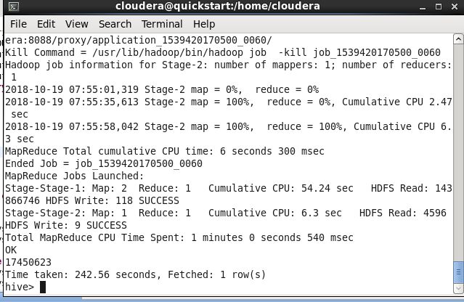
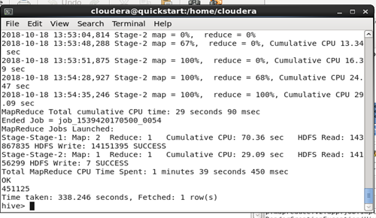
User’s location
Second step : Use hive to verify the result

Slide 20
Final step : group by location
�����������]�k�֤k�Ш|�j?����?��???????�� | 1924
���������������� | 2043
�������������������� ?scratch Gently | 2056
��������������������� | 2177
���𰪮դ��a��????? | 2432
�񳡤� | 2699
�񳡴��^????????? | 2713
�򥻤U�ⰼ | 3054
�򥻪�????�H | 3086
�򥻪�?�V??�ۤ�????�@ | 3406
�򥻪��H??���D�D�q | 3738
�򥻺֩�?�U�a��?�^??? ???????? | 3952
�򨽨D�� | 9917
🇳🇬 | 206384

Slide 21
Some learning
Normalization
in collecting tweet data, lots of user data are redundant
we must use tweet left outer join user and distinct them
Pair data must be in the same place locally when collection
Compare to RDBMS
If The amount of data is only 2 million, RDBMS will be quicker
Some hive mechanism will be useless in non-structure data
RC file or ORC file in tweet-info or user , maybe because of predicted index in where condition?
But TEZ engine is actually useful

Slide 22
Outline
Data collection
preprocessing
Analysis1—text cloud
Analysis2—user’s location
Analysis3—products popularity
conclusion

Slide 23
User’s location
Use pattern
Grep filter pattern
result
item | count
Apple Watch | 15957
Mac | 8244
iPad | 7019
iPod | 502
iphone | 19531

Slide 24
Some learning
Interesting facts
Lots of people discuss Apple Watch, IOT era?
Synonym setup
Iphone= IPHONE = Iphone
Future
Association rule : a tweet discuss ‘Apple Watch’ also talk about ‘Iphone’?
Classification : decision tree

Slide 25
Outline
Data collection
preprocessing
Analysis1—text cloud
Analysis2—user’s location
Analysis3—products popularity
conclusion

Slide 26
conclusion
Hadoop, MapReduce, Hive are very powerful to deal with social network data, but the problem is how to clean the data.
In data collection and preprocessing phase, some better mechanisms can be used to make the data cleaner and collection efficiently, such as multithread jobs, store in NoSQL.
Basic text mining isn’t difficult, but difficult to get meaningful analysis and result.
Advanced text mining, such as IR and VSM, using the existing solution ,for example , Solar , will be better than we write MapReduce by ourselves.
When considering about presentation , other languages ,such as R and Python will be easier to use.
If the data amount isn’t large enough, join will be easier in RDBMS.
Hive is very useful in ad hoc query and simulate SQL like behavior, but if the data isn’t structure, maybe some advantages in Hive can’t be used.
Some data mining and machine learning skills can be used in analyzing social media data, such as association rules, classification and clustering.

Slide 27
references
https://www.nbcnews.com/storyline/hacking-in-america/what-forged-cookie-how-did-it-allow-hackers-get-my-n721866
https://www.engadget.com/2017/03/01/yahoo-hackers-accessed-32-million-accounts-with-forged-cookies/
https://www.wired.com/story/yahoo-breach-three-billion-accounts/
http://fortune.com/2016/12/19/yahoo-hack-cyber-security/
https://www.csoonline.com/article/3180762/data-breach/inside-the-russian-hack-of-yahoo-how-they-did-it.html

Slide 28


