Slide 1
Data mining final Project -KDD from tweet data
Students: Yu-Chun,Chou

Slide 2
Outline
Data collection and preprocessing
Classification
Text mining-first time
Text mining-second time
conclusion

Slide 3
Outline
Data collection methods
Classification
Text mining-first time
Text mining-second time
conclusion

Slide 4
Data collection
Twitter API
Restful API
https://api.twitter.com/1.1/search/tweets.json
JSON format
{ "created_at": "Thu Apr 06 15:24:15 +0000 2017", "id_str": "850006245121695744",….}
Search API for history data
Stream API for nearly real time data-low latency
Can use API mode (OAuth) and user mode
Will have time rate limit

Slide 5
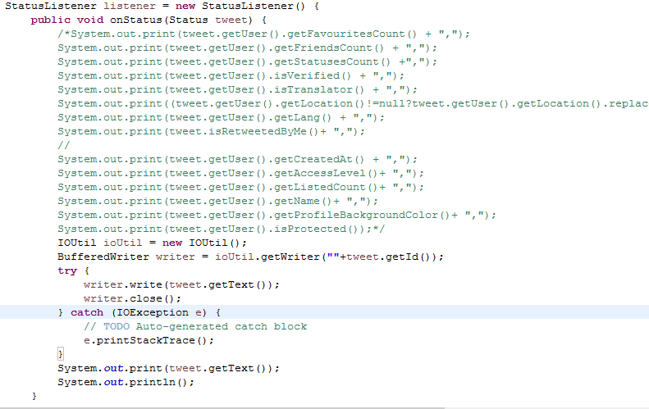
Data collection and preprocessing
Twitter4j
Java library for twitter API
Use multi thread and call back function to implement asynchronous mechanism

Slide 6
Outline
Data collection
Classification
preprocessing
Data mining
Text mining-first time
Text mining-second time
conclusion

Slide 7
preprocessing
Twitter data
Collection time
7/23/2017 02:02:51~06:50:30
7/24/2017 02:10:15~02:58:10
Data collected keyword : Nba, Spurs
Data collected amount
First time: 1242
Second time: 7873

Slide 8
preprocessing
Data format
attributes | Data source | types
FavouritesCount | The user who sent the tweet | Number(ratio)
FriendsCount | The user who sent the tweet | Number(ratio)
FriendsCount | The user who sent the tweet | Number(ratio)
isVerified | The user who sent the tweet | Boolean(binary)
isTranslator | The user who sent the tweet | Date(binary)
location | The user who sent the tweet | String(nominal)
Lang | The user who sent the tweet | String(nominal)

Slide 9
preprocessing
tasks | Choose tasks
Data cleaning—missing data | Global constant Location = unknown
Data cleaning---noisy data | Z-score Delete favoriteCount z-score>3 Delete friendsCount z-score>3 Delete statusesCount z-score>3
Data integration | Tuple duplication Delete duplicate Tweet
Data transformation | Min-max normalization friendsCount statusesCount Bin normalization favoriteCount into 4 bins

Slide 10
Outline
Data collection
Classification
preprocessing
Data mining
Text mining-first time
Text mining-second time
conclusion

Slide 11
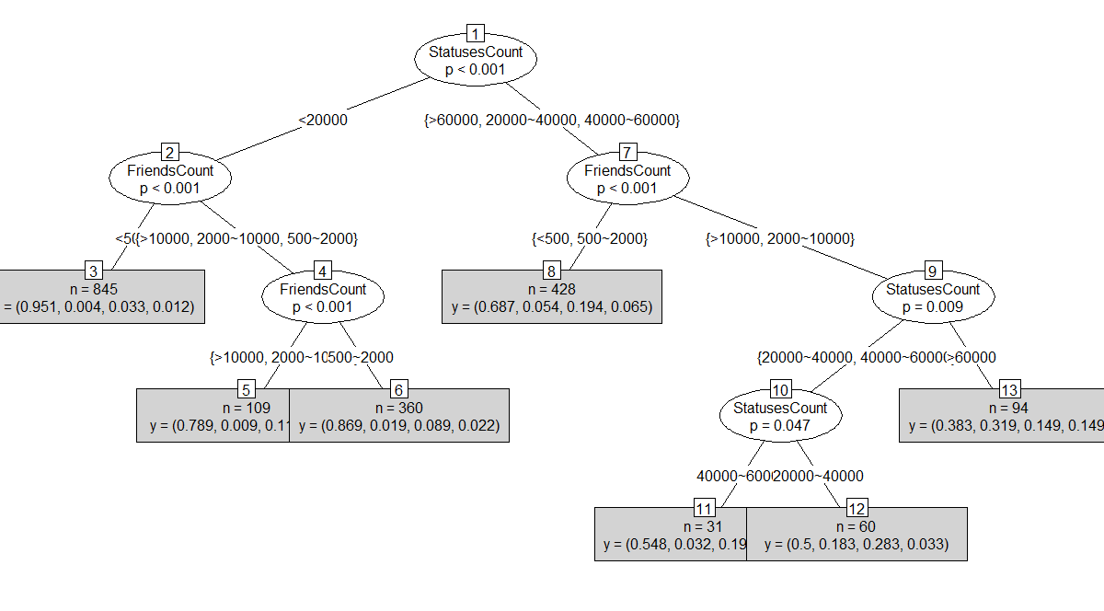
Decision tree---classification by favorite counts

Slide 12
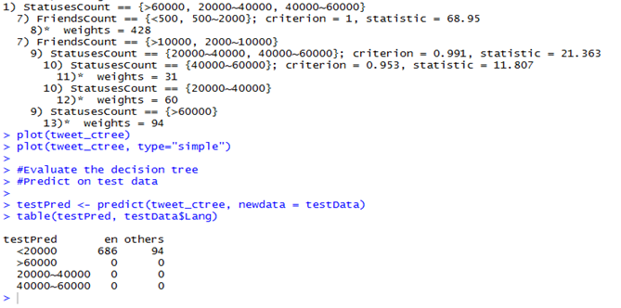
evaluation

Slide 13
Some learning
Do we need to delete all the outlier data until all data meet the requirements?
When I want to produce decision tree, if there are lots of different results of classifier, the R will crash, so I transfer the Lang to {“en”,”others”}
When I want to use the status count ,language, friendscount, location to run the decision tree, the R will meet the difficulty, so I transfer the data into different bins.
If our data source is social network, we’d better to collect all the information at the first time, because the data will change immediately, unlike the structure data in RDBMS and data warehouse.

Slide 14
Outline
Data collection and preprocessing
Classification
Text mining-first time
preprocessing
Data mining
Text mining-second time
conclusion

Slide 15
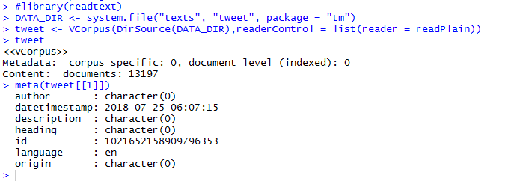
preprocessing
KEY WORD : “nba, Spurs”
Collection time : 07/23/2018 19:20~07/24/2018 07:30
Collected data : 13197
Data format : plain text , save as individual files

Slide 16
Some learning
We need to use more keyword to get the sample data more precisely, but it also will affect the
Time of gathering data.(ex: spurs is a tool when we didn’t indicate NBA)
To identify Stop words list in social network data is very difficult, because people will tend to
Use some mouthful or strange format of words, or some words about trends and fads. (ex:cydream is an Instagram hashtag)
Remove punctuation will cause some problems in social network data, because in social network, people tend to present feeling and use lots of reference network address
data | conent
Original data | rt @makeitbiz: Dangote cement¡¦s rally Spurs nse¡¦s 0.30%?rise https://t.co/gladbw1m6s https://t.co/voivvh1kgd
After content_transformer(tolower) | rt @makeitbiz: dangote cement¡¦s rally spurs nse¡¦s 0.30%?rise https://t.co/gladbw1m6s https://t.co/voivvh1kgd
After removeNumbers | rt @makeitbiz: dangote cement¡¦s rally spurs nse¡¦s 0.30%?rise https://t.co/gladbw1m6s https://t.co/voivvh1kgd
After removePunctuation | rt makeitbiz dangote cement¡¦s rally spurs nse¡¦s rise httpstcogladbwms httpstcovoivvhkgd
After stopwords | rt makeitbiz dangote cement¡¦s rally spurs nse¡¦s rise httpstcogladbwms httpstcovoivvhkgd

Slide 17
Outline
Data collection and preprocessing
Classification
Text mining
preprocessing
Data mining
Text mining-second time
conclusion

Slide 18
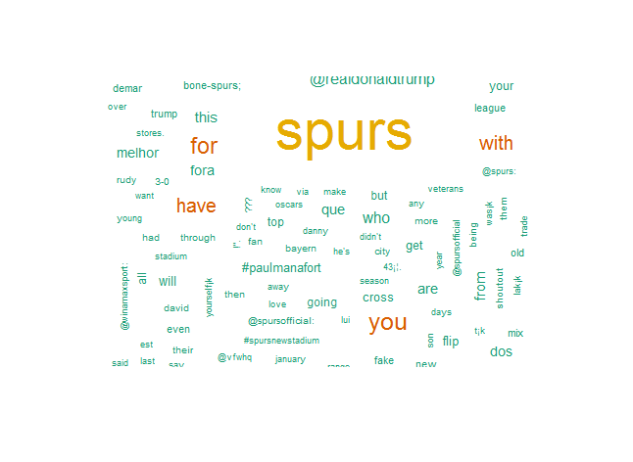
Text mining
Frequency > 100

Slide 19
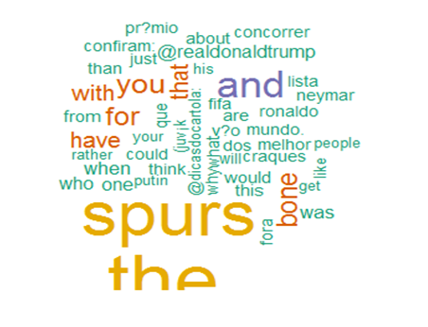
Text mining
Frequency > 500

Slide 20
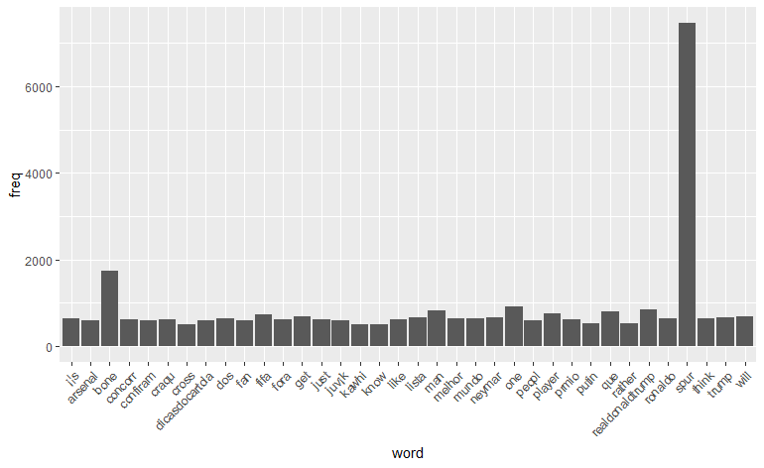
Text mining—frequency plot
Frequency > 500

Slide 21
Some learning
If we can’t use proper keyword to collect data, the mining result will be strange….

Slide 22
Outline
Data collection and preprocessing
Classification
Text mining-first time
Text mining-second time
preprocessing
Data mining
conclusion

Slide 23
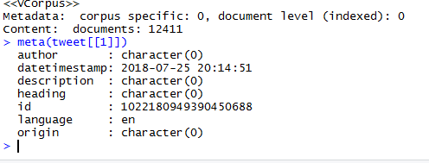
preprocessing
KEY WORD : “Spurs,nba,Kawhi”
Collection time : 07/25/2018 11:00~07/25/2018 12:30
Collected data : 12411
Data format : plain text , save as individual files

Slide 24
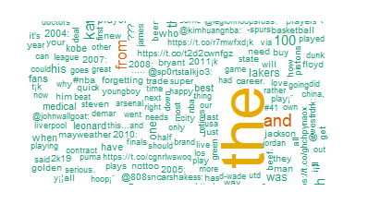
Text mining
Frequency > 100

Slide 25
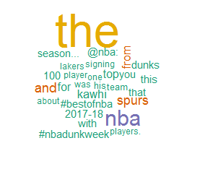
Text mining
Frequency > 500

Slide 26
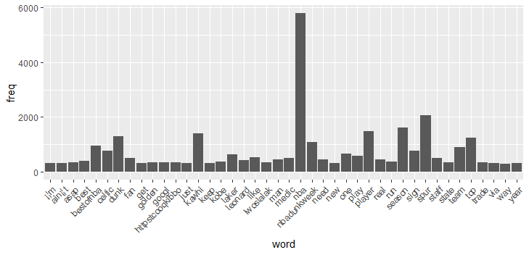
Text mining
Frequency > 500

Slide 27
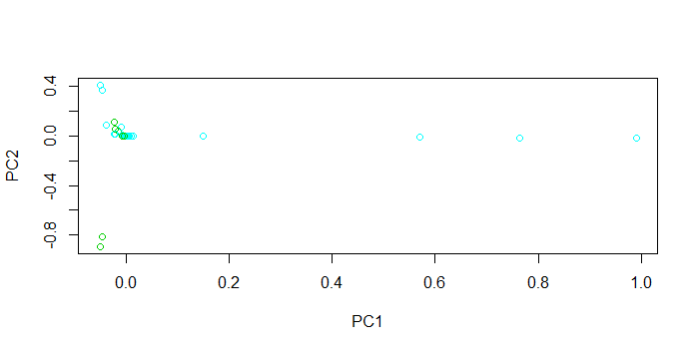
K-means

Slide 28
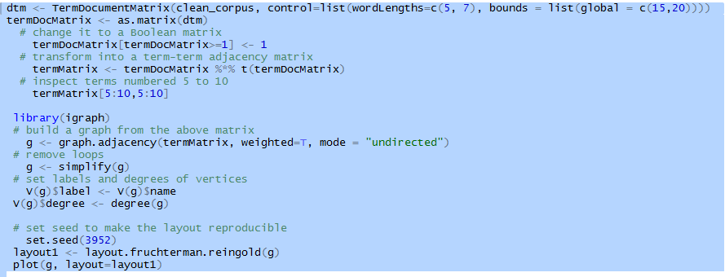
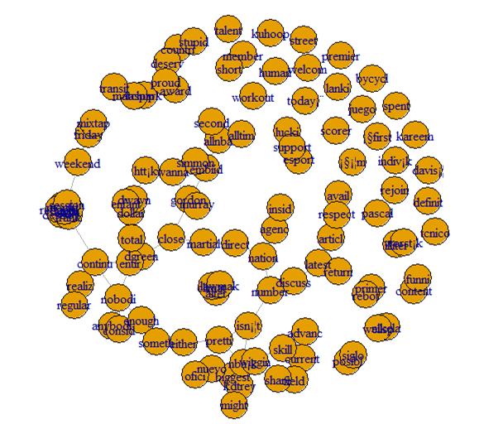
Term term Adjacency Matrix graph

Slide 29
Outline
Data collection methods
Classification
Text mining-first time
Text mining-second time
conclusion

Slide 30
conclusion
Social network data is very non-structure, we can difficultly to apply our rules in data mining
in this kind of data
In Twitter, every tweet are very short (140 characters limit) but various, it’s difficult to
classify and cluster.
Because of the data amount and content variance, maybe we can Consider about using cloud platform to do the distributed training, especially for real time analysis
AWS has the platform in their cloud infrastructure, can deal with the data parallelism and model parallelism, using YARN , TensorFlow , Kinesis,EMR ,etc..

Slide 31
references
https://www.nbcnews.com/storyline/hacking-in-america/what-forged-cookie-how-did-it-allow-hackers-get-my-n721866
https://www.engadget.com/2017/03/01/yahoo-hackers-accessed-32-million-accounts-with-forged-cookies/
https://www.wired.com/story/yahoo-breach-three-billion-accounts/
http://fortune.com/2016/12/19/yahoo-hack-cyber-security/
https://www.csoonline.com/article/3180762/data-breach/inside-the-russian-hack-of-yahoo-how-they-did-it.html

Slide 32


