Slide 1

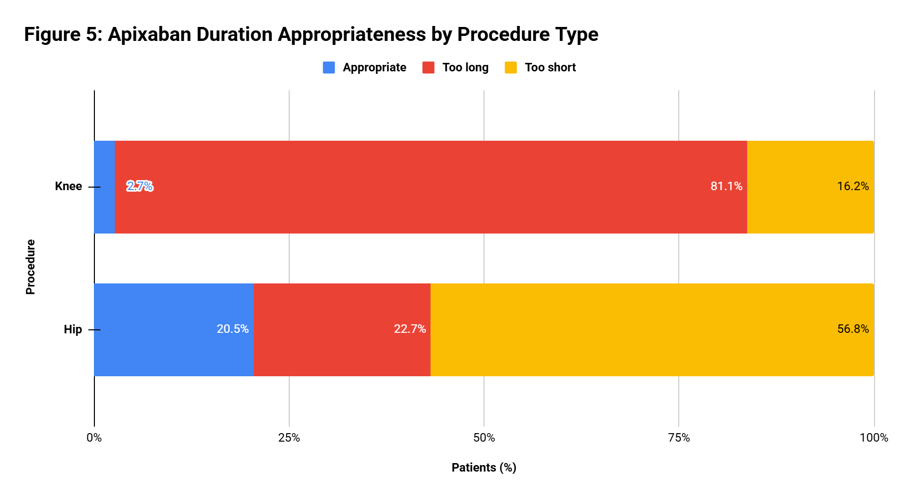
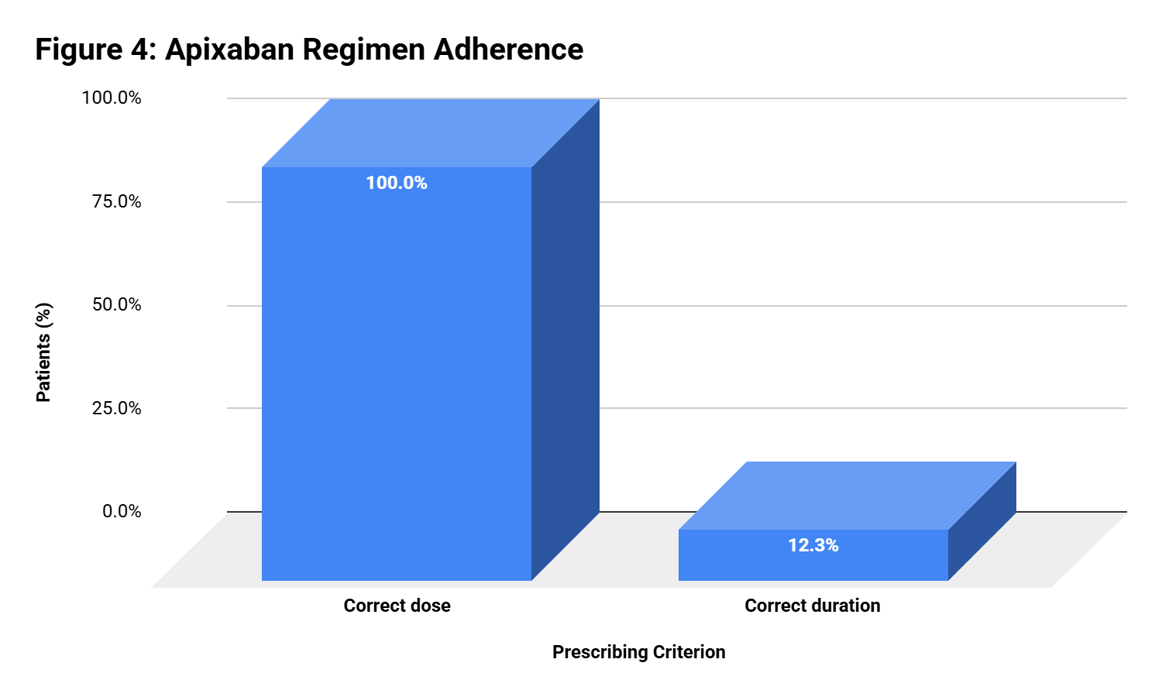
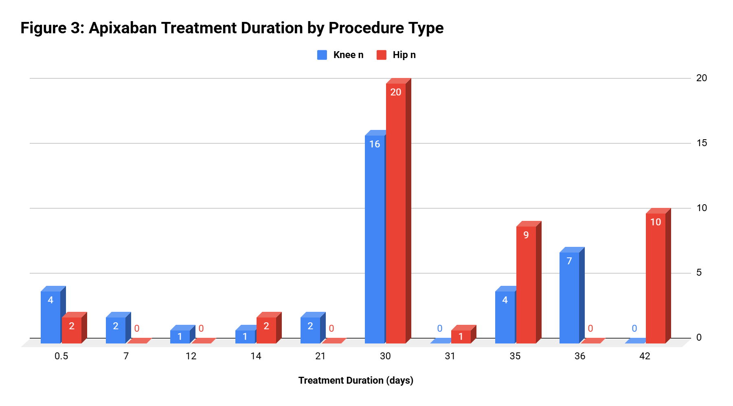
Medication Use Evaluation of Apixaban Dosing and Duration for Venous Thromboembolism Prophylaxis Following Total Hip or Knee Arthroplasty
Alhamza Hamza, PharmD
PGY1 Pharmacy Resident
Ascension St. Vincent’s Riverside
Ascension St. Vincent’s
1 Shircliff Way
Jacksonville, FL 32205
Alhamza Hamza, PharmD; Clare Brewster, PharmD, MPH; Kassandra Ramos, PharmD, MBA, BCCCP; Tina Gifford, PharmD, BCPS
The authors have no conflicts of interest.
Background
Results
Key Findings
Patients undergoing total hip or knee arthroplasty are at increased risk for postoperative venous thromboembolism (VTE), including deep vein thrombosis and pulmonary embolism.
Apixaban is used for VTE prophylaxis after hip or knee replacement surgery.
Recommended apixaban therapy is 2.5 mg orally twice daily, started 12 to 24 hours after surgery.
Recommended duration is 35 days after hip replacement and 12 days after knee replacement.
Total duration includes both inpatient and outpatient apixaban doses.
Table 1. Baseline Characteristics (n=81)
Table 2. Apixaban Use (n=81)
Among knee arthroplasty patients, 2.7% received the recommended duration; 81.1% received longer therapy and 16.2% received shorter therapy.
Among hip arthroplasty patients, 20.5% received the recommended duration; 22.7% received longer therapy and 56.8% received shorter therapy.
The frequent use of a 30-day treatment duration for both procedures may explain these trends.
Median age, years (IQR)
75 (65–80)
Indication documented
81 (100.0)
Median BMI, kg/m² (IQR)
29.7 (26.1–36.4)
Dose appropriate
81 (100.0)
Female sex
45 (55.6)
Duration recommended
10 (12.3)
Knee procedure
37 (45.7)
Duration longer than recommended
40 (49.4)
Hip procedure
44 (54.3)
Duration shorter than recommended
31 (38.3)
Primary procedure
70 (86.4)
Median treatment duration, days
30 (30–35)
Objective
Revision procedure
11 (13.6)
Prescription with ≥1 refill
0 (0.0)
Discussion
To evaluate whether apixaban prescribed for postoperative VTE prophylaxis after total hip or knee arthroplasty was consistent with the recommended dose and total treatment duration.
Apixaban dosing was correct in 100% of patients, while only 12.3% received the recommended treatment duration. All identified deviations were related to treatment duration.
Dose selection was consistent across the cohort, but treatment duration varied by procedure type.
A standardized 30-day duration may shorten therapy for hip arthroplasty and extend therapy for knee arthroplasty.
Discharge prescription duration appears to be the main opportunity for improvement.
Methods
Study design
Retrospective medication-use evaluation
Patients
Adults who underwent total hip or total knee arthroplasty
Conclusion
Time frame
January 1, 2026 to August 1, 2026
Apixaban dose selection was consistent with recommended therapy.
Treatment duration frequently differed from the recommended duration after both hip and knee arthroplasty.
Procedure-specific order sets, discharge medication reconciliation support, treatment-duration alerts, and targeted provider education may improve discharge prescription accuracy.
Data sources
EHR medication records, orthopedic power plans, discharge records, surgery documentation, labs, ED/readmission records
Primary outcome
Recommended apixaban dose and total duration
Exclusions
Other apixaban indication, chronic therapeutic anticoagulation, acute DVT/PE during admission, other orthopedic procedures, transfer
References
Recommended therapy: apixaban 2.5 mg by mouth twice daily for 35 days after hip replacement or 12 days after knee replacement.
1. Eliquis (apixaban) prescribing information. 2025. 2. Lieberman JR, Heckmann N. J Am Acad Orthop Surg. 2017;25(12):789-798. 3. Muscatelli SR et al. Arthroplast Today. 2021;10:105-107.
All values are reported as median (IQR) or n (%) unless otherwise noted.

