Slide 2
Digital Input
Connect digital input to your Arduino using Pins # 0 – 13 (Although pins # 0 & 1 are also used for programming)
Digital Input needs a pinMode command: pinMode (pinNumber, INPUT); Make sure to use ALL CAPS for INPUT
To get a digital reading:
int buttonState = digitalRead (pinNumber);
Digital Input values are only HIGH (On) or LOW (Off)

Slide 3
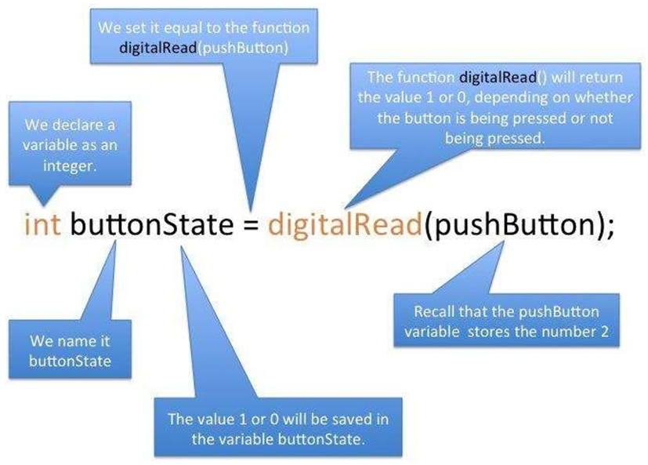
Digital Input (Cont..)

Slide 4
// Pushbutton sketch: a switch is connected to pin 2 lights the LED on pin 13
// (or) Control an LED connected to pin-13 w.r.to. a switch connected to pin-2, with the help of external resister
const int ledPin = 13; // choose the pin for the LED
const int inputPin = 2; // choose the input pin (for a pushbutton)
void setup()
{
pinMode(ledPin, OUTPUT); // declare LED as output
pinMode(inputPin, INPUT); // declare pushbutton as input
}
void loop()
{
int val = digitalRead(inputPin); // read input value
if (val == HIGH) // check if the input is HIGH
{
digitalWrite(ledPin, HIGH); // turn LED on if switch is pressed
}
else
{
digitalWrite(ledPin, LOW); // turn LED off
}
}

Slide 5
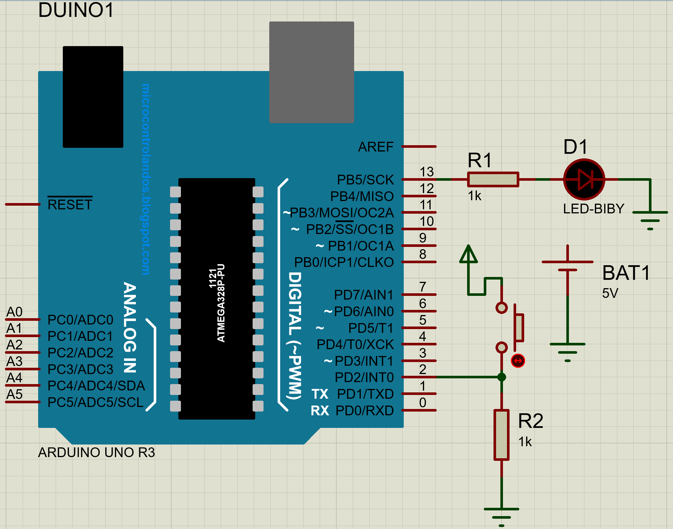

Proteus design (with external resister)

Slide 6
Using a key/push button with external resistor
The digitalRead function monitors the voltage on the input pin (inputPin), and it returns a value of HIGH if the voltage is high (5 volts) and LOW if the voltage is low (0 volts).
Actually, any voltage that is greater than 2.5 volts (half of the voltage powering the chip) is considered HIGH and less than this is treated as LOW.
If the pin is left unconnected (known as floating) the value returned from digitalRead is indeterminate (it may be HIGH or LOW, and it cannot be reliably used).
The resistor shown in Figure shown in previous slide ensures that the voltage on the pin will be low when the switch is not pressed, because the resistor “pulls down” the voltage to ground.
When the switch is pushed, a connection is made between the pin and +5 volts, so the value on the pin interpreted by digital Read changes from LOW to HIGH.

Slide 7
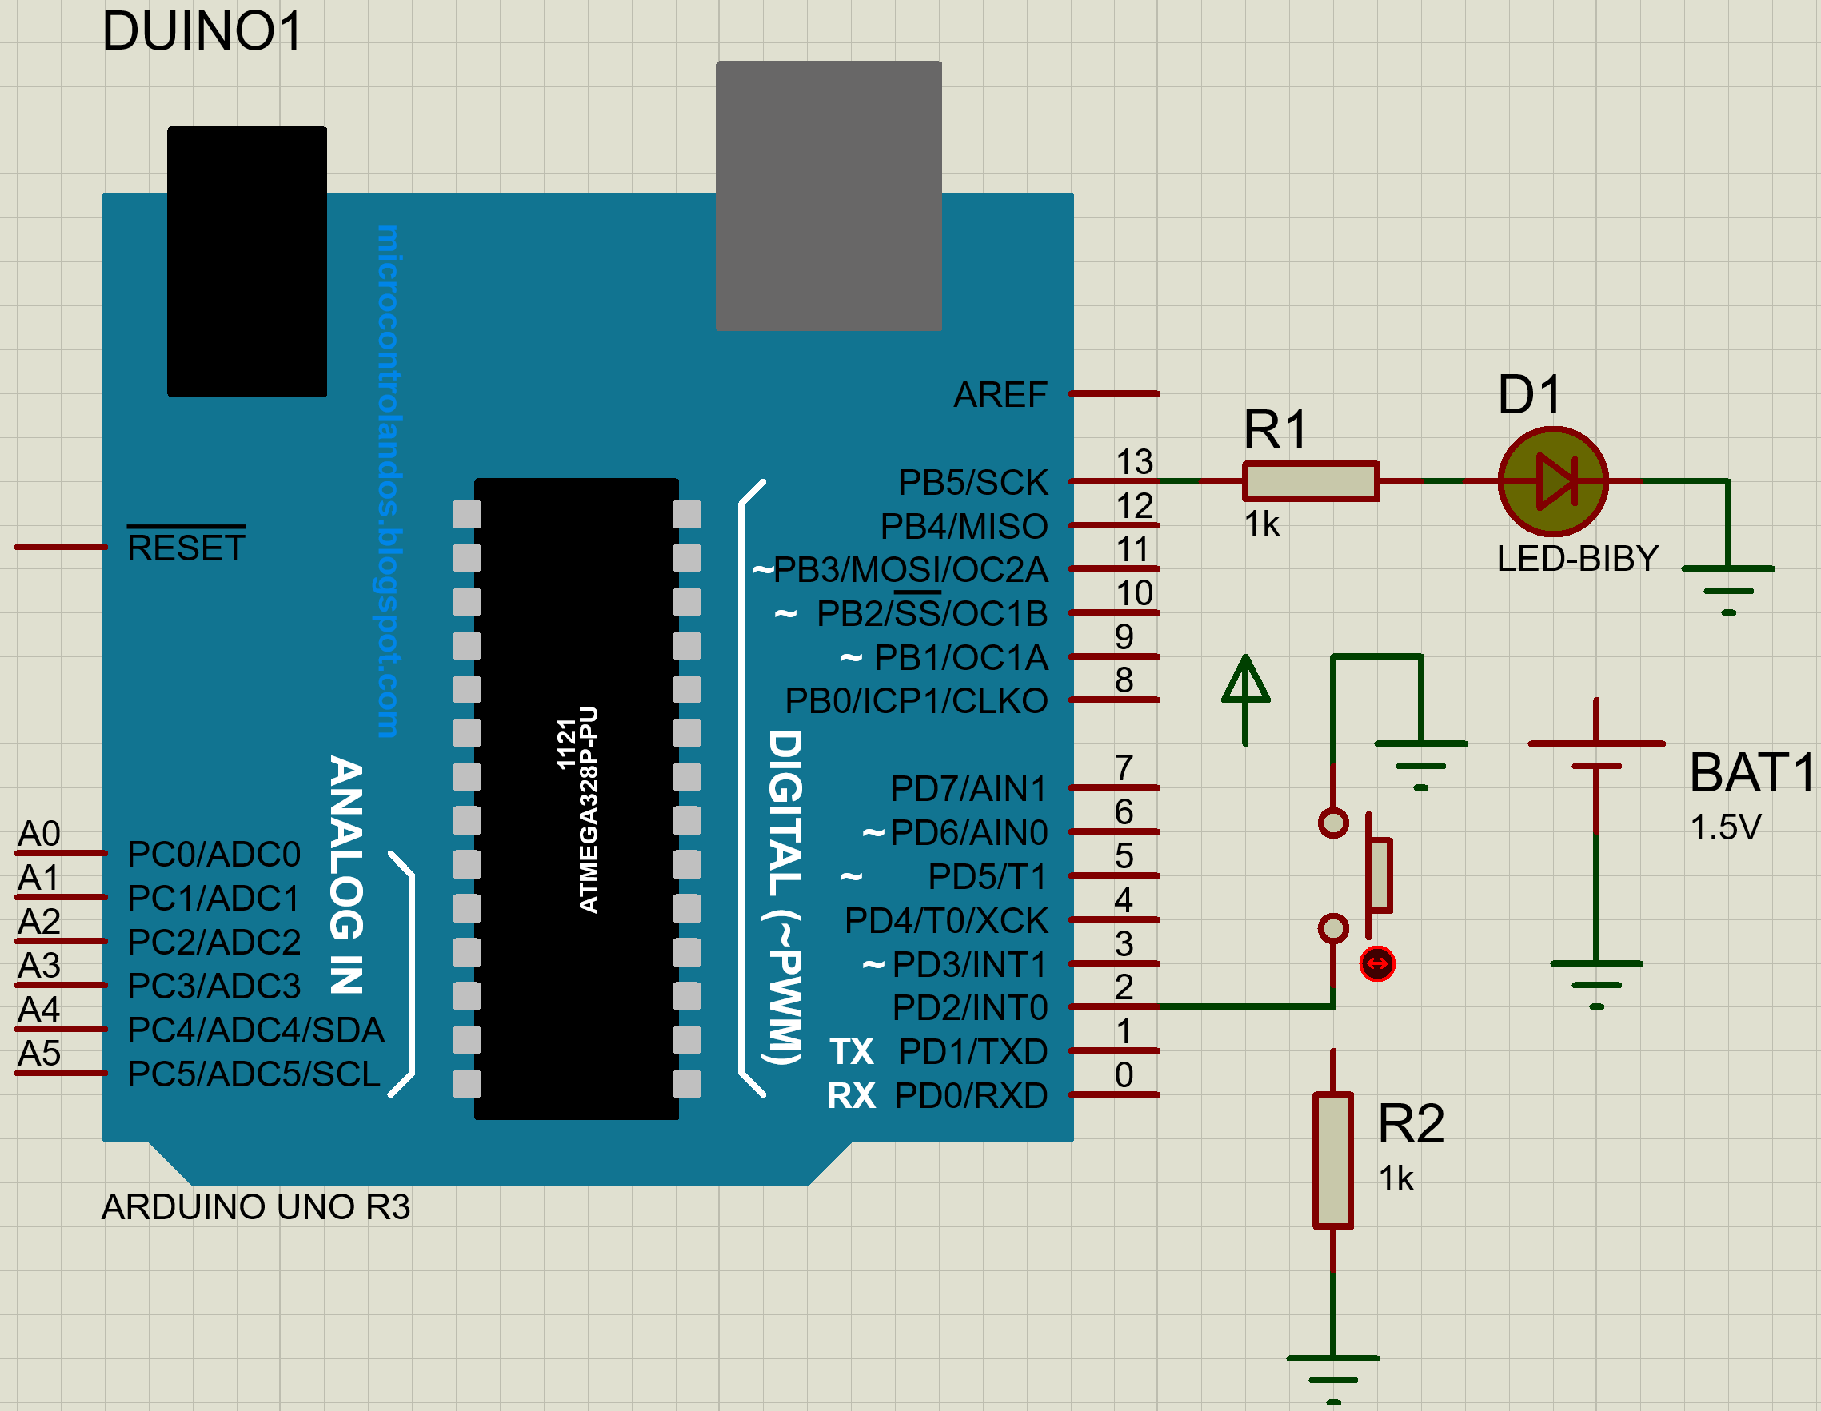
Proteus design (with out external resister)
Digital inputs must have a resistor to hold the pin to a known value when the switch is not pressed.
Arduino has internal pull-up resistors that can be enabled by writing a HIGH value to a pin that is in INPUT mode.

Slide 8
/* Pullup sketch: a switch connected to pin 2 lights the LED on pin 13 */
const int ledPin = 13; // output pin for the LED
const int inputPin = 2; // input pin for the switch
void setup()
{
pinMode(ledPin, OUTPUT);
pinMode(inputPin, INPUT);
digitalWrite(inputPin,HIGH); // turn on internal pull-up on the inputPin(i.e. at pin2)
}
void loop()
{
int val = digitalRead(inputPin); // read input value
if (val == LOW) // check if the input is LOW or switch ON
{
digitalWrite(ledPin, HIGH); // turn LED ON if switch is pressed
}
else if (val == HIGH) // check if the input is HIGH
{
digitalWrite(ledPin, LOW); // turn LED OFF
}
}

Slide 9
/* array sketch an array of switches controls an array of LEDs */
int inputPins[] = {2,3,4,5}; // create an array of pins for switch inputs
int ledPins[] = {10,11,12,13}; // create array of output pins for LEDs
void setup()
{
for(int index = 0; index < 4; index++)
{
pinMode(ledPins[index], OUTPUT); // declare LED as output
pinMode(inputPins[index], INPUT); // declare pushbutton as input
digitalWrite(inputPins[index],HIGH); // enable pull-up resistors
}
}
void loop()
{
for(int index = 0; index < 4; index++)
{
int val = digitalRead(inputPins[index]); // read input value
if (val == LOW) // check if the switch is pressed
{
digitalWrite(ledPins[index], HIGH); // turn LED on if switch is pressed
}
else
{
digitalWrite(ledPins[index], LOW); // turn LED off
}
}
}

Slide 10
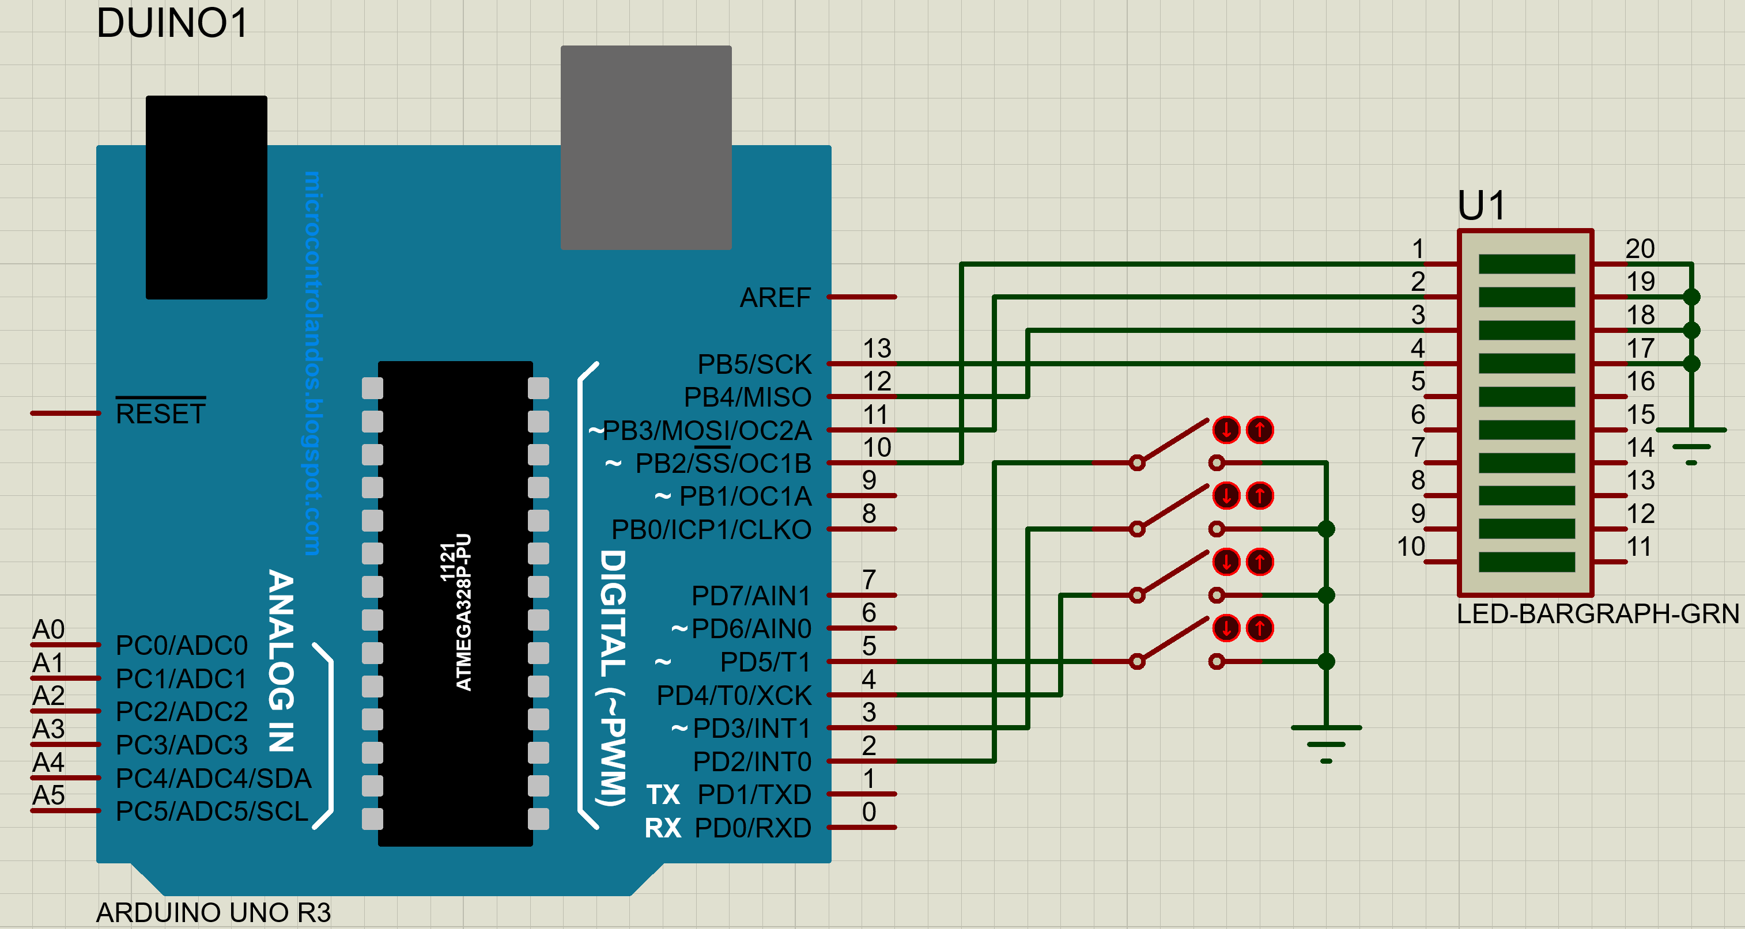
Proteus design

Slide 11
Digital v/s Analog
All physical quantities are analog.
Analog means that the quantity can take any value between its minimum value and maximum value.
Digital means that the quantity can take specific levels of values with specific offset between each other.
Ex: 1- Digital:
English alpha consists of 26 letter, there is no letter between A and B.
- Square waves are Digital.
Ex: 2- Analog:
Temperature, can take any value[-1,12.8,25.002,… etc.].
- Sine waves are analog.

Slide 12
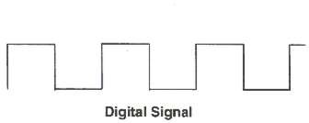

Digital v/s Analog (Cont..)
Microcontrollers are digital devices – ON or OFF. Also called – discrete.
analog signals are anything that can be a full range of values. What are some examples? More on this later…
5 V
5 V
0 V
0 V

Slide 13
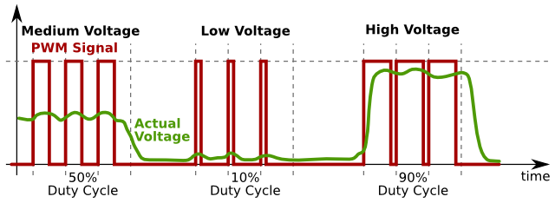
Digital v/s Analog & PWM
A few (digital) pins (3,5,6,9,10,11) on the Arduino allow for us to modify the output to mimic an analog signal.
This is done by a technique called: Pulse Width Modulation (PWM).
To create an analog signal, the microcontroller uses a technique called PWM. By varying the duty cycle, we can mimic an “average” analog voltage.
Pulse Width Modulation (PWM)

Slide 14
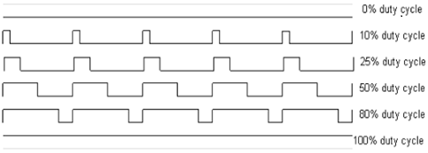
Pulse Width Modulation (PWM)
A PWM signal is a digital square wave, where the frequency is constant, but that fraction of the time the signal is on (the duty cycle) can be varied between 0 & 100%
PWM has several uses:
Dimming an LED
Providing an analog output; if the digital output is filtered,
it will provide an analog voltage between 0% and 100% .
Generating audio signals.
Providing variable speed control for motors.

Slide 15
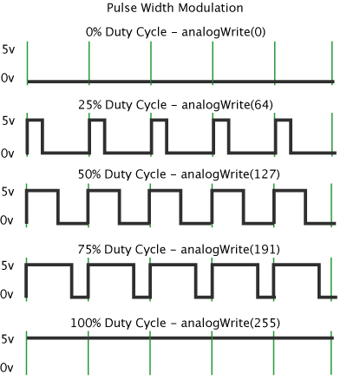
Pulse Width Modulation (PWM) Cont..
analogWrite(pin, val);
Eg. analogWrite(3, 0-255);
pin – refers to the OUTPUT pin (limited to pins 3, 5, 6, 9, 10, 11.)
– denoted by a ~ symbol
val – 8 bit value (0 – 255).
0 = 0V | 255 = 5V

Slide 16
Arduino sketch (Eg. 1)
//Arduino sketch to adjust/control the brightness of LED using PWM, use map function
int ledPin = 9; // LED connected to digital pin 9
int analogPin = A3; // potentiometer connected to analog pin 3
int val = 0, val1 = 0; // variable to store the read value
void setup()
{
pinMode(ledPin, OUTPUT); // sets the pin as output
}
void loop()
{
val = analogRead(analogPin); // read the input pin
val1=map(val,0,1023,0,255);
analogWrite(ledPin, val1); //val1 values range is: 0- 255
//analogWrite(ledPin, val / 4); // analogRead values go from 0 to 1023, // analogWrite values from 0 to 255
}

Slide 17
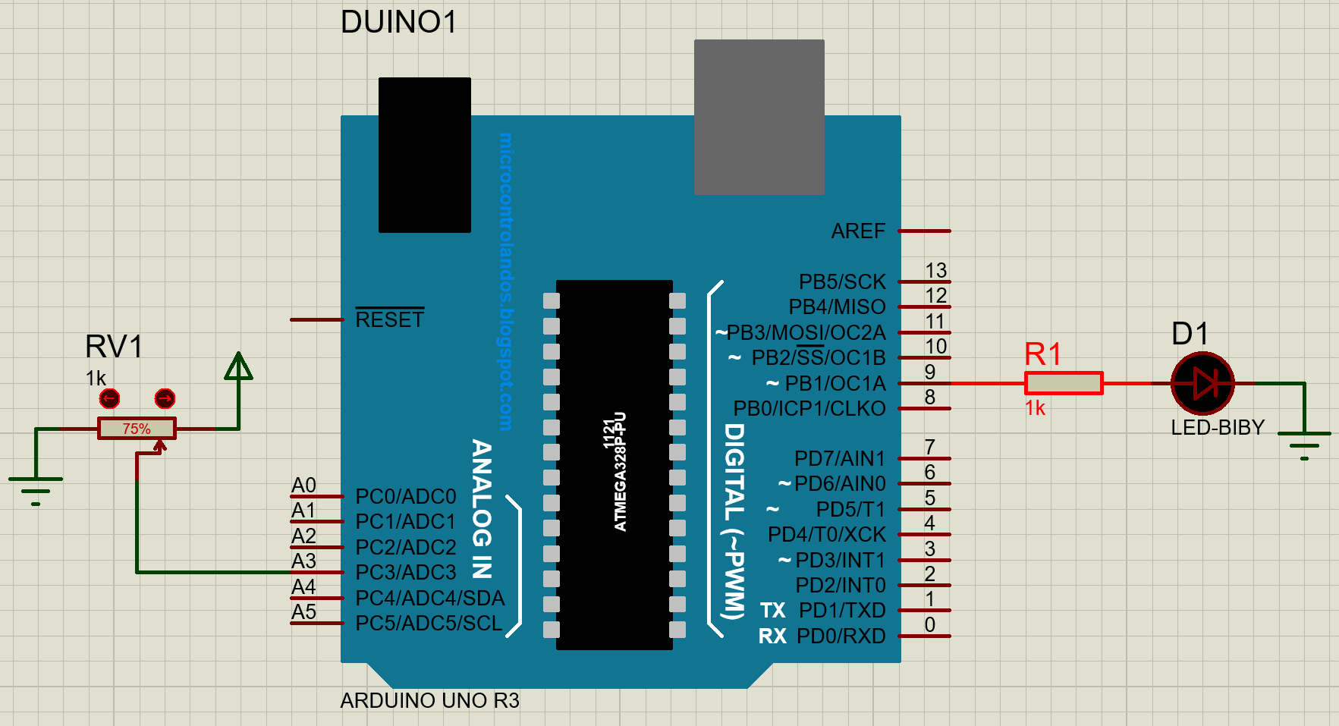
Proteus design (Eg. 1)

Slide 18
Arduino sketch (Eg. 2)
//Fading/brightness control of LED using PWM Other Way (without potentiometer)
void setup() {
// put your setup code here, to run once:
pinMode(11, OUTPUT);
}
void loop() {
// put your main code here, to run repeatedly:
for(int i=0;i<=255;i++)
{
analogWrite(11,i); //i: 0-255→ so brightness keeps on increasing to maxi.
delay(1000);
}
for(int i=255;i>=0;i--)
{
analogWrite(11,i); //i: 255-0→ so brightness keeps on decreasing to mini.
delay(1000);
}
}

Slide 19
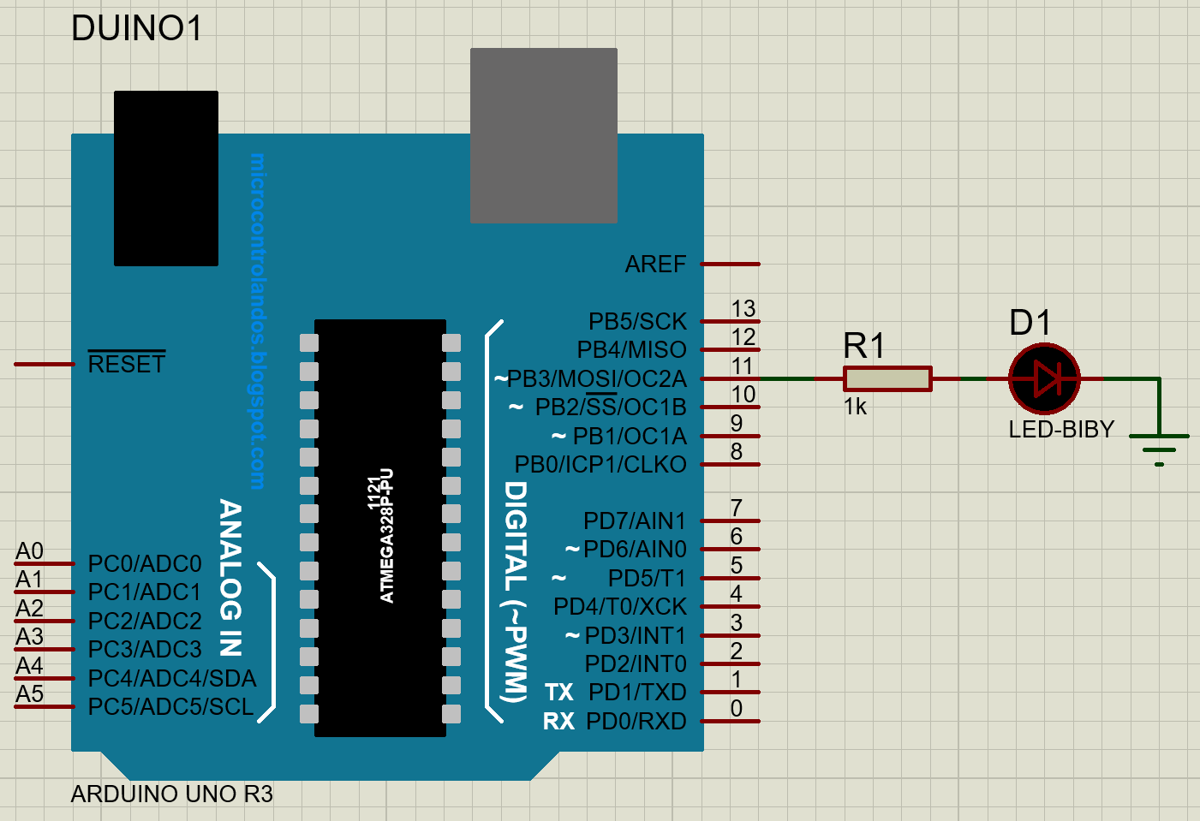
Proteus design (Eg. 2)

Slide 20
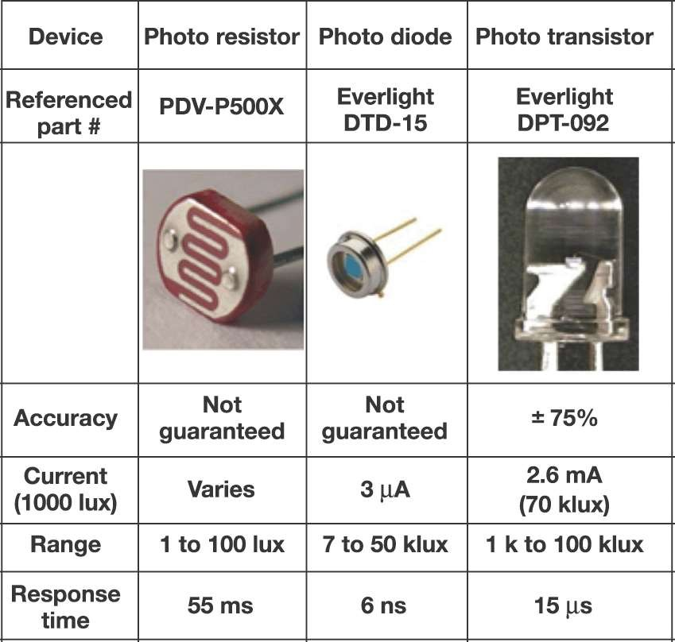
Sensors:
A device that transforms the physical quantity into electrical value.
Ex: Light sensor transduce the light into change in voltage or resistance.
Light sensors:
Photo-Resistor [photo-cell].
Photo-Diode.
Photo-Transistor.

Slide 21
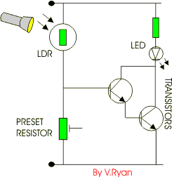
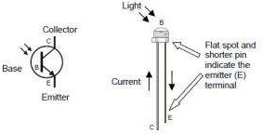
Sensors (Cont..):
Photo Resistor:
The value of the resistance depends on the incident light density.
1 K-Ohm at light, 10 K-Ohm at darkness.
Photo Diode:
The current is controlled by the incident light density.
Photo Transistor:
Base-emitter junction is controlled by the incident light density, has an amplification effect.

Slide 22
Working with Sensors

Slide 23
Digital Sensors
Digital sensors are more straight forward than Analog
No matter what the sensor there are only two settings: On and Off
Signal is always either HIGH (On) or LOW (Off)
Voltage signal for HIGH will be a little less than 5V on your Uno
Voltage signal for LOW will be 0V on most systems

Slide 24
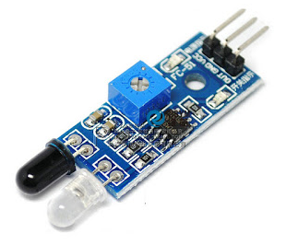
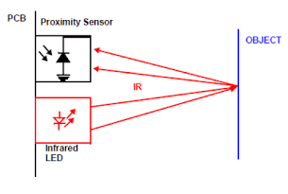
IR Sensor
Features-
Can be used for obstacle sensing, fire detection, line sensing, etc
Input Voltage: 5V DC
Comes with an easy to use digital output
Can be used for wireless communication and sensing IR remote signals
IR Sensor have three Pins
1. VCC = +5V DC
2. GND
3. D0 or OUT (Digital Output)

Slide 25
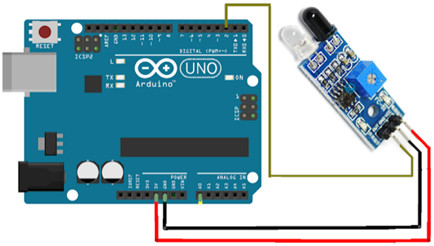
Arduino sketch & Circuit diagram
const int ProxSensor=2;
void setup()
{
pinMode(13, OUTPUT);
pinMode(ProxSensor, INPUT);
}
void loop()
{
if(digitalRead(ProxSensor)==HIGH)
{
digitalWrite(13, HIGH);
}
else
{
digitalWrite(13, LOW);
}
delay(100);
}

Slide 26
IR Sensor Interfacing, display the o/p on Serial Monitor
/*
IR Proximity Sensor interface code
Turns on an LED on when obstacle is
detected, else off.
*/
const int ProxSensor=2;
void setup()
{
// initialize the digital Serial port.
Serial.begin(9600);
// initialize the digital pin as an output.
pinMode(13, OUTPUT);
pinMode(ProxSensor,INPUT);
}
void loop()
{
if(digitalRead(ProxSensor)==LOW)
//Check the sensor output
{
digitalWrite(13, HIGH); // set the LED on
Serial.println("Stop something is ahead!! "); //Message on Serial Monitor
}
else
{
digitalWrite(13, LOW); // set the LED off
Serial.println("Path is clear");
//Message on Serial Monitor
}
delay(1000); // wait for a second
}

Slide 27
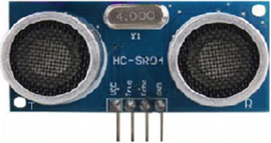
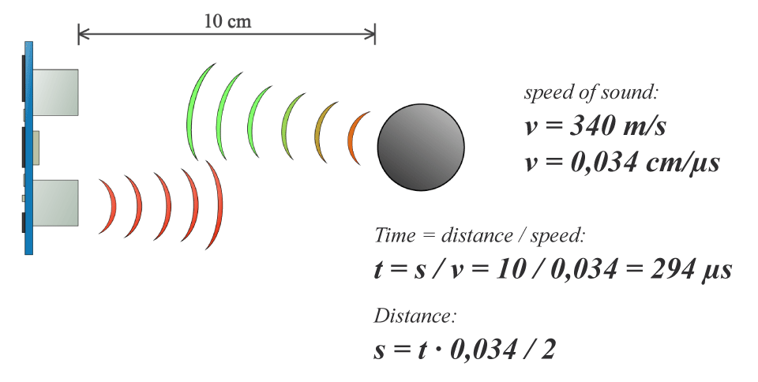

Ultrasonic Sensor
An Ultrasonic sensor is a device that can measure the distance to an object by using sound waves.
It measures distance by sending out a sound wave at a specific frequency and listening for that sound wave to bounce back.
By recording the elapsed time between the sound wave being generated and the sound wave bouncing back, it is possible to calculate the distance between the sonar sensor and the object.

Slide 28
Ultrasonic Sensor (Cont..)
Since it is known that sound travels through air at about 344 m/s (1129 ft/s), you can take the time for the sound wave to return and multiply it by 344 meters (or 1129 feet) to find the total round-trip distance of the sound wave.
Round-trip means that the sound wave traveled 2 times the distance to the object before it was detected by the sensor; it includes the 'trip' from the sonar sensor to the object AND the 'trip' from the object to the Ultrasonic sensor (after the sound wave bounced off the object).
To find the distance to the object, simply divide the round-trip distance in half.

Slide 29
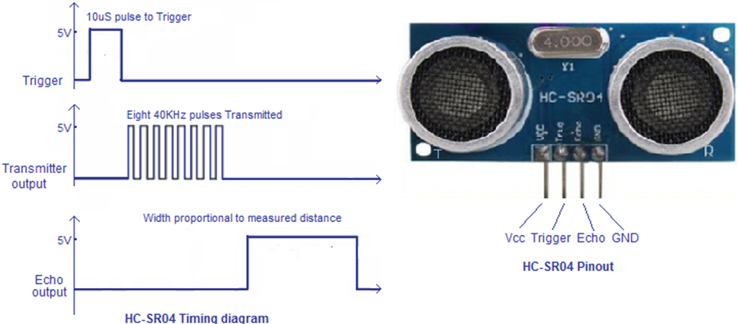
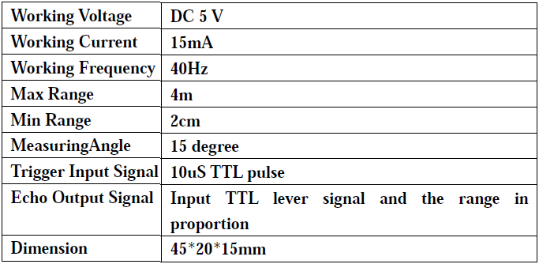
Working principle
The Trig pin will be used to send the signal and the Echo pin will be used to listen for returning signal
(1) Using IO trigger for at least 10us high level signal, Trig -> Pin-9 (o/p) of Arduino
(2) The Module automatically sends eight 40 kHz and detect whether there is a pulse signal back.
(3) IF the signal back, through high level , time of high output IO duration is the time from sending ultrasonic to returning.

Slide 30
Arduino Sketch
/*
* Ultrasonic Sensor HC-SR04 and Arduino Tutorial
*/
// defines pins numbers
const int trigPin = 9;
const int echoPin = 10;
// defines variables
long duration;
int distance;
void setup()
{
pinMode(trigPin, OUTPUT); // Sets the trigPin as an Output
pinMode(echoPin, INPUT); // Sets the echoPin as an Input
Serial.begin(9600); // Starts the serial communication
}

Slide 31
Arduino Sketch (Cont..)
void loop()
{ // Clears the trigPin
digitalWrite(trigPin, LOW);
delayMicroseconds(2);
// Sets the trigPin on HIGH state for 10 micro seconds
digitalWrite(trigPin, HIGH);
delayMicroseconds(10);
digitalWrite(trigPin, LOW);
// Reads the echoPin, returns the sound wave travel time in microsec.
duration = pulseIn(echoPin, HIGH);
// Calculating the distance
distance= (duration*0.034)/2;
// Prints the distance on the Serial Monitor
Serial.print("Distance: ");
Serial.print(distance);
Serial.println("cm");
delay(500); //500 m.sec = 0.5 sec
}

Slide 32
pulsein()
Reads a pulse (either HIGH or LOW) on a pin.
For example, if value is HIGH, pulseIn() waits for the pin
to go from LOW to HIGH, starts timing, then waits for the pin
to go LOW and stops timing.
Returns the length of the pulse in microseconds or
gives up and returns 0 if no complete pulse was received
within the timeout.

Slide 33
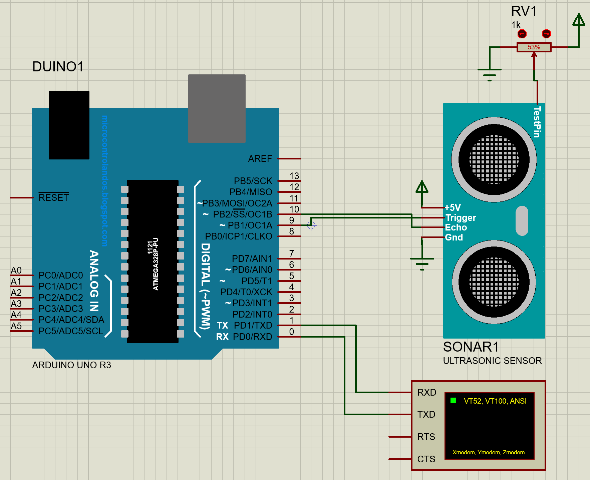
Proteus design

Slide 34
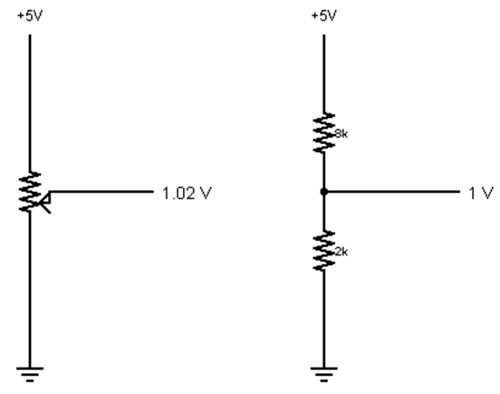
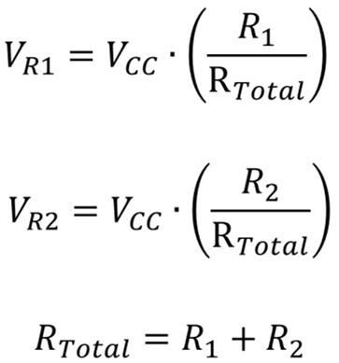
Analog Sensors
3 Pin Potentiometer = var. resistor (circuit)
a.k.a. Voltage Divider Circuit
Ohms Law… Actually, this is the “voltage divider”
Examples:
Sensors | Variables
Mic | soundVolume
Photoresistor | lightLevel
Potentiometer | dialPosition
Temp Sensor | temperature
Flex Sensor | bend
Accelerometer | tilt/acceleration

Slide 35
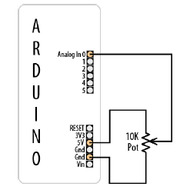
Reading analog values
analogRead(pin):
Arduino uses a 10-bit A/D Converter:
this means that you get input values from 0 to 1023
  0 V → 0
  5 V → 1023
Eg:
  int sensorValue = analogRead(A0);

Slide 36
Reading analog values (Cont..)
/*
Pot sketch blink an LED at a rate set by the position of a potentiometer
*/
const int potPin = A0; // or potPin = 0; // select the input pin for the potentiometer
const int ledPin = 13; // select the pin for the LED
int val = 0; // variable to store the value coming from the sensor
void setup()
{
pinMode(ledPin, OUTPUT); // declare the ledPin as an OUTPUT
}
void loop()
{
val = analogRead(potPin); // read the voltage on the pot
digitalWrite(ledPin, HIGH); // turn the ledPin on
delay(val); // blink rate set by pot value (in milliseconds)
digitalWrite(ledPin, LOW); // turn the ledPin off
delay(val); // turn led off for same period as it was turned on
}

Slide 37
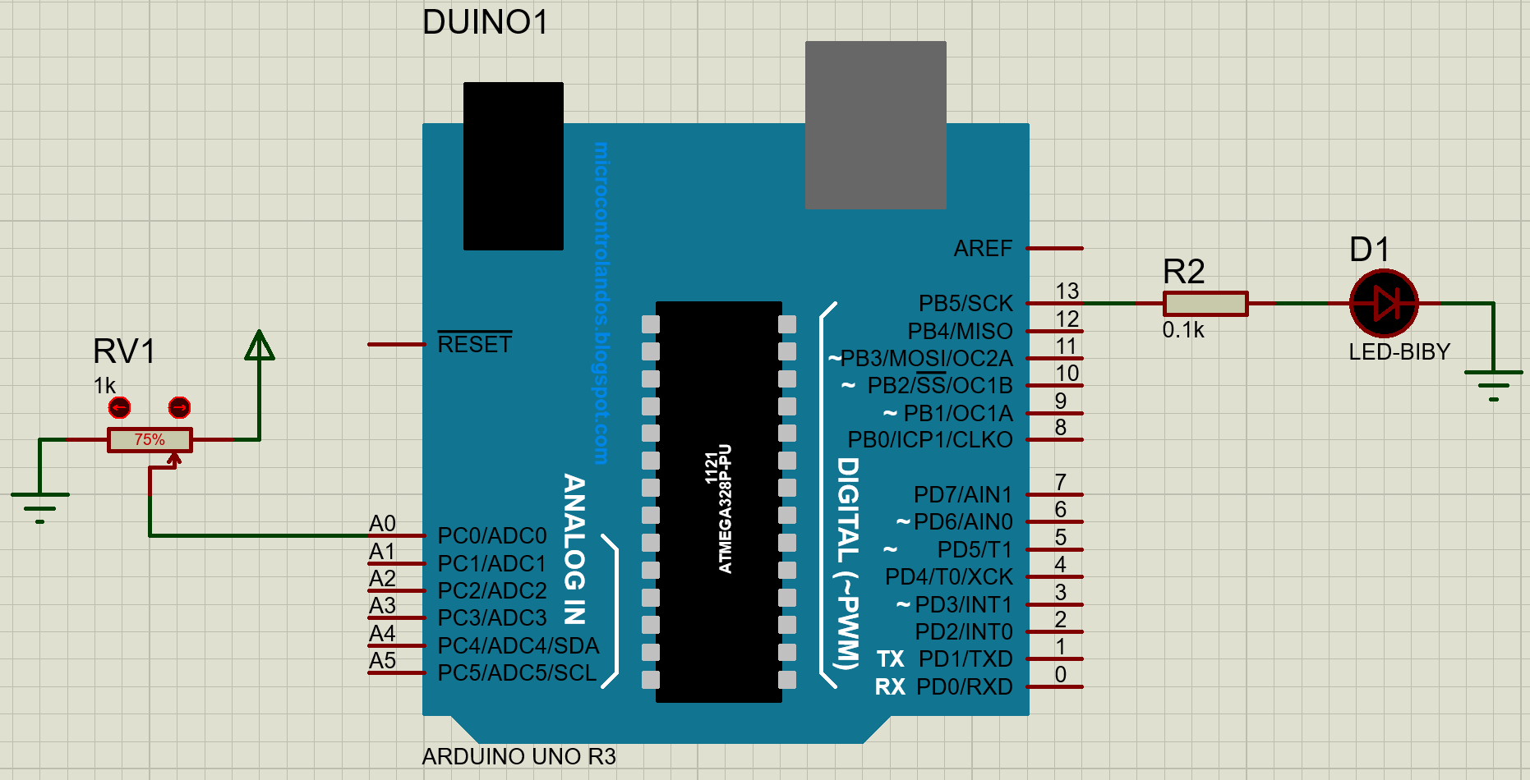
Proteus design

Slide 38
Changing the Range of Values
You want to change the range of a value, such as the value from analogRead obtained by connecting a potentiometer or other device that provides a variable voltage.
Example, suppose you want to display the position of a potentiometer knob as a percentage from 0 percent to 100 percent.
Map Function:
map(value, fromLow, fromHigh, toLow, toHigh)
Eg. map(val, 0, 1023, 0, 100)
a value of fromLow would get mapped to toLow, a value of fromHigh to toHigh, values in-between to values in-between.

Slide 39
Changing the Range of (Analog) Values:
/* Map sketch map the range of analog values from a pot to scale from 0 to 100 resulting in * an LED blink rate ranging from 0 to 100 milliseconds and Pot rotation percent * is written to the serial port */
const int potPin = 0; // select the input pin for the potentiometer
int ledPin = 13; // select the pin for the LED
void setup()
{
pinMode(ledPin, OUTPUT); // declare the ledPin as an OUTPUT
Serial.begin(9600);
}
void loop()
{
int val; // The value coming from the sensor
int percent; // The mapped value
val = analogRead(potPin); // read the voltage on the pot (val ranges from 0 to 1023)
percent = map(val,0,1023,0,100); // percent will range from 0 to 100.
digitalWrite(ledPin, HIGH); // turn the ledPin on
delay(percent); // On time given by percent value
digitalWrite(ledPin, LOW); // turn the ledPin off
delay(100 - percent); // Off time is 100 minus On time
Serial.println(percent); // show the % of pot rotation on Serial Monitor
}

Slide 40
Serial Communication

Slide 41

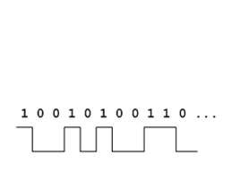
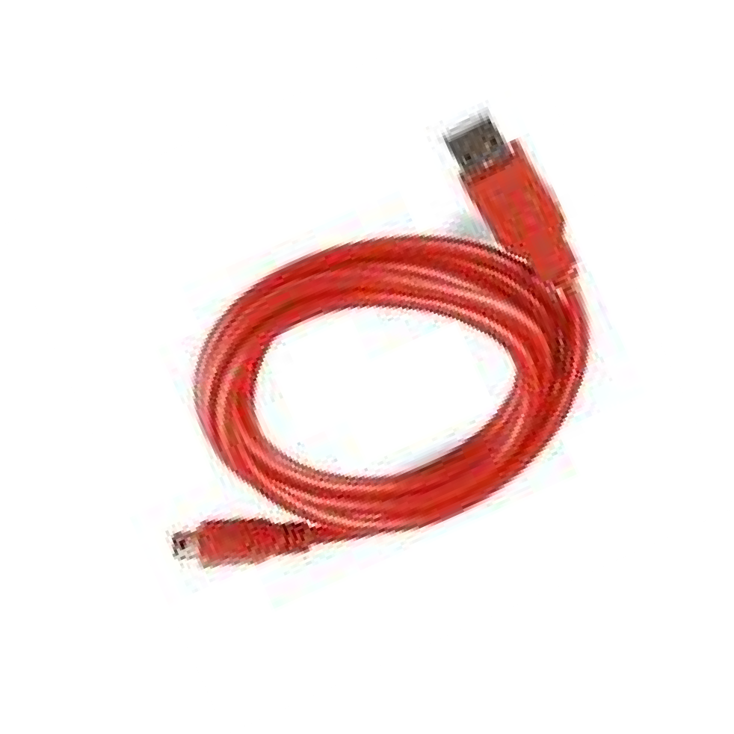
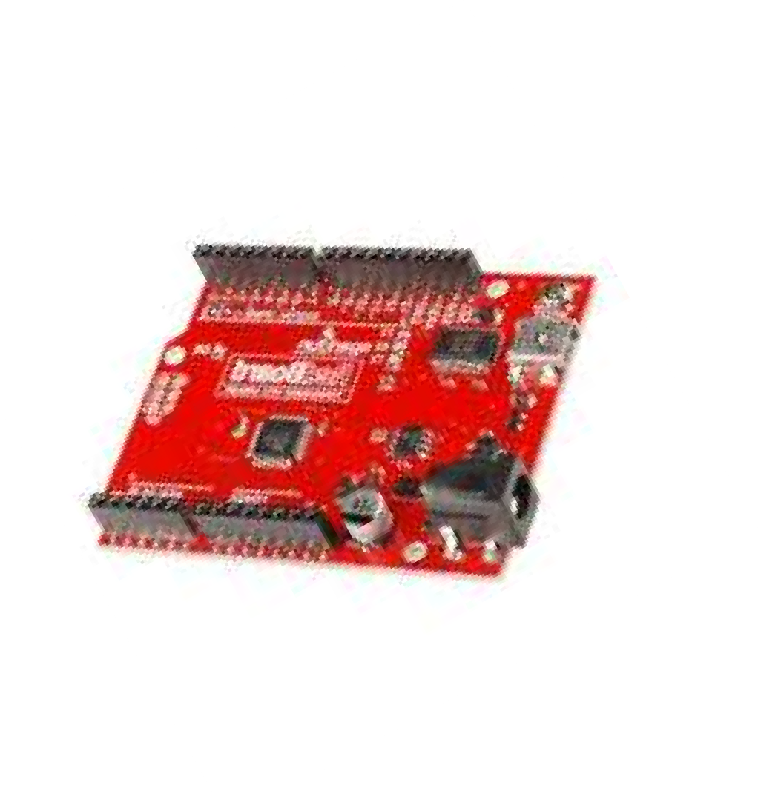
Using Serial Communication
Method used to transfer data between two devices.
Data passes between the computer and Arduino through the USB cable. Data is transmitted as zeros (‘0’) and ones (‘1’) sequentially.
Arduino dedicates: Digital I/O pin # 0 to receiving(R_{x}) and Digital I/O pin # 1 to transmit(T_{x}).

Slide 42
Using Serial Communication (Cont..)
Serial communications provide an easy and flexible way for your Arduino board to interact with your computer and other devices. This chapter explains how to send and receive information using this capability.
You can also send data from the Serial Monitor to Arduino by entering text in the text box to the left of the Send button.
Baud rate is selected using the drop-down box on the bottom right. You can use the drop down labeled “No line ending” to automatically send a carriage return or a combination of a carriage return and a line at the end of each message sent when clicking the Send button.
Your Arduino sketch can use the serial port to indirectly access (usually via a proxy program written in a language like Processing) all the resources (memory, screen, keyboard, mouse, network connectivity, etc.) that your computer has. Your computer can also use the serial link to interact with sensors or other devices connected to Arduino.

Slide 43
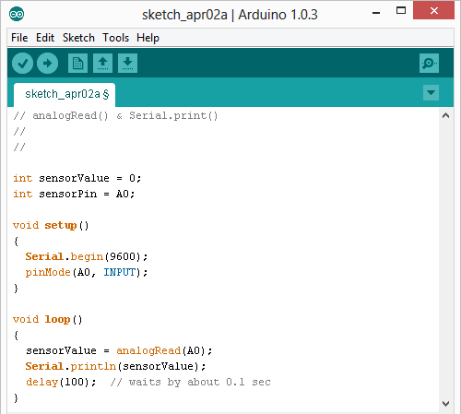
Serial Monitor & analogRead()
Initializes the Serial Communication
9600 baud data rate prints data to serial bus

Slide 44
Serial Monitor & analogRead() Cont..
Opens up a Serial Terminal Window

Slide 45
Sending Debug Information from Arduino to Your Computer
Problem: You want to send text and data to be displayed on your PC or Mac using the Arduino IDE or the serial terminal program of your choice.
Solution: This sketch prints sequential numbers on the Serial Monitor:
/* SerialOutput sketch Print numbers to the serial port */
void setup()
{
Serial.begin(9600); // send and receive at 9600 baud
}
int number = 0;
void loop()
{
Serial.print("The number is: ");
Serial.println(number); // print the number
delay(500); // delay half second between numbers
number++; // to the next number: number=number+1
}
Connect Arduino to your computer just as you did in Chapter 1 and upload this sketch.
Click the Serial Monitor icon in the IDE and you should see the output displayed as
follows:
The number is 0
The number is 1
The number is 2

Slide 46
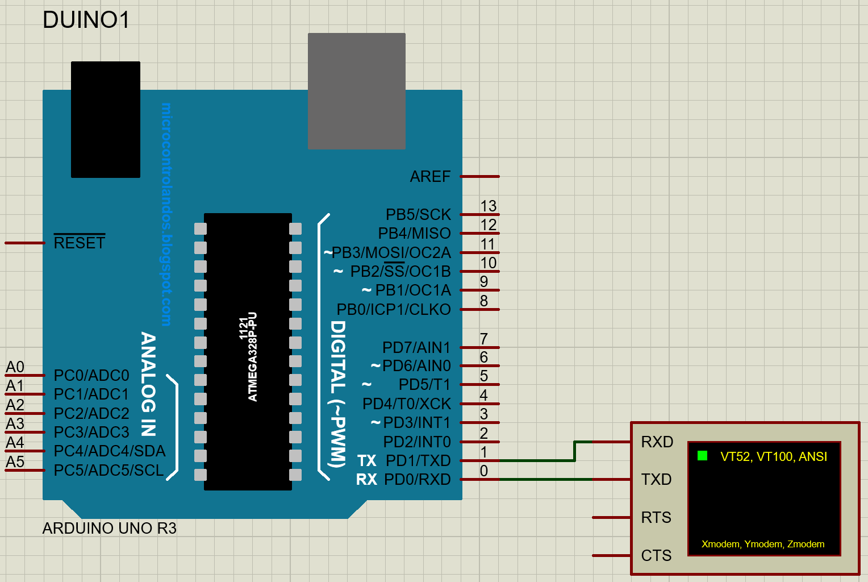
Proteus Design

Slide 47
Sending Debug Information from Arduino to Your Computer (Cont..)
Your sketch must call the Serial.begin() function before it can use serial input or output.
The function takes a single parameter: the desired communication speed.
You must use the same speed for the sending side and the receiving side, or you will see gobbledygook (or nothing at all) on the screen. This example and most of the others in this book use a speed of 9,600 baud (baud is a measure of the number of bits transmitted per second).
The 9,600 baud rate is approximately 1,000 characters per second. You can send at lower or higher rates (the range is 300 to 115,200), but make sure both sides use the same speed.

Slide 48
Sending Formatted Text and Numeric Data from Arduino
Problem: You want to send serial data from Arduino displayed as text, decimal values, hexadecimal, or binary.
Solution: You can print data to the serial port in many different formats; here is a sketch that demonstrates all the format options:
/*
* SerialFormatting
* Print values in various formats to the serial port
*/
char chrValue = 65; // these are the starting values to print
int intValue = 65;
float floatValue = 65.0;
void setup()
{
Serial.begin(9600);
}
void loop()
{
Serial.println("chrValue: ");
Serial.println(chrValue);
Serial.println(chrValue,BYTE);
Serial.println(chrValue,DEC);
Serial.println("intValue: ");
Serial.println(intValue);
Serial.println(intValue,BYTE);
Serial.println(intValue,DEC);
Serial.println(intValue,HEX);
Serial.println(intValue,OCT);
Serial.println(intValue,BIN);
Serial.println("floatValue: ");
Serial.println(floatValue);
delay(1000); // delay a second between numbers
chrValue++; // to the next value
intValue++;
}
The output (condensed here onto a few lines) is as follows:
chrValue: A A 65
intValue: 65 A 65 41 101 1000001
floatValue: 65.00

Slide 49
Receiving Serial Data in Arduino
Problem
You want to receive data on Arduino from a computer or another serial device; for
example, to have Arduino react to commands or data sent from your computer.
Solution
It’s easy to receive 8-bit values (chars and bytes), because the Serial functions use 8-
bit values. This sketch receives a digit (single characters 0 through 9) and blinks the
LED on pin 13 at a rate proportional to the received digit value:
/*
* SerialReceive sketch
* Blink the LED at a rate proportional to the received digit value
*/
const int ledPin = 13; // pin the LED is connected to
int blinkRate=0; // blink rate stored in this variable
void setup()
{
Serial.begin(9600); // Initialize serial port to send and receive at 9600 baud
pinMode(ledPin, OUTPUT); // set this pin as output
}

Slide 50
Receiving Serial Data in Arduino (Cont..)
void loop(){
if ( Serial.available() ) // Check to see if at least one character is available
{
char ch = Serial.read();
if(ch >= '0' && ch <= '9') // is this an ascii digit between 0 and 9?
{
blinkRate = (ch - '0'); // ASCII value converted to numeric value: 31-30=1
blinkRate = blinkRate * 100; // actual blinkrate is 100 mS times received digit:1*100=100
}
}
blink();
}
// blink the LED with the on and off times determined by blinkRate
void blink(){
digitalWrite(ledPin,HIGH);
delay(blinkRate); // delay depends on blinkrate value
digitalWrite(ledPin,LOW);
delay(blinkRate);
}

Slide 51
Our next topic of discussion is “Seven Segment Display (SSD) interfacing with Arduino”
Thank You
&
Queries?

