Slide 2
Bluetooth Technology

Slide 3
Introduction
Bluetooth is a wireless communication technology used for exchange of data over short distances.
It is found in many devices ranging from mobile phones and computers.
Bluetooth technology is a combination of both hardware and software.
It is intended to create a personal area networks (PAN) over a short range.
It operates in the unlicensed industrial, scientific and medical (ISM) band at 2.4 to 2.485 GHz.
It uses a radio technology called frequency hopping spread spectrum (FHSS).

Slide 4
FHSS
Frequency hopping spread spectrum (FHSS) is a method of transmitting radio signals by shifting carriers across numerous channels with pseudorandom sequence or PN Sequence, which is already known to the sender and receiver.
Frequency hopping spread spectrum is defined in the 2.4 GHz band and operates in around 79 frequencies ranging from 2.402 GHz to 2.480 GHz.
Every frequency is GFSK modulated with channel width of 1MHz and rates defined as 1 Mbps and 2 Mbps respectively.
Frequency hopping spread spectrum is a robust technology with only very little influence from reflections, noise and other environmental factors.

Slide 5
It is a packet-based protocol with a master-slave structure.
The range of Bluetooth depends upon the class of radio using.
Class 3 radios have range up to 1 meter or 3 feet.
Class 2 radios have range of 10 meters or 33 feet.
Class 1 radios have range of 100 meters or 300 feet.
The most commonly used radio is Class 2.

Slide 6
Advantages and Disadvantages
Advantages
The biggest advantage of using this technology is that there are no cables or wires required for the transfer of data over short ranges.
Bluetooth technology consumes less power when compared with other wireless communication technologies.
For example Bluetooth technology using Class 2 radio uses power of 2.5 mW.
As it is using frequency hopping spread spectrum radio technology there is less prone to interference of data if the other device also operates in the same frequency range.
Bluetooth doesn’t require clear line of sight between the synchronized devices.

Slide 7
Disadvantage
Since it uses the greater range of Radio Frequency (RF), it is much more open to interception and attack.
It can be used for short range communications only.
Although there are fewer disadvantages, Bluetooth still remains best for short wireless technology.

Slide 8
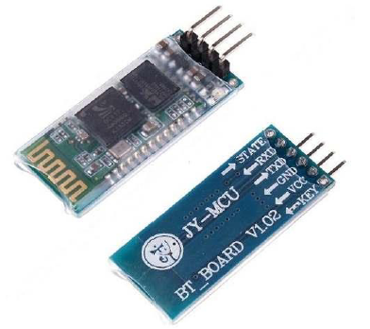
Introduction to HC-05 and HC-06 Modules
HC 05
HC-05 is a class 2 Bluetooth module with Serial Port Profile (SPP).
It can be configure either as master or salve.
It is a replacement for wired serial connection.
The module has two modes of operation, Command Mode where we can send AT commands to it and Data Mode where it transmits and receives data to another Bluetooth module.

Slide 9
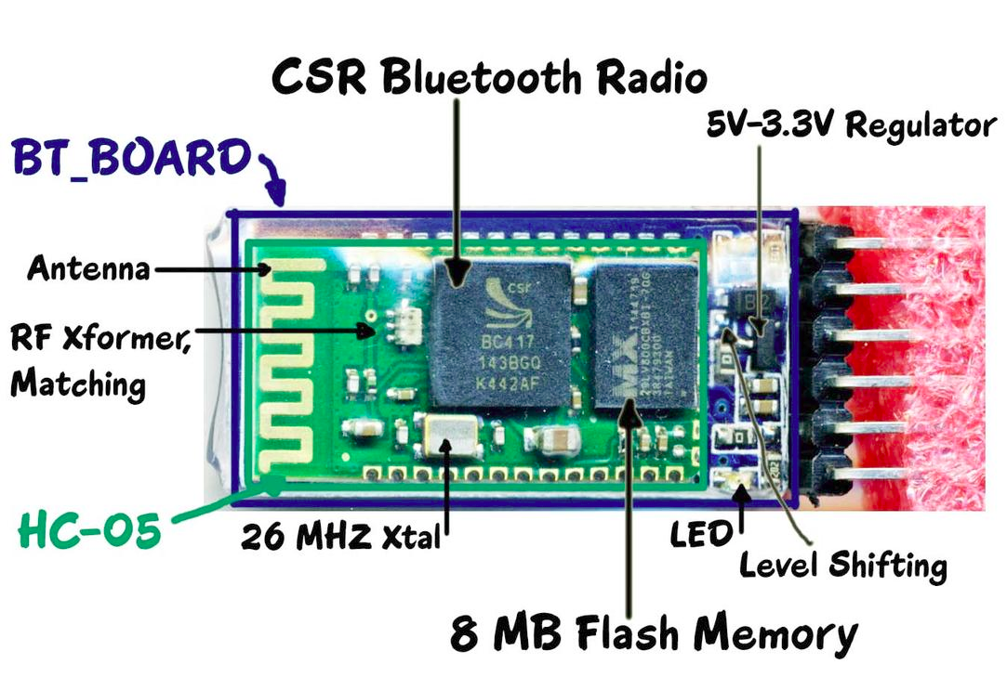

Slide 10
HC-05 Specification:
Bluetooth Protocol : Bluetooth Specification v2.0 + EDR (Enhanced Data Rate)
Frequency : 2.4 GHz ISM band
Profiles : Bluetooth Serial Port
Working Temperature : -20 to + 75 centigrade
Power of emitting : 3 dBm
The pins on the module are:
Vcc – Power supply for the module.
GND – Ground of the module.
TX – Transmitter of Bluetooth module.
RX – Receiver of the module.
Key – Used for the module to enter into AT command mode.

Slide 11
The default mode is DATA Mode, and this is the default configuration, that may work fine for many applications:
Baud Rate: 9600 bps, Data : 8 bits, Stop Bits: 1 bit, Parity : None, Handshake: None
Passkey: 1234
Device Name: HC-05

Slide 12
HC 06
HC-06 is a drop-in replacement for wired serial connection.
This can be used as serial port replacement to establish connection between PC and MCU (Microcontroller).
This is a Slave Mode only Bluetooth device.
HC-06 offers encrypted connection
This module can be configured for baud rates 1200 to 115200 bps

Slide 13
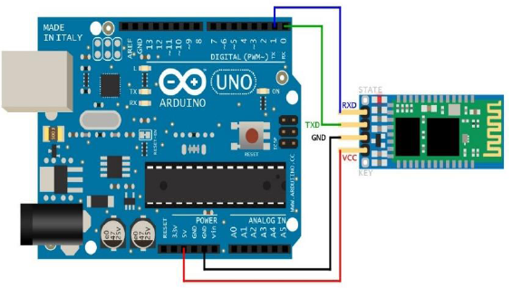
Hooking up with Arduino
Circuit connections for Data Mode of operation:
The connections are:
HC-05 Arduino
Vcc -----------> 5V
GND -----------> GND
TX -----------> RX
RX -----------> TX

Slide 14
void setup()
{
Serial.begin(9600);
pinMode(13,OUTPUT);
}
void loop()
{
if(Serial.available())
{
int ch=Serial.read();
if(ch==‘1')
{
digitalWrite(13,HIGH);
}
else if(ch==‘0')
{
digitalWrite(13,LOW);
}
}
}
Let’s control the LED on Arduino using a basic code to send command over Bluetooth.
The code is shown:

Slide 15
Configuring HC-05 with AT commands
HC-05 can be configured i.e. its name and password can be changed and many more using AT commands.
It can also be configured as either master or slave.
To set the HC-05 into AT command mode, the KEY pin of the module is made high i.e. it is connected to either 5V or 3.3V pin of Arduino and TX of Arduino is connected to TX of HC-05 and RX of HC-05 to RX of Arduino.

Slide 16
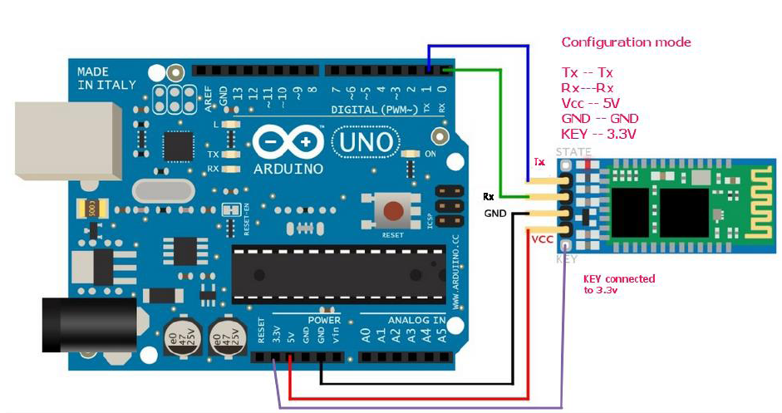
Circuit connections for Command Mode of operation:

Slide 17
To enter the AT commands open up the COM port of the Arduino to which the Bluetooth module is connected and set the baud rate to 38400.
After opening COM port if you enter command “AT” (without quotes) it should return “OK” thus it can be said that HC-05 entered into AT command mode.
Refer following link for detailed AT commands and its descriptions:
http://www.linotux.ch/arduino/HC-0305_serial_module_AT_commamd_set_201104_revised.pdf

Slide 18
Popular AT commands
AT
AT+RESET
AT+VERSION?
AT+ORGL
AT+ADDR?
AT+ ROLE?
AT+PSWD?
AT+UART?
AT+STATE?
AT+DISC
AT+NAME

Slide 19
AT : Ceck the connection.
AT+NAME : See default name
AT+ADDR : see default address
AT+VERSION : See version
AT+UART : See baudrate
AT+ROLE: See role of bt module(1=master/0=slave)
AT+RESET : Reset and exit AT mode
AT+ORGL : Restore factory settings
AT+PSWD: see default password

Slide 20
Alternate method to access AT command mode
Some bluetooth mode does not have KEY pin.
In such module, different approach is considered:
first connect the Bluetooth module to an Arduino (Nano, UNO or whatever) using the following connections…
HC-05 GND –> Gnd
HC-05 VCC –> +5V (initially disconnected) *
HC-05 TX –> D2 (any pin as required)
HC-05 RX –> D3 (any pin as required)
STATE (output) and EN (input) are not connected

Slide 21
Follow these steps:
Disconnect the power to the HC-05 module.
Load the sketch to the Arduino
Depress the small reset button on the HC-05 module and hold it down while you connect its Vcc pin to +5V.
The red LED on the module (that would otherwise be blinking quickly) will flash slowly indicating it is in AT mode.
Open a serial monitor in the Arduino IDE (or any other terminal software) and set its baud rate to 57600 and ensure that on the IDE serial terminal.
You should then see the prompt “Enter AT commands: “.
You can then type your AT commands into the terminal input line and have them control the HC-05.

Slide 22
Here are a few AT commands that I found useful:
To ensure the unit is responding, enter AT. The unit should respond OK
To return the HC-05 to its default settings, enter AT+ORGL
To see the version of your HC-05 enter AT+VERSION?
To change the name of the device to AJCLOCK, for example, enter AT+NAME=AJCLOCK
To change the default security code (1234) to 2332 enter AT+PSWD=2332
To check baud rate, enter AT+UART? (my unit reset to 38400)
To change baud rate to say, 115200, 1 stop bit, 0 parity, enter AT+UART=115200,1,0

Slide 23
#include <SoftwareSerial.h>
SoftwareSerial mySerial(10, 11); // RX | TX
void setup()
{
Serial.begin(9600);
Serial.println("Enter AT commands:");
mySerial.begin(38400); // HC-05 default speed in AT command mode
}
void loop()
{
if (mySerial.available())
Serial.write(mySerial.read());
if (Serial.available())
mySerial.write(Serial.read());
}

Slide 24
DHT11/DHT22

Slide 25
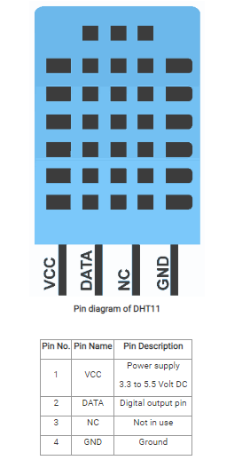
Experiment -DHT11 Sensor Interfacing with Arduino UNO

Slide 26
DHT11 sensor measures and provides humidity and temperature values serially over a single wire.
It can measure relative humidity in percentage (20 to 90% RH) and temperature in degree Celsius in the range of 0 to 50°C.
It has 4 pins; one of which is used for data communication in serial form.
DHT11 sensor uses resistive humidity measurement component, and NTC temperature measurement component.

Slide 27
DHT11 Specifications
Ultra-low cost
3 to 5V power and I/O
2.5mA max current use during conversion (while requesting data)
Good for 20-80% humidity readings with 5% accuracy
Good for 0-50°C temperature readings ±2°C accuracy

Slide 28
DHT22 Specifications
Low cost
3 to 5V power and I/O
2.5mA max current use during conversion (while requesting data)
Good for 0-100% humidity readings with 2-5% accuracy
Good for -40 to 125°C temperature readings ±0.5°C accuracy

Slide 29
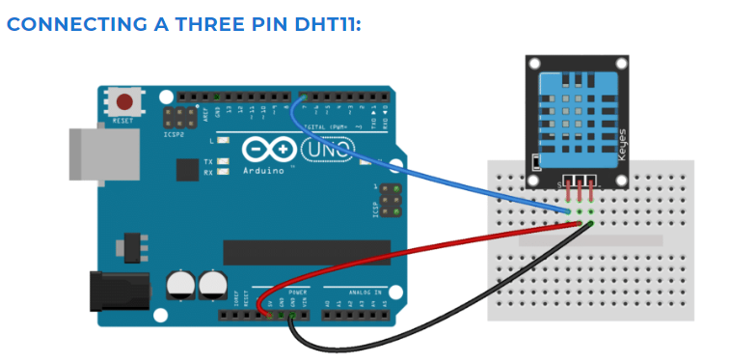

Slide 30
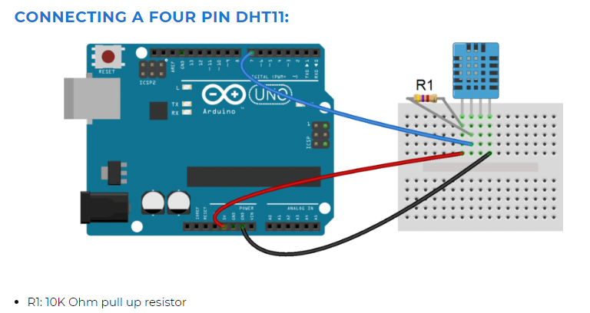

Slide 31
Before you can use the DHT11 on the Arduino, you’ll need to install the DHTLib library.
https://github.com/adafruit/DHT-sensor-library
It has all the functions needed to get the humidity and temperature readings from the sensor.
It’s easy to install, just download the DHTLib.zip and open up the Arduino IDE.
Then go to Sketch>Include Library>Add .ZIP Library and select the DHTLib.zip file.

Slide 32
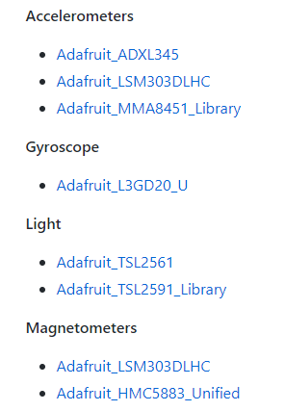
Remove Dependencies
https://github.com/adafruit/Adafruit_Sensor
The following drivers exmples are based on the Adafruit Unified Sensor Driver

Slide 33
#include <Adafruit_Sensor.h>
#include "DHT.h"
#define DHTPIN 2
#define DHTTYPE DHT11
DHT dht(DHTPIN, DHTTYPE);
void setup()
{
Serial.begin(9600);
Serial.println("DHT11 test!");
dht.begin();
}
void loop()
{
delay(2000);
float h = dht.readHumidity();
float t = dht.readTemperature();
Serial.print("Humidity: \t" );
Serial.print(h);
Serial.print(" %\n");
delay(500);
Serial.print("Temperature: \t");
Serial.print(t);
Serial.print(" *C \n");
}

Slide 34


Slide 35
Our next topic of discussion is “Sample Questions of ETP”
Thank You & Queries?

