Slide 1
Seven Segment Display (SSD) Interfacing with Arduino

Slide 2
Agenda
Introduction to Seven Segment Display
Types of 7-Segment Display
Common Cathode
Common Anode
Displaying Digital Digits
Driving 7-Segment Display
Interfacing 7-Segment Display to Arduino
Ports and Registers of ATmega328

Slide 3
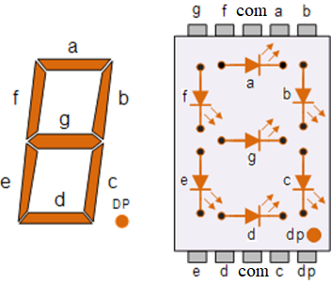
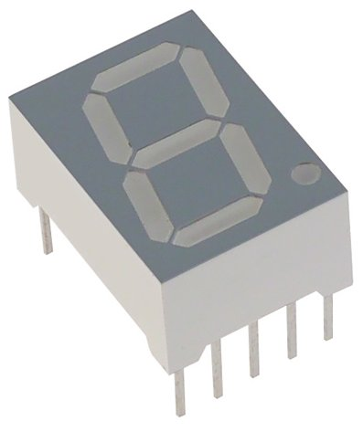
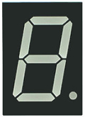
Introduction
The 7-segment display, also written as “seven segment display”, consists of seven LEDs arranged in a rectangular fashion as shown in the Figure.
Each of the seven LEDs is called a segment.

Slide 4
Introduction
Each one of the seven LEDs in the display is given a positional segment which is controlled by one pin.
These LED pins are labeled a, b, c, d, e, f, and g representing each individual LED.
The other LED pins are connected together and wired to form a common pin.
By forward biasing the appropriate pins of the LED segments, some segments will be light and others will be dark allowing the desired character pattern of the number to be generated on the display.
This allows us to display each of the ten decimal digits 0 through to 9 or hexa decimal numbers 0 through to F , on the same 7-segment display.
An additional 8th LED is sometimes used within the same package thus allowing the indication of a decimal point, (DP) when two or more 7-segment displays are connected together to display numbers greater than ten.

Slide 5
Types of 7-Segment Displays
The displays common pin is generally used to identify which type of 7-segment display it is.
As each LED has two connecting pins, one called the “Anode” and the other called the “Cathode”.
Therefore , there are two types of LED 7-segment display:
  1. Common Cathode (CC)
  2. Common Anode (CA)

Slide 6
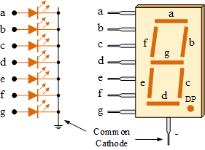
Common Cathode (CC)
In the common cathode display,
  all the cathode connections of the LED segments are joined together to logic “0″ or ground.
  The individual segments are illuminated by application of a “HIGH”, or logic “1″ signal via a current limiting resistor to forward bias the individual Anode terminals (a-g).

Slide 7
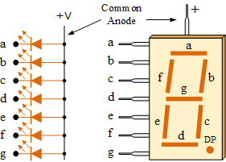
Common Anode (CA)
In the common anode display,
  all the anode connections of the LED segments are joined together to “HIGH”, or logic “1″.
  The individual segments are illuminated by application of a logic “0″ or ground signal via a suitable current limiting resistor to the Cathode of the particular segment (a-g).

Slide 8
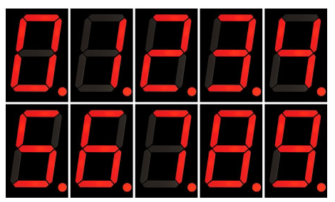
Displaying Digital Digits
Depending upon the decimal digit to be displayed, the particular set of LEDs is forward biased.
The various digits from 0 through 9 can be displayed using a 7-segment display as shown.

Slide 9
Displaying Digital Digits (Cont..)
Table 1: Display decimal digits using the 7-segments (Common Cathode)
Decimal Digit | G | F | E | D | C | B | A
0 | 0 | 1 | 1 | 1 | 1 | 1 | 1
1 | 0 | 0 | 0 | 0 | 1 | 1 | 0
2 | 1 | 0 | 1 | 1 | 0 | 1 | 1
3 | 1 | 0 | 0 | 1 | 1 | 1 | 1
4 | 1 | 1 | 0 | 0 | 1 | 1 | 0
5 | 1 | 1 | 0 | 1 | 1 | 0 | 1
6 | 1 | 1 | 1 | 1 | 1 | 0 | 1
7 | 0 | 0 | 0 | 0 | 1 | 1 | 1
8 | 1 | 1 | 1 | 1 | 1 | 1 | 1
9 | 1 | 1 | 0 | 1 | 1 | 1 | 1
A
F
G
B
E
D
C

Slide 10
Driving a 7-Segment Display
Although a 7-segment display can be thought of as a single display, it is still seven individual LEDs within a single package and as such these LEDs need protection from over-current.
LEDs produce light only when it is forward biased with the amount of light emitted being proportional to the forward current.
This means that an LEDs light intensity increases in an approximately linear manner with an increasing current.
So this forward current must be controlled and limited to a safe value by an external resistor to prevent damaging the LED segments.

Slide 11
Driving a 7-Segment Display (Cont..)
The forward voltage drop across a red LED segment is very low at about 2-to-2.2 volts.
To illuminate correctly, the LED segments should be connected to a voltage source in excess of this forward voltage value with a series resistance used to limit the forward current to a desirable value.
Typically for a standard red colored 7-segment display, each LED segment can draw about 15mA to illuminated correctly, so on a 5 volt digital logic circuit,
  the value of the current limiting resistor would be about 200Ω (5v – 2v)/15mA, or
  220Ω to the nearest higher preferred value.

Slide 12
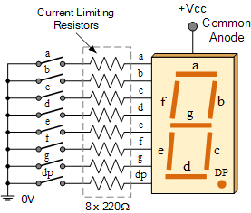
Driving a 7-Segment Display (Cont..)
So to understand how the segments of the display are connected to a 220Ω current limiting resistor consider the circuit below.

Slide 13
Driving a 7-Segment Display (Cont..)
In this example,
  the segments of a common anode display are illuminated using the switches.
  If switch a is closed, current will flow through the “a” segment of the LED to the current limiting resistor connected to pin a and to 0 volts, making the circuit.
  Then only segment a will be illuminated.
  If we want the decimal number “4″ to
  illuminate on the display, then switches
  b, c, f and g would be closed to light the
  corresponding LED segments.

Slide 14
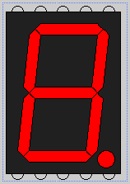
Interfacing 7-Segment Display to Arduino
The 7-Segment Display (shown in Figure below) can be interfaced to the Arduino Uno Board as shown in the next two slides.
Power supply of 5V DC is provided, either through Vcc1 pin or Vcc2 pin., with respect to a resister connected across.
Pin configuration of the 7-Segment
display with common anode
G F Vcc1 A B
CommonAnode(CA):
Com: Vcc=5V (through a Resistor)
A – G : Vcc=5V i.e. bibary ‘1’ => LEDs (A – G) will be OFF
A – G : Gnd=0V i.e. bibary ‘0’ => LEDs (A – G) will be ON
CommonCathode(CC):
Com: Gnd=0v (through a Resistor)
A – G : Vcc=5V i.e. bibary ‘1’ => LEDs (A – G) will be ON
A – G : Gnd=0V i.e. bibary ‘0’ => LEDs (A – G) will be OFF
E D Vcc2 C DP

Slide 15
Glowing the Led’s of 7-segment display
//Arduino sketch to test common anode 7 segment//
//Arduino pins from 6-12 are connected with a-g pins of common anode 7 segment display//
void setup()
{
// define pin modes
pinMode(6,OUTPUT); //pin6-a led
pinMode(7,OUTPUT); //pin7-b led
pinMode(8,OUTPUT); //pin8-c led
pinMode(9,OUTPUT); //pin9-d led
pinMode(10,OUTPUT); //pin10-e led
pinMode(11,OUTPUT); //pin11-f led
pinMode(12,OUTPUT); //pin12-g led
}
void loop()
{
// loop to turn leds of seven seg ON
for(int i=6;i<13;i++) //for_loop-1
{
digitalWrite(i, LOW); //digitalWrite(6-12,LOW);
delay(500); //500ms
}
//delay(1000); //1sec delay
// loop to turn leds of seven seg OFF
for(int i=6;i<13;i++) //for_loop-2
{
digitalWrite(i, HIGH); //digitalWrite(6-12,HIGH);
delay(500); //0.5 seconds
}
delay(1000); //1sec delay
}

Slide 16
Glowing the Led’s of 7-segment display(Cont..)
//Arduino sketch to test common anode 7 segment//
//Arduino pins from 0-7 are connected with a-g pins of common anode 7 segment display//
void setup()
{
// define pin modes
pinMode(0,OUTPUT); //pin0-a led
pinMode(1,OUTPUT); //pin1-b led
pinMode(2,OUTPUT); //pin2-c led
pinMode(3,OUTPUT); //pin3-d led
pinMode(4,OUTPUT); //pin4-e led
pinMode(5,OUTPUT); //pin5-f led
pinMode(6,OUTPUT); //pin6-g led
}
void loop()
{
// loop to turn leds of seven seg ON
for(int i=0;i<7;i++) //for_loop-1
{
digitalWrite(i, LOW); //digitalWrite(0-6,LOW);
//delay(500); //500ms
}
delay(1000); //1sec delay
// loop to turn leds of seven seg OFF
for(int i=0;i<7;i++) //for_loop-2
{
digitalWrite(i, HIGH); //digitalWrite(0-6,HIGH);
//delay(500); //500ms
}
delay(1000); //1sec delay
}

Slide 17
Display 0 and 1 on 7-segment display(Cont..)
//Arduino sketch to test common anode 7 segment//
//Arduino pins from 0-7 are connected with a-g pins of common anode 7 segment display//
void setup()
{
pinMode(0,OUTPUT); //pin0-a led
pinMode(1,OUTPUT); //pin1-b led
pinMode(2,OUTPUT); //pin2-c led
pinMode(3,OUTPUT); //pin3-d led
pinMode(4,OUTPUT); //pin4-e led
pinMode(5,OUTPUT); //pin5-f led
pinMode(6,OUTPUT); //pin6-g led
pinMode(7,OUTPUT); //pin7-dp led
}
void loop()
{
digitalWrite(0, LOW); // a-led ON
digitalWrite(1, LOW); // b-led ON
digitalWrite(2, LOW); // c-led ON
digitalWrite(3, LOW); // d-led ON
digitalWrite(4, LOW); // e-led ON
digitalWrite(5, LOW); // f-led ON
digitalWrite(6, HIGH); // g-led OFF
digitalWrite(7, LOW); // dp-led ON
delay(1000); //1sec delay
digitalWrite(0, HIGH); // a-led OFF
digitalWrite(1, LOW); // b-led ON
digitalWrite(2, LOW); // c-led ON
digitalWrite(3, HIGH); // d-led OFF
digitalWrite(4, HIGH); // e-led OFF
digitalWrite(5, HIGH); // f-led OFF
digitalWrite(6, HIGH); // g-led OFF
digitalWrite(7, LOW); // dp-led ON
delay(1000); //1sec delay
}

Slide 18
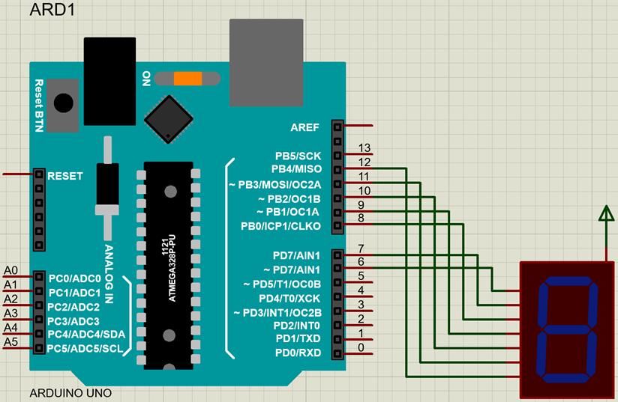
Proteus Design (CommonAnode)

Slide 19
Display 0 and 9 on 7-segment display(Cont..)
//Arduino sketch to test common anode 7 segment//
//Arduino pins from 0-7 are connected with a-g pins of common anode 7 segment display//
void setup()
{
DDRD=B11111111; //pins 7 to 0 (port D), configured/set as output port //or
//DDRD=0xFF; // in hex. notation //pins 7 to 0 (port D), configured/set as output port
}
void loop()
{
//PORTD= B01000000; // to display-0 on 7-seg. display //or
PORTD= 0x40; // in hex. notation
delay(1000);
PORTD= 0x79;
delay(1000);
PORTD= 0x24;
delay(1000);
PORTD= 0x30;
delay(1000);
PORTD= 0x19;
delay(1000);
PORTD= 0x12;
delay(1000);
PORTD= 0x02;
delay(1000);
PORTD= 0x78;
delay(1000);
PORTD= 0x00;
delay(1000);
PORTD= 0x10;
delay(1000);
}

Slide 20
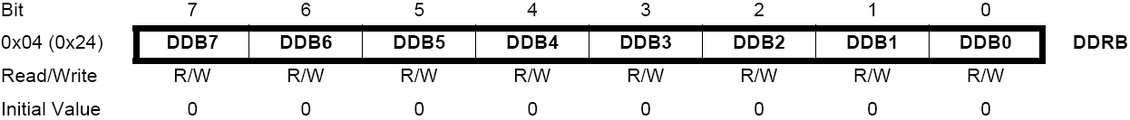
Registers of ATmega328
All the work of MCU happens through registers (special memory locations)
  Registers on the Atmega328 are 8-bits wide
The data direction register (DDRx) handles the data directions for pins in PORTx

Slide 21
Registers of ATmega328 (Cont..)
Data Direction Register:
If the bit is zero -> pin will be an input
  Making a bit to be zero == ‘clearing the bit’
If the bit is one -> pin will be an output
  Making a bit to be one == ‘setting the bit’
To change the data direction for a set of pins belonging to PORTx at the same time:
  Determine which bits need to be set and cleared in DDRx
  Store the binary number or its equivalent (in an alternate base, such as hex) into DDRx

Slide 22
Registers of ATmega328 (Cont..)
For digital IO, the important registers are:
  DDRx
    Data Direction bit in DDRx register: i/p or o/p (read/write)
  PORTx
    PORTx data register: controls wether the pin is HIGH or LOW (read/write)
  PINx
    PINx register: to read the status of INPUT pins (read only)

Slide 23
Ports of ATmega328
PORTD maps to Arduino digital pins 0 to 7
  DDRD - The Port D Data Direction Register - read/write
  PORTD - The Port D Data Register - read/write
  PIND - The Port D Input Pins Register - read only
PORTB maps to Arduino digital pins 8 to 13 The two high bits (6 & 7) map to
the crystal pins and are not usable
  DDRB - The Port B Data Direction Register - read/write
  PORTB - The Port B Data Register - read/write
  PINB - The Port B Input Pins Register - read only
PORTC maps to Arduino analog pins 0 to 5. Pins 6 & 7 are only accessible on
the Arduino Mini
  DDRC - The Port C Data Direction Register - read/write
  PORTC - The Port C Data Register - read/write
  PINC - The Port C Input Pins Register - read only

Slide 24
Displaying Hexa-Decimal Values: 0 to F
//int CommonAnode[]={0x40,0x79,0x24,0x30,0x19,0x12,0x02,0x78,0x00,0x10, 0x48,0x03,0x46,0x21,0x06,0x0E};
int CommonCathode[]={0x3F,0x06,0x5B,0x4F,0x66,0x6D,0x7D,0x07,0x7F,0x6F, 0x77,0x7C,0x39,0x5E,0x79,0x71};
void setup()
{
DDRD=B11111111; //pins 7 to 0, set port D as output i.e. pin-0 to A-led
//DDRD=0xFF; //pins 7 to 0 (port D), configured/set as output port
}
void loop()
{
for(int j=0;j<10;j++)
{
//PORTD= CommonAnode[j];
PORTD= CommonCathode[j]; // PORTD= CommonCathode[0]; => 0x3F -->’0’
delay(1000);
}
}

Slide 25
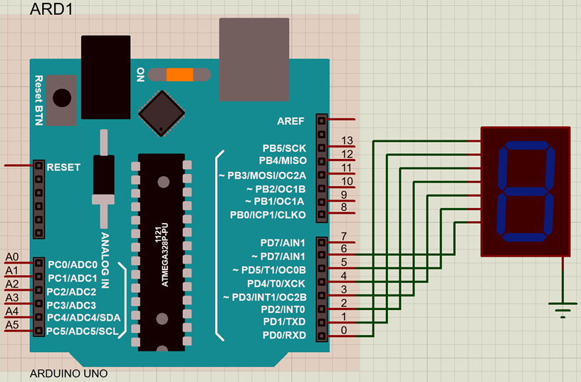
Proteus Design (CommonCathode)

Slide 26
LCD Interfacing with Arduino

Slide 27
Agenda
Introduction to LCD
LCD Interfacing (8-bit mode)
LCD Interfacing (4-bit mode)
LCD Library Commands
Still message display on LCD
Moving message display on LCD
Custom message display on LCD

Slide 28
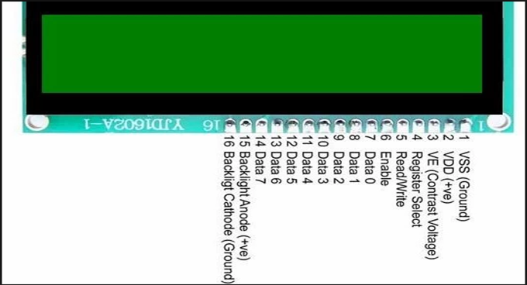
Introduction
Liquid crystal displays (LCDs) offer a convenient and inexpensive way to provide a user interface for a project.

Slide 29
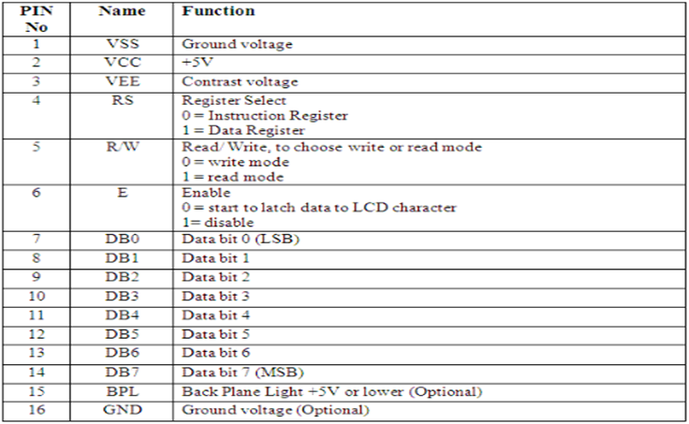

Introduction (Cont..)

Slide 30
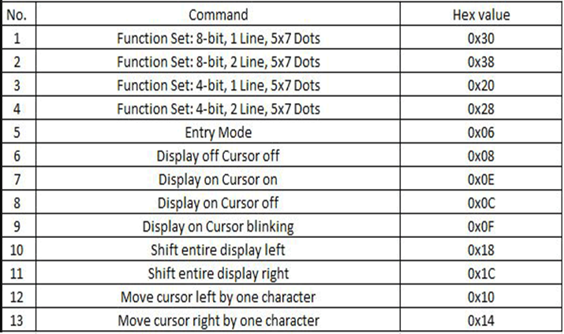
Introduction (Cont..)

Slide 31
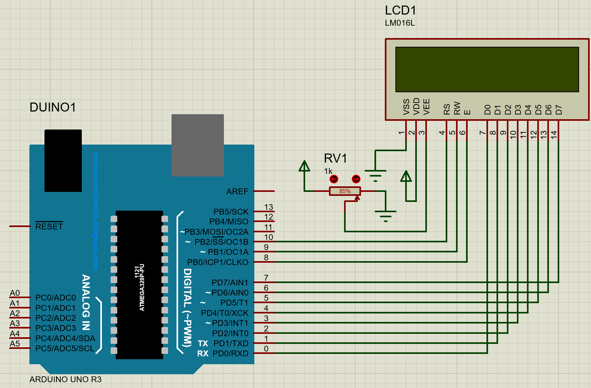
LCD Interfacing (8-bit mode)

Slide 32
int commandvalues[]={0x38,0x0E,0x0F,0x06,0x01,0xC5};
int displaymessage[]={‘L’,’O’,’V’,’E’,’L’,’Y’};
void command(unsigned int x)
{
PORTD=commandvalues[x];
digitalWrite(10,LOW);
digitalWrite(9,LOW);
digitalWrite(8,HIGH);
delay(250);
digitalWrite(8,LOW);
}
void lcddata1(unsigned int y)
{
PORTD=displaymessage[y];
digitalWrite(10,HIGH);
digitalWrite(9,LOW);
digitalWrite(8,HIGH);
delay(250);
digitalWrite(8,LOW);
}
void setup()
{
DDRD=B11111111; //set port D as output
pinMode(10,OUTPUT);
pinMode(9,OUTPUT);
pinMode(8,OUTPUT);
}
void loop()
{
for(int x=0;x<=5;x++)
{
command(x);
delay(250);
}
for(int y=0;y<=5;y++)
{
lcddata1(y);
delay(250);
}
}

Slide 33
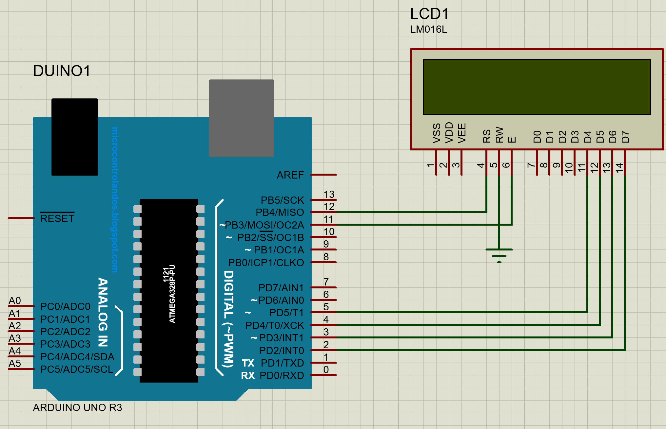
LCD Interfacing (4-bit mode)

Slide 34
LCD Interfacing (4-bit mode)
// Arduino sketch to display: **Hello Students** in Line-0 and **Study Well** in Line-1 of LCD
#include <LiquidCrystal.h> // include the library code
//constants for the number of rows and columns in the LCD
const int numRows = 2; //2 is a decimal number
const int numCols = 16; //16 is a decimal number
//initialize the library with the numbers of the interface pins
LiquidCrystal lcd(12, 11, 5, 4, 3, 2); // LiquidCrystal lcd(Rs,En,D4,D5,D6,D7)
//LiquidCrystal LPU(12, 11, 5, 4, 3, 2); // LiquidCrystal lcd(Rs,En,D4,D5,D6,D7)
void setup()
{
lcd.begin(numCols, numRows); // lcd.begin(16, 2); //set up the LCD's number of columns and rows
}
void loop()
{
lcd.setCursor(0, 0); // set the cursor to column 0, line 0
lcd.print(" **Hello Students** "); //(note: line 0 is the 1st row, since counting begins with 0)
lcd.setCursor(0, 1); // set the cursor to column 0, line 1
lcd.print(“ **Study Well** "); //(note: line 1 is the 2nd row, since counting begins with 0)
}

Slide 35
LCD Library Commands
begin()
Description
Initializes the interface to the LCD screen, and specifies the dimensions (width and height) of the display. begin()needs to be called before any other LCD library commands.
Syntax
lcd.begin(cols, rows)
Parameters
lcd: a variable of type LiquidCrystal
cols: the number of columns that the display has
rows: the number of rows that the display has

Slide 36
LCD Library Commands (Cont..)
setCursor()
Description
Position the LCD cursor; that is, set the location at which subsequent text written to the LCD will be displayed.
Syntax
lcd.setCursor(col, row)
Parameters
lcd: a variable of type LiquidCrystal
col: the column at which to position the cursor (with 0 being the first column)
row: the row at which to position the cursor (with 0 being the first row)

Slide 37
LCD Library Commands (Cont..)
write()
Description
Write a character to the LCD.
Syntax
lcd.write(data)
Parameters
lcd: a variable of type LiquidCrystal
data: the character to write to the display

Slide 38
LCD Library Commands (Cont..)
print()
Description
Prints text to the LCD.
Syntax
lcd.print(data)
Parameters
lcd: a variable of type LiquidCrystal
data: the data to print (char, byte, int, long, or string)
BASE (optional): the base in which to print numbers: BIN for binary (base 2), DEC for decimal (base 10), OCT for octal (base 8), HEX for hexadecimal (base 16).
lcd.print(data, BASE)

Slide 39
LCD Library Commands (Cont..)
cursor()
Description:
Display the LCD cursor an underscore (line) at the position to which the next character will be written.
Syntax
lcd.cursor()
noCursor()
Description
Hides the LCD cursor.
Syntax
lcd.noCursor()

Slide 40
LCD Library Commands (Cont..)
noDisplay()
Description
Turns off the LCD display, without losing the text currently shown on it.
Syntax
lcd.noDisplay()
display()
Description
Turns on the LCD display, after it's been turned off with noDisplay(). This will restore the text (and cursor) that was on the display.
Syntax
lcd.display()

Slide 41
LCD Library Commands (Cont..)
setCursor()
Description
Position the LCD cursor; that is, set the location at which subsequent text written to the LCD will be displayed.
Syntax
lcd.setCursor(col, row)
Parameters
lcd: a variable of type LiquidCrystal
col: the column at which to position the cursor (with 0 being the first column)
row: the row at which to position the cursor (with 0 being the first row)

Slide 42
LCD Library Commands (Cont..)
scrollDisplayLeft()
Description
Scrolls the contents of the display (text and cursor) one space to the left.
Syntax
lcd.scrollDisplayLeft()
scrollDisplayRight()
Description
Scrolls the contents of the display (text and cursor) one space to the right.
Syntax
lcd.scrollDisplayRight()

Slide 43
LCD Library Commands (Cont..)
leftToRight()
Description
Set the direction for text written to the LCD to left-to-right, the default. This means that subsequent characters written to the display will go from left to right, but does not affect previously-output text.
Syntax
lcd.leftToRight()
rightToLeft()
Description
Set the direction for text written to the LCD to right-to-left (the default is left-to-right). This means that subsequent characters written to the display will go from right to left, but does not affect previously-output text.
Syntax
lcd.rightToLeft()

Slide 44
LCD Library Commands (Cont..)
clear()
Description
Clears the LCD screen and positions the cursor in the upper-left corner.
Syntax
lcd.clear()
Parameters
lcd: a variable of type LiquidCrystal

Slide 45
Eg1. Still Message Display On LCD
#include <LiquidCrystal.h>
LiquidCrystal lcd(12, 11, 5, 4, 3, 2);
void setup()
{
lcd.begin(16, 2);
lcd.print("hello, world!");
}
void loop()
{
lcd.setCursor(0,1);
delay(250);
}

Slide 46
Eg2. Moving Message Display On LCD
#include <LiquidCrystal.h>
char message[]={"Lovely Professional University"};
LiquidCrystal lcd(12, 11, 5, 4, 3, 2);
void setup()
{
lcd.begin(16, 2);
}
void loop()
{
lcd.setCursor(0, 0);
for (int i = 0; i <= 30; i++)
{
lcd.print(message[i]);
delay(200);
if(i>16)
{
lcd.autoscroll();
}
}
}

Slide 47
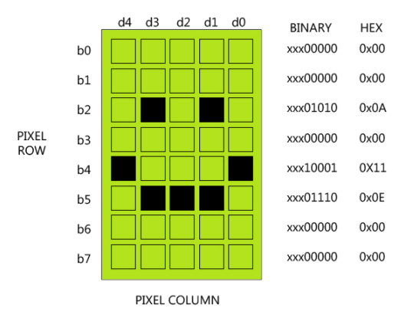
Eg3. LCD Custom Message Display
The LCD display has two lines of characters, 16 characters per line.
Each character is composed of matrix of pixels size 5x8.

Slide 48
Eg3. LCD Custom Message Display (Cont..)
DDRAM Memory (Display Data RAM)
Display data RAM (DDRAM) stores the information we send to LCD in ASCII Code.
For each letter there is a special code that represents it.
For example, the letter A in ASCII code, “receives” a value of 65 in base 10 or 01000001 in binary base, or 41 in the base 16.
The memory can contain up to 80 letters.

Slide 49
Eg3. LCD Custom Message Display (Cont..)
CGRAM Memory (Character Generator RAM)
Using CGRAM memory the user can “build” and store their own letters.
For 5x8 dots, eight character patterns can be written,
And for 5x10 dots, four character patterns can be written.
The difference between the memories is that the DDRAM memory displays on the screen the “ready” characters in accordance with the ASCII code, while the CGRAM memory displays the special characters that the user has created.

Slide 50
Eg3. LCD Custom Message Display (Cont..)
#include <LiquidCrystal.h>
LiquidCrystal lcd(12, 11, 5, 4, 3, 2);
byte customChar[8] = {
0b11111,
0b00100,
0b00100,
0b11100,
0b10111,
0b11101,
0b00101,
0b00101
};
byte customChar1[8] = {
0b11111,
0b00101,
0b01001,
0b10111,
0b10101,
0b10111,
0b01001,
0b00101
};

Slide 51
Eg3. LCD Custom Message Display (Cont..)
void setup()
{
// create new custom characters
lcd.createChar(0, customChar);
lcd.createChar(1, customChar1);
// set up number of columns and rows
lcd.begin(16, 2);
lcd.write((byte)0);
lcd.write(0);
}
void loop()
{
}

Slide 52
DC Motor Interfacing With Arduino

Slide 53
Agenda
Introduction & Working principle
H-Bridge Circuit → L293D/L298
L293D versus L298
L293D Motor Driver IC
DC Motor Connections to L293D
Arduino Connections to L293D
Controlling Speed & Direction of DC Motor
Arduino Sketch
Notes:
Power down mode
In power down mode the on chip oscillator is frozen which cuts of frequency to the CPU and the Peripheral functions such as timer, serial ports and interrupts.
This mode brings power consumption down to an absolute minimum and the contents of RAM and registers are saved and remain unchanged.

Slide 54
Introduction & Working PrincipleMotor
A motor is an electrical machine which converts electrical energy into mechanical energy.
"whenever a current carrying conductor is placed in a magnetic field, it experiences a mechanical force".
A DC motor (Direct Current motor) is the most common type of motor. DC motors normally have just two leads, one positive and one negative.
If you connect these two leads directly to a battery, the motor will rotate. If you switch the leads, the motor will rotate in the opposite direction.

Slide 55
H Bridge Circuit → L293D/L298
To control the direction of the spin of DC motor, without changing the way that the leads are connected, you can use a circuit called an H-Bridge.
An H bridge is an electronic circuit that can drive the motor in both directions.
H-bridges are used in many different applications, one of the most common being to control motors in robots.
It is called an H-bridge because it uses four transistors connected in such a way that the schematic diagram looks like an "H“.
You can use discrete transistors to make this circuit, but for this lecture, we will be using the L293D/L298 H-Bridge IC.

Slide 56
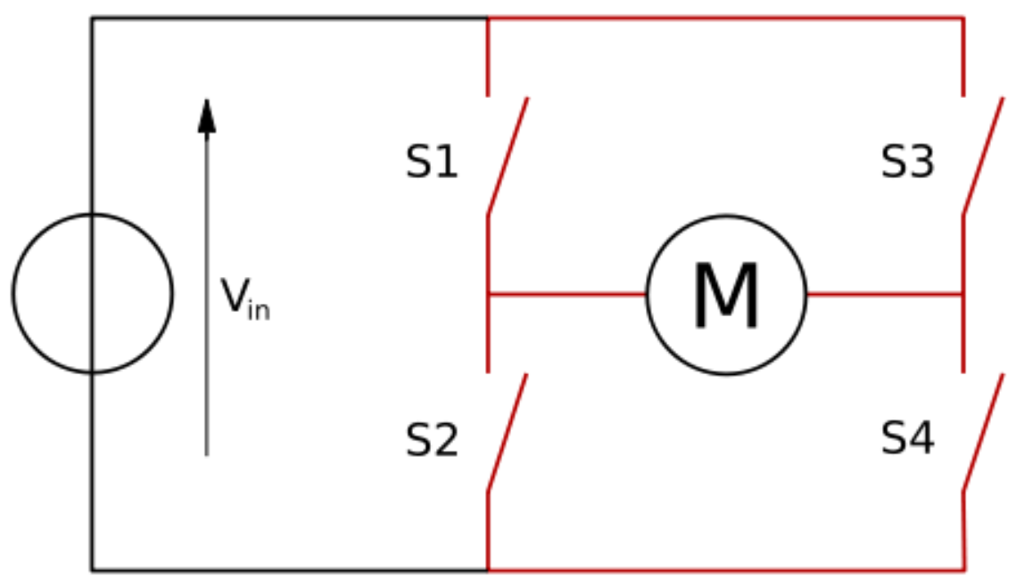

Slide 57
L293D versus L298
In L293D all four input- output lines are independent, while in L298, a half H driver cannot be used independently, full H driver has to be used.
Protective Diodes against back EMF are provided internally in L293D but must be provided externally in L298.
The L298 can control the speed and direction of DC motors & stepper motors and can control two motors simultaneously.
Its current rating is 2A for each motor. At these currents, however, you will need to use heat sinks.

Slide 58
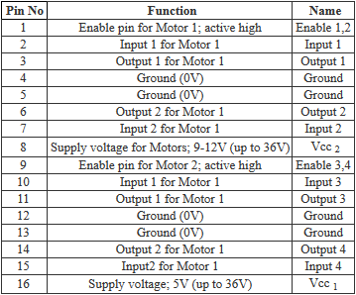
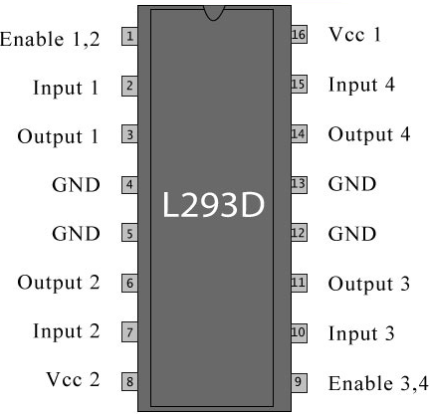
L293D Motor Driver IC

Slide 60
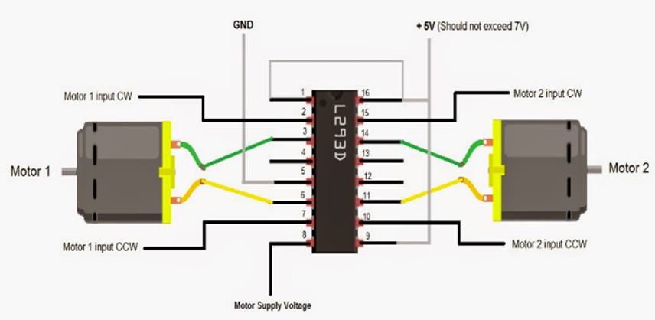
DC Motor connections to L293D

Slide 61
DC Motor Control With L239D Driver In Proteus
L293D IC is a dual H-bridge motor driver IC. One H-bridge is capable to drive a dc motor in bidirectional. L293D IC is a current attractive IC as the output from the sensor is not able to drive motors itself so L293D is used for this purpose. L293D is a 16 pin IC having two enables pins which should always be remain high to enable both the H-bridges

Slide 62
The Arduino microcontroller cannot give sufficient current to drive the DC motors, they need external supply to drive the motors, so driver IC play role in between motor and microcontroller. Motor driver take the input signals from microcontroller and generate corresponding output for motor.

Slide 63
Pin Description
L293D IC is a 16 pin IC the function of various pins is as follows-
EN1&EN2 (PIN 1&9) = Enable Pins
IN1,IN2,IN3,IN4 (PIN 2,7 & 10, 15) = Input Pins
OUT1,OUT2,OUT3,OUT4 (PIN 3,8 & 11, 14 ) = Output Pins
PIN 8 = VS (+5V)
PIN 16- VSS (voltage at which you want to drive your motor)
PIN 4,5 & 12,13 = Ground Pins

Slide 64
Component required:
Arduino Board
Proteus software
DC motor
L239D module
2 LEDS
Power Terminal(5v)
Ground Terminal

Slide 65
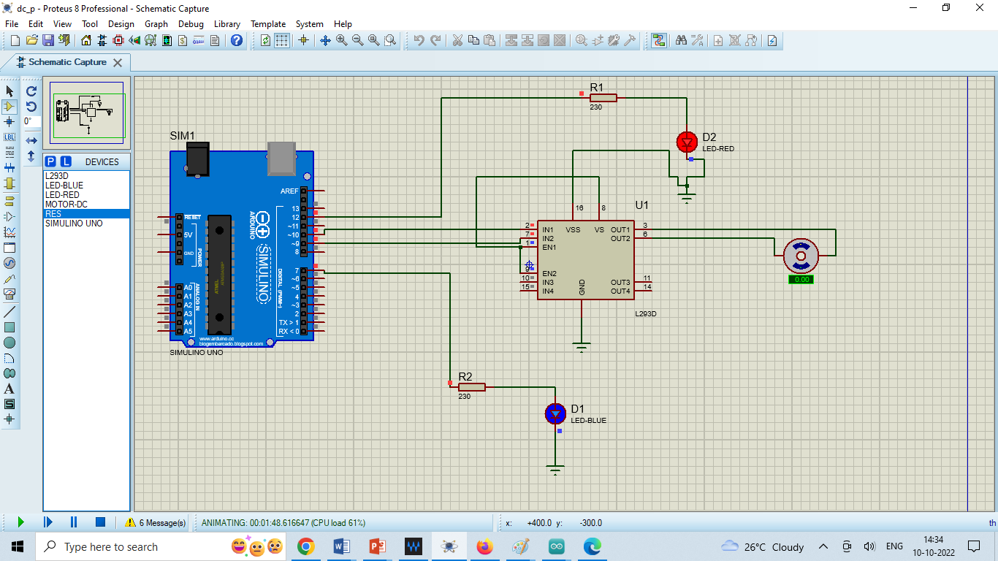

Slide 66
const int inputPin1 = 10; // Pin 10 of L293D IC
const int inputPin2 = 9; // Pin 9 of L293D IC
const int ledPin1 = 7; //pin 7 for led 1
const int ledPin2 = 12; // pin 12 for led 2
void setup()
{
pinMode(inputPin1, OUTPUT);//Define inputPin1 as output
pinMode(inputPin2, OUTPUT);//Define inputPin2 as output
pinMode(ledPin1, OUTPUT);//Define ledPin1 as output
pinMode(ledPin2, OUTPUT);//Define ledPin1 as output
}
void loop()
{ // motor ready to start//
digitalWrite(inputPin1, HIGH);
digitalWrite(inputPin2, HIGH);
digitalWrite(ledPin1, HIGH);
digitalWrite(ledPin2, HIGH);
delay(1000);
// motor in fordward direction//
digitalWrite(inputPin1, HIGH);
digitalWrite(inputPin2, LOW);
digitalWrite(ledPin2, HIGH);
delay(2000);
// taking some time interval//
digitalWrite(inputPin1, LOW);
digitalWrite(inputPin2, LOW);
digitalWrite(ledPin2, LOW);
digitalWrite(ledPin1, LOW);
delay(1000);
// motor in reverse direction//
digitalWrite(inputPin1, LOW);
digitalWrite(inputPin2, HIGH);
digitalWrite(ledPin1, HIGH);
digitalWrite(ledPin1, HIGH);
delay(2000);
}

Slide 67
The direction the motor will turn based on the digital values of IN1 and IN2.
If IN1 = Low(0) and IN2 = Low(0) means Motor in OFF condition.
If IN1 = High(1) and IN2 = Low(0) means Motor in Forward direction.
If IN1 = Low(0) and IN2 = High(1) means Motor in Backward(Reverse) direction.
If IN1 = High(1) and IN2 = High(1) means Motor in Motor in OFF condition.

Slide 68
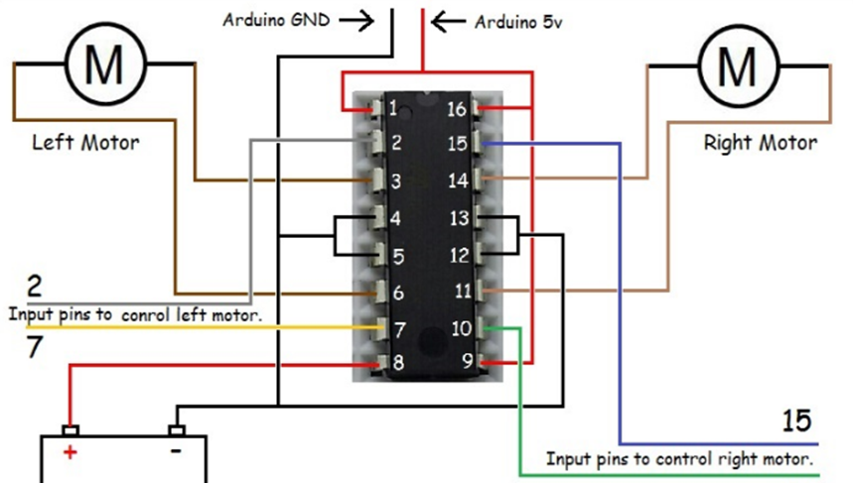
Arduino connections to L293D

Slide 69
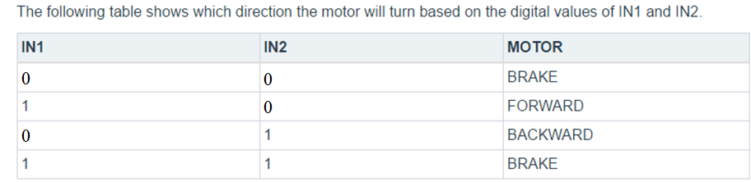
Controlling Speed & Direction of DC Motor
We will connect the Arduino to IN1 (pin 5), IN2 (pin 7), and Enable1 (pin 6) of the L293d IC. Pins 5 and 7 are digital.,
i.e. ON or OFF inputs, while pin 6 needs a pulse-width modulated (PWM) signal to control the motor speed.

Slide 70
Arduino Sketch
const int pwm = 3 ; //initializing pin 3 as pwm
const int in_1 = 8 ;
const int in_2 = 9 ; //For providing logic to L293d IC to choose the direction of the DC motor
void setup()
{
pinMode(pwm,OUTPUT) ; //we have to set PWM pin as output
pinMode(in_1,OUTPUT) ; //Logic pins are also set as output
pinMode(in_2,OUTPUT) ;
}

Slide 71
Arduino Sketch (Cont..)
void loop()
{
//For Clock wise motion , in_1 = High , in_2 = Low
digitalWrite(in_1,HIGH) ;
digitalWrite(in_2,LOW) ;
analogWrite(pwm,255) ; //2^8= 256 (0-255)
delay(3000) ; //3sec.
/*setting pwm of the motor to 255 we can change the speed of rotaion by chaning pwm input but we are only using arduino so we are using highest value to driver the motor */

Slide 72
Arduino Sketch (Cont..)
//For brake
digitalWrite(in_1,HIGH) ; digitalWrite(in_2,HIGH) ;
delay(1000); //1sec
//For Anti Clock-wise motion - IN_1 = LOW , IN_2 = HIGH
digitalWrite(in_1,LOW) ; digitalWrite(in_2,HIGH) ; delay(3000); //3sec
//For brake
digitalWrite(in_1,LOW) ; digitalWrite(in_2,LOW) ; delay(1000) ; //1sec
}

Slide 73
Servo Motor Interfacing With Arduino

Slide 74
Agenda
Introduction
Circuit connections
Arduino sketch
Notes:
Power down mode
In power down mode the on chip oscillator is frozen which cuts of frequency to the CPU and the Peripheral functions such as timer, serial ports and interrupts.
This mode brings power consumption down to an absolute minimum and the contents of RAM and registers are saved and remain unchanged.

Slide 75
Introduction
A servo motor allows a precise control of the angular position, velocity, and acceleration. It’s like you’re at the steering wheel of your car.
You control precisely the speed of the car and the direction.
These servos are essential parts if we need to control the position of objects, rotate sensors, move arms and legs, drive wheels and tracks, and more.

Slide 76
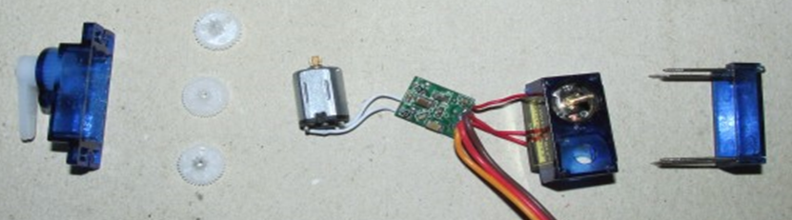
Introduction (Cont..)
Inside the micro servo, you will find the pieces like they are showing in the image below.
The top cover hosts the plastic gears while the middle cover hosts a DC motor, a controller, and the potentiometer.

Slide 77
Introduction (Cont..)
The servo motor has three leads, with one more than a DC motor.
Each lead has a color code.
So you have to connect the brown wire from the micro servo to the GND pin on the Arduino.
Connect the red wire from the servo to the +5V on the Arduino.
And finally, connect the orange wire from the SG90 servo to a digital pin (pin 9) on the Arduino.

Slide 78
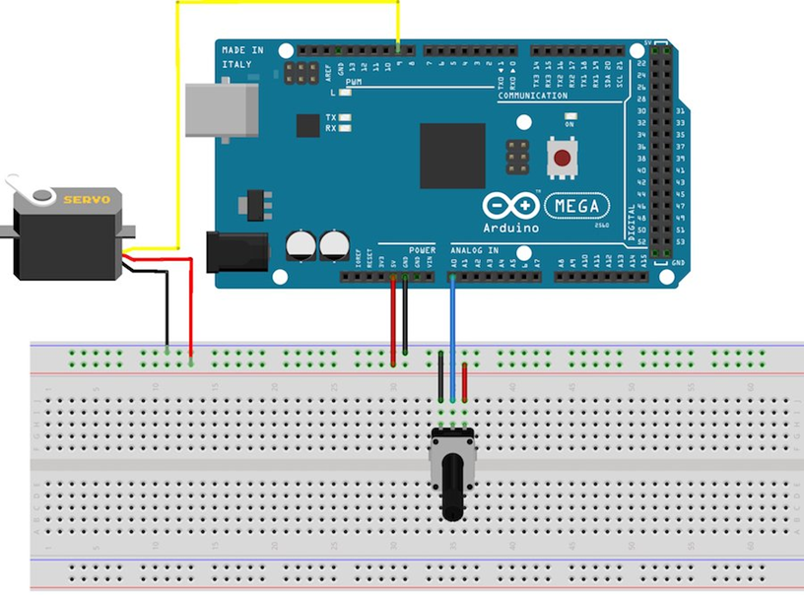
Circuit connections

Slide 79
Arduino Sketch
#include <Servo.h>
Servo myservo; // create servo object to control a servo
//Servo lpu;
int potpin = A0; // analog pin used to connect the potentiometer
int val; // variable to read the value from the analog pin
void setup()
{
myservo.attach(9); // attaches the servo on pin 9 to the servo object
}
void loop()
{
val = analogRead(potpin); // reads the value of the potentiometer (value between 0 and 1023)
val = map(val, 0, 1023, 0, 180); // scale it to use it with the servo (value between 0 and 180)
myservo.write(val);
// sets the servo position according to the scaled value
delay(100); //0.1 seconds delay
// waits for the servo to get there
}

Slide 81
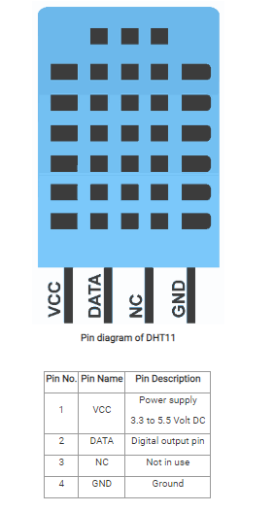
DHT11 Sensor Interfacing with Arduino UNO

Slide 82
DHT11 sensor measures and provides humidity and temperature values serially over a single wire.
It can measure relative humidity in percentage (20 to 90% RH) and temperature in degree Celsius in the range of 0 to 50°C.
It has 4 pins; one of which is used for data communication in serial form.
DHT11 sensor uses resistive humidity measurement component, and NTC temperature measurement component.

Slide 83
DHT11 Specifications
Ultra-low cost
3 to 5V power and I/O
2.5mA max current use during conversion (while requesting data)
Good for 20-80% humidity readings with 5% accuracy
Good for 0-50°C temperature readings ±2°C accuracy

Slide 84
DHT22 Specifications
Low cost
3 to 5V power and I/O
2.5mA max current use during conversion (while requesting data)
Good for 0-100% humidity readings with 2-5% accuracy
Good for -40 to 125°C temperature readings ±0.5°C accuracy

Slide 85
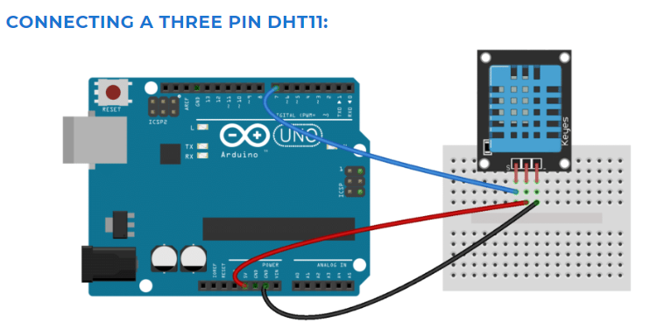

Slide 86
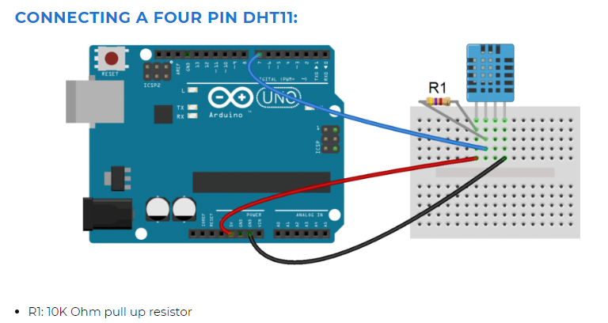

Slide 87
Before you can use the DHT11 on the Arduino, you’ll need to install the DHTLib library.
https://github.com/adafruit/DHT-sensor-library
It has all the functions needed to get the humidity and temperature readings from the sensor.
It’s easy to install, just download the DHTLib.zip and open up the Arduino IDE.
Then go to Sketch>Include Library>Add .ZIP Library and select the DHTLib.zip file.

Slide 88
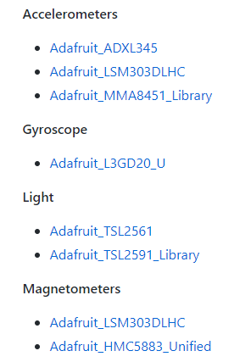
Remove Dependencies
https://github.com/adafruit/Adafruit_Sensor
The following drivers exmples are based on the Adafruit Unified Sensor Driver

Slide 89
#include <Adafruit_Sensor.h>
#include "DHT.h"
#define DHTPIN 2
#define DHTTYPE DHT11
DHT dht(DHTPIN, DHTTYPE);
void setup()
{
Serial.begin(9600);
Serial.println("DHT11 test!");
dht.begin();
}
void loop()
{
delay(2000);
float h = dht.readHumidity();
float t = dht.readTemperature();
Serial.print("Humidity: \t" );
Serial.print(h);
Serial.print(" %\n");
delay(500);
Serial.print("Temperature: \t");
Serial.print(t);
Serial.print(" *C \n");
}

Slide 91
Our next topic of discussion is “Sample Questions of ETP”
Thank You & Queries?

