Slide 1
Matplotlib

Slide 2
Pyplot
Most of the Matplotlib utilities lies under the pyplot submodule, and are usually imported under the plt alias:
import matplotlib.pyplot as plt

Slide 3
Draw a line in a diagram from position (0,0) to position (6,250):
import matplotlib.pyplot as plt import numpy as np xpoints = np.array([0, 6]) ypoints = np.array([0, 250]) plt.plot(xpoints, ypoints) plt.show()

Slide 4
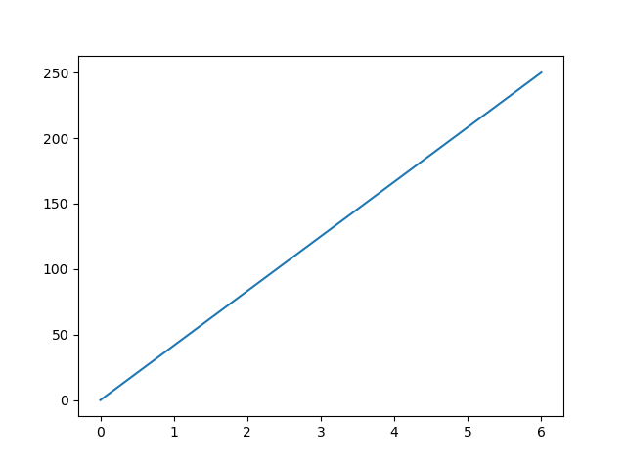

Slide 5
Plotting x and y points
The plot() function is used to draw points (markers) in a diagram.
By default, the plot() function draws a line from point to point.
The function takes parameters for specifying points in the diagram.
Parameter 1 is an array containing the points on the x-axis.
Parameter 2 is an array containing the points on the y-axis.
If we need to plot a line from (1, 3) to (8, 10), we have to pass two arrays [1, 8] and [3, 10] to the plot function.

Slide 6

Example Draw a line in a diagram from position (1, 3) to position (8, 10):
import matplotlib.pyplot as plt import numpy as np xpoints = np.array([1, 8]) ypoints = np.array([3, 10]) plt.plot(xpoints, ypoints) plt.show()

Slide 7
Plotting Without Line
To plot only the markers, you can use shortcut string notation parameter 'o', which means 'rings'.

Slide 8
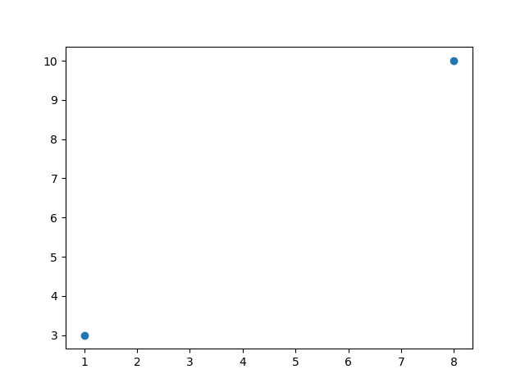
Example Draw two points in the diagram, one at position (1, 3) and one in position (8, 10):
import matplotlib.pyplot as plt import numpy as np xpoints = np.array([1, 8]) ypoints = np.array([3, 10]) plt.plot(xpoints, ypoints, 'o') plt.show()

Slide 9
Multiple Points
You can plot as many points as you like, just make sure you have the same number of points in both axis.

Slide 10
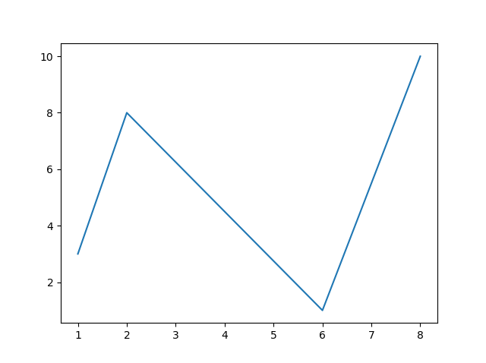
Example Draw a line in a diagram from position (1, 3) to (2, 8) then to (6, 1) and finally to position (8, 10):
import matplotlib.pyplot as plt import numpy as np xpoints = np.array([1, 2, 6, 8]) ypoints = np.array([3, 8, 1, 10]) plt.plot(xpoints, ypoints) plt.show()

Slide 11
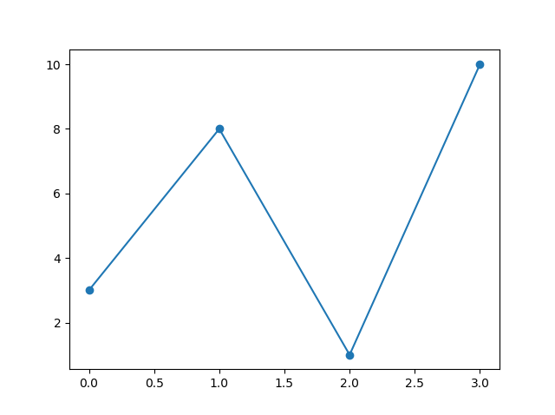
Matplotlib Markers
You can use the keyword argument marker to emphasize each point with a specified marker:
import matplotlib.pyplot as plt import numpy as np ypoints = np.array([3, 8, 1, 10]) plt.plot(ypoints, marker = 'o') plt.show()

Slide 12
Marker Reference
Marker | Description
'o' | Circle
'*' | Star
'.' | Point
',' | Pixel
'x' | X
'X' | X (filled)
'+' | Plus
'P' | Plus (filled)
's' | Square
'D' | Diamond
'd' | Diamond (thin)
'p' | Pentagon
'H' | Hexagon
'h' | Hexagon
'v' | Triangle Down
'^' | Triangle Up
'<' | Triangle Left
'>' | Triangle Right
'1' | Tri Down
'2' | Tri Up
'3' | Tri Left
'4' | Tri Right
'|' | Vline
'_' | Hline

Slide 13
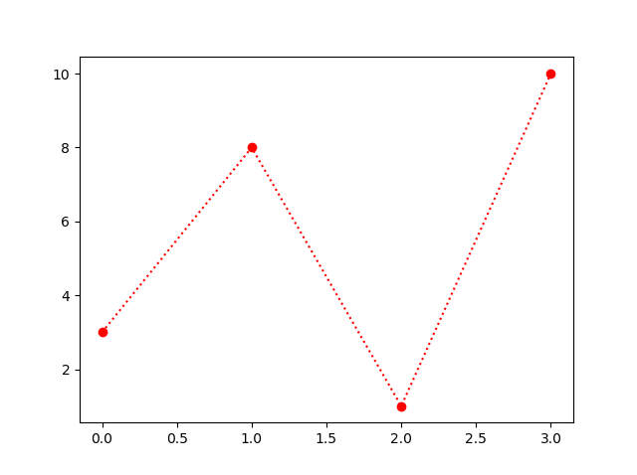
You can use also use the shortcut string notation parameter to specify the marker. This parameter is also called fmt, and is written with this syntax: marker |line | color
Mark each point with a circle:
import matplotlib.pyplot as plt import numpy as np ypoints = np.array([3, 8, 1, 10]) plt.plot(ypoints, 'o:r') plt.show()

Slide 14
Line Reference
Line Syntax | Description
'-' | Solid line
':' | Dotted line
'--' | Dashed line
'-.' | Dashed/dotted line

Slide 15
Color Reference
Color Syntax | Description
'r' | Red
'g' | Green
'b' | Blue
'c' | Cyan
'm' | Magenta
'y' | Yellow
'k' | Black
'w' | White

Slide 16
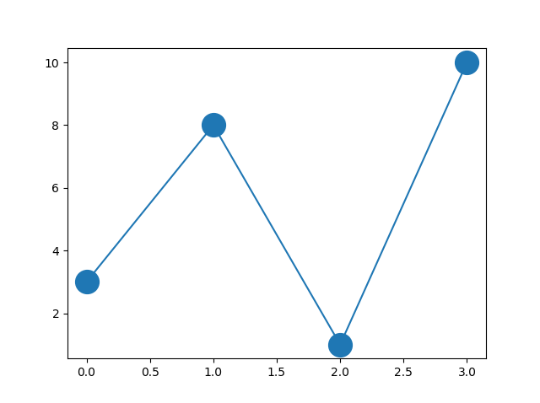
Marker Size
You can use the keyword argument markersize or the shorter version, ms to set the size of the markers:
Set the size of the markers to 20:
import matplotlib.pyplot as plt
import numpy as np
ypoints = np.array([3, 8, 1, 10])
plt.plot(ypoints, marker = 'o', ms = 20)
plt.show()

Slide 17
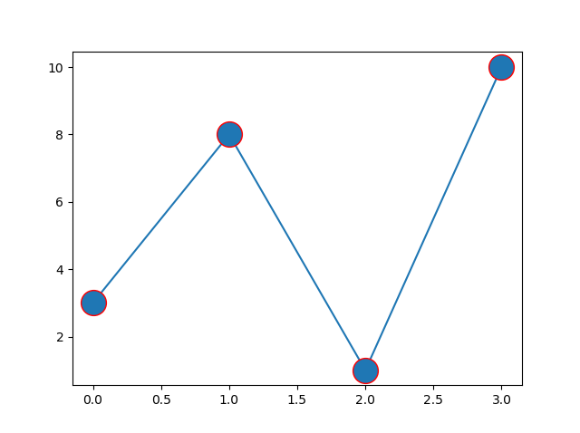
Marker Color
You can use the keyword argument markeredgecolor or the shorter mec to set the color of the edge of the markers:
Set the EDGE color to red:
import matplotlib.pyplot as plt
import numpy as np
ypoints = np.array([3, 8, 1, 10])
plt.plot(ypoints, marker = 'o', ms = 20, mec = 'r')
plt.show()

Slide 18
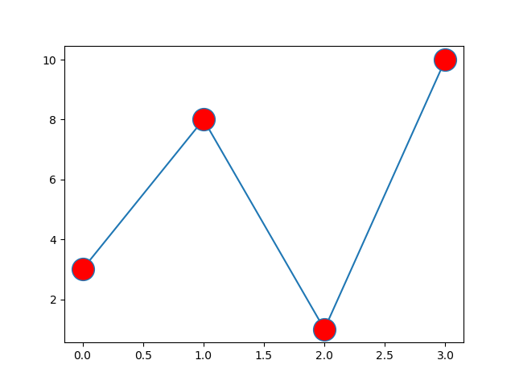
Face Color
You can use the keyword argument markerfacecolor or the shorter mfc to set the color inside the edge of the markers:
Set the FACE color to red:
import matplotlib.pyplot as plt
import numpy as np
ypoints = np.array([3, 8, 1, 10])
plt.plot(ypoints, marker = 'o', ms = 20, mfc = 'r')
plt.show()

Slide 19
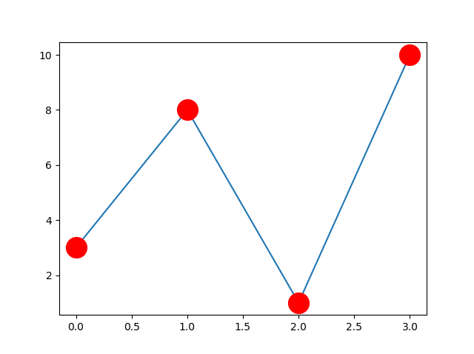
Use both the mec and mfc arguments to color of the entire marker:
Set the color of both the edge and the face to red:
import matplotlib.pyplot as plt
import numpy as np
ypoints = np.array([3, 8, 1, 10])
plt.plot(ypoints, marker = 'o', ms = 20, mec = 'r', mfc = 'r')
plt.show()

Slide 20

Matplotlib Markers
You can use the keyword argument marker to emphasize each point with a specified marker:
import matplotlib.pyplot as plt
import numpy as np
ypoints = np.array([3, 8, 1, 10])
plt.plot(ypoints, marker = 'o')
plt.show()

Slide 21
Marker Reference
Marker Description
'o' Circle
'*' Star
'.' Point
',' Pixel
'x' X
'X' X (filled)
'+' Plus
'P' Plus (filled)
's' Square
'D' Diamond
'd' Diamond (thin)
'p' Pentagon
'H' Hexagon
'h' Hexagon
'v' Triangle Down
'^' Triangle Up
'<' Triangle Left
'>' Triangle Right
'1' Tri Down
'2' Tri Up
'3' Tri Left
'4' Tri Right
'|' Vline
'_' Hline

Slide 22
Format Strings fmt
You can use also use the shortcut string notation parameter to specify the marker.
This parameter is also called fmt, and is written with this syntax:
marker|line|color

Slide 23
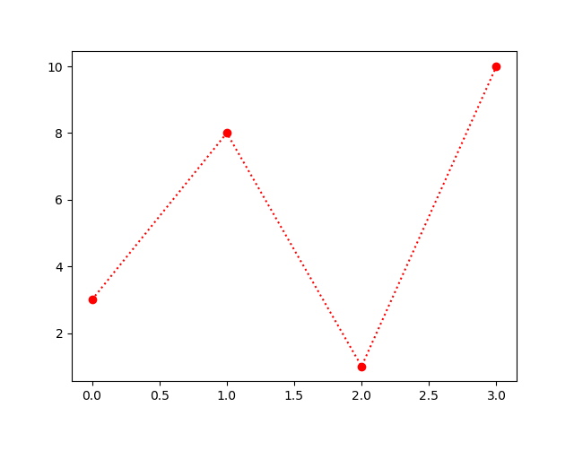
Example
Mark each point with a circle:
import matplotlib.pyplot as plt
import numpy as np
ypoints = np.array([3, 8, 1, 10])
plt.plot(ypoints, 'o:r')
plt.show()

Slide 24
Line Reference
Line Syntax Description
'-’ Solid line
':’ Dotted line
'--’ Dashed line
'-.’ Dashed/dotted line

Slide 25
Color Reference
Color Syntax Description
'r' Red
'g' Green
'b' Blue
'c' Cyan
'm' Magenta
'y' Yellow
'k' Black
'w' White

Slide 26
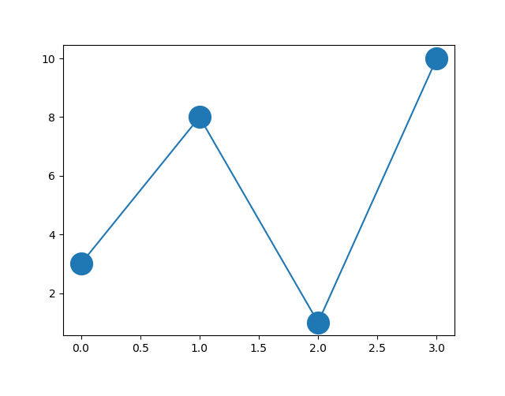
Marker Size
You can use the keyword argument markersize or the shorter version, ms to set the size of the markers:
Set the size of the markers to 20:
import matplotlib.pyplot as plt
import numpy as np
ypoints = np.array([3, 8, 1, 10])
plt.plot(ypoints, marker = 'o', ms = 20)
plt.show()

Slide 27
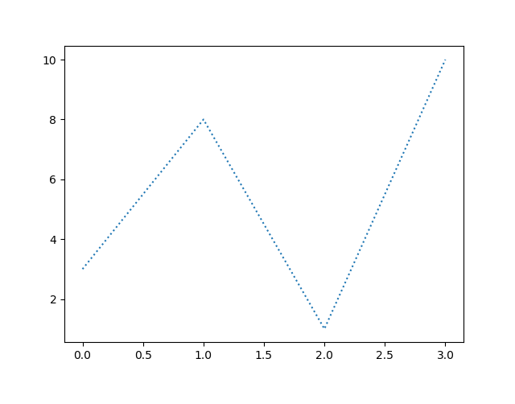
Matplotlib Line
Linestyle
You can use the keyword argument linestyle, or shorter ls, to change the style of the plotted line:
Example
Use a dotted line:
import matplotlib.pyplot as plt import numpy as np ypoints = np.array([3, 8, 1, 10]) plt.plot(ypoints, linestyle = 'dotted') plt.show()

Slide 28
Line Styles
Style Or
'solid’ (default) '-'
'dotted’ ':'
'dashed’ '--'
'dashdot’ '-.'
'None' '' or ' '

Slide 29
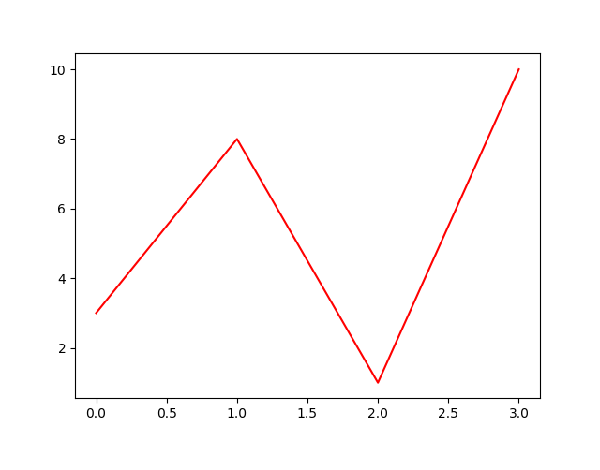
Line Color
You can use the keyword argument color or the shorter c to set the color of the line:
Example
Set the line color to red:
import matplotlib.pyplot as plt
import numpy as np
ypoints = np.array([3, 8, 1, 10])
plt.plot(ypoints, color = 'r')
plt.show()

Slide 30
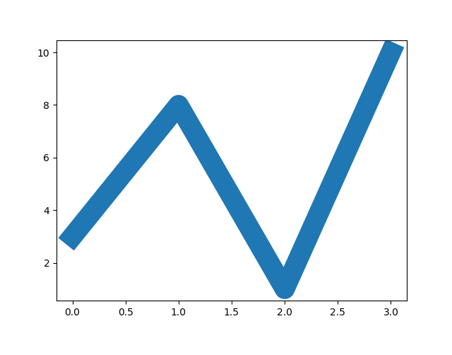
Line Width
You can use the keyword argument linewidth or the shorter lw to change the width of the line.
The value is a floating number, in points:
Example
Plot with a 20.5pt wide line:
import matplotlib.pyplot as plt
import numpy as np
ypoints = np.array([3, 8, 1, 10])
plt.plot(ypoints, linewidth = '20.5')
plt.show()

Slide 31
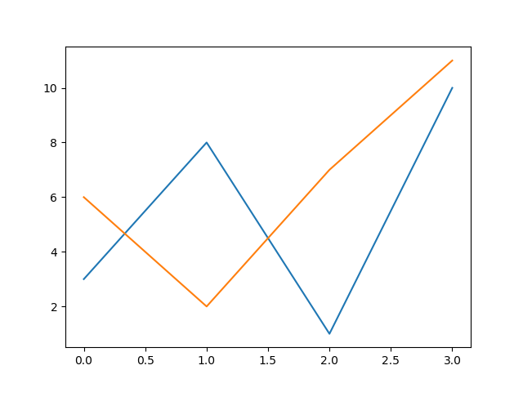
Multiple Lines
You can plot as many lines as you like by simply adding more plt.plot() functions:
Draw two lines by specifying a plt.plot() function for each line:
import matplotlib.pyplot as plt
import numpy as np
y1 = np.array([3, 8, 1, 10])
y2 = np.array([6, 2, 7, 11])
plt.plot(y1)
plt.plot(y2)
plt.show()

Slide 32
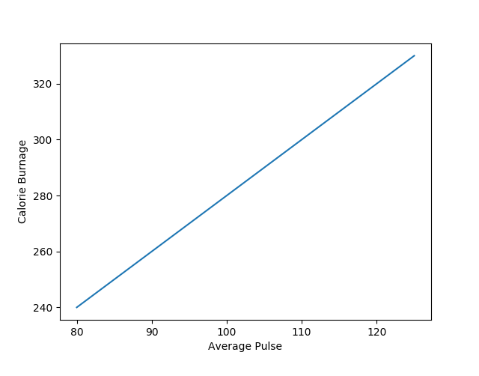
Matplotlib Labels and Title
Create Labels for a Plot
With Pyplot, you can use the xlabel() and ylabel() functions to set a label for the x- and y-axis.
import numpy as np
import matplotlib.pyplot as plt
x = np.array([80, 85, 90, 95, 100, 105, 110, 115, 120, 125])
y = np.array([240, 250, 260, 270, 280, 290, 300, 310, 320, 330])
plt.plot(x, y)
plt.xlabel("Average Pulse")
plt.ylabel("Calorie Burnage")
plt.show()

Slide 33
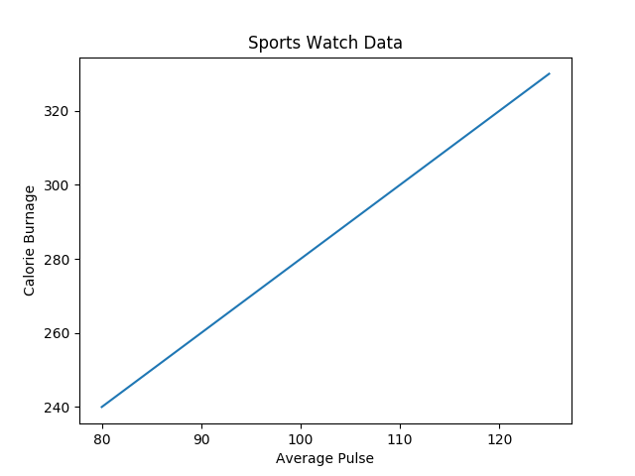
Create a Title for a Plot
With Pyplot, you can use the title() function to set a title for the plot.
Example
Add a plot title and labels for the x- and y-axis:
import numpy as np import matplotlib.pyplot as plt x = np.array([80, 85, 90, 95, 100, 105, 110, 115, 120, 125]) y = np.array([240, 250, 260, 270, 280, 290, 300, 310, 320, 330]) plt.plot(x, y) plt.title("Sports Watch Data") plt.xlabel("Average Pulse") plt.ylabel("Calorie Burnage") plt.show()

Slide 34
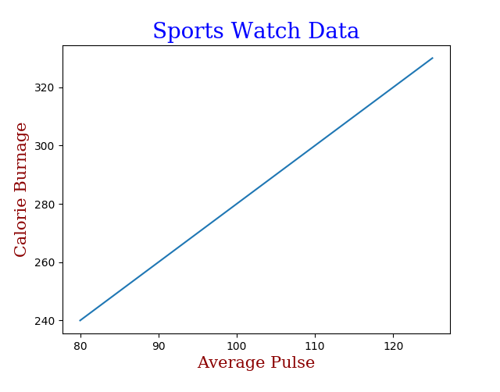
Set Font Properties for Title and Labels
Example
Set font properties for the title and labels:
import numpy as np import matplotlib.pyplot as plt x = np.array([80, 85, 90, 95, 100, 105, 110, 115, 120, 125]) y = np.array([240, 250, 260, 270, 280, 290, 300, 310, 320, 330]) font1 = {'family':'serif','color':'blue','size':20} font2 = {'family':'serif','color':'darkred','size':15} plt.title("Sports Watch Data", fontdict = font1) plt.xlabel("Average Pulse", fontdict = font2) plt.ylabel("Calorie Burnage", fontdict = font2) plt.plot(x, y) plt.show()

Slide 35
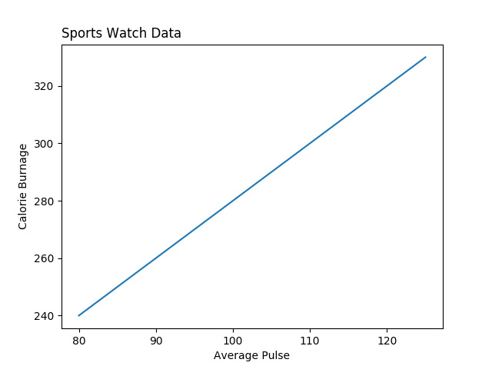
Position the Title
You can use the loc parameter in title() to position the title.
Legal values are: 'left', 'right', and 'center'. Default value is 'center'.
Position the title to the left:
import numpy as np
import matplotlib.pyplot as plt
x = np.array([80, 85, 90, 95, 100, 105, 110, 115, 120, 125])
y = np.array([240, 250, 260, 270, 280, 290, 300, 310, 320, 330])
plt.title("Sports Watch Data", loc = 'left')
plt.xlabel("Average Pulse")
plt.ylabel("Calorie Burnage")
plt.plot(x, y)
plt.show()

Slide 36

Matplotlib Adding Grid Lines
With Pyplot, you can use the grid() function to add grid lines to the plot.
import numpy as np import matplotlib.pyplot as plt x = np.array([80, 85, 90, 95, 100, 105, 110, 115, 120, 125]) y = np.array([240, 250, 260, 270, 280, 290, 300, 310, 320, 330]) plt.title("Sports Watch Data") plt.xlabel("Average Pulse") plt.ylabel("Calorie Burnage") plt.plot(x, y) plt.grid() plt.show()

Slide 37
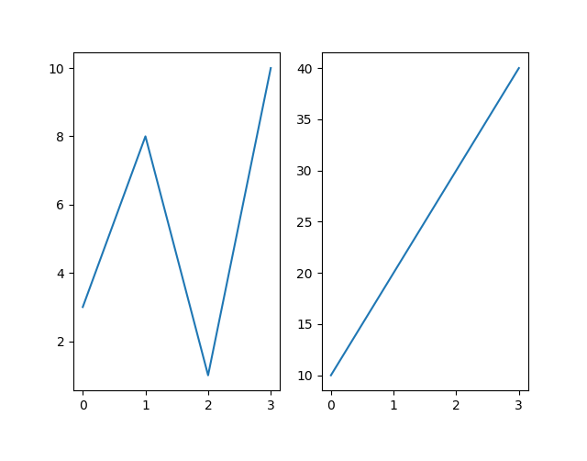
Matplotlib Subplot
With the subplot() function you can draw multiple plots in one figure:
import matplotlib.pyplot as plt import numpy as np #plot 1: x = np.array([0, 1, 2, 3]) y = np.array([3, 8, 1, 10]) plt.subplot(1, 2, 1) plt.plot(x,y) #plot 2: x = np.array([0, 1, 2, 3]) y = np.array([10, 20, 30, 40]) plt.subplot(1, 2, 2) plt.plot(x,y) plt.show()

Slide 38
The subplot() Function
The subplot() function takes three arguments that describes the layout of the figure.
The layout is organized in rows and columns, which are represented by the first and second argument.
The third argument represents the index of the current plot.

Slide 39
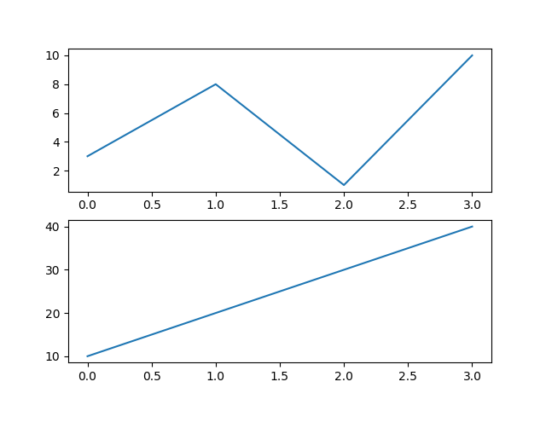
import matplotlib.pyplot as plt import numpy as np #plot 1: x = np.array([0, 1, 2, 3]) y = np.array([3, 8, 1, 10]) plt.subplot(2, 1, 1) plt.plot(x,y) #plot 2: x = np.array([0, 1, 2, 3]) y = np.array([10, 20, 30, 40]) plt.subplot(2, 1, 2) plt.plot(x,y) plt.show()

Slide 40
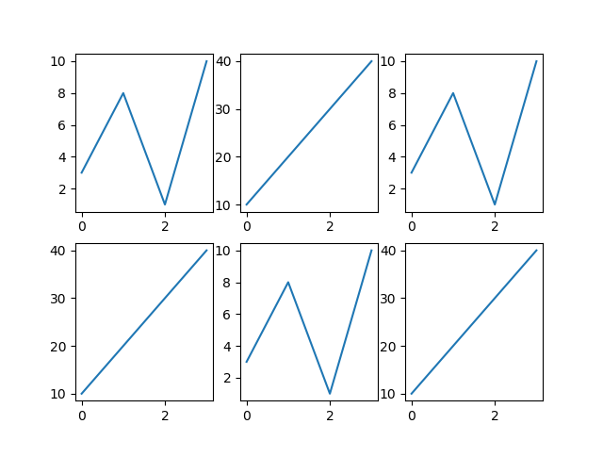
import matplotlib.pyplot as plt import numpy as np x = np.array([0, 1, 2, 3]) y = np.array([3, 8, 1, 10]) plt.subplot(2, 3, 1) plt.plot(x,y) x = np.array([0, 1, 2, 3]) y = np.array([10, 20, 30, 40]) plt.subplot(2, 3, 2) plt.plot(x,y) x = np.array([0, 1, 2, 3]) y = np.array([3, 8, 1, 10]) plt.subplot(2, 3, 3) plt.plot(x,y) x = np.array([0, 1, 2, 3]) y = np.array([10, 20, 30, 40]) plt.subplot(2, 3, 4) plt.plot(x,y) x = np.array([0, 1, 2, 3]) y = np.array([3, 8, 1, 10]) plt.subplot(2, 3, 5) plt.plot(x,y) x = np.array([0, 1, 2, 3]) y = np.array([10, 20, 30, 40]) plt.subplot(2, 3, 6) plt.plot(x,y) plt.show()

Slide 41
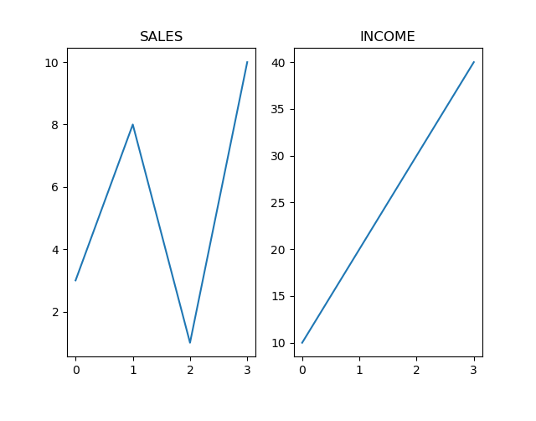
Title
You can add a title to each plot with the title() function:
import matplotlib.pyplot as plt import numpy as np #plot 1: x = np.array([0, 1, 2, 3]) y = np.array([3, 8, 1, 10]) plt.subplot(1, 2, 1) plt.plot(x,y) plt.title("SALES") #plot 2: x = np.array([0, 1, 2, 3]) y = np.array([10, 20, 30, 40]) plt.subplot(1, 2, 2) plt.plot(x,y) plt.title("INCOME") plt.show()

Slide 42
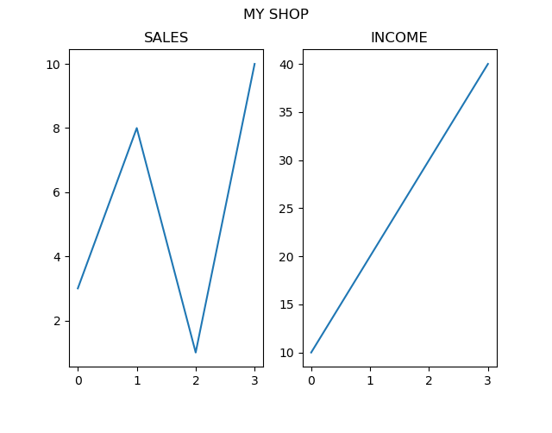
import matplotlib.pyplot as plt import numpy as np #plot 1: x = np.array([0, 1, 2, 3]) y = np.array([3, 8, 1, 10]) plt.subplot(1, 2, 1) plt.plot(x,y) plt.title("SALES") #plot 2: x = np.array([0, 1, 2, 3]) y = np.array([10, 20, 30, 40]) plt.subplot(1, 2, 2) plt.plot(x,y) plt.title("INCOME") plt.suptitle("MY SHOP") plt.show()

Slide 43
Matplotlib Scatter
Creating Scatter Plots
With Pyplot, you can use the scatter() function to draw a scatter plot.
The scatter() function plots one dot for each observation. It needs two arrays of the same length, one for the values of the x-axis, and one for values on the y-axis:

Slide 44
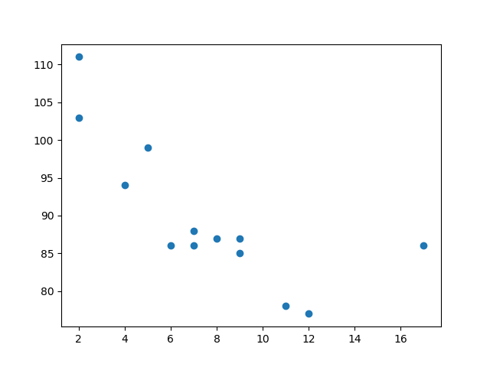
import matplotlib.pyplot as plt import numpy as np x = np.array([5,7,8,7,2,17,2,9,4,11,12,9,6]) y = np.array([99,86,87,88,111,86,103,87,94,78,77,85,86]) plt.scatter(x, y) plt.show()

Slide 45
Compare Plots
import matplotlib.pyplot as plt import numpy as np #day one, the age and speed of 13 cars: x = np.array([5,7,8,7,2,17,2,9,4,11,12,9,6]) y = np.array([99,86,87,88,111,86,103,87,94,78,77,85,86]) plt.scatter(x, y) #day two, the age and speed of 15 cars: x = np.array([2,2,8,1,15,8,12,9,7,3,11,4,7,14,12]) y = np.array([100,105,84,105,90,99,90,95,94,100,79,112,91,80,85]) plt.scatter(x, y) plt.show()

Slide 46
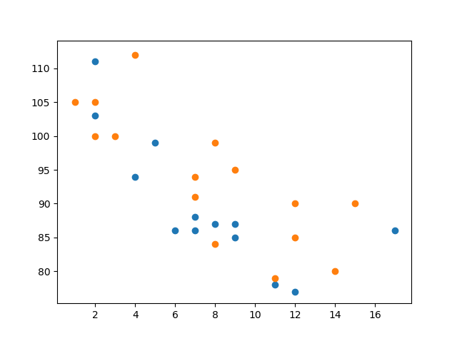

Slide 47
Color Each Dot
import matplotlib.pyplot as plt import numpy as np x = np.array([5,7,8,7,2,17,2,9,4,11,12,9,6]) y = np.array([99,86,87,88,111,86,103,87,94,78,77,85,86]) colors = np.array(["red","green","blue","yellow","pink","black","orange","purple","beige","brown","gray","cyan","magenta"]) plt.scatter(x, y, c=colors) plt.show()

Slide 48
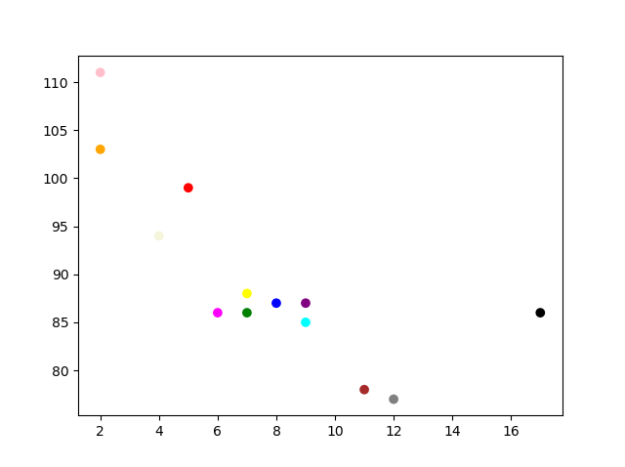

Slide 49
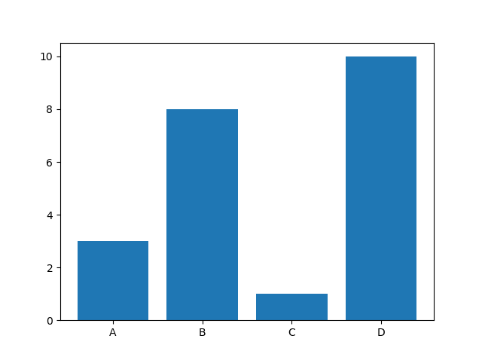
Matplotlib Bars
Creating Bars
With Pyplot, you can use the bar() function to draw bar graphs:
import matplotlib.pyplot as plt import numpy as np x = np.array(["A", "B", "C", "D"]) y = np.array([3, 8, 1, 10]) plt.bar(x,y) plt.show()

Slide 50
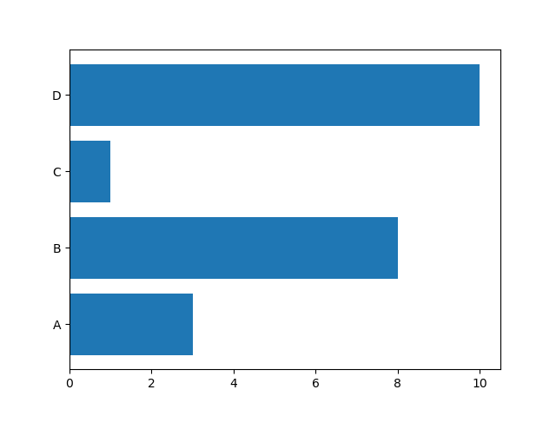
Horizontal Bars
If you want the bars to be displayed horizontally instead of vertically, use the barh() function:
Draw 4 horizontal bars:
import matplotlib.pyplot as plt import numpy as np x = np.array(["A", "B", "C", "D"]) y = np.array([3, 8, 1, 10]) plt.barh(x, y) plt.show()

Slide 51
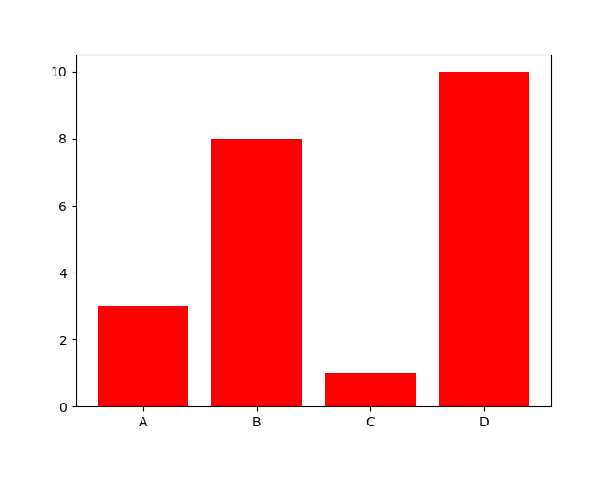
Bar Color
The bar() and barh() takes the keyword argument color to set the color of the bars:
Example
Draw 4 red bars:
import matplotlib.pyplot as plt import numpy as np x = np.array(["A", "B", "C", "D"]) y = np.array([3, 8, 1, 10]) plt.bar(x, y, color = "red") plt.show()

Slide 52
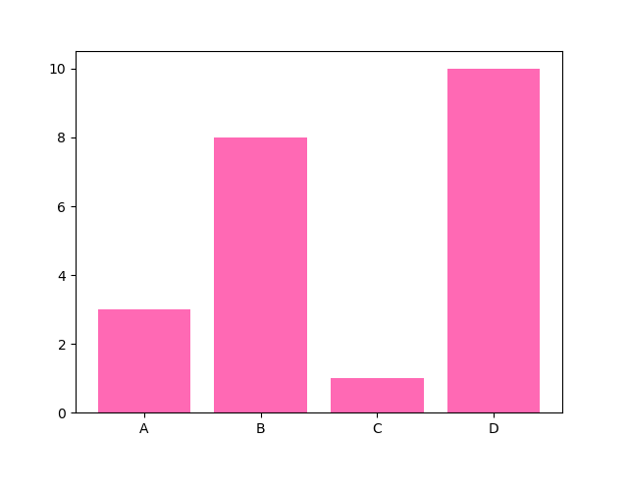
Color Names
Example
Draw 4 "hot pink" bars:
import matplotlib.pyplot as plt import numpy as np x = np.array(["A", "B", "C", "D"]) y = np.array([3, 8, 1, 10]) plt.bar(x, y, color = "hotpink") plt.show()

Slide 53
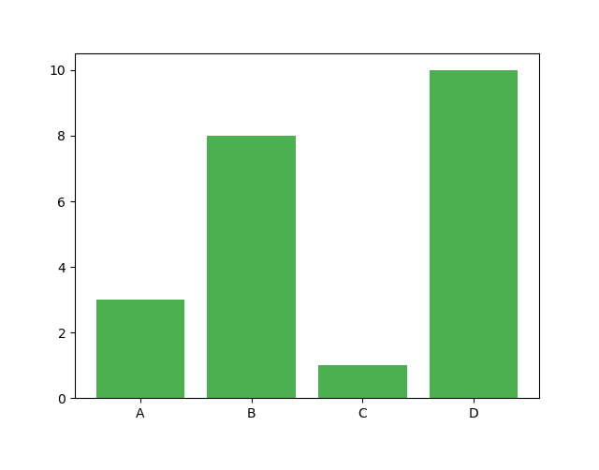
Color Hex
Example
Draw 4 bars with a beautiful green color:
import matplotlib.pyplot as plt import numpy as np x = np.array(["A", "B", "C", "D"]) y = np.array([3, 8, 1, 10]) plt.bar(x, y, color = "#4CAF50") plt.show()

Slide 54
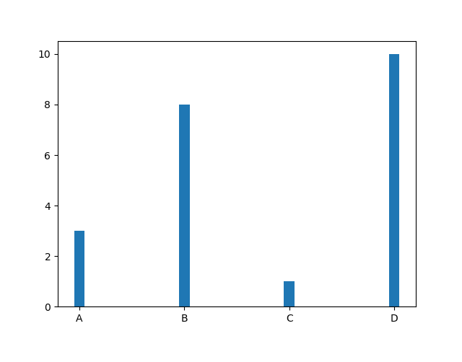
Bar Width
The bar() takes the keyword argument width to set the width of the bars:
import matplotlib.pyplot as plt import numpy as np x = np.array(["A", "B", "C", "D"]) y = np.array([3, 8, 1, 10]) plt.bar(x, y, width = 0.1) plt.show()

Slide 55
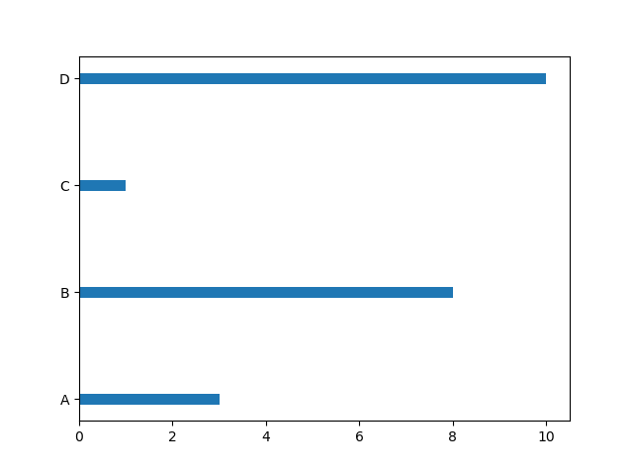
Bar Height
The barh() takes the keyword argument height to set the height of the bars:
import matplotlib.pyplot as plt import numpy as np x = np.array(["A", "B", "C", "D"]) y = np.array([3, 8, 1, 10]) plt.barh(x, y, height = 0.1) plt.show()

Slide 56
Matplotlib Histograms
Histogram
A histogram is a graph showing frequency distributions.
It is a graph showing the number of observations within each given interval.
Example: Say you ask for the height of 250 people, you might end up with a histogram like this:

Slide 57
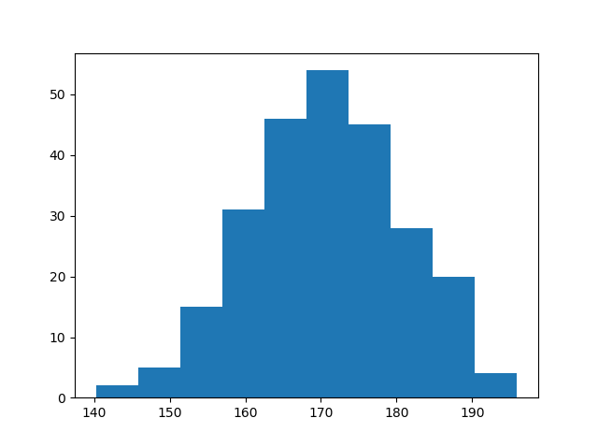

Slide 58
You can read from the histogram that there are approximately:
2 people from 140 to 145cm 5 people from 145 to 150cm 15 people from 151 to 156cm 31 people from 157 to 162cm 46 people from 163 to 168cm 53 people from 168 to 173cm 45 people from 173 to 178cm 28 people from 179 to 184cm 21 people from 185 to 190cm 4 people from 190 to 195cm

Slide 59
Create Histogram
In Matplotlib, we use the hist() function to create histograms.
The hist() function will use an array of numbers to create a histogram, the array is sent into the function as an argument.
For simplicity we use NumPy to randomly generate an array with 250 values, where the values will concentrate around 170, and the standard deviation is 10

Slide 60
Example
A Normal Data Distribution by NumPy:
import numpy as np x = np.random.normal(170, 10, 250) print(x)

Slide 61
output
[167.62255766 175.32495609 152.84661337 165.50264047 163.17457988
162.29867872 172.83638413 168.67303667 164.57361342 180.81120541
170.57782187 167.53075749 176.15356275 176.95378312 158.4125473
187.8842668 159.03730075 166.69284332 160.73882029 152.22378865
164.01255164 163.95288674 176.58146832 173.19849526 169.40206527
166.88861903 149.90348576 148.39039643 177.90349066 166.72462233
177.44776004 170.93335636 173.26312881 174.76534435 162.28791953
166.77301551 160.53785202 170.67972019 159.11594186 165.36992993
178.38979253 171.52158489 173.32636678 159.63894401 151.95735707
175.71274153 165.00458544 164.80607211 177.50988211 149.28106703

Slide 62
The hist() function will read the array and produce a histogram:
import matplotlib.pyplot as plt import numpy as np x = np.random.normal(170, 10, 250) plt.hist(x) plt.show()

Slide 63
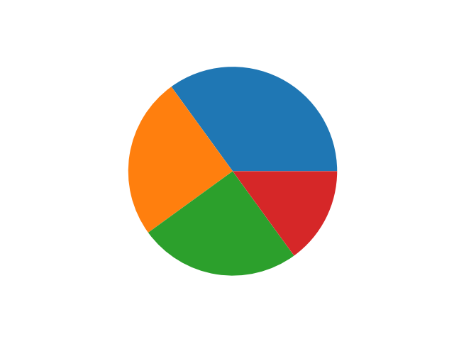
Matplotlib Pie Charts
Creating Pie Charts
With Pyplot, you can use the pie() function to draw pie charts:
import matplotlib.pyplot as plt import numpy as np y = np.array([35, 25, 25, 15]) plt.pie(y) plt.show()

Slide 64
Labels
Add labels to the pie chart with the label parameter.
The label parameter must be an array with one label for each wedge:
import matplotlib.pyplot as plt import numpy as np y = np.array([35, 25, 25, 15]) mylabels = ["Apples", "Bananas", "Cherries", "Dates"] plt.pie(y, labels = mylabels) plt.show()

Slide 65
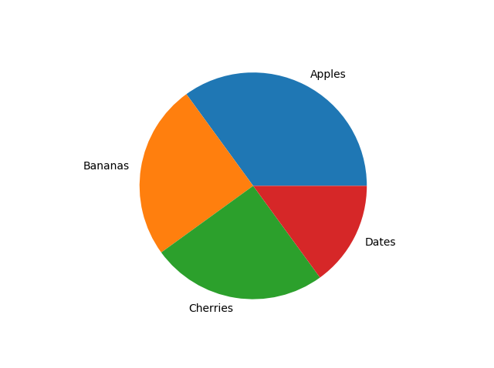

Slide 66
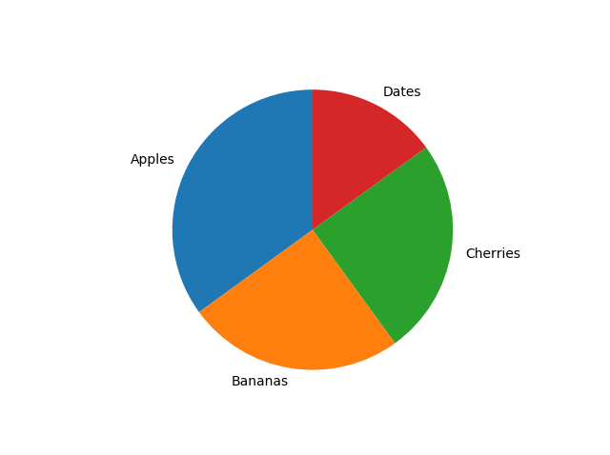
Example
Start the first wedge at 90 degrees:
import matplotlib.pyplot as plt import numpy as np y = np.array([35, 25, 25, 15]) mylabels = ["Apples", "Bananas", "Cherries", "Dates"] plt.pie(y, labels = mylabels, startangle = 90) plt.show()

Slide 67
Explode
Example
Pull the "Apples" wedge 0.2 from the center of the pie:
import matplotlib.pyplot as plt import numpy as np y = np.array([35, 25, 25, 15]) mylabels = ["Apples", "Bananas", "Cherries", "Dates"] myexplode = [0.2, 0, 0, 0] plt.pie(y, labels = mylabels, explode = myexplode) plt.show()

Slide 68
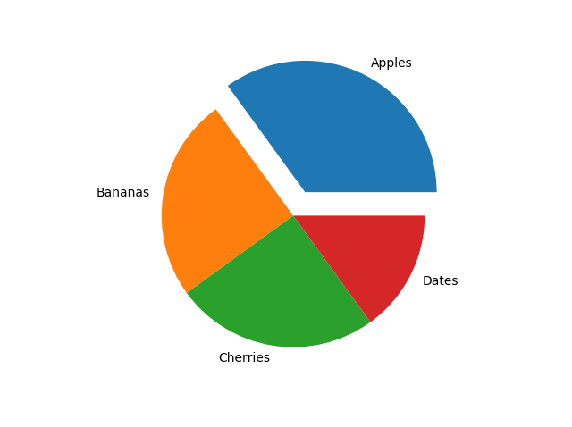

Slide 69
Shadow
Add a shadow to the pie chart by setting the shadows parameter to True:
import matplotlib.pyplot as plt import numpy as np y = np.array([35, 25, 25, 15]) mylabels = ["Apples", "Bananas", "Cherries", "Dates"] myexplode = [0.2, 0, 0, 0] plt.pie(y, labels = mylabels, explode = myexplode, shadow = True) plt.show()

Slide 70
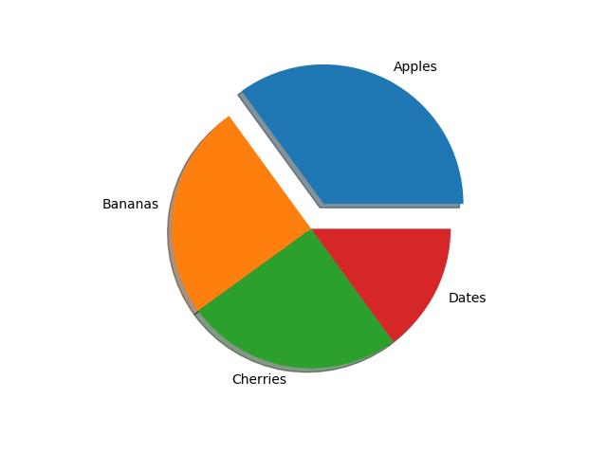

Slide 71
Colors
import matplotlib.pyplot as plt import numpy as np y = np.array([35, 25, 25, 15]) mylabels = ["Apples", "Bananas", "Cherries", "Dates"] mycolors = ["black", "hotpink", "b", "#4CAF50"] plt.pie(y, labels = mylabels, colors = mycolors) plt.show()

Slide 72
