Slide 1
Pandas

Slide 2
What is Pandas?
Pandas is a Python library used for working with data sets.
It has functions for analyzing, cleaning, exploring, and manipulating data.
The name "Pandas" has a reference to both "Panel Data", and "Python Data Analysis" and was created by Wes McKinney in 2008.

Slide 3
Why Use Pandas?
Pandas allows us to analyze big data and make conclusions based on statistical theories.
Pandas can clean messy data sets, and make them readable and relevant.
Relevant data is very important in data science.

Slide 4
What Can Pandas Do?
Pandas give you answers about the data. Like:
Is there a correlation between two or more columns?
What is the average value?
Max value?
Min value?
Pandas are also able to delete rows that are not relevant or contain wrong values, like empty or NULL values. This is called cleaning the data.

Slide 5
Installation of Pandas
If you have Python and PIP already installed on a system, then installation of Pandas is very easy.
Install it using this command:
C:\Users\Your Name>pip install pandas
C:\Users\Your Name>pip install pandas

Slide 6
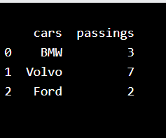
Example
import pandas mydataset = { 'cars': ["BMW", "Volvo", "Ford"], 'passings': [3, 7, 2] } myvar = pandas.DataFrame(mydataset) print(myvar)

Slide 7
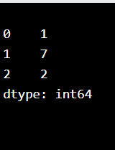
Pandas Series
A Pandas Series is like a column in a table.
It is a one-dimensional array holding data of any type.
Example
Create a simple Pandas Series from a list:
import pandas as pd a = [1, 7, 2] myvar = pd.Series(a) print(myvar)

Slide 8
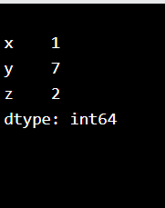
Create Labels
With the index argument, you can name your own labels.
Example
Create your own labels:
import pandas as pd a = [1, 7, 2] myvar = pd.Series(a, index = ["x", "y", "z"]) print(myvar)

Slide 9
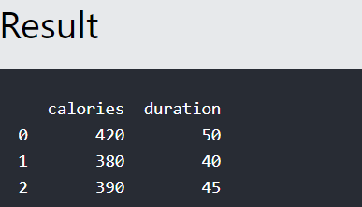
Pandas DataFrames
A Pandas DataFrame is a 2-dimensional data structure, like a 2-dimensional array, or a table with rows and columns.
Example
Create a simple Pandas DataFrame:
import pandas as pd data = { "calories": [420, 380, 390], "duration": [50, 40, 45] } #load data into a DataFrame object: df = pd.DataFrame(data) print(df)

Slide 10
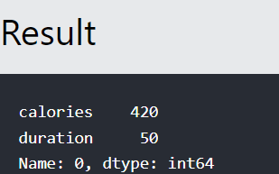
Locate Row
As you can see from the result above, the DataFrame is like a table with rows and columns.
Pandas use the loc attribute to return one or more specified row(s)
Example
#Return row 0:
#refer to the row index:
print(df.loc[0])

Slide 11
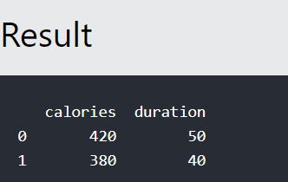
Example
Return row 0 and 1:
#use a list of indexes: print(df.loc[[0, 1]])

Slide 12
Pandas Read CSV
Read CSV Files
A simple way to store big data sets is to use CSV files (comma separated files).
CSV files contains plain text and is a well know format that can be read by everyone including Pandas.
In our examples we will be using a CSV file called 'data.csv'.

Slide 13
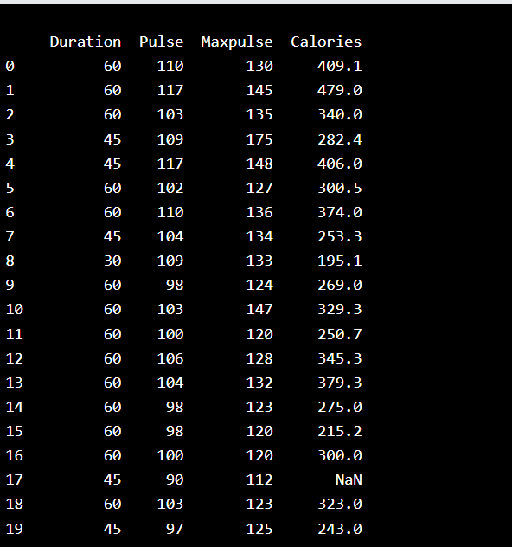
Example
Load the CSV into a DataFrame:
import pandas as pd df = pd.read_csv('data.csv') print(df.to_string())

Slide 14
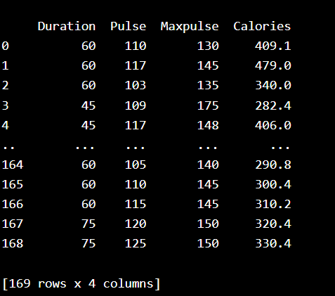
Example
If you have a large DataFrame with many rows, Pandas will only return the first 5 rows, and the last 5 rows:
Print the DataFrame without the to_string() method:
import pandas as pd
df = pd.read_csv('data.csv')
print(df)

Slide 15
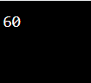
max_rows
he number of rows returned is defined in Pandas option settings.
You can check your system's maximum rows with the pd.options.display.max_rows statement.
Example
Check the number of maximum returned rows:
import pandas as pd print(pd.options.display.max_rows)

Slide 16
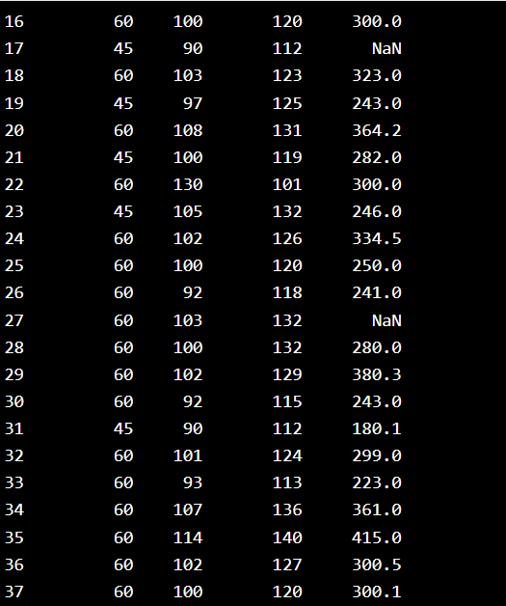
Example
Increase the maximum number of rows to display the entire DataFrame:
import pandas as pd pd.options.display.max_rows = 9999 df = pd.read_csv('data.csv') print(df)

