Slide 1
Android手機遠端即時操控系統 Android Mobile Phone Real-time Remote Control System
2014 03 21
黃騰嶢

Slide 2
Contents
Remote Display
VNC software

Slide 3
Remote Display
DLNA
WiFi-Miracast
GoogleCast

Slide 4
DLNA
Digital Living Network Alliance

Slide 5
WiFi-Miracast

Slide 6
VNC software
RFB protocol
Features of VNC

Slide 7
RFB protocol
Remote FrameBuffer
Display Protocol
put a rectangle of pixel data at a given x,y position
Input protocol
Input events are simply sent to the server by the client whenever the user presses a key or pointer button, or whenever the pointing device is moved.

Slide 8
Features of VNC
Virtual Network Computing
Thin Client
VNC Server ←--→ VNC Client(Viewer)
TCP/IP
Cross-platform Viewer
(Server not include)

Slide 9
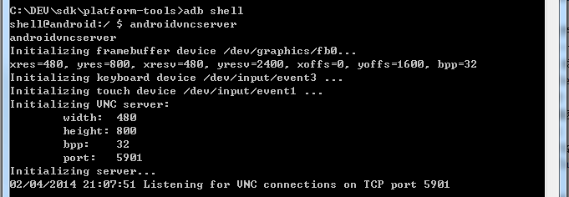

Slide 10

E
N
D
Thanks for listening

